Slide 1
BI LHC operational experience, developments and needs for HL-LHC
Gianluigi Arduini – CERN - BE/ABP
on behalf of the BI and LHC teams
Acknowledgements: T. Baer, E. Bravin, O. Brüning, J. Esteban Muller, S. Fartoukh, R. Giachino, D. Jacquet, R. Jones, M. Lamont, T. Lefèvre, E. Métral, M. Giovannozzi, G. Iadarola, T. Pieloni, S. Redaelli, F. Roncarolo, G. Rumolo, M. Sapinski, E. Shaposhnikova, R. Steinhagen, J. Wenninger et al.

Slide 2
Introduction
The success of the LHC start-up and of the LHC Run I has been largely the result of the availability FROM DAY ONE of a:
  Reliable
  User-friendly
  Accurate
  Well supported (by a dedicate/inventive team)
beam diagnostics for:
  intensity
  position
  beam size
  tune
  ….
High intensity/brightness operation in 2012 (see Oliver’s presentation) has highly stressed the instrumentation and increased the requirements in terms of bunch-by-bunch and intra-bunch/turn-by-turn monitoring to understand effects related to impedance, beam-beam, electron cloud, etc..

Slide 3
Orbit measurement and feedback
Operation with tight collimator settings (effectively very close to nominal settings for 7 TeV profiting of the smaller transverse emittance) has required accurate measurement and tight control of the orbit in particular in the collimation regions and in the beam dump area ➔ operation heavily relying on orbit acquisition and orbit feedback system
  Channel availability greater than 97%
  Orbit Resolution in the order of 10 μm
Main Issues
  Long term stability and reproducibility
    Dependence on temperature, bunch charge and filling scheme
    Mitigated for 2012 run but still needs improvement
  Accuracy of IR BPMs
    In addition to the above also suffer from directivity of stripline pick-ups

Slide 4
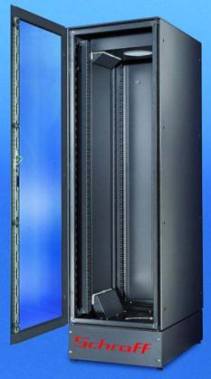
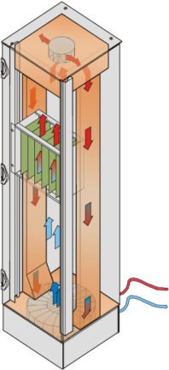
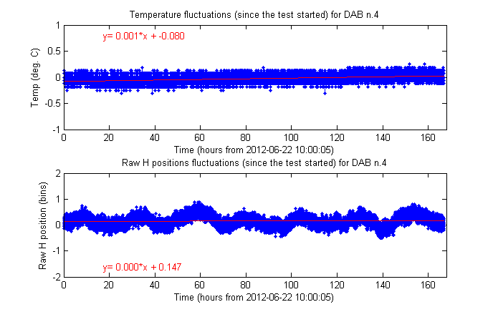
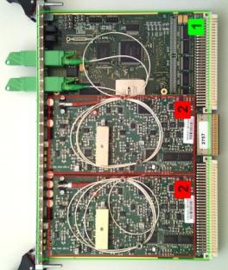
BPM Temperature Dependence
Improvements Foreseen
  Installation of thermalised racks
  Maintains temperature within ±0.2°C
  Prototype successfully tested in 2012
BPM position
from 2010
Beam position [μm]
Temperature
Crate Temp. [C]
1 bin ~ 30μm
Notes:
Thermalized Racks consist of:
Heat exchanger (bottom)
Air flow isolating walls
High constant speed fan (top)
PID controlled water valve

Slide 5
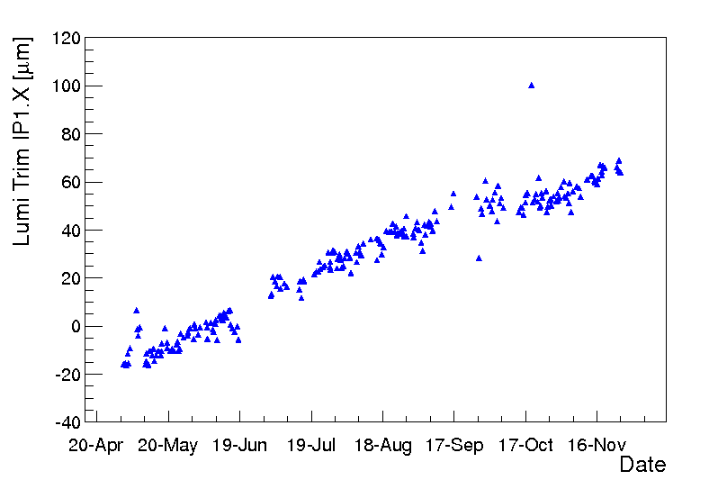
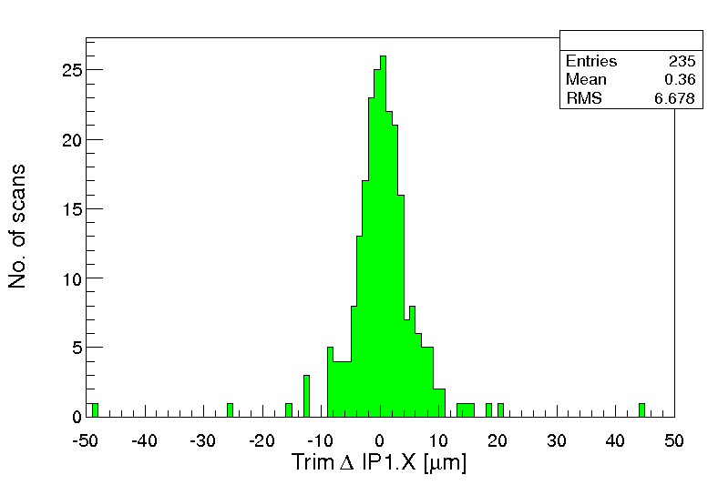
Orbit Feedback System
  ON from start of the ramp to end of squeeze. Overall remarkable performance!! Only some issues related to controls.
  Current correction quality limits (not yet a real problem):
    Arcs + most of the LSS: BPM Fill to Fill reproducibility – 50 μm rms.
    Common regions 1,2,5 & 8, ~ 200 μm rms (directivity of stripline BPM)
Orbit correction at IP to bring beams head-on (here B1H correction)
Slow drift over the year →not corrected by OFB.
80 μm
7 μm rms
Fill to fill difference is very small and sufficiently good (↔ squeeze in collision)

Slide 6
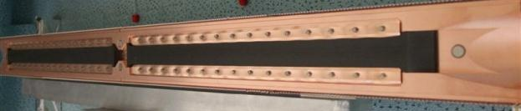
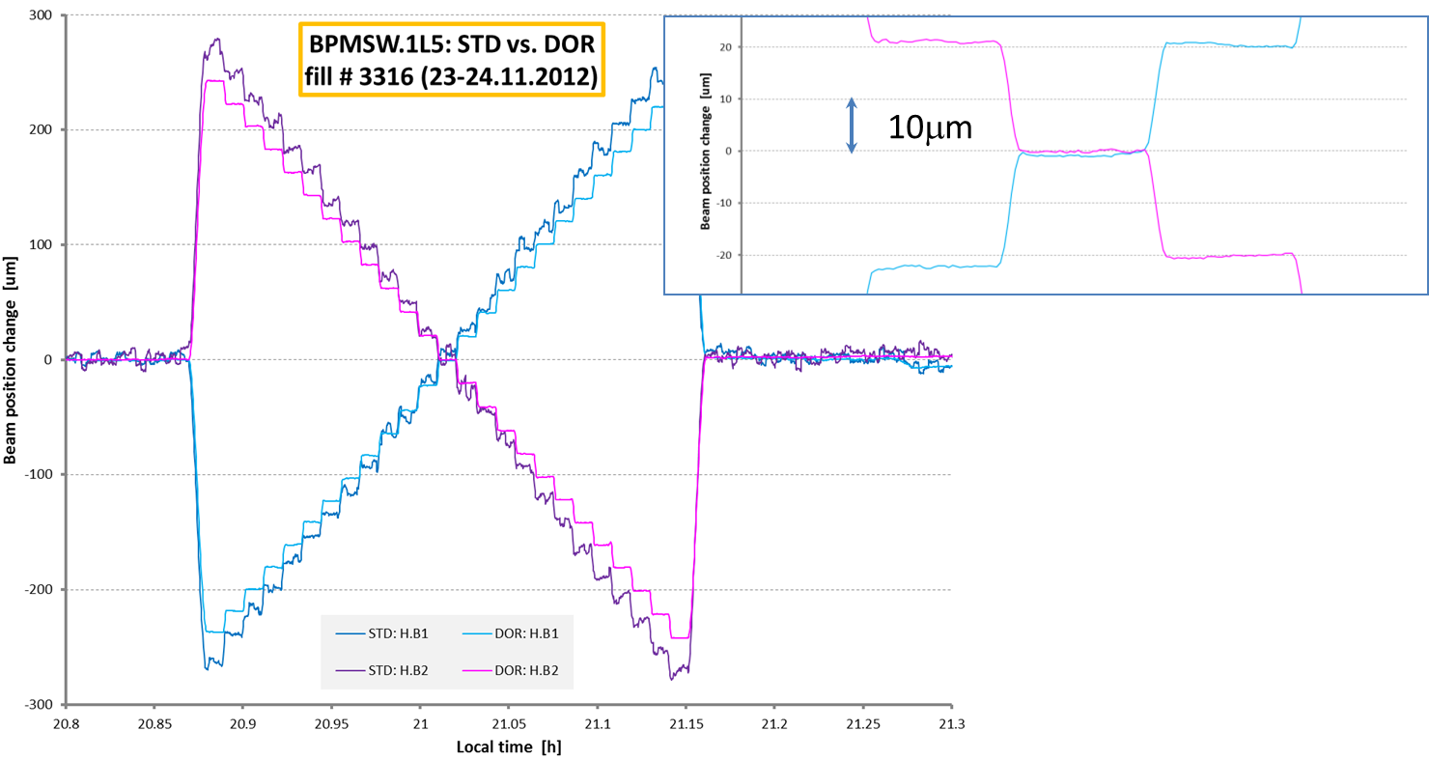
Collimator & LSS BPM Systems
Diode ORbit & Oscillation System – DOROS
  New technique developed to provide accurate beam position measurements for collimator BPMs
  Optimised for position resolution, absolute accuracy for centred beams
  Can also provide phase measurement for continuous local beta-beat calculation with very low oscillation amplitudes
  No bunch-by-bunch measurement but could be gated
Resolution <100nm
Tested in the SPS collimator prototype and in parallel to existing BPM system in LHC
Preparing the cable infrastructure during LS1 for TCT collimators and LSS BPMs
Notes:
What is the main advantage of this technique? Ask Marek? Thibaud?

Slide 7
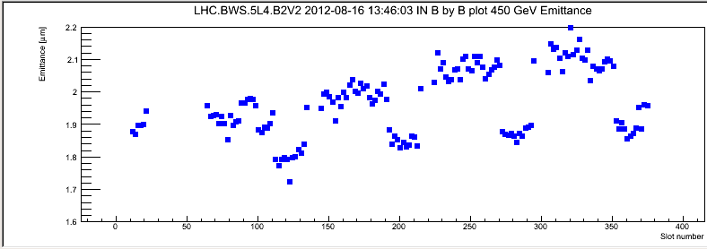
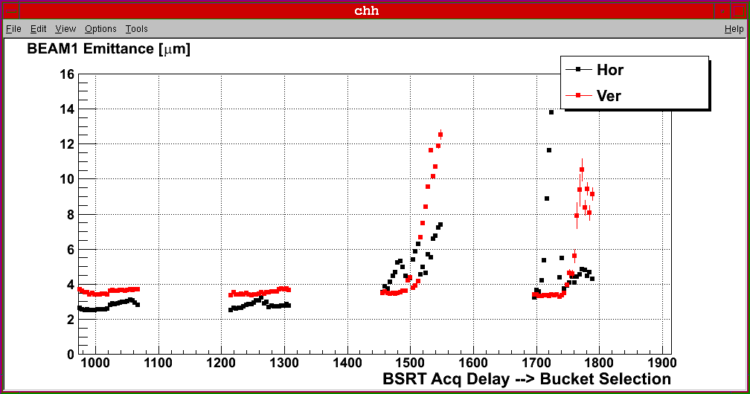
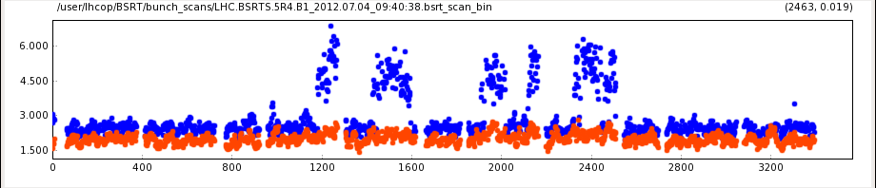
Beam size measurements
LHC has been facing/will have to face the challenge of preserving the extremely high brightness delivered by the injectors ➔
  Cross calibration with injectors and experiments (from luminosity/luminous region size data)
  Relative emittance evolution measurement through the cycle. At present blow-up mostly observed in B2 also for low intensity.
  Bunch-by-bunch relative emittance blow-up measurement to understand single particle and collective effects.
  All that from single to multi-bunch/high intensity beams
  3 main devices:
    Wire Scanners (BWS)
    Synchrotron Radiation monitor (BSRT)
    Rest Gas Monitor (BGI) - ions
Injectors - BWS
e-cloud - BSRT
Instabilities - BSRT

Slide 8
Wire Scanners
Reference device for transverse profile measurements and cross calibration with injectors
  30 μm Carbon wire flying at 1 m/s
  Bunch per bunch measurements
    50 ns ok
    25 ns cross-talk observed (being studied)
Dynamic range controlled by PM gain and optical filters
Can be used up to a maximum intensity that depends on beam energy
  Above: wire damage and/or quench downstream magnets
Accuracy
  Absolute accuracy expected to be ~1%
  Evidence of dependence on working point (PM gain + filter settings)
  Smaller number of points/sigma at 7 TeV ➔ might need to overlap more profiles (possible only at constant energy)
Energy [TeV] | Intensity Limit [10¹² p] | Reason
0.45 | 27 | Wire damage
4 | 3.6 | BLM threshold
6.5 | 1 | BLM threshold

Slide 9
Wire Scanners – Issues and plans
Vacuum leaks
  Bellow designed for ~ 10000 scans (one failure at 10200 scans in 2012) ➔ Redesign to obtain lifetime >50000 scans
Wire breaking
  Evidence of ageing due to sublimation.
  Broke several wires due to controls issues
    Need to be understood & mitigated during LS1
Upgrades
  Possibly thinner wires on all systems (LS1)
  New fast (20 m/s) devices (LS2)
  Possibly new detectors (e.g. diamonds) to increase dynamic range and get rid of filters (LS2)
new wire
34 um
aged wire
16 um
Notes:
Result of the tests with thinner wires ? Federico

Slide 10
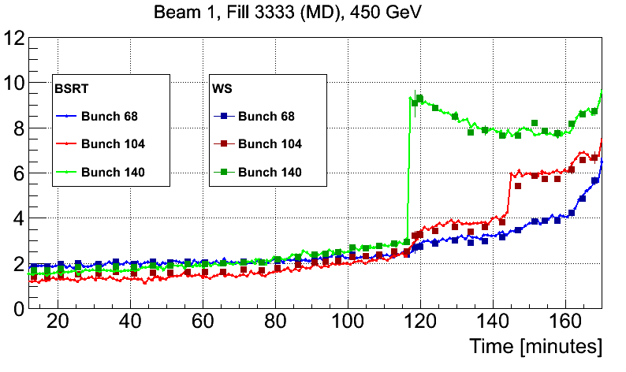
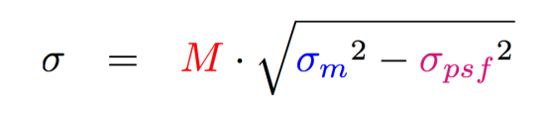
BSRT
Contribution from US-LARP – LTV programme
Provides Bunch-by-bunch beam size @ ~12Hz (limited by controls + acquisition)
Dynamic Range from pilot to full intensity
Energy dependent correction factors (transition from wiggler to dipole -D3- source) ➔ evolution of the emittance during the ramp (in particular at source transition) not measurable
After installation of new light optics:
  Excellent agreement BSRT-BWS at 0.45/4 TeV
  Smaller correction factors but still important
Developing optics for λ < 300nm (lenses, folding mirrors, camera sensor) to reduce diffraction
Vert. Emittance [μm]
Controlled transverse blow-up
1 mm
1.3 mm
0.8 mm
More critical at 7 TeV!
 | Correction Factors
 | Old Optics | New Optics | Old Optics | New Optics
450 GeV | ~0.9 | 0.85 | ~1.1 | 0.87
4 TeV | ~0.6 | 0.35 | ~0.7 | 0.33
 | Horizontal Plane |  | Vertical Plane
Notes:
σ_{psf} [pixels] = measurement error due to
aberration, diffraction
extraction mirror aging/deformation
Ions: from ~30 bunches to nominal intensity

Slide 11
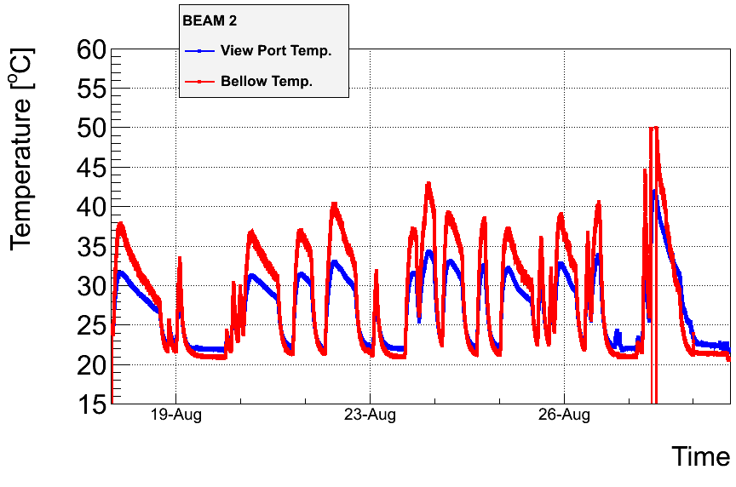
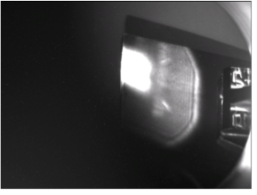
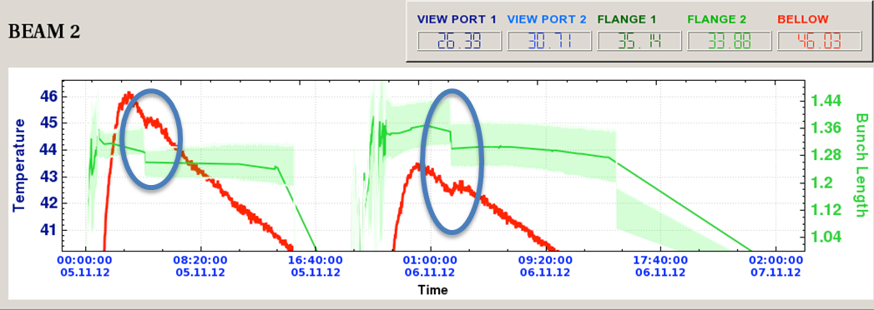
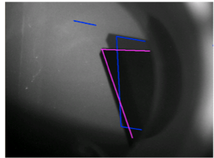
BSRT Heating Issue
28-Aug-2012
  Light spot observed to be off-centre
  Dumped beam & retracted mirror
  Mirror later dropped down in out position
Clear temperature dependence on bunch length ➔ RF heating

Slide 12
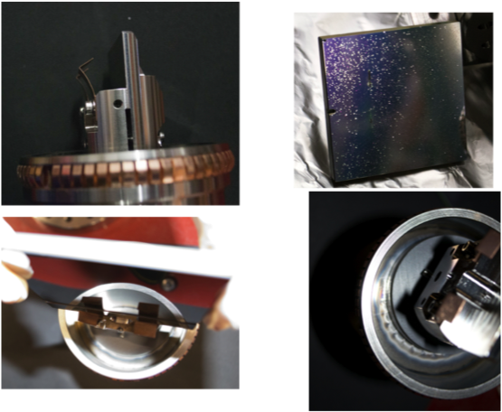
BSRT Heating Issue
Mirror clamps deformed by heating
Mirror coating damaged by heating?
Several tests and measurements performed during the last part of the run.
Modifications clearly required to the current design. Several options being followed.
Traces of heating at the ferrite location
Mirror as it would have been in place

Slide 13
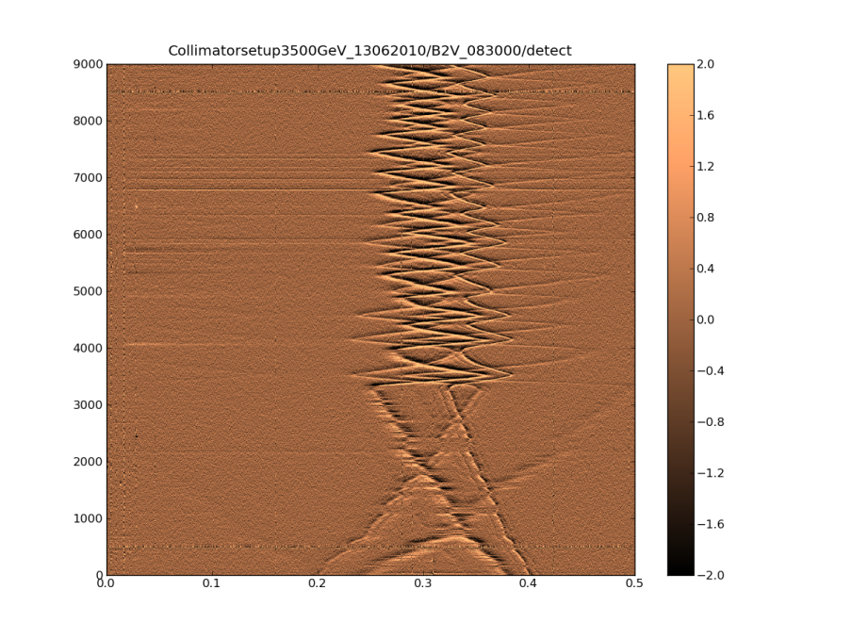
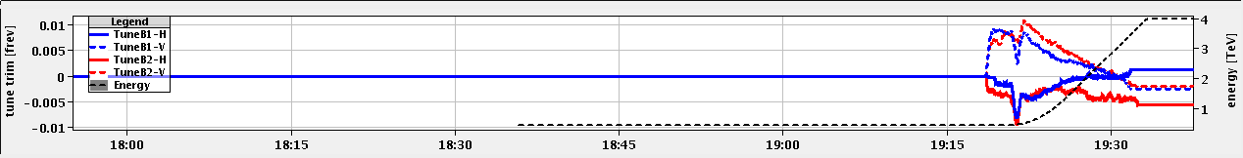
Tune measurement and feedback
BBQ based tune measurement:
  Sub-micrometric sensitivity allowing studies for noise characterization (e.g. the mains harmonics, the so called “hump” (2009-2010))
    ➔ no need for PLL based technique
    ➔ “almost” no need of excitation, but therefore very sensitive to noise
  Work-horse for tune and chromaticity measurements and tune feedback. Which worked from the first year of operation!
Schottky measurement:
  Still in the development phase
  Reduced expertise in Schottky data analysis and interpretation at CERN
Time [s]
Tune
R. De Maria, M.-C. Alabau Pons

Slide 14
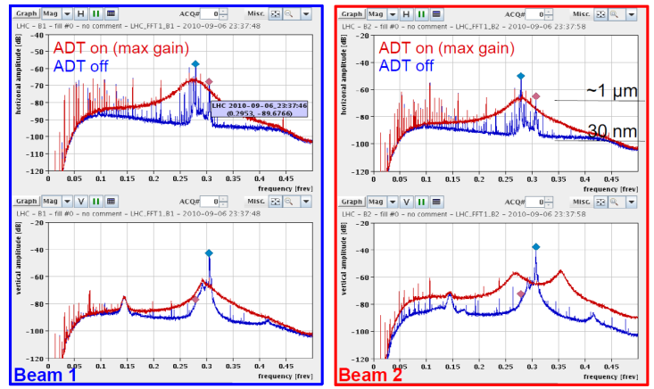
BBQ Tune Systems
Incompatibility with transverse damping
  Damper operated at high gain suppressing signal
  Large octupole currents & chromaticity broadening tune peak
50Hz mains harmonic interference at low oscillation amplitudes leading to frequent fast jumps ➔ QPS trips
Solved during 2012 through implementation of gated BBQ system gating on bunches for which the damper operates at lower gain
Post LS1 Operation
  Installation of dedicated pick-ups for gated tune. Better tune signal with gating should help reduce spurious tune jump
  Software upgraded to allow profiting of the full gated tune functionality
  Higher threshold levels on QPS for trim quadrupoles will be implemented to reduce sensitivity to fast tune jumps

Slide 15
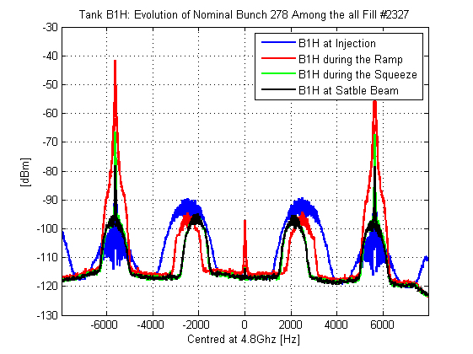
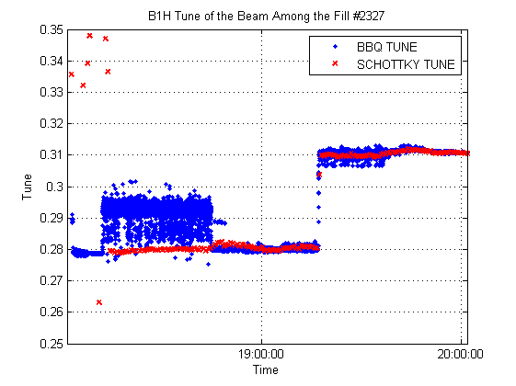
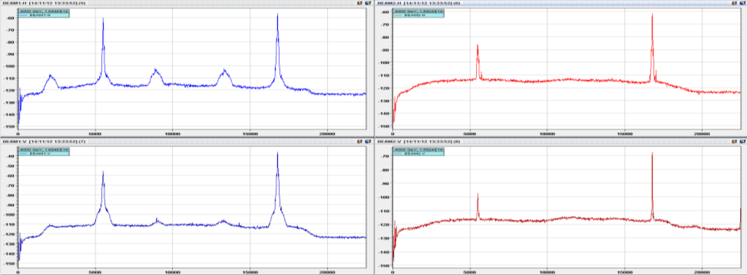
Schottky
US-LARP contribution
Run with Ions in 2011
  Good Schottky signals observed on ion fills only
  Single bunch tune/chromaticity measurements tested in MD
Run with Protons in 2012
  Signal good on B1H for single & multi bunch measurements at injection & stable beams
  Large coherent signals saturate and destroy the pre-amps in the other systems!
  So far not an operational tool ➔ work on it during LS1

Slide 16
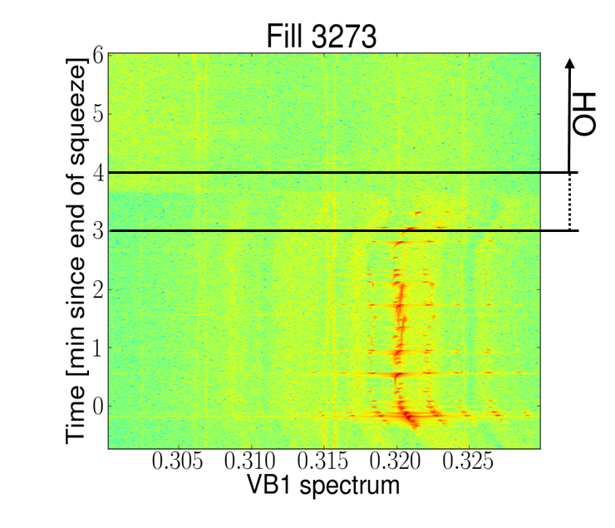
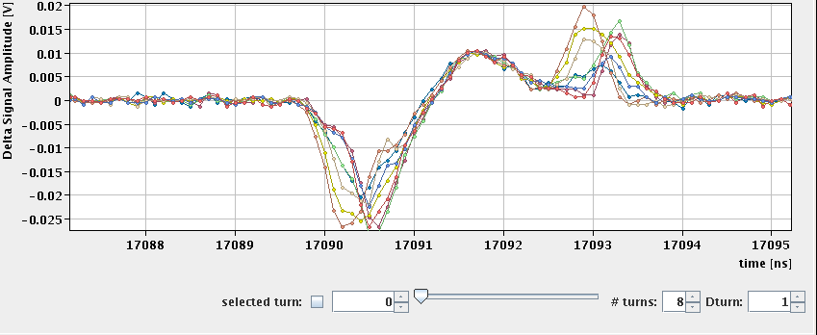
Intra-bunch transverse diagnostics
Operation with tight collimator settings and above nominal bunch population in 2012 has led to the observation of beam instabilities.
Synchrotron side-bands have been seen in tune (BBQ) spectra but:
  No bunch by bunch information
  Which head-tail mode(s) were excited?
Transverse diagnostics intra-bunch diagnostics based on the so-called “head-tail” monitor:
  Wide-band (6 GHz) pick-up with high bandwidth scope (3.5 GHz) – 10 GS/s
  Unreliable remote access to the scope (frequent crashes)
  Limited number of bunches/turns can be acquired making virtually impossible to catch the instability
  Limited resolution (~100 μm) due to limited common mode rejection in the hybrid
B. Salvant, R. Steinhagen
reflection

Slide 17
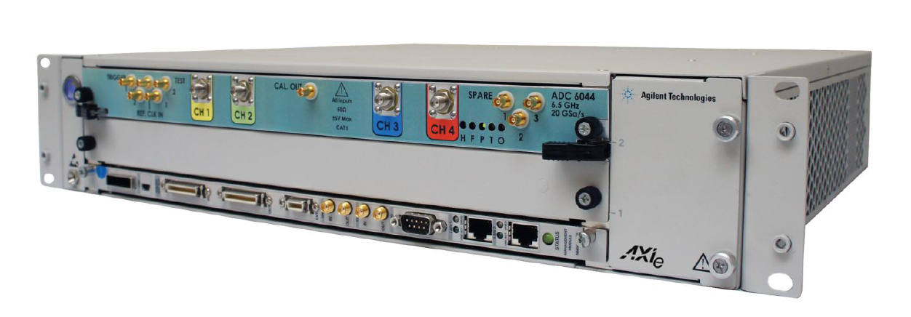
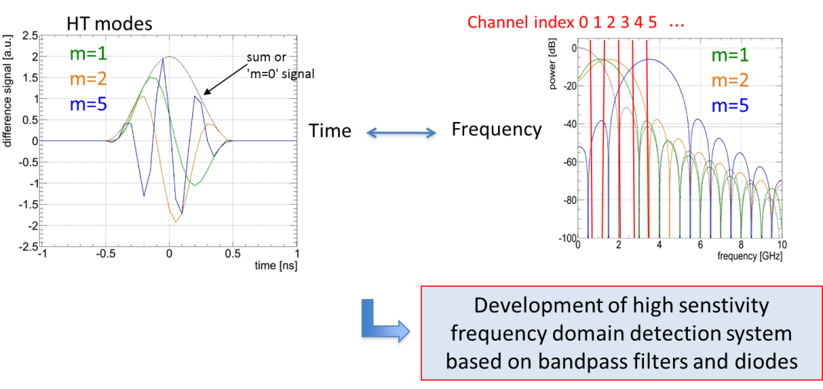
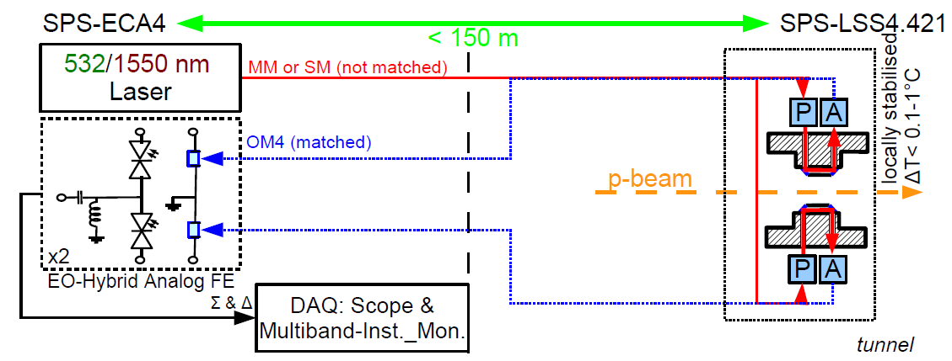
Intra-bunch transverse diagnostics
  Options:
    Replacement of fast oscilloscopes
      More adapted acquisition system for performance & reliability.
        Still limited resolution
    High sensitivity frequency domain detection system based on band-pass filters and diodes.
        Interpretation of the data might not be evident
    Electro-optical pick-up:
        particle beam modulates crystal birefringence
        very wide-band signal
        no beam power issues
  4 (2,1) ch@ 4 (6.5/8, 13) GHz
  16 (32) GB/ch sampling buffer ↔ monitoring of 1.6 s of beam data!
R. Steinhagen
Notes:
Can we install the prototype of electro optical pick-up in the LHC?

Slide 18
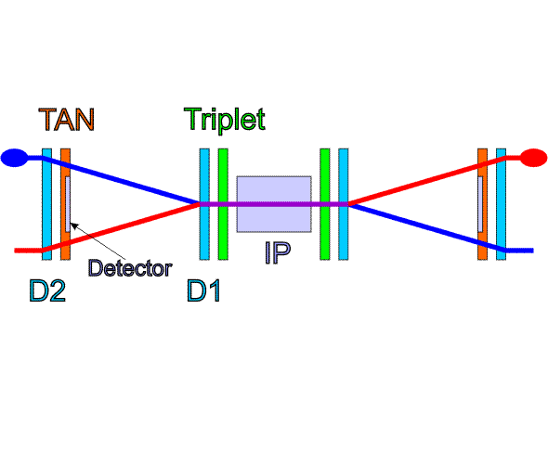
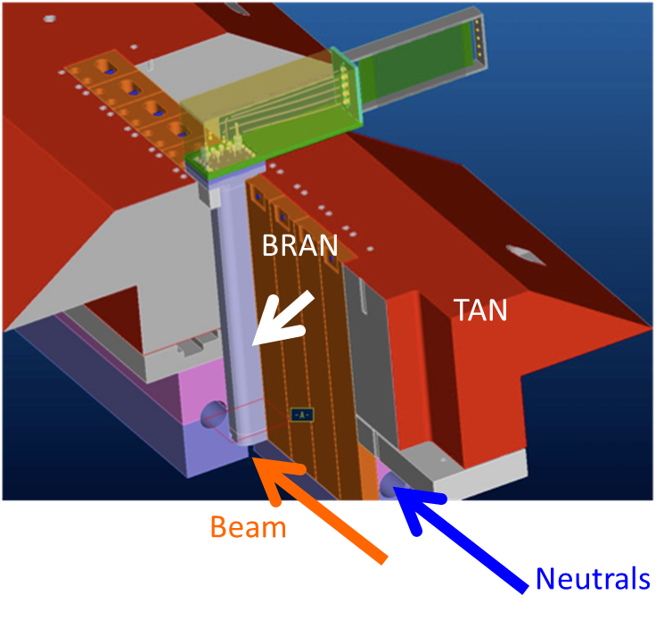
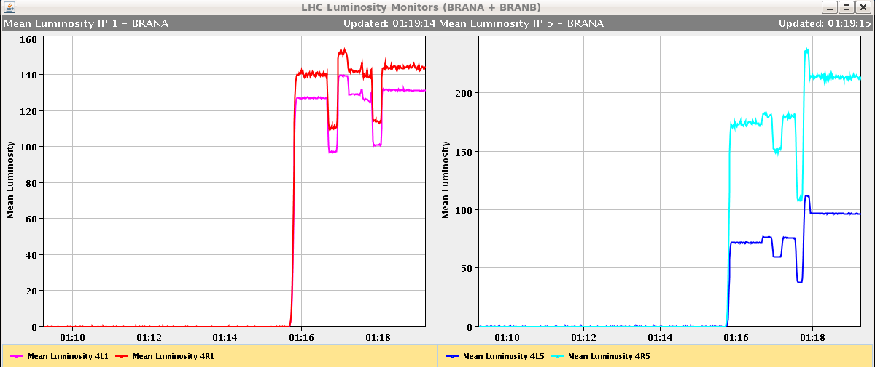
Luminosity measurement (BRAN)
US-LARP contribution
Fast ionization chambers providing relative bunch-by-bunch instantaneous collision rate measurement in IP1 and 5 with sensitivity in the few % range
Operational since the startup of LHC
Regularly used for optimization and levelling
Sensitivity adequate for nominal bunches and squeezed optics. Not enough sensitive for un-squeezed beams or low intensity bunches.
Main limitation coming from EM noise

Slide 19
RF stable phase measurement
Electron cloud build-up (and impedances) lead to energy loss to be compensated by the RF system ➔ change of stable phase
Relative bunch-by-bunch and average measurements have been used to estimate the total energy loss and the energy loss dependence along the bunch trains to be compared with electron cloud simulations (in the approximation heat load due to electron cloud is dominating)
Absolute numbers still being verified as comparison with heat load in the beam screens inferred from cryogenic measurements performed during 2012 25 ns run evidenced discrepancies by a factor 1.5-2.
G. Rumolo, G. Iadarola

Slide 20
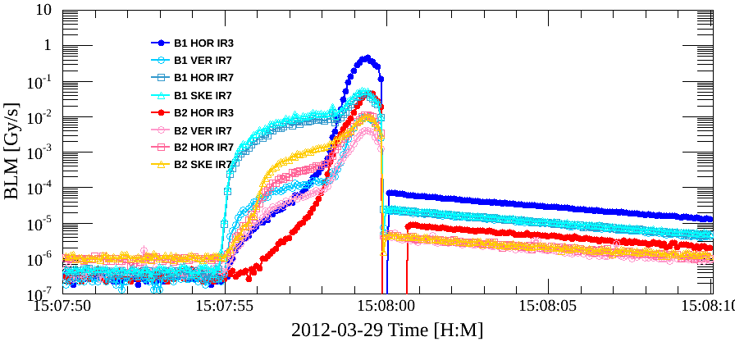
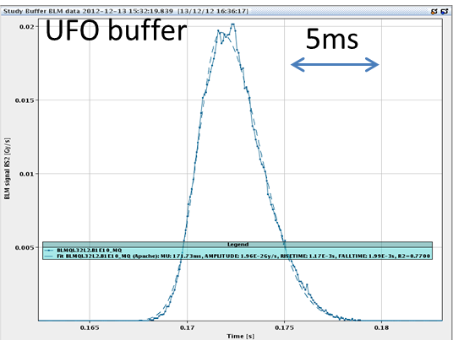
BLMs
Very reliable and central system for safe LHC operation.
  Heavily used in CCC and for analysis under all LHC operational conditions.
Main issue
  Saturation for very fast losses (mainly injection). Development of ad-hoc ionization chambers
Dedicated 12.5 Hz data
Heavily used for automatic collimator beam based alignment
    Allowed much faster collimator set-up
    Excellent diagnostic tool
      time evolution of losses, halo population & diffusion rates
New UFO Study Data Buffer
Capture buffer allowing 80 μs integral with 4396 samples/channel
Automatic triggering when abnormal losses detected

Slide 21
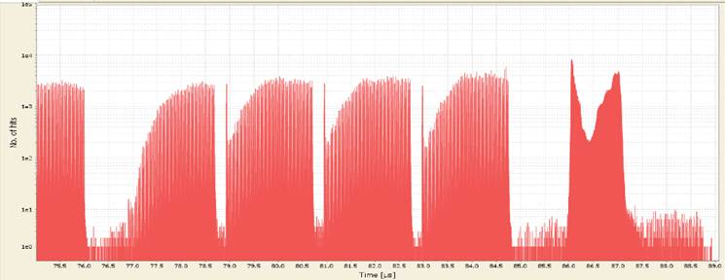
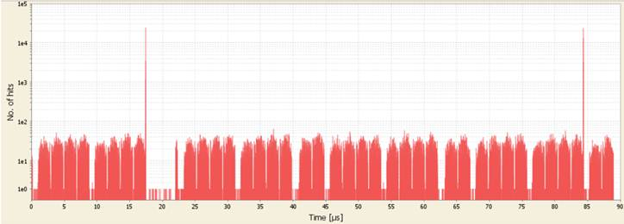
Fast BLMs based on diamond detectors
Recent application of diamond detectors to study fast losses (bunch by bunch and turn by turn) for injection studies, UFOs, instabilities
Losses associated with e-cloud build up are visible.
The losses between 86μs and 87μs are due to the abort gap cleaning.
Counts
Time [μs]
Two bunches at the end of two trains become unstable leading to high losses.
Counts
T. Baer, T. Pieloni
Time [μs]
Plenty of information can be extracted: tune, information on head-tail motion (sampling time 100 ps), …

Slide 22
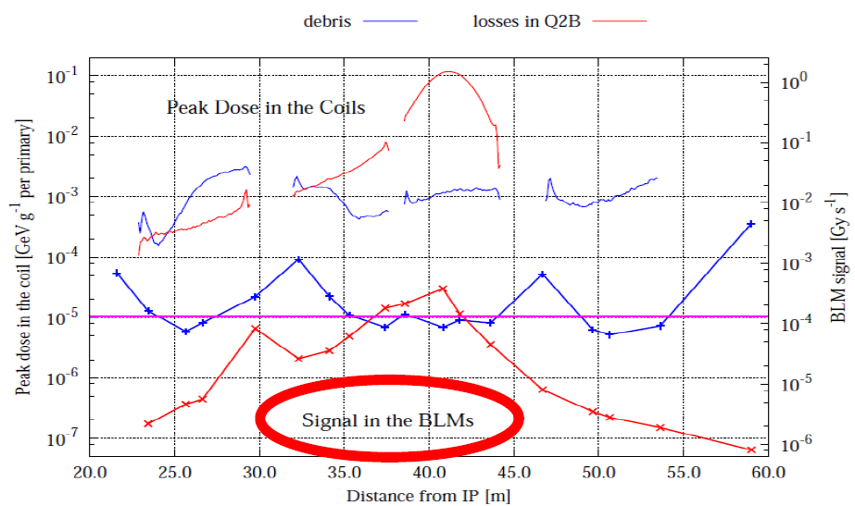
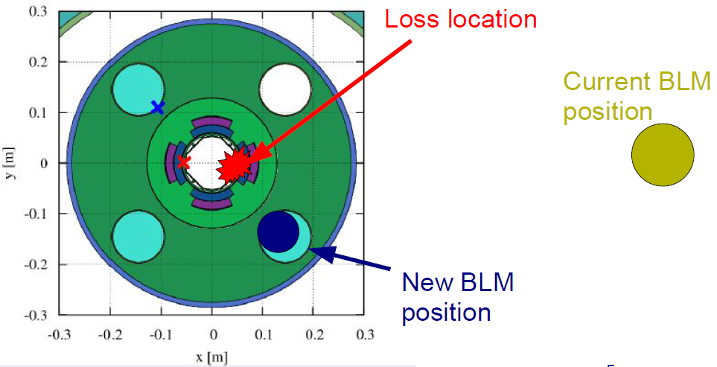
Studies for HL-LHC
A. Mereghetti
At 7 TeV/nominal luminosity in the triplets the signal in the BLMs (outside from the cryostat) resulting by collision debris is similar to that resulting from steady state proton losses
Need to place BLMs closer to the element to be protected ➔ cryogenic environment
C. Kurfuerst

Slide 23
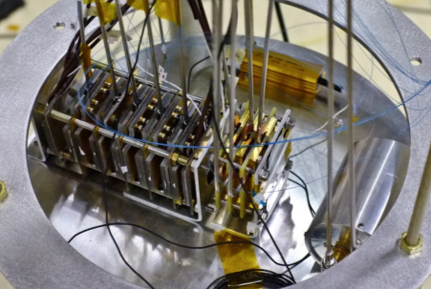
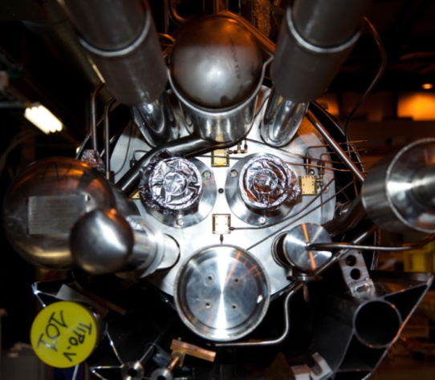
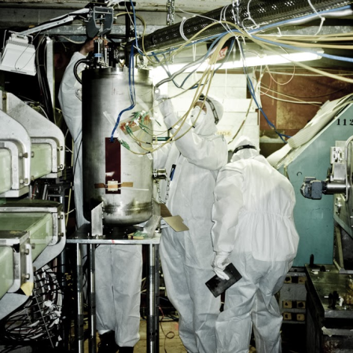
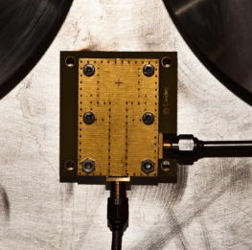
Studies for HL-LHC
Investigating use of diamond, silicon and liquid helium chambers as future BLMs at 1.9 K
Installation of 2 diamond and 2 silicon detectors on cold mass of Q7R3
Cold Irradiation in PS T7
Cryostat at
irradiation position

Slide 24
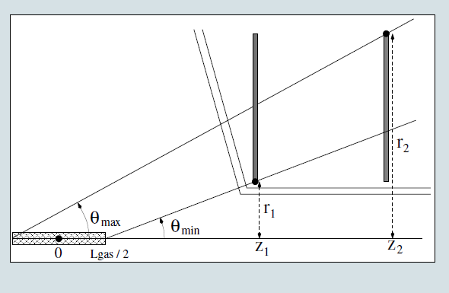
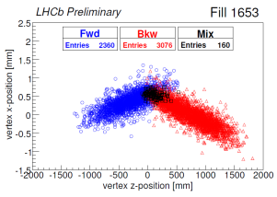
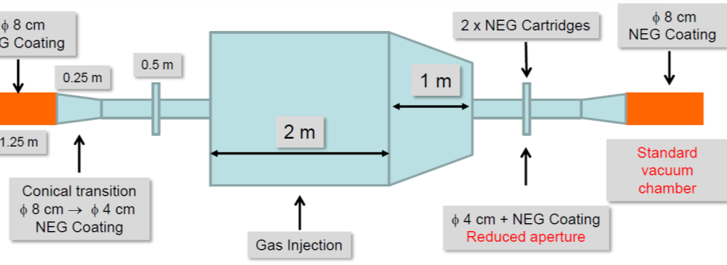
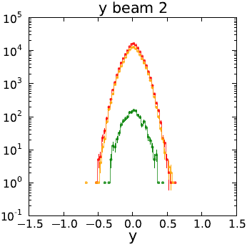
Studies for HL-LHC
Beam Gas Vertex Imager for non invasive beam size measurement
  Based on experience of LHCb VELO
  Aims
    5 % uncertainty on bunch width in 3 min
    5 % uncertainty on beam emittance in 3 min
    Might be used also as halo monitor (in steady state)
  Feasibility study nearly complete
LHCb Example
Number of Vertices

Slide 25
More HL-LHC requirements on instrumentation
The higher intensity/brightness specifications will further enhance the requirements on instrumentation and in most cases will profit of the developments above described, in particular:
  Intra-bunch transverse measurements for:
    understanding/controlling crab-cavities
    electron-cloud effects
    necessary step for implementation of a high bandwidth transverse feedback
  Halo monitoring to measure transverse beam density (2D) with a typical dynamic range of 10⁻⁶ in less than a minute for:
    Machine protection (e.g. related to crab cavities operation)
    Understanding/controlling beam-beam effects
  Schottky noise measurement and analysis for bunch-by-bunch on-line monitoring of:
    Beam-beam tune shift/spread
  .......

Slide 26
Conclusions
We have been “spoiled” with an excellent instrumentation allowing an extremely fast and efficient start-up of the machine and bringing us very rapidly to explore the parameter space close or beyond nominal operation
This has triggered more demanding requests in terms of bunch-by-bunch diagnostics
Main Challenges:
  Restarting after LS1 with everything back in working order
  Reliable emittance measurements
  Reliable intra-bunch beam diagnostics
  Reliable machine protection systems (halo diagnostics)
HL-LHC is going to push even further the already challenging requests that we have for after LS1 25 ns high intensity operation

Slide 28
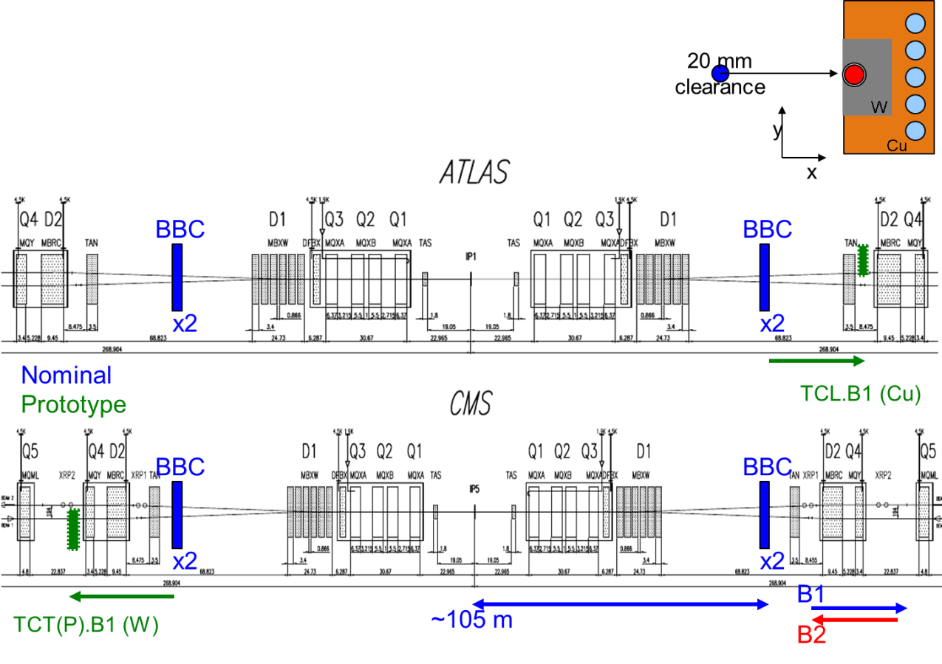
Beam-beam long range compensator (BBC)
Initial proposal in 2001 (J.-P. Koutchouk)
Tests so far: wire-wire compensation (SPS, RHIC) allowed to benchmark simulations → indication of what to expect at LHC
Proof-of-principle requires BBLR prototype into machine well before HL-LHC
Operation close to MP envelope:
  Need to embed wire in collimator jaw type structure
  Prototype installation limited to two wires
Wire parameters:
  Solid wire radius of ~1mm → 1kW power dissipation
  sub-σ level of hor./ver. position control
  Pulsed wire not feasible at this stage
H
V

Slide 29
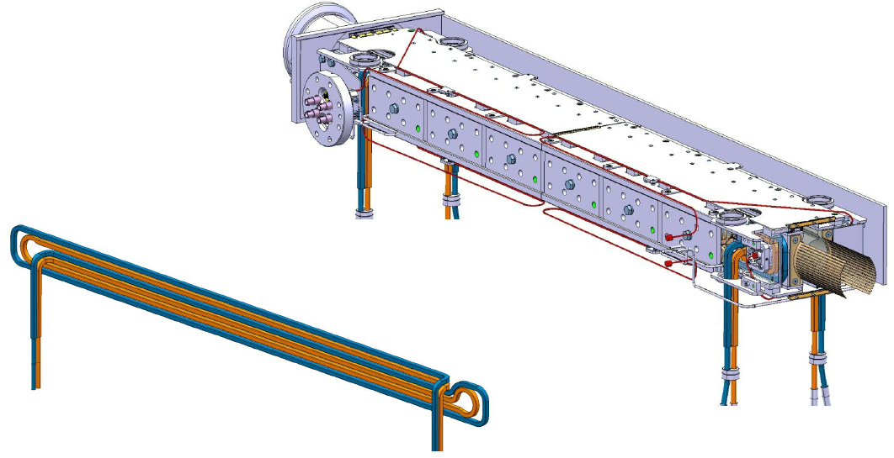
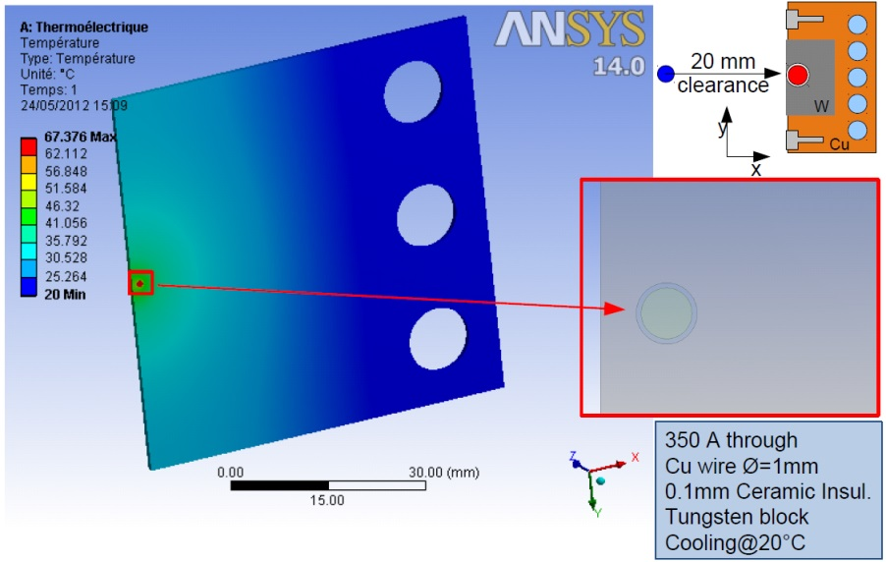
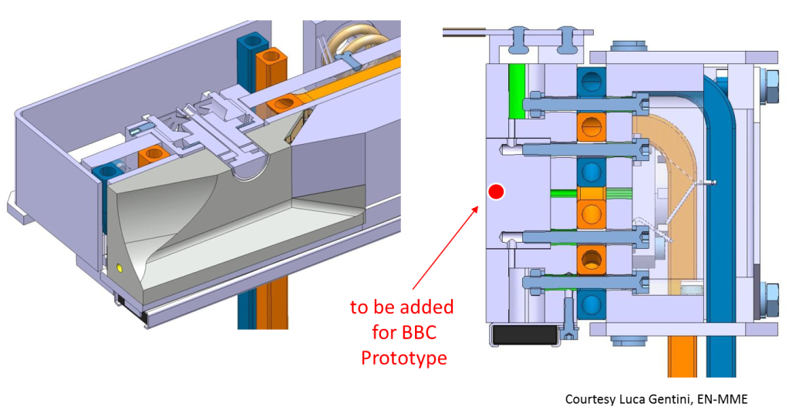
TCTP – BBC prototype
R. Steinhagen
Can re-use nearly 100% of existing TCTP design (with BPMs).
Remaining challenge: finding space for the wire current feed-through amongst the cooling circuits and BPM button feedthroughs.
Aiming for installation during first winter stop after LS1
Notes:
Timescale: installation of infrastructure and installation after LS1 (Stefano?)
Technical stop 2015-16

Slide 30
Schottky Systems Post LS1
Overhaul of all Schottky pick-ups
  Reduction of reflections for better return loss on waveguide-to-coaxial transitions
    New transitions to be manufactured
Improve symmetry of opposite electrodes
Replace all internal SiO₂ coaxial cables
  Some are leaking argon into vacuum
  Same issue with collimator BPM cables due to non-adapted material choices and welding procedures
    Followed up by EN/MME and BE/BI teams directly with manufacturer
Overhaul of the RF signal processing
  Modify the gating of all front-ends
  New RF input filter to cope better with amplifier saturation
Controls and software
  Extend the attenuator & phase shifter control to all systems
  Adapt the front-end control software to the hardware modifications.
  Complete replacement of the Java user application software

Slide 31
Systems for machine protection
Abort Gap Monitor
  Depends on light from synchrotron light monitor
  Data published @1Hz with resolution that varies with energy & species
    Protons - required resolution (0.1 of the quench level) met at all the energies
    Pb - required resolution only met from 1.5TeV onwards
  The present level of reliability doesn’t allow for inclusion in the interlock system

Slide 32


BGI
Collect electrons from beam-gas ionization
  Dipole B field to avoid drift from ionization location to Multi Channel Plate (MCP)
  MCP electron multiplication
  Phosphor coupled to MCP output
  Imaging of phosphor output
Designed for heavy ions.
No bunch-by bunch acquisition.
Issues:
  MCP failures in early 2012
  Difficult cross-calibration (No intensity overlap with WS during p-p runs + BSRT B2 mirror problem)
  Space charge affecting the measurements
Ions

Slide 33



BSRT Heating Issue
Removal of B1 mirror evidenced similar effects
  Both mirrors were: silicon bulk + dielectric coating
TS#3: replaced both mirrors
  B1: glass bulk + metallic coating – OK only at low beam intensities
  B2: silicon bulk + polishing (no coating) – not usable for imaging
New assembly during 2012/2013 winter TS
  Instrumented with 6 thermocouples in vacuum distributed throughout the mirror support
  High intensity proton fill at injection to benchmark simulations
Modifications clearly required to the current design. Several options being followed.
Mirror front
Mirror Back

