Slide 1



RF Modeling of the LHC Crab Cavity
Zenghai Li
SLAC

Slide 2
Outline
RF Dipole Cavity (SLAC-ODU design)
  Cavity shape optimization
  FPC and HOM coupler design
DQW Cavity Simulation (BNL design)
  FPC comparison – small vs large port opening
  Surface fields and multipole field components
Multipacting simulation
Summary

Slide 3
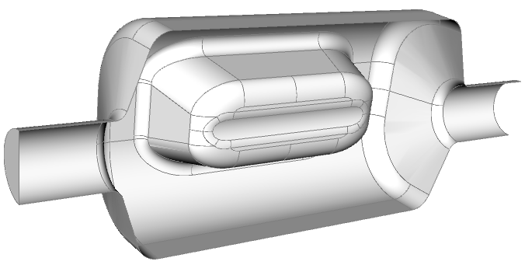
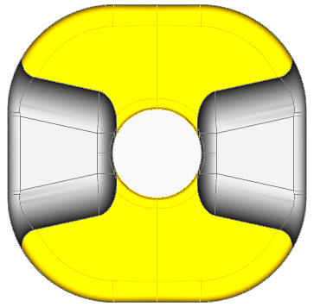
RF Dipole – SLAC-ODU Design
Iris aperture (diameter) (mm) | 84
Transverse dimension (mm) | 281
Vertical dimension (mm) | 281
R_{T} (ohm/cavity) | 433
V_{T} (MV/cavity) | 3.34
Bs (mT) | 55.6
Es (MV/m) | 33.4
Multipole b3 (mT.m)/m² (for Vt=10MV) | 486
Multipole b5 (mT.m)/m⁴ (for VT=10MV) | 2.2e6
Cavity shape optimization
Pole surface curved to reduce b3 component
Transverse Inner dimension fit within 281mm

Slide 4
Field Multipole Component
b_{n} definition

Slide 5
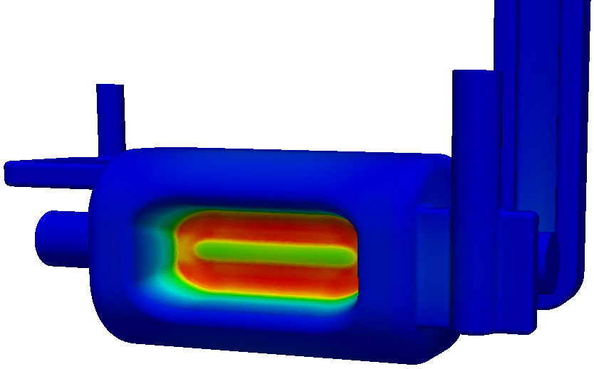
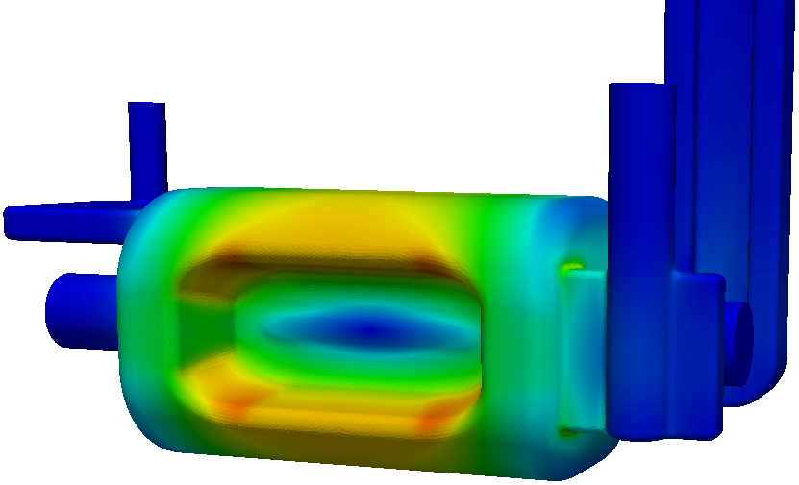
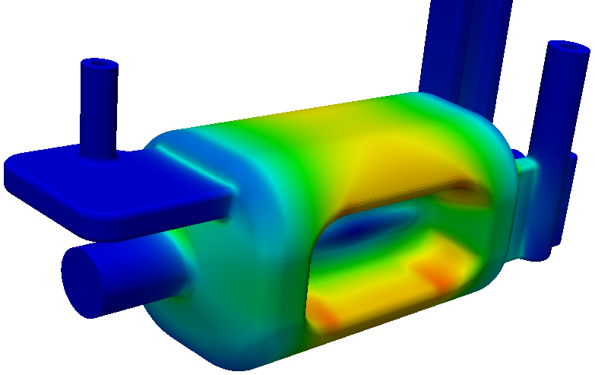
RF Dipole – SLAC – ODU Design
E B
HOM coupler
  deflecting plane (H-plane): ridged waveguide
  Other plane (V-plane): selective waveguide stub+coax
FP Coupler
  Coupling through symmetrizing waveguide stub

Slide 6
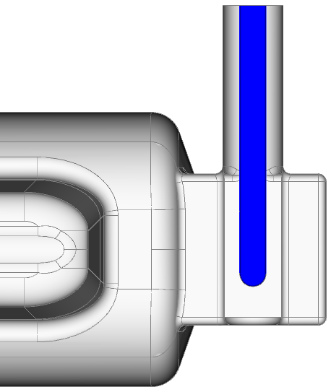
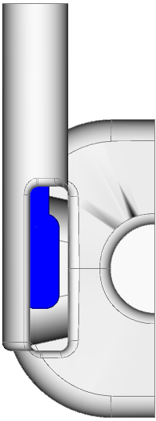
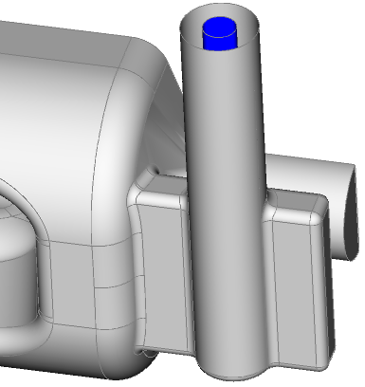
FPC coupler – SLAC-ODU Design
Outer diameter: 62 mm
Inner diameter: 27 mm
On symmetrizing stub waveguide
No field enhancement

Slide 7
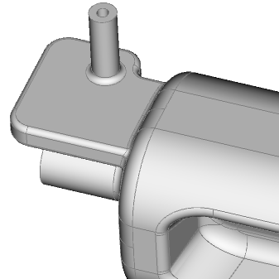
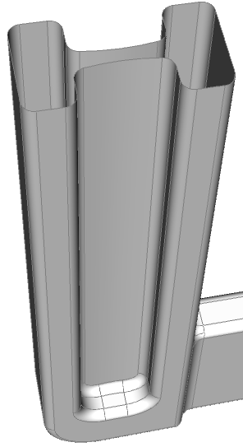
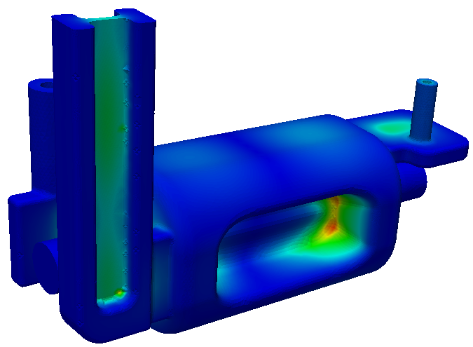
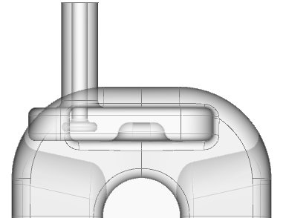
Ridged Waveguide & Selective Coupling HOM Couplers
Ridged waveguide coupler for H-dipole and accelerating modes – operating mode below cutoff
Selective WG-stub-coaxial coupler for V-dipole and accelerating modes – no filter needed

Slide 8
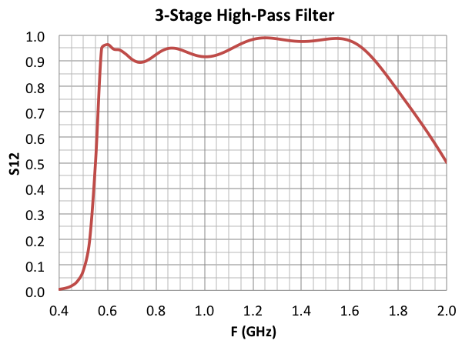
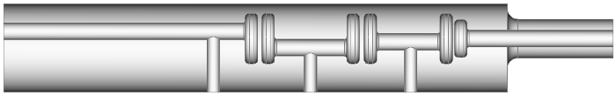
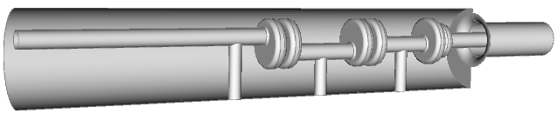
Alternative 3-Stage High-Pass Filter HOM Coupler
With improved pass-band transmission and operating mode isolation
Good isolation of the operating mode (400MHz)
Lowest HOM is around 600 MHz. Good transmission above 570 MHz

Slide 9
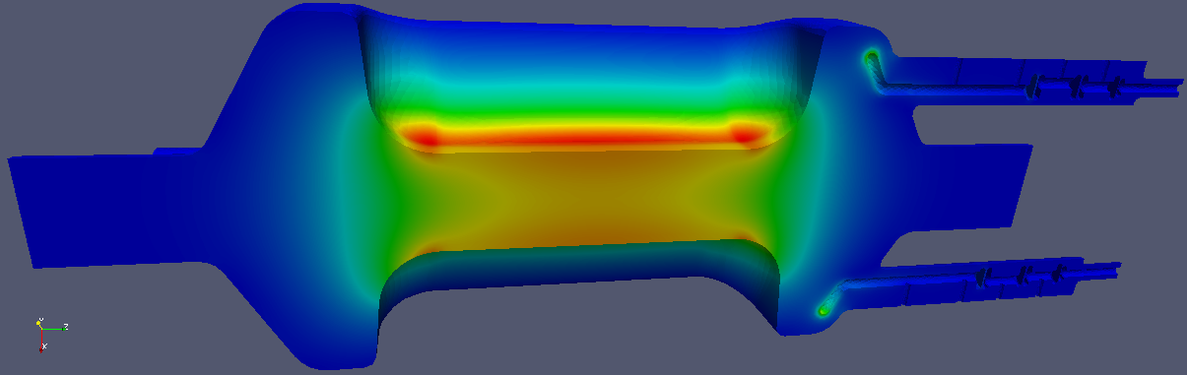
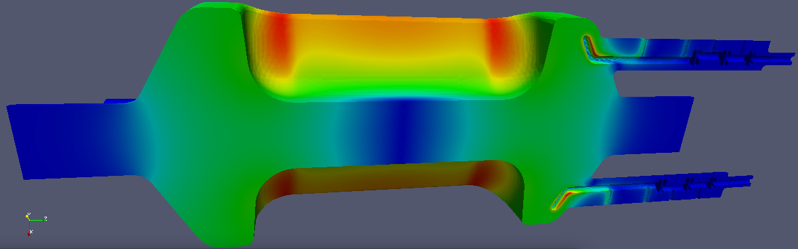
3-Stage High-Pass Filter HOM Coupler
Hook shaped antenna HOM coupler
E and B fields of operating mode
Showing rejection from the HOM coupler
Strong damping achieved for all the important modes
High B field on the HOM antenna is similar in amplitude as on the cavity wall
Cleaning, assembly, beam power handling? (beam power due to lowest acc mode (I=0.5AM): ~16*Qext)

Slide 10
HOM damping with a 3-stage HOM HOM coupler
Strong damping achieved

Slide 11
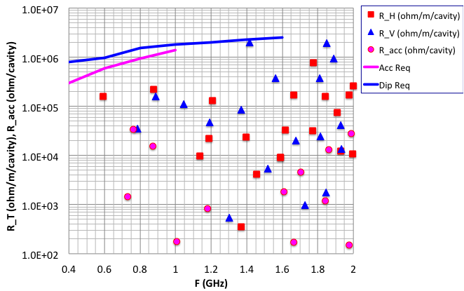
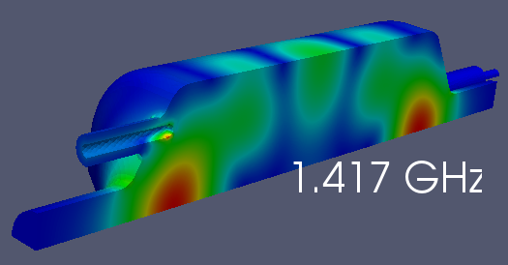
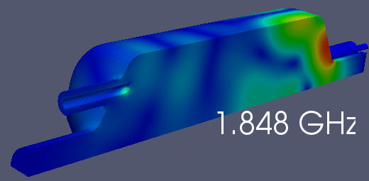
Impedance: (R_T/Q)*Q_{ext}*k
(3 stage filter HOM coupler)

Slide 12
Impedance
Transverse impedance referred in this file is R_{T}

Slide 13
Ridged Waveguide Coupler:
Qext & Impedance
(preliminary)
H-HOM coupler couples to both H-dip and Acc modes
V-HOM coupler couples to both V-dip and Acc modes

Slide 14
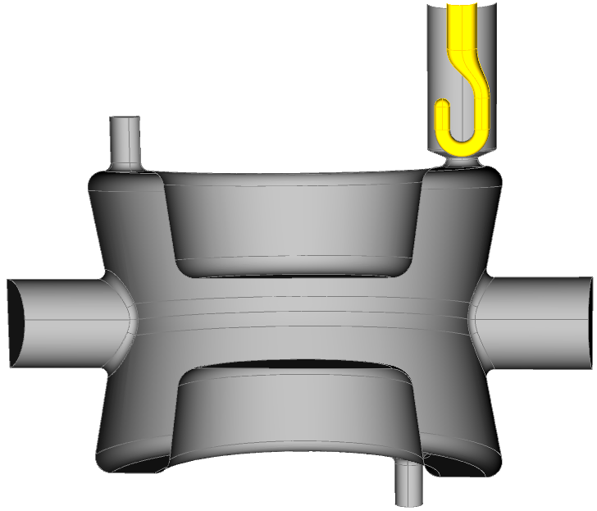
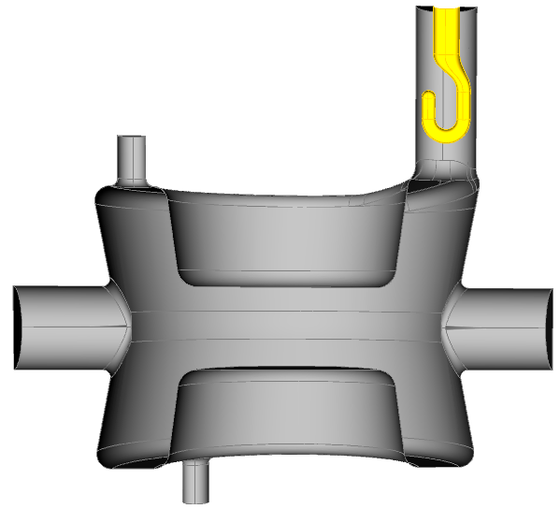
BNL DQW Cavity Simulation- FPC coupler
small FPC
FPC coupling: 2.5e6
large FPC
FPC coupling: 1.1e6

Slide 15
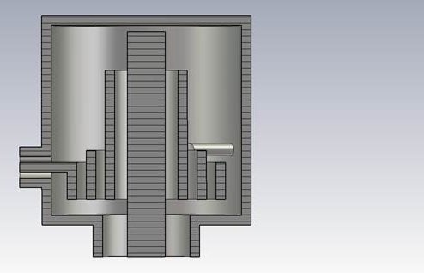
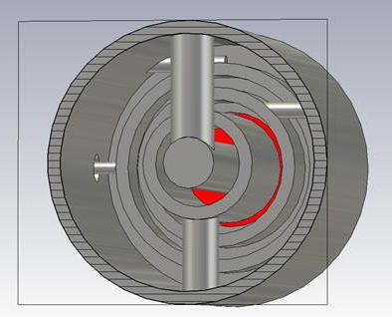
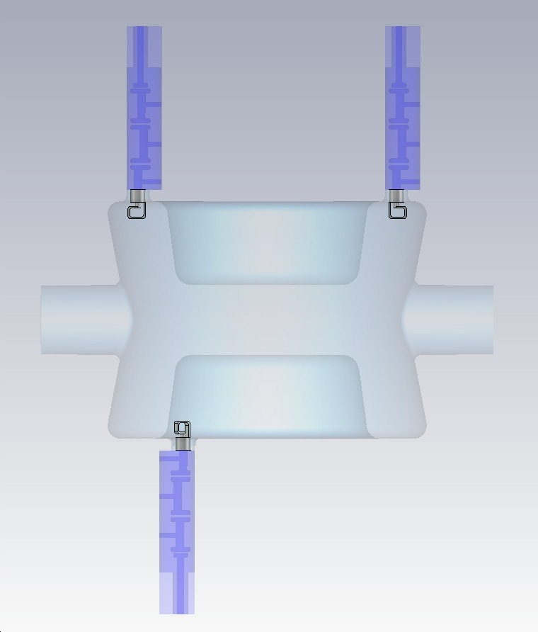
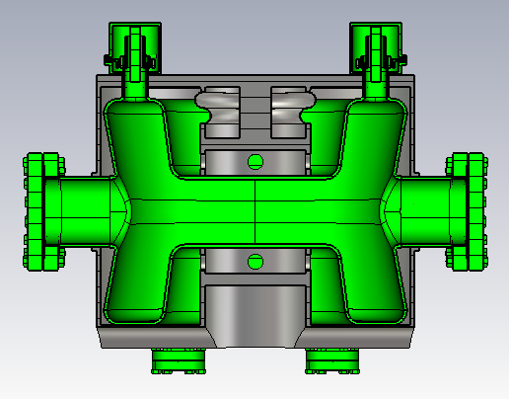
Cavity with HOM high-pass filter
66 mm
66 mm
Z. Li @ 2nd Joint HiLumi LHC-LARP Annual Meeting
Modified from BNL HOM filter for 56 MHz SRF Quarter Wave Cavity

Slide 16
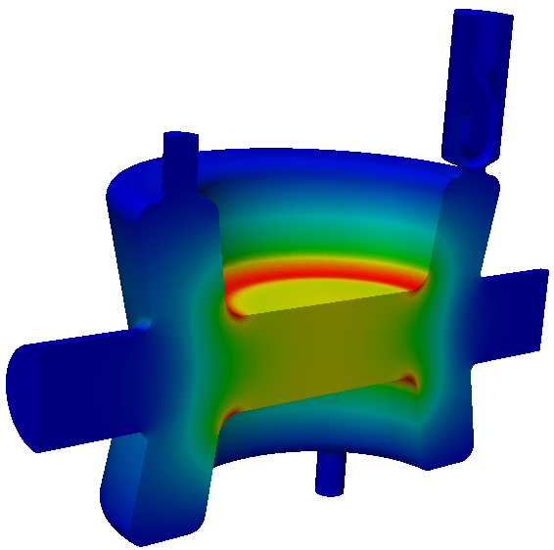
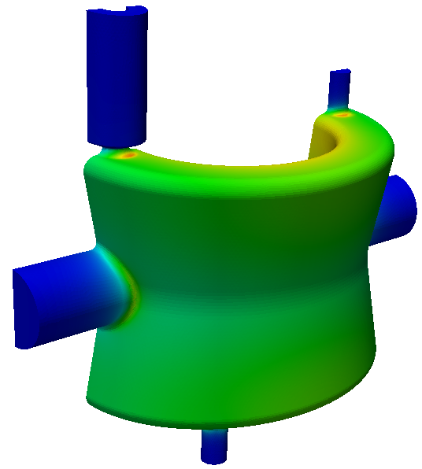
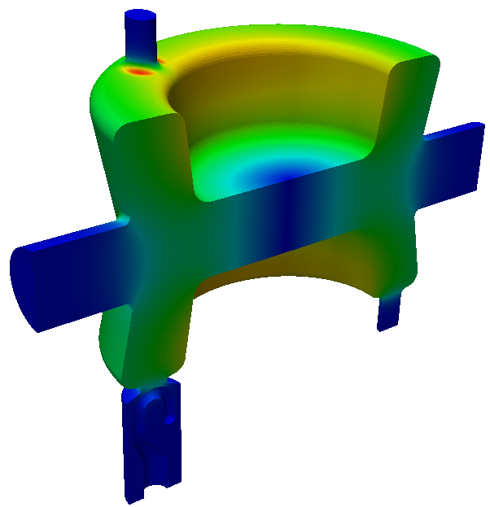
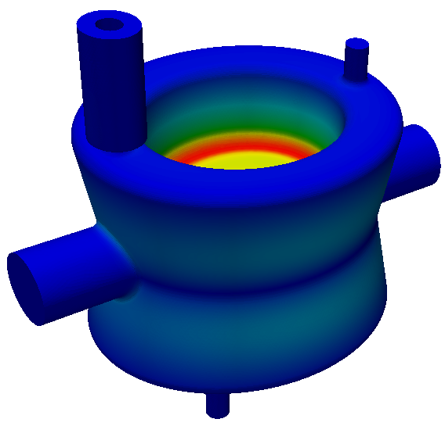
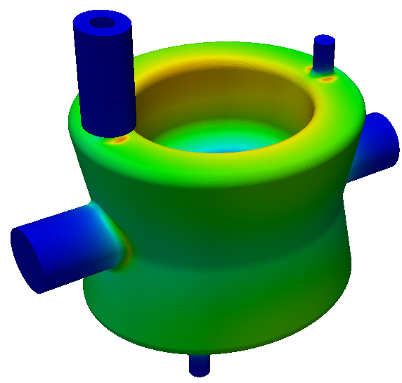
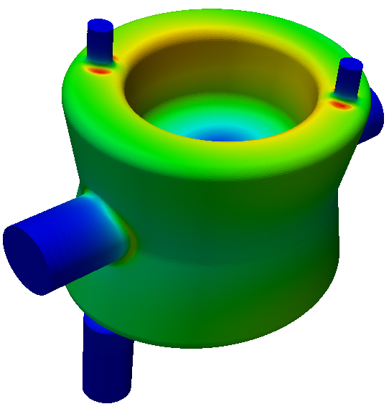
BNL DQW Cavity Simulation – small FPC opening
same HOM small FPC
E B
diff HOM small FPC
Peak surface B field at the rounding of HOM port

Slide 17
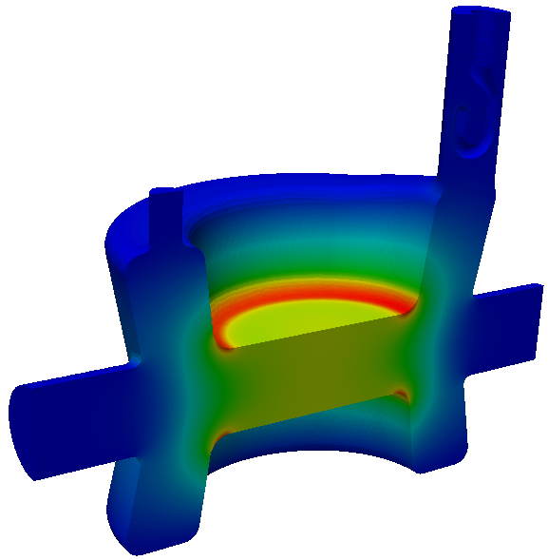
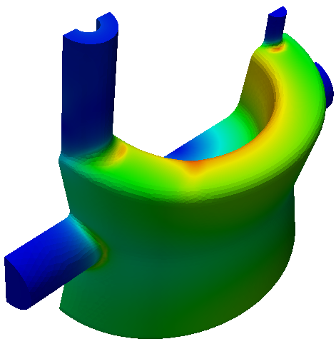
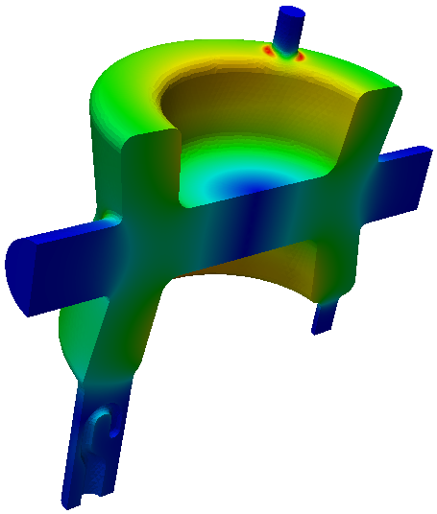
BNL DQW Cavity Simulation – large FPC opening
E B
Peak surface B field at the rounding of HOM port
Field asymmetric due to large FPC opening, symmetrizing needed

Slide 18
BNL DQW Cavity Parameters
Parameters | same HOM small FPC | same HOM large FPC
Frequency (MHz) | 398 | 396
Qext | 2.5e6 | 1.1e6
R_{T} (ohm/cavity) | 400
V_{T} (MV/cavity) | 3.34 | 3.34
Bs (mT) | 88 | 81
Es (MV/m) | 37.4 | 37.6
Electric center offset (mm) | 0.03 | 1.67
Multipole b3 (mT.m)/m² (for VT=10MV) | 1074 | 1096
Multipole b5 (mT.m)/m⁴ (for VT=10MV) | 1.7e5 | 8.9e4

Slide 19
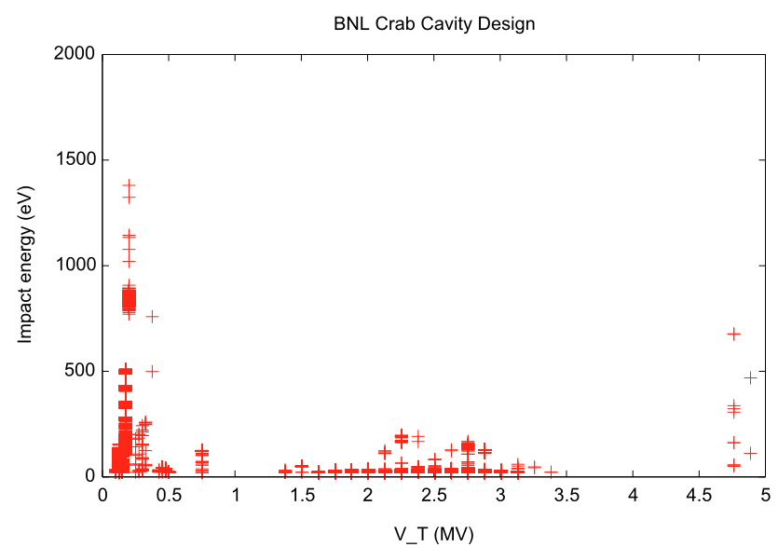
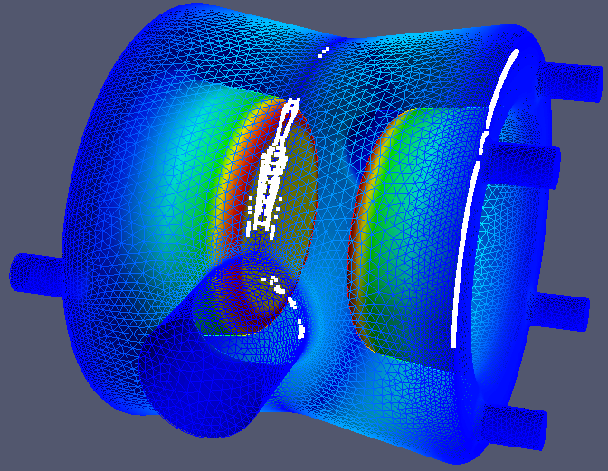
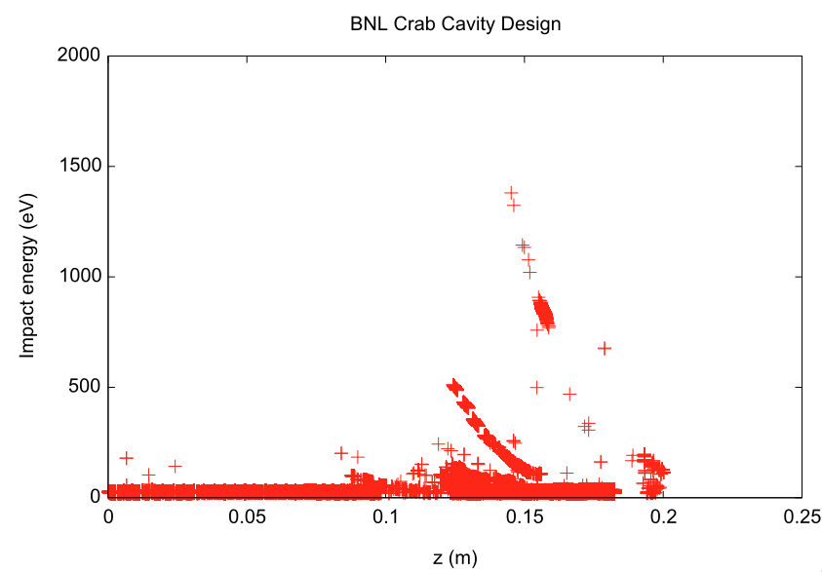
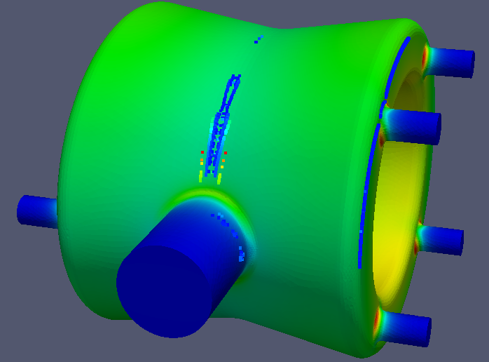
BNL Design Multipacting - preliminary

Slide 20
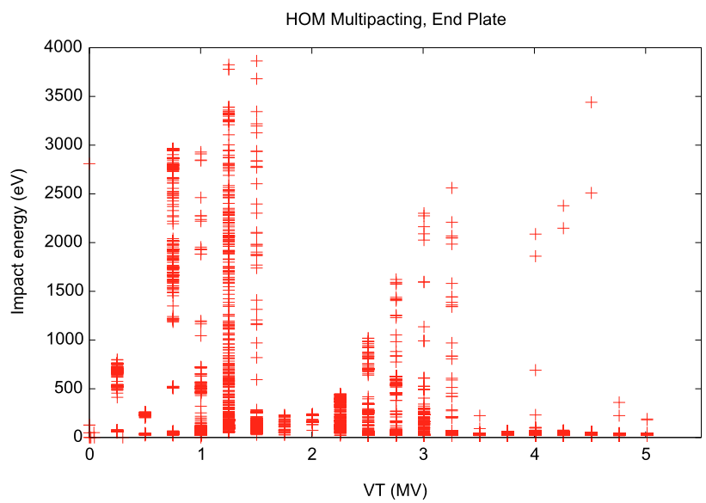
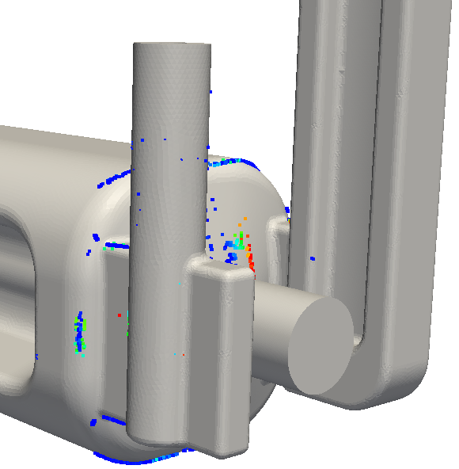
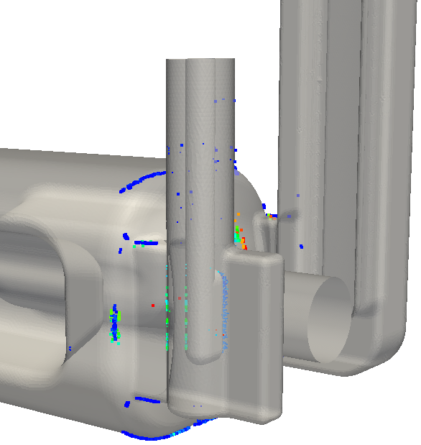
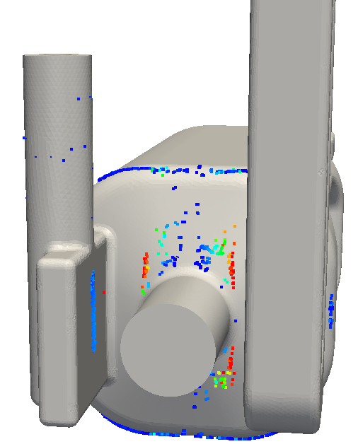
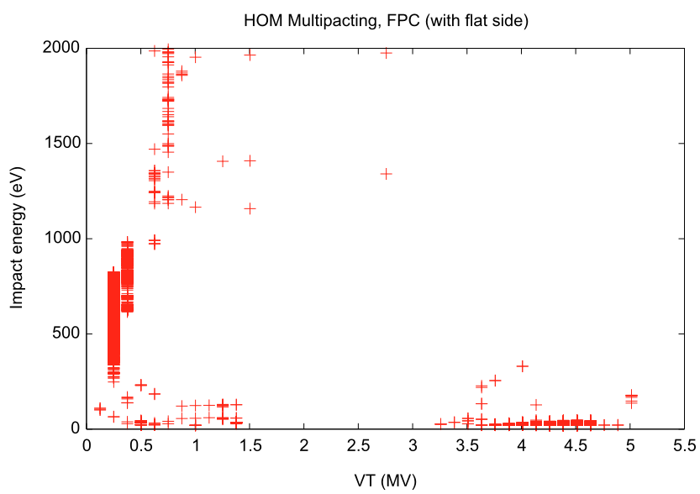
MP on End-plate and FPC coupler
MP on end-plate
Similar to the original prototype
MP at FPC

Slide 21
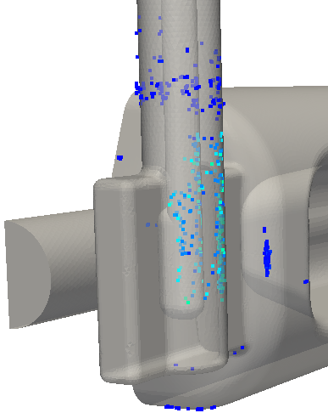
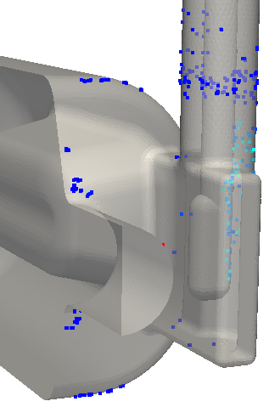
FPC MP Improvement
MP at FPC improved with full rounding

Slide 22
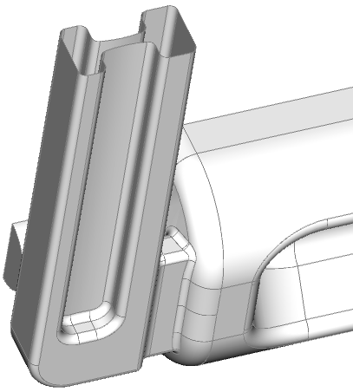
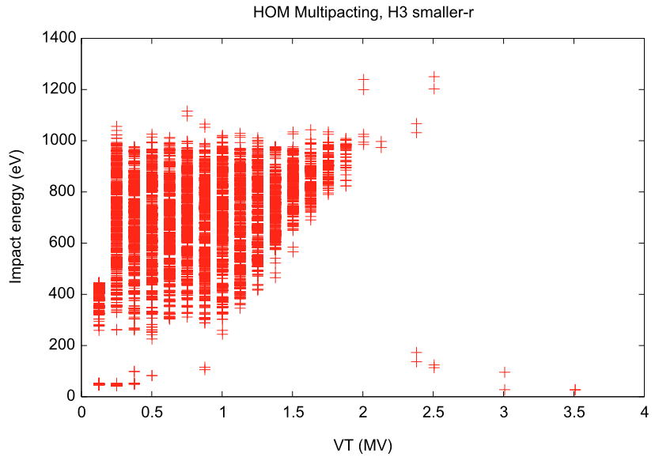
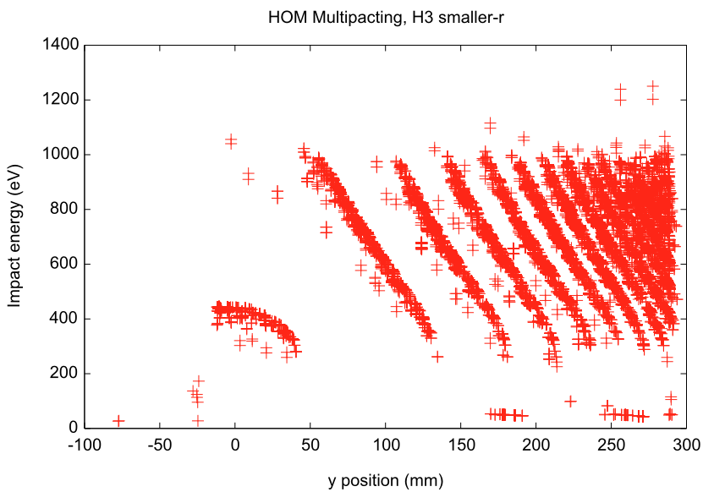
MP in Waveguide HOM Coupler
Significant MP between the (small curvature) ridged waveguide
(scan not complete )
Same V,
different y position
(partial result)

Slide 23
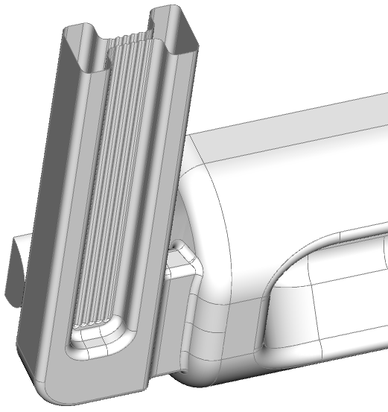


MP in Waveguide HOM Coupler
Vertical groove not effective in suppressing MP
(scan not complete)
Same V,
different y position
(partial result)

Slide 24



MP in Waveguide HOM Coupler
Slanted groove not effective in suppressing MP
(scan not complete)
(partial result)

Slide 25



WG HOM Coupler MP mitigation
Larger curvature ridged gap minimizes the MP region
Small bump on one side of ridge further suppresses MP resonances

Slide 26
Summary
RF Dipole crab cavity
  Cavity shape optimized to reduce multipole field components
  Ridged waveguide H-coupler and selective V-coupler provide effective damping
  MP mitigation in HOM coupler studied
BNL DQWCC
  RF parameter for different FPC coupler configurations being analyzed
In progress: coupler improvements, shape optimization, full multipacting scan and mitigation

