Slide 1
Simulation of beam-beam induced emittance growth in the HL-LHC with crab cavities
Joint LARP CM20/HiLumi meeting
Stefan Paret and Ji Qiang

Slide 2
Outline
Feedback and noise models
Simulation of LHC in 2012
Simulation of 50 ns HL-LHC scenario (preliminary)

Slide 3
Feedback Model (FB) I
Based on LHC’s damper *
Includes
Hilbert notch filter (h_{k}(φ_{H}))
Delay (d)
Kick:
* V.M. Zhabitsky, E9-2011-95, 2011; W. Höfle, priv. communication

Slide 4
FB model II
2 Pick-ups (BPMs) 1 Kicker
Transfer of centroid via linear map
ΔX’+δX’
g₁, g₂
X₂+δX₂
kicker
BPM2
beam
X₁+δX₁
BPM1

Slide 5
Crab cavity (CC) noise models
White noise on phase
Offset due to phase perturbation *
Time correlated phase noise *
Mono frequent perturbation *
* K. Ohmi et al., TUPAN048, PAC07
}
Not yet applied to HL-LHC

Slide 6
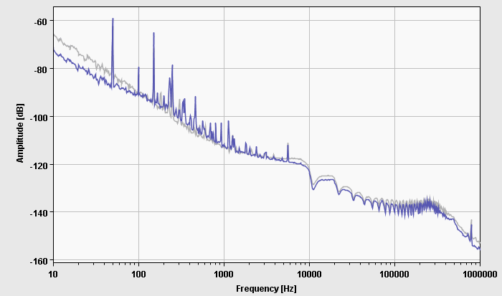
RF noise level
ACS phase noise
RF noise in LHC’s accelerating cavities can be measured
Estimation of white noise level with equivalent power in all betatron side bands: 2×10⁻⁴ rad rms * * P. Baudrenghien, LLRF for crab cavities, 2nd Joint HiLumi LHC-LARP Annual Meeting, Nov. 2012
Courtesy P. Baudrenghien

Slide 7
Numerical Setup
Strong-strong soft Gaussian collision model
1 bunch per beam
Linear transfer maps
No long range effects
8 million macro particles
2 cases:
LHC parameters from 2012
50 ns bunch spacing HL scenario

Slide 8
Comparison of BeamBeam3D simulations with LHC performance
Goal: Verify reliability of code and determine noise level for FB model
Data from physics run in 2012 (fill 2710) as example
Measured by operators:
Luminous region
Intensity
Emittance calculated from luminous region:
Sampling rate larger than simulation time ➔ Interpolation

Slide 9
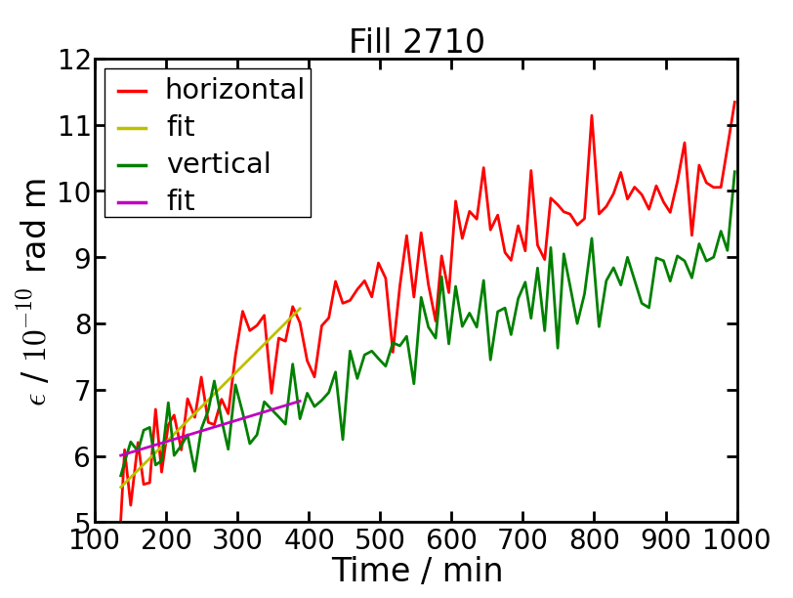
Emittance growth observed in LHC *
Initial linear growth rate:
12.8 %/h hor.
3.4 %/h ver.
Exclusion of IBS
Horizontally IBS accounts for ≈ 5 %/h **
➔ Max. 8 %/h due to beam-beam effects
* LHC operations data: courtesy G. Trad, CERN
** M. Schaumann, J. Jowett, CERN-ATS-Note-2012-044 PERF

Slide 10
Beam parameters
 | 2012 operation § | HL 50 ns **
N_{p} / 10¹¹ | 1.5 | 3.5
ε_{n} / μm | 2.3 | 3.0
β* / m | 0.6 | 1.02 ***
Q_{x} | 64.31 | 64.31
Q_{y} | 59.32 | 59.32
θ / mrad | 0.29 | 0.59
g₁+g₂ | 0.1 | 0.1
f_{CC} / MHz | - | 400.8
Collisions / turn | 1 hor., 1 ver. | 1 hor., 1 ver.
§ G. Trad, private communication
** O. Brüning et al., MOPPC005, IPAC2012
*** assuming leveling via beta function

Slide 11
Simulation of LHC in 2012

Slide 12
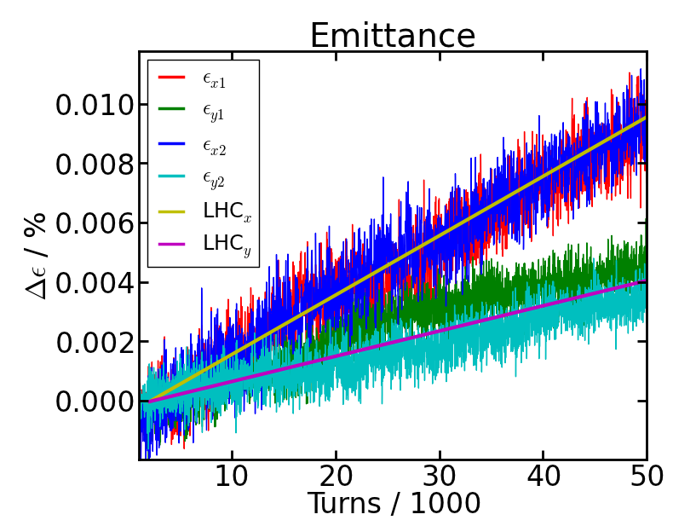
Comparison of measured and simulated emittance growth
rms offset fluctuation
at β* = 0.6 m
δX = 0.11 μm
δY = 0.09 μm
Validation of emittance simulations provides base for simulations with HiLumi beam parameters and crab cavities

Slide 13
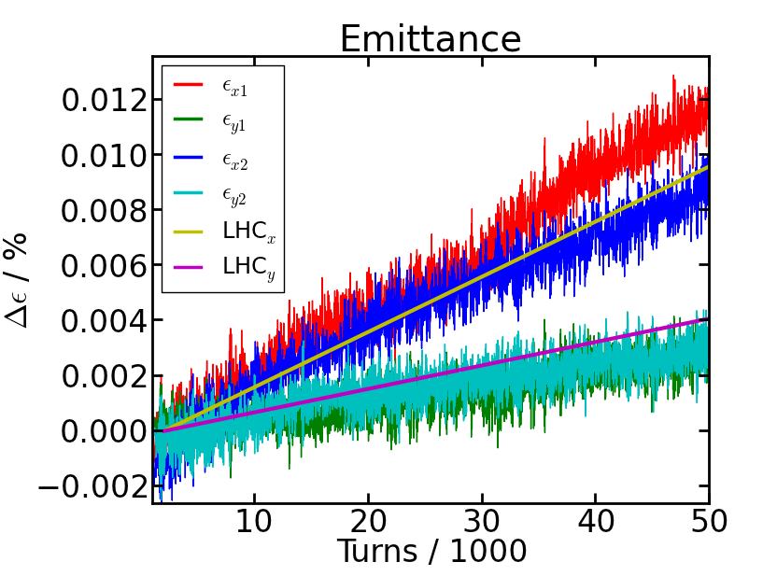
2012 beams – Emittance with FB noise and CCs
No CC noise
Emittance growth is quite the same

Slide 14
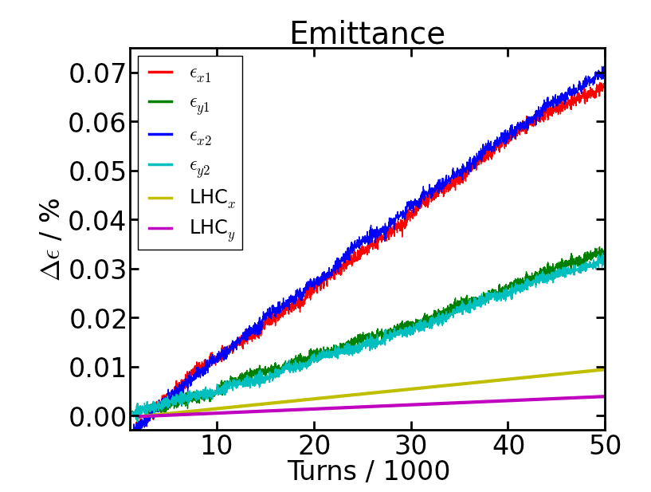
2012 beams – Emittance with white CC noise
CC noise:
0.2 mrad
(7 nm rms)
No FB noise
White CC noise leads to 60 %/h (hor) and 27 %/h (ver) emittance growth

Slide 15
Simulation of HL-LHC
(generally 50 ns scenario)

Slide 16
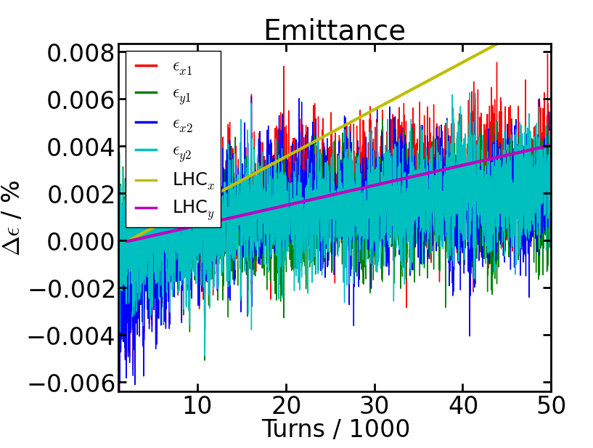
HL – Emittance without external noise
Emittance growth due to residual noise: 2 %/h

Slide 17
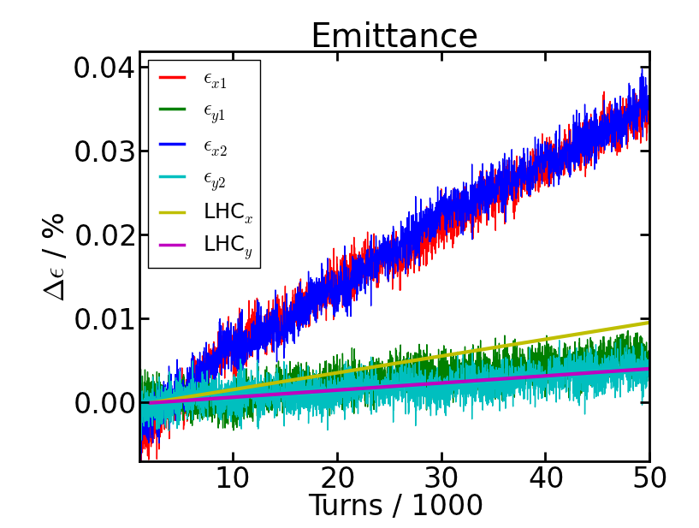
HL – Emittance with FB noise
Resulting emittance growth 30 %/h (hor) and 4.0 %/h (ver)

Slide 18
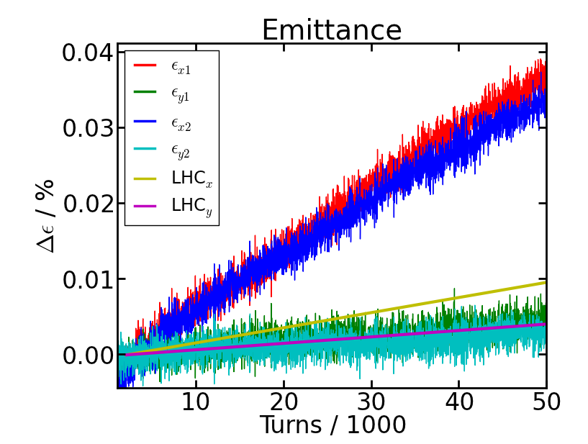
θ = 0 versus CC
θ = 0
θ = 0.59 mrad, with CC
Quite the same emittance growth

Slide 19
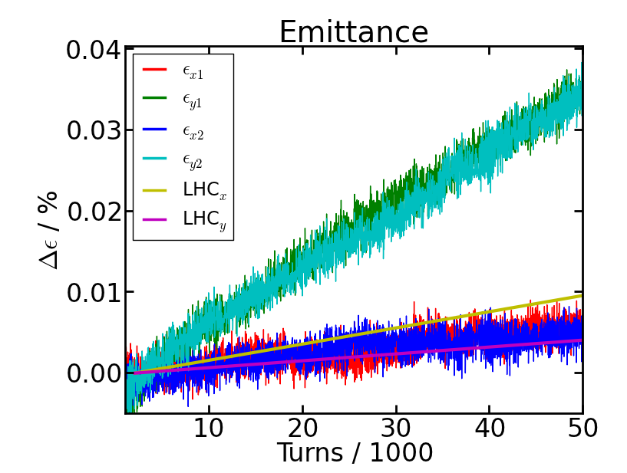
Consistency test with exchanged planes
Growth rates change to 4.8 %/h (hor) and 30 %/h (ver)
x-y discrepancy due to working point and FB

Slide 20
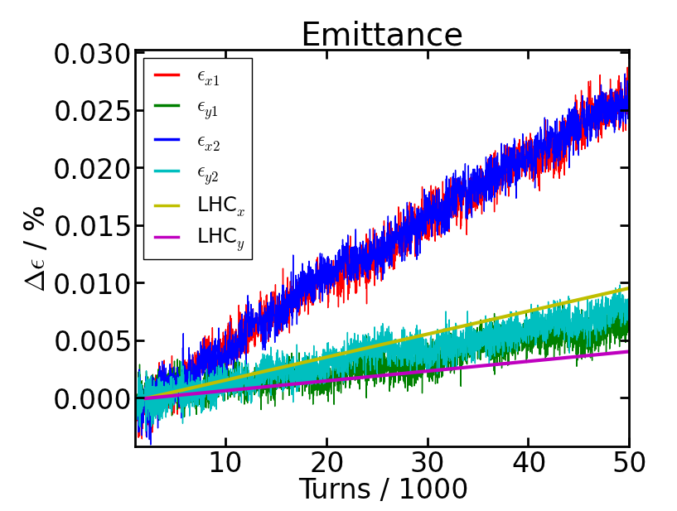
25 ns HL* – emittance with FB noise
N_{p} = 2.2×10¹¹
ε_{n} = 2.5 μm
β* = 0.49 m
White CC noise causes 22 %/h (hor) and 6 %/h (ver) emittance growth
Less sensitive than 50 ns scenario
* O. Brüning et al., MOPPC005, IPAC2012

Slide 21
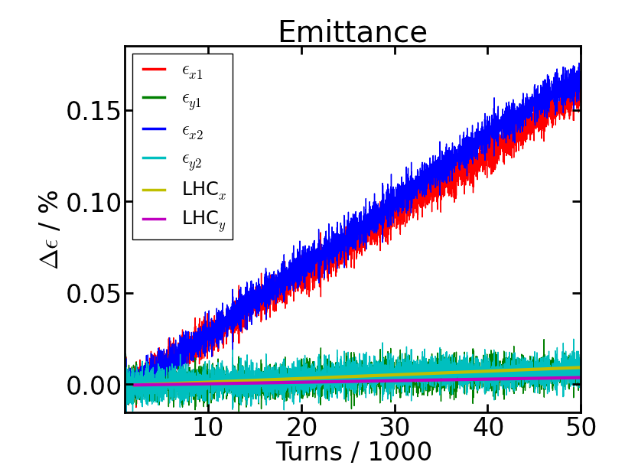
HL – emittance with white CC noise
δφ = 0.2 mrad rms
No FB noise
White CC noise causes 140 %/h (hor) and 7 %/h (ver) emittance growth

Slide 22
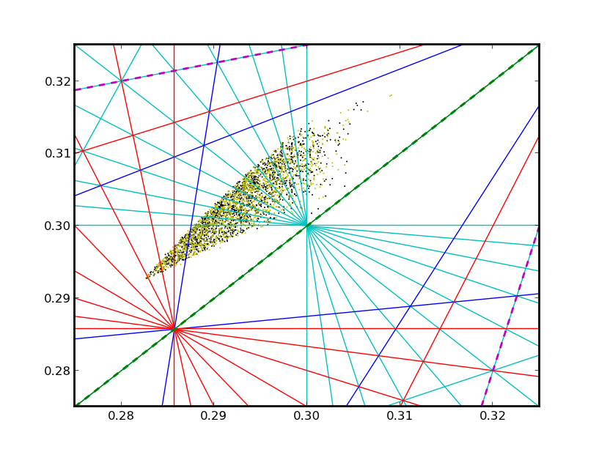
HL – Tune diagram of colliding beams
9th order
10th order
7th order

Slide 23
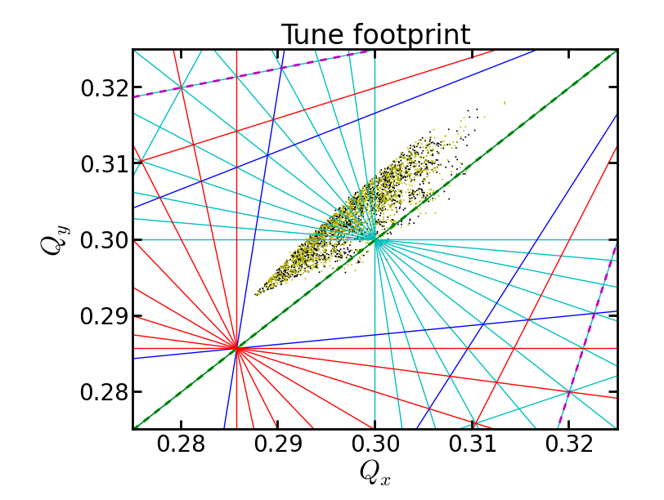
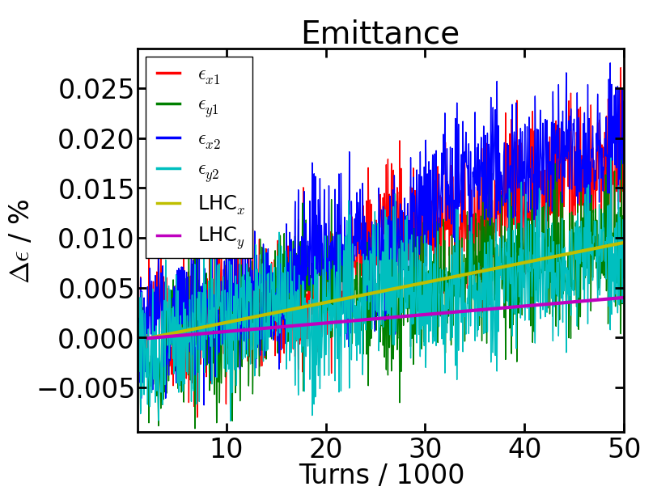
Change of working point
Q_{x} = 0.315 avoids resonances
Emittance growth:
17 %/h (hor) and 8 %/h (ver)
Instead of 30 %/h (hor) and 4 %/h (ver)

Slide 24
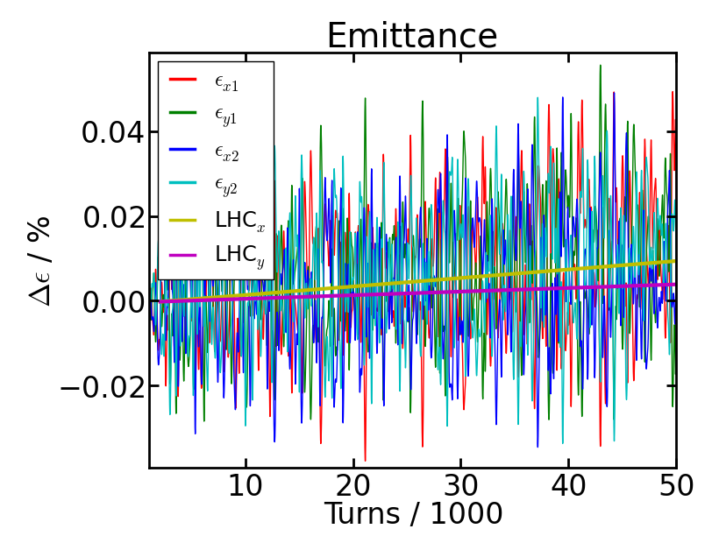
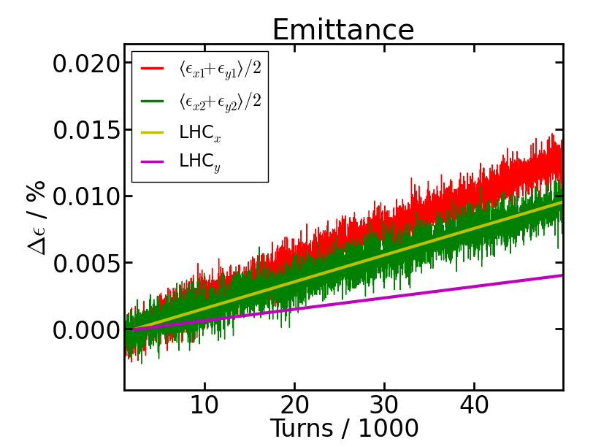
Change of working point II
Q_{x} = 0.32
Strong fluctuation due to coupling
Even less emittance growth: 8 %/h (hor) and 11 %/h (ver)
Instead of 30 %/h (hor) and 4 %/h (ver)

Slide 25
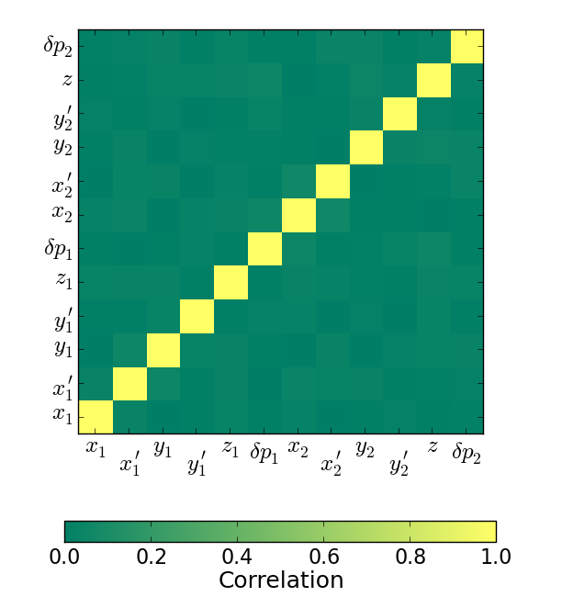
Correlation
Phase space correlation after 50,000 turns
Deviation between 4D emittance and ε_{x} ε_{y} is about 0.1 %

Slide 26
Correlation
Phase space correlation after 50,000 turns
Deviation between 4D emittance and ε_{x} ε_{y} is about 0.1 %

Slide 27
Conclusions
Measured emittance growth was reproduced by simulations with BeamBeam3D
Simulations with HL parameters started
Working point needs to be adjusted to tune shift

Slide 28
Outlook
Find optimal tune
Employ other
Noise models
Leveling procedures
Beam parameters
to predict emittance growth in HL-LHC

Slide 29
Thank you for your attention
Thanks to G. Trad, W. Höfle and M. Schaumann for useful information

