Slide 1
QXF Winding/Curing Tooling and Curing Mold
Miao Yu, FNAL
04/09/2013

Slide 2
Outline
Coil x-section at each fabrication step
Coil winding and curing
Winding table and tensioner
Winding/Curing Tooling
FNAL Curing Press
Curing Mold
Curing Stress Analysis
Summary

Slide 3
Coil during Curing
1.5 mm (60 mil)
Curing Retainer
175 µm (7 mil)
S2 glass
125 µm (5 mil)
S2 glass sleeve
500 µm (20 mil)
SS or Mylar shim
Each layer 250 µm
OR: 115.376 mm
OL IR: 94.438 mm
OR: 113.376 mm
250 µm
(10 mil)
IL OR: 93.938 mm
IR: 75 mm
500 µm (20 mil)
S2 glass
Midplane
250 µm (10 mil)
SS shim

Slide 4
Coil during Reaction
250 µm (10 mil) MICA
each layer 125 µm
250 µm (10 mil)
S2 glass
OR: 113.876 mm
OR: 113.376 mm
IR: 75 mm
Midplane
125 µm (5 mil)
MICA
75 µm (3 mil )
MICA
IR: 74.8 mm
250 µm (10 mil) MICA
each layer 125 µm

Slide 5
Coil during Impregnation
125 µm (5 mil)
Polyimide trace
125 µm (5 mil)
S2 glass
RTV
250 µm (10 mil)
MYLAR
OR: 113.876 mm
IR: 113.376 mm
IR: 75 mm
Midplane
125 µm (5 mil)
S2 glass
75 µm (3 mil )
Polyimide trace
125 µm (5 mil)
MYLAR
IR: 74.8 mm
125 µm (5 mil)
G11

Slide 6
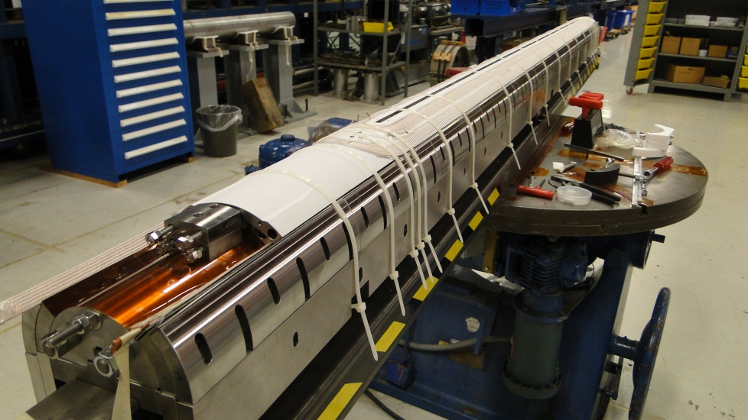
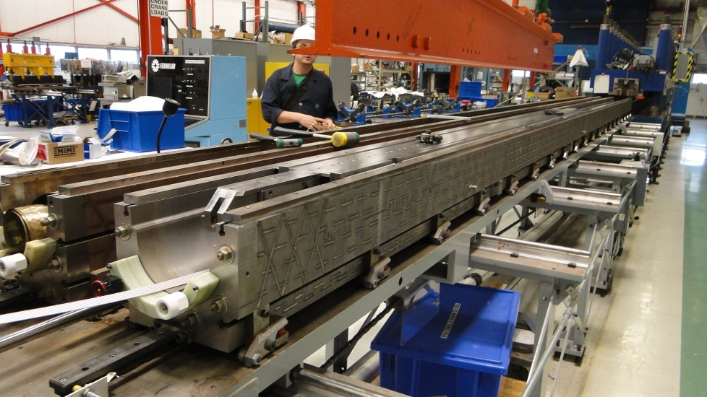
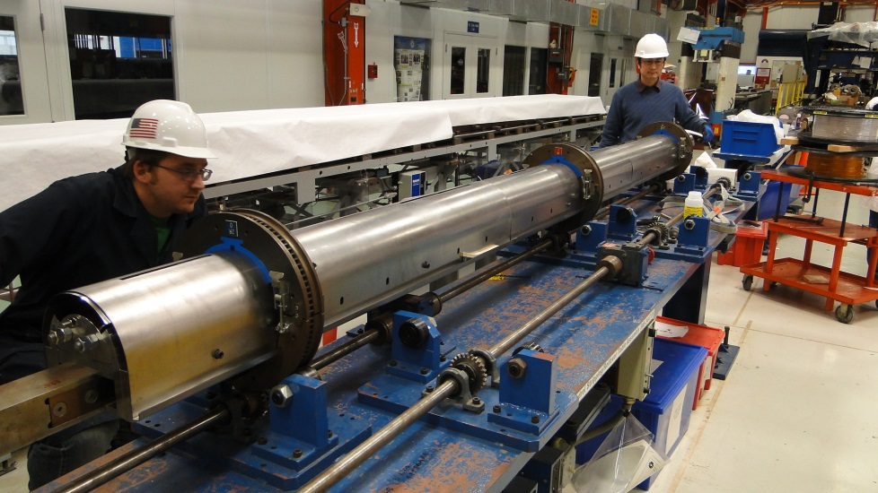
Coil Winding and Curing
Coil OL Winding
Finish Coil Winding
Coil inside Curing Mold
Coil Rotation for Curing

Slide 7
Winding table and tensioner
Winding Table:
Used for winding 3.3 m LQ/LHQ coil
Will be used for SQXF and LQXF
Maximum winding length is 4.324 m
1.5 m
4.324 m
Tensioner
Coil Length:
SQXF: 1.5 m (OK)
LE saddle length 31.2 mm
RE saddle length 49.2 mm
Saddle extension length 130 mm
LQXF: 4.312 m (winding and curing with a shorter saddle extension, even w/o it)
Winding Table
SQXF
LQXF
Half magnetic length: 2000 mm

Slide 8
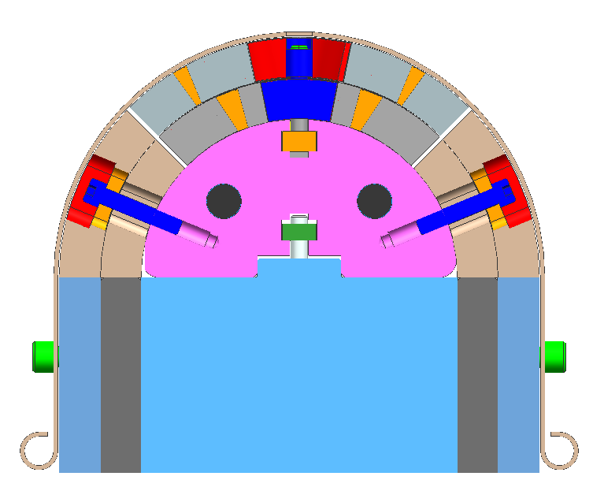
Winding/Curing Tooling
Retainer
Pole key bar
Mandrel key bar
Coil
Mandrel
Sector pusher
Sector pusher
Side pusher
Side pusher
Mandrel support block
SQXF/LQXF
HQ/LHQ
QXF coil ID is fixed 75 mm, OD is dependent on final cable size
Mandrel, mandrel support block and key bars are being designed.
Pushers and retainer will be designed later once we have the final cable size.
The curing mold is designed based on the current cable dimension, and the thickness of the retainer can be adjusted to accommodate any small amount change in the cable size

Slide 9
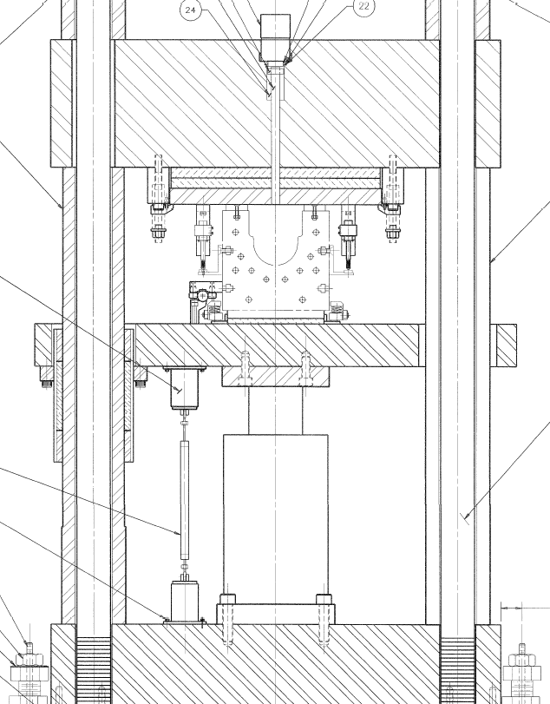
FNAL Curing Press
Mandrel cylinder
Capacity: 10,000 pump psi = 15 ton
11T Dipole
LHQ
Main cylinder
Capacity: 10,000 pump psi = 200 ton
Curing press:
~8.8 m long
 | Max. load/cylinder (ton/kN) | Spacing (inch/cm) | Max. load (kN/m) | Max. load for LHQ (kN/m) | Cylinder Pressure (pump psi)
Main Cylinders | 200/1780 | 12/30 | 5934 | ~1780 | 1250
Mandrel Cylinders | 15/134 | 6/15 | 894 | ~180 | 2000

Slide 10
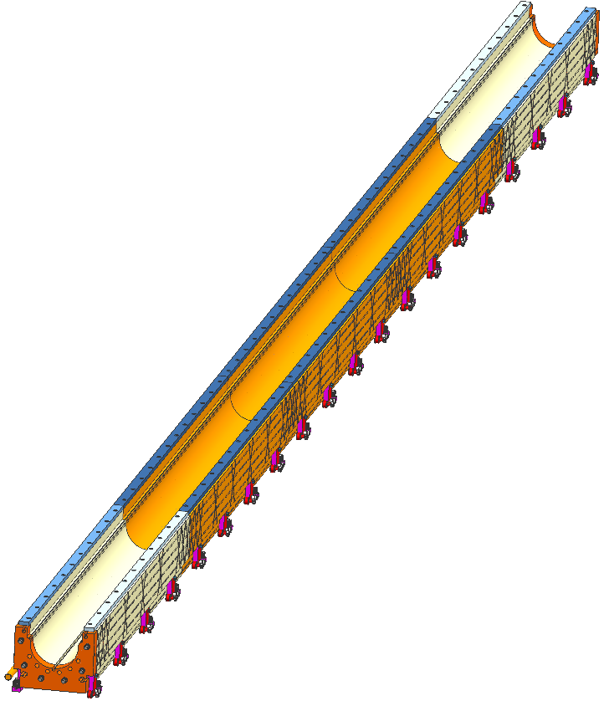
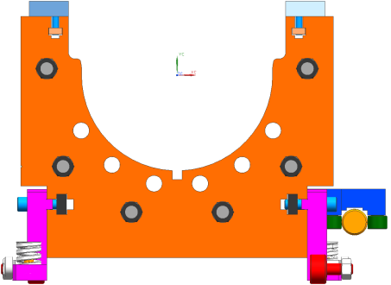
Curing Mold
24 MPa
(same hydraulic
pressure to the coil)
Curing Mold for SQXF and LQXF
~8.8 m long
~5500 laminations
5 sections
Stacking and welding
Final assembly
22 MPa
1.2 MPa
Backup Mold for SQXF:
~2.1 m long
~1300 laminations
LHQ Curing Mold
Unit: mm

Slide 11
Curing Stress Analysis
Component | Material
Coil | Nb₃Sn
Mold | 1050 steel
Mandrel | SS 304
Sector pusher | SS 304
Stop bar | A2 Steel
Use annealed steel 1050 for the lamination with yield strength 345 MPa
 | P_{mandrel} =1.2 MPa |  | P_{mandrel} =1.2 MPa P_{coil} =22 MPa |  | P_{mandrel} =1.2 MPa P_{coil} =22 MPa P_{mold} =24 MPa
 | _{Stress} _{(MPa)} | _{Deflection (µm) in x/y} | _{Stress} _{(MPa)} | _{Deflection (µm)} | _{Stress} _{(MPa)} | _{Deflection (µm)}
Coil (MPa) | _{2.7} | ₋ | _{18.0} | ₋ | _{20.7} | ₋
Mold (MPa) | _{6.1} | _{3/1} | _{43.6} | _{32/16} | ₁₁₀ | _{107/58}

Slide 12
Summary
Tooling is designed based on the coil x-section
Winding table, tensioner and curing press are available at FNAL for SQXF and LQXF coil fabrication
Winding and curing tooling are being designed. The plan is to have them ready by this October.
Curing mold lamination and end blocks were designed, and start the procurement process.
Most of the curing mold tooling are available from LHQ mold. The plan is to have QXF curing mold ready by this October.

