Slide 1
Discussion led by Provocateur
Mainly focusing on the Plenary and Accelerator Systems Sessions
With input from many colleagues and information from coffee discussions!
USLARP Collaboration Meeting 8-10 April 2013, Napa Ca
Oliver Brüning BE-ABP CERN
1

Slide 2
Questions and Comments: Magnets
Gianluca: decision to split Q1 and Q3 based on managerial approach. ➔ Should we come back to this decision and make sure the same criteria are applied to the Q1-Q3 and the Q2 designs?
Length control for the triplet coils and FQ: are we ready for accelerator grade manufacturing?
Need for confident time estimates for new triplet magnet production (critical ingredient to LS2 and LS3 planning)! ➔ Ezio: Rejection rate for coils?; Gianluca: 6 to 12 month potential delay of the delivery time.

Slide 3
Questions and Comments: Magnets
Is there anything else one can do to shorten the time to have a final MQXF prototype (2017!)?
Smallest acceptable beam size at IP (β∗ = 10cm ➔ beam size of ca. 5μm @ IP and 5mm @ triplet) ➔ implications on triplet magnet tolerances and monitoring (vibrations, aperture etc.)?
40% difference in radiation dose between MARS and FLUKA for MCBX-3?
Lucio: CERN’s role in the USLARP management for the magnet production?

Slide 4
Questions and Comments: Beam Dynamics
Origin of the observed emittance growth during 2012 operation (ca. 30% but not equal in both beams and both planes)? ➔ do we have adequate Beam Instrumentation for identifying the origin and for curing the cause for HL-LHC operation?
What needs to be done for getting Schottky; Head-
Tail monitor and the monitor for high bandwidth
feedback systems operational in the LHC?
Can we exclude e-cloud activity for 50ns operation ➔ do we have adequate Beam Instrumentation?

Slide 5
Questions and Comments: e-Lens
Currently no USLARP proposal to contribute to Halo monitor development? ➔ Key device for validating the hollow e-lens and it’s operation in the LHC!
➔ Does USLARP really NOT want to be actively
involved in this development?

Slide 6
Questions and Comments: RF
Promising progress for Crab Cavities: Congratulations!!! ➔ But do we have selection criteria in place for choosing the final cavity type? Should avoid ‘first come first serve’ decision while keeping an eye on the timing constraints from the SPS test. ➔ How will the remaining teams be integrated into the ‘winning bid’? Possibility for more then one cavity type for the final LHC implementation?
Need for confident estimates for Crab Cavity production times (critical ingredient to LS2 and LS3 planning)! ➔SPS tests and required infrastructure preparation (Erk’s talk);

Slide 7
Questions and Comments: RF
When do we need to take a decision on CC tests in the LHC IR4 to be useful or feasible (required preparation work and potential space conflict with other proposals)?
Compatibility of default RF operation mode (phase modulation) with Higher Harmonic RF system (800MHz)? ➔ ‘square’ bunch profile and lower IBS
Possibility and impact of a lower frequency HL-LHC RF system (e.g. 200 MHz) ➔ impact on Crab Cavity development and operation scenario’s without Crab Cavities?

Slide 8
Questions and Comments: General
Is the current LARP structure adequate for the transition to a production project (separation between Magnet and Accelerator Systems etc.; WPs with deliverables)?
Are GARD grants really a realistic option for funding of ‘additional’ HL-LHC developments (if yes, what is the actual ceiling for such requests-proposals)?
What would LARP like from CERN (or: what can CERN do to facility the LARP program)?

Slide 9
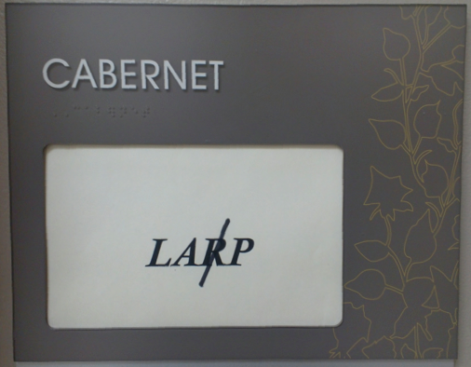
Questions and Comments: General
Future of LTV program? ➔ requires adequate funding!
Is it the right time to remove the ‘R’ in LARP?

