Slide 1
A New Test Beamline in MCenter
Erik Ramberg, Aria Soha
20 December, 2012

Slide 2
Integrating Mcenter into the Fermilab Test Beam Facility

Slide 3
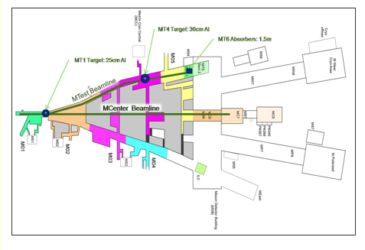
The Current MTest Beam Line
Recall that there are 2 targets – one is far upstream and can give higher momentum tunes (>32 GeV)
Downstream of the MT4 target, the magnets have special low current power supplies that give accurate tunes down to 1-2 GeV
Spill structure is the same for both beams

Slide 4
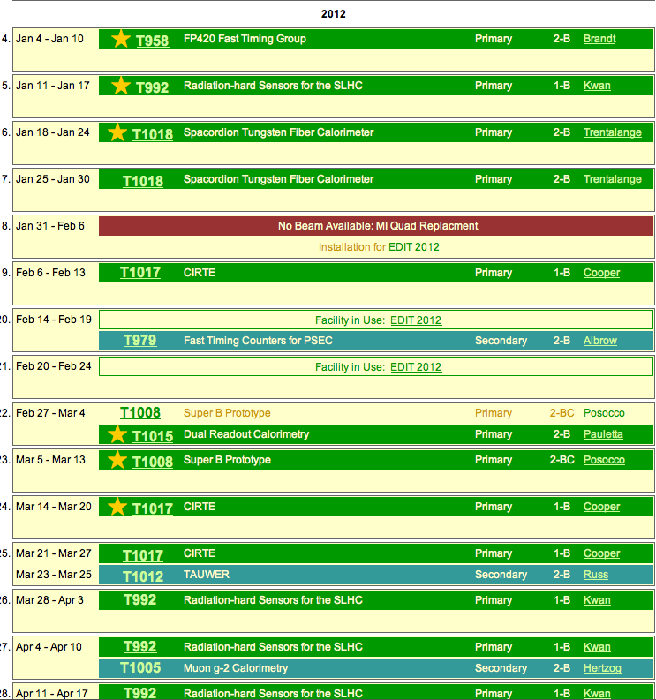
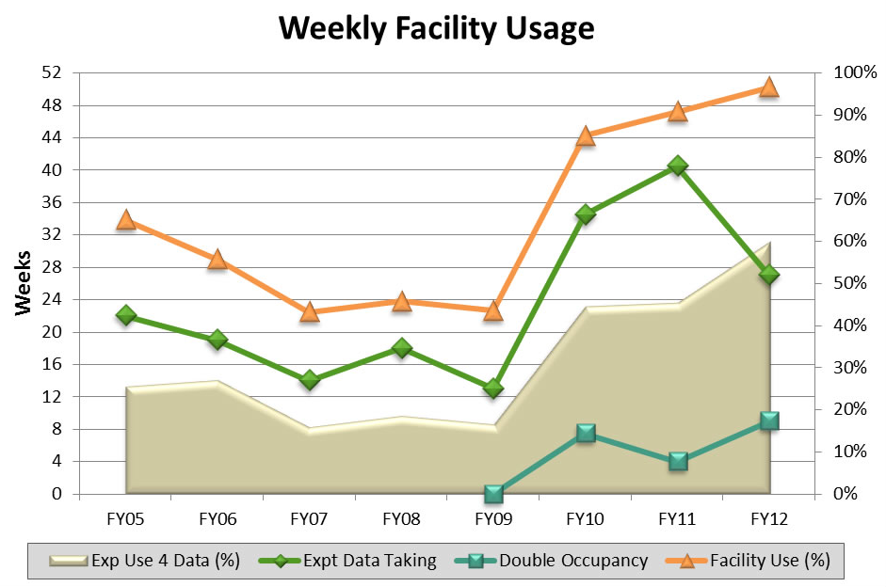
The Need for a New Test Beamline
The Fermilab Test Beam Facility is extremely popular and will remain so for the foreseeable future.
Having multiple users running simultaneously is a common occurrence.
CERN test beam users will be looking for a new home for 2013 and 2014.
The need for a second beamline was endorsed and partially funded by DOE.
The lab should give priority to the energizing of the Mcenter beamline

Slide 5
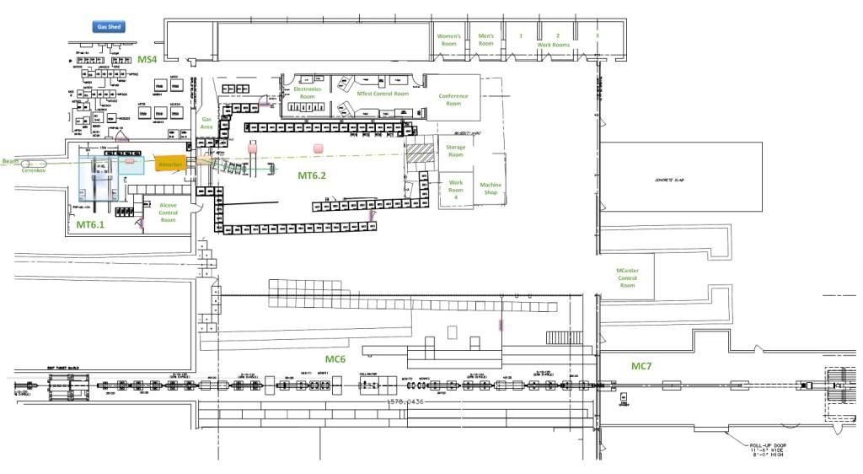
MCenter Layout as part of the Fermilab Test Beam Facility
Tertiary beam moved to MC7
Potential new control room?
An electronics room (or possible control room) in the MWest stub
Installed cable
route for users
Walkway to access MC7-needs to be covered
This section of pipe has been removed. User area is mostly here.
Can put another user area near JGG

Slide 6
Beam Rates and Shielding

Slide 7
Beam rates calculated for MIPP

Slide 8
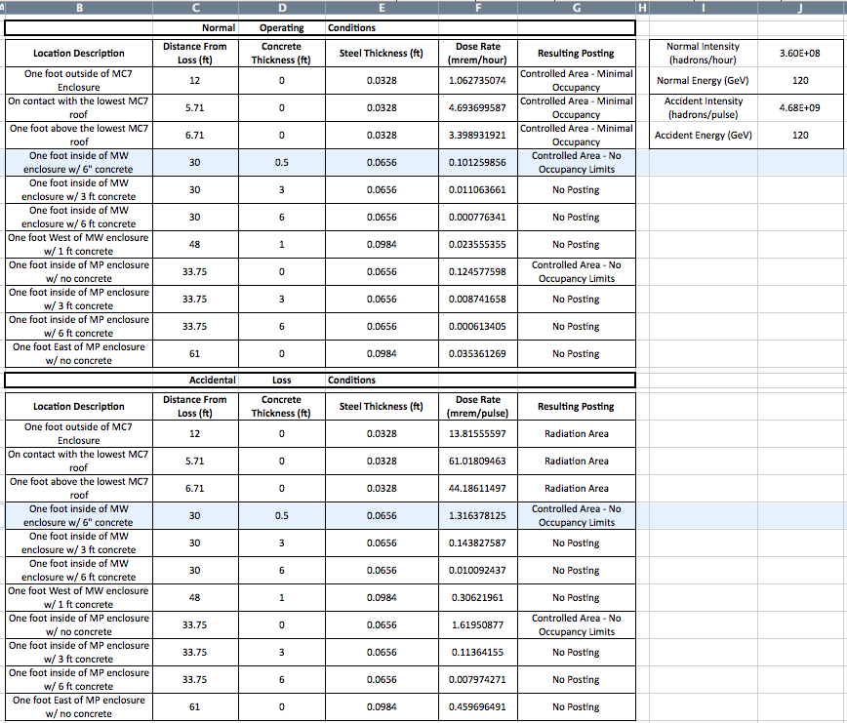
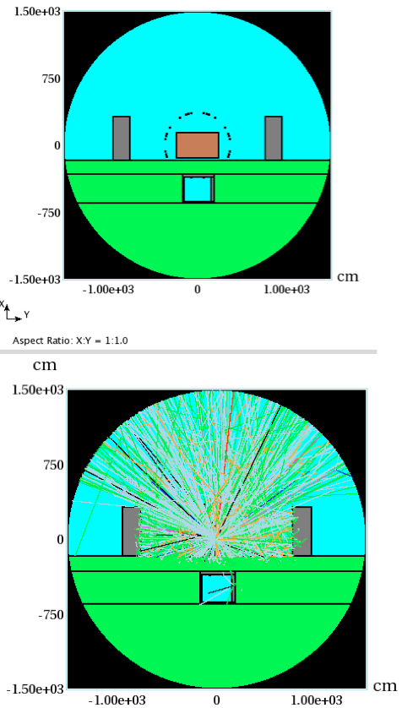
Shielding calculations of MC7 with Absorber in Beam (from Nathan Duff)

Slide 9
Radiation measurement needed with beam on –
Extra shielding can be easily accommodated
Are target muons a problem?
Target for Mcenter is closer to user area than MTest

Slide 10
PPD Work for MCenter

Slide 11
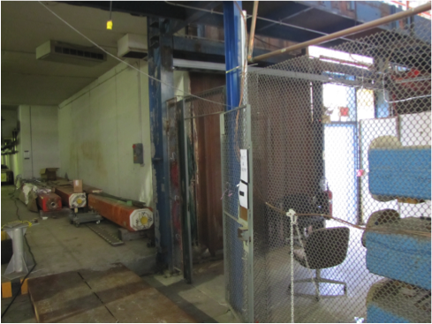
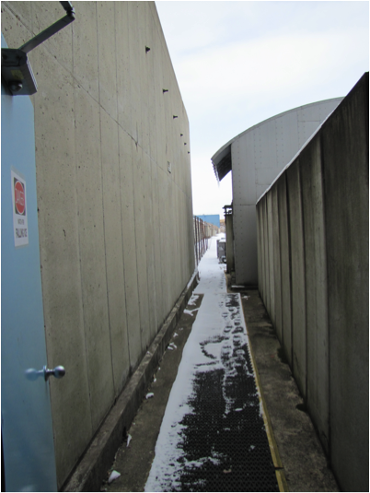
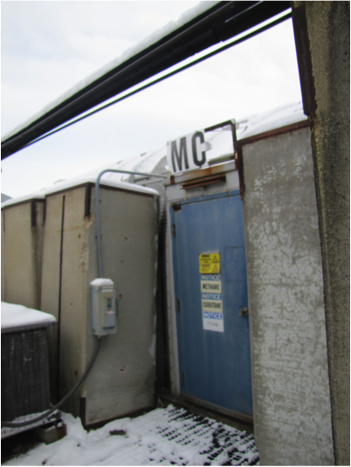
A Walkway from MDB to MC7
Needs lighting and protection from rain/snow
Key tree & interlocks

Slide 12
Cryogenic/Lq Ar processing Area
Flammable gas racks need to be purged & removed to make space for Cryogenic Area
ODH analysis needs to be done by ES&H
Air Duct needs to be re-routed
Shielding blocks need to be removed

Slide 13
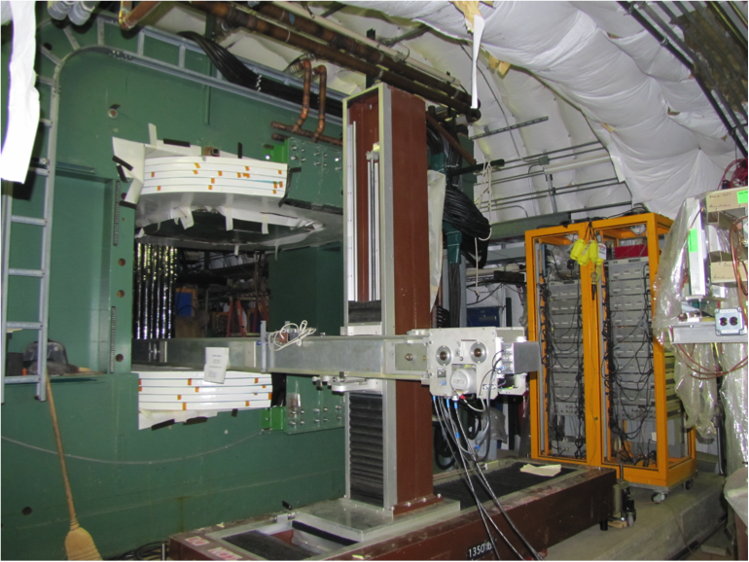
JGG Operations
Making the Jolly Green Giant operational is eventually important for the facility, but not right away.
JGG was repaired after initial testing found ground faults.
Kilmer (August 8):
“We got all of the shorts fixed and it should be ready to run. We would still need to let Bob Slazak know so he can get the water system up and running. I don’t know anything about their status. Walt should probably be asked to check out the power supply and also be the person who turns it on for you the first time. Jerry Zimmerman has been busy with cryo shows and also working on learning the routers at lab 8 and how to program them. I don’t know for sure when he will be available on a steady basis, but I think he could certainly help some.”
Rosie needs the same attention since both magnets need to be energized simultaneously to satisfy safety criteria.

Slide 14
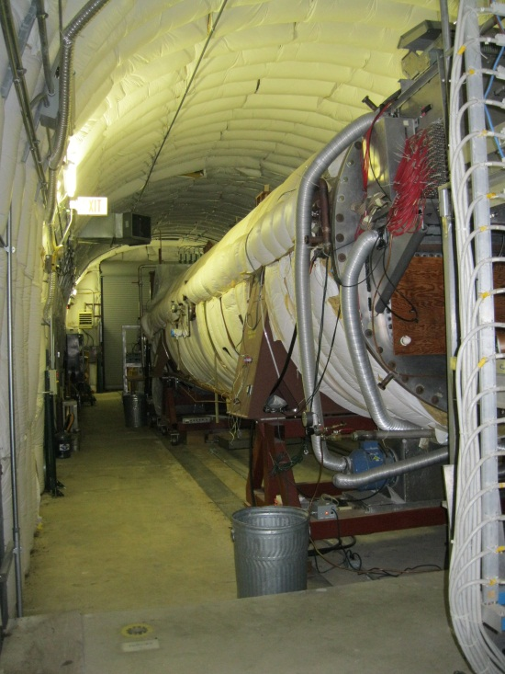
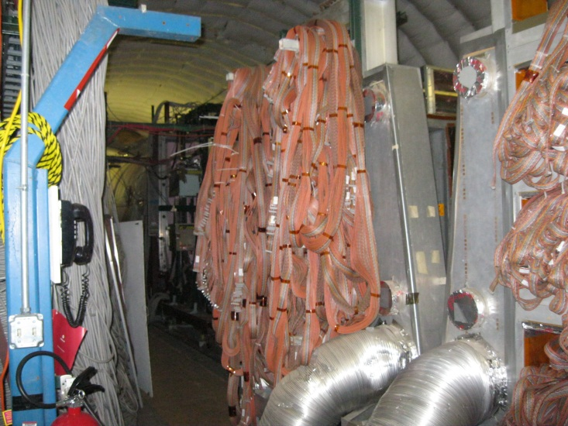
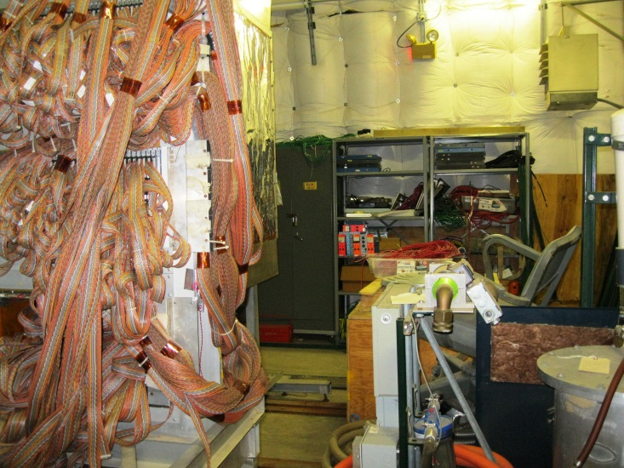
Removing Extraneous Equipment
ES&H would like as much equipment removed as possible so as not to be un-necessarily irradiated.
Space needed in MC7.2 for large detectors (possibly NOvA calibration, or LAriaT phase II)
Wire chambers can be used in a cosmic test stand
Other equipment can be returned to PREP, used elsewhere or excessed.

Slide 15
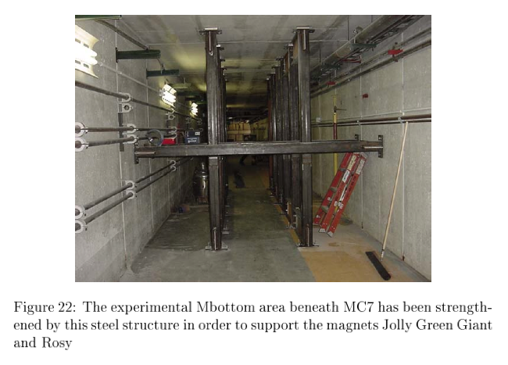
MBottom
Shoring up of the MC7 floor was made in the Mbottom area to accommodate the enormous JGG and Rosie magnets.
An analysis needs to be made to determine what the loading capabilities of the current MC7 floor is.

Slide 16
Experimental Program at MCenter

Slide 17
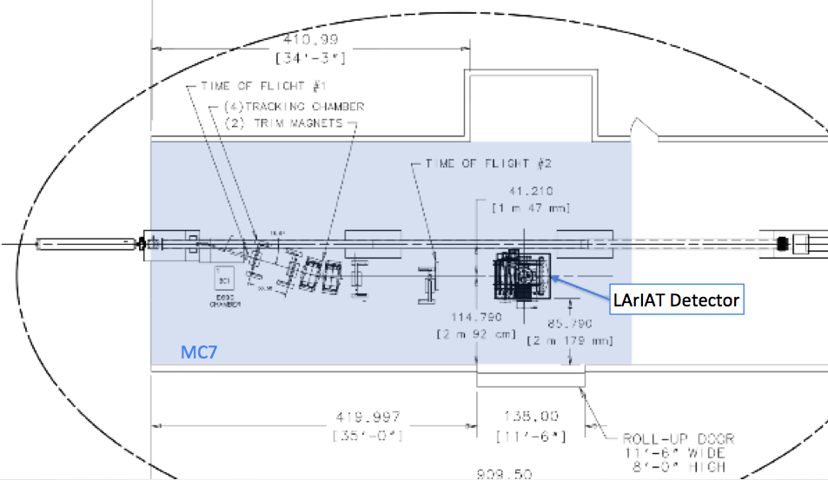
LAriaT proposal
Two stage proposal:
Stage 1: Put ArgoNeut (300 kg) into tertiary beam in Mcenter
Stage 2: Put as large a new detector as possible (2x2x5 m³) in downstream half of MC7
Physics and budget to be reviewed after this meeting
Imagine being able to study tagged kaon or positron tracks in liquid Argon! That alone is worth approving this proposal.
Propose to create a cryogenic system large enough for Stage 2, using some parts already purchased. Scaled back proposal would initially use current ArgoNeut cryo system.

Slide 18
A Longer View of Test Beam in MCenter
Use MIPP apparatus to create a tagged neutron facility.
Import a large bore solenoid for TPC tests
Use the JGG spectrometer magnet to simulate jet physics for advanced calorimetry.
Install LAriaT phase 2 liquid Argon detector in downstream area
Creating a ‘jet’ in the Jolly Green Giant
Toy schematic of future programs

Slide 19
Prioritized tasks:
Submit Shielding Assessment to committee
If manpower allows, replace leaking magnets.
Modifications in MC7 to allow for ArgoNeut – air ducts, some shielding, s
Get engineering assessment of floor loading capability
Start engineering for appropriate cryo system for ArgoNeut
Deliver beam and measure rates
If rates in MDB are too high, install additional shielding and test again
Funds potentially available for MCenter work
40.51.03.08 LAr Test Beam $ 200K M&S, $ 260K SWF
40.13.03: Test Beam Operations $ 30K M&S, $ 200K SWF
40.51.01.01 Future Det. Initiatives $ 30K M&S, $ 100K SWF
40.51.03.06: Cold Electronics $ 50K SWF

Slide 20
Summary Notes
Demand will be very high for our test beams over the next two years.
DOE agreed with our proposal that we should create a second test beam line in the MC7 enclosure, using MCenter beam, and we need to deliver it this year.
The operational characteristics of the MCenter beamline are very similar to the MTest beamline, and have been exercised in the past for MIPP, so commissioning should be relatively quick.
A radiation shielding assessment document has been written but no review has been scheduled. We should encourage movement on this review.
We have tested all components that can be tested without beam. Beam could be delivered soon after permits are granted.
However, slow water leaks in 4 magnets exist.
We can replace magnets now, while the accelerator complex is down, or…
Defer replacement and run with air cooling at lower energies ( < 25 GeV ). This would not affect the experimental program much.
Once beam is delivered, we can test whether the current MW alcove can be used as a control room. If not, then a new room should eventually be built, sooner rather than later. But the lack of a dedicated control room separate from Mtest should not hold up beam delivery.
The MCenter beamline does not have the low energy supplies that MTest has for low energy (<5 GeV) tuning. We should work towards solving that problem in future years.
A tertiary beamline in Mcenter, along with the JGG, gives flexibility in what we can do there.
There will likely be dedicated experiments (LAriaT) in residence for a long time. We need ability to support other users in MC7 at the same time, however. Can LAriaT move so the tertiary beam is available to other users?

