Slide 1
Fermilab experience with SiPM readout, as viewed through NEXT colored glasses
P Rubinov, Dec 4 2012

Slide 2
3 basic options
All electronics outside (“just cables”)
Amplifier/buffer close to SiPM (“only amp”)
Everything inside (“ASIC”)

Slide 3
Just Cables
We have tried this on the TB4 (long coax cables, used with up to 10+ m)
I think this can work but
Cable design is critical (especially for crosstalk)
Must have EXCELLENT common mode rejection
Signals are small, potential for noise pickup is great
Practical issues
Testing will be tricky- the test system will have to be large enough to reproduce real system parasitics.

Slide 4
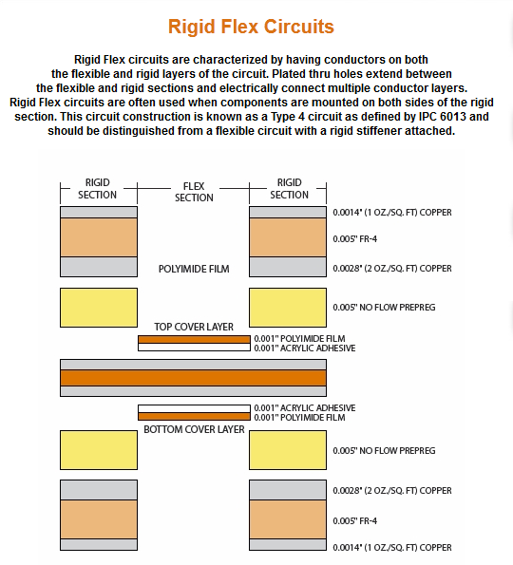
Fairly standard technology
Rule: if there is a picture of a cell phone on the manufacturers web page, it is inexpensive.

Slide 5
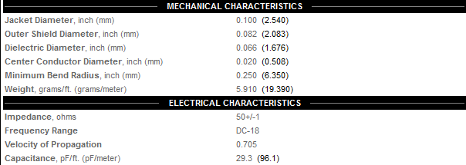
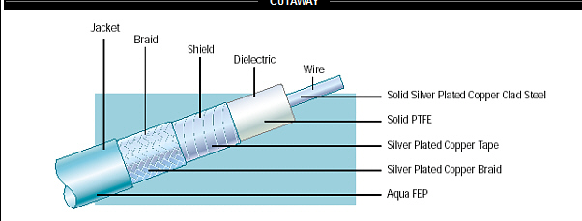
Available
0.1in = 2.54mm
Rule: if there is a picture of a tank (or worst of all fighter!) on the web page, it
Silver plated copper: is it ok?
20db @1ghz per 100ft
Not too lossy! ~same as lemo

Slide 6
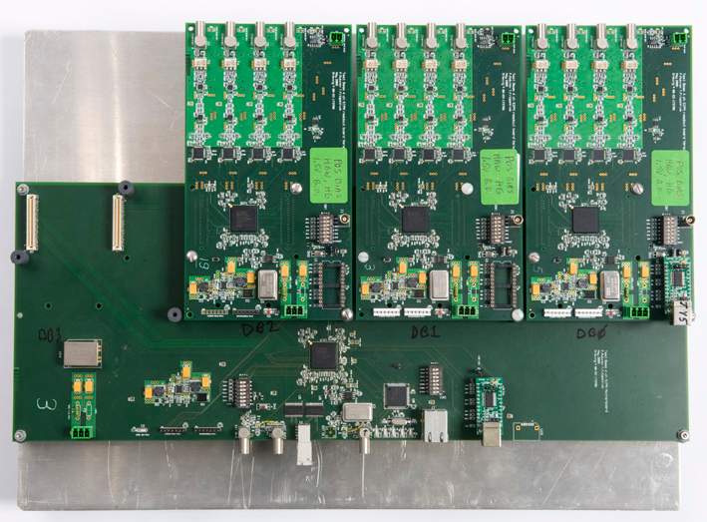

Slide 7
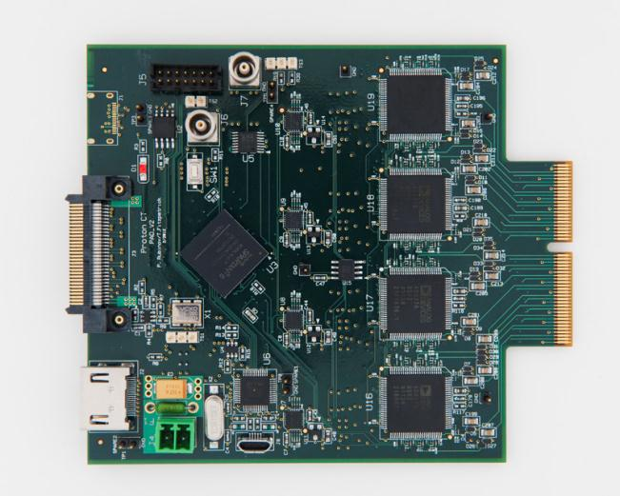

Slide 8
Buffer only
The idea would be to present the SiPM with larger impedance, drive cable with lower impedance.
Adv: less susceptible to noise, xtalk
Dis: power traces additional, can you do this without caps?
I have no direct experience to offer
Many commercials chips can be had a bare die

Slide 9
ASIC
Actually, there are 2 options here: existing “ASIC” (aka commercial chips) or new ASIC
EASIROC (LAL Orsay), TriP-t (FNAL), many others
Can be very powerful, but not power hungry
I don’t know of any that do not require bypass caps!
Reliability would be a concern, but can be very good

Slide 10
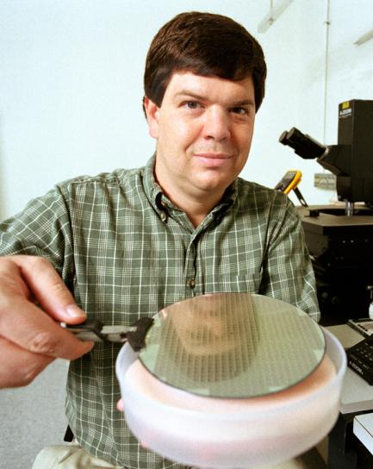
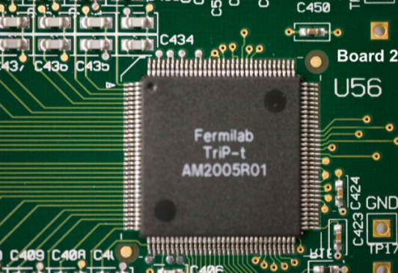

Slide 11
Summary
My gut feeling is that something in the middle is often best
Some electronics, behind some shielding?
Are there other options?
Delay line readout?
Some other encoding scheme?

