Slide 1
Studies on SINBAD benchmarking, PIP-II, and BNB projects
Alajos Makovec
19 October 2023
MARS group – Target Systems Department – Accelerator Directorate

Slide 2
Table of contents
SINBAD benchmarking
  Methodology of the SINBAD benchmark
  Residual dose rate calculations with the DORIAN code
  Residual dose rate calculations with the MARS-15 code
  Comparison of the calculated dose rates with experimental data
  Impact of the simulation parameters on the results
  Comparison of results from DORIAN simulations based on MARS versus FLUKA isotope lists for copper target
PIP-II Shielding Assessment(s)
  Assessment Objectives & Purpose
  Integration of the horizontal and vertical PIP-II collimators to the existing MARS model
  Integration of magnets to the existing MARS model
  Dose Rate Distribution from MARS Simulation: Accident Case
Integration & Preparation: BNB Study
  Project overview: BNB beam, target, and horn design
  Integration of the BNB target assembly into the MARS model
  Future steps for BNB study
Additional Contributions & Initiatives
  Attenuation of Neutrons in Labyrinths
  Particle Distribution Analyzer (PDA)
  Energy Spectra Analyzer (ESpA)

Slide 3
A)
Comparison of residual dose rates from MARS and DORIAN simulations with experimental data from the SINBAD database

Slide 4
1) Methodology of the SINBAD benchmark (1/2)
BENCHMARK STUDY OF RESIDUAL DOSE RATES WITH FLUKA [1]
Samples were irradiated in the stray radiation field of the CERN-EU high-energy Reference Field facility (CERF):
  Pulsed, 120 GeV/c momentum mixed hadron beam (1/3 protons, 2/3 positively charged pions) from the Super Proton Synchrotron (SPS) impinging on the copper target
  35% protons, 61% pions and 4% kaons, as determined experimentally
  During the spill (5.1 s spill within an SPS cycle of 16.8 s) the beam intensity is constant, thus producing a constant radiation field at the exposure locations
Residual dose rate measurements at various cooling times and distances:
  Measurements at contact (2.4 cm), 12.4 cm, 22.4 cm and 32.4 cm, distances between the surface of the sample (facing the CERF target during the irradiation) and the center of the detector
  Measurements were carried out using a portable spectrometer in a laboratory with a low background radiation dose rate of 55 nSv/h:
    The instrument was based on a NaI crystal of cylindrical shape with a diameter and height of about 5 cm
    Dose rates could be measured up to 100 µSv/h
[1] SINBAD ABSTRACT NEA-1552/26: CERF Residual Dose Rates (2003)

Slide 5
1) Methodology of the SINBAD benchmark (2/2)
BENCHMARK STUDY OF RESIDUAL DOSE RATES WITH FLUKA [1]
The irradiation experiment was simulated with the FLUKA code:
  Distinct simulations were performed for proton and pion beam particles and their results were combined in a post-processing step to comply with the actual beam composition
  Specific activities were calculated considering the decay chains and build-up of isotopes, as well as the correct intensity profile of the respective irradiation experiment
  Residual dose rates were calculated following a two-step approach based on specifically developed user routines:
    Isotope information was written into files for a total of 12 cooling times
    Simulation of the electromagnetic cascade caused by gamma and positron emitter was performed for each cooling time
    Equivalent dose was calculated by folding the particle fluence with appropriate fluence-to-dose equivalent conversion factors
  Simulation parameters used:
    The standard FLUKA preset, "NEWDEFAULTS," dictated the physics processes.
    During the irradiation simulation, transport of electrons, positrons, gammas, muons, and neutrinos was omitted.
    An energy transport cut-off was set at 1 keV for all particles, except for neutrons and K_L, which had a threshold of 50 MeV.
    Full transport was applied to both light and heavy ions.
    The coalescence mechanism wasn't applied, and no superposition model (i.e., ion splitting into nucleons during nonelastic interactions) was in place.
    Additionally, photonuclear interactions and muon pair production by photons were disregarded.
    Pair production and bremsstrahlung by high energy muons, charged hadrons, and light ions were also excluded from the simulation.
[1] SINBAD ABSTRACT NEA-1552/26: CERF Residual Dose Rates (2003)

Slide 6
1) Methodology of the SINBAD benchmark
CALCULATING MEASUREMENT UNCERTAINTY
According to the SINBAD paper, there are three sources of uncertainty for the measurement:
  “All measured data points carry errors which include the following uncertainties: a 2 mm uncertainty for the determination of the effective centre of the detector, a 2 mm uncertainty for the positioning of the sample with the holder (i.e., distance to the detector), and a systematic instrument uncertainty of 1 nSv/h corresponding to the last significant figure on the display of the respective devices.” [1]
The table below lists the sum of geometry related uncertainties:
  Dose rates are calculated based on the inverse square law
  Differences in dose rates due to geometry uncertainty are calculated for both upper and lower limits:
    At 0 cm, the mean total geometry related uncertainty is 21.9%
    At 30 cm, the mean total geometry related uncertainty is 2.7%
    Plus ±1 nSv/h systematic instrument uncertainty
Distance [cm] | Dose rate [arbitrary unit] | Difference [%] | 2 mm uncertainty for the determination of the effective centre of the detector | 2 mm uncertainty for distance to the detector
2.3 | 118.15 | 18.1 | -2 mm | 0 mm, could not be put closer than contact
2.5 | 100.00
2.9 | 74.32 | -25.7 | + 2 mm | + 2 mm
29.6 | 102.72 | 2.7 | -2 mm | -2 mm
30 | 100.00
30.4 | 97.39 | -2.6 | + 2 mm | + 2 mm
[1] SINBAD ABSTRACT NEA-1552/26: CERF Residual Dose Rates (2003)

Slide 7
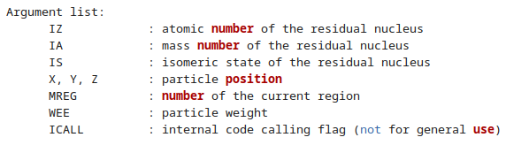
2) Residual dose rate calculations with the DORIAN code (1/3)
The DORIAN (DOse Rate Inspector and Analyzer) code splits
the computation of residual dose rates into three steps [2].
Step 1:
FLUKA input file from SINBAD benchmark (aug03c1offp-neweva.inp) is used for the irradiation part of the simulation with updated parameters (see next slide)
Creation of radionuclides in the copper, iron, titanium, aluminum and concrete samples (SINBAD indexes 05, 04, 01, 02, and 03, respectively) is recorded
Separate simulations are performed for proton and pions:
  250k / 500k primaries for protons / positively charged pions
Step 2:
Simplified geometry is used, where the sample of interest is positioned in air and all other regions are removed
Decay of radioactive isotopes is enabled using a RADDECAY card with the semi-analogue decay option (the isotope of interest must have a decay data available in the FLUKA isotope database, see Appendix I)
(*) See in Step 3
Step 3:
All calculations are based on a typical SPS cycle with a cycle length of 16.8 seconds and a 5.1-second spill at the beginning of in each cycle, following the recorded irradiation profile
(*) Algorithm added and validated for calculating statistical uncertainty for DORIAN results:
  It works by dividing the recorded isotope list into five parts, performing 5 parallel cycles of DORIAN’s second and third steps using these parts as inputs, and then calculating the mean values and statistical uncertainties based on the results
Parameter | Value
FLUKA version | CERN FLUKA 4-3.0
Momentum | 120 GeV/c
Beam | 1/3 protons 2/3 positively charged pions
Irradiation profile | from the corresponding file
Cool-down times (s) | At measurement of given sample 360.0 720.0 1800.0 3600.0 7200.0 18000.0 36000.0 72000.0 180000.0 360000.0 720000.0 3600000.0
[2] R. Froeschl, “The DORIAN code for the prediction and analysis of residual dose rates due to accelerator radiation induced activation”, CERN EDMS 1333693 v.1 (2013), CERN-OPEN-2022-017

Slide 8
2) Residual dose rate calculations with the DORIAN code [2] (2/3)
Isotopes excluded from DORIAN step 2 calculation
FLUKA does not handle some isotopes:
  No dose rate contribution from these isotopes are considered (decay of these isotopes are ignored)
  Removal of files that cause FLUKA crashes, which would occur with isotopes that had high half-life values (>10^9 seconds)
    The error message “Abort called from RDCYEV reason T12CHK>=T12INF Run stopped!” could indicate that the half-life value of the given isotope exceeds a predetermined threshold in FLUKA
    Examples of such isotopes include ⁵⁰Cr (T_{1/2}= 1.8e17 y), ⁴⁸Ca (T_{1/2}= 5.3e19 y), and ¹¹⁰Pd (T_{1/2}= 6.0e17 y)
Copper (Cu1) | Iron (SSZ) | Titanium (Ti) | Aluminum (Al1) | Concrete (CN1/CNMIX)
~8% | ~6% | ~2% | ~11% | ~3%
Ag-106_Cd-106 | Cr-50_Cr-50 | Ca-48_Ca-48 | Am-242_Bi-209 | Ca-48_Ca-48
Ag-108_Cd-108 | Cu-64_Zn-64 | Cr-50_Cr-50 | Bi-204_Pb-204 | Cr-50_Cr-50
Ag-110_Pd-110 | Dy-153_Sm-149 | Ni-58_Ni-58 | Bi-209_Bi-209 | Kr-78_Kr-78
Ca-48_Ca-48 | Fe-50_Cr-50 | V-50_Cr-50 | Cd-108_Cd-108 | Mn-50_Cr-50
Cd-106_Cd-106 | Hf-168_Yb-168 |  | Cr-50_Cr-50 | Rb-78_Kr-78
Cr-50_Cr-50 | Mn-50_Cr-50 |  | Cu-64_Zn-64 | V-50_Cr-50
Cu-58_Ni-58 | Ni-58_Ni-58 |  | La-142_Ce-142
Cu-64_Zn-64 | Re-171_Hf-171M |  | Mn-50_Cr-50
Mn-50_Cr-50 | V-50_Cr-50 |  | Ni-58_Ni-58
Mo-100_Mo-100 | W-183_W-183 |  | Pb-204_Pb-204
Mo-92_Mo-92 | W-184_W-184 |  | Pb-209_Bi-209
Mo-98_Mo-98 | W-186_W-186 |  | Re-171_Hf-171M
Ni-58_Ni-58 | Yb-161_Tm-161M |  | Ru-96_Ru-96
V-50_Cr-50 | Zn-64_Zn-64 |  | Sn-124_Sn-124
Zn-64_Zn-64 |  |  | V-50_Cr-50
 |  |  | Zn-64_Zn-64
 |  |  | Zr-94_Zr-94
For instance, Ag-106_Cd-106 means:
  decays of ¹⁰⁶Cd at locations
  where ¹⁰⁶Ag has been initially produced

Slide 9
2) Residual dose rate calculations with the DORIAN code [2] (3/3)
The physics processes and particle transport parameters for the simulation were adjusted to match the experiment's specifics. The changes made, in comparison to the FLUKA file used in the SINBAD Benchmark, are listed below.
DEFAULTS changed from NEW-DEFAults to PRECISIOn:
  Compton scattering now includes Rayleigh scattering and inelastic form factor corrections (previously only the latter)
  Photoelectric edge treatment and fluorescence photons are enabled (previously disabled)
  Fully analog absorption for low-energy neutrons (previously non-analog with 0.95 probability for thermal groups)
  Particle transport threshold set to 100 keV (except 1E-5 eV for neutrons), previously 10 MeV
  Multiple scattering threshold set to the minimum allowed energy for primary/secondary charged particles (previously 20 MeV for secondaries only)
  Delta ray production threshold set to 100 keV (previously 1 MeV)
  Heavy particle bremsstrahlung enabled (explicit photon production above 300 keV, previously above 1 MeV)
EMF enabled (previously disabled by user)
No suppression of particle transport (previously suppressed for e-/e+, (anti)neutrino, photon, and muon +/-)
Energy thresholds for transport set to 1E-5 eV for neutrons, 100 keV for e-/e+, and 80 keV for photons
Kinetic energy thresholds for production set to 100 keV for e-/e+ and 80 keV for photons
Full transport of all light and heavy ions enabled (in addition to heavy fragment transport activated by using PRECISION, previously disabled)
Coalescence mechanism enabled (previously disabled)
Superposition model activated (i.e., ion splitting into nucleons for nonelastic interactions, between 0.005 and 0.150 GeV/n, for deuterons only; previously disabled)
Photonuclear interactions activated at all energies with inelastic hadronic interaction, biasing applied to all generations (factor of 0.05, previously disabled)
Muon pair production by photons activated (all options on) with a bias of 0.05 (previously disabled)
Full simulation of muon nuclear interactions and secondary hadron production (previously disabled)
Pair production and bremsstrahlung by high-energy muons, charged hadrons, and light ions activated (explicit pair production with zero threshold, and 80 keV threshold for explicit bremsstrahlung production; previously disabled)

Slide 10
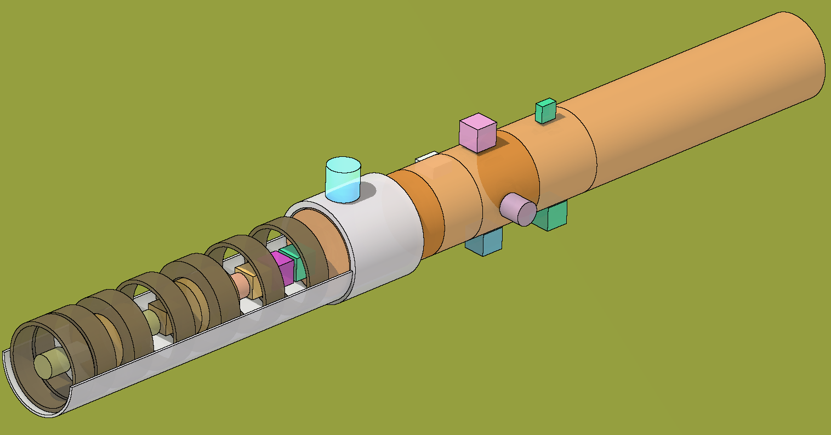
3) Residual dose rate calculations with the MARS-15 code [3, 4, 5]
To ensure that the results of the simulation accurately reflected the conditions in the experiment being modeled, the beam parameters, irradiation profiles, material compositions, and geometries reported in the SINBAD benchmark are used
The 3D geometry is reconstructed in GDML format to provide a precise representation for the MARS simulations
Residual dose rates are calculated using "single step" MARS simulation (by Igor Tropin)
The MARS simulation incorporates the FLUKA simulation parameters from the SINBAD benchmark study, along with default settings for any parameters not detailed in the study (for comparison of our results with the FLUKA findings detailed in the SINBAD benchmark).
Note: at present, MARS does not handle nuclear isomers. In instances where there is the potential for the generation of an atomic nucleus in an energetically excited nuclear state, MARS instead registers a nucleus with the lowest energy ground state
3D model of MARS geometry exported into GDML format, then imported and visualized with FLAIR.
[3] N.V. Mokhov and C.C. James, "The Mars Code System User's Guide, Version 15 (2016)", Fermilab-FN-1058-APC (2017) https://mars.fnal.gov
[4] N.V. Mokhov et al., "MARS15 Code Developments Driven by the Intensity Frontier Needs ", Prog. Nucl. Sci. Technol., 4, pp. 496-501 (2014)
[5] N.V. Mokhov, "Status of MARS Code", Fermilab-Conf-03/053 (2003)

Slide 11
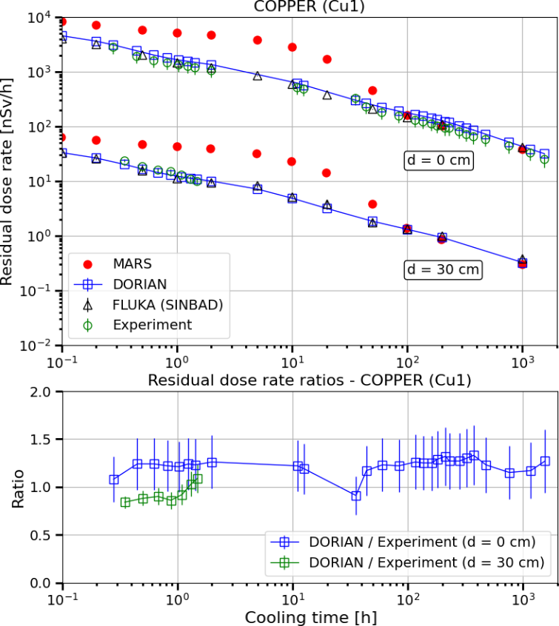
4) Comparison of the calculated dose rates with experimental data – copper sample
Parameter | Value
Irradiation profile | long 1
 | irrcyc_Aug03_15.inp
No. of SPS cycles | 31133
Total No. of beam particles | 1.42755E+12
Volume | 4.0 cm³
Density | 8.988 g/cm³
Mass (SINBAD) | 28.253 g
Mass (DORIAN) | 35.952 g
Sample position | lateral / body 27 / region 24
Distance | Exp. Data (SINBAD) | FLUKA (SINBAD)
Contact | ms00Cu1_05.dat | ms00Cu1_05.out
12.4 | ms10Cu1_05.dat | 10Cu1_05.out
22.4 | ms20Cu1_05.dat | 20Cu1_05.out
32.4 | ms30Cu1_05.dat | 30Cu1_05.out
The reported mass of the copper target in the SINBAD benchmark (28.253 g) is 21.4% less than the mass calculated from the geometrical and density data (35.952 g) - typo in the paper (?)
High geometry related uncertainties for measurements taken at contact (0 cm), much lower at 30 cm
Good agreement between the DORIAN results and the SINBAD measurements, considering the uncertainties
There is an anomaly for cooling times below approximately 100 hours, where MARS gives higher dose rates in comparison to the experimental data
Dose rate is dominated by ⁶²Cu for cooling times less than 30 min, by ⁶¹Cu for cooling times ranging from 30 min to 2 h, by ⁶⁴Cu for cooling times 5 to 10 h, by ⁵²Mn for cooling times between 20 and 200 h and by ⁵⁸Co for 1000 h of cooling

Slide 12
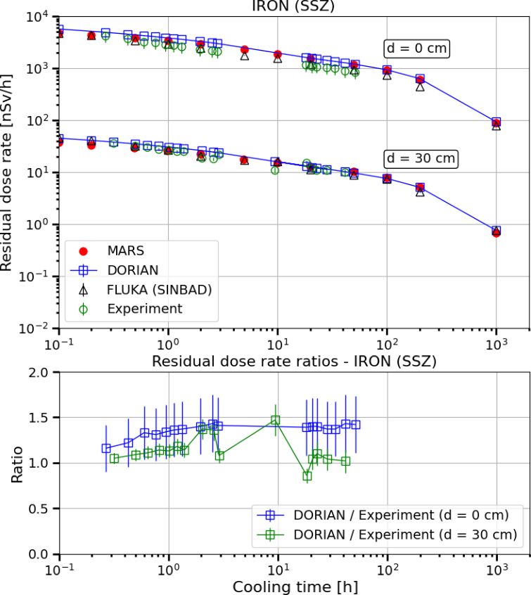
4) Comparison of the calculated dose rates with experimental data – iron sample
Parameter | Value
Irradiation profile | long 4
 | irrcyc_Aug03_13.inp
No. of SPS cycles | 29675
Total No. of beam particles | 1.31815E+12
Volume | 6.80 cm3
Density | 6.676 g/cm3
Mass (SINBAD) | 45.378 g
Mass (DORIAN) | 45.397 g
Sample position | downstream / b. 22 / reg. 16
Distance | Exp. Data (SINBAD) | FLUKA (SINBAD)
Contact | ms00SSZ_04.dat | ms00SSZ_04.out
12.4 | ms10SSZ_04.dat | 10SSZ_04.out
22.4 | ms20SSZ_04.dat | 20SSZ_04.out
32.4 | ms30SSZ_04.dat | 30SSZ_04.out
Both the MARS and DORIAN results are in good agreement with the experimental data, both models yield slightly higher dose rates at contact
Measurements taken at 30 cm and at cooling times from 3 to 20 h exhibit unexpected fluctuations: a lower dose rate for shorter cooling times and vice versa
For cooling times between 6 minutes and 200 hours, ⁵²Mn is the primary contributor to the dose rate, with notable contributions from ⁴⁴Sc between 6 minutes and 3 hours and from ⁴⁸V between 20 and 200 hours. At a cooling time of 1000 hours, ⁴⁸V becomes the dominant contributor to the dose rate.

Slide 13
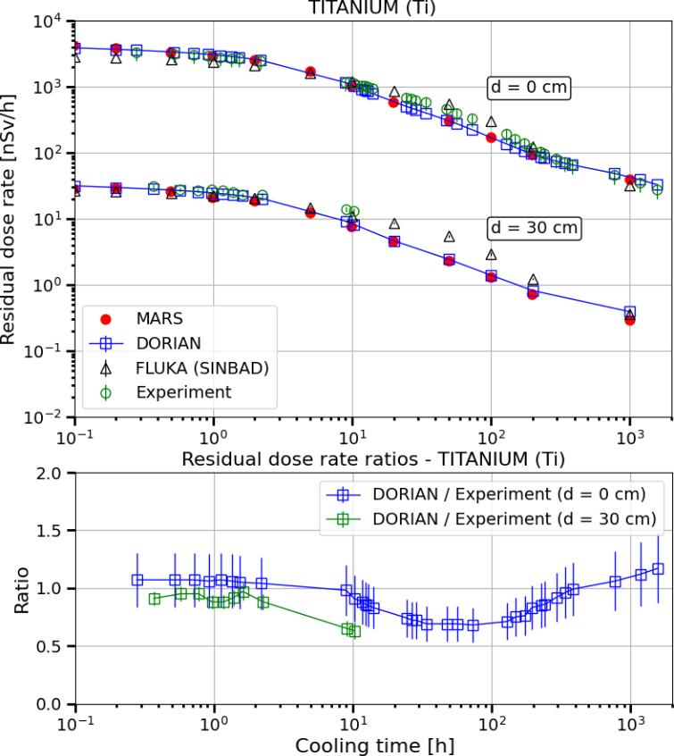
4) Comparison of the calculated dose rates with experimental data – titanium sample
Parameter | Value
Irradiation profile | long 5
 | irrcyc_Aug03_12.inp
No. of SPS cycles | 28412
Total No. of beam particles | 1.26343E+12
Volume | 6.283 cm3
Density | 4.42 g/cm3
Mass (SINBAD) | 27.796 g
Mass (DORIAN) | 27.772g
Sample position | downstream / b. 23 / reg. 17
Distance | Exp. Data (SINBAD) | FLUKA (SINBAD)
Contact | ms00Ti_01.dat | ms00Ti_01.out
12.4 | ms10Ti_01.dat | 10Ti_01.out
22.4 | ms20Ti_01.dat | 20Ti_01.out
32.4 | ms30Ti_01.dat | 30Ti_01.out
Both MARS and DORIAN show good agreement with the experimental data, except for cooling times between 20 and 200 hours where both methods give slightly lower values than measured at contact
The observed discrepancy between the dose rates produced by DORIAN and the experimental data is consistent for the range of cooling times between 20 and 200 hours:
  Comparing the results for 10 cm and 20 cm, DORIAN gives slightly lower dose rates for cooling times between 20 and 200, and between 20 and 50 hours, respectively
For cooling times ranging from 6 minutes to 10 hours, ⁴⁴Sc is the primary contributor to the dose rate, from cooling times between 20 to 200 hours ⁴⁸Sc and ⁴⁶Sc are the dominant contributors, while for cooling times of 200 and 1000 hours, most of the dose comes from the decay of ⁴⁶Sc.

Slide 14
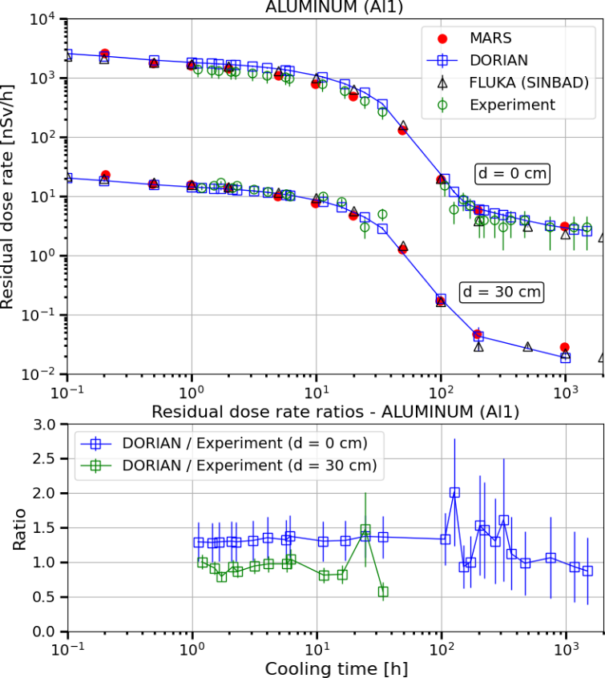
4) Comparison of the calculated dose rates with experimental data – aluminum sample
Parameter | Value
Irradiation profile | long 2
 | irrcyc_Aug03_16.inp
No. of SPS cycles | 33210
Total No. of beam particles | 1.55178E+12
Volume | 6.283 cm3
Density | 2.718 g/cm3
Mass (SINBAD) | 17.055 g
Mass (DORIAN) | 17.078 g
Sample position | lateral / body 25 / region 22
Distance | Exp. Data (SINBAD) | FLUKA (SINBAD)
Contact | ms00Al1_02.dat | ms00Al1_02.out
12.4 | ms10Al1_02.dat | 10Al1_02.out
22.4 | ms20Al1_02.dat | 20Al1_02.out
32.4 | ms30Al1_02.dat | 30Al1_02.out
Both MARS and DORIAN results are in good agreement with the experimental data, considering the uncertainties
DORIAN slightly overestimates at contact for cooling times under 200 hours, similarly to FLUKA in the SINBAD benchmark
The fluctuations observed in the experimental data within the ratio plot between 100 to 400 h are consistent with the high geometrical uncertainties at contact
At 30 cm, DORIAN shows good agreement with the experimental data, except for the last 2 values: these values show unexpected fluctuations (lower dose rate for shorter cooling time)
The dose rate is dominated by ²⁴Na for cooling times ranging from 6 minutes to 100 hours, and by ⁴⁸V and ²²Na for cooling times of 200 and 1000 hours.

Slide 15
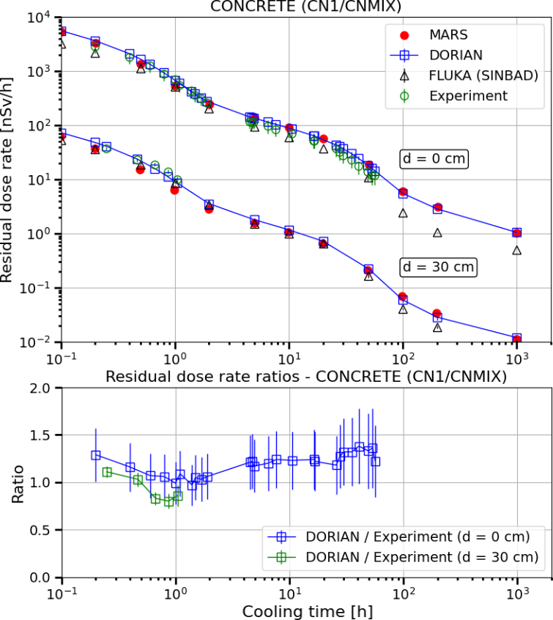
4) Comparison of the calculated dose rates with experimental data – concrete sample
Parameter | Value
Irradiation profile | short 1-4
 | irrcyc_Aug03_03.inp
No. of SPS cycles | 12812
Total No. of beam particles | 3.87697E+11
Volume | 62.21 cm3
Density | 1.7 g/cm3
Mass (SINBAD) | 102.853 g
Mass (DORIAN) | 105.759 g
Sample position | downstream / b. 31 / reg. 18
Distance | Exp. Data (SINBAD) | FLUKA (SINBAD)
Contact | ms00CN1_03.dat | ms00CN1_03.out
12.4 | ms10CN1_03.dat | 10CN1_03.out
22.4 | ms20CN1_03.dat | 20CN1_03.out
32.4 | ms30CN1_03.dat | 30CN1_03.out
The residual dose rate results from both MARS and DORIAN show good agreement with the experimental data, considering the uncertainties
At 30 cm, both MARS and DORIAN show an agreement with the experimental data within a range of ±20%
The trend is that, for 4 out of the 5 samples, the values obtained at contact are lower than those provided by DORIAN: this suggests that the samples may have been placed slightly farther away from the detector (opposite would be strange)
For cooling times between 6 and 12 minutes, the dose rate primarily comes from the decays of ¹¹C and ³⁸K. For cooling times between 30 minutes and 1 hour the decay of ¹¹C is the dominant contributor to the dose rate. For a cooling time of 2 hours, the dose rate is dominated by ²⁴Na and ¹⁸F, whereas for cooling times between 5 and 50 hours, ²⁴Na is the primary contributor. For cooling times from 100 to 200 hours ⁵²Mn is the dominant contributor to the dose rate, while for a cooling time of 1000 hours, ²²Na and ⁷Be are the primary contributors.

Slide 16
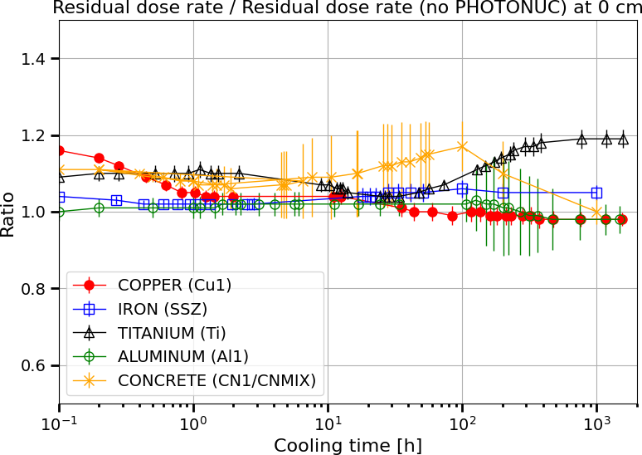
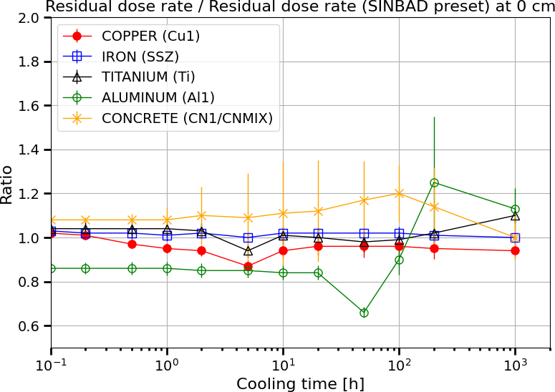
5) Impact of the simulation parameters on the results
Further simulations were conducted to examine the effects of photonuclear interactions, muon pair production, and muon nuclear interactions on the results
The influence of these processes varies across different samples, but generally, when these processes are considered, they can increase the dose rate by up to 20% for the considered samples and cooling times
The samples most impacted by these processes are copper, titanium, and concrete:
  Dose rates from the activated copper sample are predominantly affected at shorter cooling times, while those from the titanium sample are influenced both at short and more noticeably at longer cooling times
The ratio between our DORIAN results obtained using the experimental parameters and those derived from the FLUKA parameter set for each sample were also investigated
Implementing the FLUKA parameters from the SINBAD benchmark:
  Overestimates the residual dose rate from the copper sample by approximately 10%
  Overestimates the dose rate from the aluminum sample by around 15%, this overestimation shifts to an underestimation after approximately 100 hours of cooling
  Underestimates the residual dose rate for the concrete sample

Slide 17
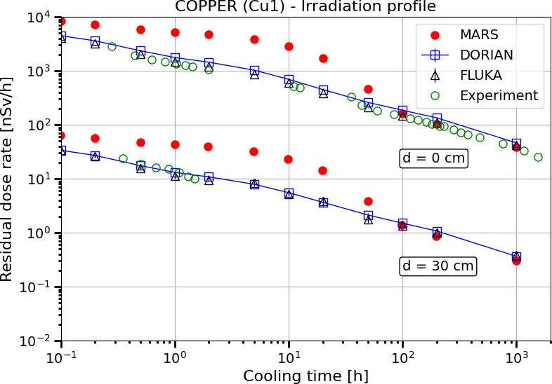
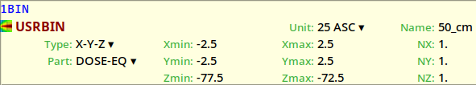
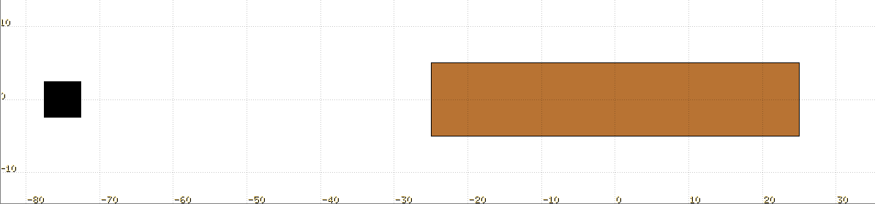
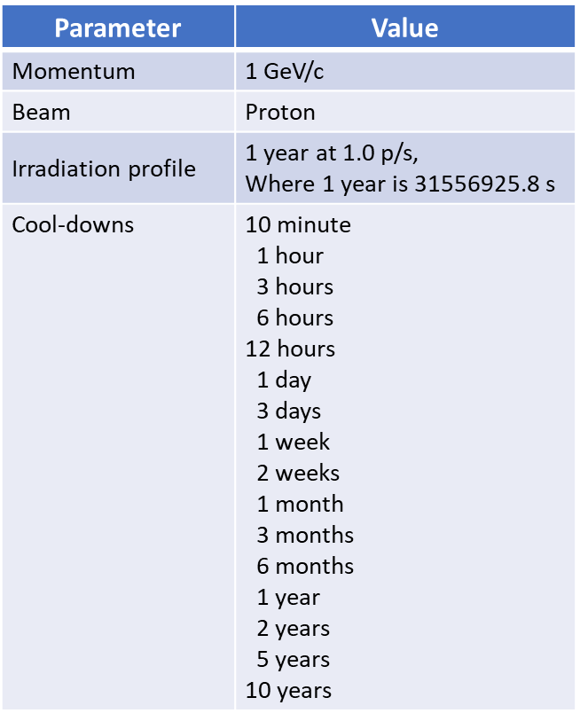
6) Comparison of results from DORIAN simulations based on MARS vs FLUKA isotope lists for copper target (1/4)
Goal: To investigate the MARS overestimation of residual dose rates from the activated copper sample for cooling times less than 100 hours
Method: Elimination of the potential influence of different fluence-to-dose
conversion factors by:
Creation of isotope lists from both MARS and FLUKA for the copper sample
Using these lists as input for the second step calculations in a DORIAN analysis
Comparing the DORIAN results generated from the isotope lists produced by MARS and FLUKA
Comparison of residual dose rates from MARS and DORIAN with experimental data from the SINBAD benchmark study
SCORING
d = 50 cm
L = 50 cm
r = 5 cm
l = 5 cm
beam
TARGET
Geometry used for FLUKA and DORIAN simulations
The simulation parameters and geometry correspond to those reported in the DORIAN paper [2]:
A cylindrical copper target with a radius of 5 cm and a length of 50 cm
A proton beam with a momentum of 1 GeV/c impinges onto the target at the center of the circular front face
The dose rate is scored at 50 cm upstream from the impact face after one year of irradiation at a unit beam intensity, i.e., one proton per second
The FLUKA and MARS isotope lists are generated using 1.6e7 and 5.0e5 primaries, respectively
FLUKA preset "PRECISIOn", with the EMF option activated
Particle transport threshold set at 100 keV, except for neutrons (1E-5 eV) for both the irradiation and decay segments of the simulation
Full transport is applied to both light and heavy ions.
Coalescence mechanism active, along with the Superposition model, within the energy range of 0.005 to 0.150 GeV/n
[2] R. Froeschl, “The DORIAN code for the prediction and analysis of residual dose rates due to accelerator radiation induced activation”, CERN EDMS 1333693 v.1 (2013), CERN-OPEN-2022-017

Slide 18
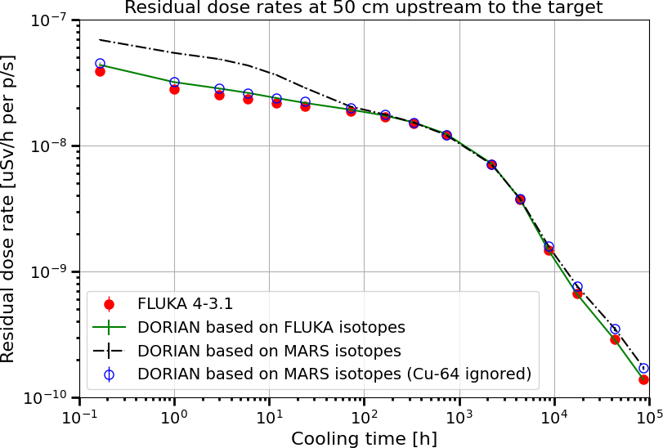
6) Comparison of results from DORIAN simulations based on MARS vs FLUKA isotope lists for copper target (2/4)
Comparison of DORIAN results based on isotope lists from MARS and FLUKA
Comparison of residual dose rates from MARS and DORIAN with experimental data from the SINBAD benchmark study
A comparison of the DORIAN results generated from the isotope lists produced by MARS and FLUKA reveals:
Significantly higher dose rates (up to 90%) based on MARS isotopes for short cooling times (<3 days) in comparison to the use of isotopes from FLUKA
Dose rates up to 25% higher based on MARS isotopes for long cooling times (>1 year) – high uncertainty
DORIAN produces up to 20% higher values for short cooling times (<3 days), which is consistent with the findings from the DORIAN paper [2]
In-depth analysis to understand the cause of the elevated dose rates:
Comparing dose rates of individual contributors from DORIAN results derived from both the MARS and FLUKA isotope lists for each considered cooling time
Regardless of whether the isotope lists from MARS or FLUKA are used, the DORIAN approach ensure the utilization of the same fluence-to-dose conversion factors, therefore the results can be interpreted as a comparison of production rates for isotopes significantly influencing the total residual dose rate

Slide 19
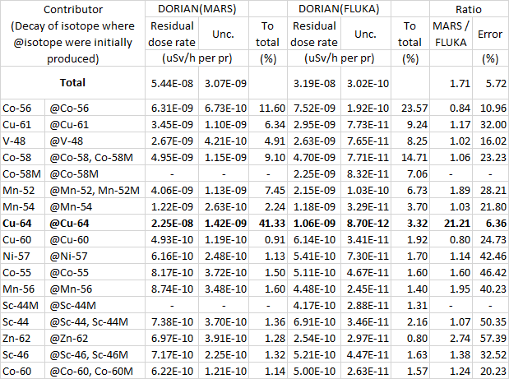
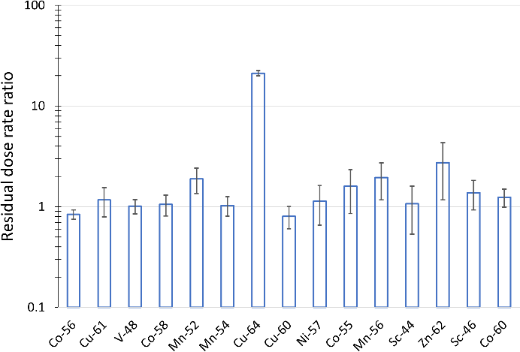
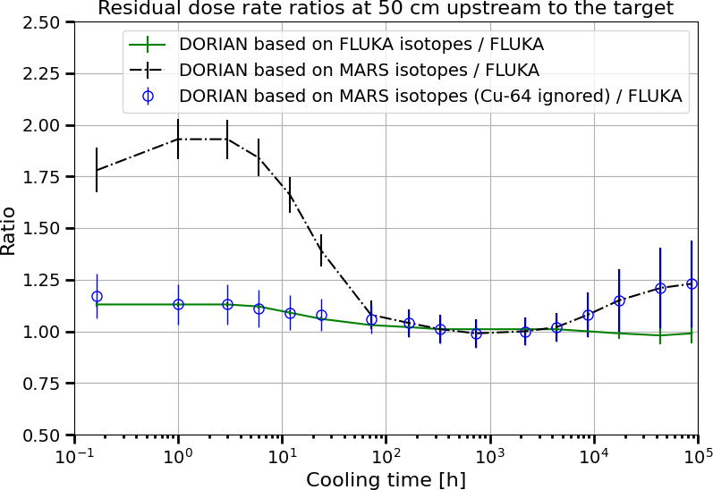
6) Comparison of results from DORIAN simulations based on MARS vs FLUKA isotope lists for copper target (3/4)
Comparison of residual dose rates from DORIAN calculations based on the MARS and FLUKA isotope lists for a 1-hour cooling time
Ratios of residual dose rates for dominant contributors from DORIAN calculations using the MARS and FLUKA isotope lists for a 1-hour cooling time
This comparison reveals a general agreement between MARS and FLUKA regarding the production rate of dominant isotopes within the copper sample
However, ⁵²Mn, ⁵⁶Mn, and ⁶²Zn show differences by a factor of 2-3 and a much higher disparity can be observed in the production rate of ⁶⁴Cu, as it is over 20 times higher in MARS than in FLUKA:
Excluding the contribution of ⁶⁴Cu from the DORIAN results based on MARS isotopes shows good agreement with DORIAN results based on FLUKA isotopes at short cooling times
No change in the reported dose rates for long cooling times

Slide 20
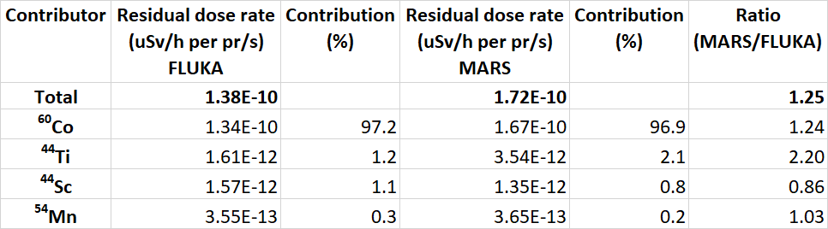
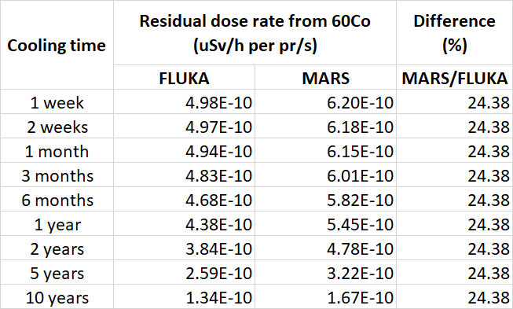
6) Comparison of results from DORIAN simulations based on MARS vs FLUKA isotope lists for copper target (4/4)
Question remains:
What causes the difference in results at long cooling times?
Comparing the contributions of ⁶⁰Co decay to the residual dose rate in DORIAN results based on MARS and FLUKA isotopes
Comparing the contributions of ⁶⁰Co decay to the residual dose
rate in DORIAN results using MARS and FLUKA isotopes
Statistics for cooling times longer than 1 year are relatively weak, but the ratio graph shows that MARS results in higher dose rates, up to 25% in comparison to results based on FLUKA isotopes:
97% of the dose comes from ⁶⁰Co in both cases (MARS/FLUKA)
The second highest contributor gives only 1 to 2% to the total
Reasonable to conclude that MARS overestimates the production of ⁶⁰Co isotopes in comparison to FLUKA/experimental data
An approximate 25% increase in dose rate from the decay of ⁶⁰Co is noted across all cooling times
Since the flux-to-dose conversion factor is the same using DORIAN regardless of the source of the isotope list, the observed difference in dose rate must come from the difference in the number of ⁶⁰Co isotopes generated by MARS and FLUKA

Slide 21
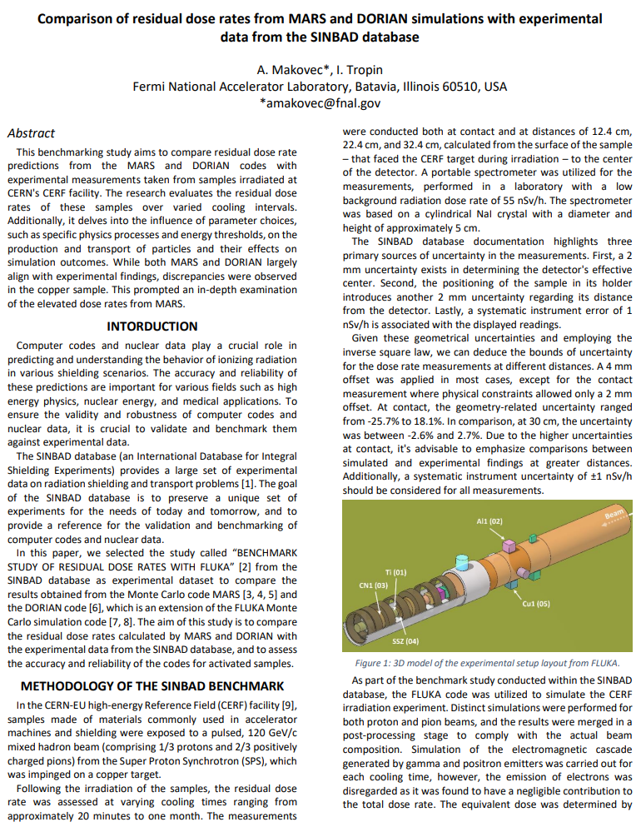
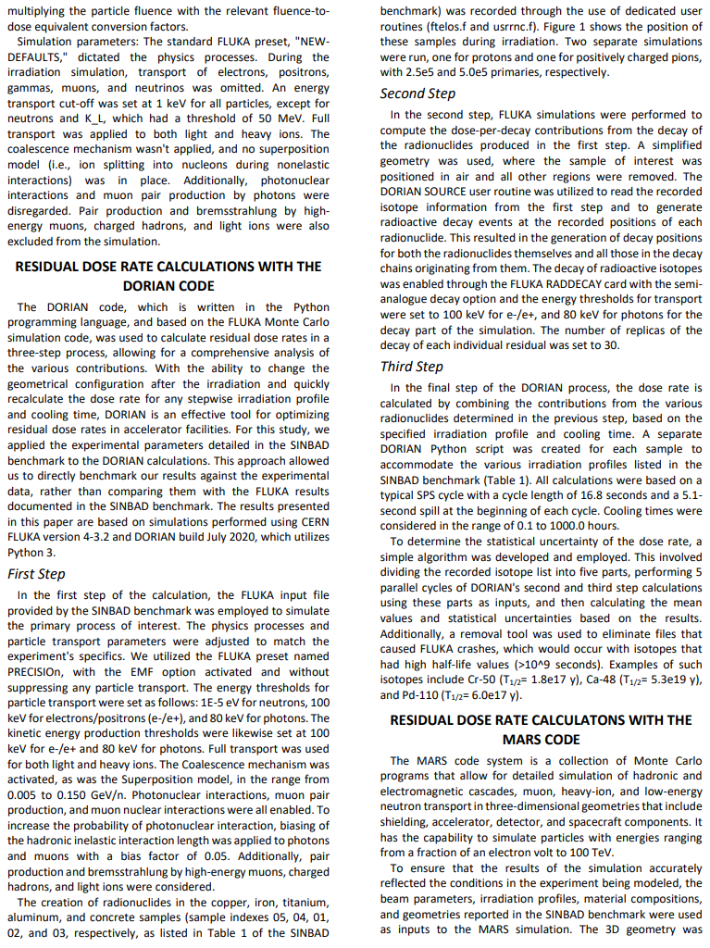
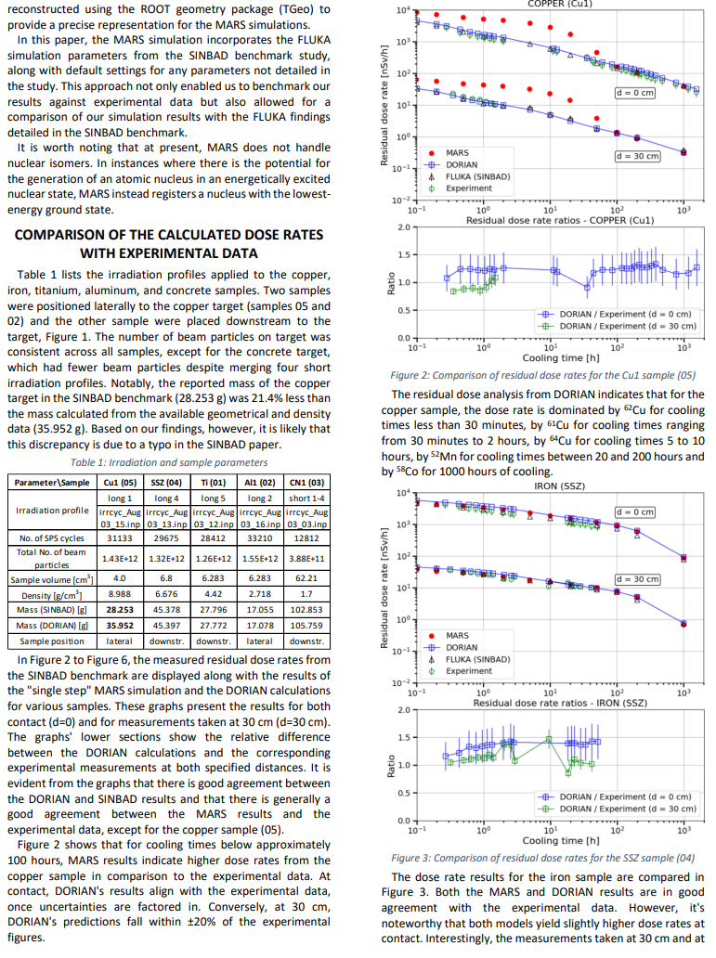
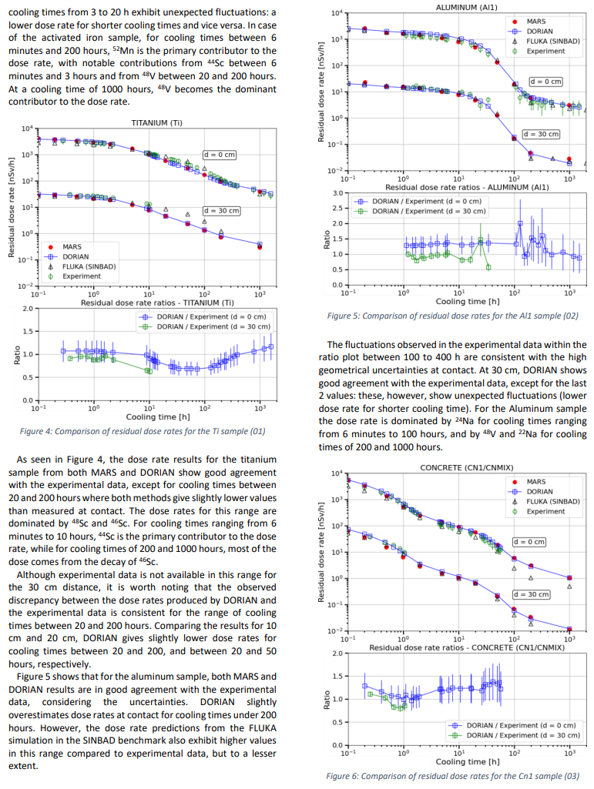
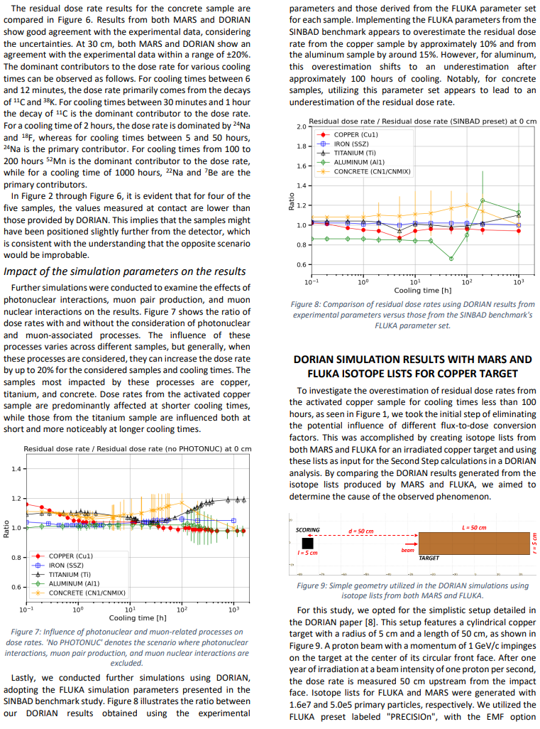
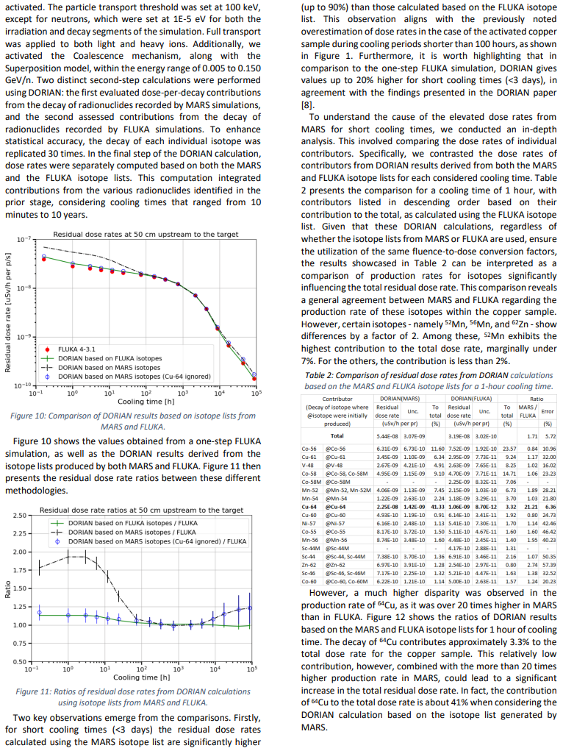
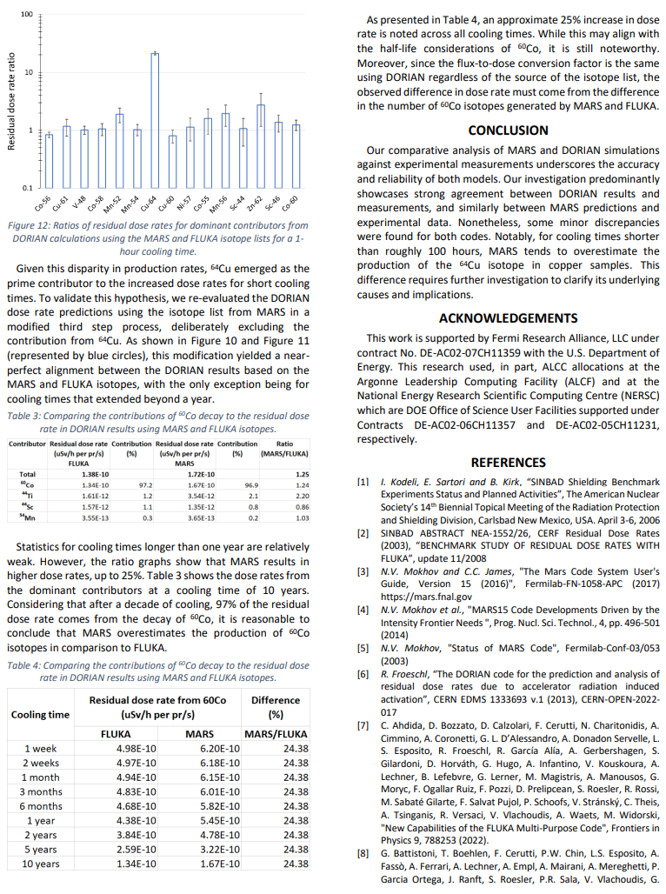
A) Summary
Our comparative analysis of MARS and DORIAN simulations against experimental measurements underscores the accuracy and reliability of both models
Our investigation predominantly showcases strong agreement between DORIAN results and measurements, and similarly between MARS predictions and experimental data
However, some minor discrepancies were found for both codes. Notably, for cooling times shorter than roughly 100 hours, MARS tends to overestimate the production of the ⁶⁴Cu isotope in copper samples. This difference requires further investigation to clarify its underlying causes and implications
Outputs:
Paper prepared for a peer-reviewed journal, currently under internal preview (subject to DOE's Export Control and Patent reviews); not yet submitted to external publications
Enhanced the DORIAN code by introducing features such as
  An algorithm to calculate statistical uncertainty for DORIAN results
  A removal tool for isotopes with T_{1/2} ≥ 10⁹s to prevent FLUKA crashes
Based on the added features, demonstrated the expertise needed to possibly develop a version of the DORIAN code specifically for MARS, should the need arise

Slide 22
B)
PIP-II Shielding Assessment(s)

Slide 23
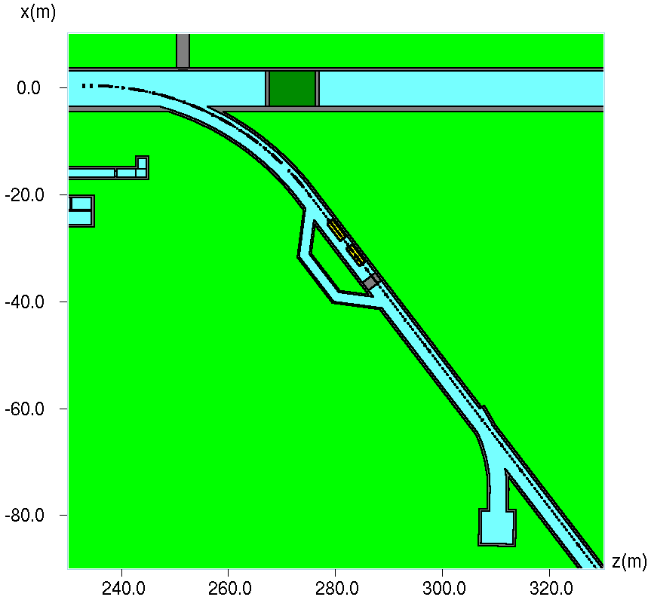
1) Assessment Objectives & Purpose
Note:
  The work presented here builds on previous PIP-II, BTL, and collimator model developments and studies conducted by other members of the MARS group: Igor Tropin, Igor Rakhno, and Dali Georgobiani.
Motivation:
  Assess dose rate levels in the event of an accident using the refined geometry, which incorporates a 6-ft thick shielding wall as well as newly added collimators and magnets. This assessment ensures effective radiation control downstream of the wall, especially given ongoing beamline operations further upstream.
Goal:
  Verify that the dose rate downstream of the shielding wall aligns with the appropriate threshold as specified by the Fermilab Radiological Control Manual (FRCM).
6-ft thick shielding wall

Slide 24
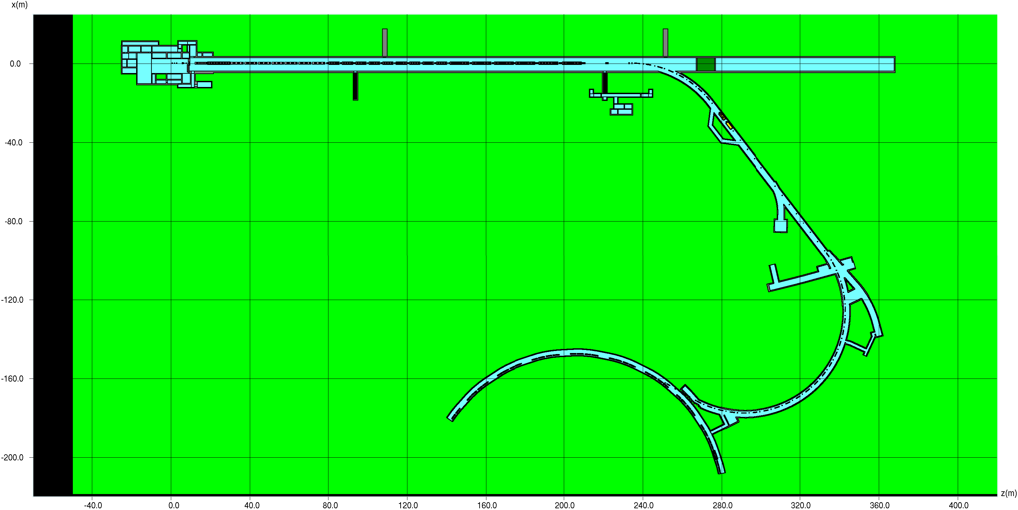
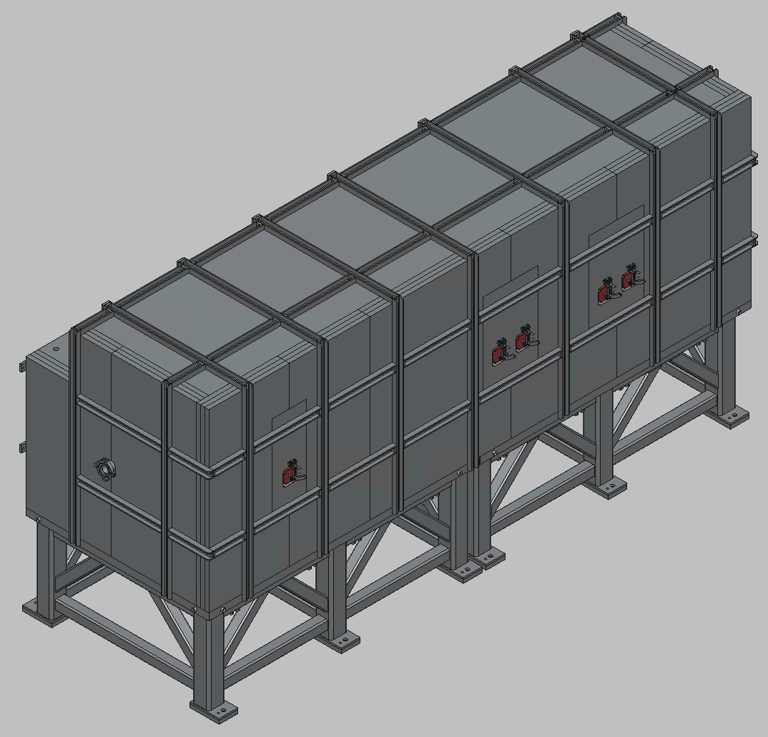
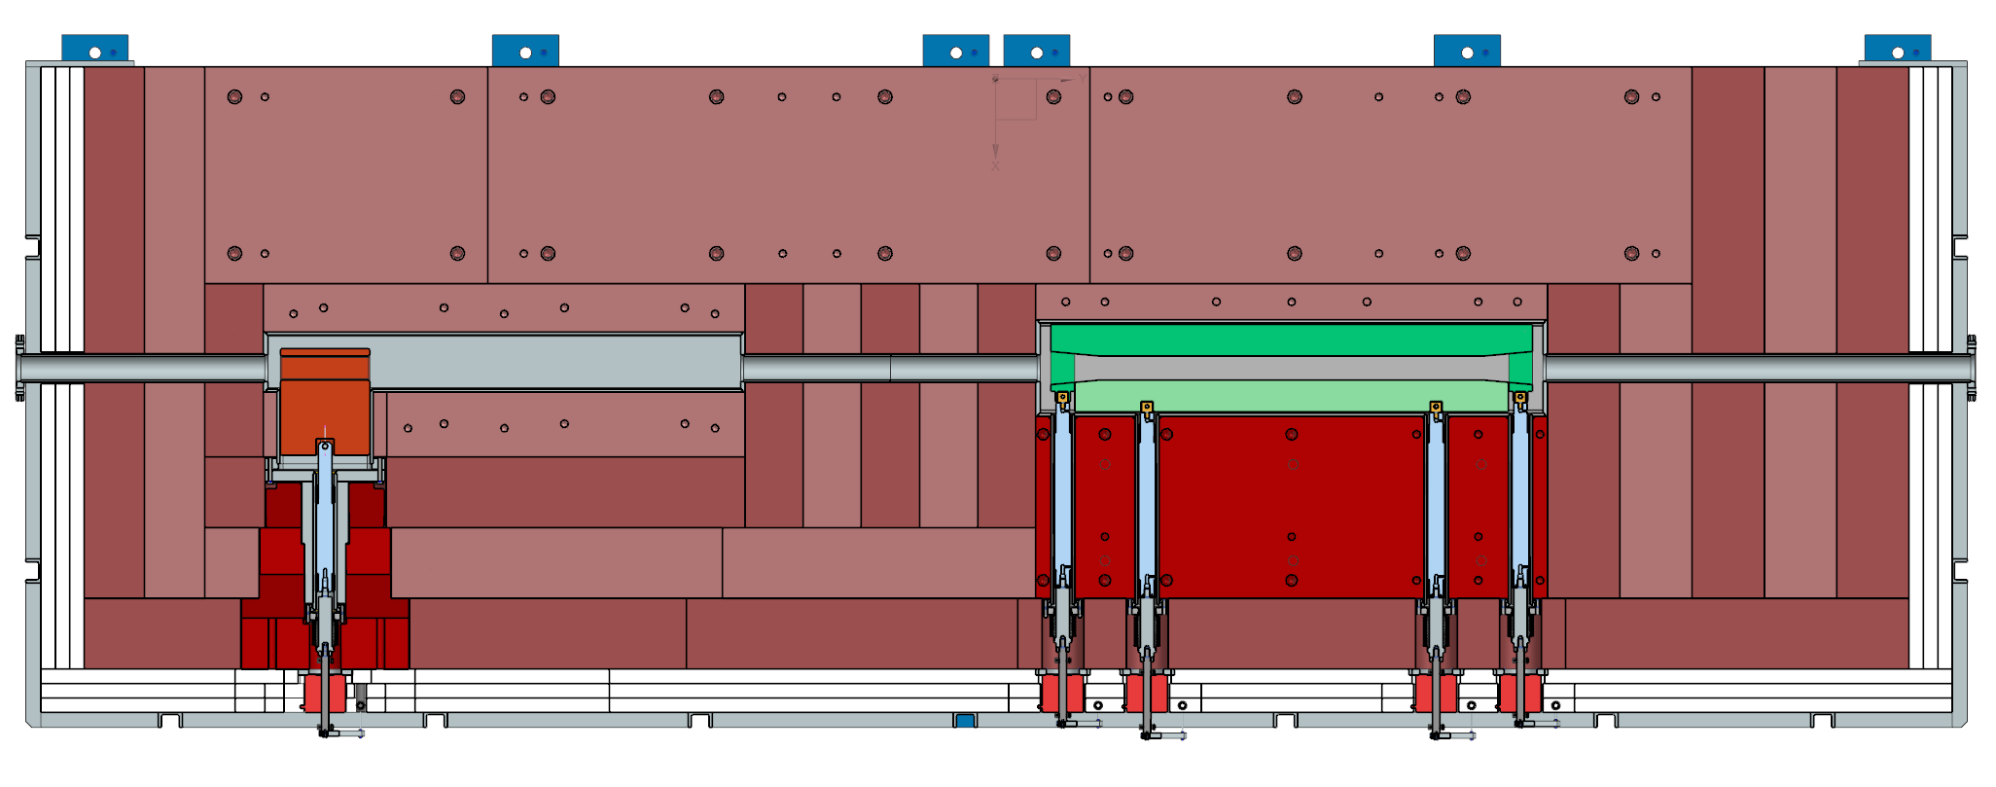
2) Integration of the horizontal and vertical PIP-II collimators to the existing MARS model (1/5)
TOP view of the layout in MARS
Motivation:
  Ensuring the MARS model remains a reliable and comprehensive tool for the many individuals working on the PIP-II project by adding these collimators
Goal:
  Updating the existing MARS model by integrating two (horizontal and vertical) PIP-II collimators
Position of the collimators:
  The highlighted area within the red circle on the image represent the position for the horizontal and vertical PIP-II collimators
3D view of the horizontal PIP-II collimator's CAD model
Primary jaw
Secondary jaw
Cross-sectional view of the horizontal PIP-II collimator, revealing its primary and secondary jaws

Slide 25
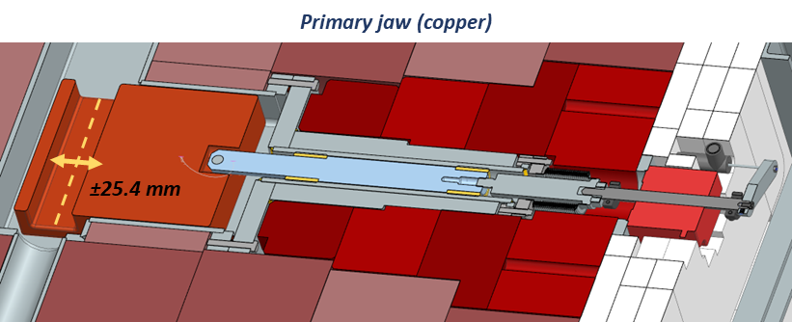
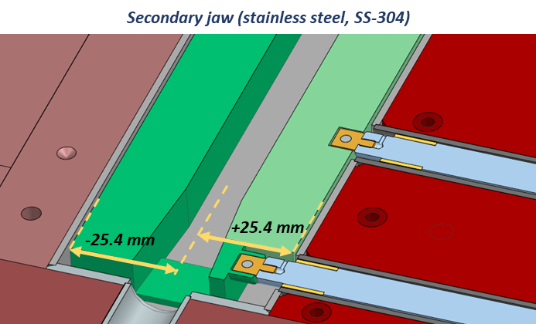
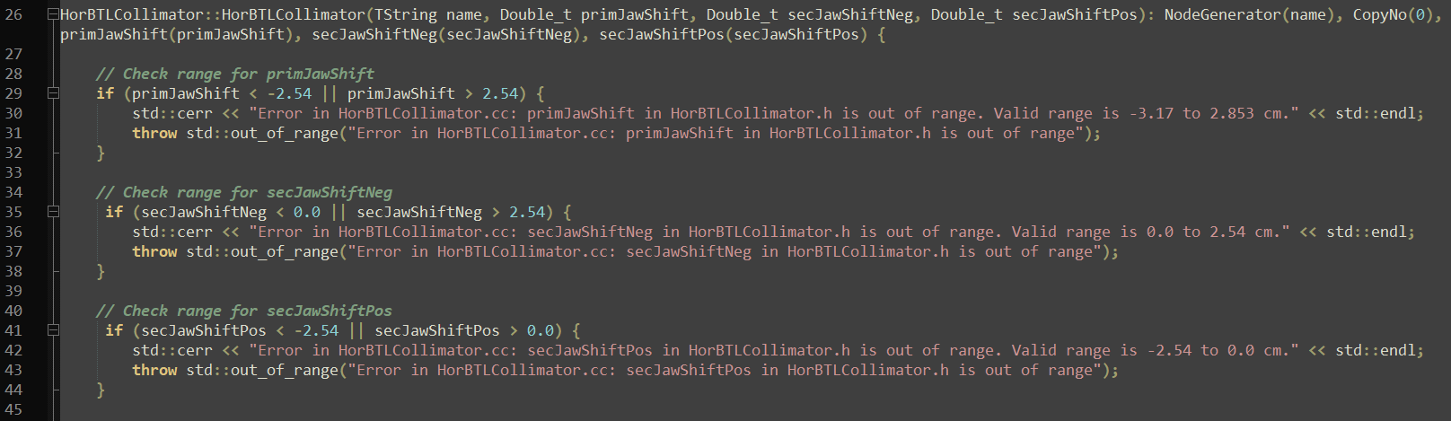
2) Integration of the horizontal and vertical PIP-II collimators to the existing MARS model (2/5)
  The primary jaw shifts ±25.4 mm from its nominal centered location, with a “hard stop” safeguard to prevent contact with the vacuum chamber
  The parameter ‘primJawShift' dictates the position of the primary jaw in the MARS model:
    Ranging from -2.54 cm to 2.54 cm, with 0 cm signifying the centered position
Operating mechanics of the collimator jaws
  Both sides of the secondary jaw operate independently, moving 25.4 mm inward but not outward from their nominal positions
  The parameters 'secJawShiftNeg' and 'secJawShiftPos' establish the position of the secondary jaw components in the MARS model:
    The range is 0.0 cm (fully open) to 2.54 cm for the smaller piece ('secJawShiftNeg’),
    -2.54 cm to 0.0 cm (fully open) for the larger piece ('secJawShiftPos')
Code implementation of collimator jaw shifts:
The shift mechanics of both the primary and secondary jaws are defined in the header and source files of the collimators
The header file outlines the variables 'primJawShift', 'secJawShiftNeg', and 'secJawShiftPos' that control the jaw movements
In the source files, these variables are used within the constructor for the 'HorBTLCollimator’ and ‘VerBTLCollimator’ class
Range checks are added for each shift variable to ensure the valid operation of the collimators, throwing an error if an out-of-range value is detected
HorBTLCollimator.h
HorBTLCollimator.cc

Slide 26
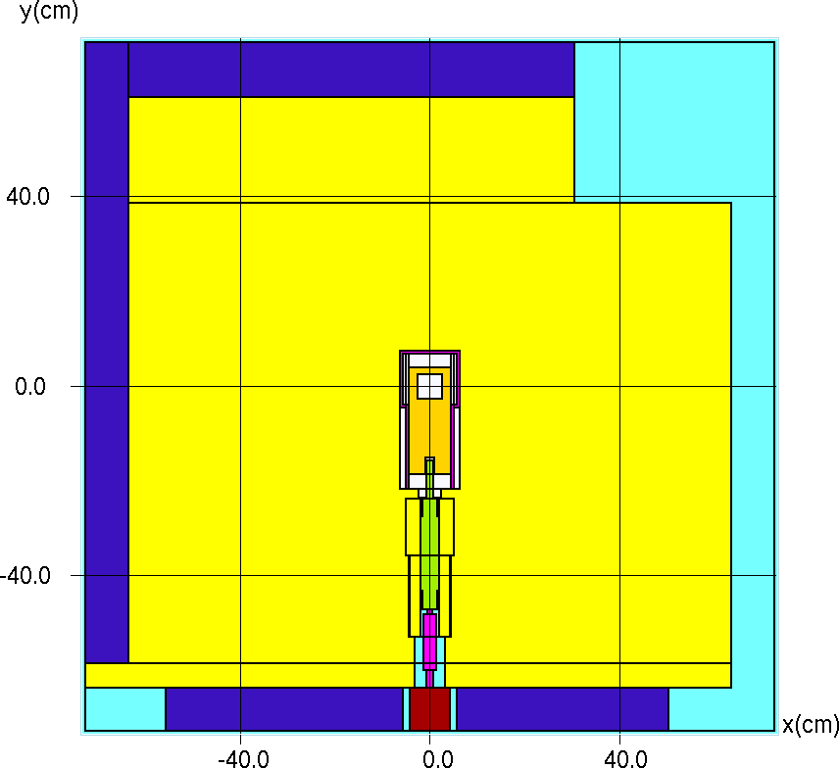
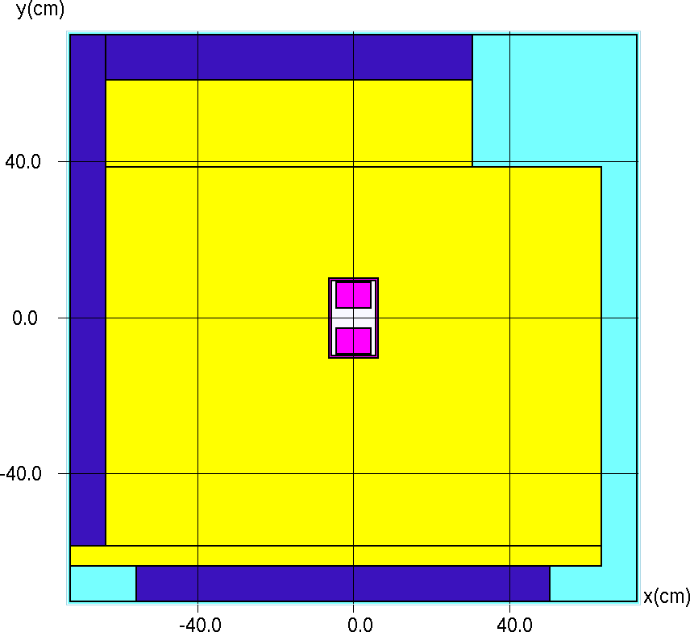
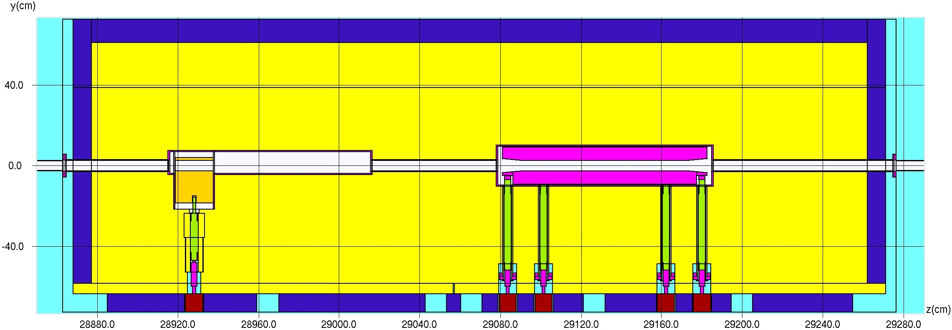
2) Integration of the horizontal and vertical PIP-II collimators to the existing MARS model (3/5)
Vertical collimator – primary jaw
Vertical collimator – secondary jaw
Z = 28928.0 cm (beamline)
Z = 29138.0 cm (beamline)

Slide 27
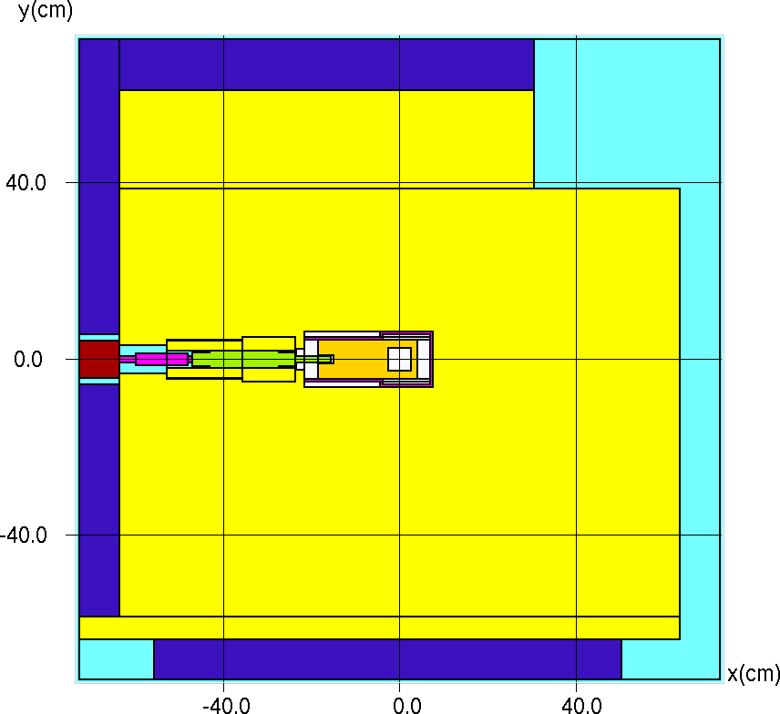

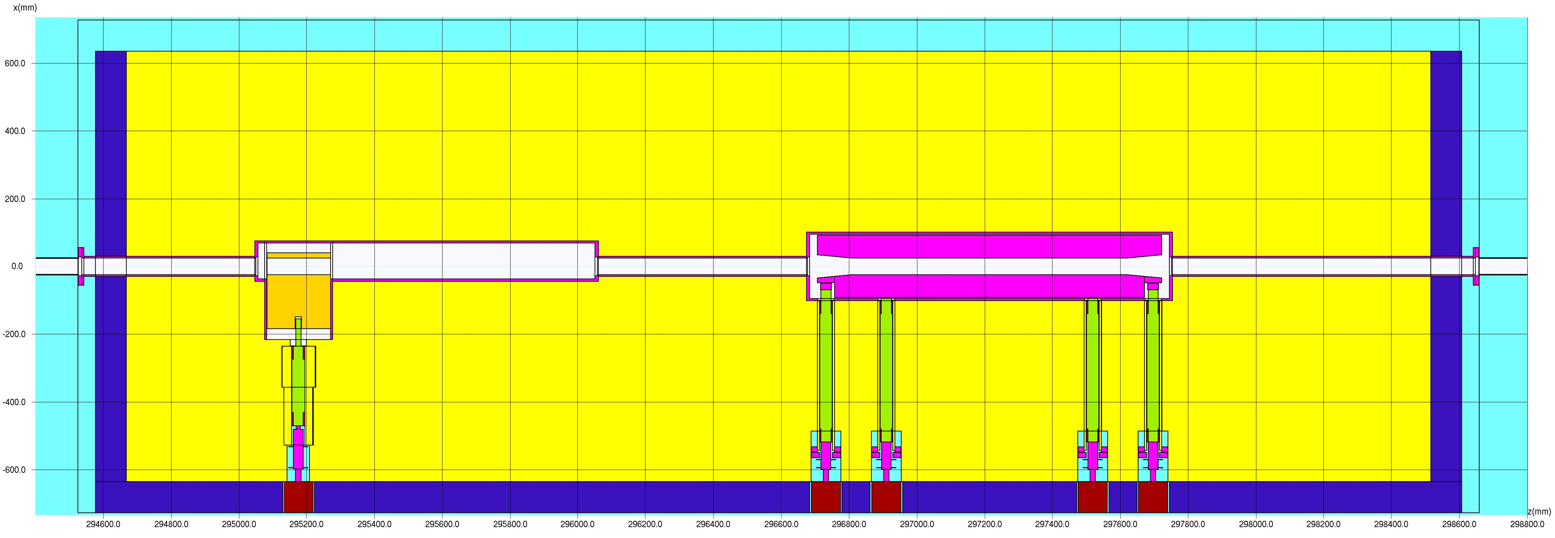
2) Integration of the horizontal and vertical PIP-II collimators to the existing MARS model (4/5)
Horizontal collimator – primary jaw
Horizontal collimator – secondary jaw
Z = 29517.5 cm (beamline)
Z = 29737.5 cm (beamline)

Slide 28
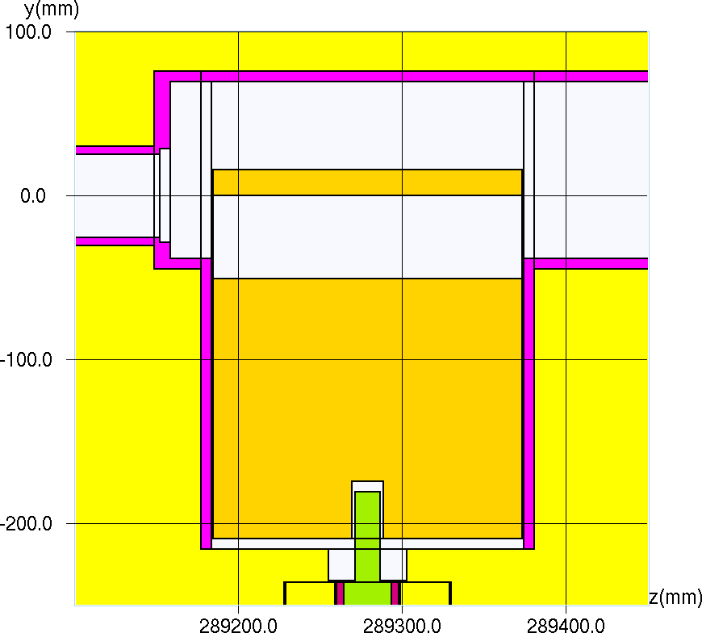
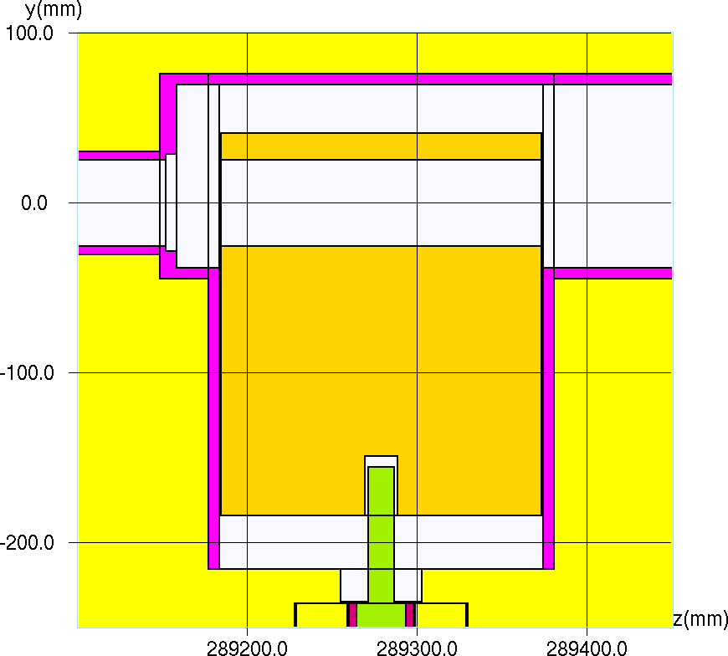
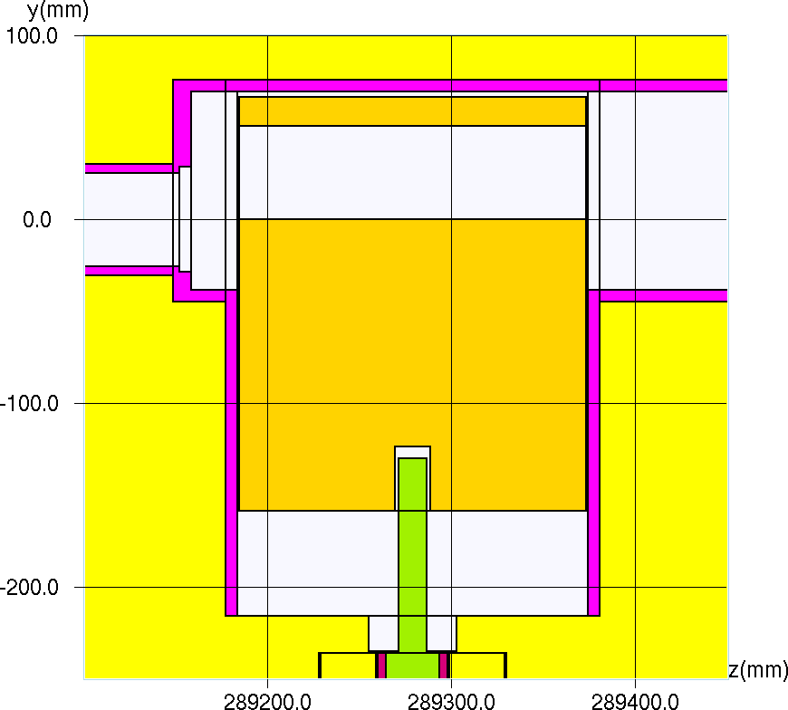
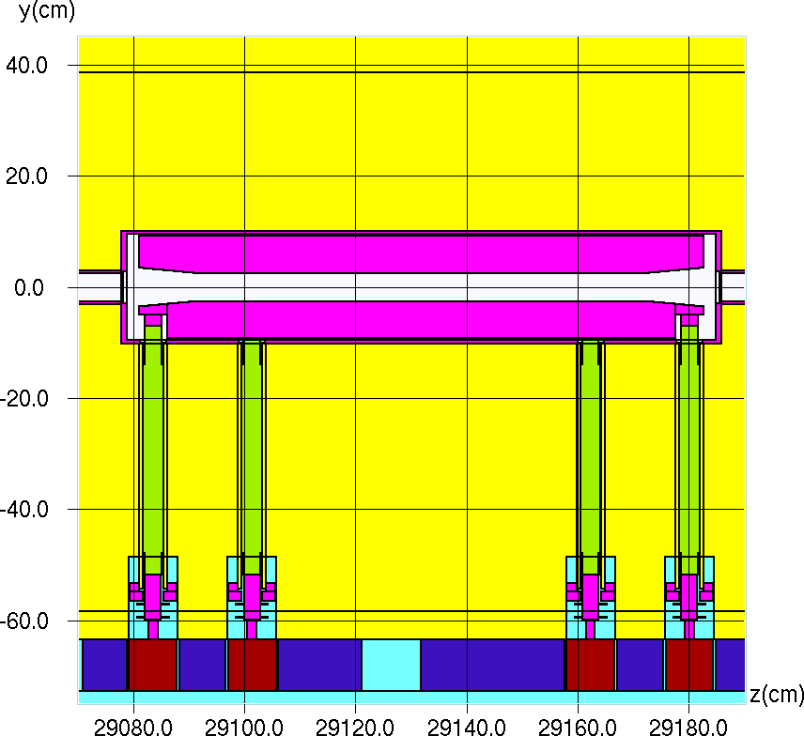

2) Integration of the horizontal and vertical PIP-II collimators to the existing MARS model (5/5)
Vertical collimator – primary jaw – Side view
primJawShift = -2.54 cm
primJawShift = 0.0 cm
primJawShift = 2.54 cm
Vertical collimator – secondary jaw – Side view
Fully open:
secJawShiftNeg = 0.0 cm
secJawShiftPos = 0.0 cm
Fully closed:
secJawShiftNeg = 2.54 cm
secJawShiftPos = -2.54 cm

Slide 29
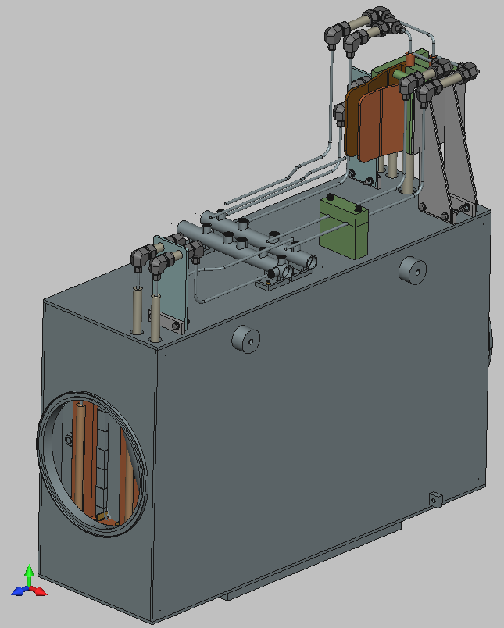
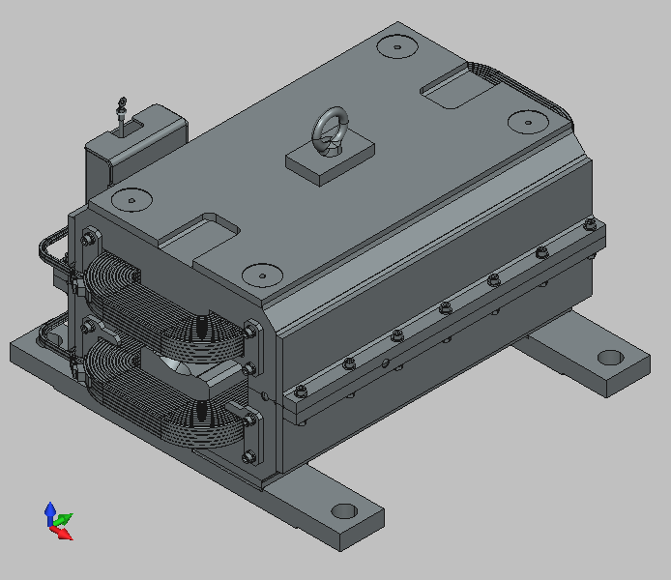
3) Integration of magnets to the existing MARS model (1/3)
TOP view of the layout in MARS
Motivation:
  Ensuring the MARS model remains a reliable and comprehensive tool for the many individuals working on the PIP-II project by adding these magnets
Goal:
  Updating the existing MARS model by integrating magnets: Fast Kicker Dipole, and BoosterInjORBE
Position of the magnets:
  The highlighted areas within the red circles on the image represent the positions for the magnets
BoosterInjORBE
Fast Kicker Dipole

Slide 30
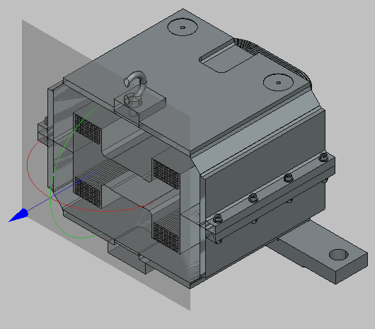
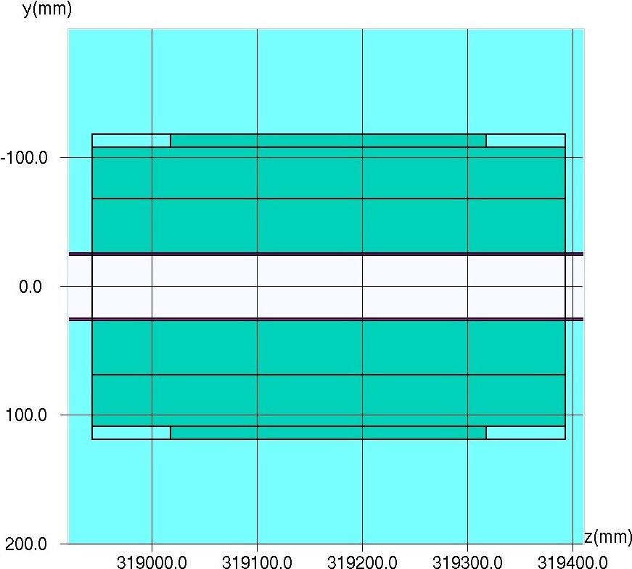
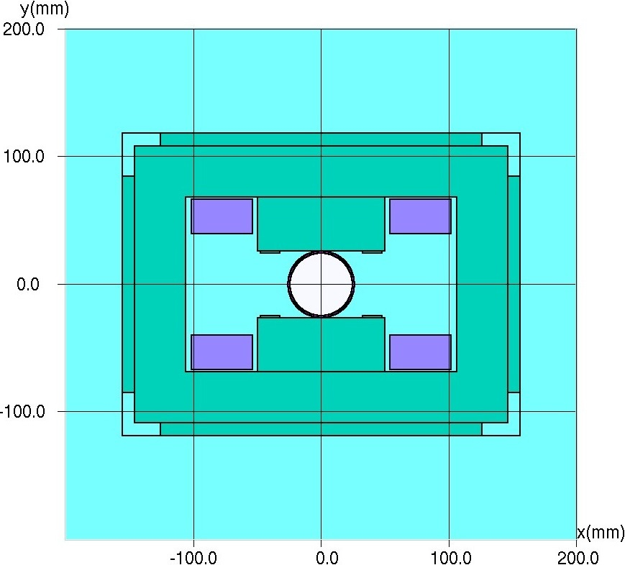
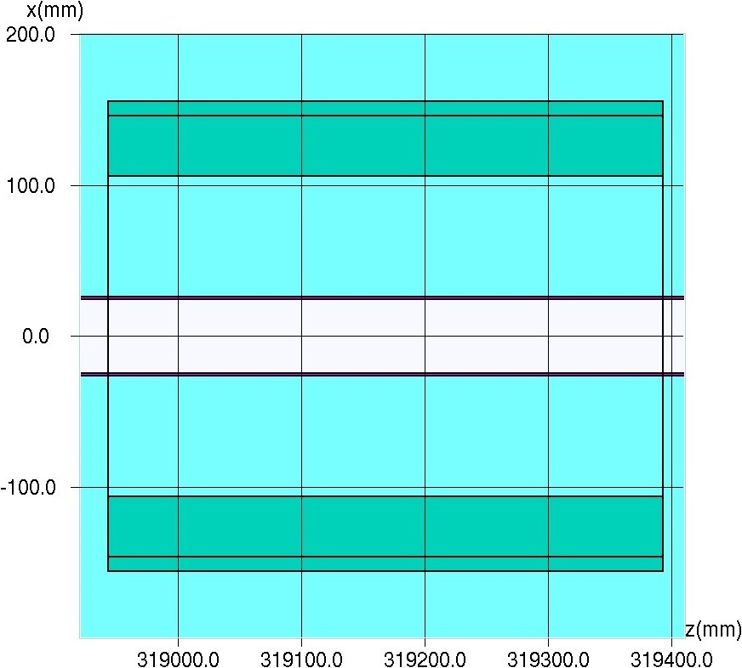
3) Integration of magnets to the existing MARS model (2/3)
Fast Kicker Dipole
Side view
Front view
Top view

Slide 31
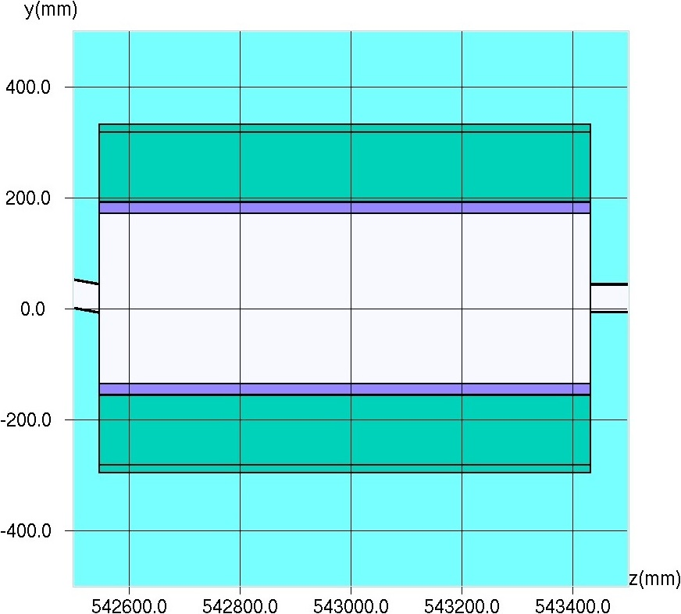
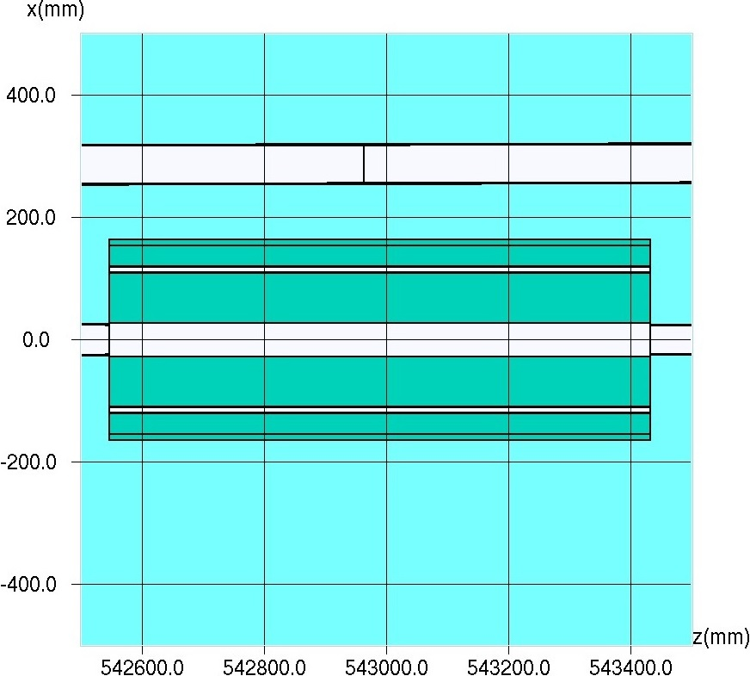


3) Integration of magnets to the existing MARS model (3/3)
Side view
Top view
Front view
BoosterInjORBE
Per-volume assignment of magnetic field

Slide 32

4) Dose Rate Distribution from MARS Simulation: Accident Case (1/3)
Accident Scenario (PIP-2 Linac Shielding Assessment)
  Incident: Full Linac beam at 1 GeV is lost
  Duration: 3 seconds
  In CW mode, this corresponds to:
  1.25e16 H-/sec * 3 = 3.75e16 H-/accident
6-ft thick shielding wall
Accident beam position and directional cosine parameters in ‘source.f’:
  X = 22.1318 cm
  Y = -6.4535 cm
  Z = 23572.53 cm
  DCX =-0.0025
  DCY = 0.0
  DCZ = sqrt(1.d0-DCX*DCX)
Dose rate monitoring setup (‘XYZHIS.INP’):
  X: -9000 to 1000 cm (100 bins)
  Y: -137.16 to 43 cm (1 bins)
  Z: - 23000 to 33000 cm (100 bins)
Dose rate (mrem/3-sec accident)

Slide 33


4) Dose Rate Distribution from MARS Simulation: Accident Case (2/3)
Projection pathway along BTL:
Chosen to capture attenuation effects along the BTL beamline, including the influence of the 6-ft shielding wall
'Distance = 0' marks the (upstream) start of the shielding wall
Projection pathway along 3-leg bypass
Chosen to show attenuation effects within the 3-leg bypass
The 1D dose rate projection from the 3-leg bypass is re-projected onto the pathway of the BTL tunnel (see parallel arrows in the image below)
Projection pathway along BTL (~30x2 bins)
6-ft thick shielding wall
The 1D projection graph shows that that the dose rate downstream of the shielding wall is below 10 mrem per accident, and that the dose rate drops below 1 mrem per accident between the first and second bends of the bypass tunnel.
In the 3rd leg, the dose rate is under 0.1 mrem per accident , however, there's a noticeable increase towards the end of the bypass. This uptrend highlights the contribution from the BTL tunnel at this point.
We can conclude that the wall attenuates the radiation level by more than two orders of magnitude, and that the bypass is well designed in the sense that it decreases the stray radiation further than the shielding wall
Projection pathway along 3-leg bypass (~21x2 bins)
Dose rate (mrem/3-sec accident)

Slide 34


4) Dose Rate Distribution from MARS Simulation: Accident Case (3/3)
Dose rate projected along a pathway, chosen to capture attenuation effects along the BTL beamline up to the position of the gate
'Distance = 0' marks the (upstream) start of the shielding wall
The position of the gate is approximately at ‘distance = 30 m’
6-ft thick shielding wall
The projection graph shows that the dose rate downstream of the shielding wall remains below 10 mrem per accident
Beyond approximately 20 meters downstream of the shielding wall, the dose rate appears to decrease to below 1 mrem per accident
However, additional simulations may be required to further reduce uncertainty at the position of the gate
Projection pathway 2 along BTL (~43x2.3 bins)
Dose rate (mrem/3-sec accident)

Slide 35
B) Summary
Built upon prior PIP-II, BTL, and collimator studies by Igor Tropin, Igor Rakhno, and Dali Georgobiani
Conducted MARS simulations for an accident scenario, and assessed dose rate levels downstream of the 6-ft shielding wall in the BTL line for effective radiation control, in line with Fermilab Radiological Control Manual (FRCM) standards
Integrated PIP-II collimators and magnets into the MARS model, enhancing its reliability and utility for the broader PIP-II project
Additional outputs:
  Developed a ROOT script to convert MARS output histograms from HBOOK to ASCII format, aiding in post-processing
  Created a Python GUI script to filter, average, and output data and errors based on selected coordinate files and hbook2ascii outputs
Possible Improvements
  Implement branching techniques for the 6-ft shielding wall to reduce simulation runtimes
  Unifying the ROOT and Python scripts for a more streamlined user experience
  Enhance the script to produce 1D projection graphs either from a chosen coordinate file or through interactive user selection on the displayed 2D histogram

Slide 36
C)
Integration & Preparation: BNB Study

Slide 37


1) Project overview: BNB beam, target, and horn design
Goal:
  To generate energy deposition data from simulations that can be imported into ANSYS for thermal analyses. This will enable us to evaluate the thermal-mechanical performance of the Booster Neutrino Beamline (BNB) target assembly under current beam conditions and future scenarios with higher frequencies.
Beryllium Sleeve
Target Base Block
Beam Parameters [3]:
  Origin: the BNB uses protons from Fermilab's Booster synchrotron
  Energy: protons have 8 GeV of kinetic energy (8.89 GeV/c)
  Repetition Rate: maximum average rate is 5 Hz, with bursts of up to 11 pulses at 15 Hz - testing will extend this to over 10 Hz
  Protons-per-Pulse: each pulse contains up to 5×10^12 protons
Target Parameters:
  Composition: made up of seven cylindrical beryllium slugs
  Dimensions: each slug is ~10 cm long, forming a ~71 cm long cylinder with a radius of ~0.5 cm
  Sleeve: enclosed in a ~0.1 cm thick beryllium sleeve with a ~1.37 cm inner radius
  Support: 3 beryllium fins radially connect each slug to the sleeve
Horn Parameters:
  Function: Pulsed electromagnet that focuses or defocuses secondary particles
  Material: Made from aluminum alloy
  Current: Operates at approximately 174 kA with about 1 kA variations
  Magnetic Field: 1/R field, reaching up to 1.5 Tesla at its narrowest point (2.2 cm radius)
Ceramic Cooling Tube
BNB target assembly
Upstream Slug Locator
Cylindrical Beryllium Slug
Locator Pin
Beryllium Support Fins
Contact Bellows Weldment
Beryllium Window
[3] MiniBooNE Collaboration. (2009). The Neutrino Flux prediction at MiniBooNE. arXiv:0806.1449v2 [hep-ex]

Slide 38



2) Integration of the BNB target assembly into the MARS model (1/2)
Target hall: MiniBooNE horn surrounded by shielding
Upstream slug locator and locator fins
MARS geometry includes:
  Target hall, MiniBooNE pulsed horn, and horn shielding (prepared by Igor Tropin)
  BNB target assembly (prepared by Alajos Makovec)
The target assembly is inserted into the inner conductor from the left side of the MiniBooNE horn

Slide 39

2) Integration of the BNB target assembly into the MARS model (2/2)
Full-length geometry: MARS model of BNB target assembly
Zoomed-in sections: detail view of BNB target assembly

Slide 40
3) Future steps for BNB study
The next phases of our study are multi-fold and interdependent, encompassing mesh creation, simulations, and thermal-mechanical evaluations.
Mesh creation:
The initial step is to generate a mesh using the CGNS (CFD General Notation System) format. This will facilitate the population of energy deposition data. Instead of the original CAD, we have decided to utilize the MARS model for this meshing process
Igor Tropin has already produced a CAD representation from the MARS model
Simulation phase:
Following mesh creation, we will proceed to run simulations. This will populate the mesh with essential data concerning energy deposition, which will be critical for the subsequent analysis phases
Data integration and thermal analysis:
Once the simulation phase is complete, the collected data will be handed over to the designated team. This data will be imported into ANSYS for thermal-mechanical evaluations of the BNB target assembly. The goal is to assess its performance under both the current beam conditions and in anticipation of future scenarios with higher frequencies

Slide 41
D)
Additional Contributions & Initiatives

Slide 42




1) Attenuation of Neutrons in Labyrinths (1/2)
As part of an update to Dali’s simple labyrinth analysis that was presented at the SATIF-15 meeting [4], a simple FLUKA simulation has been carried out using the FLUKA code
Comparison of attenuation of accelerator-produced neutrons in labyrinths
Results form semi-analytical technique developed at Fermilab compared with results from Monte Carlo radiation transport codes (MARS, PHITS, MCNP and FLUKA)
FLUKA geometry used for the simulation
The joint paper on the labyrinths is in preparation,
to be published in a peer-reviewed journal
Importance biasing
The tunnel wall and the soil shielding surrounding the labyrinth consists of 20 cm thick spherical layers in FLUKA
Each AirCube is an individual region with a volume of 1 m³
This approach allowed the implementation of importance biasing in FLUKA to decrease the computational time needed to achieve good statistics (<2.5% relative uncertainty in the outermost AirCube, #15)
FLUKA reports the highest prompt dose rate in each AirCube region, with the difference increasing as we move further from the labyrinth entrance:
FLUKA results seem to have better statistics in comparison to the dose rate maps presented in [4]
Relative uncertainty is shown only for FLUKA in the comparison graph
[4] D. Georgobiani, T. Ginter, N. Mokhov, I. Rakhno, M. Vincent, J. C. Zamora - Attenuation of Neutrons in Labyrinths: Comparison of Various Calculation Techniques. SATIF-15 Proc. (NEA)

Slide 43





1) Attenuation of Neutrons in Labyrinths (2/2)
FLUKA geometry used for the simulation
MARS results [4]:
Neutron-induced (left) and photon-induced (right) dose rates
Rel. Uncertainty (Neutron-induced)
No biasing applied

Slide 44




3) Particle Distribution Analyzer (PDA)
Particle Distribution Analyzer (PDA)
Developed in Python using tkinter and matplotlib
GUI interface for user-friendly experience
File selection through an interactive pop-up window
Particle selection via dropdown: all 40 particle types available
Custom axis plotting: any combination of X, Y, and Z axes
Adjustable axis limits
Header input field: default available, with option to modify
Scattered plot visualization: each dot represents a particle
Color-coded energy: visualize particle energy through color gradients
Save functionality saves plots in .png format
Motivation:
Surprising peak in the dose rate map, positioned above the beamline
Seemingly no apparent features in the existing geometry correlate with the peak's location, raising questions about its origin
Future enhancements
Improved colorbar for better energy representation
Integration of particle weight info
Predefined headers for quick selection
Enhanced visualization options: aspect ratios, font scaling, etc.
Error handling: improve resilience to file and data issues
Interactive colorbar: allow user-defined colormaps
User settings: save and load preferred default settings
Guide and documentation for users
Enhanced logging: replace terminal prints with structured logs

Slide 45




3) Energy Spectra Analyzer (ESpA)
Energy Spectra Analyzer (ESpa)
User-friendly GUI for easy usage
File selection via an interactive pop-up window
Particle selection via dropdown: all 40 particle types available
Color selection for plots via dropdown menu
Option to plot multiple energy spectra on the same graph
Adjustable bin number with default value
Adjustable axis limits
Choice between linear or logarithmic plotting for X, Y axis via dropdown menus
Grid toggle option via checkbox
Editable header input field with a default option
Save functionality for plots in .png format
Future enhancements
Refresh button to update axis limits without replotting
Predefined headers for quick selection
Expanded visualization options: aspect ratios, font scaling, etc.
Improved error handling for file and data issues
User settings to save and load preferred defaults
Comprehensive guide and documentation for users
Potential integration with MARS GUI:
If a Graphical User Interface for MARS is developed, similar to how Flair is used with FLUKA, these tools (PDA and ESpA) could be easily integrated. This would allow users to interact directly with MARS simulation inputs and outputs through these utilities.

Slide 46
Thank you
Special thanks to my colleagues:
Igor Rakhno
Dali Georgobiani
Igor Tropin
Your assistance and expertise have been invaluable!
And a big Thank You to All for listening!

