Slide 1


MQXFA17
Coil Pack and Shimming Proposal
Dan Cheng, Paolo Ferracin, Mike Solis Jennifer Doyle, Katherine Ray
6-Oct-2023
LBNL

Slide 2
Outline
Coil Selection Review Recap
Coil CMM Summary
Coil Matrix
Proposed Coil Pack and shimming
Summary

Slide 3
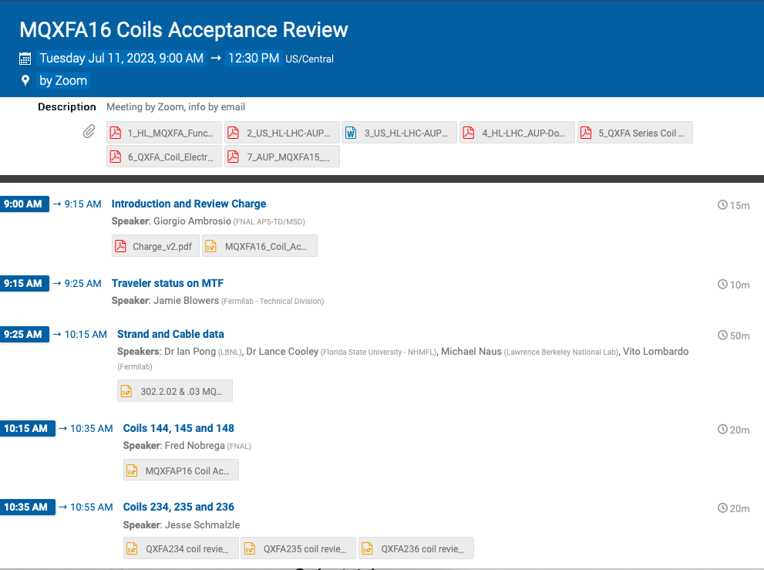
Coil Selection Review Report Summary
MQXFA17 Coil Selection Review was held 6-Oct-2023
  Coils 150, 151, 152, 237, 239, 242 reviewed
  See https://indico.fnal.gov/event/61535/
All coils are approved for use, but
  Coilx 150, 242 appear to be the smaller coils
    Concerns about coil size based on potential effects observed in MQXFA13 test
    Will choose 151, 152, 237, 239
  Fabrication reports and CMM reported

Slide 4
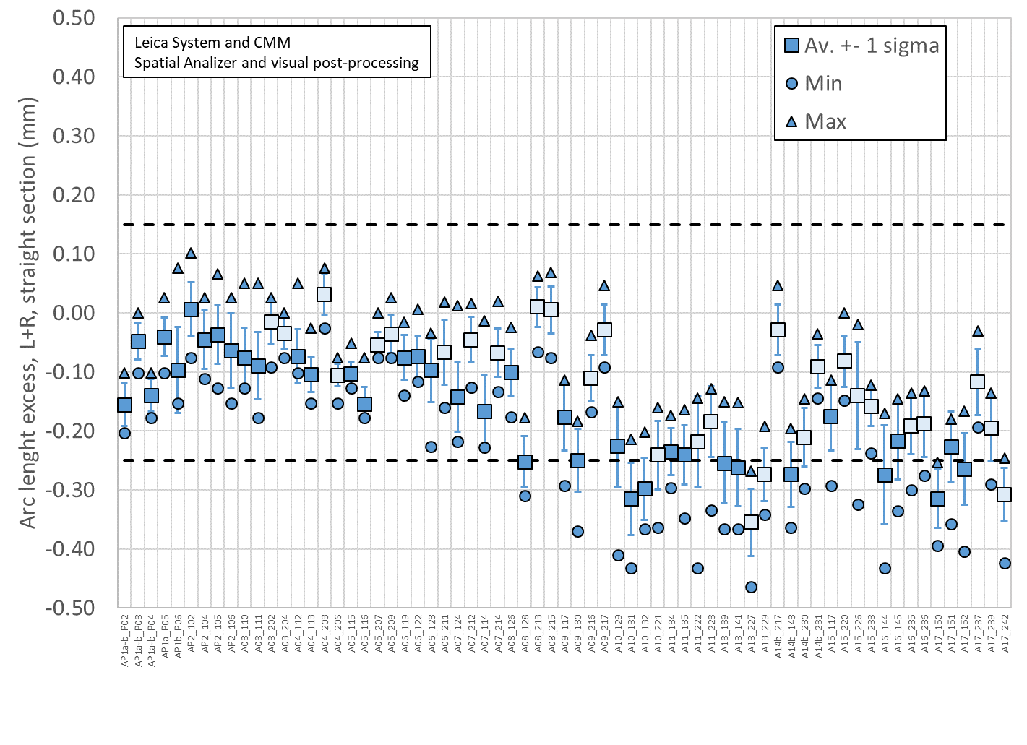
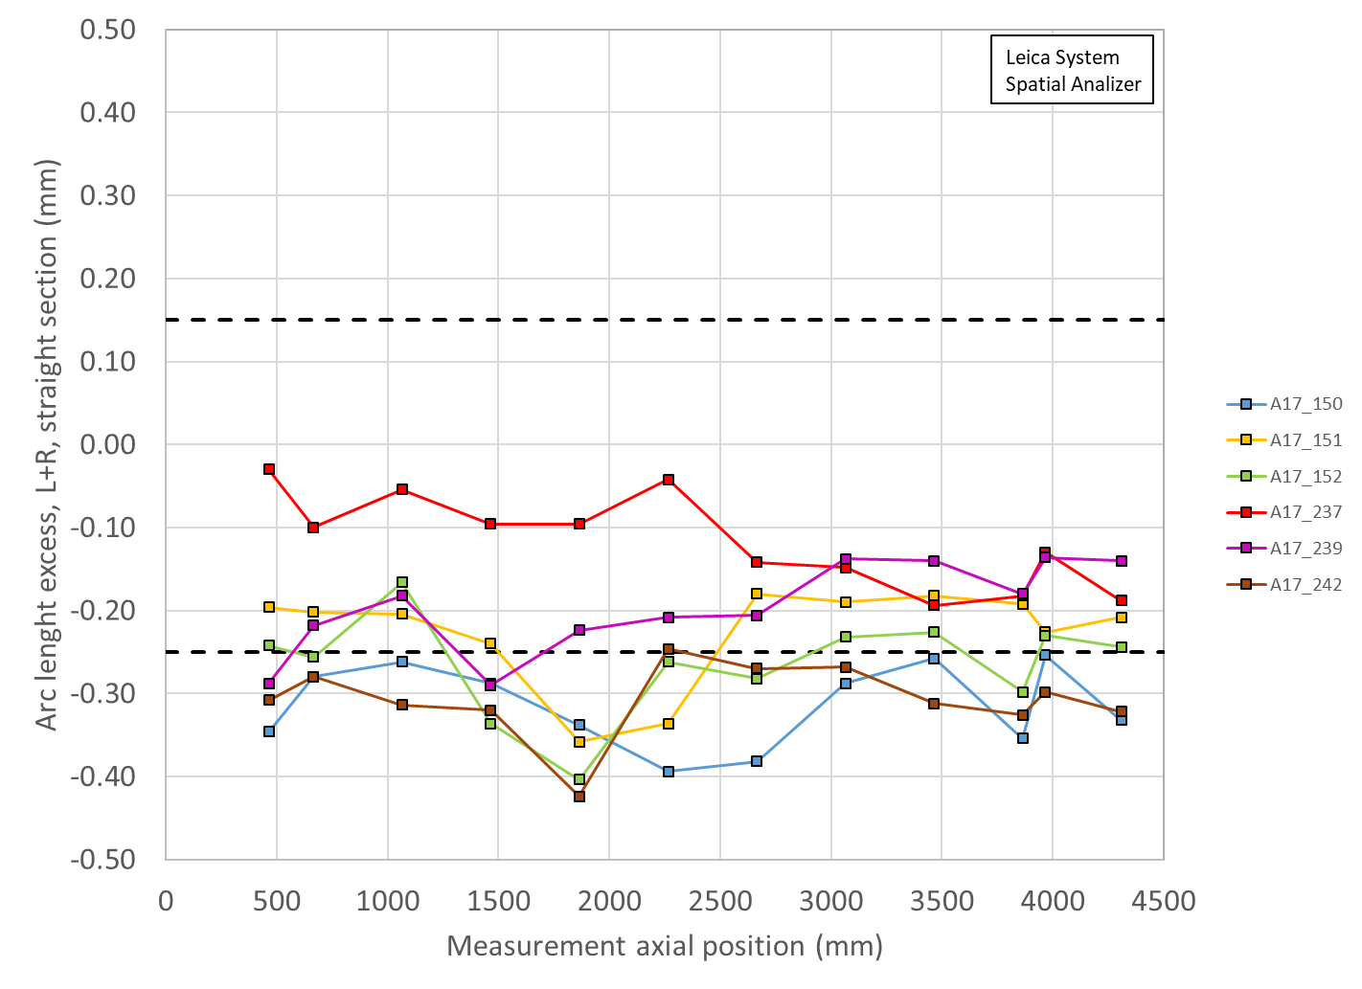
Total Arc Length Excess (Straight Section)
All coils smaller than spec
3965 mm is location of SG:
150 -254 µm (-315 µm avg)
151 -225 µm (-226 µm avg)
152 -230 µm (-264 µm avg)
237 -130 µm (-117 µm avg)
239 -136 µm (-196 µm avg)
242 -298 µm (-307 µm avg)

Slide 5
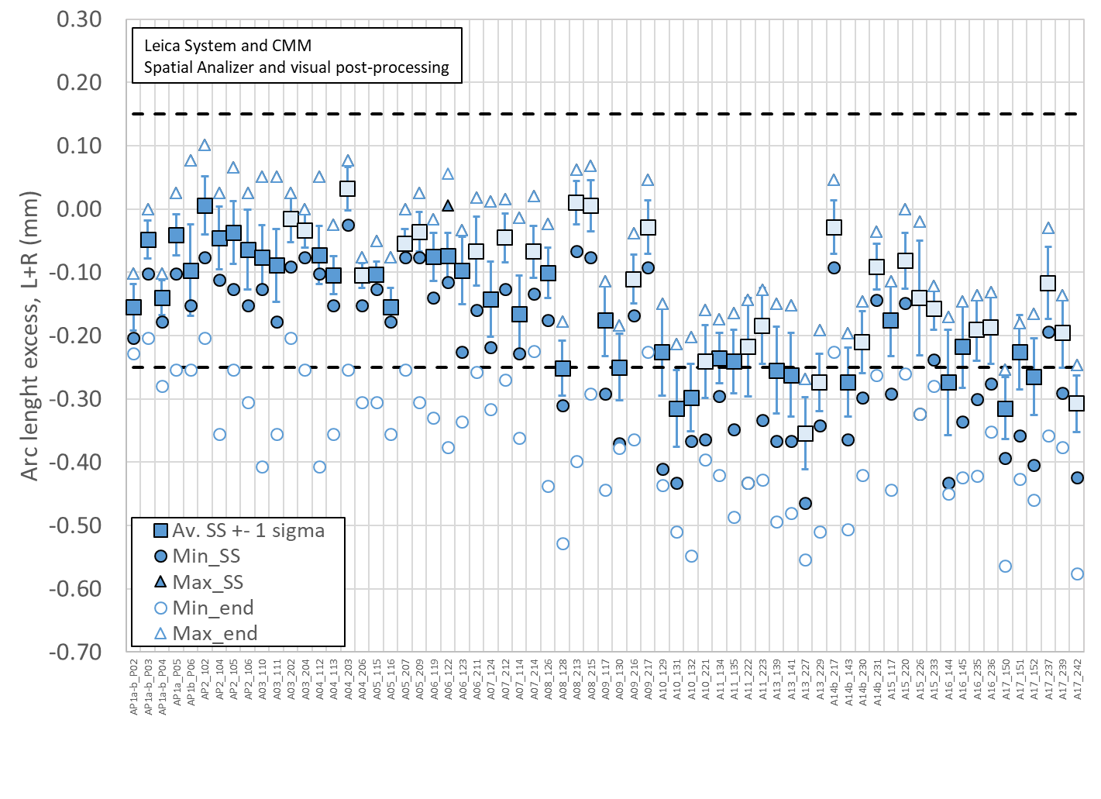
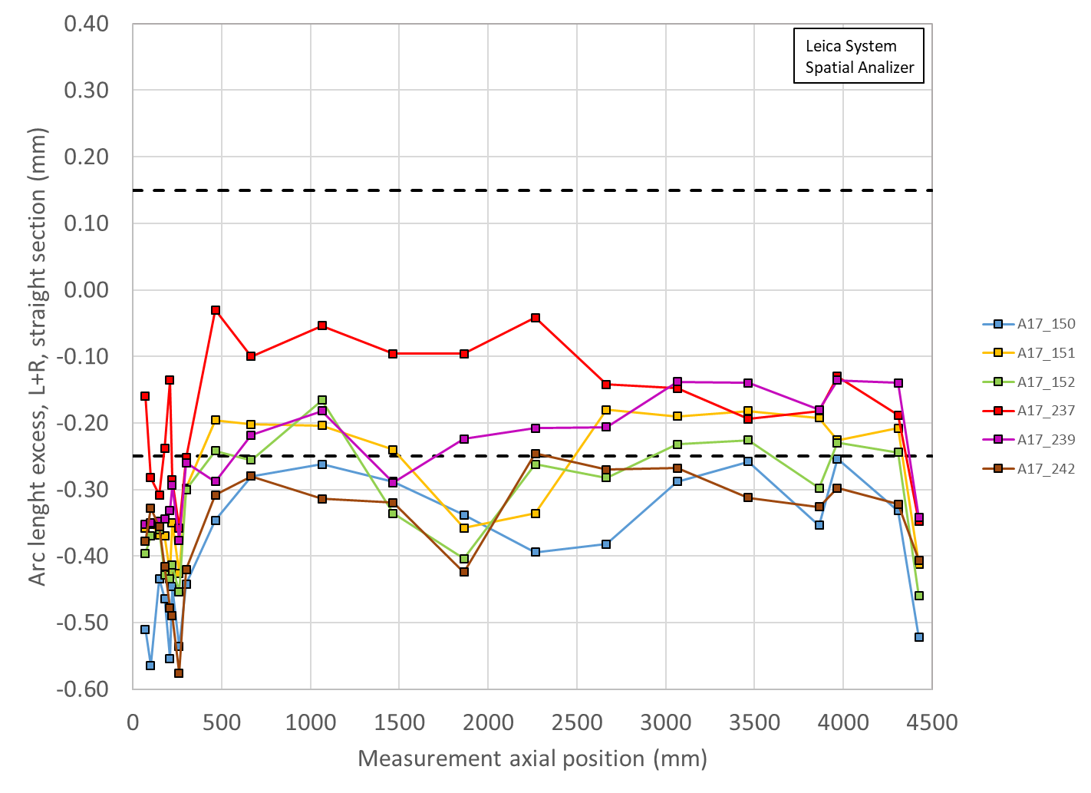
Total Arc Length Excess (Full length)
All coils smaller than spec
3965 mm is location of SG:
150 -254 µm (-392 µm avg)
151 -225 µm (-289 µm avg)
152 -230 µm (-323 µm avg)
237 -130 µm (-180 µm avg)
239 -136 µm (-255 µm avg)
242 -298 µm (-359 µm avg)

Slide 6
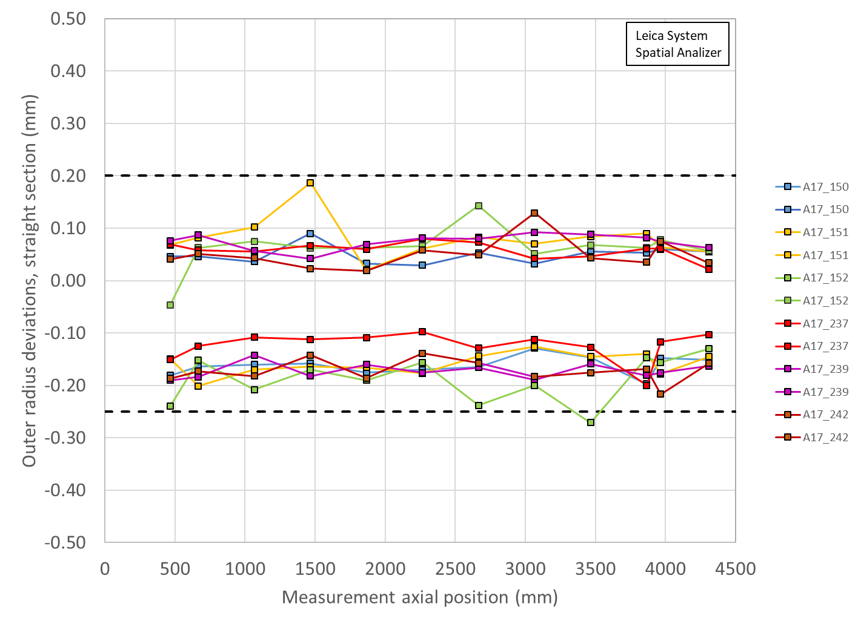
Outer Radius Profile Deviations (Leica)
All Coils avg. within spec
Outer Radius deviation ranges are all similar among the coils
One location undersized

Slide 7
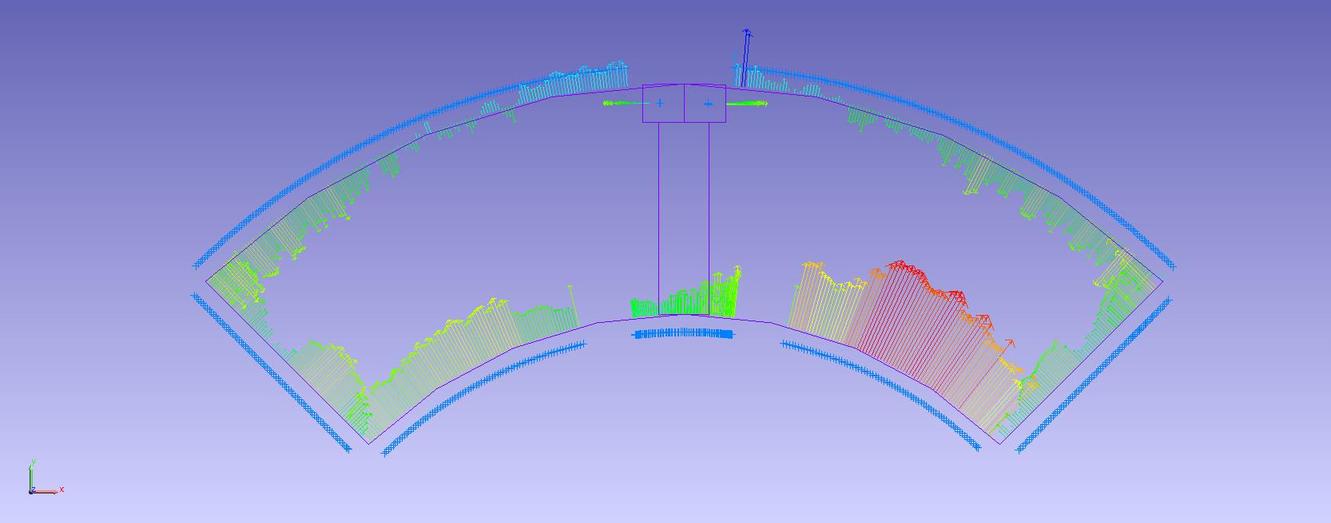
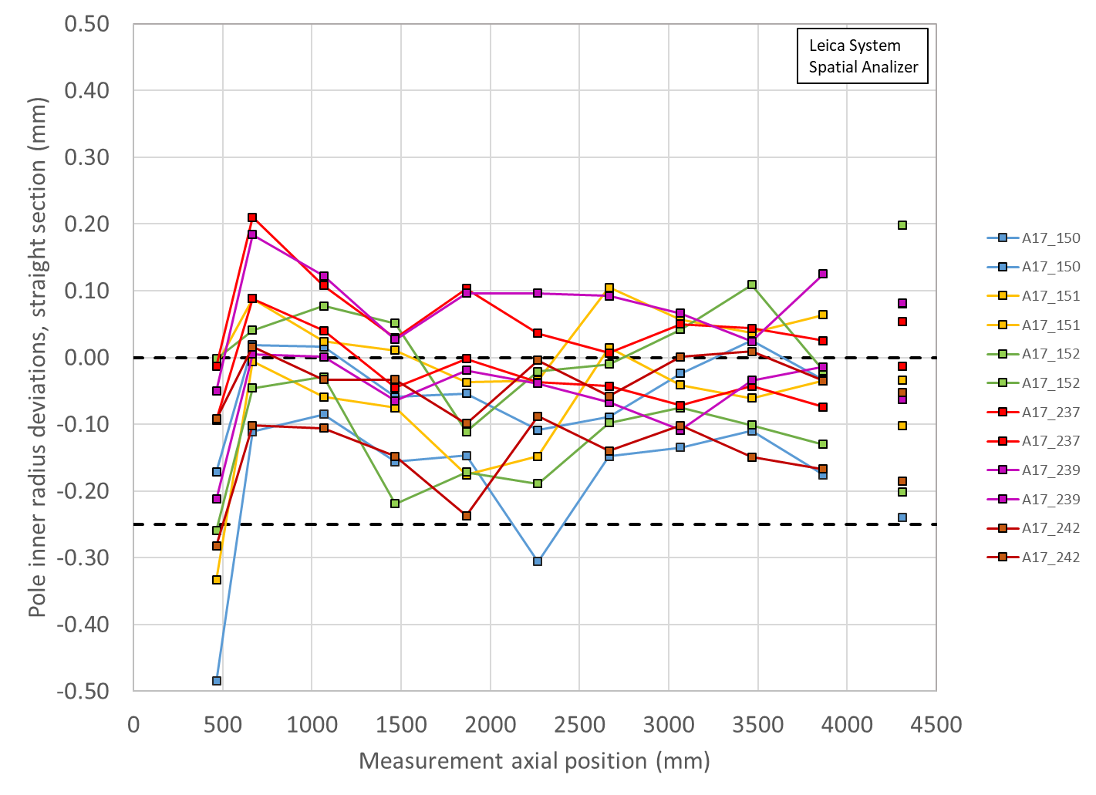
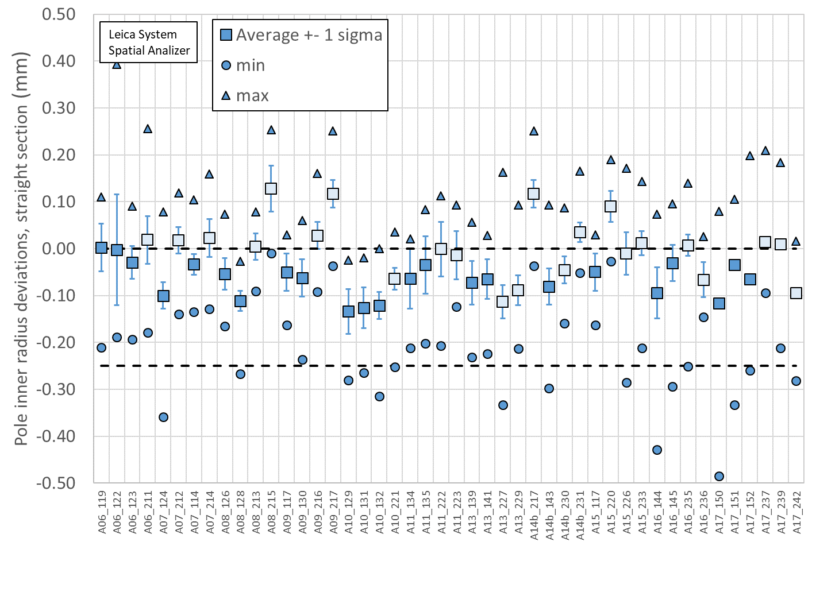
Pole Inner Radius Deviations (Pion Locations)
Inner Radius of the pole key is small (deviation into the bore)

Slide 8
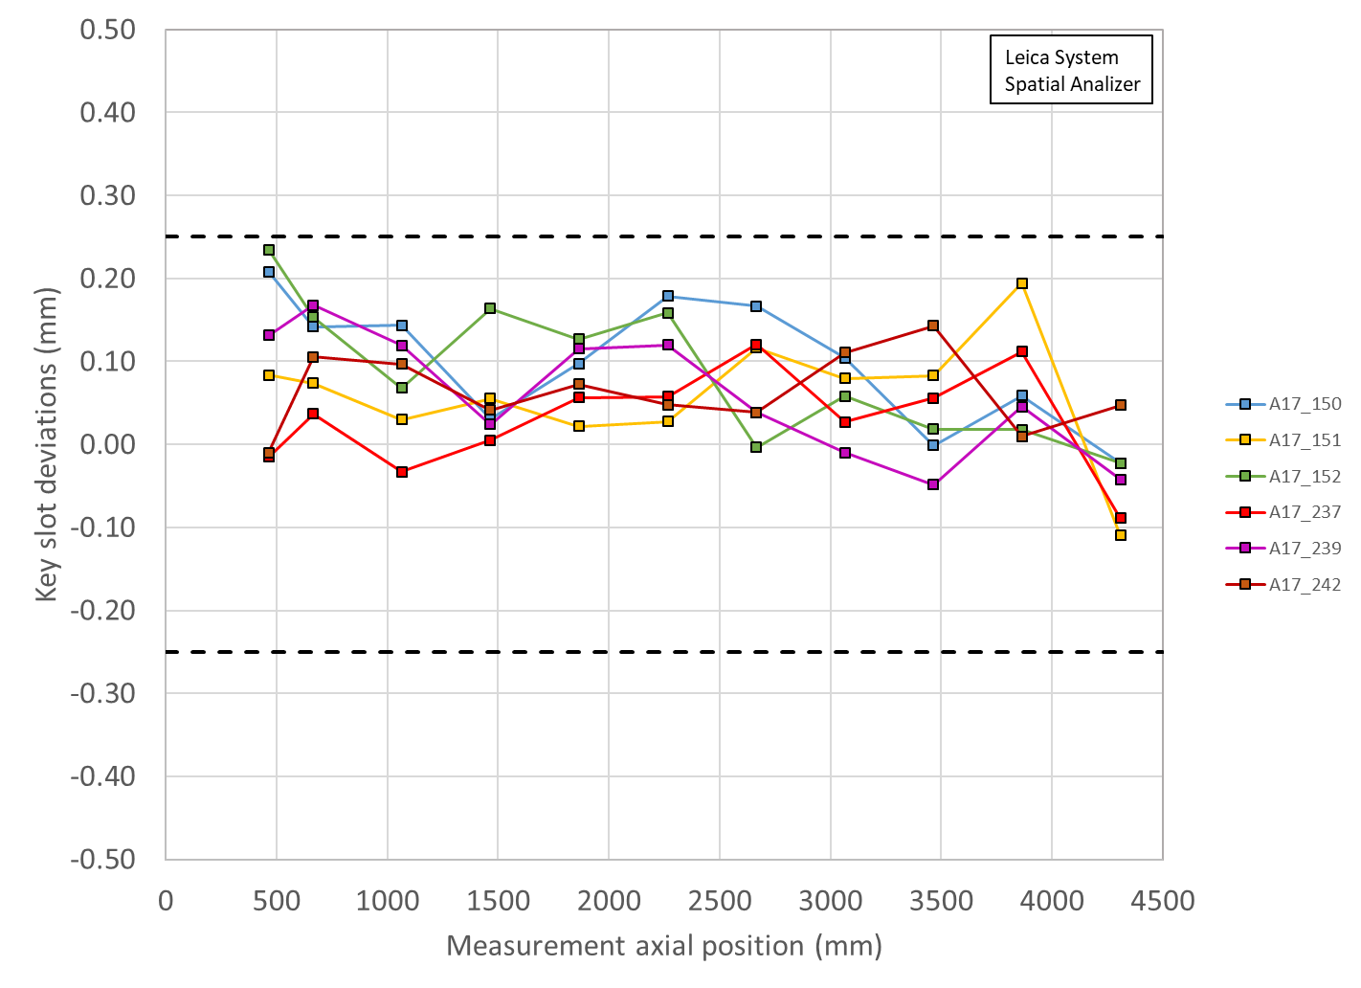
Key Slot Deviations
All Coils within spec
No keyslots out of spec

Slide 9
MQXFA17 Coils Matrix
Coil | b6 Corr. | Keyway shift | Avg. Pole Inner R Dev | Avg R Dev. | Avg. Midpl Dev.
150 | Yes | Ok | ~105 µm over | ~-50 µm | ~-157 µm
151 | Yes | Ok | ~25 µm over | ~-40 µm | ~-113 µm
152 | Yes | Ok | ~65 µm over | ~-50 µm | ~-132 µm
237 | Yes | Ok | ~10 µm under | ~-20 µm | ~-59 µm
239 | Yes | Ok | ~5 µm under | ~-30 µm | ~-98 µm
242 | Yes | Ok | ~100 µm over | ~-50 µm | ~-154 µm
OD: all coils undersized
Midplane: all coils undersized; will require extra midplane shims
Most coils pole inner radii show deviations into the bore; pions will need to be machined in these locations
LBNL measurements are using Leica system data

Slide 10
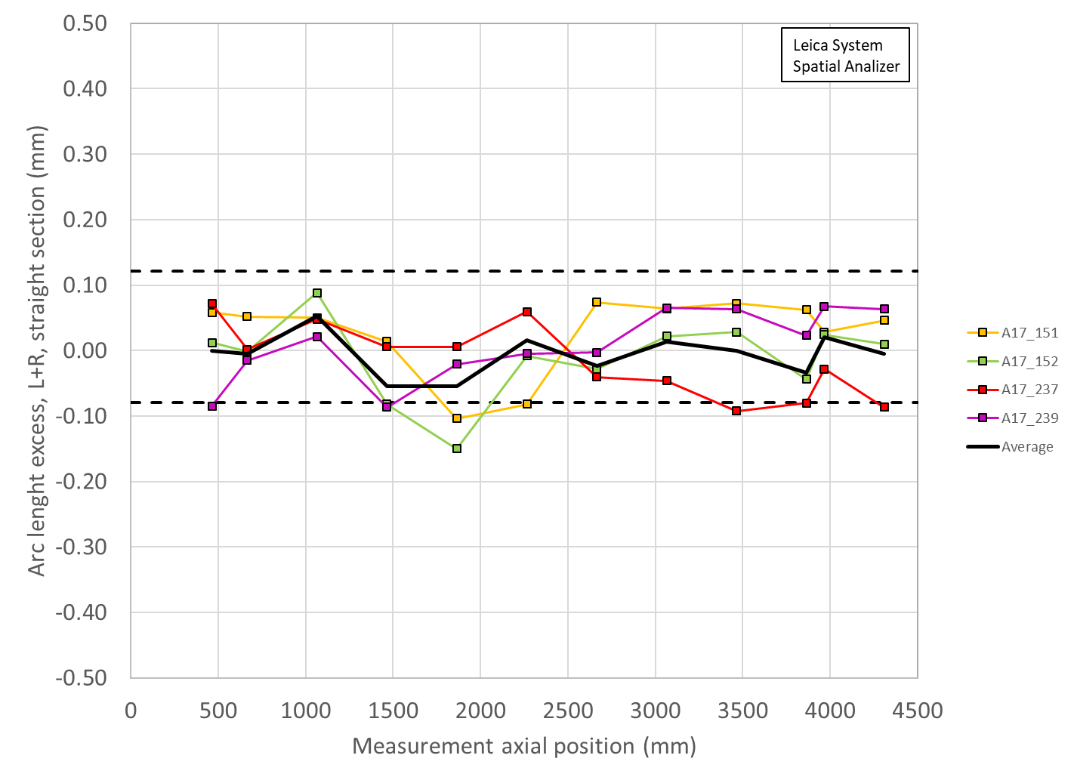
Coil Size estimates with midplane shims
Coil measurement plots created to show the effect of adding shims to both midplanes of Coils 151, 152, 237, 239
Limited by thicknesses of Kapton midplane shim availalble
Shimming:
0.005” on Coil 151
0.005” on 152
0.002” on 237
0.002” + 0.002” on 239
Unshimmed

Slide 11
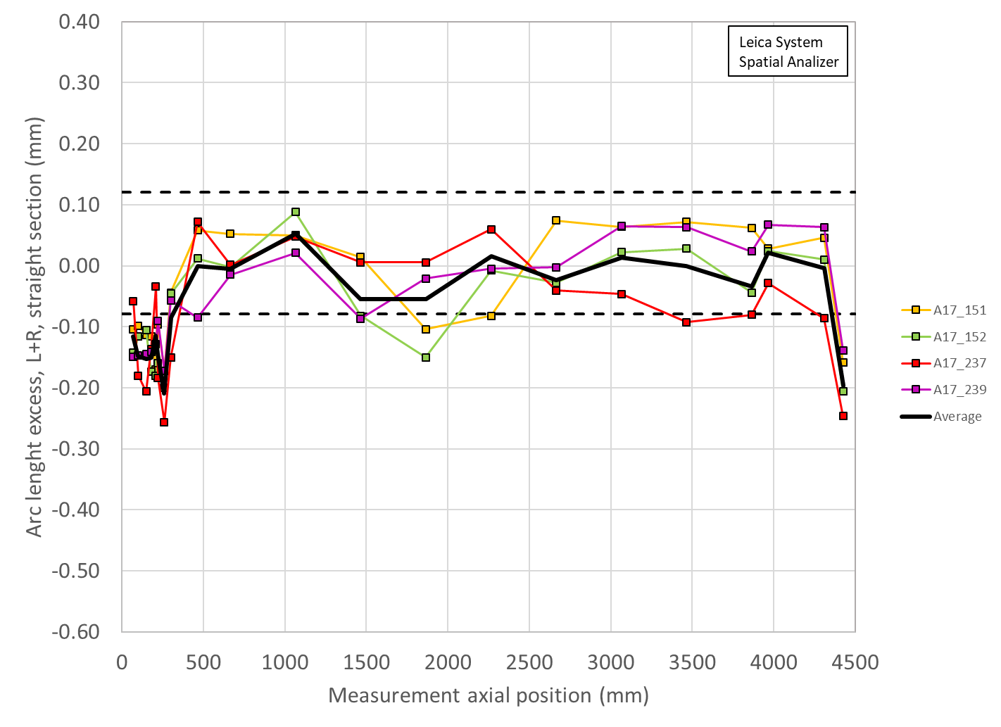
Coil Size estimates with midplane shims
Coil measurement plots created to show the effect of adding shims to both midplanes of Coils 151, 152, 237, 239
Limited by thicknesses of Kapton midplane shim availalble
Shimming:
0.005” on Coil 151
0.005” on 152
0.002” on 237
0.002” + 0.002” on 239
Unshimmed

Slide 12
Acceptable coil ordering (150 spare)
Coils are reported in mechanical order
There are 74 (with coil 152) acceptable coil orderings with voltage < 353 V that are common for both rolled and minor edge RRR values (values reported for rolled RRR)
  11 combinations without 150
P1 | P2 | P3 | P4 | Volt
239 | 237 | 151 | 152 | 329
239 | 150 | 151 | 152 | 329
150 | 239 | 151 | 152 | 330
239 | 150 | 151 | 237 | 331
151 | 239 | 152 | 150 | 331
151 | 150 | 152 | 239 | 331
150 | 237 | 151 | 152 | 331
239 | 237 | 151 | 150 | 332
239 | 237 | 150 | 151 | 332
239 | 151 | 150 | 237 | 332
237 | 239 | 151 | 152 | 332
237 | 150 | 151 | 152 | 332
151 | 237 | 152 | 239 | 332
150 | 239 | 151 | 237 | 332
150 | 237 | 239 | 151 | 332
150 | 151 | 239 | 237 | 332
151 | 237 | 152 | 150 | 333
150 | 237 | 152 | 151 | 333
150 | 237 | 151 | 239 | 333
239 | 237 | 152 | 151 | 334
237 | 239 | 150 | 151 | 334
237 | 150 | 239 | 151 | 334
151 | 239 | 152 | 237 | 334
151 | 239 | 150 | 237 | 334
151 | 237 | 239 | 150 | 334
P1 | P2 | P3 | P4 | Volt
151 | 237 | 150 | 239 | 334
151 | 150 | 239 | 237 | 334
151 | 150 | 152 | 237 | 335
150 | 239 | 152 | 151 | 335
239 | 150 | 152 | 151 | 337
150 | 237 | 152 | 239 | 337
239 | 237 | 152 | 150 | 339
239 | 237 | 150 | 152 | 341
237 | 239 | 150 | 152 | 341
237 | 150 | 239 | 152 | 341
150 | 237 | 239 | 152 | 341
152 | 150 | 151 | 239 | 342
152 | 239 | 151 | 150 | 343
151 | 152 | 239 | 237 | 343
152 | 237 | 151 | 239 | 344
239 | 152 | 150 | 151 | 344
237 | 151 | 239 | 152 | 344
151 | 152 | 239 | 150 | 344
151 | 152 | 150 | 239 | 344
151 | 152 | 150 | 237 | 344
150 | 152 | 239 | 151 | 344
152 | 237 | 151 | 150 | 345
151 | 237 | 239 | 152 | 345
239 | 151 | 150 | 152 | 346
151 | 237 | 150 | 152 | 346
P1 | P2 | P3 | P4 | Volt
150 | 239 | 152 | 237 | 346
150 | 151 | 239 | 152 | 346
152 | 237 | 239 | 151 | 347
152 | 151 | 239 | 150 | 347
152 | 151 | 150 | 239 | 347
151 | 239 | 150 | 152 | 347
151 | 150 | 239 | 152 | 347
150 | 152 | 239 | 237 | 347
152 | 239 | 151 | 237 | 348
152 | 239 | 150 | 151 | 348
152 | 237 | 150 | 151 | 348
152 | 150 | 239 | 151 | 348
152 | 150 | 151 | 237 | 348
152 | 151 | 239 | 237 | 349
152 | 151 | 150 | 237 | 349
239 | 150 | 152 | 237 | 349
152 | 237 | 150 | 239 | 350
239 | 152 | 150 | 237 | 350
150 | 152 | 151 | 239 | 350
150 | 151 | 152 | 239 | 350
152 | 237 | 239 | 150 | 351
239 | 152 | 151 | 150 | 352
239 | 151 | 152 | 150 | 352
152 | 150 | 239 | 237 | 353
Coils reported in mechanical ordering from CSR
Peak voltages evaluated in usual failure scenarios
Removed Coil 150 from original selection
Preserving opposing quadrants for FNAL/BNL coils
Several cases available; choosing lowest available voltage

Slide 13
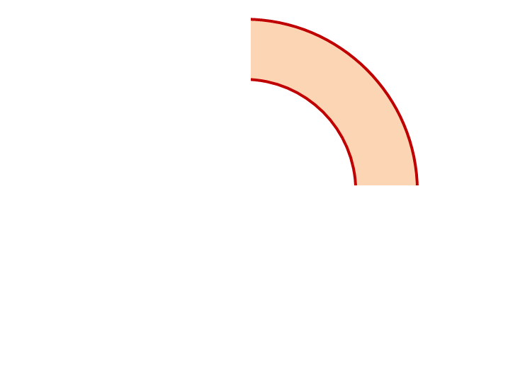
MQXFA17 Proposed Coil Arrangement
8 x δ_{midplane} = 2 π x δR_{OR}
~0.001” Undersized R
neglected
~.0025” Undersized per Midpl.
Add 0.002” shim per side
~0.0015” Undersized R
Neglected
~0.0045” Undersized per Midpl.
Add 0.005” shim per side
237
151
Q2
Q1
Q3
Q4
152
239
~0.002” Undersized R
Neglected
~0.005” Undersized per Midpl.
Add 0.005” shim per side
~.001” Undersized R
Neglected
~0.004” Undersized per midpl.
Add 0.002” + 0.002” shim per side
Coil Electrical Order: A :151 – 239 – 237 – 152: B
Conforms to a favorable order based on RRR data

Slide 14
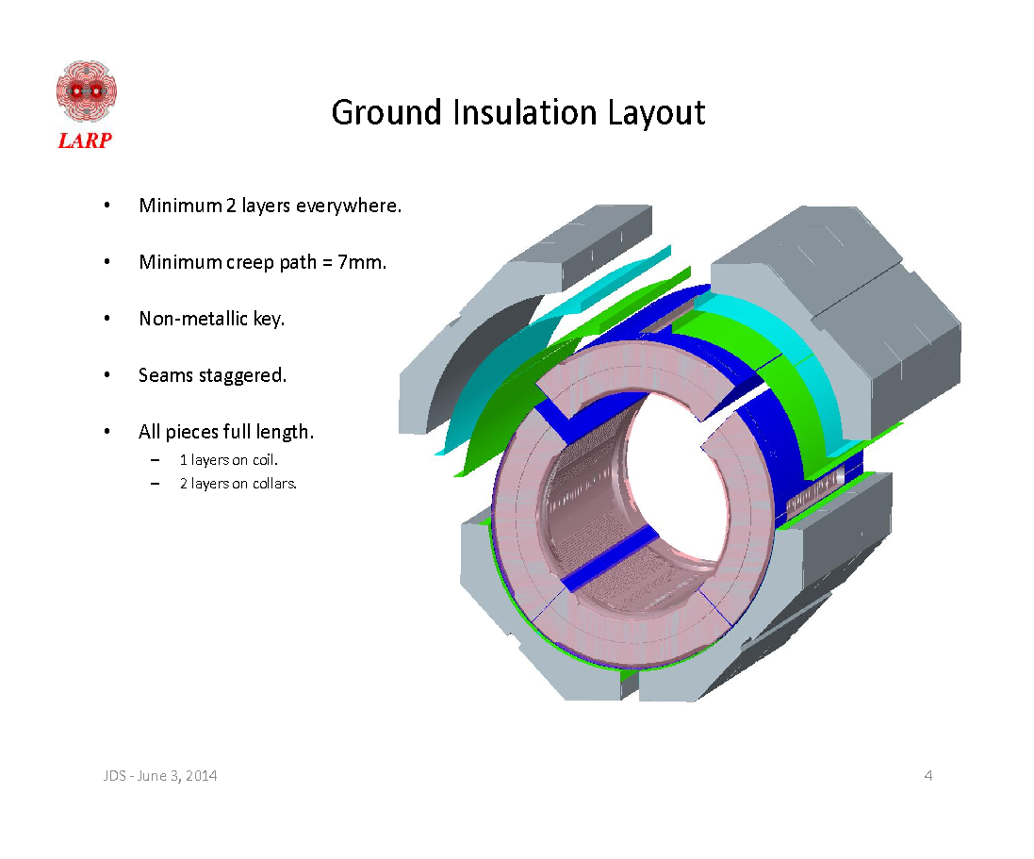
MQXFA17 Coil Pack Build 1 (Fuji)
Nominal Collar R: 114 mm
Nominal Coil R: 113.376 mm
Nominal Radial shim = 0.025” (0.624 mm)
  But we still target ~0.020”
Fuji radial stack up is ~0.021” (~0.54 mm)
  0.0045” Coil GPI + 0.007” Fuji + 0.005” Kapton & 0.005” G11
Add Kapton to various midplanes
 | 151 | 237 | 152 | 239
Kapton Ground plane insulation | 0.0045” (0.114 mm)
Coil Specific Radial Shim | 0 | 0 | 0 | 0
Coil-specific midplane shim | 0.005” 0.125 mm | 0.002” 0.05 mm | 0.005” 0.125 mm | 0.002“ + 0.002“ 0.100 mm
Fuji paper | 0.007” (0.175 mm)
Radial Shim | 0.005” Polyimide + 0.005” G11 (~0.25 mm)

Slide 15
MQXFA17 Coil Pack Build (Final)
Nominal Collar R: 114 mm
Nominal Coil R: 113.376 mm
Nominal Radial shim = 0.025” (0.624 mm)
  But we still target ~0.020”
Actual radial stack up is ~0.020” (~0.51 mm)
  0.0045” Coil GPI + 0.005” Kapton + 0.005” Kapton & 0.005” G11
Add Kapton to various midplanes
 | 151 | 237 | 152 | 239
Kapton Ground plane insulation | 0.0045” (0.114 mm)
Coil Specific Radial Shim | 0 | 0 | 0 | 0
Coil-specific midplane shim | 0.005” 0.125 mm | 0.002” 0.05 mm | 0.005” 0.125 mm | 0.002“ + 0.002“ 0.100 mm
Fuji paper | 0.000” (0.0 mm)
Radial Shim | 0.005” Polyimide + 0.005” Polyimide + 0.005” G11 (~0.38 mm)

Slide 16
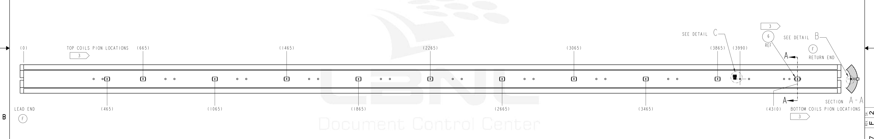
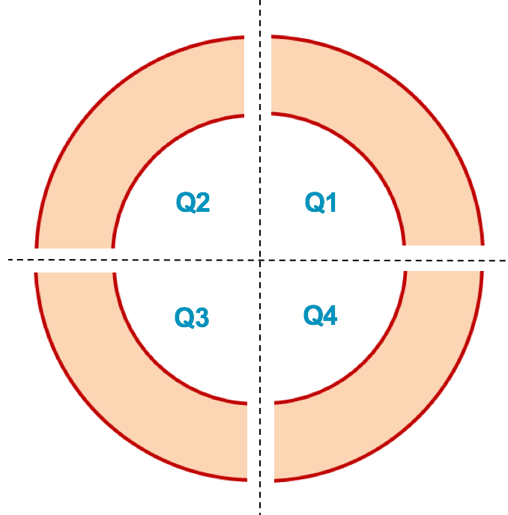
MQXFA17 Pion Machining Positions
Upper Coils, Pion thickness (mm)
Loc. | 665 | 1465 | 2265 | 3065 | 3865
151 | 1.10 | 1.18 | 1.20 | 1.12 | 1.12
237 | 1.00 | 1.16 | 1.16 | 1.15 | 1.16
1.00
1.05
1.10
Lower Coils, Pion thickness (mm)
1.15
Loc. | 465 | 1065 | 1865 | 2665 | 3465 | 4310
152 | 1.20 | 1.12 | 1.20 | 1.20 | 1.09 | 1.00
239 | 1.20 | 1.08 | 1.10 | 1.10 | 1.18 | 1.12
Upper Coils
Upper Coils
237 151
Lower Coils
Lower Coils
152 239

Slide 17
Summary
Coils 151, 152, 237, 239 chosen for the MQXFA17 magnet
  Coils 150 and 242 are smaller, remain the spares
  Midplane shimming determined to be added:
    Coil 151 will have 0.005” per side added
    Coil 152 will have 0.005” per side added
    Coil 237 will have 0.002” per side added
    Coil 239 will have 0.002” + 0.002” per side added
  Coil 151, 237 will be upper coils
    Most coils will require a number of Pions to be machined, even for the lower coils
    All coils will have FBG gauges installed since this magnet will go straight to FNAL for cold mass
Coil circuit order is 151-239-237-152
  Conforms to a favorable order based on RRR data

Slide 18
Additional Slides

