Slide 1


MQXFA17 Structure and Status
Dan Cheng, for the AUP team
18-Oct-2023
LBNL

Slide 2
MQXFA16 Structure Assembly
Coil Pack Assembly Plans
Applying Lessons Learned
Status and Summary

Slide 3
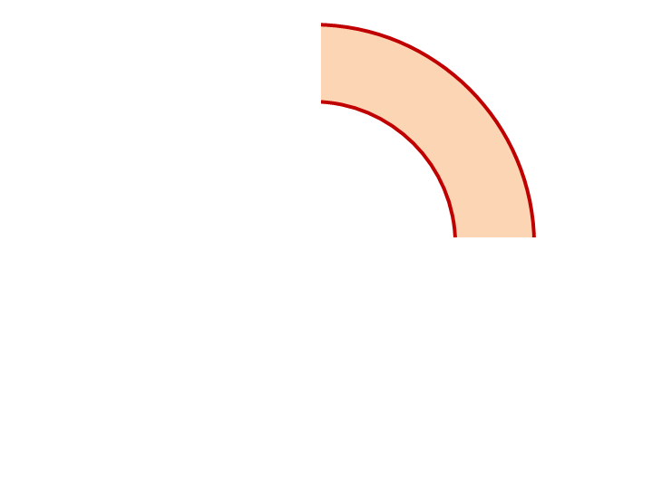
MQXFA17 Proposed Coil Arrangement
8 x δ_{midplane} = 2 π x δR_{OR}
~0.001” Undersized R
neglected
~.0025” Undersized per Midpl.
Add 0.002” shim per side
~0.0015” Undersized R
Neglected
~0.0045” Undersized per Midpl.
Add 0.005” shim per side
237
151
Q2
Q1
Q3
Q4
152
239
~0.002” Undersized R
Neglected
~0.005” Undersized per Midpl.
Add 0.005” shim per side
~.001” Undersized R
Neglected
~0.004” Undersized per midpl.
Add 0.002” + 0.002” shim per side
Coil Electrical Order: A :151 – 239 – 237 – 152: B
Conforms to a favorable order based on RRR data

Slide 4
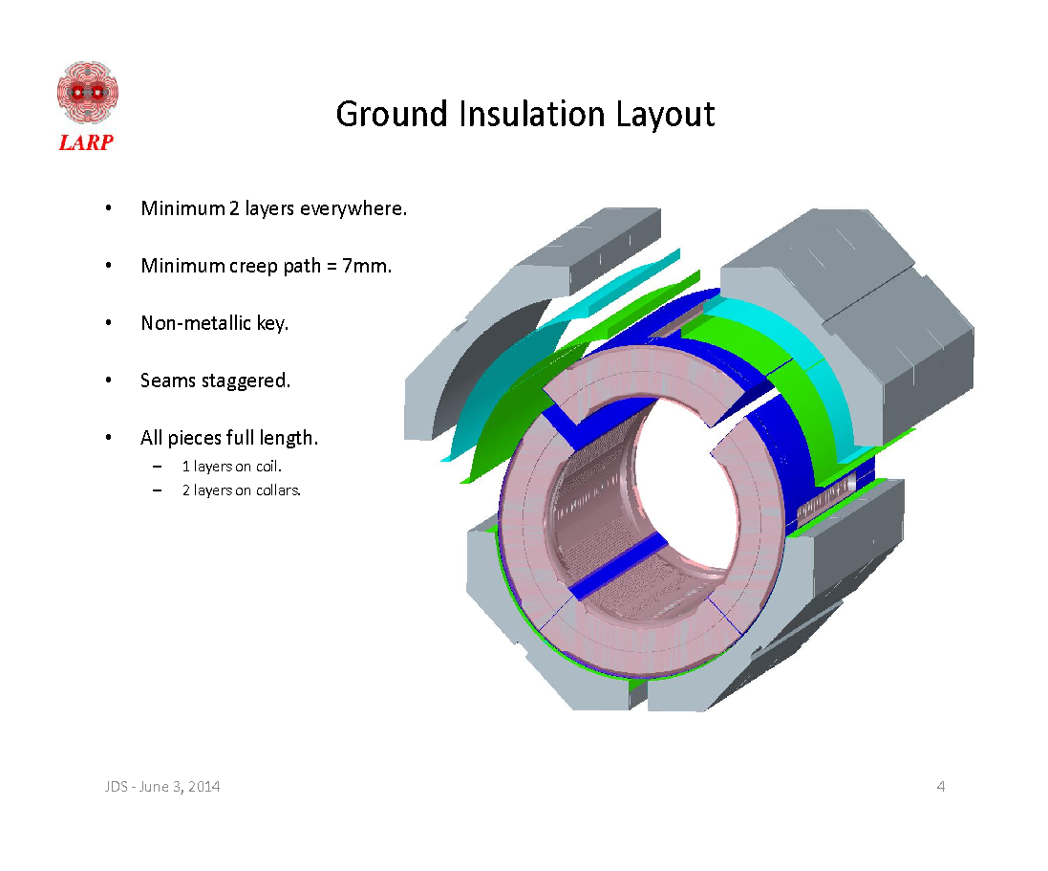
MQXFA17 Coil Pack Build 1 (Fuji)
Nominal Collar R: 114 mm
Nominal Coil R: 113.376 mm
Nominal Radial shim = 0.025” (0.624 mm)
  But we still target ~0.020”
Fuji radial stack up is ~0.021” (~0.54 mm)
  0.0045” Coil GPI + 0.007” Fuji + 0.005” Kapton & 0.005” G11
Add Kapton to various midplanes
 | 151 | 237 | 152 | 239
Kapton Ground plane insulation | 0.0045” (0.114 mm)
Coil Specific Radial Shim | 0 | 0 | 0 | 0
Coil-specific midplane shim | 0.005” 0.125 mm | 0.002” 0.05 mm | 0.005” 0.125 mm | 0.002“ + 0.002“ 0.100 mm
Fuji paper | 0.007” (0.175 mm)
Radial Shim | 0.005” Polyimide + 0.005” G11 (~0.25 mm)

Slide 5
MQXFA17 Coil Pack Build (Final)
Nominal Collar R: 114 mm
Nominal Coil R: 113.376 mm
Nominal Radial shim = 0.025” (0.624 mm)
  But we still target ~0.020”
Actual radial stack up is ~0.020” (~0.51 mm)
  0.0045” Coil GPI + 0.005” Kapton + 0.005” Kapton & 0.005” G11
Add Kapton to various midplanes
 | 151 | 237 | 152 | 239
Kapton Ground plane insulation | 0.0045” (0.114 mm)
Coil Specific Radial Shim | 0 | 0 | 0 | 0
Coil-specific midplane shim | 0.005” 0.125 mm | 0.002” 0.05 mm | 0.005” 0.125 mm | 0.002“ + 0.002“ 0.100 mm
Fuji paper | 0.000” (0.0 mm)
Radial Shim | 0.005” Polyimide + 0.005” Polyimide + 0.005” G11 (~0.38 mm)

Slide 6
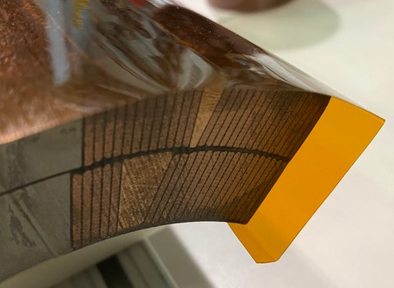
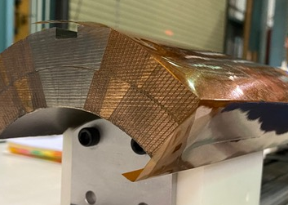
Fuji Assembly Notes (1)
GPI Layers will have ID fold
  Process was developed and incorporated into MQXFA07 and later coils
Preventing a repeat of the MQXFA09 NCR:
  Fuji build will have Kapton tape holding fold down on the ID
  Final build will use Araldite spots of glue with tape removed
  Inspection step after the upper coil pair is placed on top of bottom coil pair will verify no foldback condition is present

Slide 7
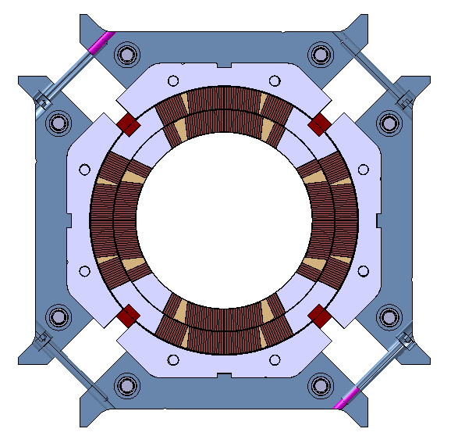
Fuji Assembly Notes (2)
Based on MQXFA12 size and gap size with respect to the 75 in-lbs. torque vs. 125 in-lbs. torque:
  Mechanical measurements show ~0.006” on coil pack size difference
  Equates to ~ 0.001” pole key gap difference, per side
Large gaps
Large gaps
Q2
Q1
Q3
Q4
Small gaps
Small gaps
Depiction not to scale

Slide 8
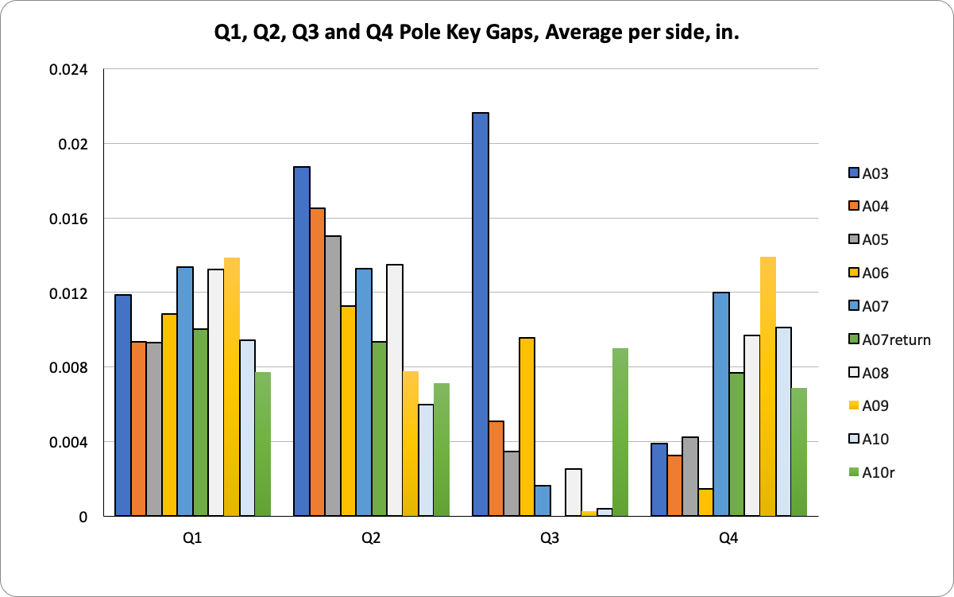
Final Coil Pack Assembly Notes
Lessons learned from MQXFA07 disassembly and MQXFA10 rebuild
  A revised process for squaring and torqueing the Coil Pack was developed
  Greater emphasis on squareness and gap uniformity throughout the entire torqueing process
  Torque target is 75 +/- 25 in-lbs., depending on gaps
  Iterative measurements throughout build will ensure and verify that the gaps and coil pack squareness specifications are met
Uniform gaps
Q2
Q1
Q3
Q4
Improved squareness
See next slide

Slide 9
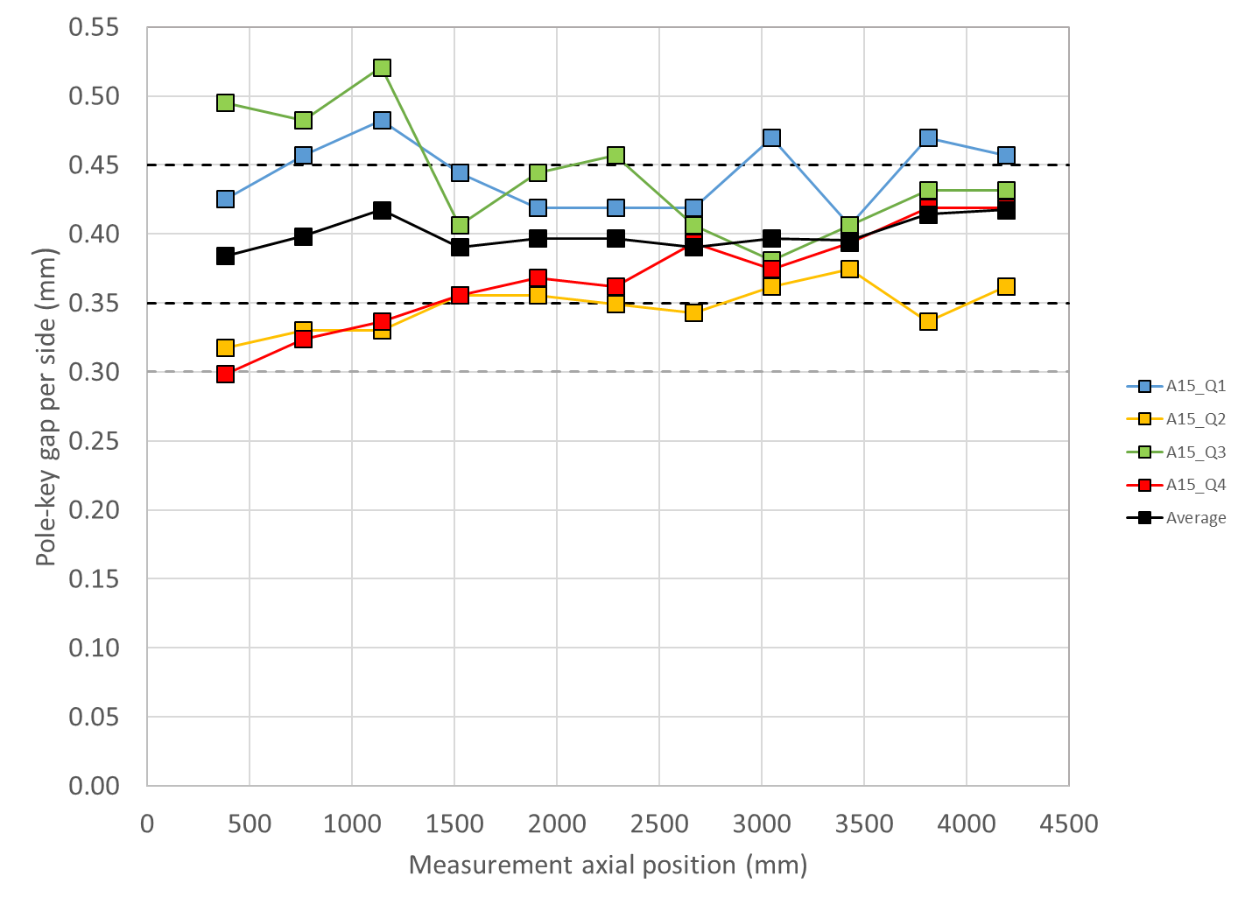
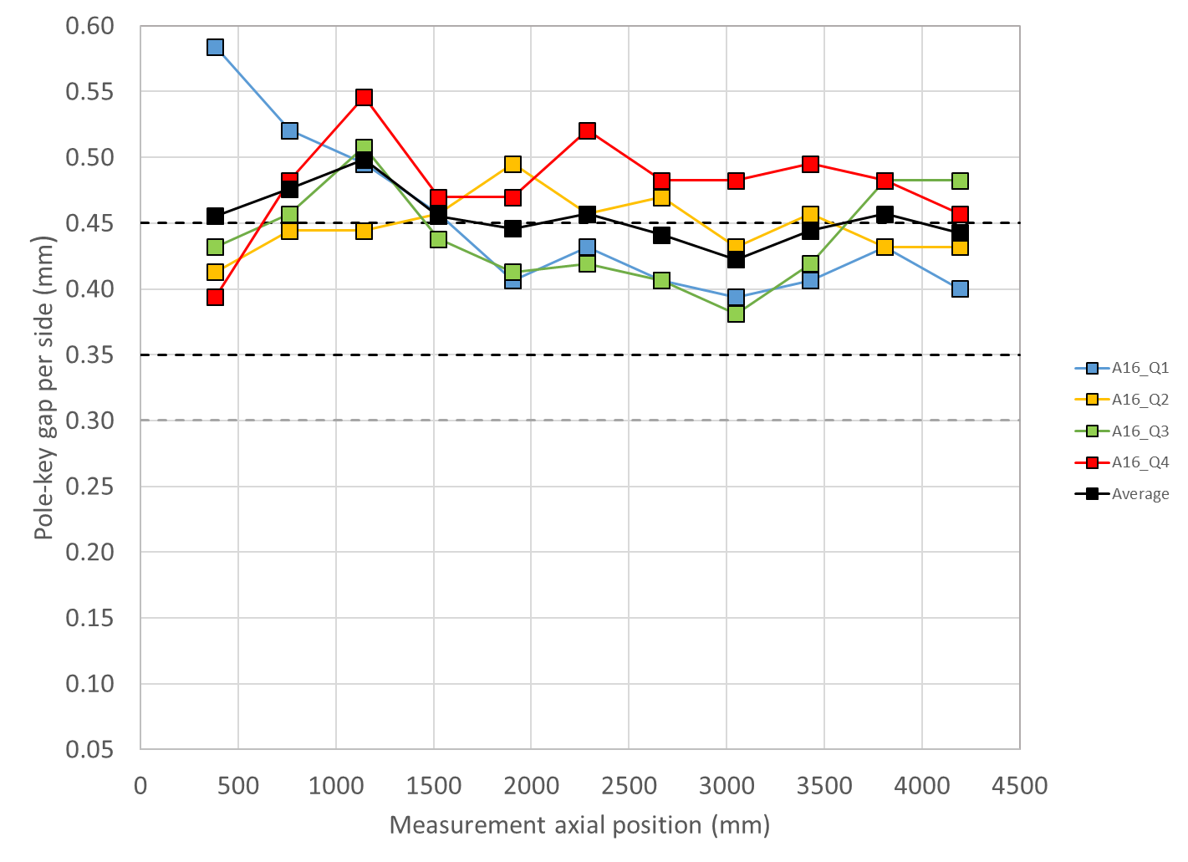
MQXFA15 and A16 Gap Measurements
Updated Specification wording in Doc DB 4009
For the pole key gap:
  The average pole key gap (per side) among the four coils on each longitudinal location shall be +0.400 ±0.050 mm.
  The minimum pole key gap (per side) in any quadrant and in any longitudinal location shall be > +0.300 mm.
MQXFA15
MQXFA16

Slide 10
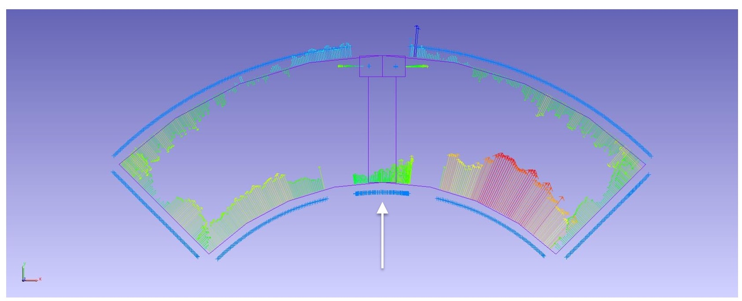
Pion Machining, Details
Used “average” values as starting point
  Measurements based on best-fit of combined Outer Radius and Midplane deviations
Positive deviations = extra material in bore
  This is what needs to be removed from a nominal 1.2 mm thick pion
Negative deviations will not require “addition” of material
  Nothing will be done to these pions
For MQXFA16 many pions need to be modified

Slide 11
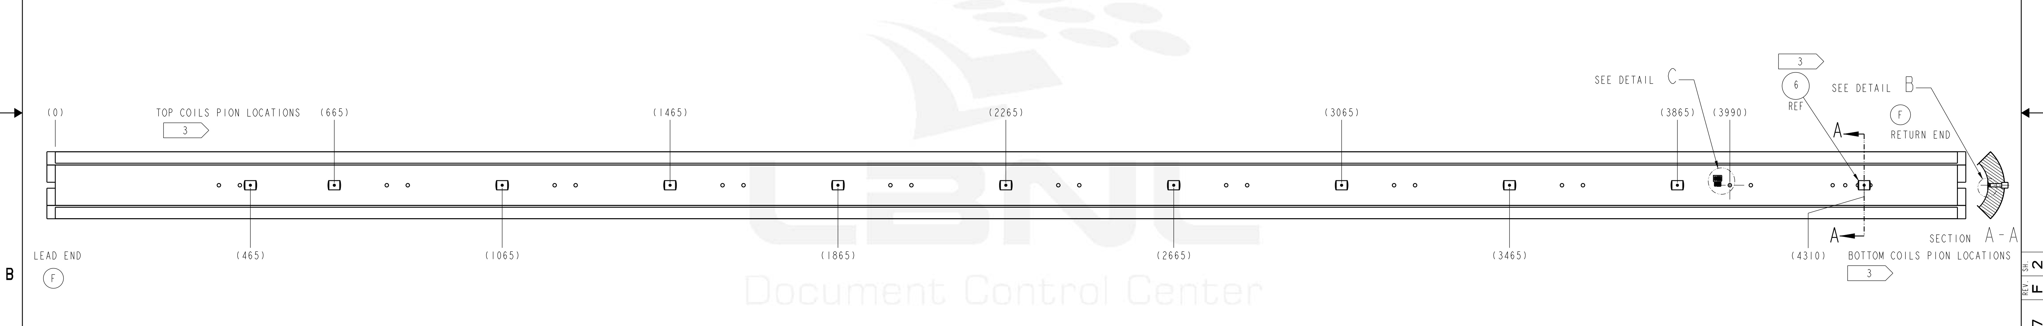
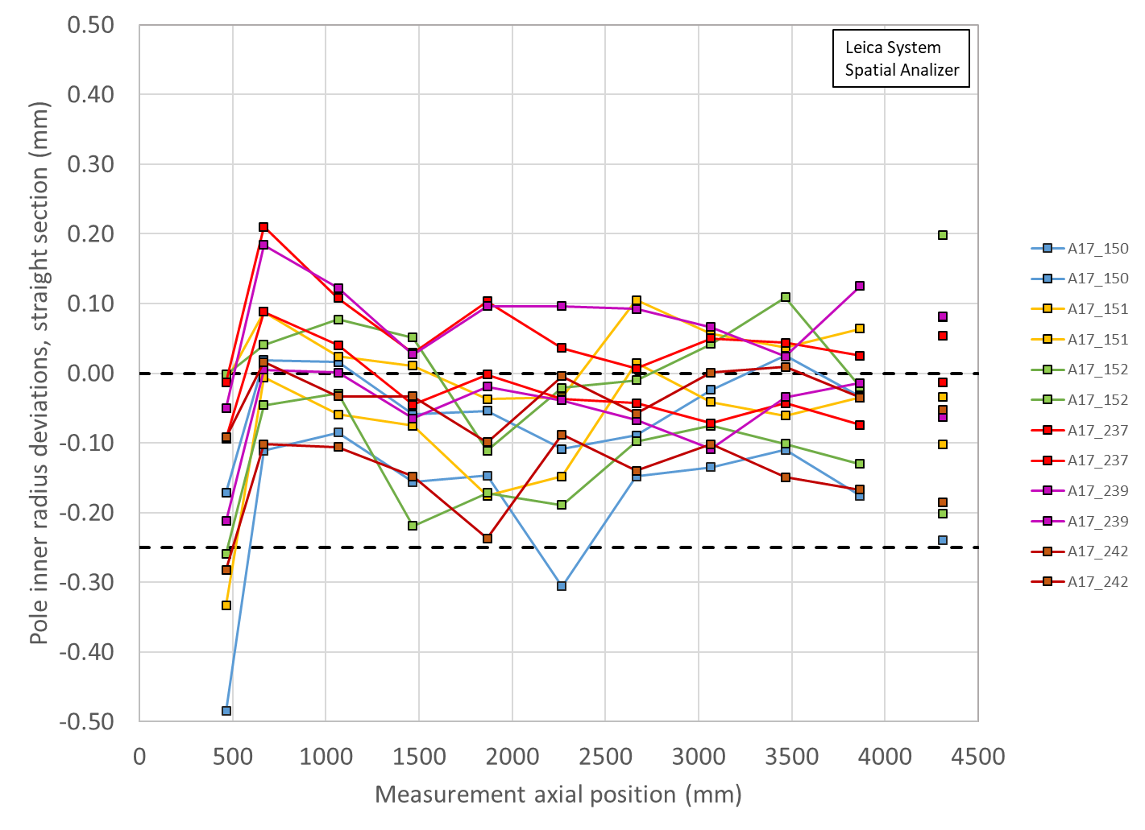
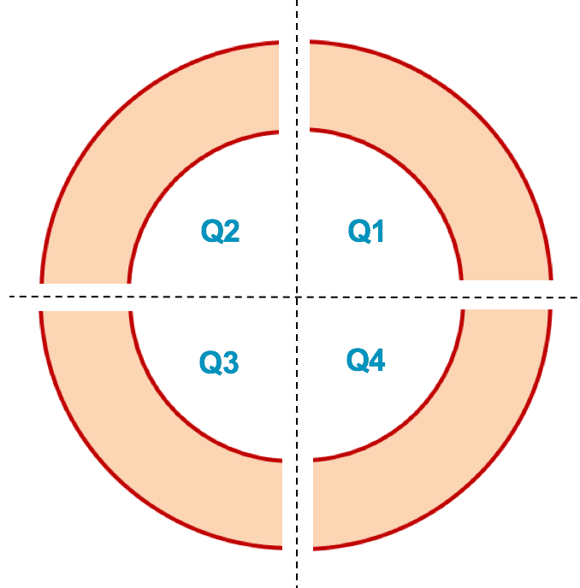
MQXFA17 Pion Machining Positions
Upper Coils, Pion thickness (mm)
Loc. | 665 | 1465 | 2265 | 3065 | 3865
151 | 1.10 | 1.18 | 1.20 | 1.12 | 1.12
237 | 1.00 | 1.16 | 1.16 | 1.15 | 1.16
1.00
1.05
1.10
Lower Coils, Pion thickness (mm)
1.15
Loc. | 465 | 1065 | 1865 | 2665 | 3465 | 4310
152 | 1.20 | 1.12 | 1.20 | 1.20 | 1.09 | 1.00
239 | 1.20 | 1.08 | 1.10 | 1.10 | 1.18 | 1.12
Upper Coils
Upper Coils
237 151
Lower Coils
Lower Coils
152 239

Slide 12
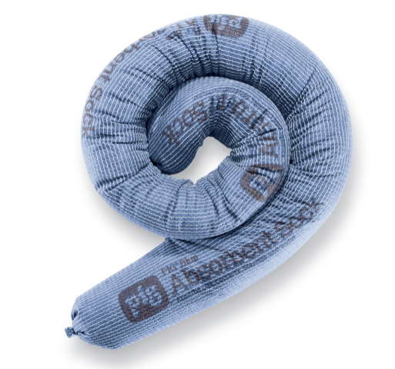
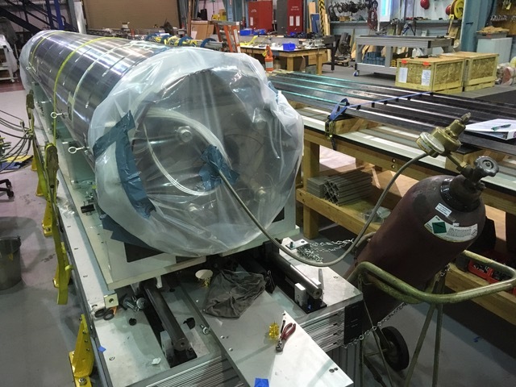
Avoiding Electrical Issues
Updated procedures first used in magnet MQXFA05 will continue to be used
  Avoiding water in the system due to bladder failures
    Absorbent socks in cooling holes to better dam and prevent pooling of water
      Leaves dust, did not prove to protect from significant rust, as observed from MQXFA08 (50% bladder failures…)
    Dehumidifiers on hand during bladder operations to bag and flow immediately after operations are complete
    Increase load key step sizes to 0.005” (reduces the number of bladder cycles)
3” dia. absorbent sock

Slide 13
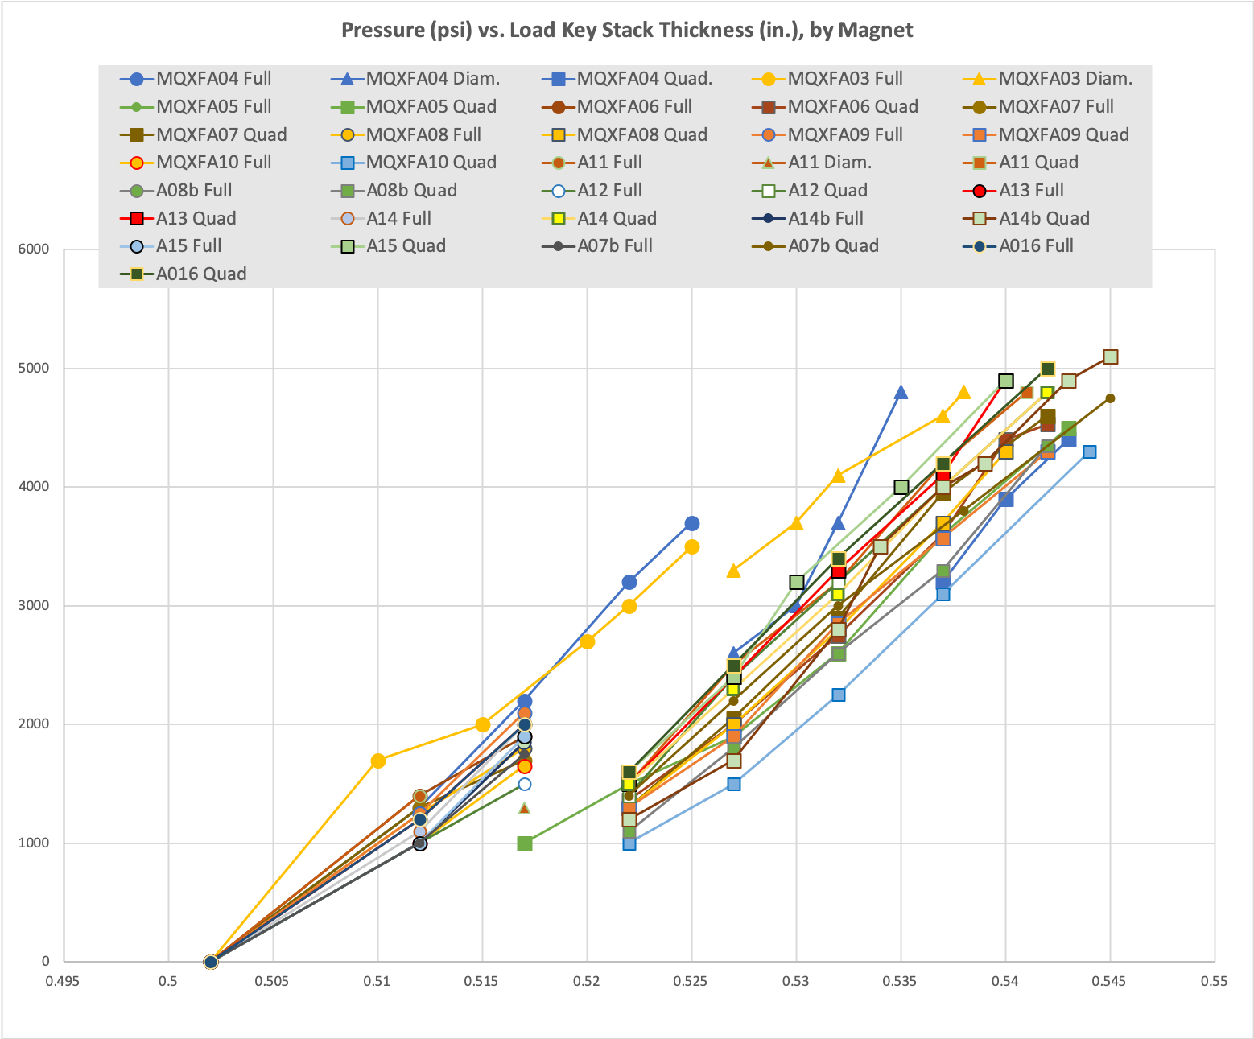
Reducing Bladder Cycles
Based on the bladder failure/load key incident experienced in MQXFA04 we successfully introduced procedural changes starting with MQXFA05
Magnet preload operations will continue to implement the following:
  A pressure check at the beginning of operations
  A “stable hold” at target pressures
  Fewer pressure cycles by using 0.005” thick shim steps (about 8 steps expected)
  Spare keys on hand to replace as needed, and/or second set of keys ready to replace
50% Azimuthal load
Starting with MQXFA06 an additional 0.005” step was added using all bladders before transitioning to quadrant loading.

Slide 14
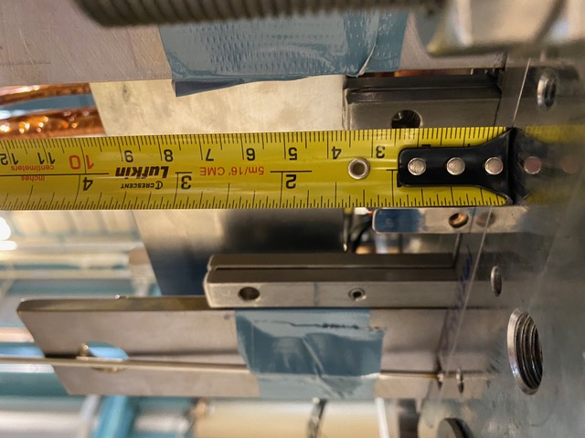
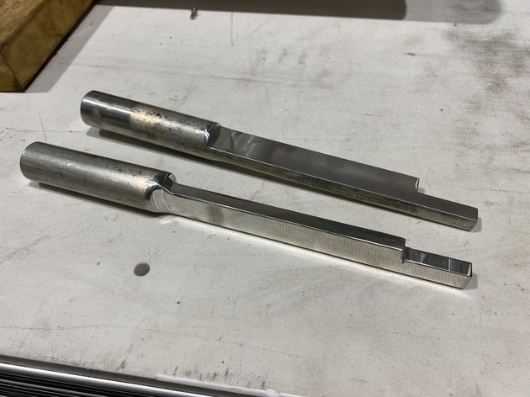
Lessons Learned (MQXFA08b Load Key NCR)
NCR #381 in MQXFA08b
  One load key was sticking out of bottom by ~1.75”
  The tooling used to push the key in (to proper length) hit something, and the key was not visually verified prior to releasing pressure
Lessons Learned to be applied:
  Modified tooling
  New visual checks, especially on bottom where it takes more effort to see
  WI will be updated with these instructions
This section was narrowed for better clearance between preload tooling and components

Slide 15
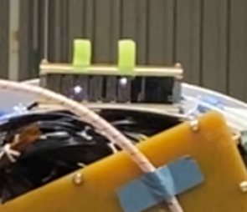
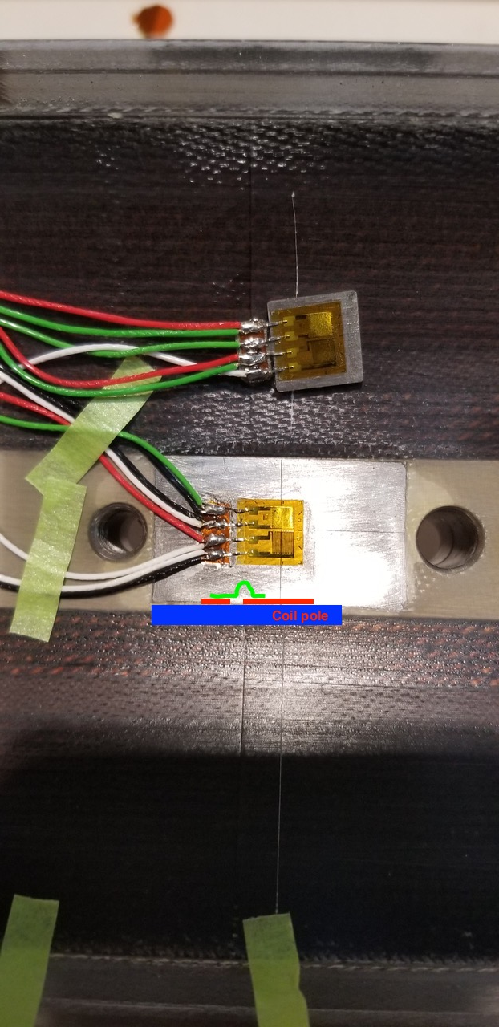
Strain Gauges and Hipot
MQXFA12 revealed potential weakness of SG to coil pole, if pins are incorrectly placed
  If the Coil pole charges up, high voltage between SG wiring and ground can occur
MQXFA13 & MQXFA14
  SGs were disconnected after preload prior to EQC
  All SG connector signals will be verified prior to post-preload EQC is performed
Recent MQXFA Strain gauges controls:
  Test pieces were tested to verify bonding and protection; protections were inconsistent, often installation dependent
SGs have been disconnected after preload and not used for testing
Shells and Rods can still be present
  Would need to study this data from prior magnets to understand ability to interpret mechanical behavior, if possible

Slide 16
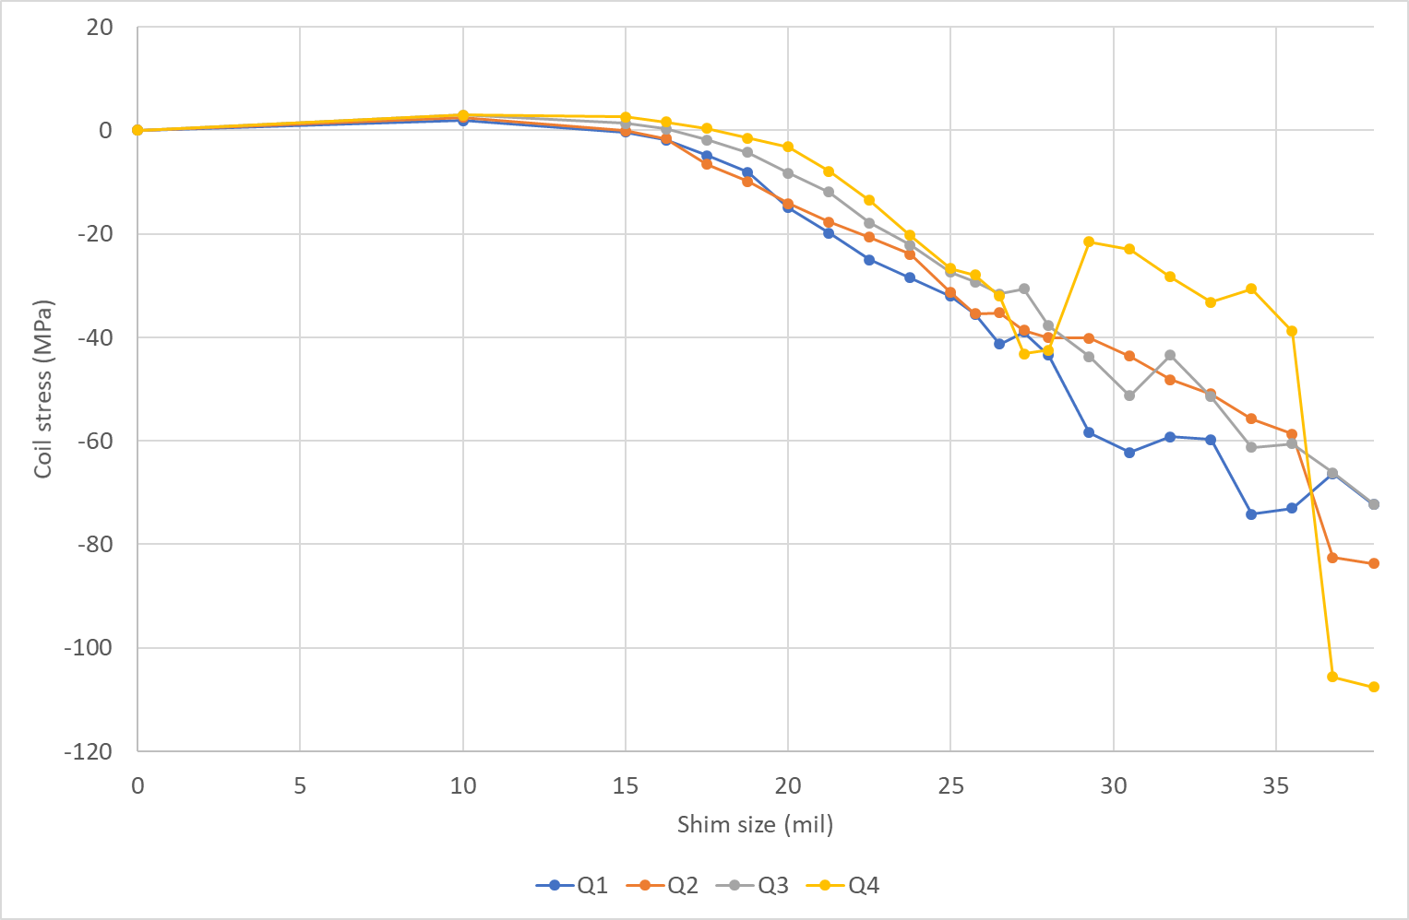
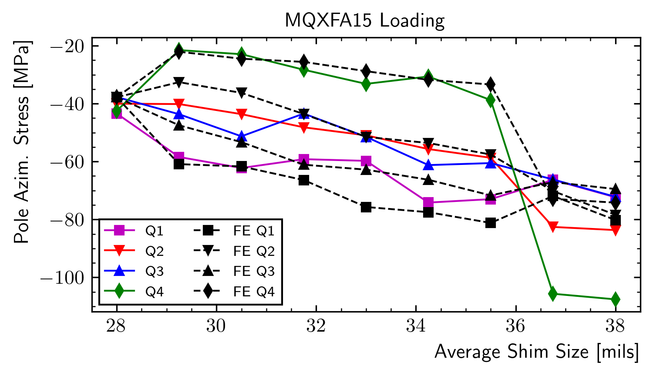
Lessons from “theoretical” MQXFA15 asymmetric shimming
MQXFA15 Preload experienced uniform loading until the 0.033” shim step
  Q4 coil experienced significant loss of compression; Q1 experienced significant increase of compression
  Final state ended with Q4 highly compressed
  Subsequent FEA modeled asymmetric shimming (slides at https://indico.fnal.gov/event/59997/ ) exhibited similar behavior, but did not fully replicate observations
Preload operations with key shim stacks will be verified prior to insertion and swap

Slide 17
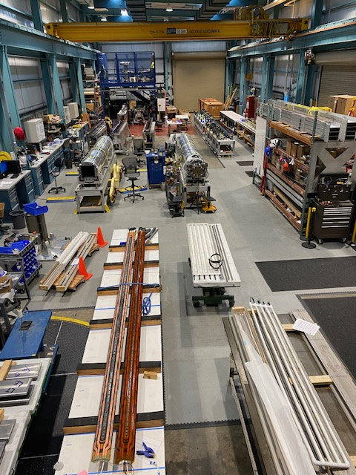
MQXFA17 Structure Status
MQXFA15
  In the process of having preload increased
  Will ship in November
MQXFA17
  Pad-collar assemblies are complete
  Shell-yoke assemblies are complete
  No significant issues found
  Dressed coil operations completed
  Fuji coil pack built and exposed
  ~Late November completion; ship in December before holidays
MQXFA17
MQXFA15
Spare coils

Slide 18
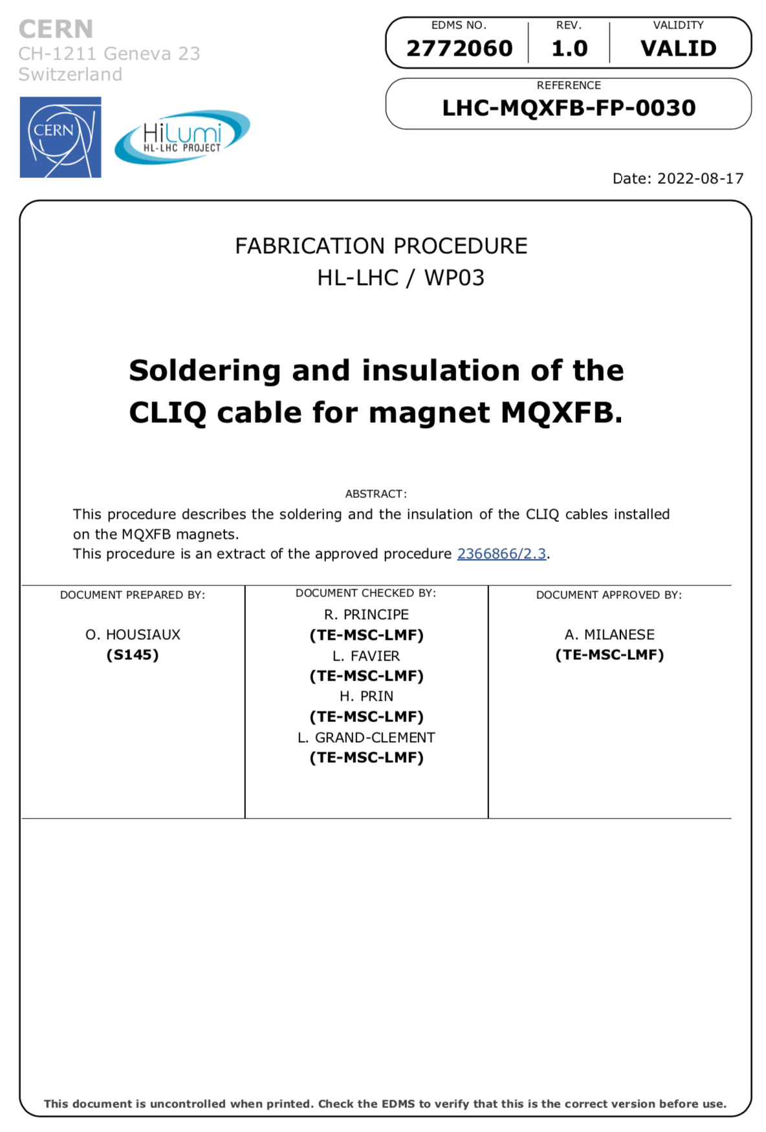
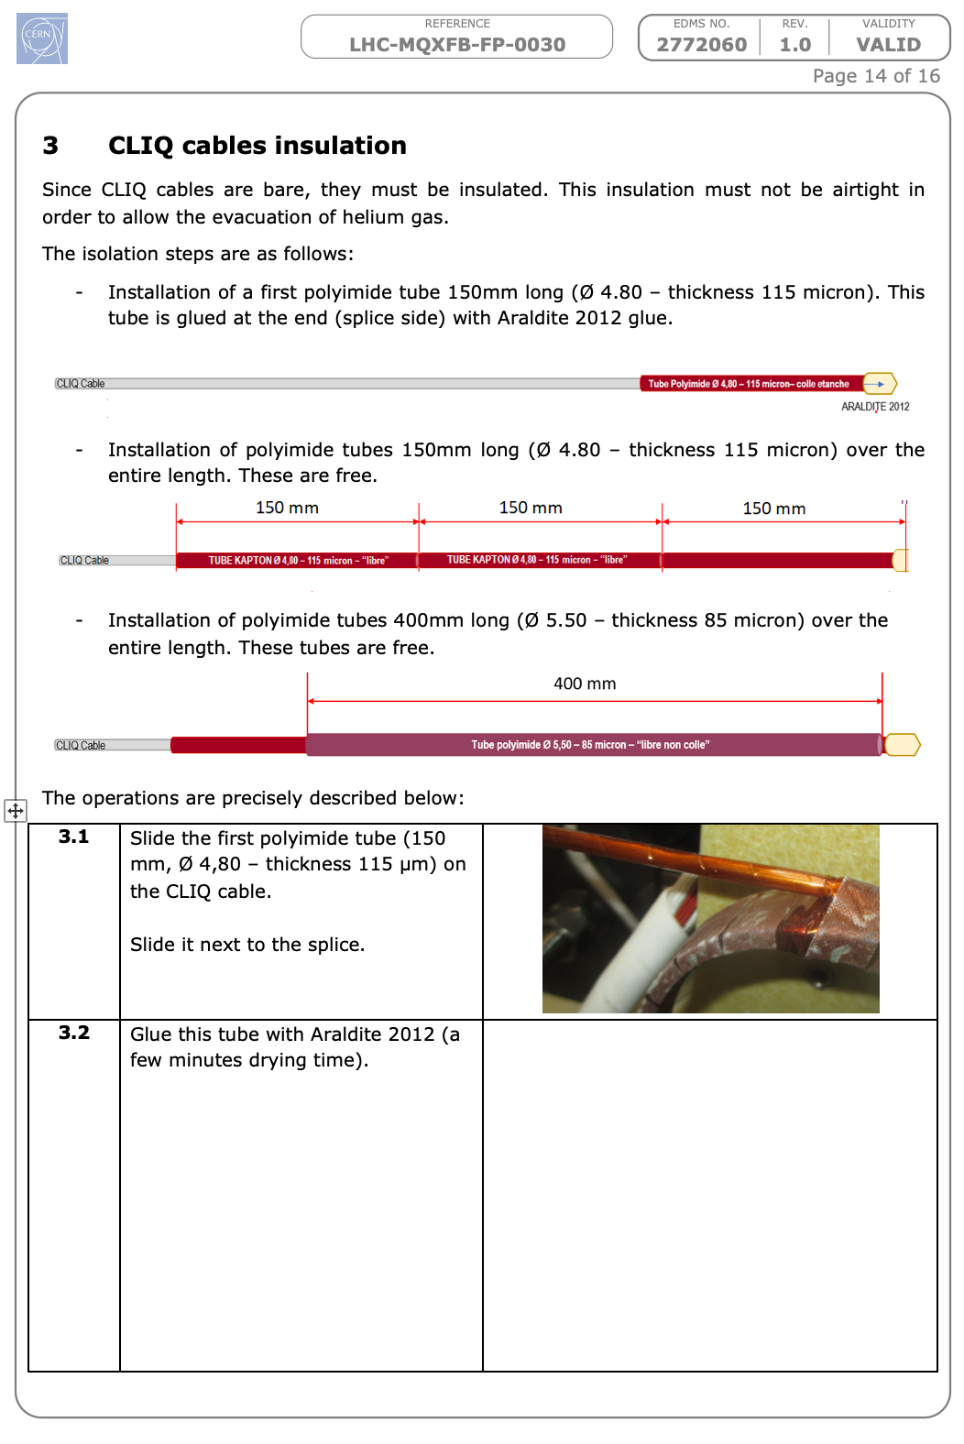
MQXFA17 Structure Status (2)
MQXFA17 uses the new CLIQ lead design
  Implemented in MQXFA13 for first shipped magnet

Slide 19
Summary
MQXFA17 structural parts are being prepared
  Rods are being instrumented
Lessons learned from recent magnets are being applied to build this magnet
  What was learned from MQXFA07 and MQXFA10 re-squaring (and rebuild of A10, A11, and A08b and subsequent magnet builds) of the coil pack will also be applied
  MQXFA08b key insertion has been addressed
  MQXFA12 SG hipot issue has been addressed; removing connector blocks from skirts prior to final EQC
  Possible MQXFA15 asymmetric shimming has been addressed
Pion locations were identified that require modification in all coils
MQXFA17 is expected to ship in December 2023

Slide 20
Additional Slides

