Slide 1


Magnet Fabrication Travelers, Non-Conformities and Resolution
Jennifer Doyle, Katherine Ray, Mike Solis
October 18, 2023 – MQXFA17 Structure and Loading Review

Slide 2
Overview
State of the Magnet Fabrication Travelers
Structural Components
  Shell
  Yoke laminations and stacks
  Master keys
  Load pad laminations and stacks
  Collar laminations
Assembly
Non-Conformances on MQXFA17

Slide 3
Magnet Fabrication Travelers Overview
# | Title | Revision | ID
1 | Coil Acceptance WI | C | SU-1011-5294
2 | Coil CMM WI | A | SU-1012-3958
3 | Yoke Pre-Stack WI | C | SU-1008-8072
4 | Yoke Half Stack WI | H | SU-1009-7829
5 | Shell Instrumentation WI | H | SU-1009-3745
6 | Shell-Yoke Assy WI | F | SU-1008-2169
7 | Loadpad Pre-Stack WI | B | SU-1008-8075
8 | Dressed Coil WI | M | SU-1008-8073
9 | Pad-Collar Assy WI | H | SU-1010-1610
10 | Coil Pack Subassy WI | H | SU-1008-8074
11 | Magnet Electrical QA at LBNL | L | SU-1010-1903
12 | Magnetic Measurements | C | SU-1010-2018
13 | Integration and Loading WI | K | SU-1011-5637
14 | Axial Rods Instrumented WI | F | SU-1008-8069
15 | Connectors and Finishing WI | D | SU-1012-5517
16 | Splice Box WI | G | SU-1008-8067
17 | Magnet Shipping WI | F | SU-1011-3284
18 | Disassembly WI | B | SU-1013-8309

Slide 4
Magnet Fabrication Travelers Overview
# | Title | Revision | ID
1 | Coil Acceptance WI | C | SU-1011-5294
2 | Coil CMM WI | A | SU-1012-3958
3 | Yoke Pre-Stack WI | C | SU-1008-8072
4 | Yoke Half Stack WI | H | SU-1009-7829
5 | Shell Instrumentation WI | H | SU-1009-3745
6 | Shell-Yoke Assy WI | F | SU-1008-2169
7 | Loadpad Pre-Stack WI | B | SU-1008-8075
8 | Dressed Coil WI | M | SU-1008-8073
9 | Pad-Collar Assy WI | H | SU-1010-1610
10 | Coil Pack Subassy WI | H | SU-1008-8074
11 | Magnet Electrical QA at LBNL | L | SU-1010-1903
12 | Magnetic Measurements | C | SU-1010-2018
13 | Integration and Loading WI | K | SU-1011-5637
14 | Axial Rods Instrumented WI | F | SU-1008-8069
15 | Connectors and Finishing WI | D | SU-1012-5517
16 | Splice Box WI | G | SU-1008-8067
17 | Magnet Shipping WI | F | SU-1011-3284
18 | Disassembly WI | B | SU-1013-8309
We continue to update the travelers based on lessons learned.

Slide 5
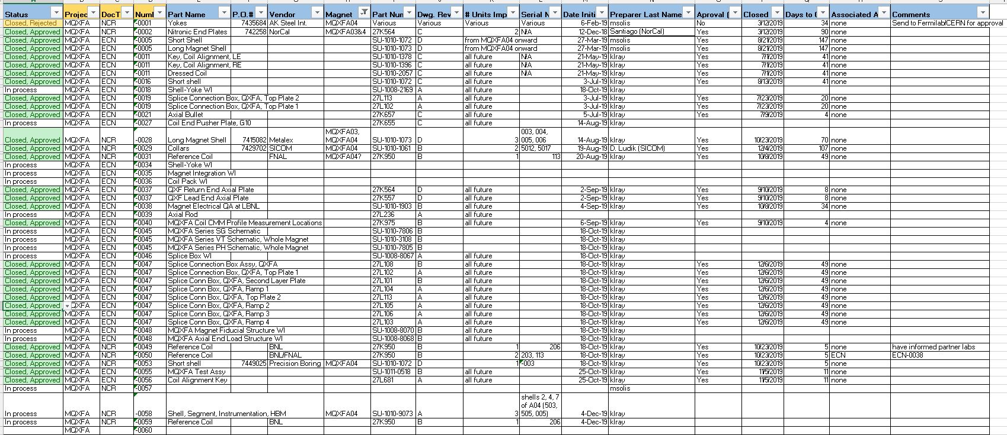
Change Records
We are tracking Non-Conformances, Deviations and Engineering Changes in one spreadsheet
These are currently communicated to Fermilab L2 on a monthly basis

Slide 6
Parts to be used on MQXFA17
The following parts will be used:
Coils:
  151, 152, 237, 239
 | PO #
Shells | 7532732
Yokes | 7541806
Master Keys | 7580728
Load Pads | 7545358
Collars | 7532712
Axial Rods | 7603412

Slide 7
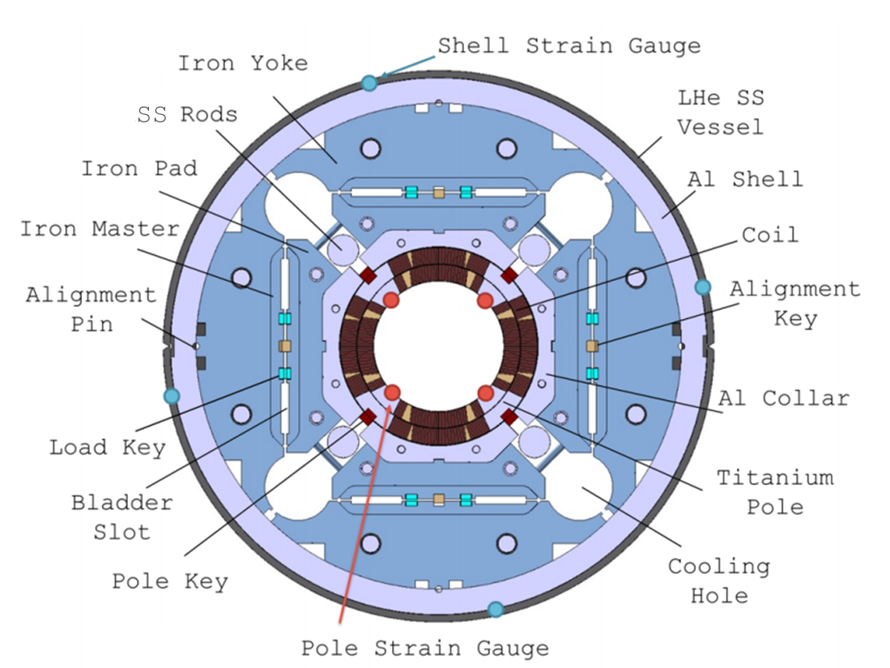
Introduction

Slide 8
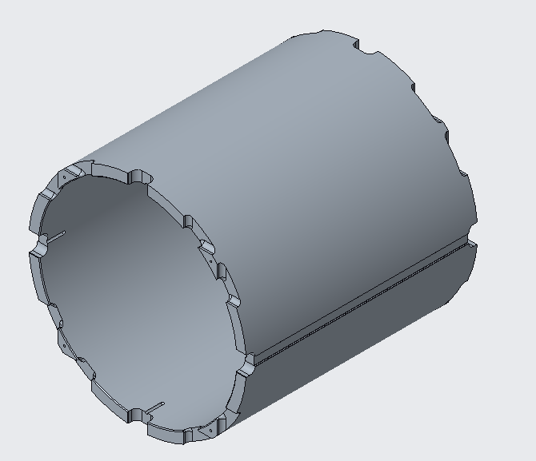
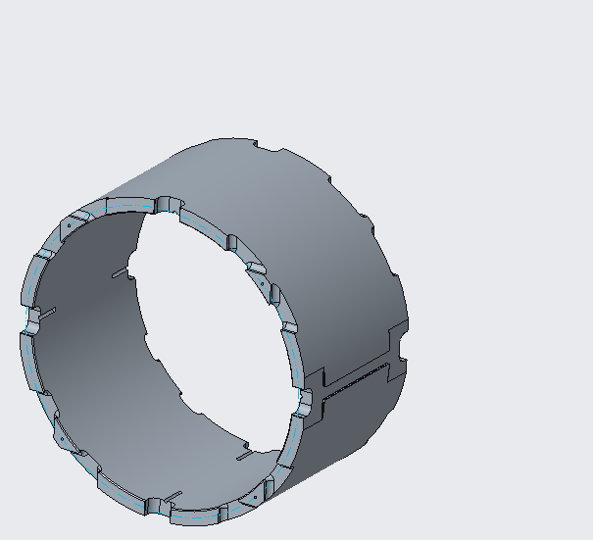
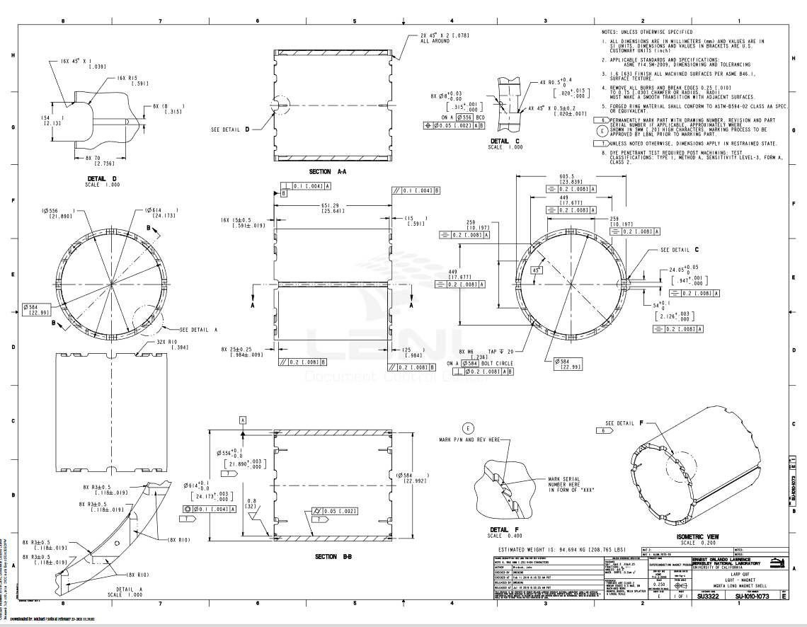
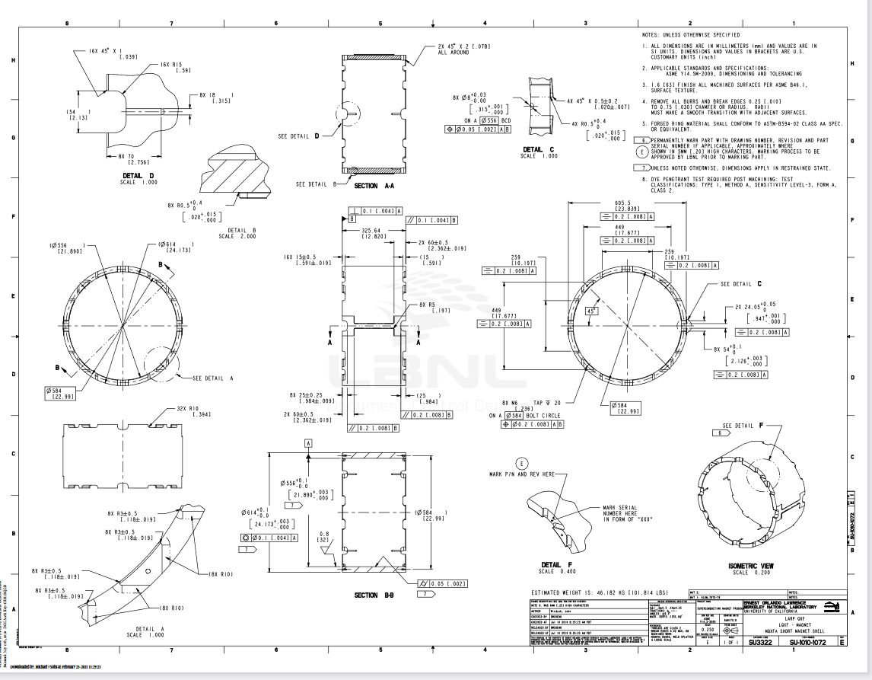
Shell
Long Shell: SU-1010-1073
Short Shell: SU-1010-1072

Slide 9
Shell
For the shell ID and OD, the following specifications are set:
The shell ID at 5 evenly spaced rings shall have an average diameter of 556 mm +0.1/-0.0
The shell OD at 5 evenly spaced rings shall have an average diameter of 614 mm +0.1/-0.0
PO 7532732 approved
  NCR -0151

Slide 10
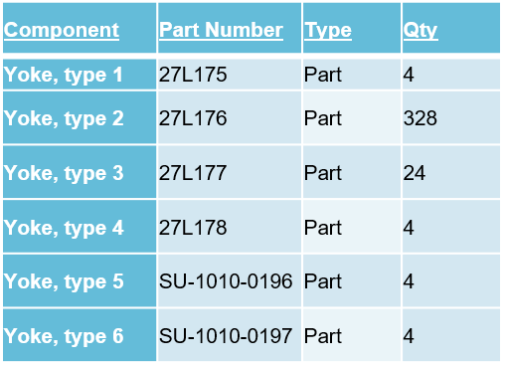
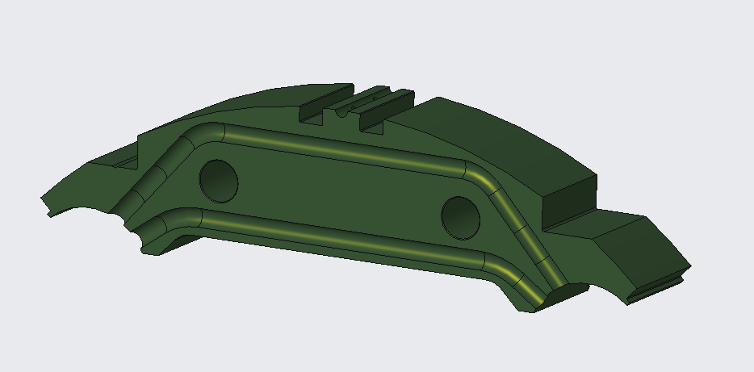
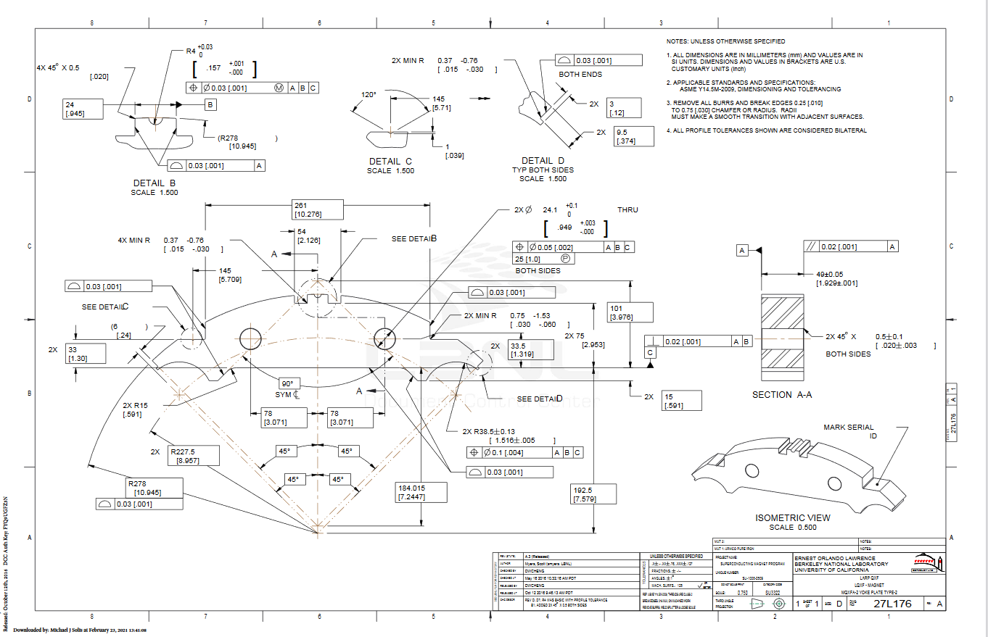
Yoke Laminations and Stacks

Slide 11
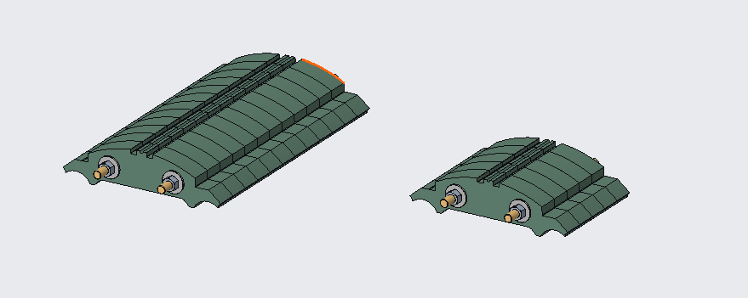
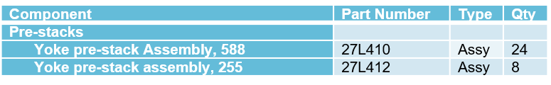
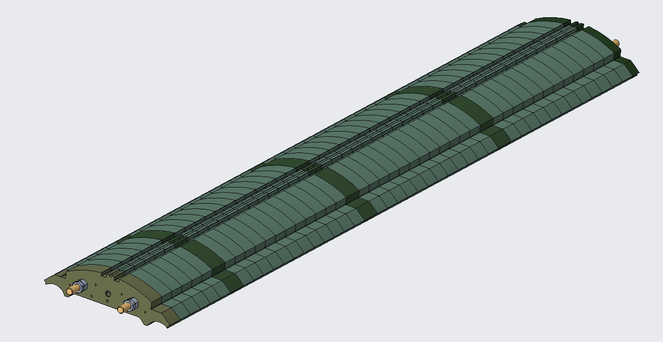
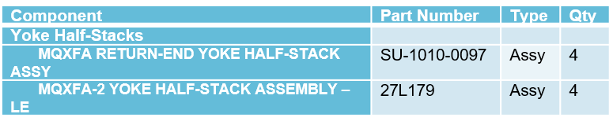
Yoke Laminations and Stacks

Slide 12
Yoke Laminations and Stacks
For the yoke outer radius, the following specifications are set:
The yoke radial profile shall maintain a 0.03 [.001”] tolerance.
For the yoke master key interface, the following specifications are set:
The yoke master key interface profile shall maintain a 0.03 [.001”] tolerance.
For the yoke pre-stacks, the following specifications are set:
588 mm Pre-stacks width shall be 588 mm +/- 0.13 with a Parallelism of 0.03 [.001”]
245 mm Pre-stacks width shall be 245 mm +/- 0.13 with a Parallelism of 0.03 [.001”]
For the yoke half-stacks, the following specifications are set:
Yoke half-stacks width shall be 2281.5 mm +/- 0.25 with a Parallelism of 0.05
PO 7541806 approved
  NCR -0241

Slide 13
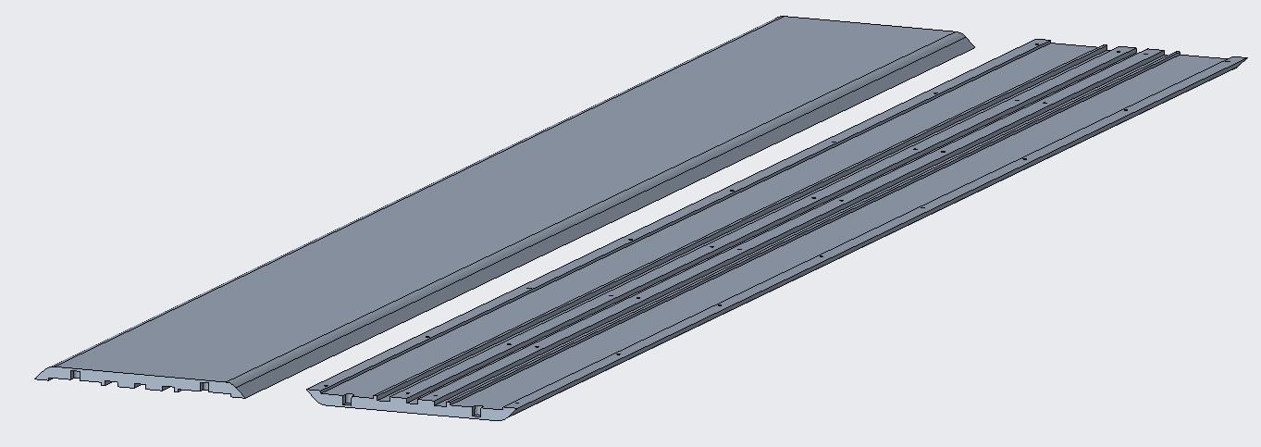
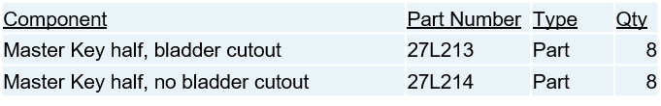
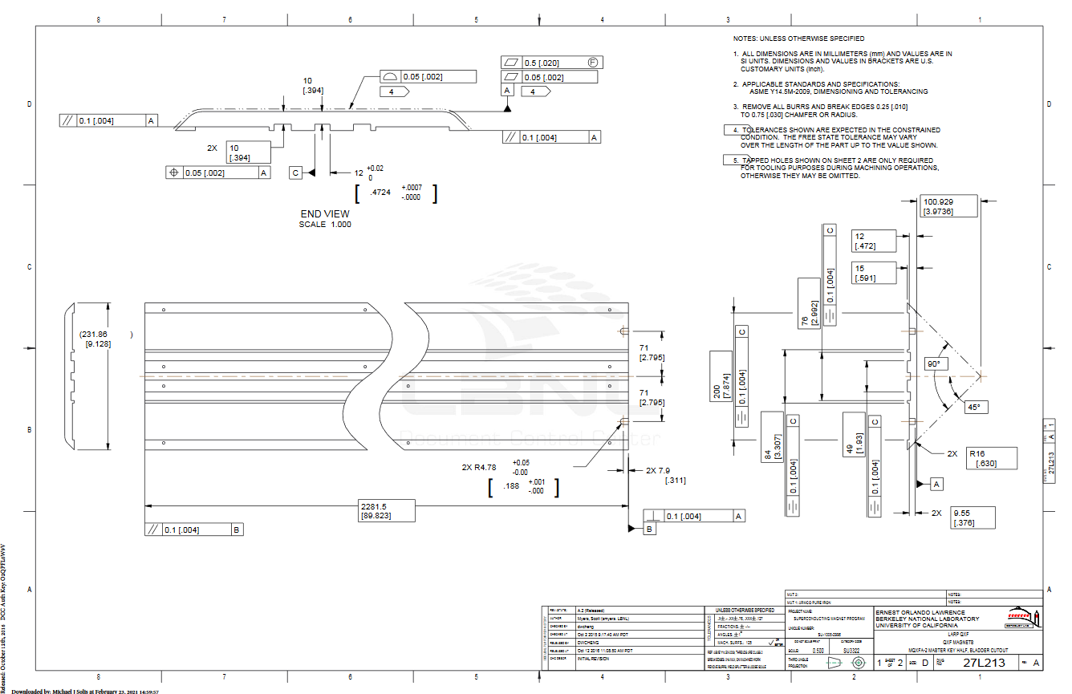
Master Keys

Slide 14
Master Keys
For the master key outer profile, the following specifications are set:
The master key outer profile scan shall maintain a .05 [.002”] tolerance.
PO 7580728 approved
  No NCRs

Slide 15
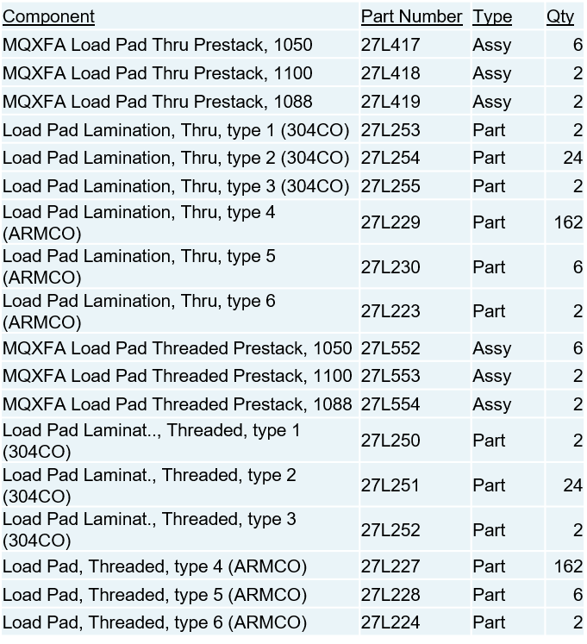
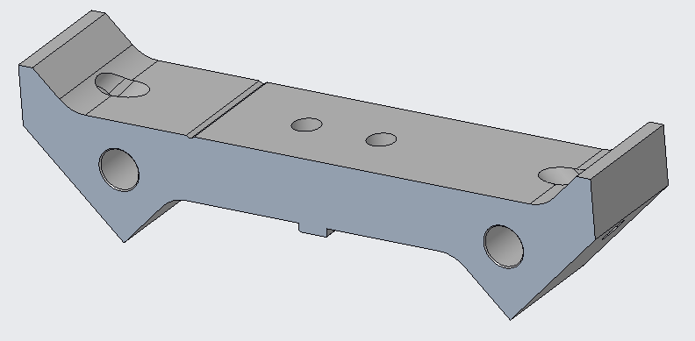
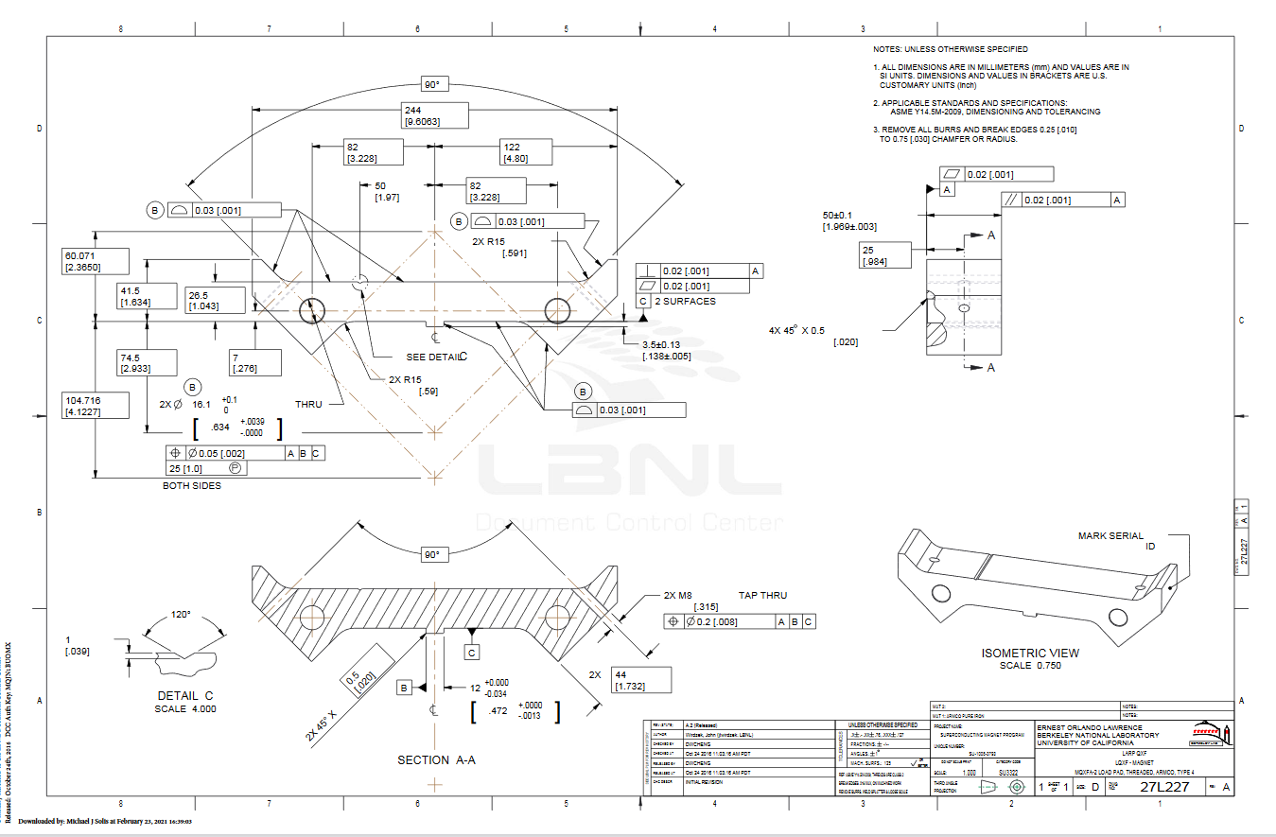
Load Pad Laminations

Slide 16
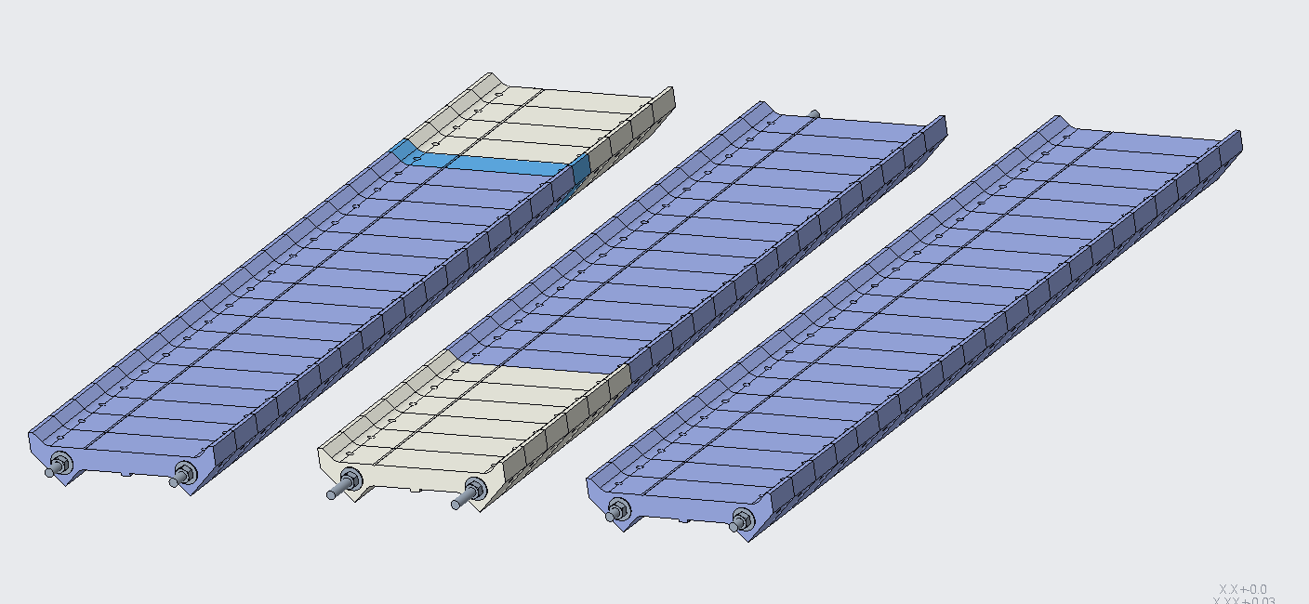
Load Pad Pre-Stacks

Slide 17
Load Pad Laminations and Stacks
For the load pad master key interface profile, the following specifications are set:
The Load Pad master key interface profile shall maintain a 0.03 [.001”] tolerance.
For the load pad collar key interface profile, the following specifications are set:
The Load Pad collar interface profile shall maintain a 0.03 [.001”] tolerance.
For the stainless-steel section of the pad pre-stack, the following specifications are set:
On the LE pre-stack, the LE pads shall have a stainless-steel section of 300 ± 0.6 mm and an overall pre-stack length of 1050 ±0.13 mm
On the RE pre-stack, the RE pads shall have a stainless-steel section of 200 ± 0.4 mm and an overall pre-stack length of 1088 ±0.13 mm
The 1100 pre-stack shall have an overall length of 1100 ±0.13 mm
PO 7545358 approved
  NCR -0192

Slide 18
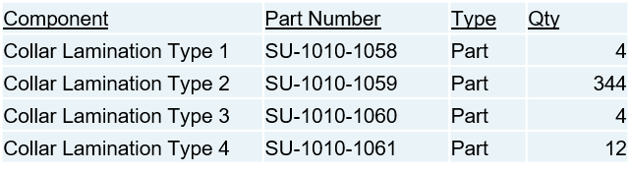
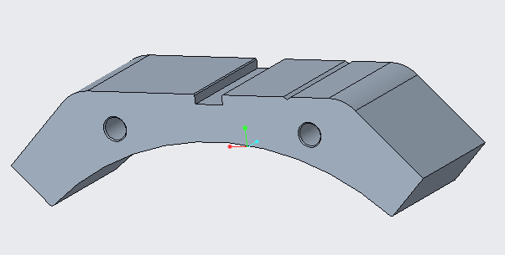
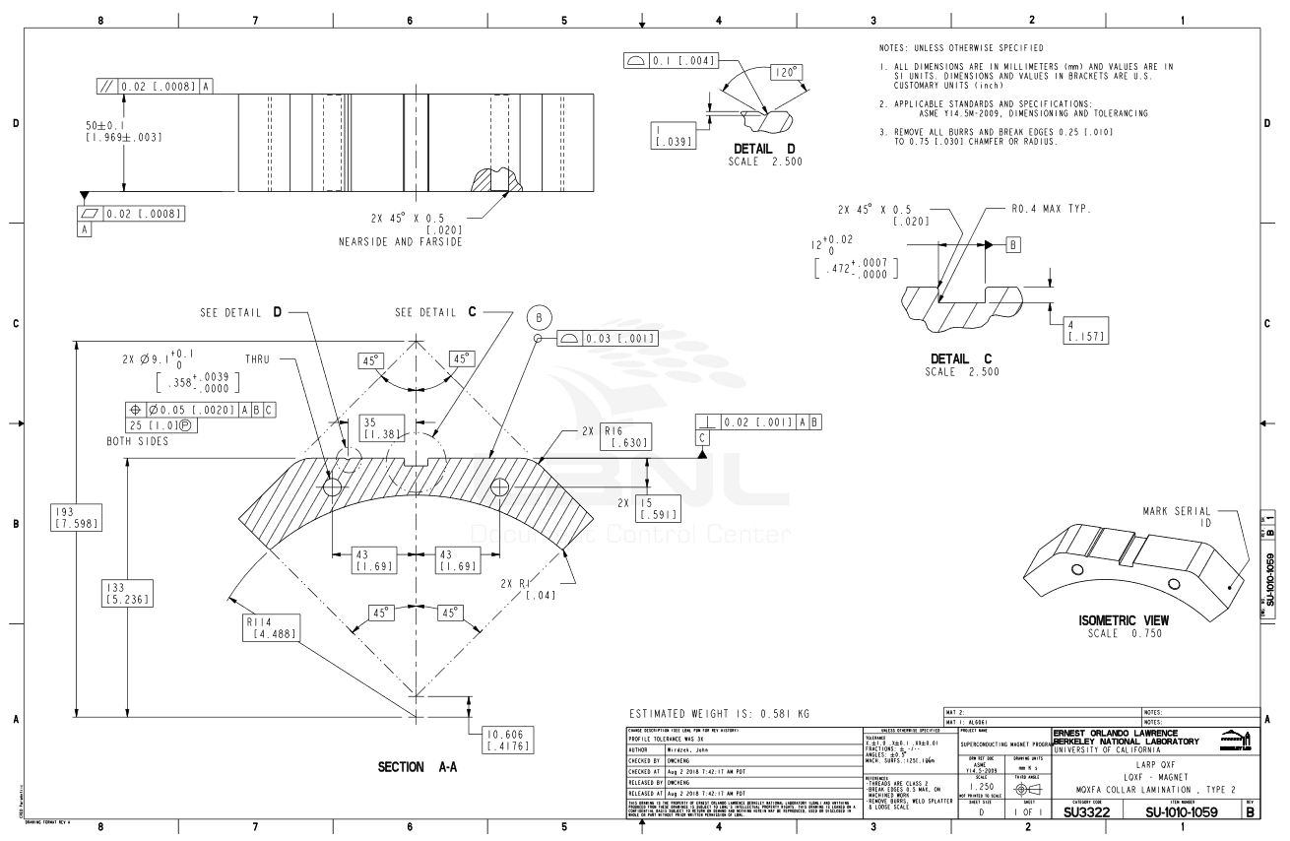
Collar Laminations

Slide 19
Collar Laminations
For the collar to load pad interface profile, the following specifications are set:
The entire collar to load pad interface profile shall maintain a 0.03 [.001”] tolerance all around.
For the collar to coil interface profile, the following specifications are set:
The collar to coil interface profile shall maintain a 0.03 [.001”] tolerance all around.
PO 7532712 approved
  No NCRs

Slide 20
MQXFA17 Change Records
NCRs on A17 thus far:
  #151 – Minor shell non-conformances
  #241 – Minor yoke non-conformances
  #192 – Minor loadpad non-conformances (some loadpads oversized)
  #552 (DEV) – Instrumented all four coils with fiber gauges
  #593 – Coil 239 accelerometer issues upon arrival
  #601 – Proud pin on Coil 239 at 1365 mm from LE (modified alignment key)
  #603 (DEV) – Did not connect SG system during shell-yoke preload ops
  #606 – Loadpad pre-stacks oversized (shaved laminations on bottom assy)
  #609 (DEV) – Use 186.5 (not 185) mm wide Kapton for radial layers
  #610 – Loadpad-collar radial layers wrinkled during curing process (replaced)
  #613 – SGs with different gauge factors installed on active vs. compensator for Coil 237 (replaced)
  #616 – Scratches on Coil 152 GPI
  #618 (DEV) – Use G11 alignment keys 13.48 mm wide instead of 13.55 mm

Slide 21
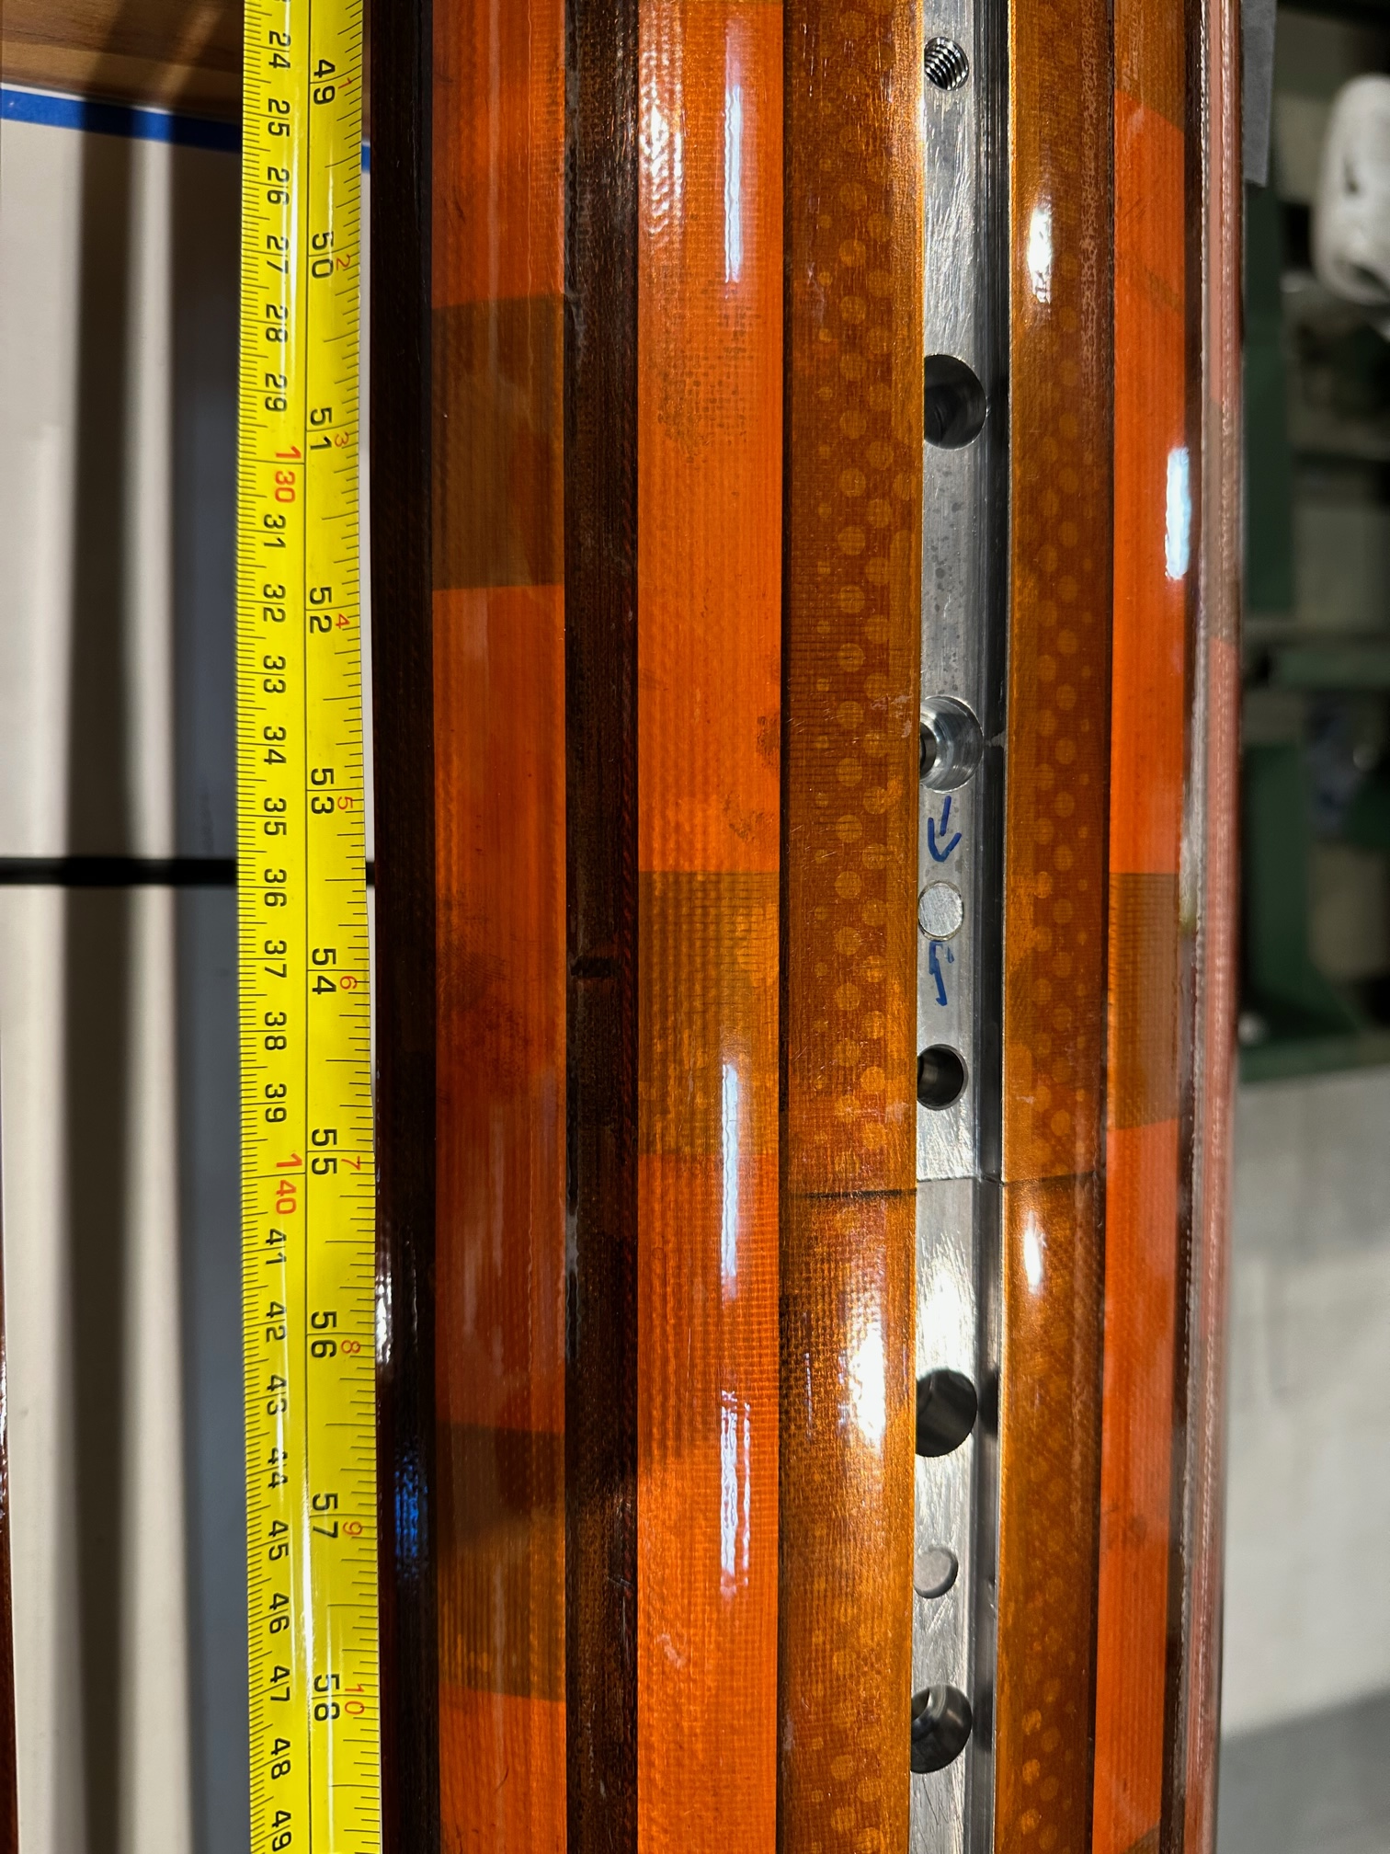
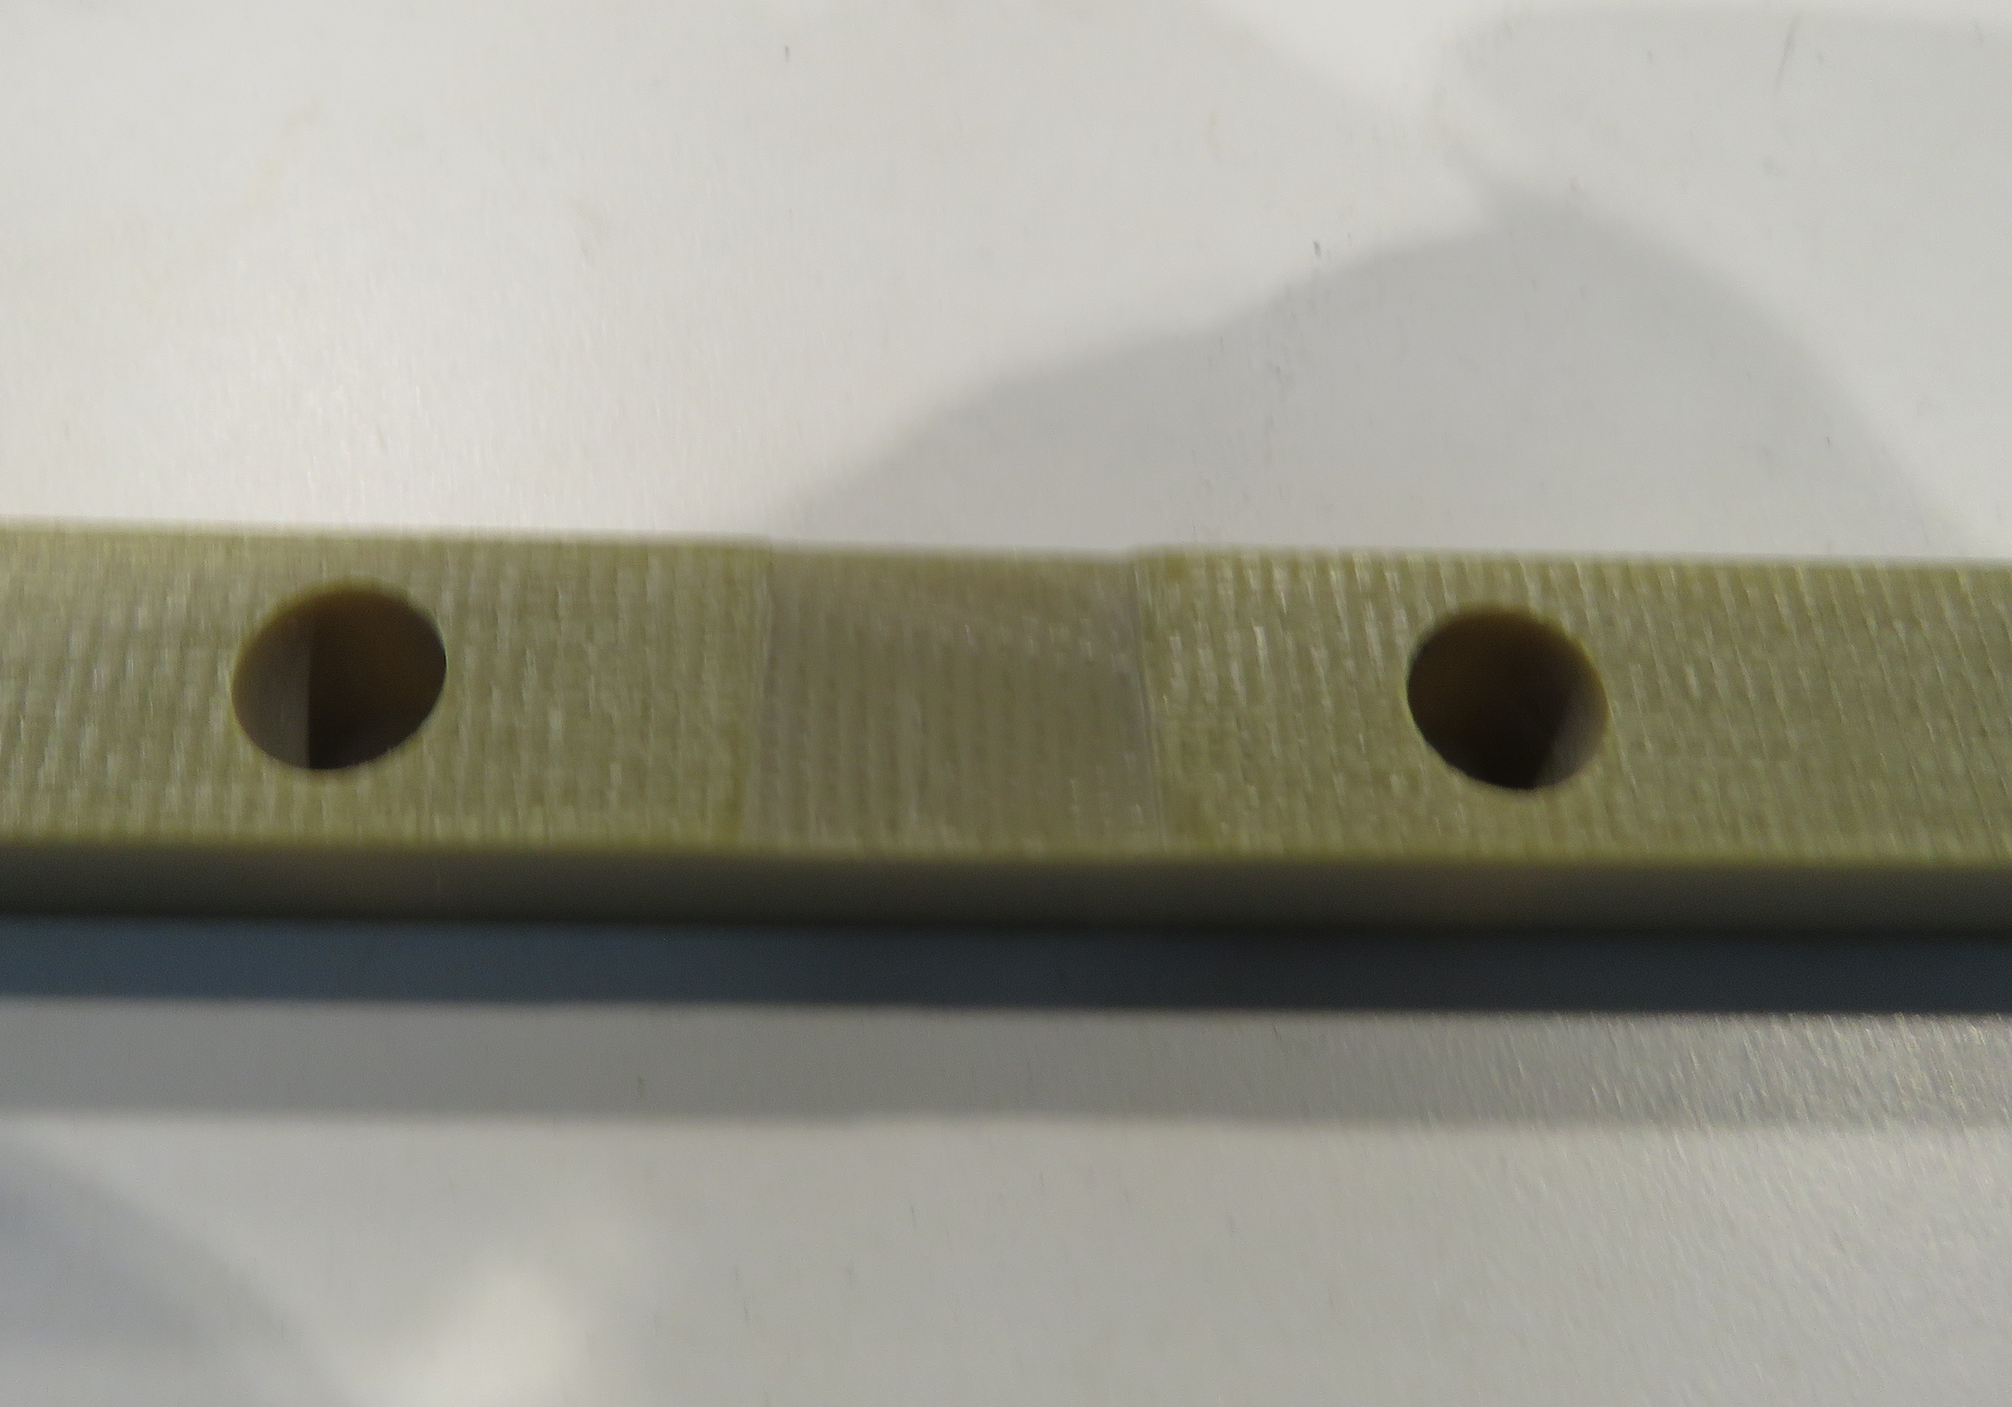
NCR #601 Detail
Proud Pin → Modified pole key

Slide 22
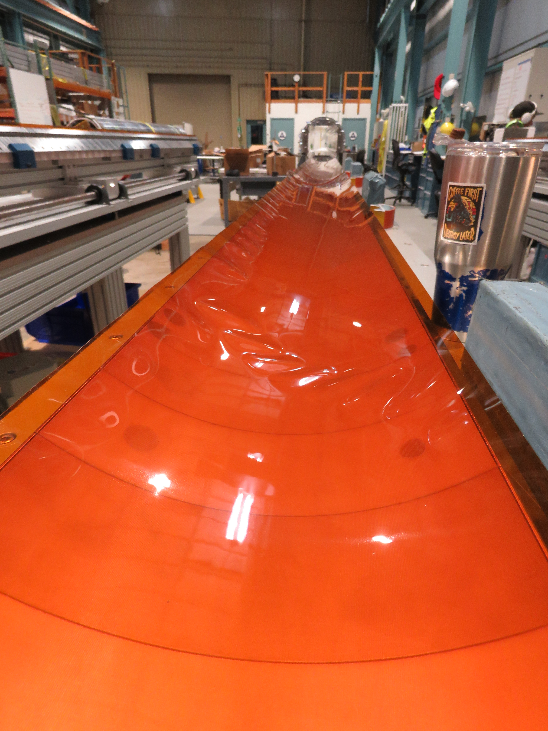
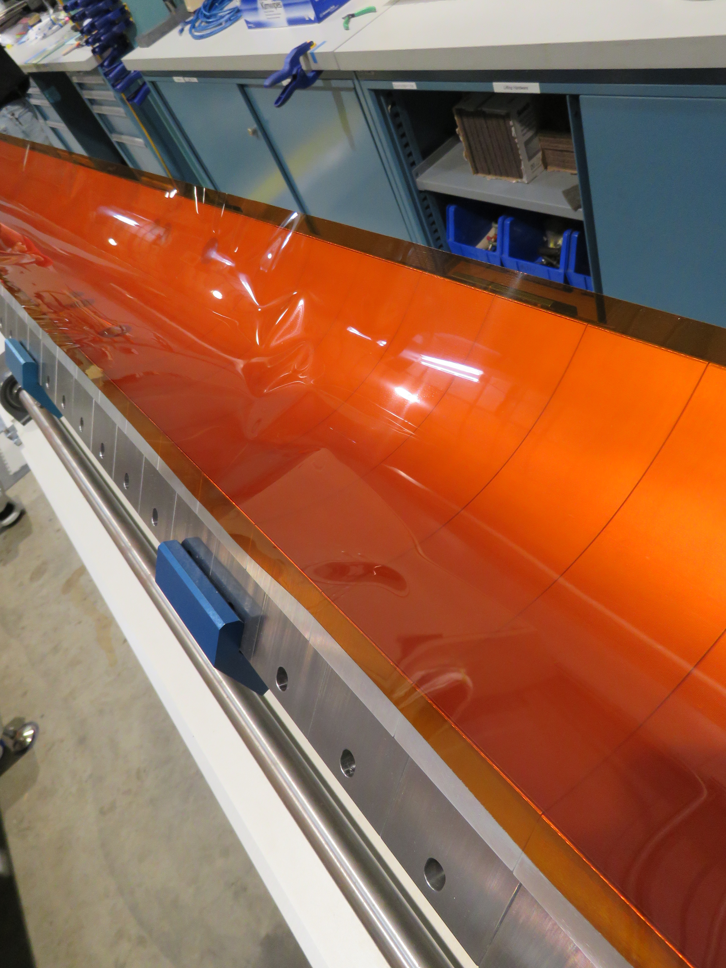
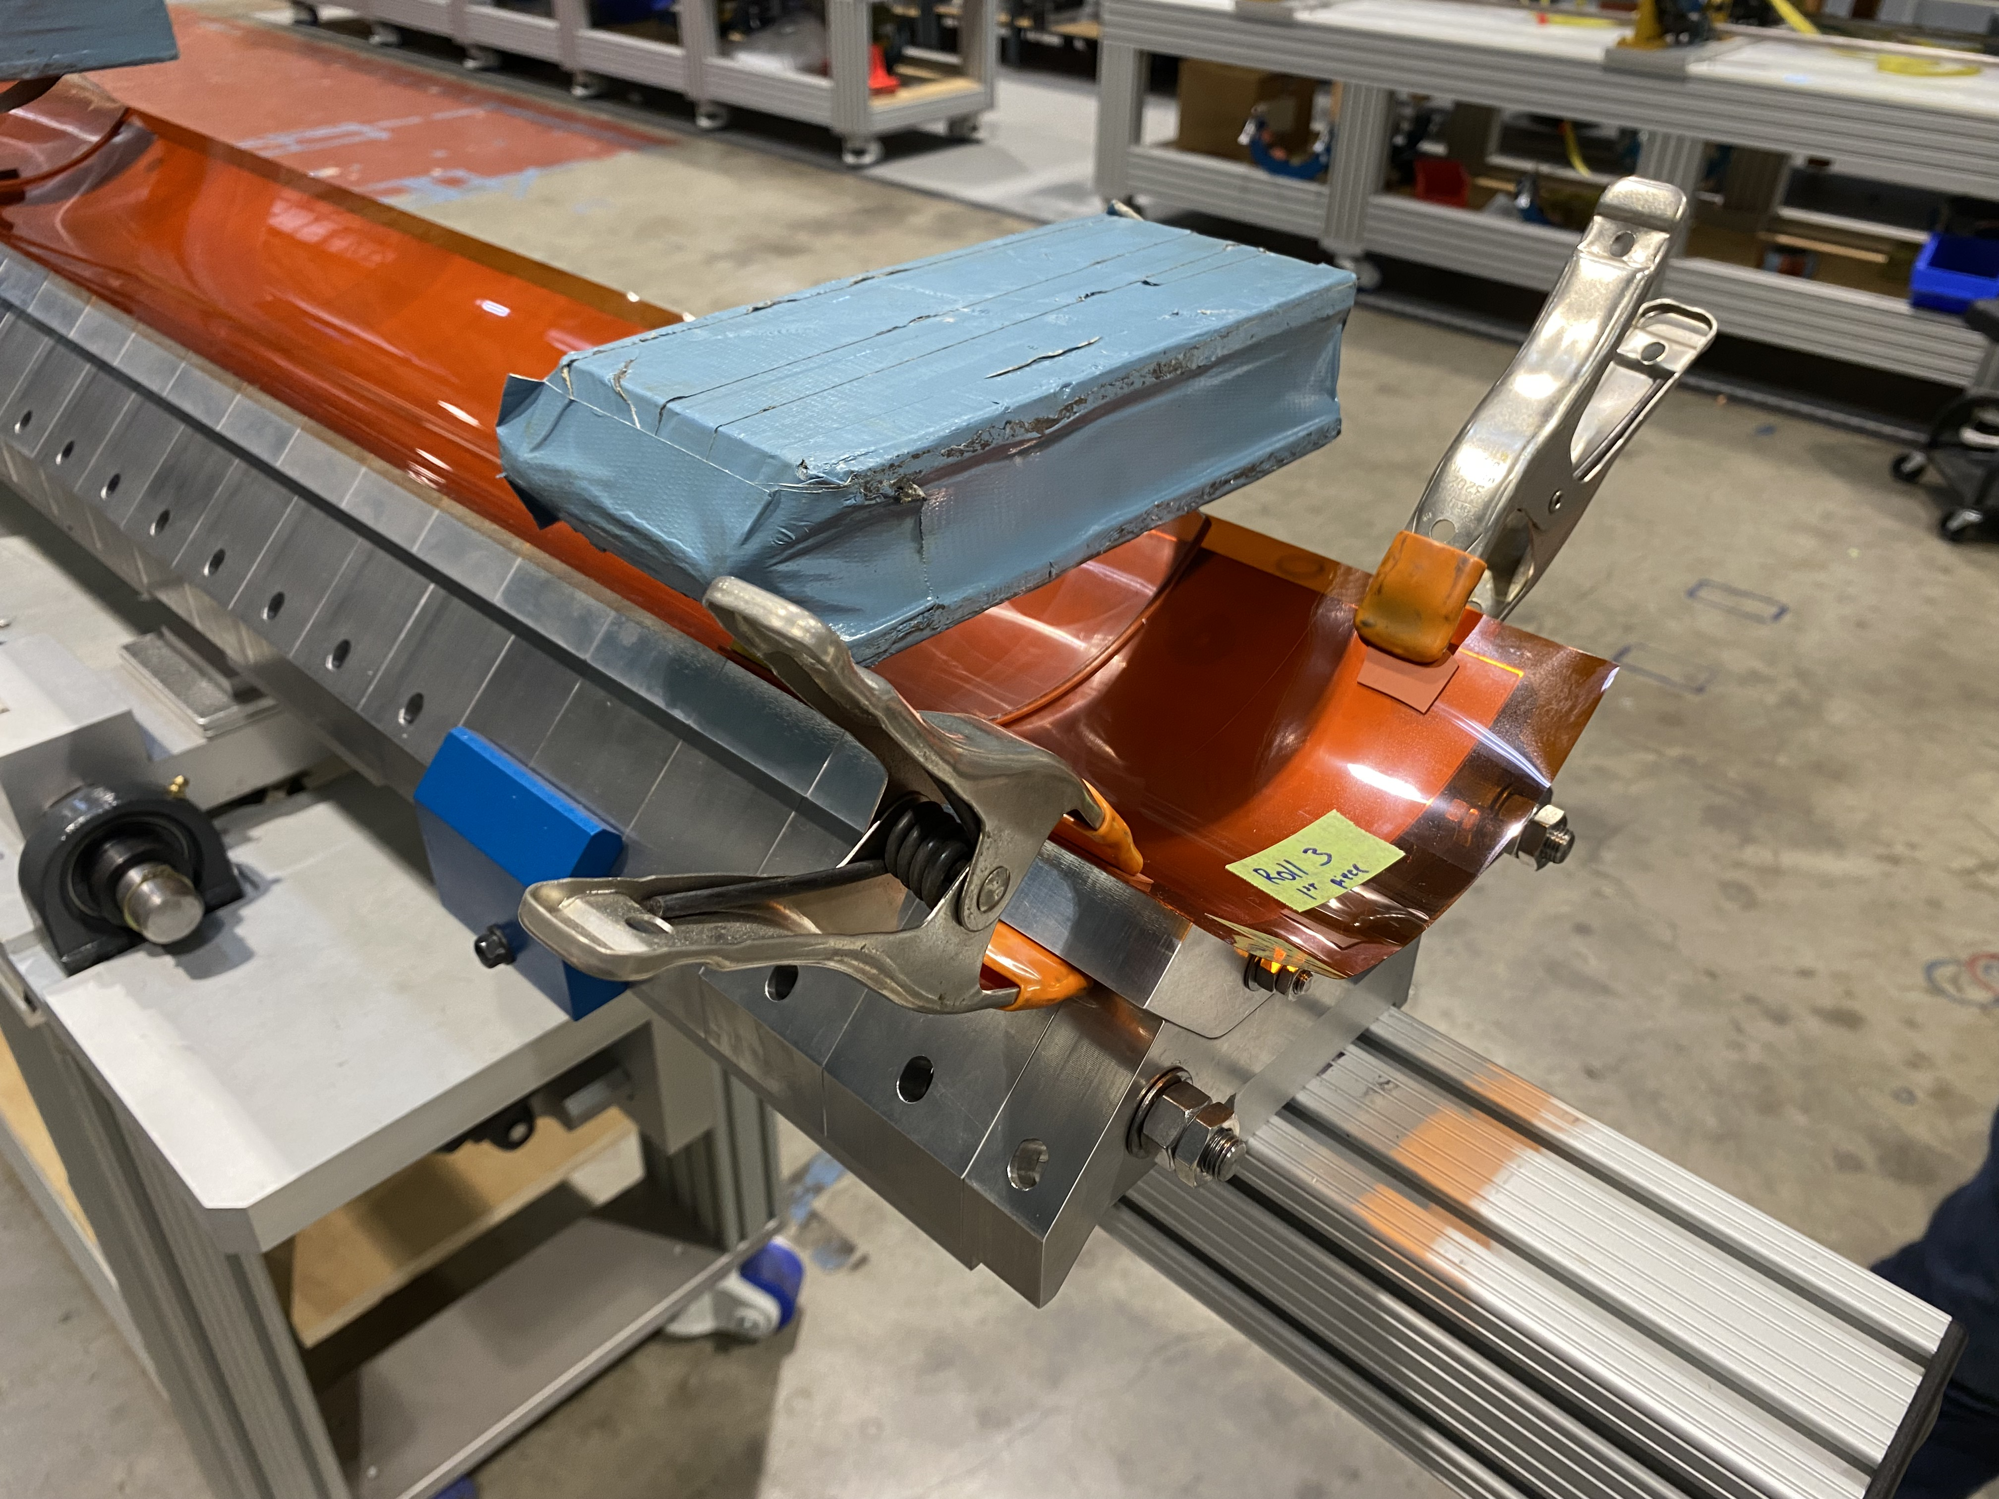
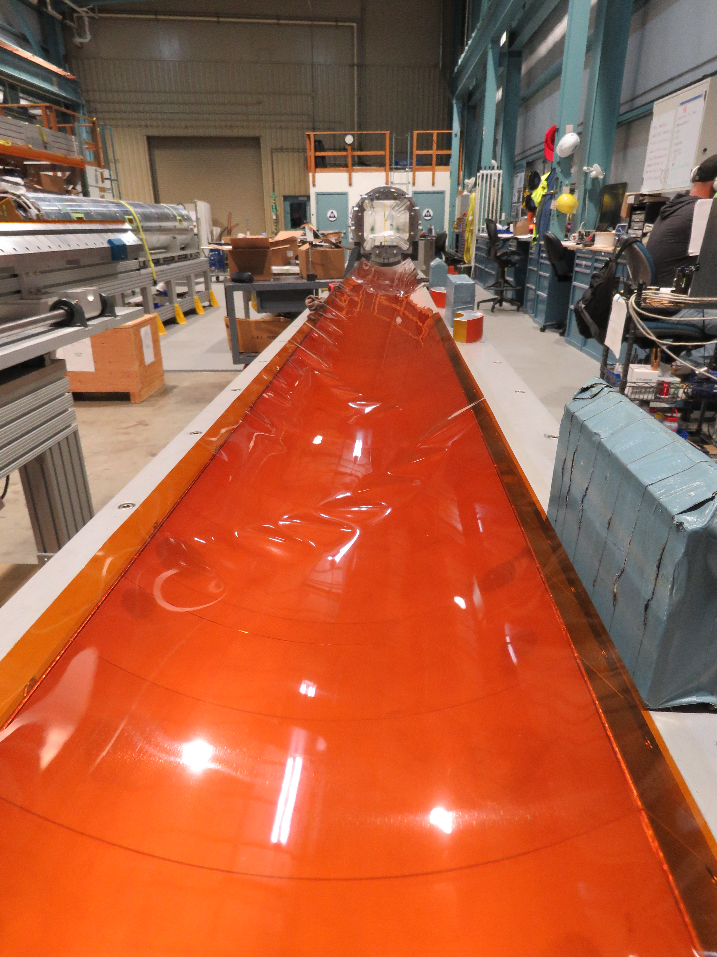
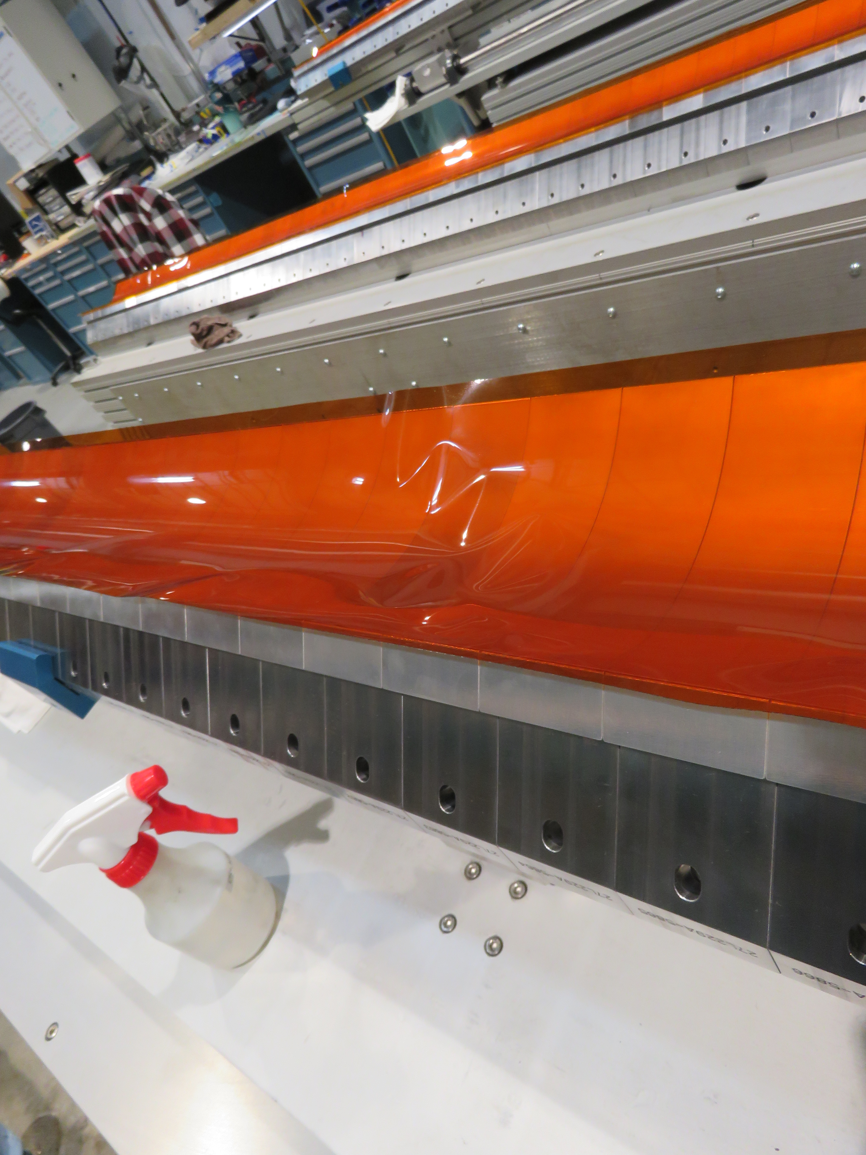
NCR #610 Detail
Wrinkled radial layers → Replaced, investigated

Slide 23
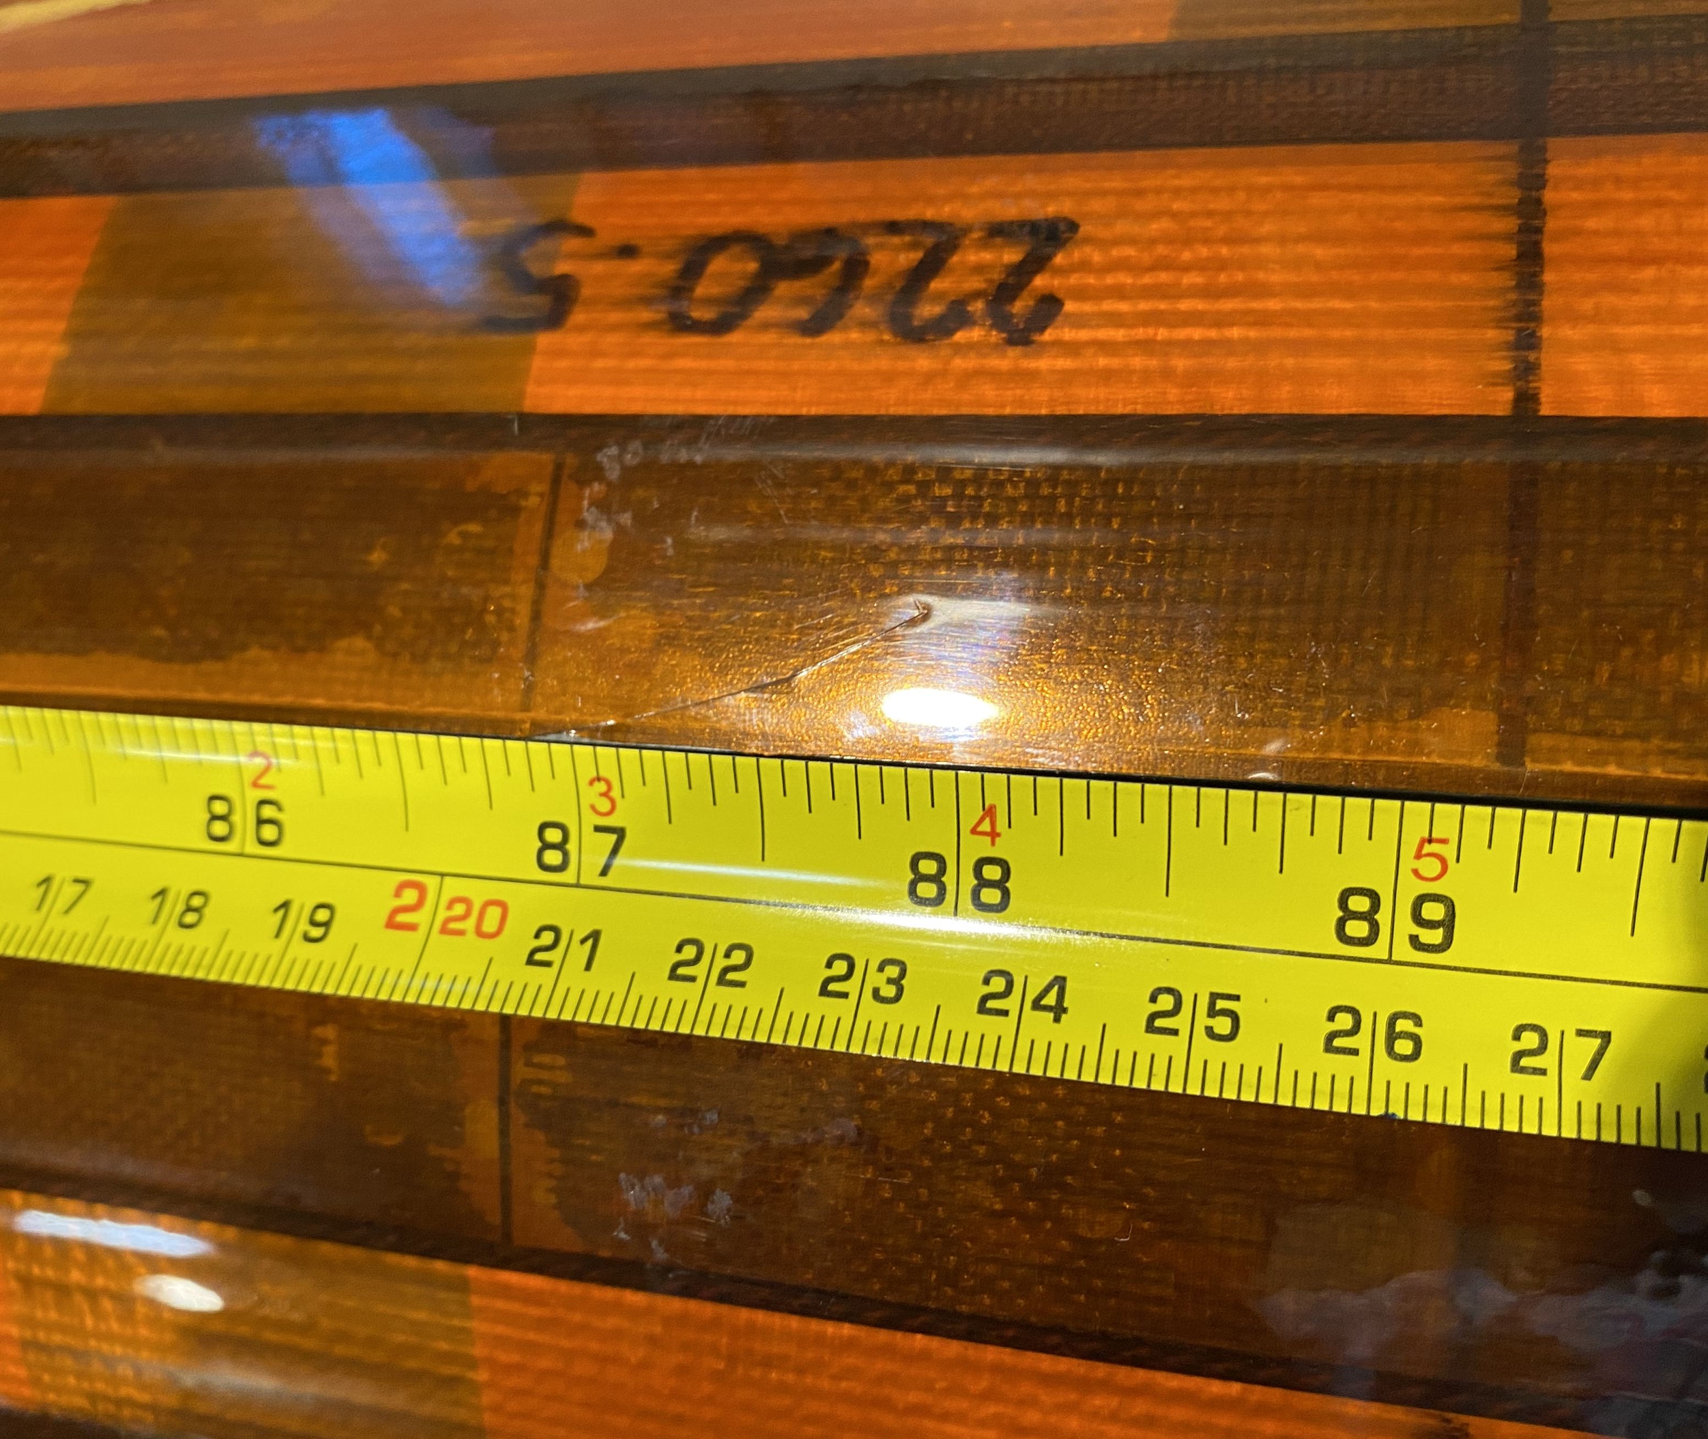
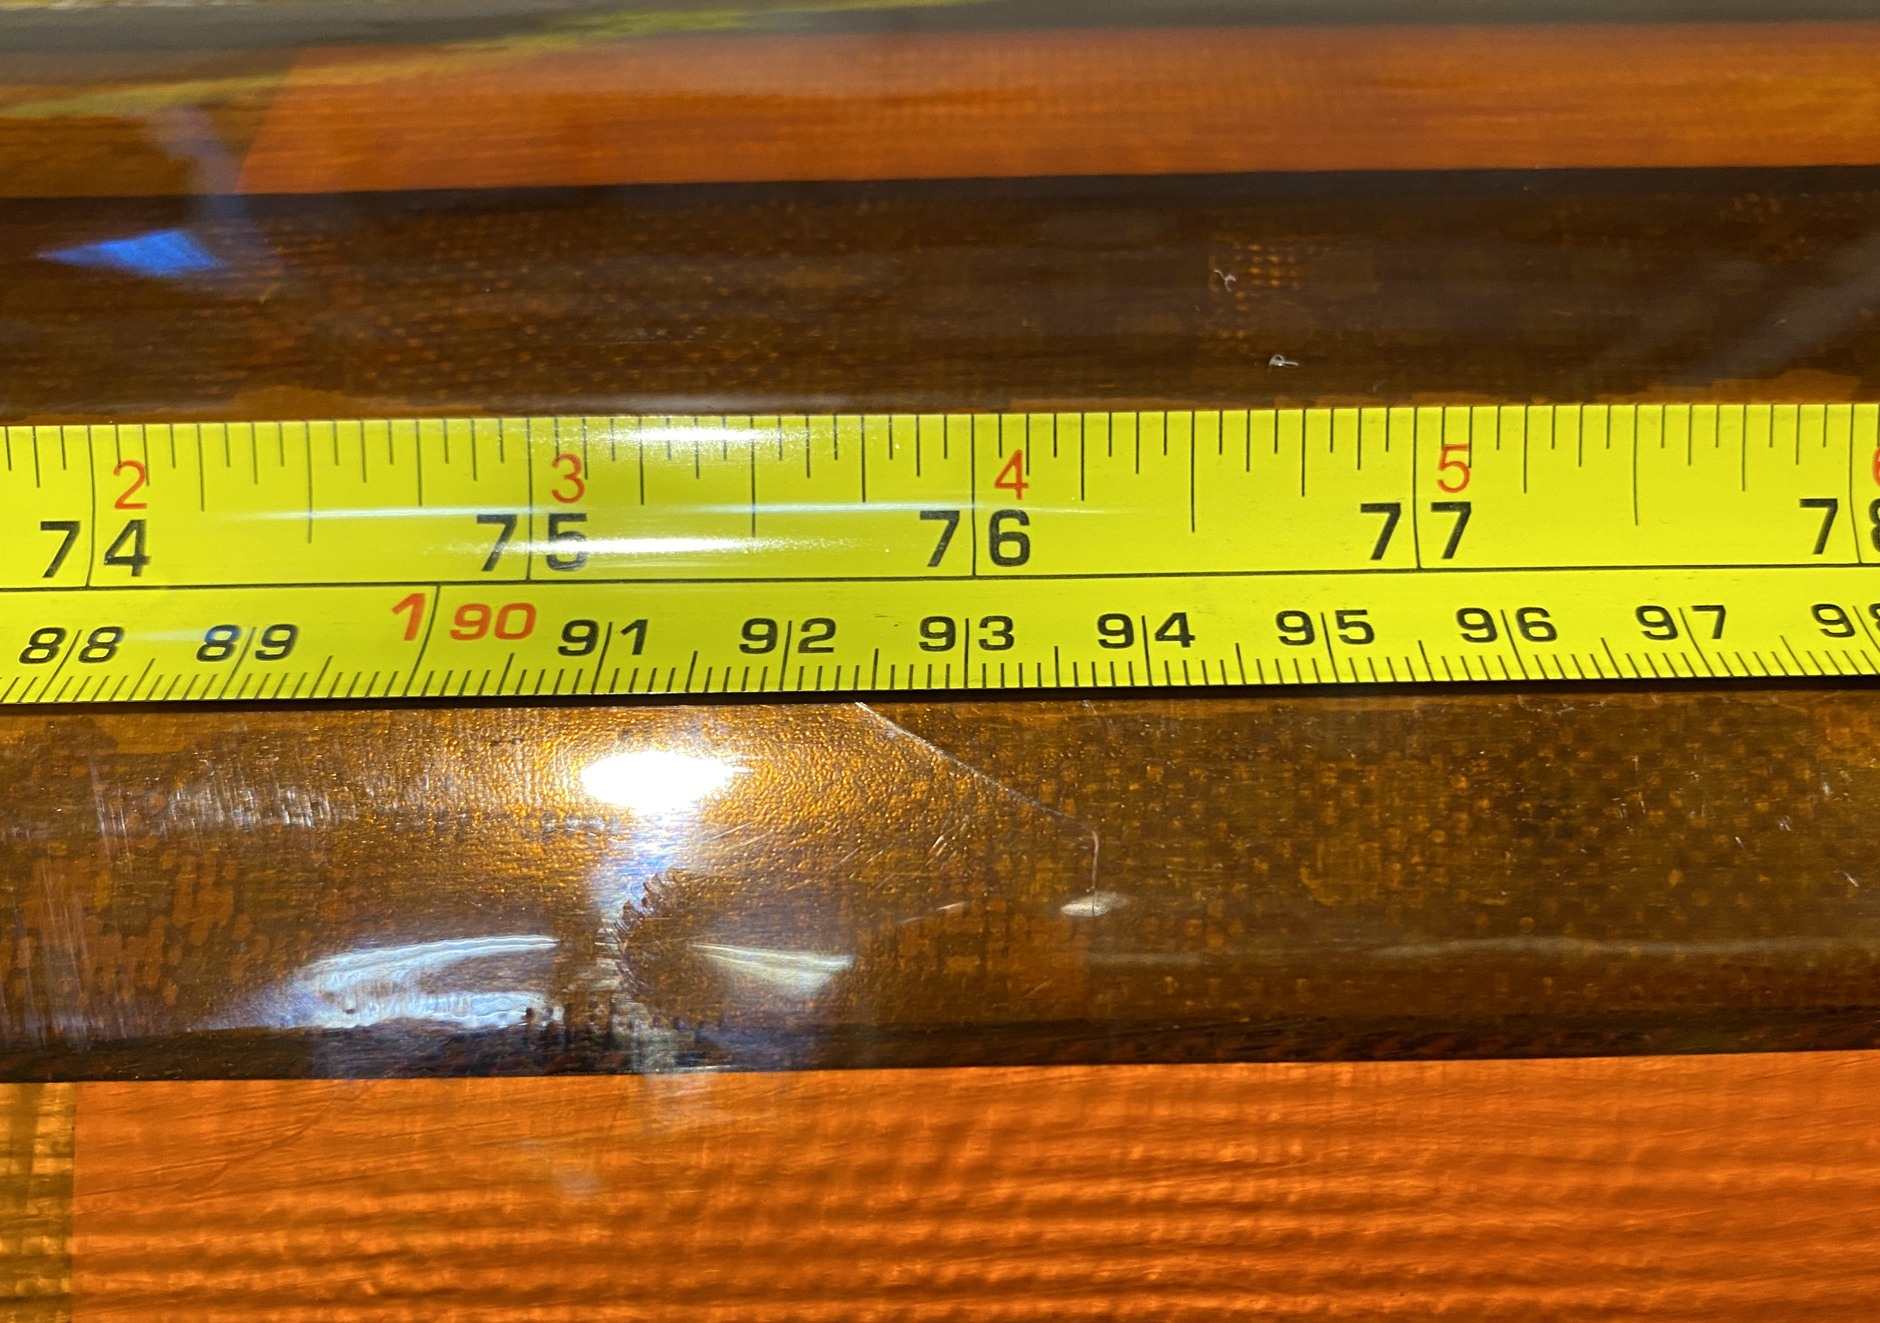
NCR #616 Detail
GPI scratches → Left as-is

