Slide 1
Loading shim proposal for A17
Paolo Ferracin, Dan Cheng, Laura Garcia Fajardo, Giorgio Vallone
on behalf of the MQXF collaboration
MQXFA17 Structure & Shims Review
LBNL, USA
October 18th, 2023

Slide 2
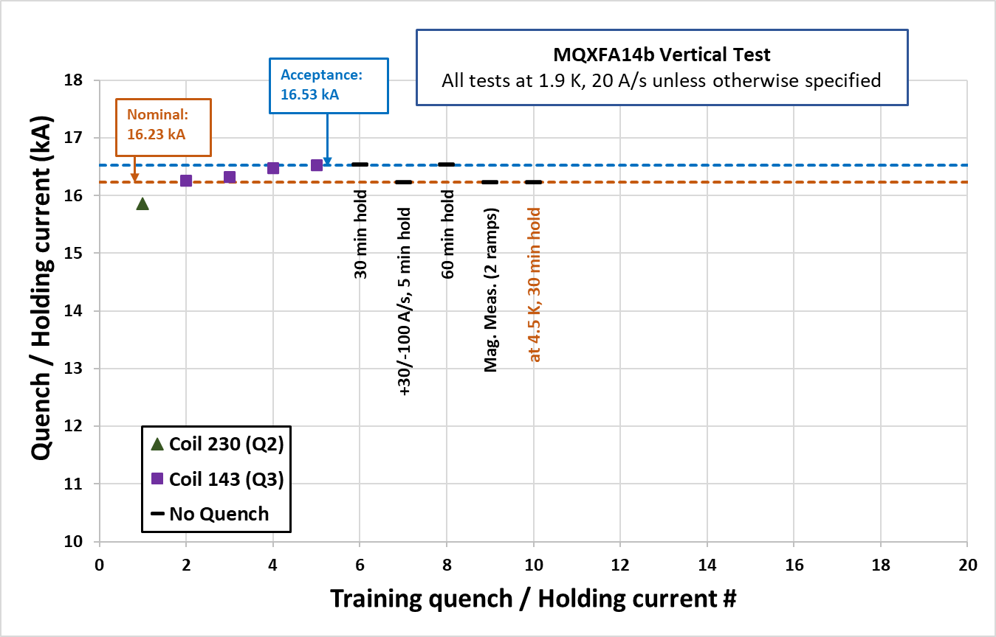
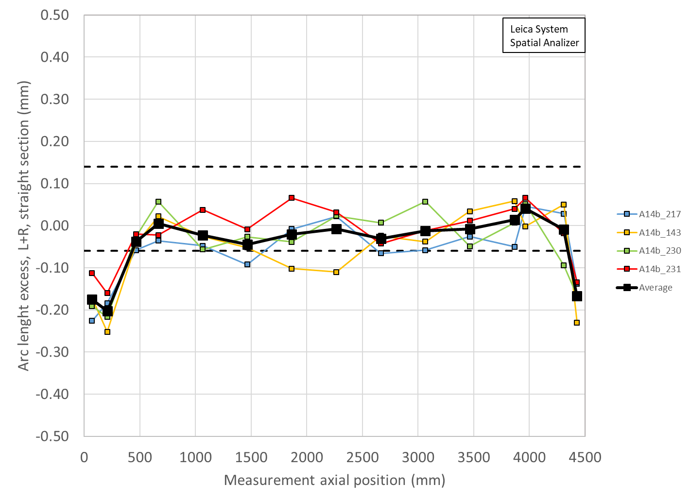
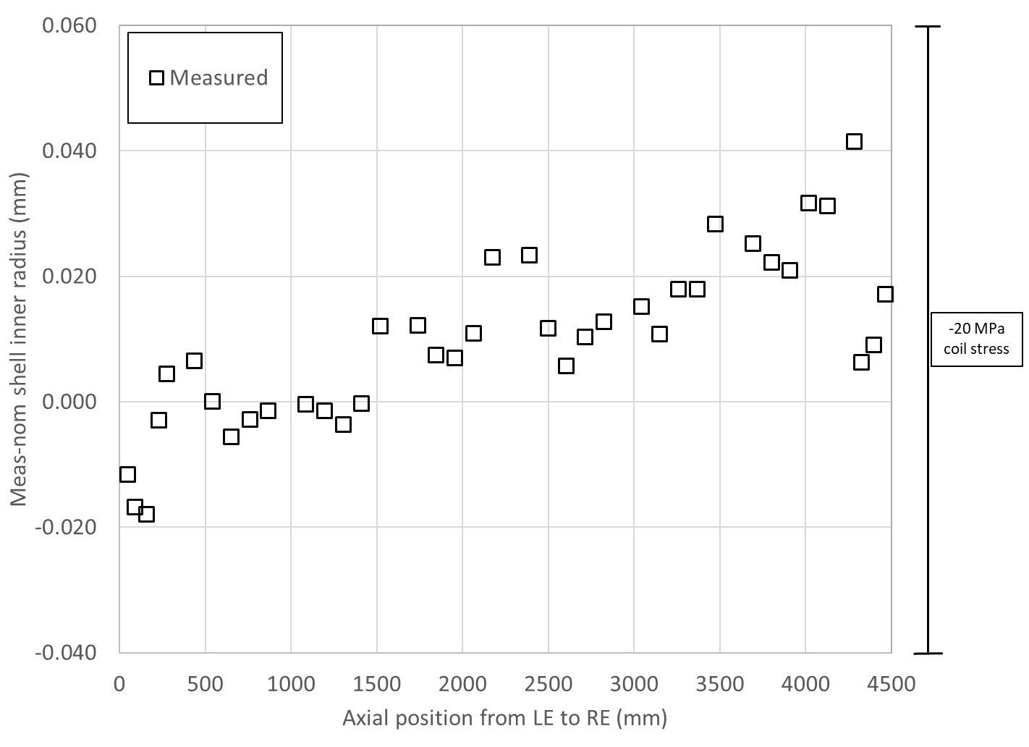
A14b quench performance, shimmed coil size, shell size, and loading key size
Loading shim size: 43 mils, 1.092 mm
Total key size: 13.84 mm

Slide 3
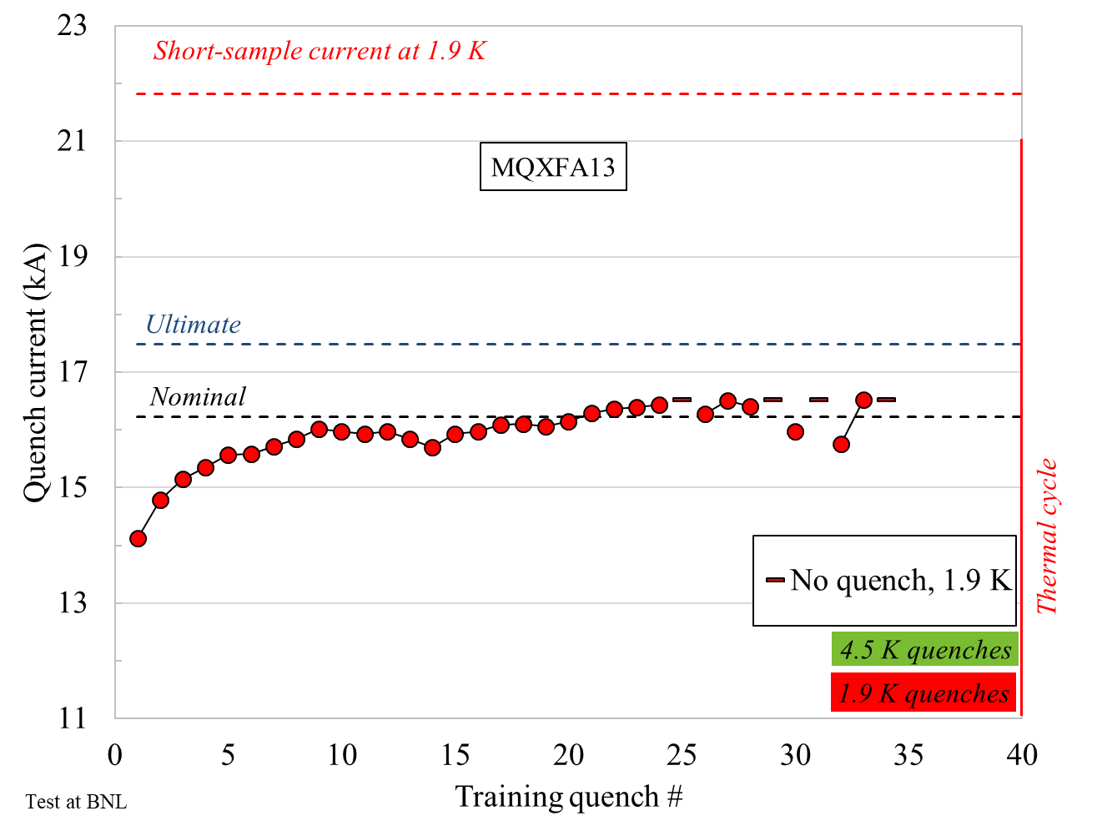
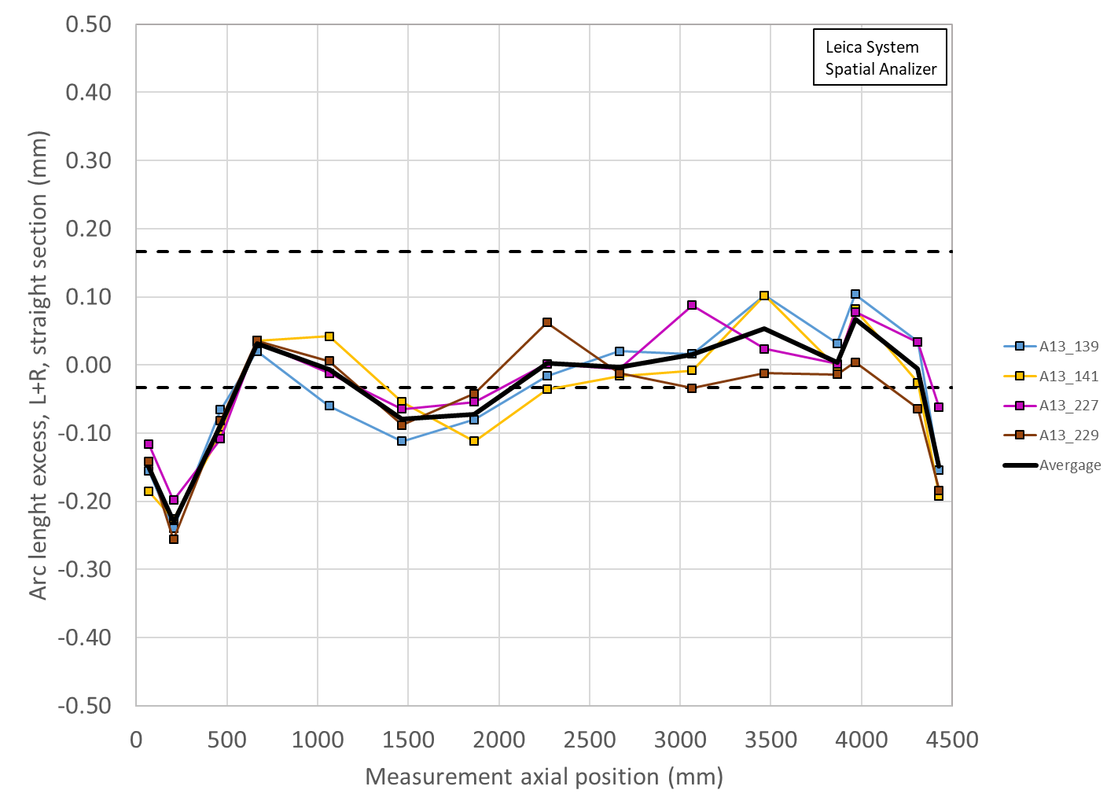
A13 quench performance, shimmed coil size, shell size, and loading key size
Loading shim size: 38 mils, 0.965 mm
Total key size: 13.72 mm

Slide 4
A05 quench performance, shimmed coil size, shell size, and loading key size
Why A05?
Very good magnet, short training
Instead
A06, good but trained first at 4.5 K then 1.9 K
A07/A08 not good
A10/A11 good but long training
A8b good but 3 re-tested coils
A03, A04, good but work in progress to collect data…..

Slide 5
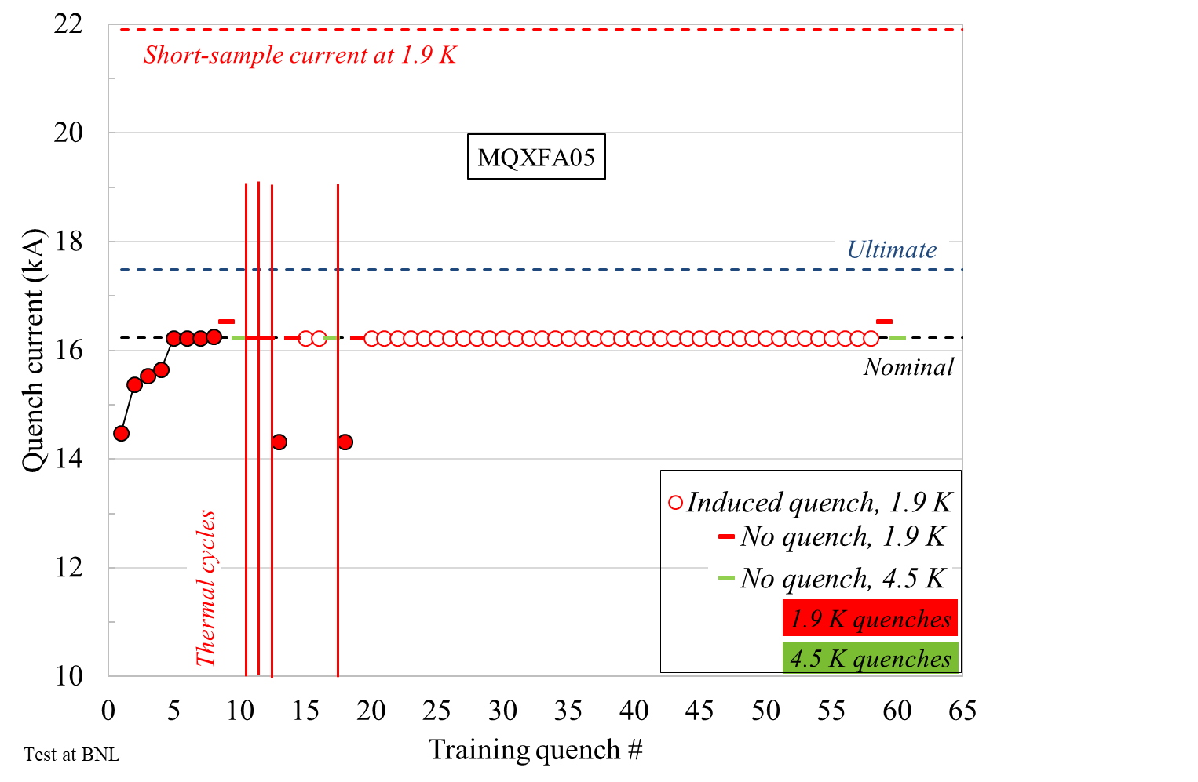
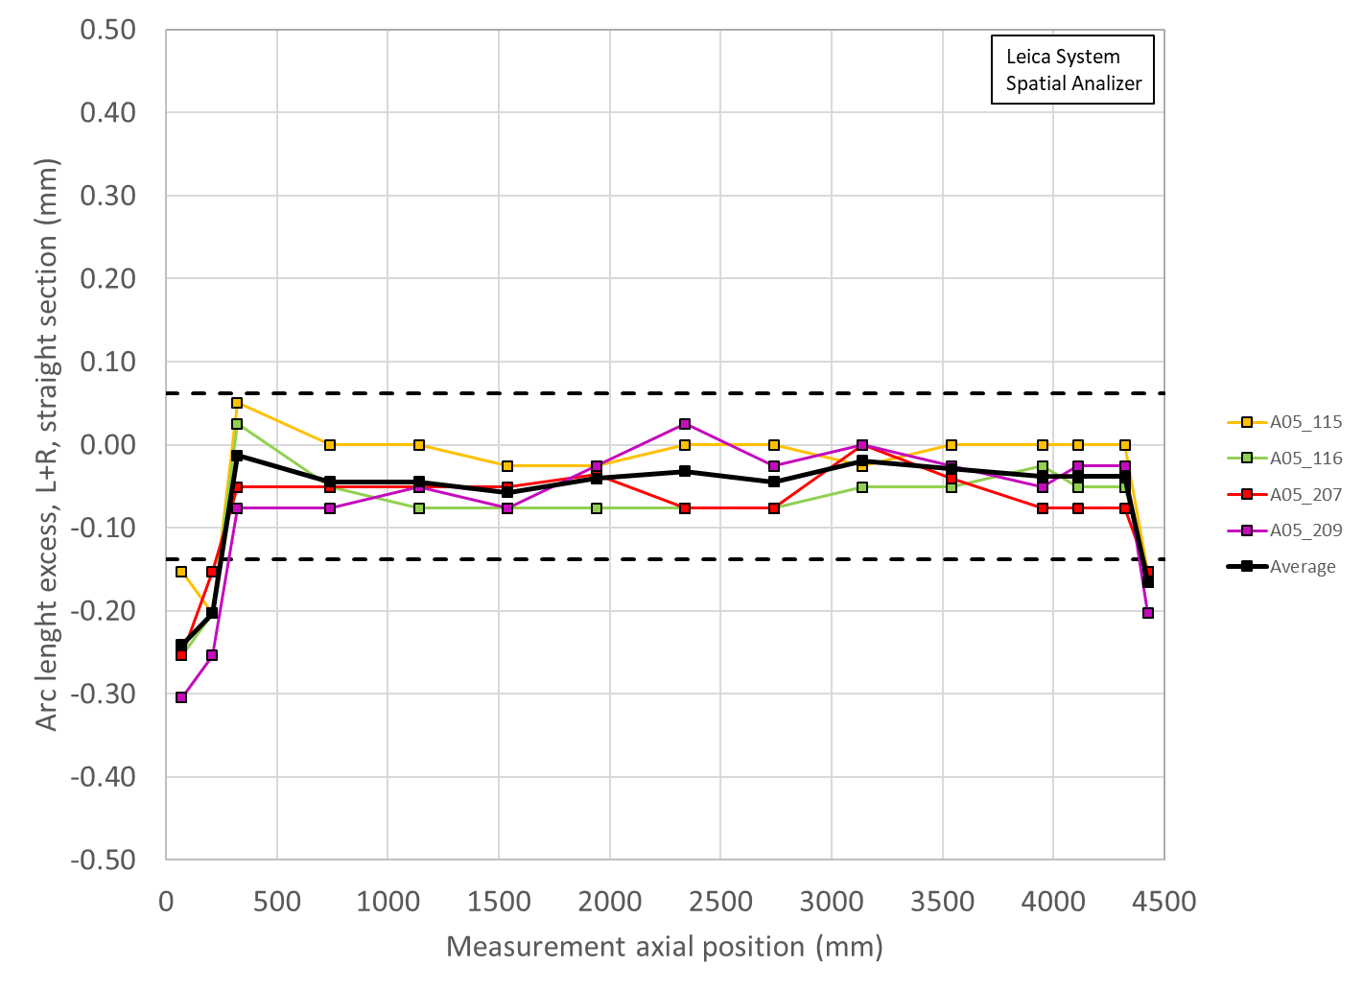
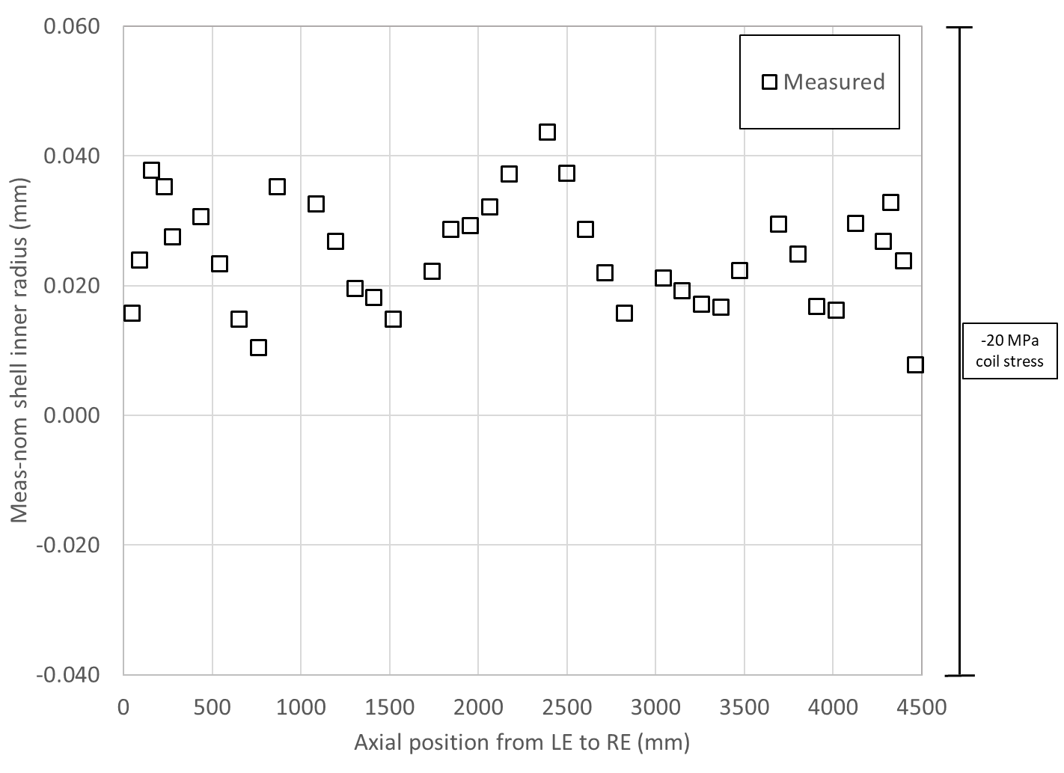
A05 quench performance, shimmed coil size, shell size, and loading key size
Loading shim size: 41 mils, 1.041 mm
Total key size: 13.79 mm

Slide 6
Summary A14b, A05, A13
Loading shim size: 43 mils, 1.092 mm
Total key size: 13.84 mm
Loading shim size: 41 mils, 1.041 mm
Total key size: 13.79 mm
Loading shim size: 38 mils, 0.965 mm
Total key size: 13.72 mm

Slide 7
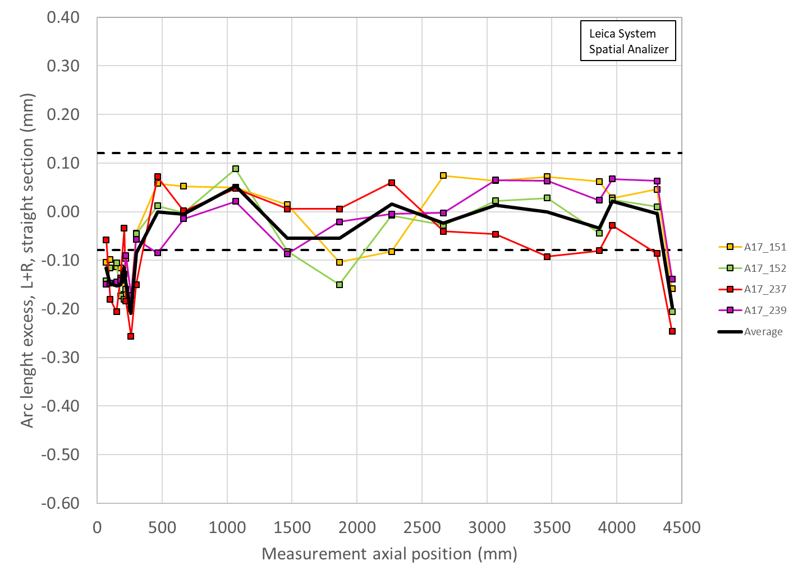
A07 shimmed coil size

Slide 8
Summary Coil arc length (shimmed) deviation and key/shim size
 | Ave ss | LE min | RE min | Key | Shim | Shim
 | mm | mm | mm | mm | mils | mm
A17 | -0.006 | -0.210 | -0.197 | ? | ? | ?
A07b | -0.023 | -0.180 | -0.126 | 13.84 | 43 | 1.092
A16 | 0.037 | -0.140 | -0.125 | 13.77 | 40 | 1.016
A15 | 0.001 | -0.156 | -0.070 | 13.72 | 38 | 0.965
A14b | -0.011 | -0.203 | -0.167 | 13.84 | 43 | 1.092
A13 | -0.007 | -0.230 | -0.148 | 13.72 | 38 | 0.965
A8b | -0.001 | -0.285 | -0.214 | 13.77 | 40 | 1.016
A11 | 0.006 | -0.196 | -0.074 | 13.74 | 39 | 0.991
A10 | -0.145 | -0.348 | -0.313 | 13.82 | 42 | 1.067
A8 | -0.046 | -0.340 | -0.269 | 13.72 | 38 | 0.965
A7 | -0.055 | -0.218 | -0.179 | 13.77 | 40 | 1.016
A6 | -0.053 | -0.217 | -0.279 | 13.72 | 38 | 0.965
A5 | -0.039 | -0.241 | -0.165 | 13.79 | 41 | 1.041

Slide 9
From arc length deviation to radial deviation
Δ_arc-length * 4 = 2π Δr
Δr = Δ_arc-length * 2/ π

Slide 10
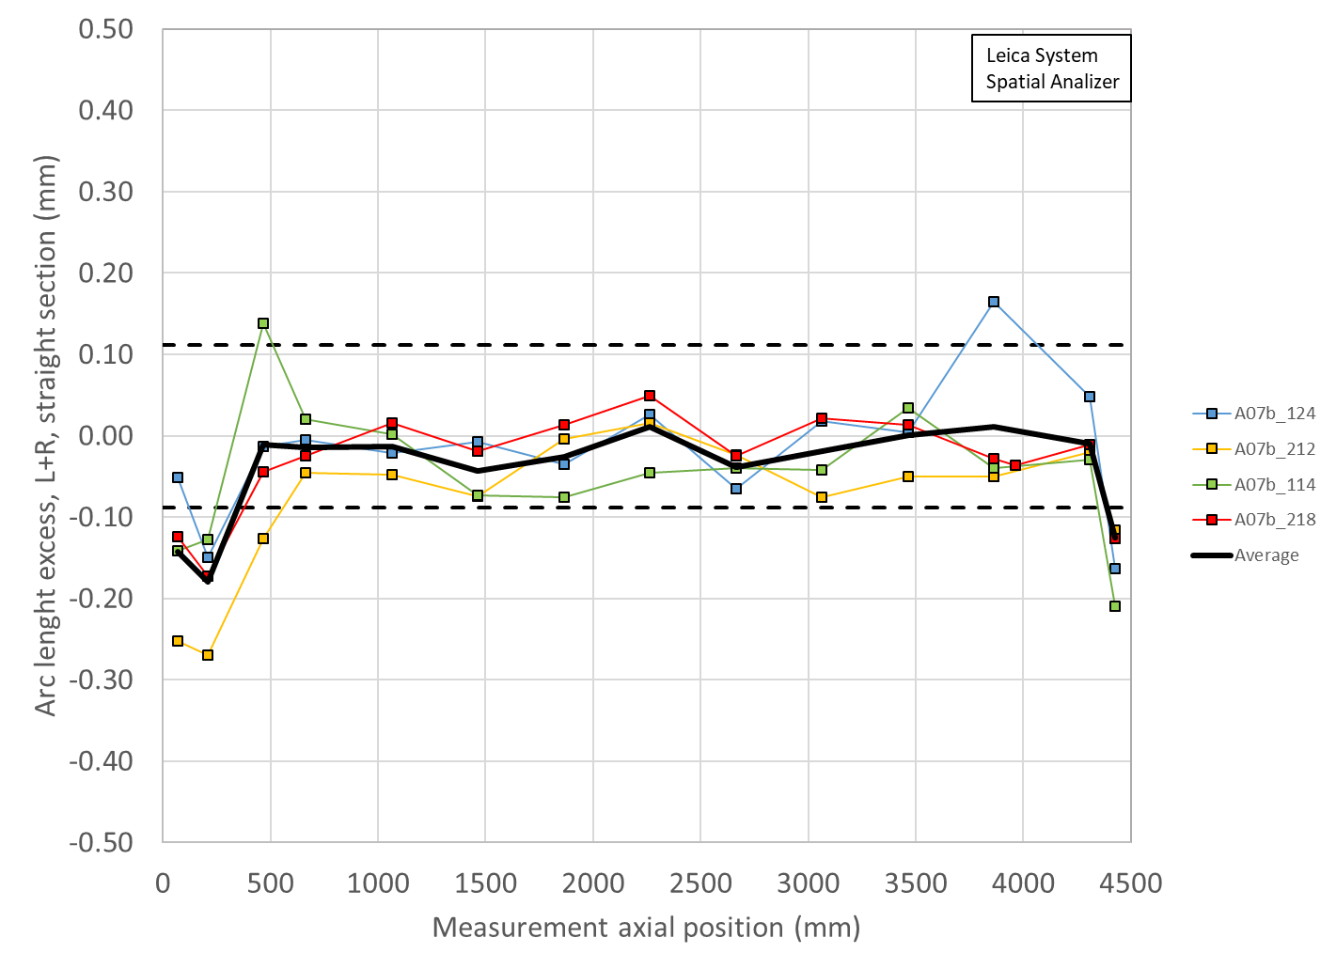
Summary Coil radial (shimmed) deviation and key/shim size
 | Ave ss | LE min | RE min | Key | Shim | Shim | Ave ss + shim | LE + shim | RE + shim
 | mm | mm | mm | mm | mils | mm | mm | mm | mm
A17 | -0.004 | -0.134 | -0.125 | 0 | 0 | 0
A07b | -0.015 | -0.115 | -0.080 | 13.84 | 43 | 1.092 | 1.077 | 0.977 | 1.012
A16 | 0.023 | -0.089 | -0.080 | 13.77 | 40 | 1.016 | 1.039 | 0.927 | 0.936
A15 | 0.000 | -0.099 | -0.045 | 13.72 | 38 | 0.965 | 0.965 | 0.866 | 0.920
A14b | -0.007 | -0.129 | -0.107 | 13.84 | 43 | 1.092 | 1.085 | 0.963 | 0.985
A13 | -0.004 | -0.146 | -0.094 | 13.72 | 38 | 0.965 | 0.961 | 0.819 | 0.871
A8b | 0.000 | -0.181 | -0.136 | 13.77 | 40 | 1.016 | 1.016 | 0.835 | 0.880
A11 | 0.004 | -0.124 | -0.047 | 13.74 | 39 | 0.991 | 0.995 | 0.867 | 0.944
A10 | -0.092 | -0.221 | -0.199 | 13.82 | 42 | 1.067 | 0.975 | 0.846 | 0.868
A8 | -0.029 | -0.216 | -0.172 | 13.72 | 38 | 0.965 | 0.936 | 0.749 | 0.793
A7 | -0.035 | -0.139 | -0.114 | 13.77 | 40 | 1.016 | 0.981 | 0.877 | 0.902
A6 | -0.034 | -0.138 | -0.178 | 13.72 | 38 | 0.965 | 0.931 | 0.827 | 0.787
A5 | -0.025 | -0.154 | -0.105 | 13.79 | 41 | 1.041 | 1.016 | 0.887 | 0.936

Slide 11
A07b
Let’s assume that
A17 “upper” is like A14b
A17 “lower” is like A05

Slide 12
Summary straight section Coil radial (shimmed) deviation + key/shim size
 | Ave ss | Key | Shim | Shim | Ave ss + shim
 | mm | mm | mils | mm | mm
A17 up | -0.004 | 13.84 | 43 | 1.092 | 1.088
A17 low | -0.004 | 13.77 | 40 | 1.016 | 1.012
A14b | -0.007 | 13.84 | 43 | 1.092 | 1.085
A5 | -0.025 | 13.79 | 41 | 1.041 | 1.016

Slide 13
Summary LE Coil radial (shimmed) deviation + key/shim size
 | LE | Key | Shim | Shim | LE + shim
 | mm | mm | mils | mm | mm
A17 up | -0.134 | 13.84 | 43 | 1.092 | 0.959
A17 low | -0.134 | 13.77 | 40 | 1.016 | 0.882
A14b | -0.129 | 13.84 | 43 | 1.092 | 0.963
A5 | -0.154 | 13.79 | 41 | 1.041 | 0.887

Slide 14
Summary RE Coil radial (shimmed) deviation + key/shim size
 | RE | Key | Shim | Shim | RE + shim
 | mm | mm | mils | mm | mm
A17 up | -0.125 | 13.87 | 44 | 1.118 | 0.992
A17 low | -0.125 | 13.82 | 42 | 1.067 | 0.941
A14b | -0.107 | 13.84 | 43 | 1.092 | 0.985
A5 | -0.105 | 13.79 | 41 | 1.041 | 0.936

Slide 15
Summary and proposal
 | Ave ss | Key | Shim | Shim | Ave ss + shim
 | mm | mm | mils | mm | mm
A17 up | -0.004 | 13.84 | 43 | 1.092 | 1.088
A17 low | -0.004 | 13.77 | 40 | 1.016 | 1.012
 | LE | Key | Shim | Shim | LE + shim
 | mm | mm | mils | mm | mm
A17 up | -0.134 | 13.84 | 43 | 1.092 | 0.959
A17 low | -0.134 | 13.77 | 40 | 1.016 | 0.882
 | RE | Key | Shim | Shim | RE + shim
 | mm | mm | mils | mm | mm
A17 up | -0.125 | 13.87 | 44 | 1.118 | 0.992
A17 low | -0.125 | 13.82 | 42 | 1.067 | 0.941
Proposed target
Aiming at a shim of 43 mils, with the possibility of going to 42-44 mils depending on SG data

Slide 16
Appendix

