Slide 1
PIP-II Weekly Report
13 October 2023
the PIP-II team

Slide 2
PIP-II In-Kind Contributions
PIP-II is the the first U.S. accelerator project to be built with significant International Contributions.
The IKC to PIP-II Project has an estimated value of: $310M+ (PIP-II is $987M)
Courtesy: Allan Rowe

Slide 3
PIP-II In kind Contributions – Cryomodules

Slide 4
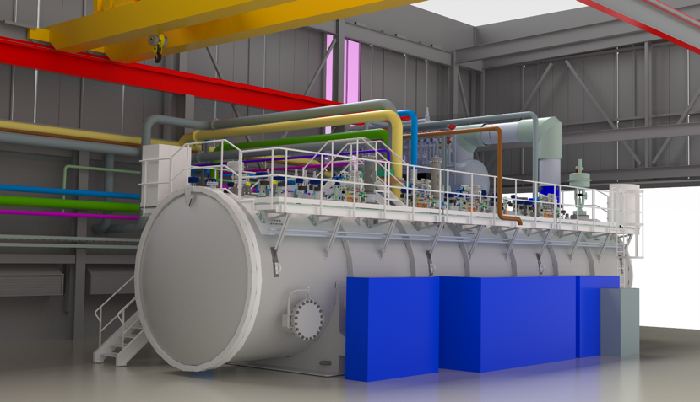
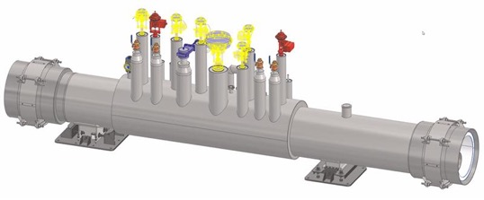
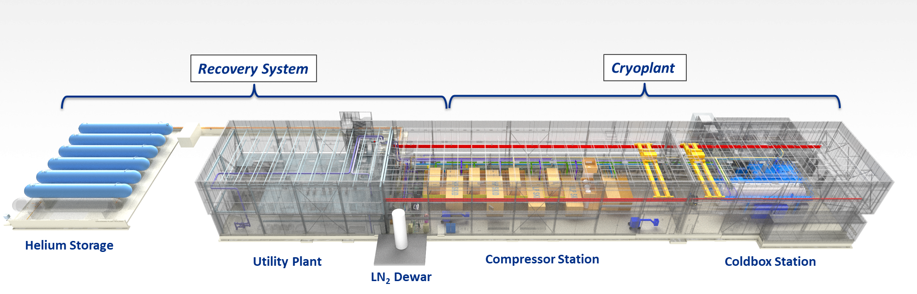
PIP-II In kind Contributions – Cryoplant & Tunnel Transfer Line
TTL Module
~8-12 m
The TTL comprises 25 such modules in series

Slide 5
PIP-II In kind Contributions – Cryomodules

Slide 6
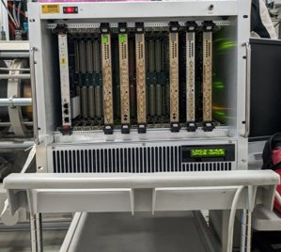
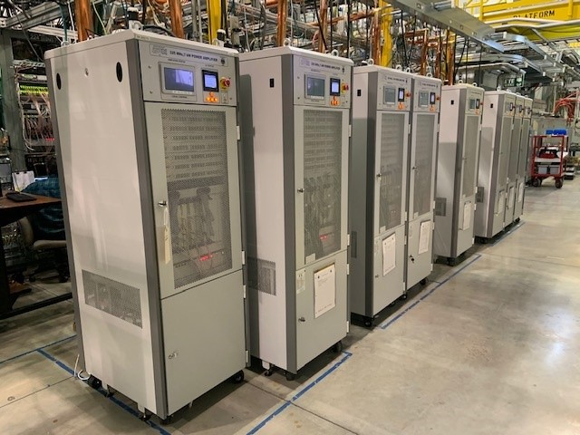
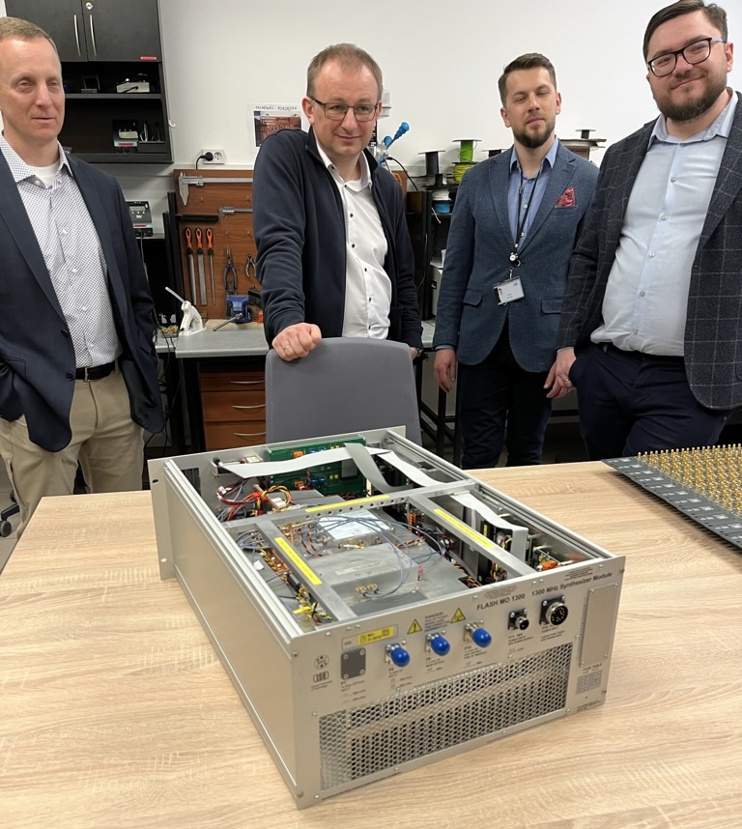

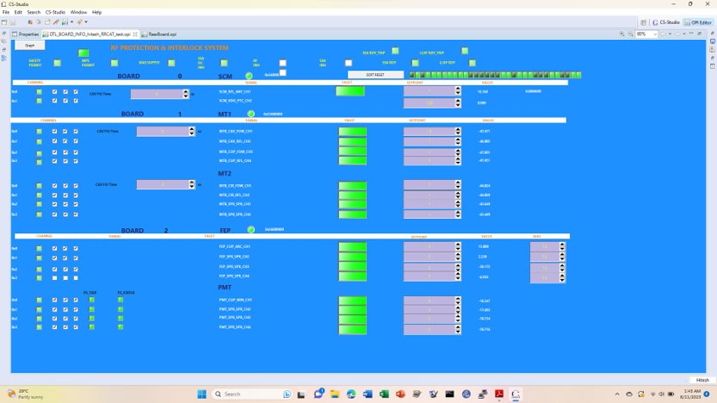

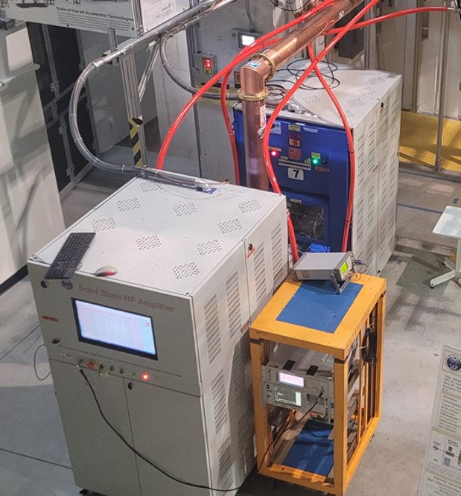



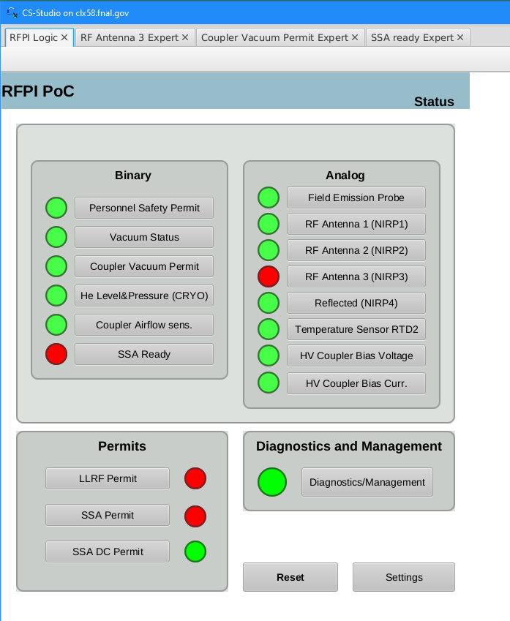
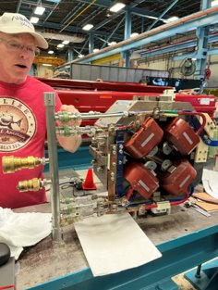

DAE/BARC
LLRF deliverables
PIP-II In kind opportunities & deliverables
New IKC Opportunities:
Phase Reference Line
RF Protection Interlock System
RF cavity simulators
LLRF Systems
DAE Solid State Amplifier deliverables
Poland/WUT Team
BARC
325 MHz 7 kW SSAs
Poland/TUL
Proof of Concept RFPI chassis
DAE/BARC
prototype magnet deliverables
RRCAT
650 MHz 40 kW SSA

