Slide 1


ACORN
Adam Watts
AD/Ops 0900 ACORN Update
13 October 2023

Slide 2
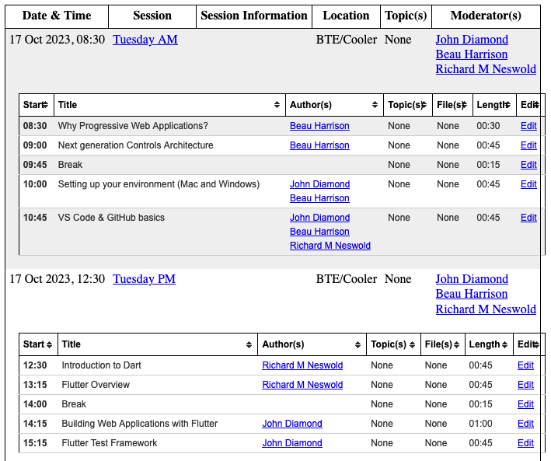
Introduction to Controls Application Development
ACORN, Controls, PIP-II developing new web browser application framework
Two-day clinic to learn about the framework, motivations, and get help building applications
October 17 and 18, in BTE Cooler or on Zoom
Event itinerary: https://beamdocs.fnal.gov/cgi-bin/sso/DisplayMeeting?conferenceid=276
Anyone interested in joining, Adam can forward the calendar invite.
Topics include: Progressive web applications, Dart and Flutter, Visual Studio Code, GitHub and GitHub Actions, Docker and Podman, Kubernetes, Test-Driven Development, GraphQL, gRPCs

Slide 3
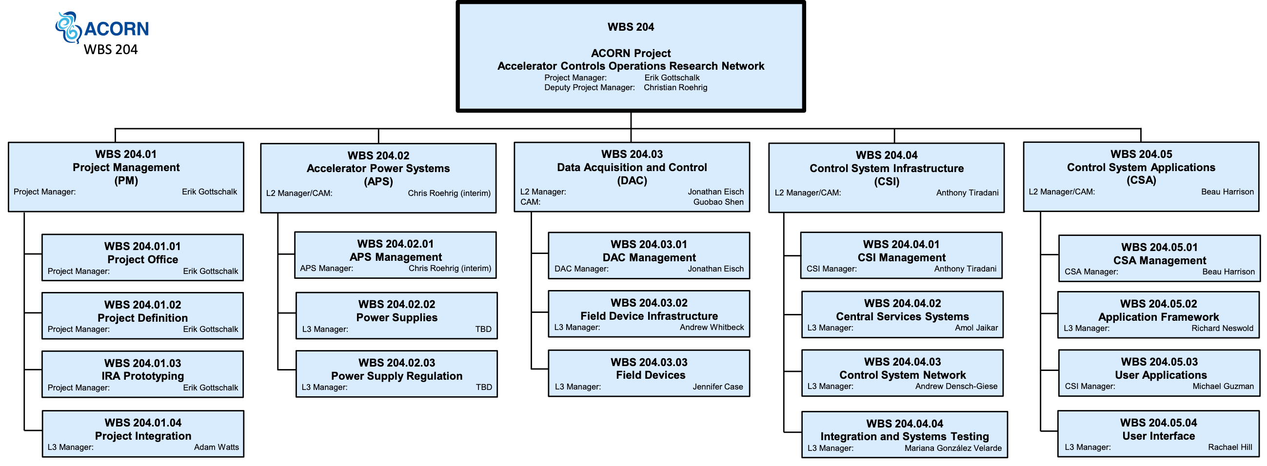
ACORN 204.05: Control System Applications

Slide 4
ACORN 204.05: Control System Applications
Developing web browser framework for control system applications in collaboration with PIP-II.
Consulting with expert users to determine application criticality to operations, feature requests, how application is used
Analyzing all current control system applications, developing labor estimate for upgrading. Developing algorithm for determining application priority based on effort, criticality, user input, etc.
Working with 204.04 (Control System Infrastructure) to create standard software development process following modern CI/CD principles
Human factors approach to application and user interface design; partnering with Idaho National Lab psychologists to develop style guide of best practices for application accessibility
Some R&D funding available for expert users of specific applications to consult with the 204.05 team. Reach out to Beau Harrison if you think you can help.

