Slide 1
LBNF - Beamline – Target Complex
Horns
Friction Stir Welding vendor verification
First horn stripline returned to SDSMT to reweld
Samples sent to German vendor
Negotiating with PNNL to do samples
Continued work on drawings of inner and outer conductors of Horns B & C.
Redesigning of electrical break between Horn A Prototype outer conductor and the collection water tank
Horns Power Supply
Single cell prototype testing continues
Many purchase requisitions being generated for full power supply for the Horns Test Stand at MI-8.
Soon electrical work will be performed at MI-8 to support Test stand power supply and water cooling system.

Slide 2
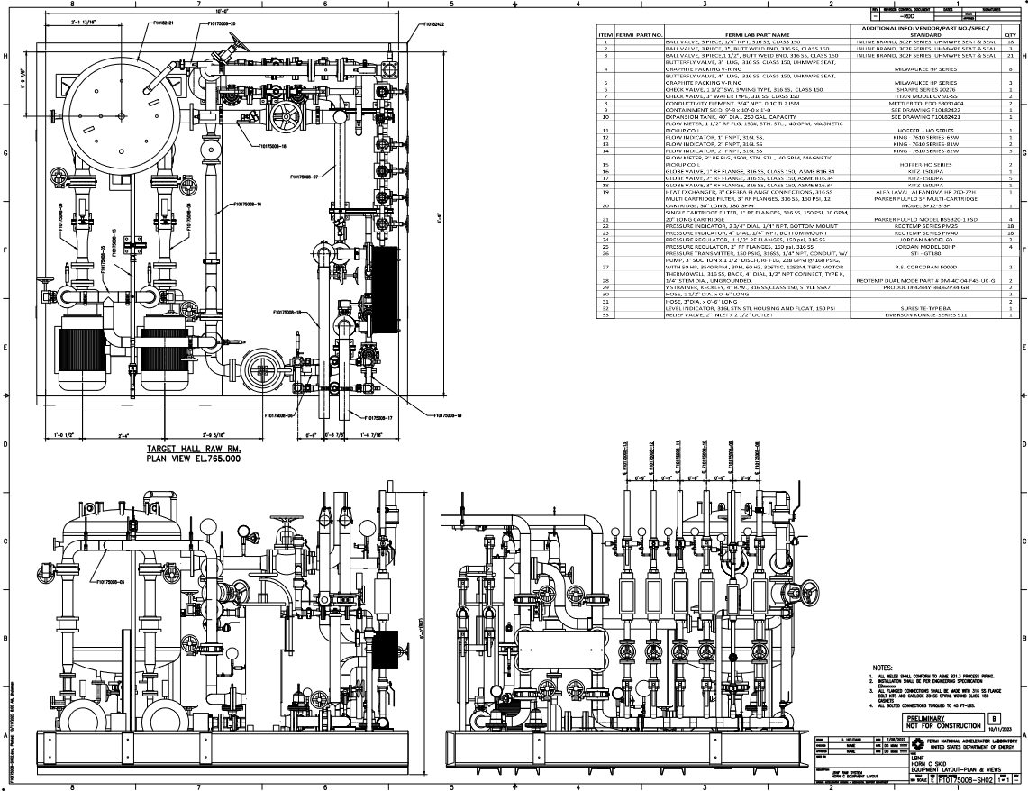
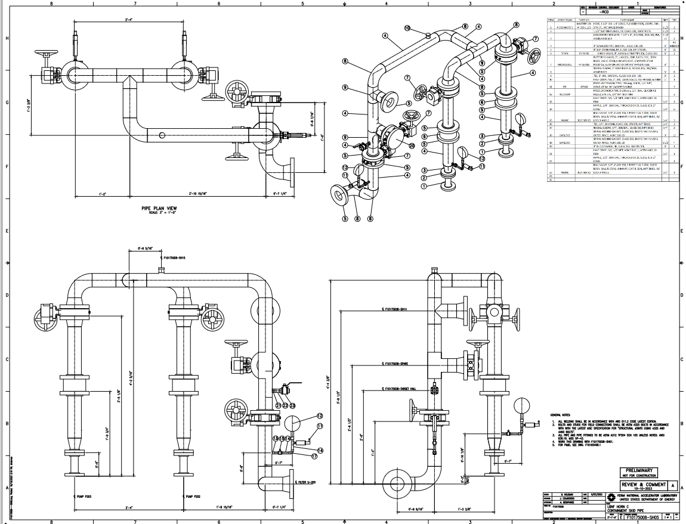
LBNF - Beamline – Target Complex
Water Cooling System
Design work continues for
Horn Test Stand
Absorber RAW
Intermediate Systems for the TC & AC
Horn B & Horn C RAW systems
Water Cooling System
Working with Controls to design layout for instrumentation and control of valves
Horn Test Stand is ongoing
Initial exchange of information for TC & AC systems
Electrical work at C0 to allow testing of prototype gas control system for H₂ from disassociation in water & allow for radioactive decay of ⁴¹Ar

Slide 3
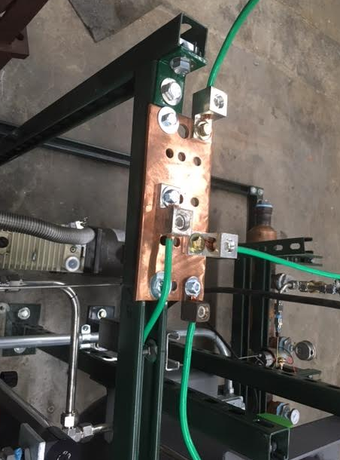
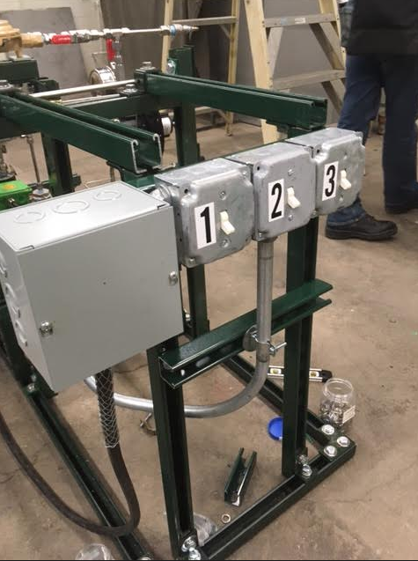
131.NSCFB.03.03.06 -- RAW Water Systems (incl Horn Test Stand)
Mechanical design work and fabrication drawings progressing well for:
Absorber RAW
Horn Test Skid
TC and AC Intermediate systems
Horn C RAW system. Here are the latest prints for Horn C which are being checked by Yurick:
Completed kick-off meeting with Mark Austin and Tom Zuchnik (Controls). Gathering all P&IDs, instrumentation lists, and control system logic documentation for AC systems and providing them to the controls group.
The PLC and controls system design for the Horn Test Skid is progressing well. We have finalized the location of the PLC in MI8 for the test skid.
Electrical work at C0 on the gas prototype (Paul Neville):
Horn C RAW
Horn C RAW

