Slide 1
ES&H Radiation Physics Operations
Joel M Fulgham
Oct 13, 2023

Slide 2
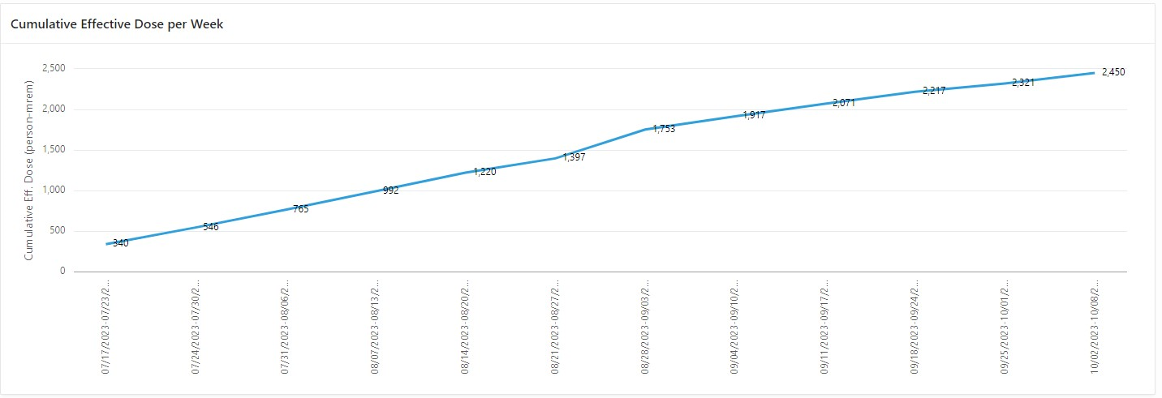
Highest dose individual was 141 mrem. Majority are 1-25 mrem.
Notes:
From dye test in 2012 we know all the sump wells except 3 have a broken pipe somewhere. This is how tritiated water gets into sump well 4.

Slide 3
New Positions
Floyd Flanigan is the new RCT Group Lead and his contact information is
Phone X4007, email flanigan@fnal.gov.
Please email both of us while we are switching over.
He is out today so just contact me.
If you haven’t met him yet Gary Buckley is the new RPO Department Head.
Phone X5141, email gbuckley@fnal.gov

Slide 4
More changes
If you need changes to the MCR Key authorization list please contact me for the changes. I have taken that over from Maddie.
Radiography was scheduled for tomorrow but that has been postponed.
Speaking of radiography, radiography request will start coming to me instead of Kathy Graden.

Slide 5
More changes
Since we will be in Controlled Access for an extended amount of time with no beam we are preparing interim RWP without the PPE requirements.

