Slide 1
Mu2e Production Solenoid
Production Solenoid
Houses Production Target
Inner bore lined with a bronze and water heat and radiation shield to limit radiation damage to the PS coils
Captures pions and accelerates them towards the other solenoids
8 GeV proton beam
2.5 T
4.6 T
Production Target

Slide 2
Mu2e upstream and downstream Transport Solenoids
Production Solenoid
Houses Production Target
Inner bore lined with a bronze and water heat and radiation shield to limit radiation damage to the PS coils
Captures pions and accelerates them towards the other solenoids
Transport Solenoid
  Collimation system selects muon charge and momentum range
  Pbar windows upstream of first collimator and in the middle of central collimators
2.5 T
2 T

Slide 3
Mu2e Stopping Target
10¹⁰ Hz of stopped muons!
Technique demonstrated by MμSIC Collaboration
1 T
2 T
Stopping Target

Slide 4
Mu2e Detector Solenoid
Detector Solenoid
  Graded upstream field to improve acceptance and reject backgrounds
  Uniform field downstream for momentum analysis
105 MeV electron
1 T
1 T
2 T
Calorimeter
Tracker

Slide 5
Work at Mu2e building
2024 is going to be a busy year at the Mu2e building
  We are expecting delivery of the upstream Transport Solenoid (presently at HAB) very soon, followed soon thereafter by downstream Transport Solenoid, then the Production Solenoid, and finally the Downstream Solenoid…
  Calorimeter expected to arrive in Summer, followed by the Tracker…
The plan was
  Production Solenoid (PS)
  Upstream Transport Solenoid (TSu)
  Downstream Transport Solenoid (TSd)
  Detector Solenoid (DS)
Now the plan is
  Upstream Transport Solenoid (TSu)
  Downstream Transport Solenoid (TSd)
  Production Solenoid (PS)
  Detector Solenoid (DS)

Slide 6
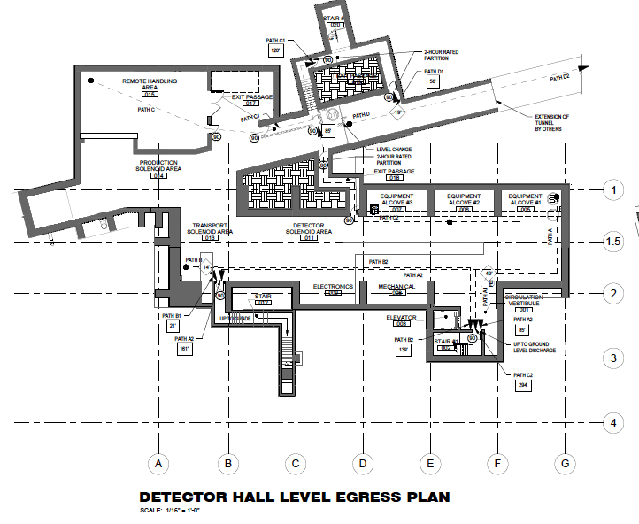
This adds some complications to our lives
Artist’s depiction of solenoids
.
PS
TSu
TSd
DS

Slide 7
Original plan
Artist’s depiction of hatches
.
PS hatch
DS hatch
Original plan: lower all solenoids through DS hatch, maneuver magnets on lower level to final locations

Slide 8
New plan
Artist’s depiction of hatches
.
PS hatch
TSu
TSd
DS hatch
New plan: lower TSu, TSd through DS hatch, maneuver to final locations, lower PS through PS hatch…
… This will require to rent a crane with heavy lifting capacity with a long reach to reach the PS hatch… Wish us luck!

