Slide 1
Project Activities in MSD
Mayling Wong-Squires
AD Operations Friday 9am Meeting
13 October 2023

Slide 2
MSD Report - 13 October 2023
LBNF
Target Bunker, Target Utility Corridor, and RAW room: supplied new material estimates for interconnecting piping to create BCR
Primary Beam Enclosure: checking drawings for support stands; design of LCW, FCC, and conduit to this area from MI-14
Primary Beamline: design, analysis, drawings, engineering notes and other engineering oversight for beamline vacuum components, structural supports, LCW; working with vendor on plan for sample coating of ceramic tiles; dipole tube installation demonstration at MI-60 is being planned for mid-late November
LBNF-05 power supply room: work continues
Instrumentation: BPM design, spool piece drawing review, support stand engineering note in review
Primary beam window: engineering review of final cartridge design drawings
PIP-II
RF cavities and PA’s: receiving of components, assembly of new MI cavity’s dual PA, design of new 53-MHz RR cavity
BTL collimator: drawings in progress; PRR rescheduled to February, 2024
Instrumentation: engineering and component procurement in progress for instruments and and stands
Vacuum: BTL and LPM design, drafting, and analysis; BTL evaluating dipole and septum vacuum chambers fabrication options as part of upcoming BTL Final Design Review; preparing for upcoming Integrated Vacuum Systems Final Design Review
Mu2e
Septa: await arrival of stand parts; septum to moved NWA
HRS skid: technicians are setting up the test, with relief valves that were delivered from PAB

Slide 3
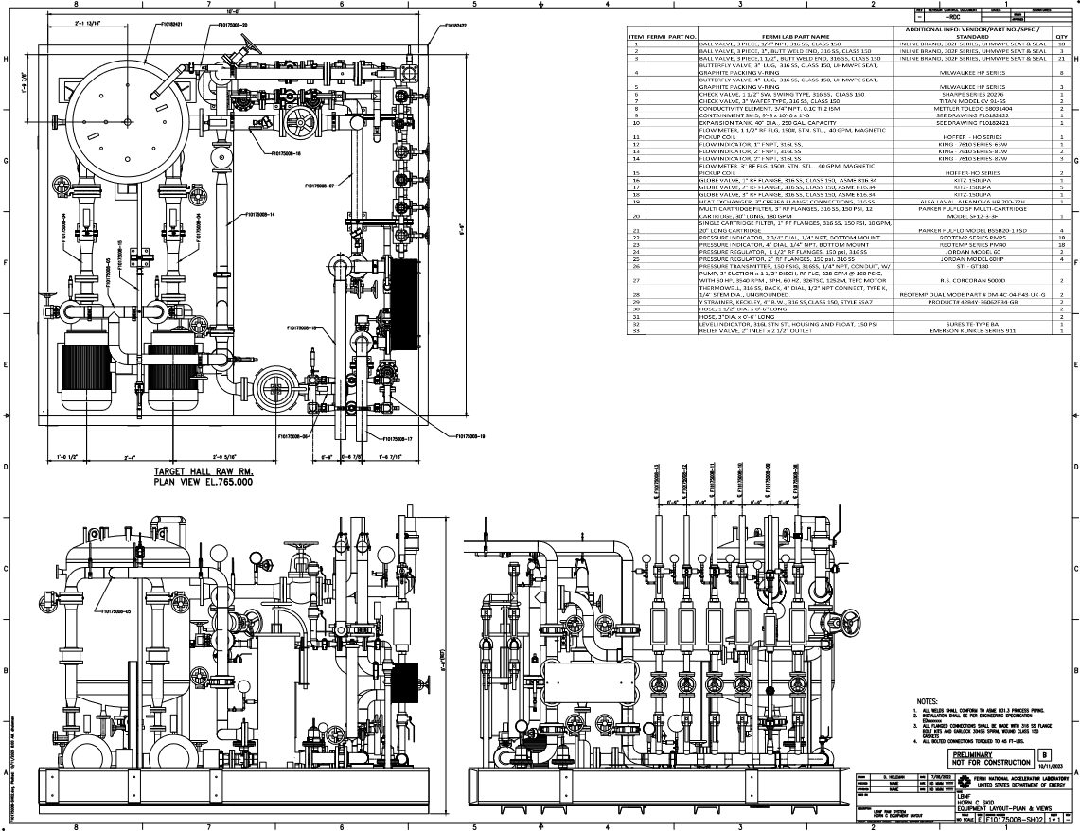
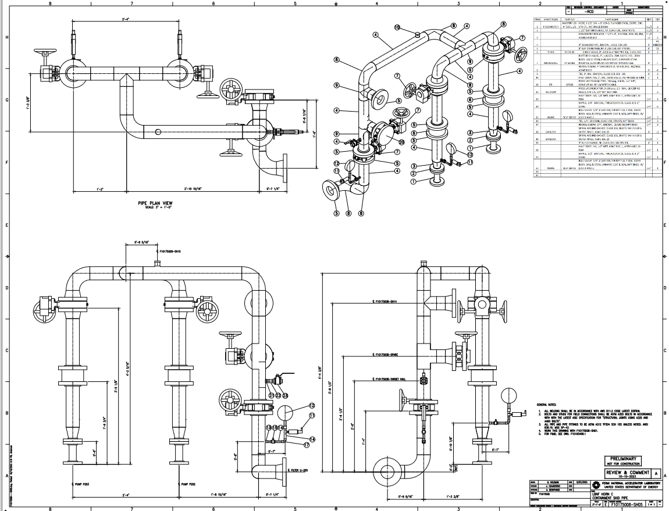
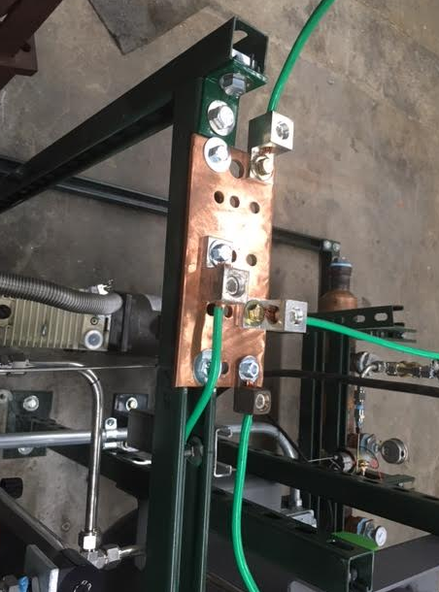
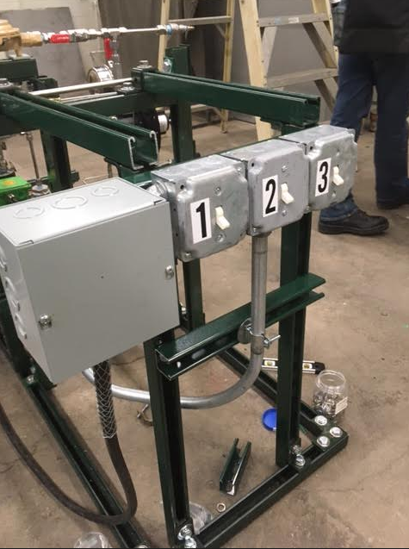
LBNF RAW Systems (incl Horn Test Stand) and C0 gas prototype
Mechanical design work and fabrication drawings progressing well for:
Absorber RAW
Horn Test Skid
TC and AC Intermediate systems
Horn C RAW system. Here are the latest prints for Horn C which are being checked:
Completed kick-off meeting with Mark Austin and Tom Zuchnik (Controls). Gathering all P&IDs, instrumentation lists, and control system logic documentation for AC systems and providing them to the controls group.
The PLC and controls system design for the Horn Test Skid is progressing well. We have finalized the location of the PLC in MI8 for the test skid.
Electrical work at C0 on the gas prototype (Paul Neville):
Horn C RAW
Horn C RAW

