Slide 1
MI/RR General
HVAC installation finishing up with punch-list items. Electrical conduits need to
be moved. Meeting this morning for updates.
Working on LAM61 cables and Recycler 620 sextupole cables next week.
RF maintenance continues.
Finished the cavity water path rework. Re-assembling the cavity so we can pull
another cavity to rework before the next shutdown (or not).
MI-60 Test Cave anode PS transformer replacement is delayed.
1
MI Department Meeting | D. Morris
10/13/2023

Slide 2
Tunnel Work
Removed two Recycler sextupoles from 322 and re-installing them at 620.
Finishing up connections at Q333 and Q319.
Need to reconnect the bus.
Upgrading MI RF#4 to dual PA operations.
Most of the LCW hoses have been replaced.
Finished behind the NuMI line and overhead at 616-618.
Still need to change hoses in MI-30 collimation section.
2
MI Department Meeting | D. Morris
10/13/2023

Slide 3
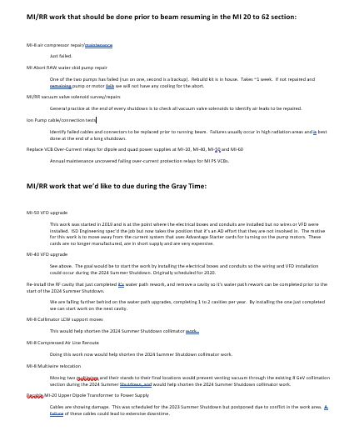
Work Left/We’d Like To Do During Extended Downtime
3
MI Department Meeting | D. Morris
10/13/2023

