Slide 1
Muon Campus Operation Report
Jerry Annala
Friday 09:00 Operation Meeting
October 13, 2023

Slide 2
Muon Campus status
Wall Current relocation from Delivery Ring to 907 in M4 Line
Extraction line modification at 907 complete
Under rough vacuum
Ion pumps will be turned on after leak check
ESS1 Electrostatic Septum acceptance testing NWA
Pump down began last Friday (10/6/2023)
Low voltage will be applied today (10/13/2023)
Electrostatic Septum ESS2 remains isolated and under vacuum
Venting to reconnect to Delivery Ring vacuum depends on ESS1 progress
Preparing to replace LCW braided hoses to Delivery Ring sub-headers
Working on plan for draining AP-0 RAW systems
Still need Vault access to confirm isolation valve locations
Will keep Dump system filled and running for possible future Mu2e target test
Pre-Target exhaust blower EF1 replacement VFD controller on order
ISD ordered spare unit 8/30 with expected arrival time in first week of October
AP-0 Air Conditioner Replacement work continues to be paused
Waiting on contractors to return and finish installation
Only a week or two of work needed before system can be tested
LCW make up rate still suspiciously good
Study – M1-M3 Optics
Study – Alternative M5 optics
KPS5A PFL Repair
MC-1 Controlled Access
G-2 Trolley Run
Intentional Accelerator
Standby Period
<------------Week Days -------------------→

Slide 3
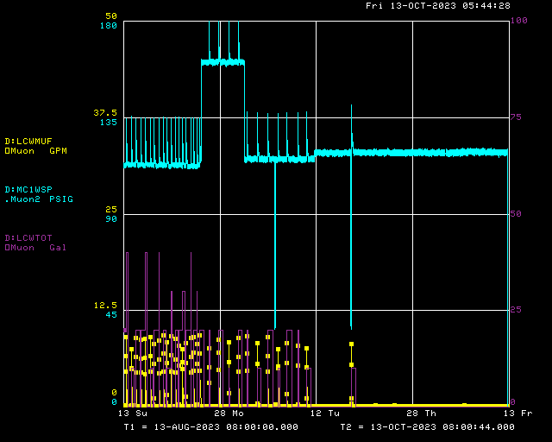
Muon Campus LCW make up for last two months
Last month
10 gallons on Sep 18
Previous month
20+ gallons/day
Historical best in memory
Once every 8 days

Slide 4
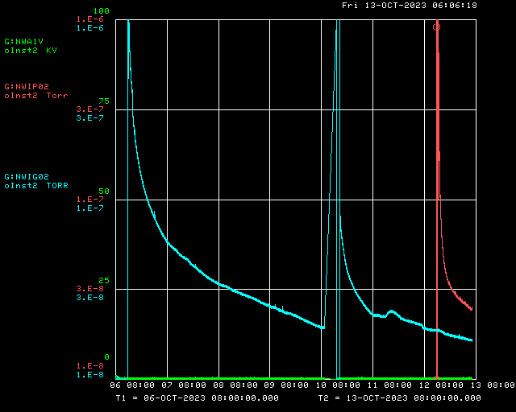
ESS1 Vacuum at NWA (one week plot)
Power outage at NWA
Plan to turn on to low voltage today.
Conditioning begins when vacuum reaches 1e-8 torr
Initial pump down

Slide 5
Upcoming work
Vacuum leak check in V907 region of M4 Line
Replace two LCW sub-header braided hoses in Delivery Ring Enclosure
Replace four leaking NSA Sextupoles in the Delivery Ring
AP-0 A/C work on hold, awaiting return of contractor
Replace EF1 Pre-Target rad air exhaust VFD Controller when replacement arrives
Finish repair of AP-30 transformer (install new cable jumpers being made at machine shop)
Replace breaker in AP-10
Post Shutdown work
Install ESS1
Finalize installation of ESS2
Replace Q205 with rad hard modification
Survey and Alignment jobs
M4 Line Wall Current Monitor and vacuum pipe
D30 straight section survey when crew becomes available
If ESS1 installed in Delivery Ring later this Fall, will need to be aligned

Slide 6
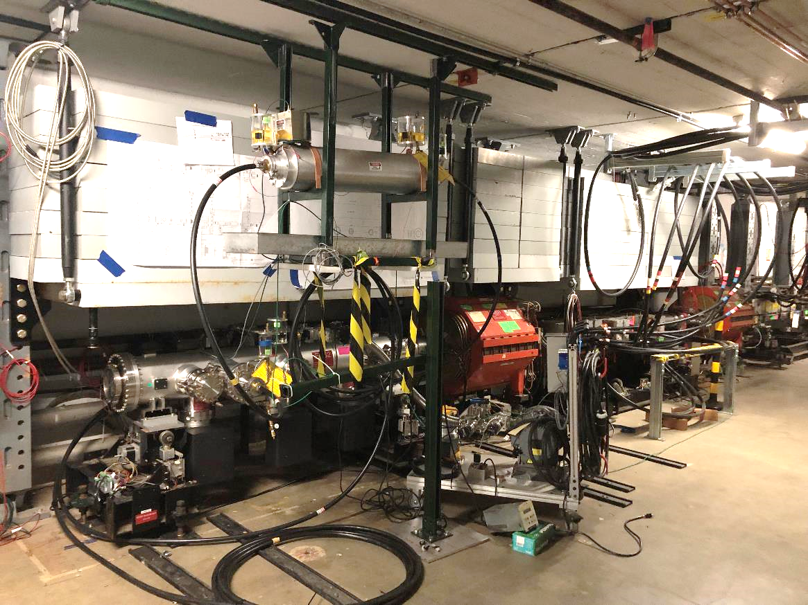
ESS2 isolated in D30 straight section of Delivery ring
Extraction Kicker
(future home of ESS1)
ESS2

