Slide 1
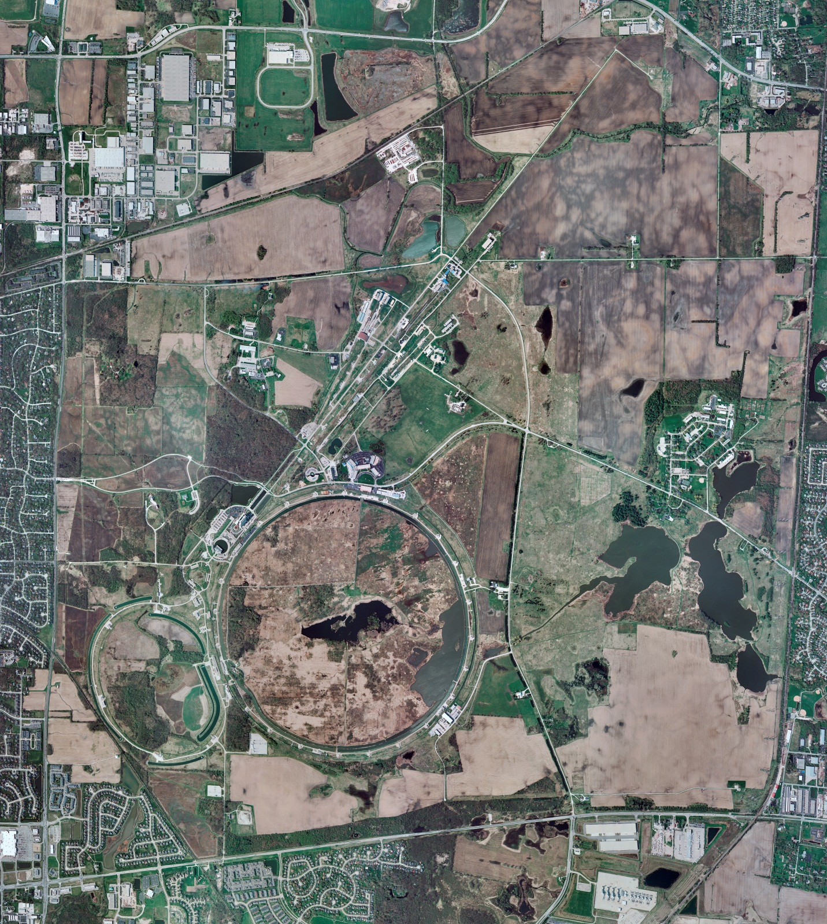
Helium Cryogenics
Status 10/13/2023 J.Makara
CMTF: SCP is cold and operating fine
CMTS: HECM27 CM at RT under LOTO for its removal
PIP2IT: SSR1 pCM cooldown in progress
North CM stand empty
MCTF: cryo system is cold and running fine after controls issues fixed.
MDB/HTS: at RT
MDB/STC: .SSR2 was cooled down to 2 K, RF testing done, and now warmup in progress
MDB Magnet: at RT
NML/FAST: Cryo system is cold and running fine with good excess capacity
CC1: at 2 K
CC2: at 2 K
CM: at 2 K
IB1: cryo system is at RT for 4-week maintenance period.
Muon Campus: A0 comprs (3) online with MC-1 g-2 cryogenic system running fine at 5 K with g-2 magnet powering.
Misc: .

