Slide 1
AD Controls Department Report
Adam Watts
13 October 2023

Slide 2
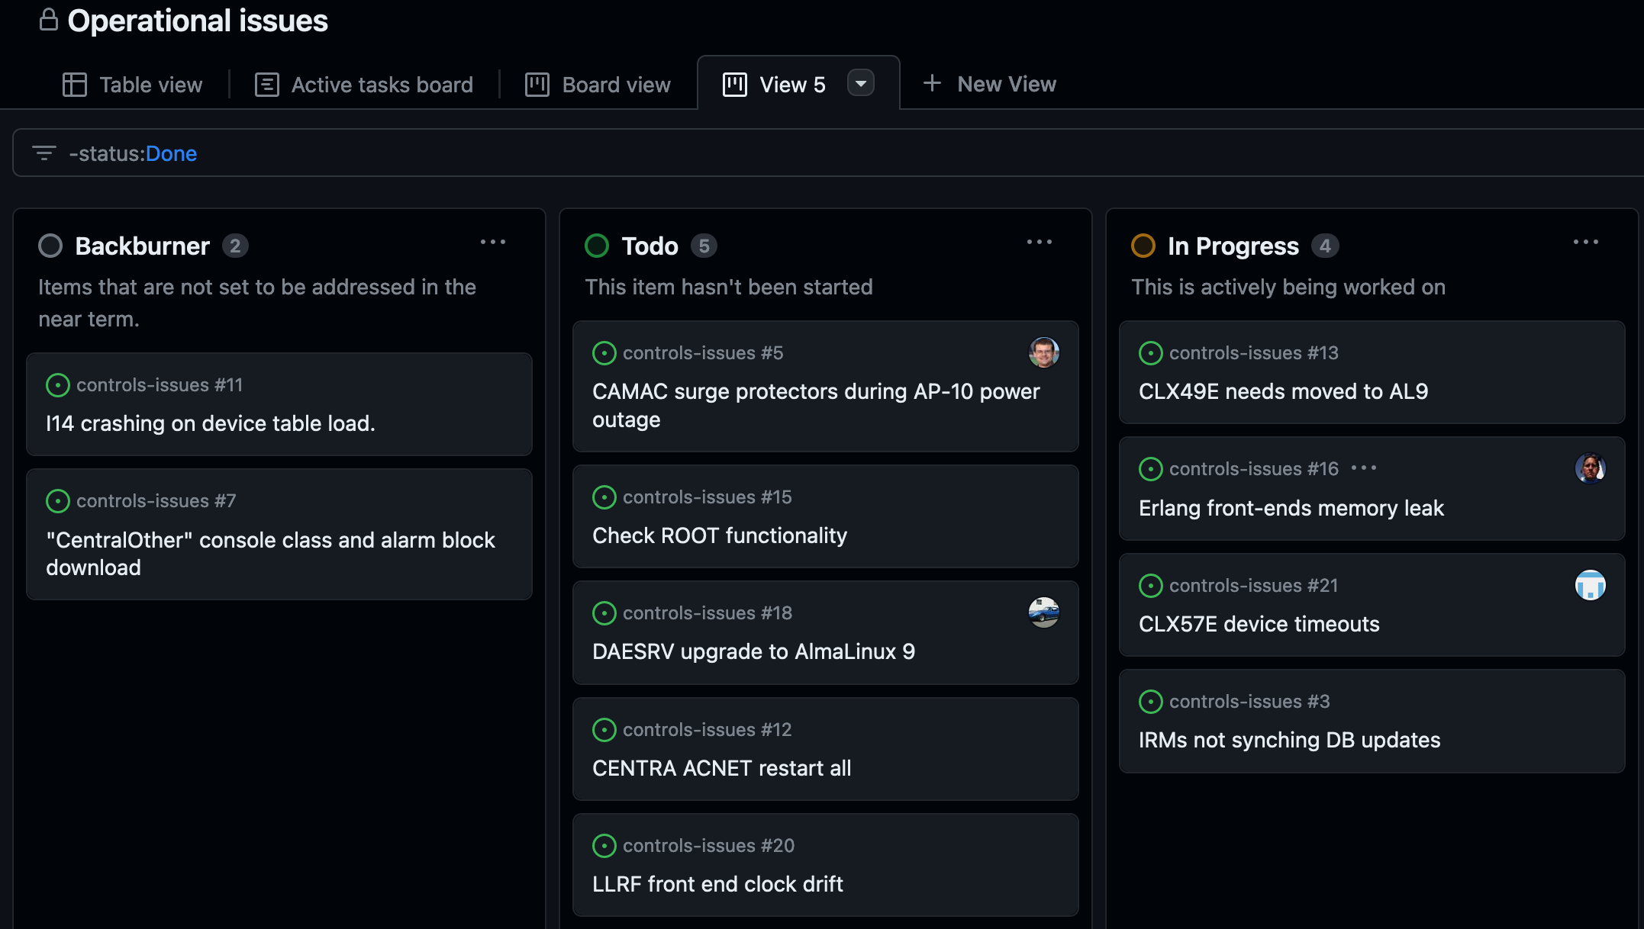
Ongoing issues
Erlang front end memory leak appears fixed by upgrading to Erlang 26.1. Finding out if any front ends still need the upgrade.
IRM database change syncing broken again. Troubleshooting.
Looking to schedule DAESRV swap to AlmaLinux 9. Affects Java engines (including OACs, DPM, DAEs), Elog, remote file shares (Samba), Java app servers. Switchover ~1 hour. Proposed outage time: Tuesday 10/17, 09:00 – 10:00.
Looking to schedule CLX49E (GPIB front end) move to AlmaLinux 9. Already tested GPIB driver on AL9; estimate 30-40 minutes downtime. Takes 30 minutes to retreat if a problem.
Looking to schedule restart of all central services. (On Centra, “acnet restart all”)
Note that several department members are at an international conference.
Notes:
We are working on another robot that used to be part of the MARV family. It is now called HERMES, short for Helpful Robotic Messenger). It is the smallest robot that we have that can be used for confined spaces and high radiation areas. A co-op engineering student designed a 3D printed chassis. Curently, under Susanna Stevenson's and Adam Watt's guidance, a senior engineering design group at Northern Illinois University is buidling a payload for autonomous photographic mapping of enclosures.

