Slide 1
MAGIS-100:
A 100 meter atom interferometer for fundamental physi
Rob Plunkett
Fermilab Cosmic Day 2023
October 30, 2023

Slide 2



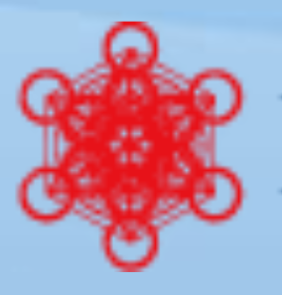

MAGIS-100 Collaboration
US/UK International Collaboration to bring LB Atom Inteferometry to Fermilab.
Collaboration initiated 2017.
Funding Sources: Gordon and Betty Moore Foundation, US DOE, STFC/AION, Kavli Foundation. Our thanks!
Kavli Foundation

Slide 3
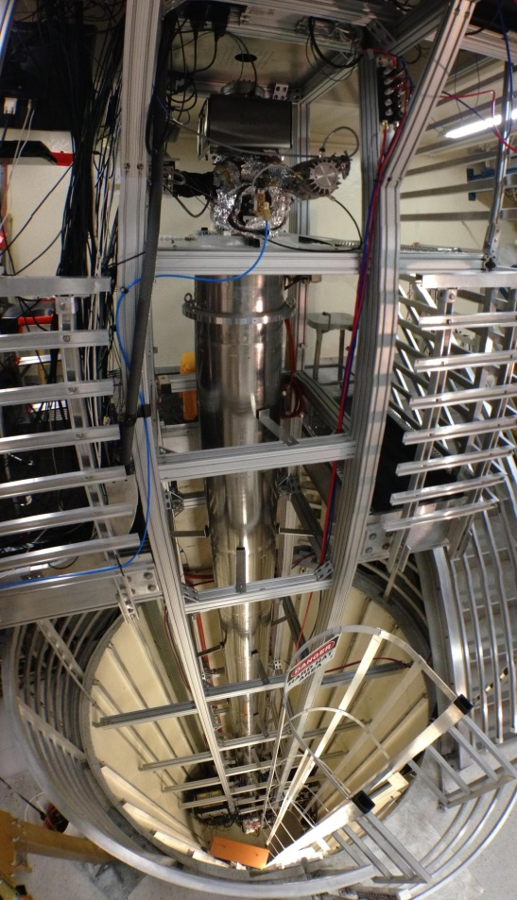
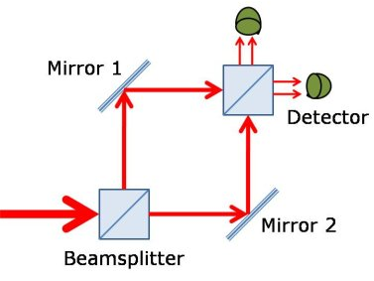
Brief Introduction to Atom Interferometry
Use cold atoms to detect phase shifts from split paths.
Analogous to Mach-Zender Interferometry with light.
Sensitivities for many fundamental physics applications scale with length of the baseline.
Current baselines about 10 m
Will extend this to ~100 m, increasing sensitivity.
Existing 10 m Interferometer
at Stanford

Slide 4
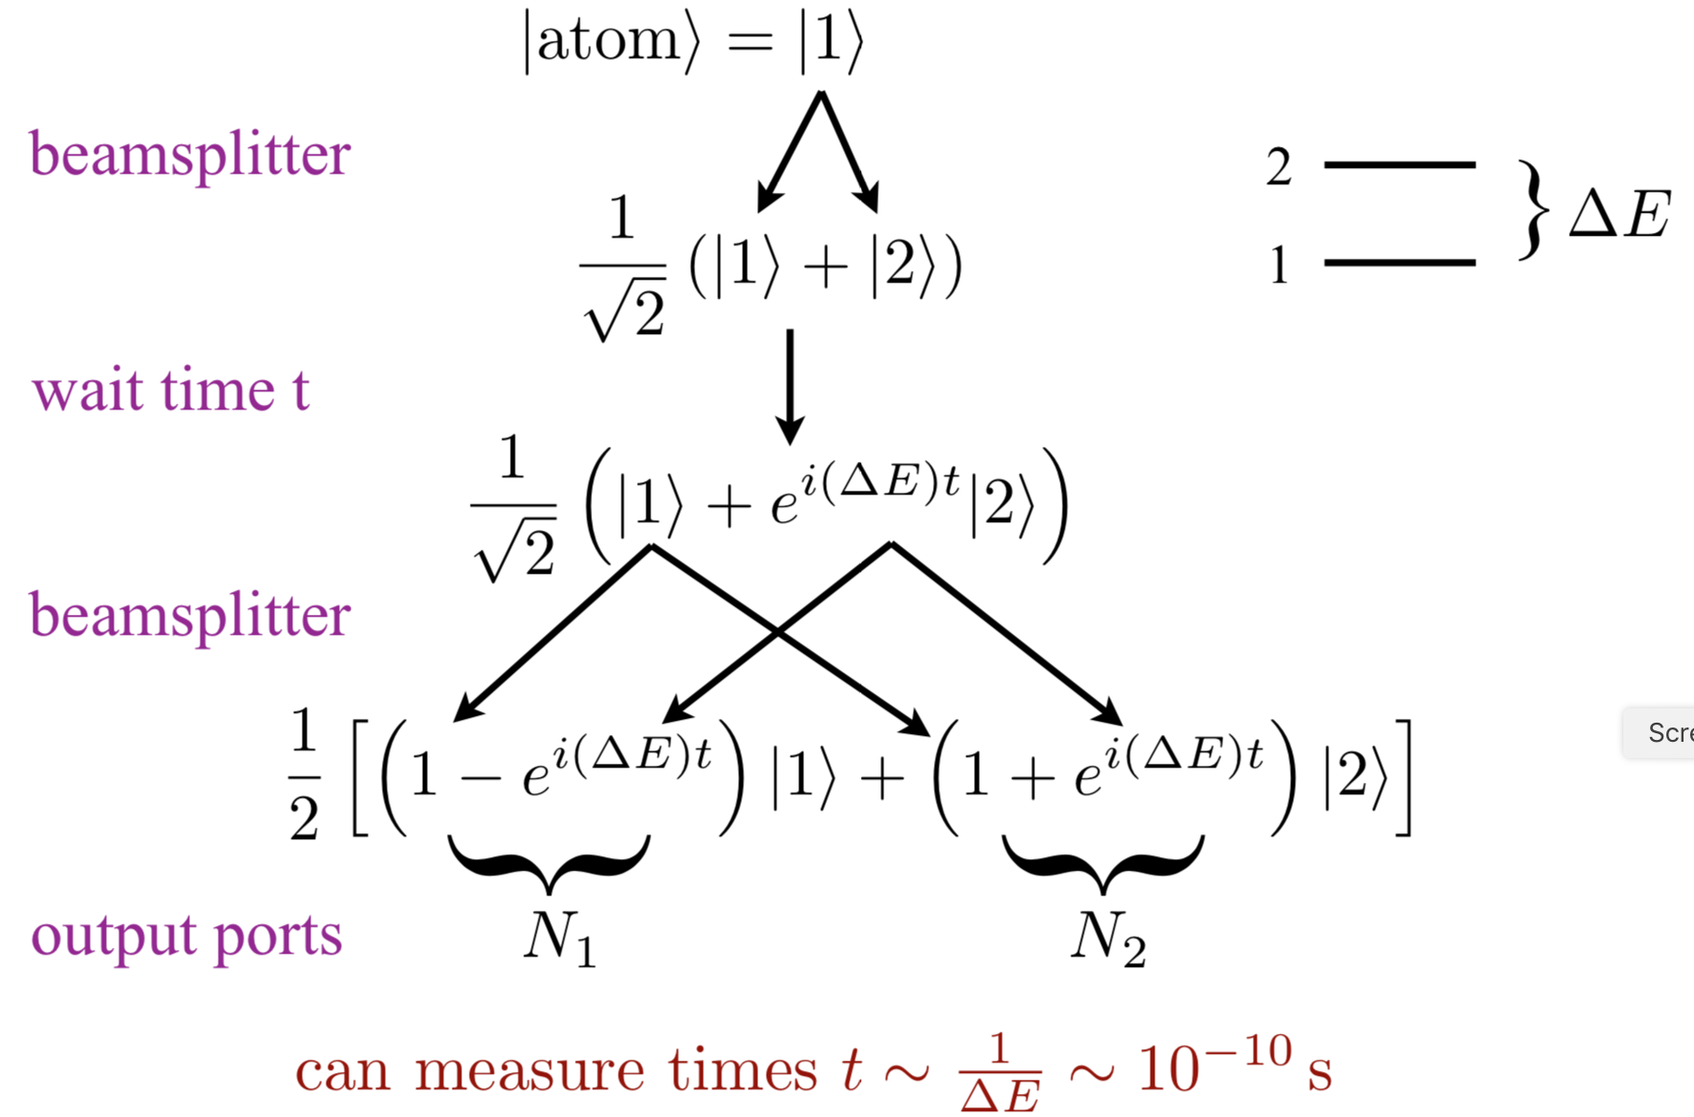
Pulsed Atomic Clock

Slide 5
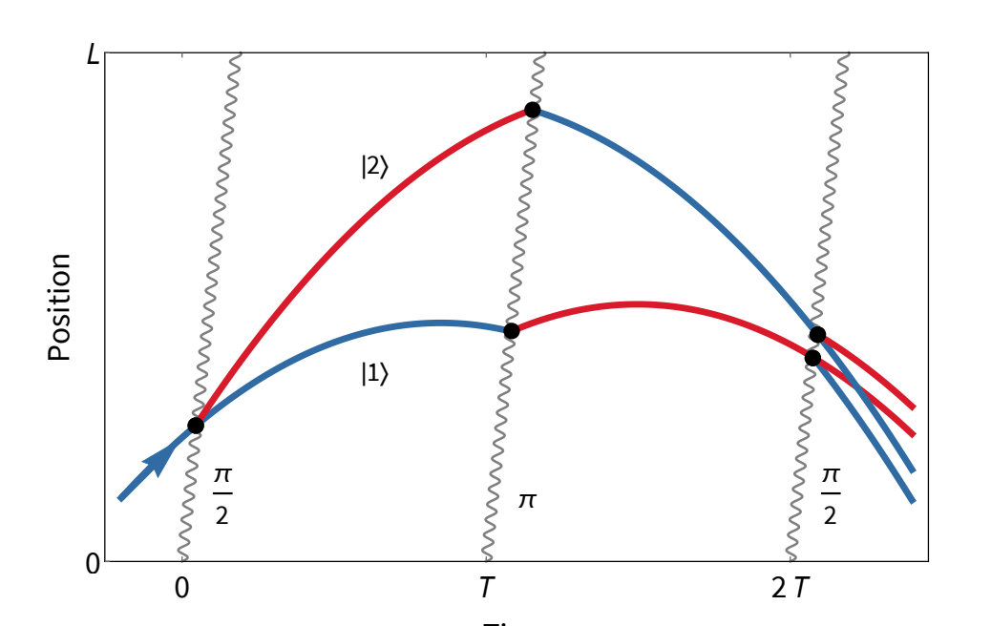
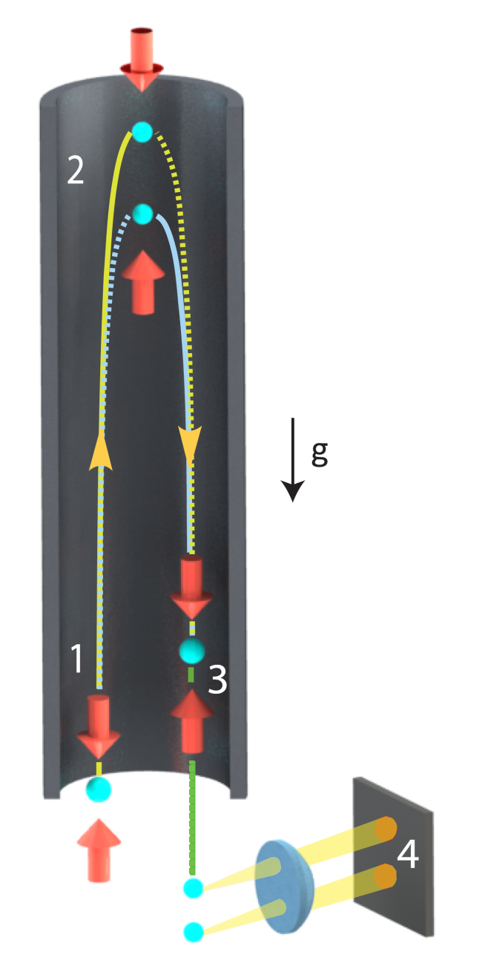
Fountain Interferometer

Slide 6
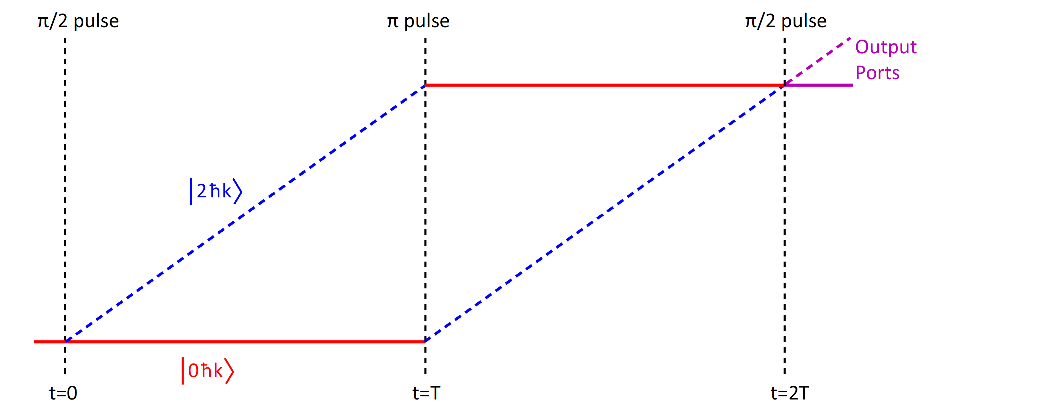
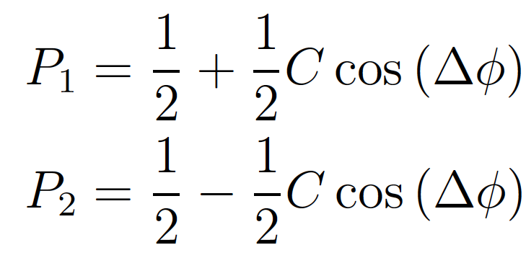
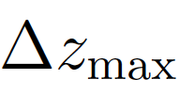
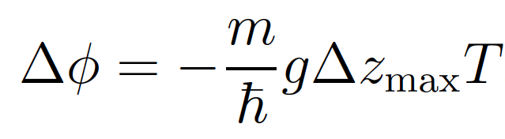

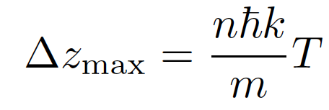
Interferometer Phase Shift
Back-of-the-envelope phase shift calculation (not fully rigorous, but gives the right answer): look at gravitational potential energy difference between two paths
g
n
Acceleration sensitivity (consideration sensitivity to g as illustrative example)
For n=100, 461 nm light (for Sr atoms), T = 1 s, phase shift from g is 10¹⁰ radians

Slide 7


Gradiometer Using Different Internal Clock States
Excited state phase evolution:
Two ways for phase to vary:
Dark matter
Gravitational wave
DM causes time-variation of transition frequency
Each interferometer measures the change over time T
Laser noise is common-mode suppressed in the gradiometer
Graham et al., PRL 110, 171102 (2013).
Arvanitaki et al., PRD 97, 075020 (2018).
Notes:
Differential atomic clock

Slide 8
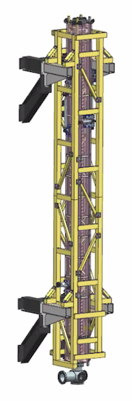
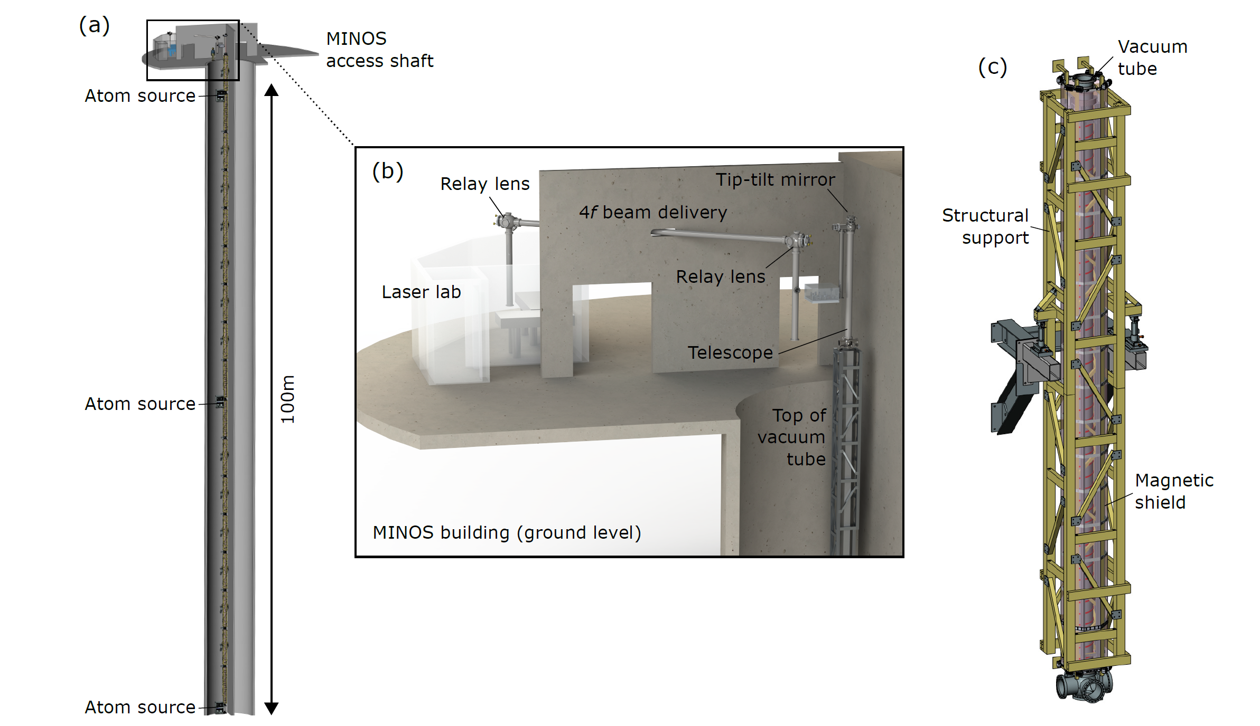
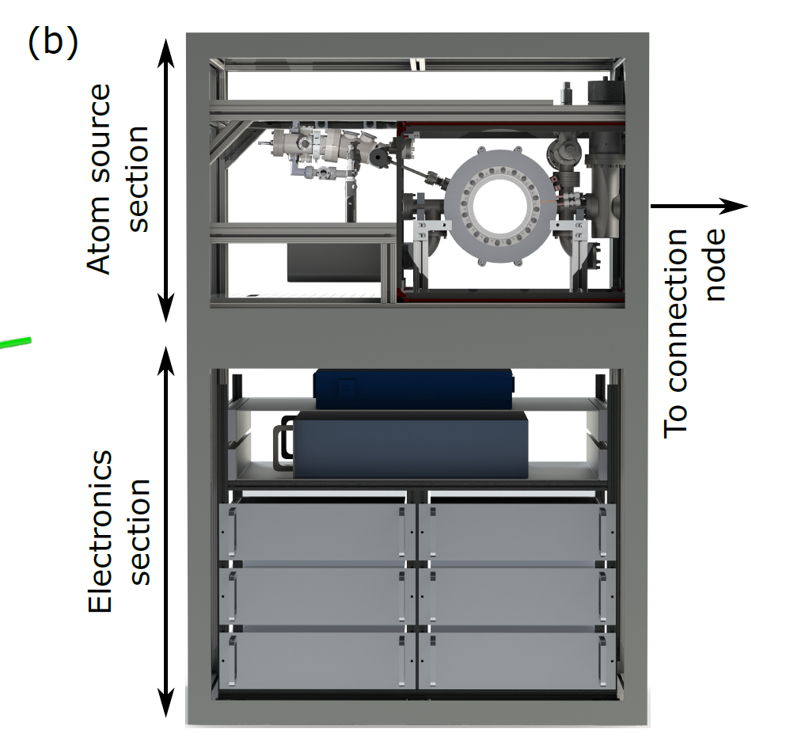
Experiment Layout: Shaft, and Surface
Vacuum tube
Modular Section
x 17
Structural
support
Magnetic
shield
Atom Source
x 3

Slide 9
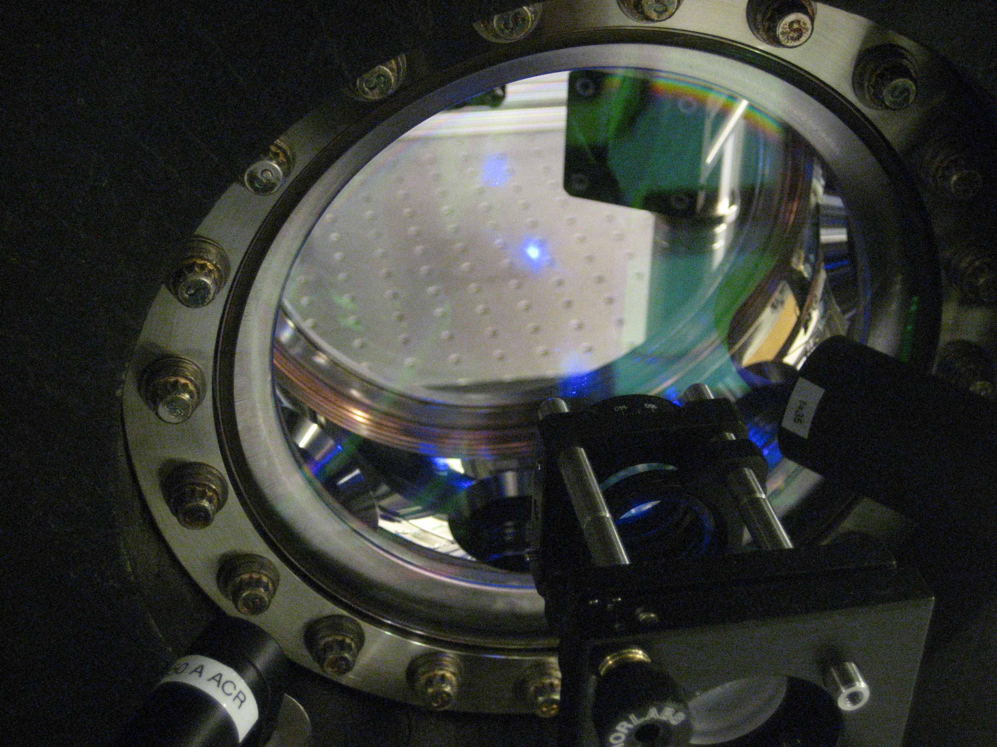
Cloud of Cooled Sr Atoms (Stanford)

Slide 10
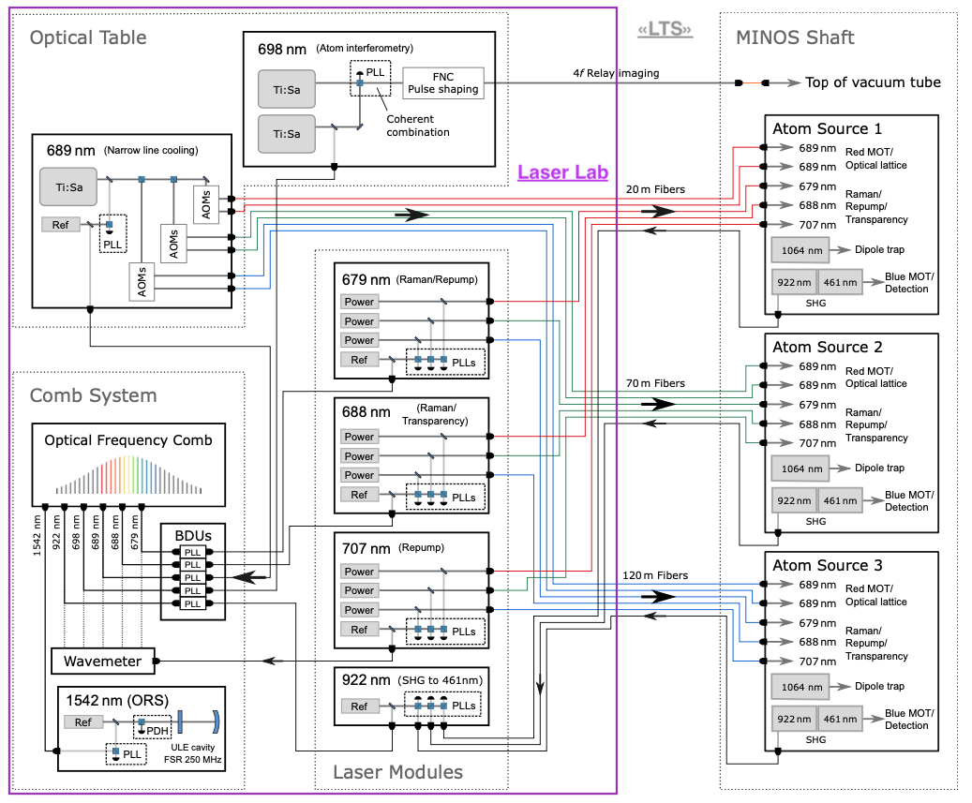
Laser System
= Safety System Laser Shutters
4w
8w
Vacuum Transport
Tele Seed Optics Box
Vacuum Telescope
4w
Laser System Schematic
  22 lasers
  8 wavelengths
On surface and in shaft
Integrated via optical comb
400mW
100mW
100mW
50mW
100W
400mW
Atom Interferometer vacuum pipes
400mW
100mW
100mW
50mW
100W
400mW
400mW
100mW
100mW
50mW
SS Permit or
AC Contactor ?
100W
400mW

Slide 11
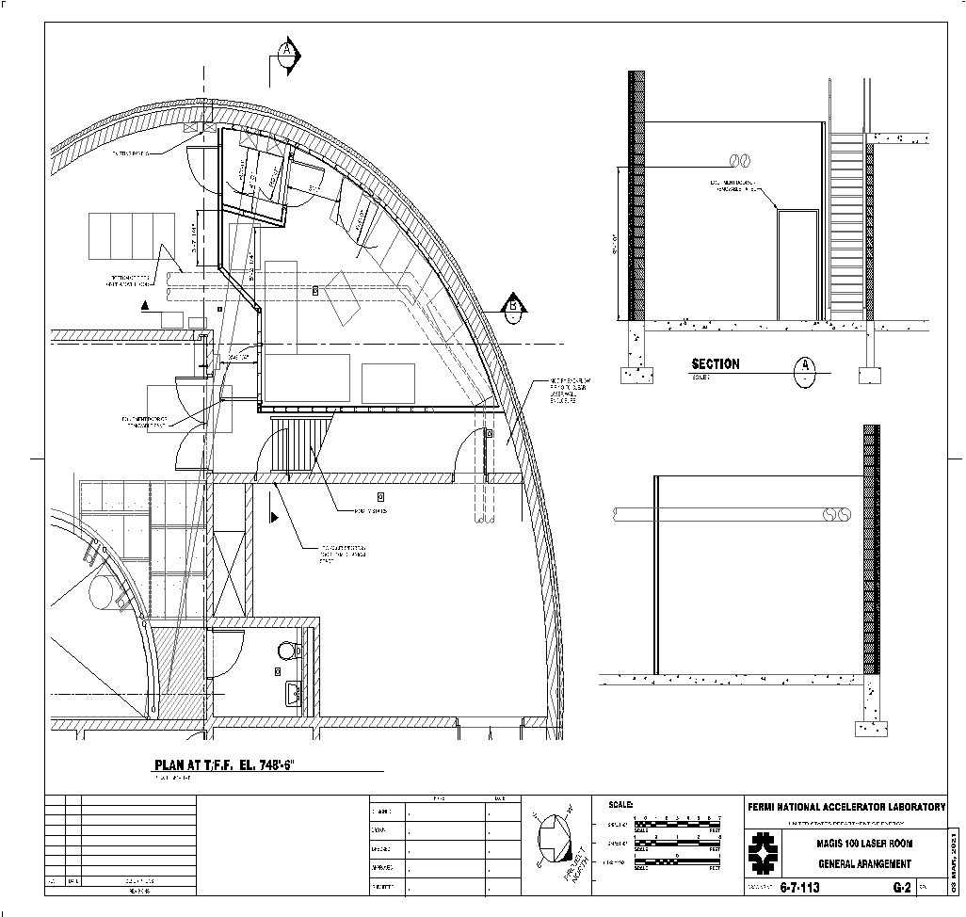
Laser Laboratory
Holds Interferometry Lasers, many others.
Houses Optical Comb
Support system for transport system.
Safety Interlocks.
Utilities on second level
Finalizing contract. Expect construction in summer.
MODULAR
DESK Sys
MODULAR
DESK Sys
Gate Valve
f
3x6
Optics Table
CART
MODULAR
DESK Sys
3x8
Optics Table
RR
RR
RR
SS
LTS
Laser Lab Equipment:
4 RR with fiber lasers in them
3 Free-space lasers on 3x8 table
2 optical transport (X) towers
AS
Telescope Seed
Optics Box (TSOB)
AI
T
Atom Interferometer 100m, beam pipe
f
Gate Valve

Slide 12
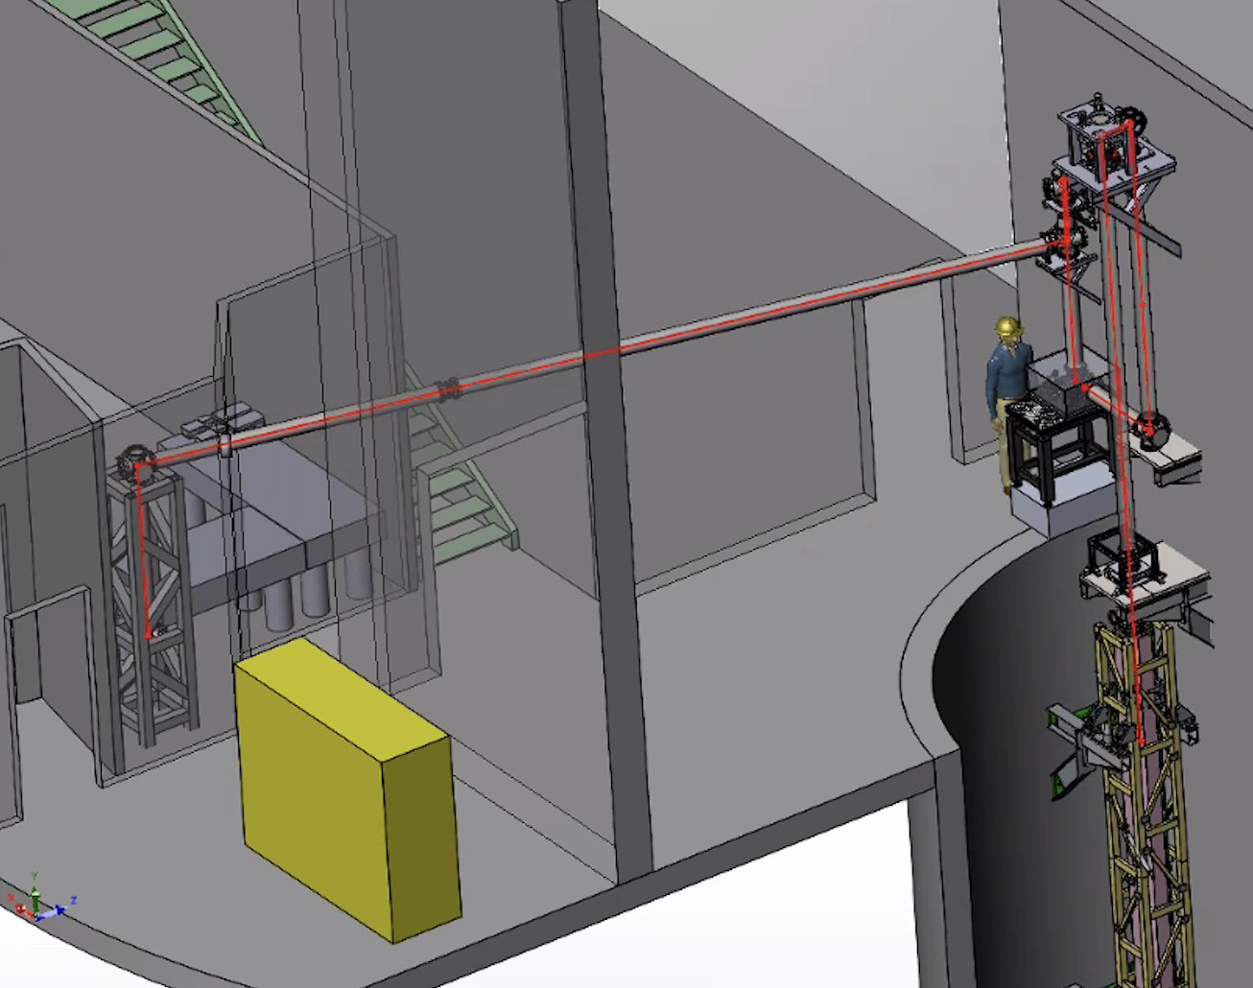
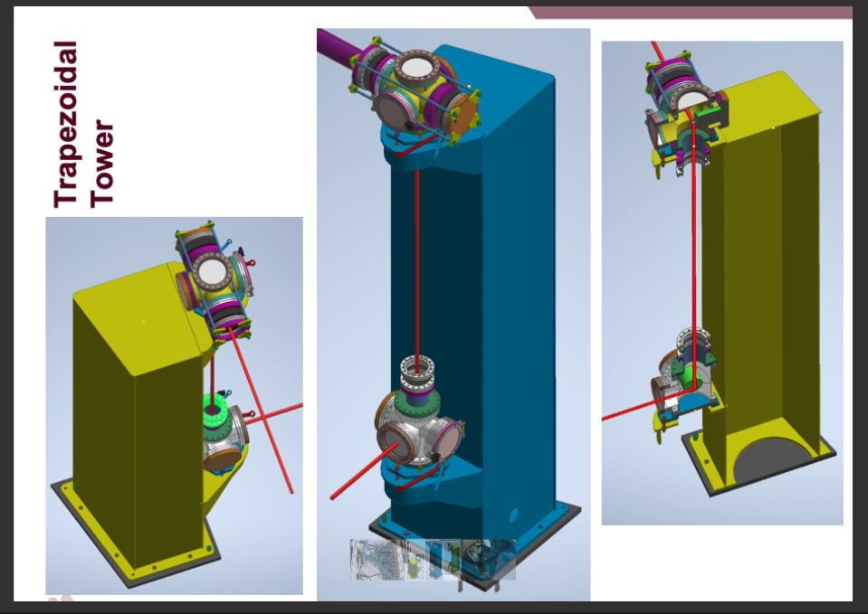

Laser transport system layout
Graphics: Northwestern University
ANL Engineering

Slide 13
MAGIS-100 Operation Modes
100 m

Slide 14
Landscape
Credit: A. Sushkov
Figure from DOE Dark Matter Research Needs Report, 2018

Slide 15

Ultralight scalar dark matter
Ultralight dilaton DM acts as a background field (e.g., mass ~10⁻¹⁵ eV)
+ …
Electron
coupling
Photon
coupling
e.g., QCD
DM scalar field
DM mass density
DM coupling causes time-varying atomic energy levels:
DM induced oscillation
+ δω
Dark matter coupling
Time
More info at Phys. Rev. D 97, 07520 (2018)

Slide 16

Measurement Concept
Essential Features
Light propagates across the baseline at a constant speed
Clocks read transit time signal over baseline
DM changes number of clock ticks associated with transit by modifying clock ticking rate
Many pulses sent across baseline (large momentum transfer) to coherently enhance signal
Atom
Clock
Atom
Clock
L
Notes:
Clock instability at 10-18 level

Slide 17
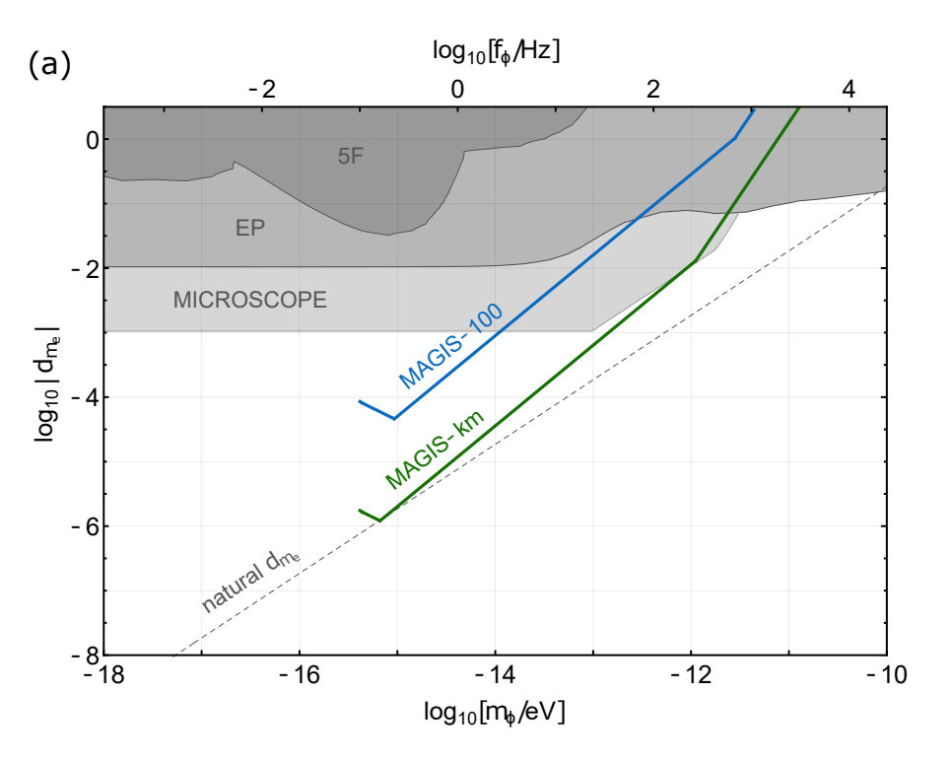
Dark Matter Sensitivity – Electron Coupling

Slide 18
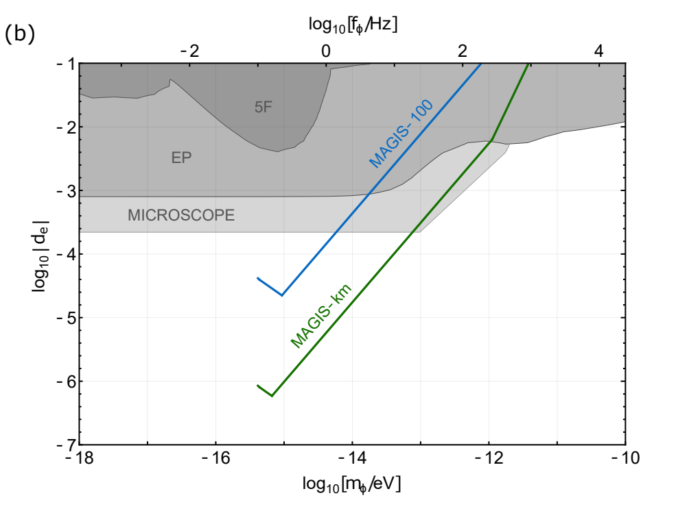
Dark Matter Sensitivity – Photon Coupling

Slide 19
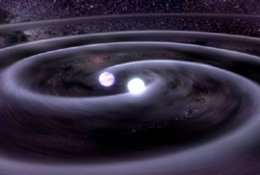

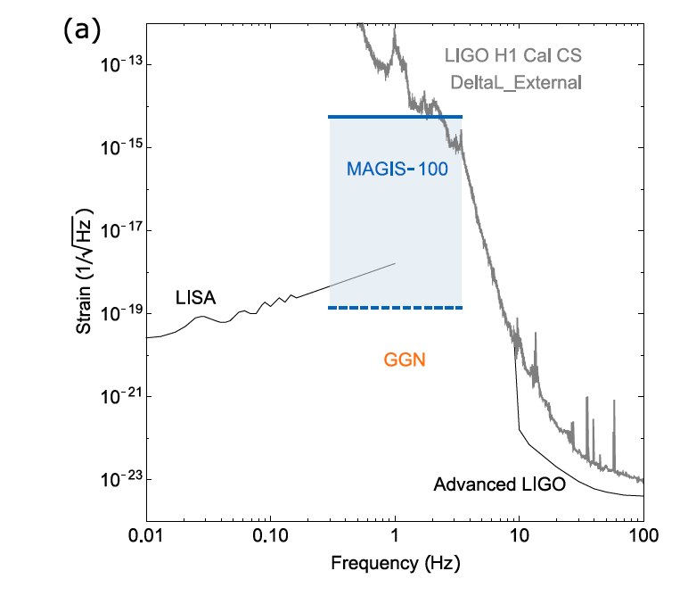
Gravitational Wave Detection
frequency
L (1 + h sin(ωt ))
Megaparsecs…
strain
New carrier for astronomy: Generated by moving mass instead of electric charge
Tests of gravity: Extreme systems (e.g., black hole binaries) test general relativity
Cosmology: Can see to the earliest times in the universe
arXiv:2104.02835

Slide 20
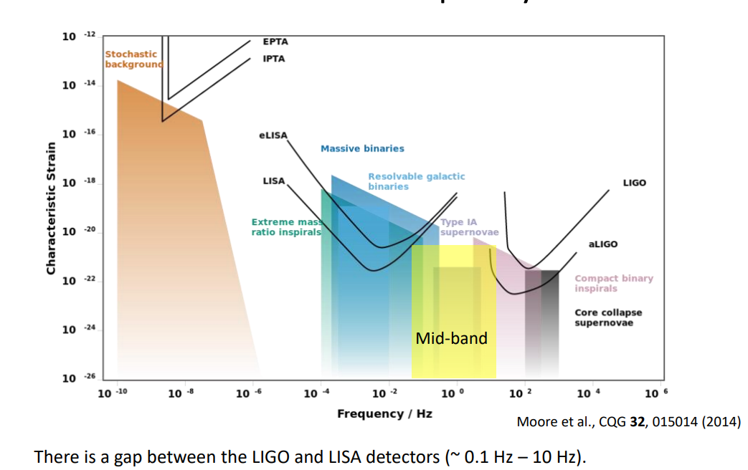
Gravitational Wave Frequency Bands

Slide 21
Measurement Concept
Essential Features
Light propagates across the baseline at a constant speed
Clock atoms read transit time signal over baseline
GW changes number of clock ticks associated with transit by modifying light travel time across baseline
Many pulses sent across baseline (large momentum transfer) to coherently enhance signal
Atom
Clock
Atom
Clock
L (1 + h sin(ωt ))
Notes:
Clock instability at 10-18 level

Slide 22



Two Atomic Clocks
GW changes baseline, and therefore light travel time, between pulses (signal maximized when GW period on scale of time between pulses)
Time
Atom clock
Atom clock

Slide 23
Mid-band Science
Mid-band discovery potential
Historically every new band/modality has led to discovery
Observe LIGO sources when they are younger
Optimal for sky localization
Predict when and where events will occur (before they reach LIGO band)
Observe run-up to coalescence using electromagnetic telescopes
Astrophysics and Cosmology
White dwarf binaries (Type IA supernovae), black hole binaries, and neutron star binaries
Early universe stochastic sources? (cosmic GW background)
- e.g., from inflation
- operating in mid-band instead of lower frequencies may be advantageous for avoiding background noise from white dwarf sources
Notes:
Midband could see intermediate mass black holes that don’t reach LIGO band (intermediate mass black holes (10^2 to 10^5 solar masses), probes later stages of inflation where many parameters unknown (could be enhanced GW production)

Slide 24
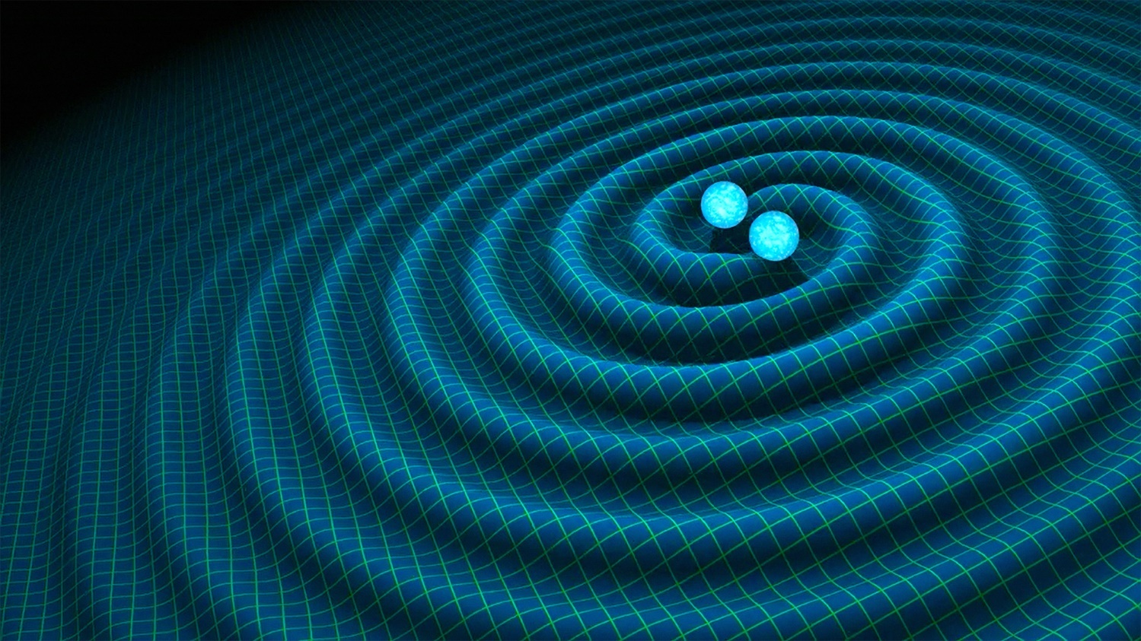
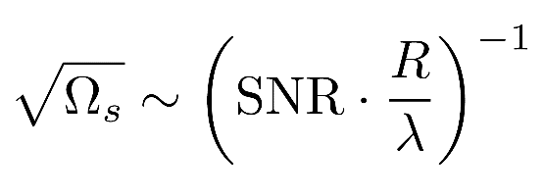
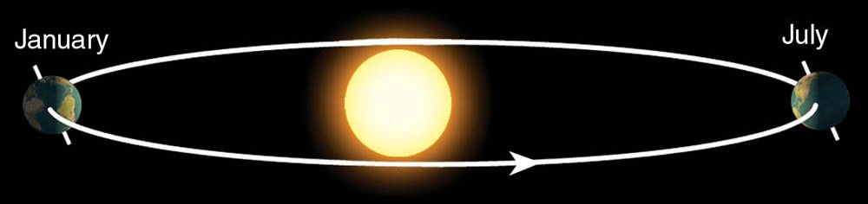
Sky position determination
Sky localization precision:
Mid-band advantages
- Small wavelength λ
- Long source lifetime (~months) maximizes effective R
λ
R
Images: R. Hurt/Caltech-JPL; 2007 Thomson Higher Education
Notes:
Smaller wavelength means larger Doppler shift, detector reorients as orbits sun, ground detector would need significant improvement of GGN at low freqs to do this well, otherwise order tens of degrees depends somewhat on source, LIGO NS-NS event was 130 million light years away (40 Mpc)

Slide 25
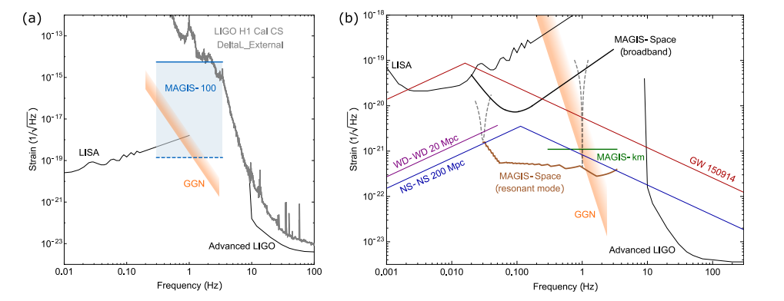
GW Sensitivity in Near and Long Term
Full Scale future MAGIS detector fills frequency sensitivity gap in ~1 Hz range.
MAGIS-100 will give limits in this range several orders of magnitude beyond existing (but no known sources of such strength.)

Slide 26
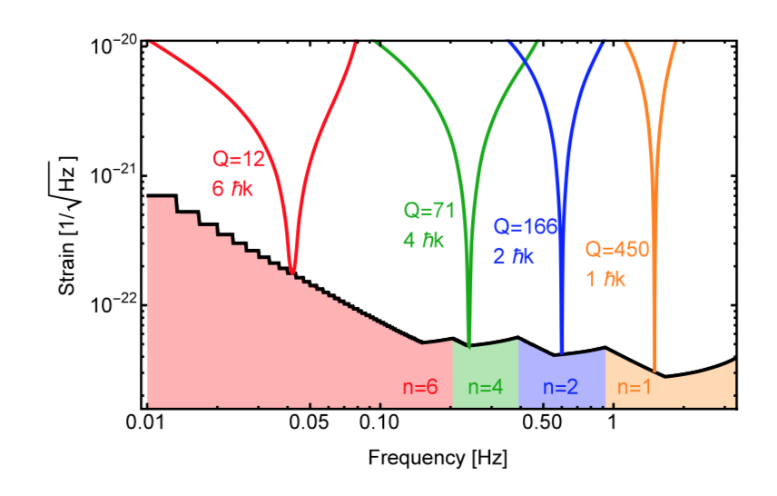
Resonant Pulse Sequences
Resonant sequence (Q = 4)
Multiple Interferometer sequences (Q) act as band pass filter.
Graham, et al., PRD (2016)

Slide 27
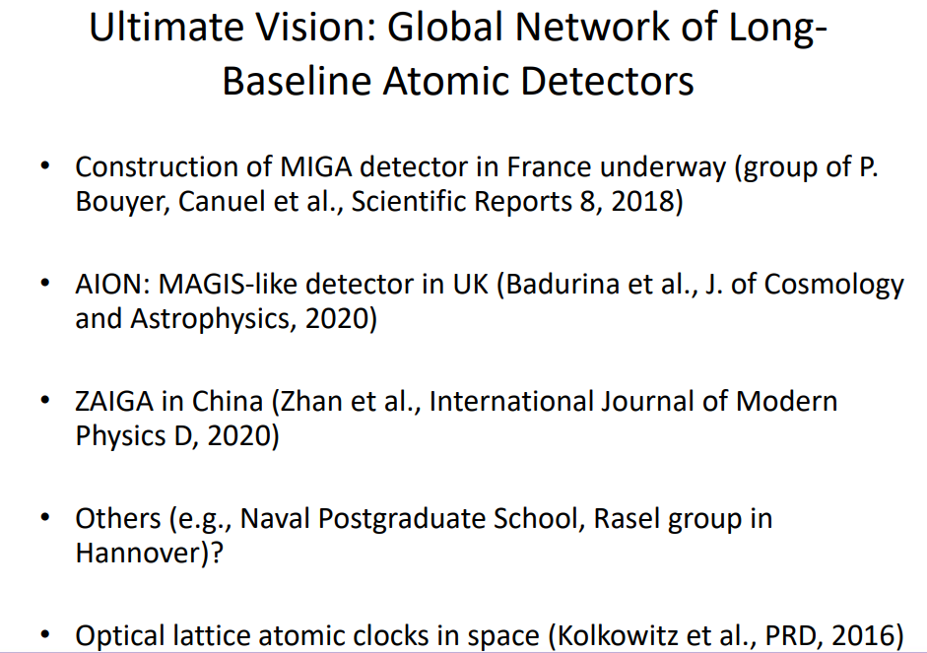
A Network of Sensors

Slide 28
B-L Dark Forces
In addition to scalar dark matter, other types of interactions can be looked for.
One example is a new vector boson coupling to B-L
If dark matter, will have time dependence.
If new force sourced by earth, force is static.
MAGIS-100 will search for this with atom source with dual isotope capability.
Competitive and extremely complementary to, other efforts, e.g. upgraded torsion pendula.

Slide 29
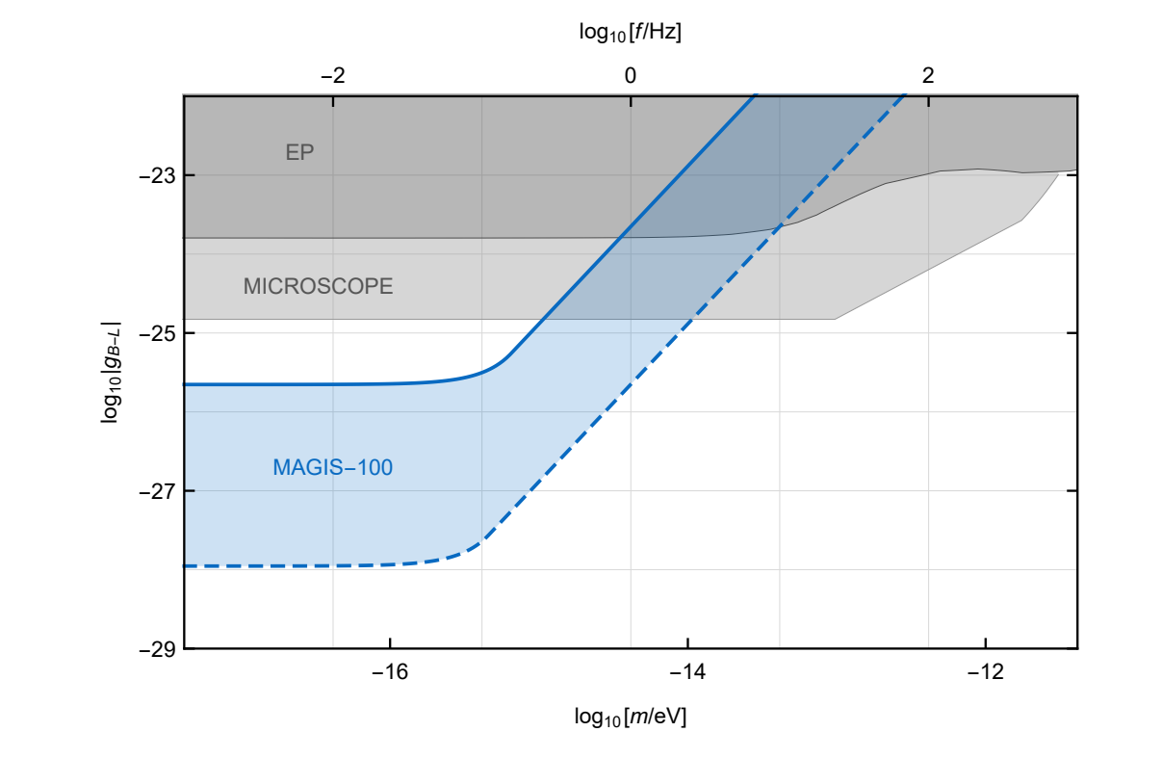
Varying assumptions for running conditions
Expected MAGIS-100 B-L dark matter sensitivity
More info at Phys. Rev. D93, 075029 (2016)

Slide 30
Status and Prospects
Atom interferometry will open new science and instrumentation windows.
MAGIS-100 accepted by DOE as project lite in budget of OHEP.
Cost to DOE is about $15 M (includes contingency).
Expect collaborator components mid 2025.
Testing and commissioning at FNAL during vacuum install for about a year.
  Earlier commissioning efforts at universities.
Schedule funding limited, especially in FY2024.
Will move up schedule if possible, possibly with additional collaboration effort (still growing).

Slide 31
BACKUP

Slide 32
10-meter Sr prototype design
Vacuum system CAD
Bias magnetic field simulation
Magnetic shield design and simulations
Example multi-layer design
Layer thickness 0.02 inch
Conservative
100 μm gaps
staggered layer design
2D FEM shielding results
2D transverse octagonal shield simulation, with coils for transverse bias field
Prototype assembly to occur in summer/fall 2019

Slide 33
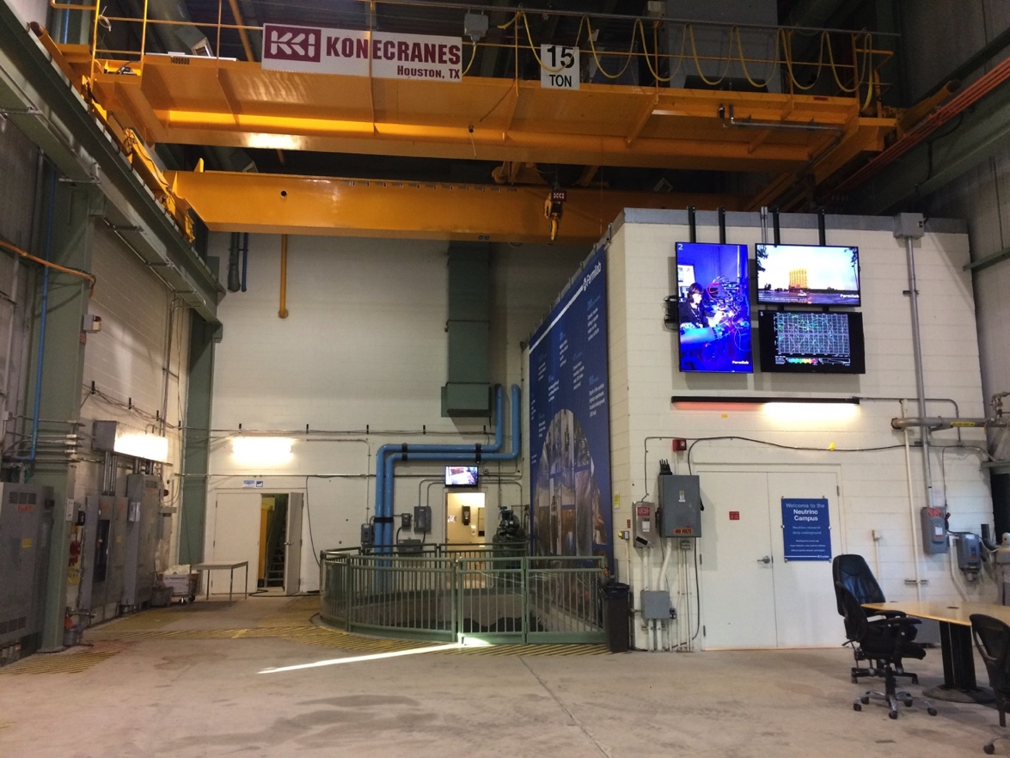
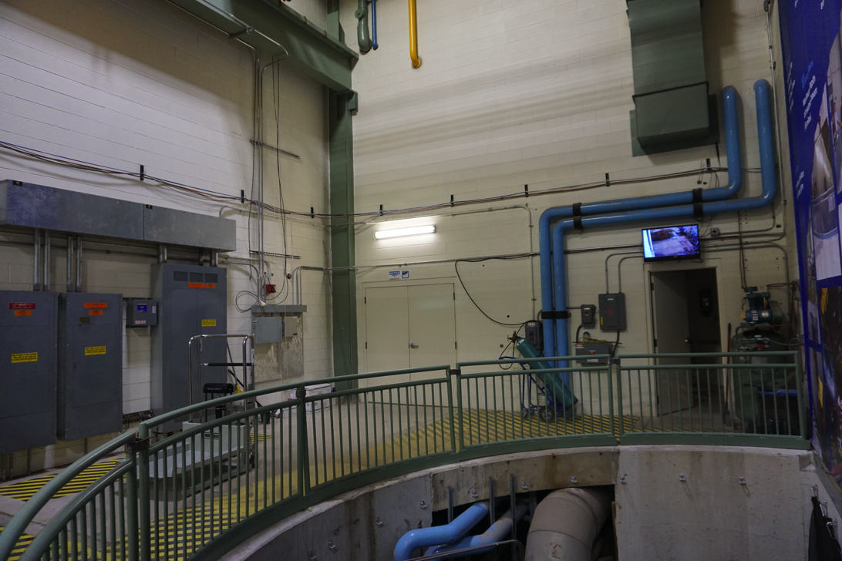
Location – MINOS building
Ground level of MINOS building.

Slide 34
Atom source laser system
Wavelengths: 461, 689, 679, 707, 688(?)
Three atom sources; use common master lasers where possible
Keep lasers at top, amplified and sent through fiber (except 461)
Design alternatives
Blue lasers
461 ECDL lock to AOSense oven in each source + 461 slave diodes
Lock 922 to comb, send through fiber, TA + freq double in atom source
Red lasers
689 locked to cavity, 679/707 locked to spectroscopy or wavemeter at top
All locked to comb at top
Spectroscopy: Blue I + Red I
Hybrid: Blue I + Red II
Comb: Blue II + Red II

Slide 35
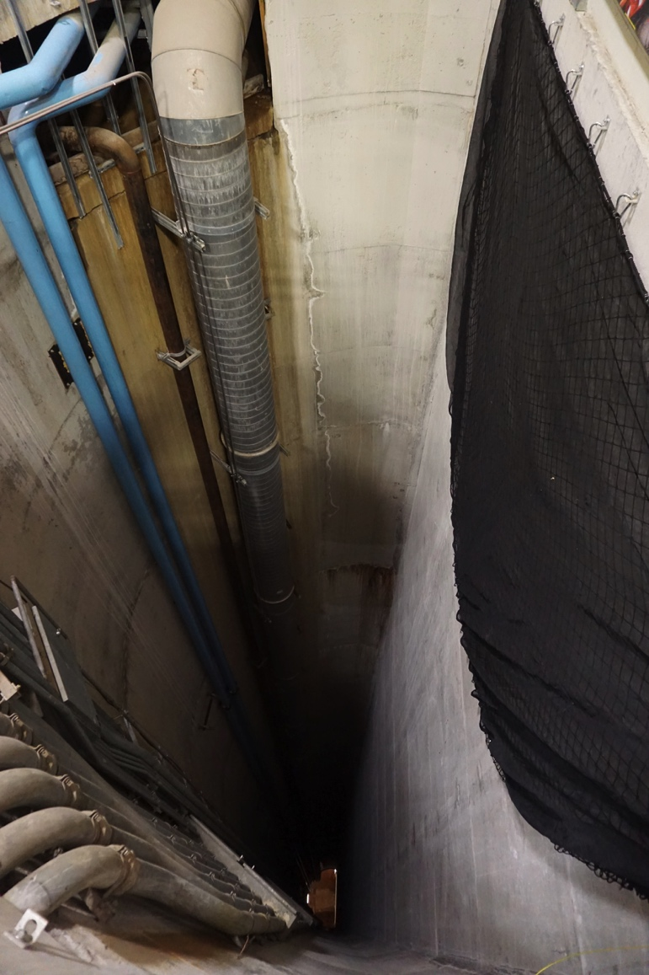
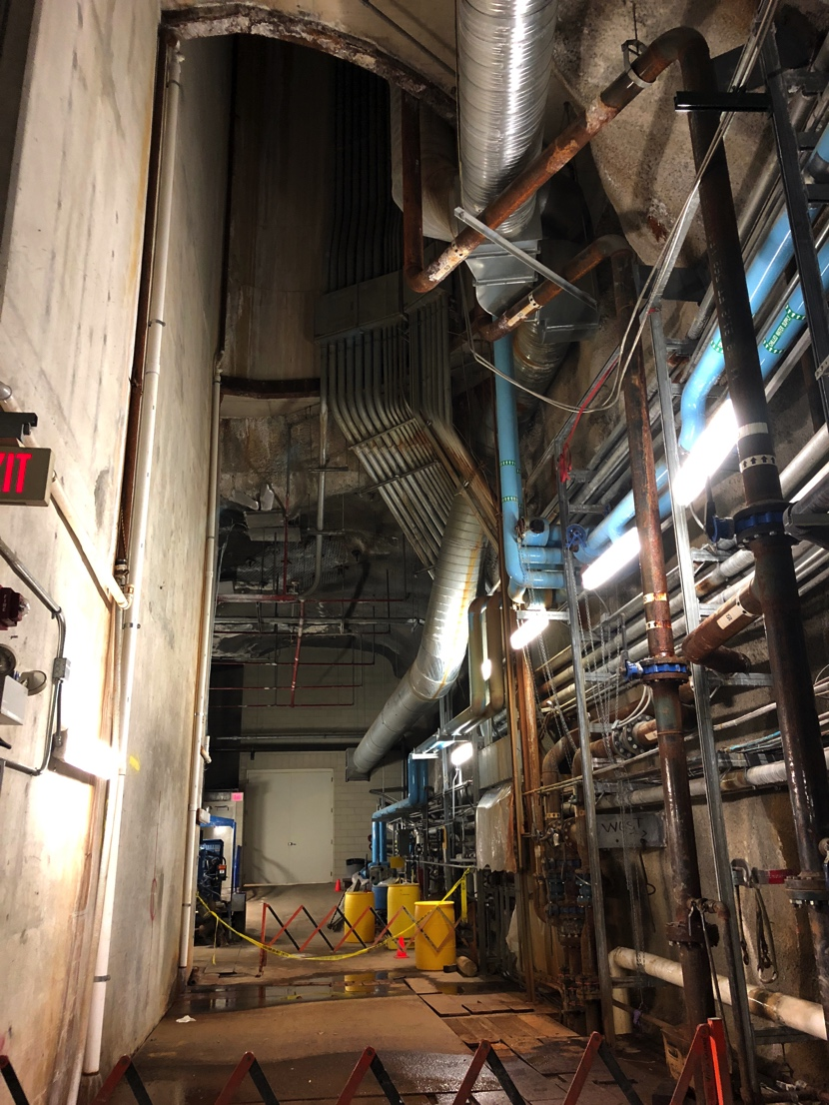
Location – Shaft in MINOS building
Top and bottom of ~100m shaft.

Slide 36

Optical Frequency Comb
Frequency comb
Optical reference cavity
Reviewed: 3/2019
Purchased: 9/2019
Ti:Sa integration and locking complete.
Diode laser integration next step (lasers shipped).
Delivery Dec. 2020
Wavelengths
1542 nm (cavity)
698 nm (atom optics)
689 nm (Red MOT)
707 nm (Repump)
679 nm (Repump/Raman)
688 nm (Raman/transparency)
922 nm (SHG Blue MOT)

Slide 37
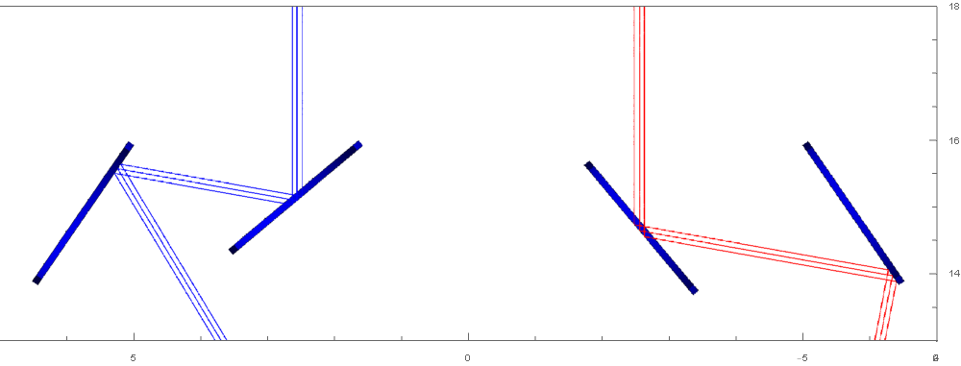
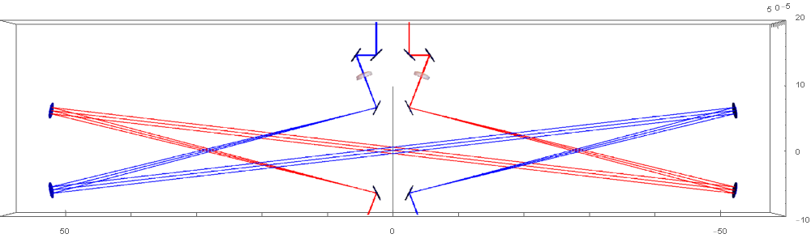
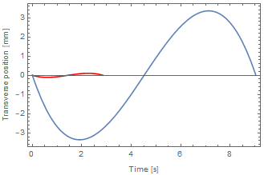

Optical Lattice Launching
Control Mirror Block
Mirrors in Vacuum
Optics Controls outside for adjustment
100 meter
10 meter
Coriolis Compensated Launch for 3 pulse sequence

Slide 38
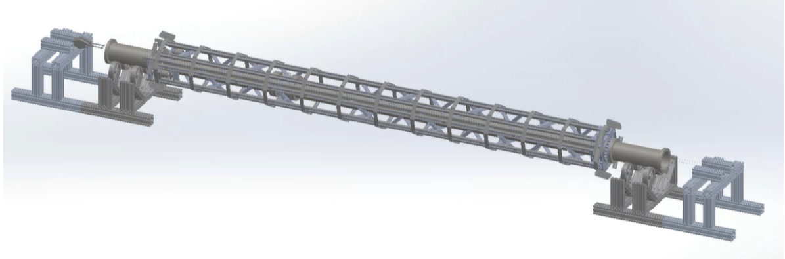
Assembly process for modular sections
Rotisserie concept, image from Stanford University.
Assembly process for modular sections will include use of a rotisserie-style fixture to:
Outfit vacuum tube with bake system, temperature sensors, thermal insulation, and magnetometers.
Wind and install bias coil wires.
Assemble layers of magnetic shield and stage magnetic coupler for later installation.

Slide 39
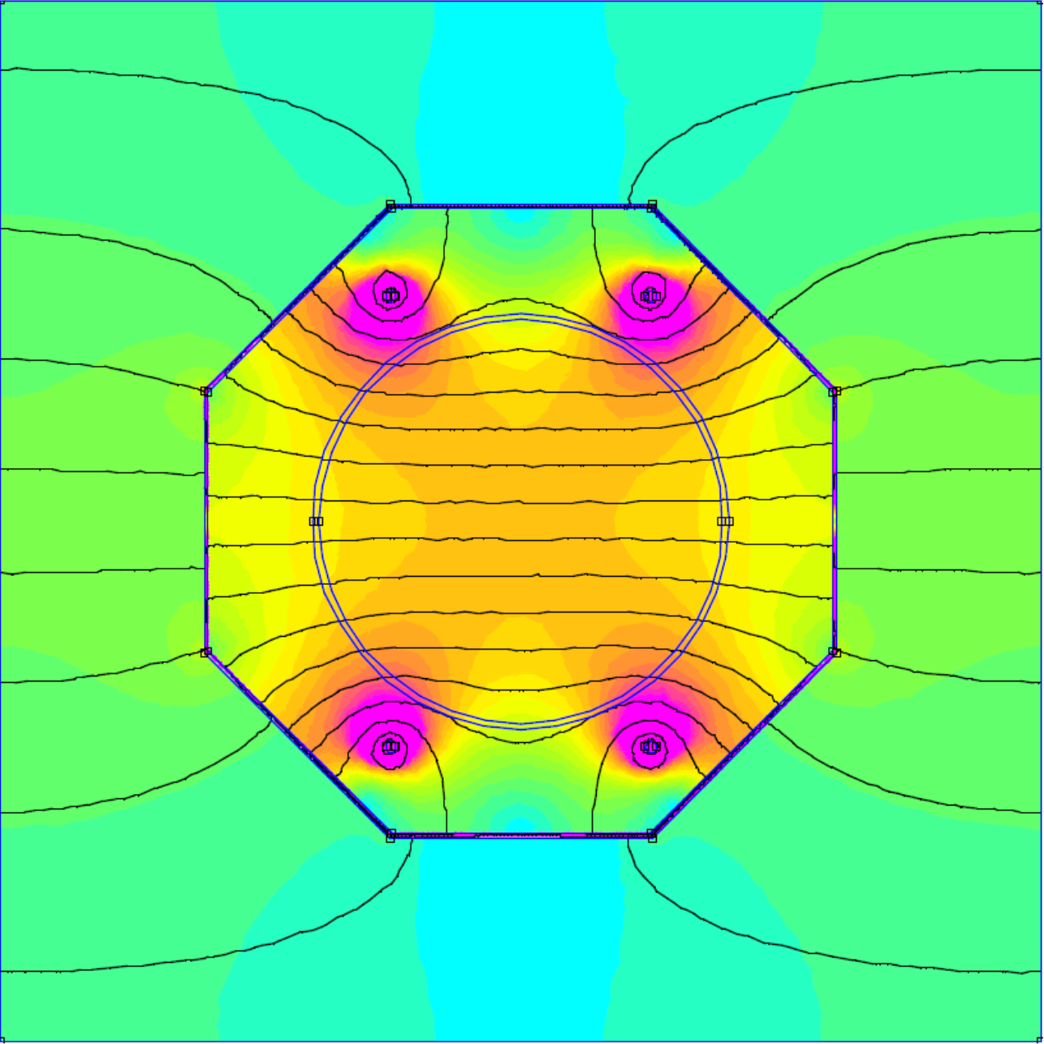
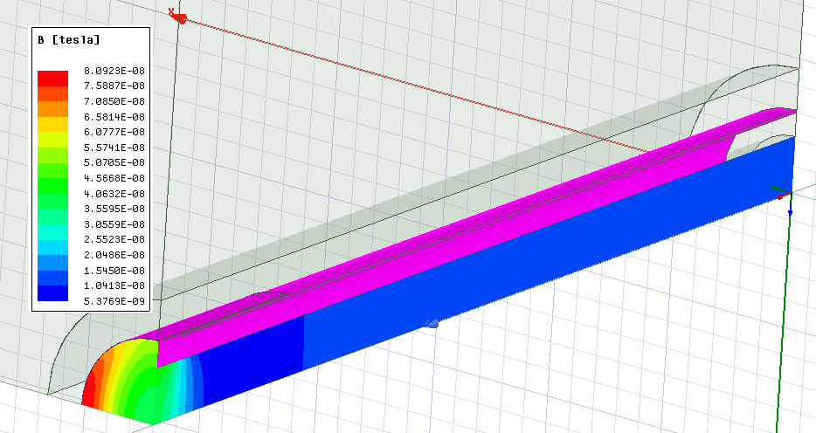
Magnetic Shield
New shield design and simulation work
Octagon shield
4 sheet, overlapping design
Internal bias coils
Shield + bias field simulation (Stanford)
3D horizontal field simulation (Fermilab)

Slide 40
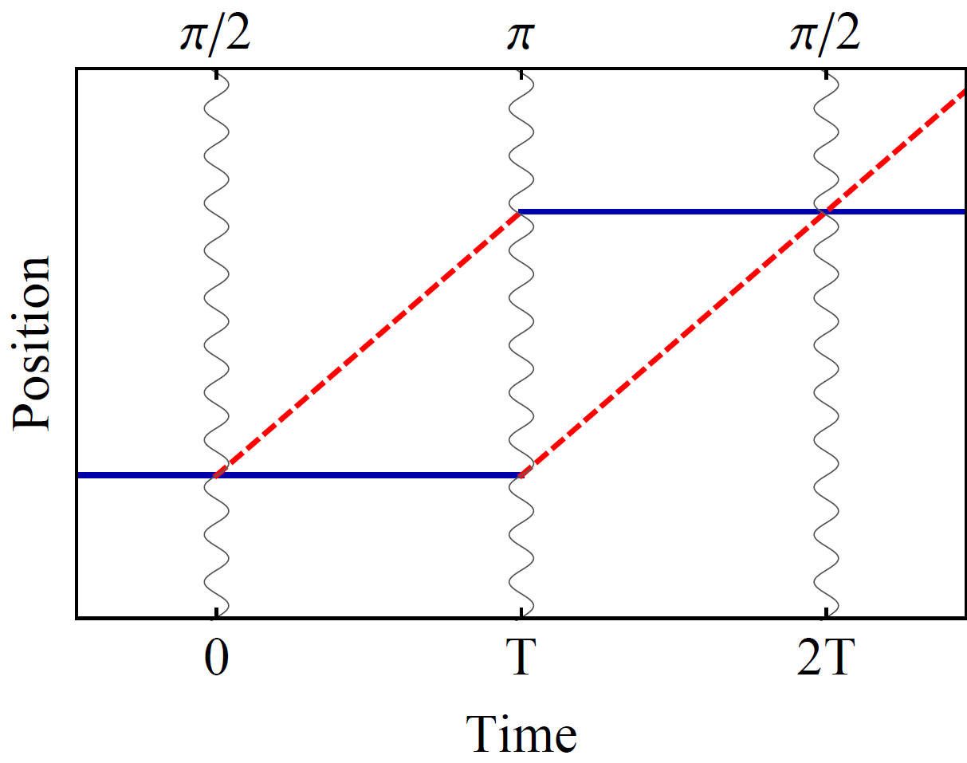

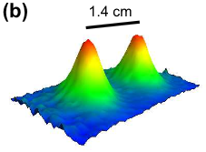
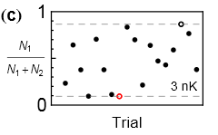
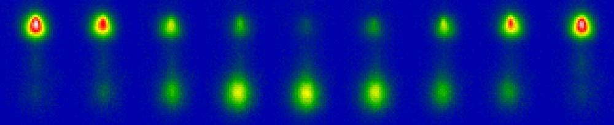

Interference at long interrogation time
Port 1
Port 2
Wavepacket separation at apex (this data 50 nK)
2T = 2.3 seconds
1.4 cm wavepacket separation
Interference (3 nK cloud)
Dickerson, et al., PRL 111, 083001 (2013).

Slide 41
Experimental Simulation – getting ready for Science
Start with
analytically derived wavefunction → atom population at end of interferometer sequence, in imaging region
Simulation ingredients
photon emission rate & imaging time
optics: geom. acceptance & magnification
CCD pixel geometry & quantum efficiency
pixel readout noise + Gaussian fluctuations
Atom statistics + Poisson fluctuations
Photon emission statistics + Poisson fluctuations
Simulated Data
single-port fringes
1
photons/bin (x1000)
500
pixel z-index
two-port asymmetry
Simulated Data
1000
Asymmetry
1
200
400
pixel x-index

Slide 42
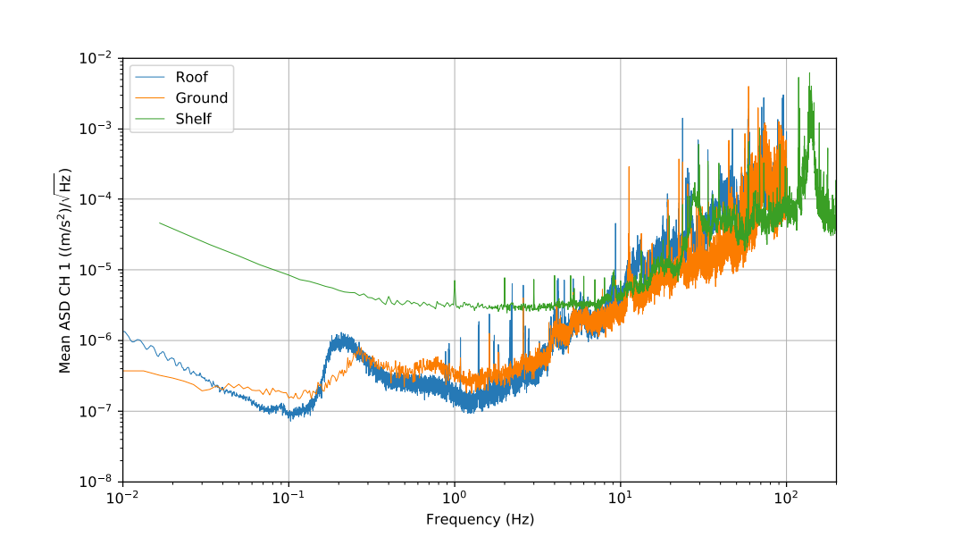
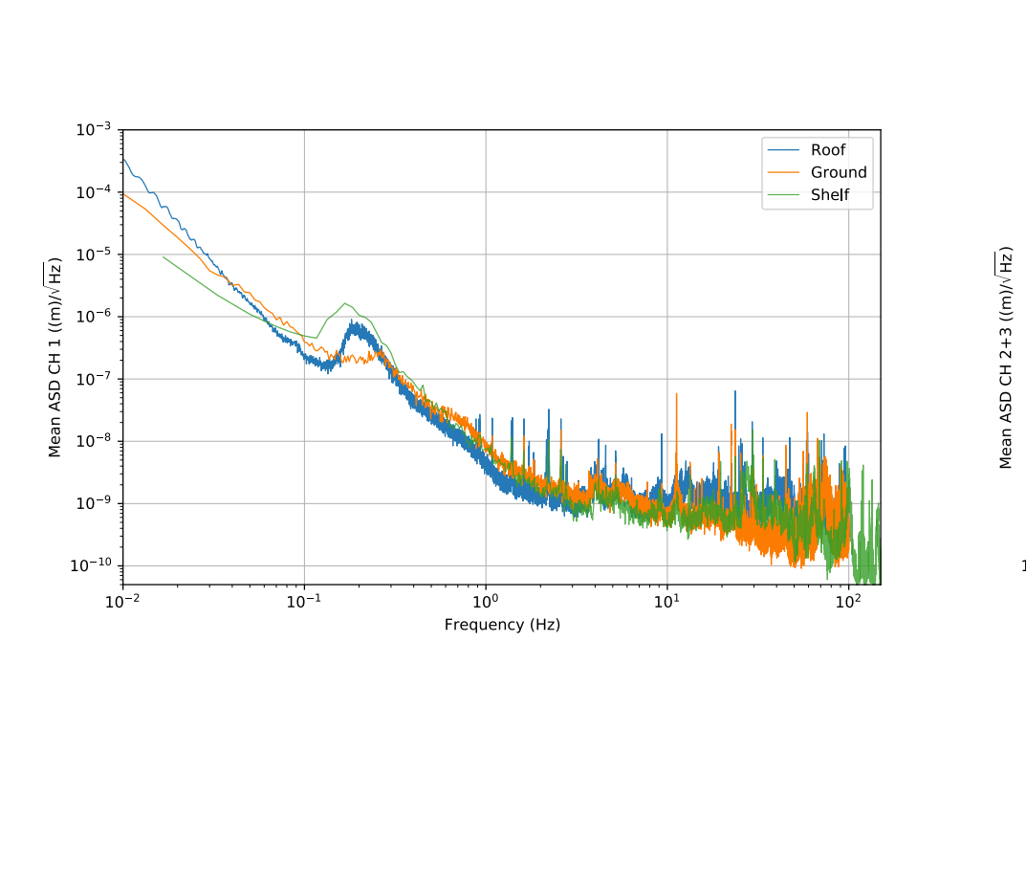
Elevator Wall Measurements
Seismometer vs. Accelerometer
Acceleration
Amplitude
Varying locations

Slide 43
Gradiometer DM Signal (same as GW configuration)
Phase shift of an interferometer determined by difference in times spent in excited clock state for arm 1 vs arm 2
Look at difference in phase shifts for two interferometers separated by baseline ~L (gradiometer phase shift)
Magnitude of contribution to gradiometer phase shift from each interferometer zone:
For constant (or linearly drifting) L and transition frequency, gradiometer phase shift cancels between all three zones
To have a nonzero gradiometer phase shift, need transition frequency or L to vary on the time scale of time T between each zone
beam splitter 2
mirror
beam splitter 1
Two ways to get a signal:
Dark matter
Graham et al., PRL 110, 171102 (2013).
Arvanitaki et al., PRD 97, 075020 (2018).
Gravitational wave
Notes:
Differential atomic clock

Slide 44
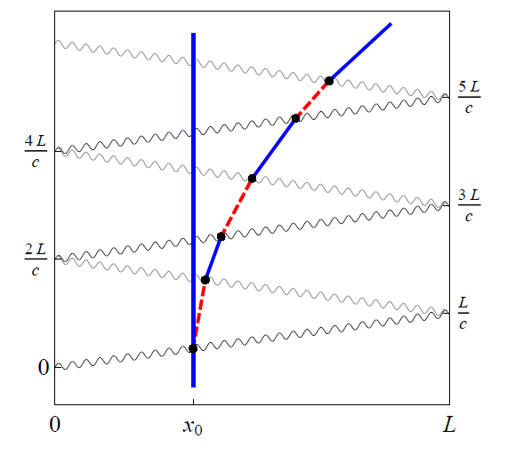
Large Momentum Transfer (LMT) Pulse Sequences
Sequential single-photon transitions remain laser noise immune
LMT beamsplitter
Additional laser pulses exchanged across baseline, further accelerate one of the interferometer arms (detuned from second arm due to Doppler shift)
Additional pulses coherently enhance differential clock signal: total amount of time spent in excited state during beam splitter decreases as x increases from 0 to L (giving differential signal) and is proportional to number of pulses
Magnitude of contribution to differential phase shift from each interferometer zone for beam splitters with 2n pulses:
Graham, et al., PRL (2013)

Slide 45
Bounds on stochastic GW sources
Example resonant sequence
Envelope
(cosmic strings)
(phase transition)
White dwarf
Graham, et al., arXiv:1606.01860 (2016)
Narrow band sensitivity possible in 1 year

Slide 46
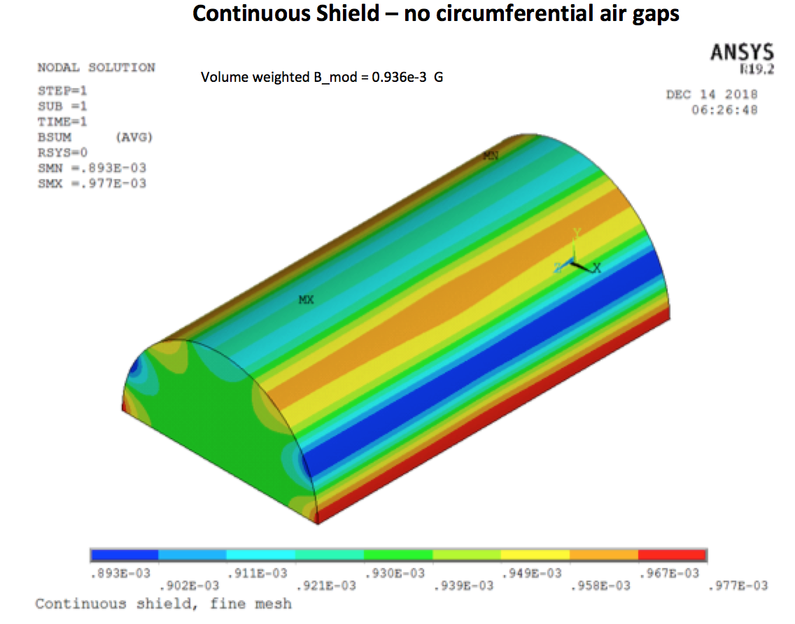
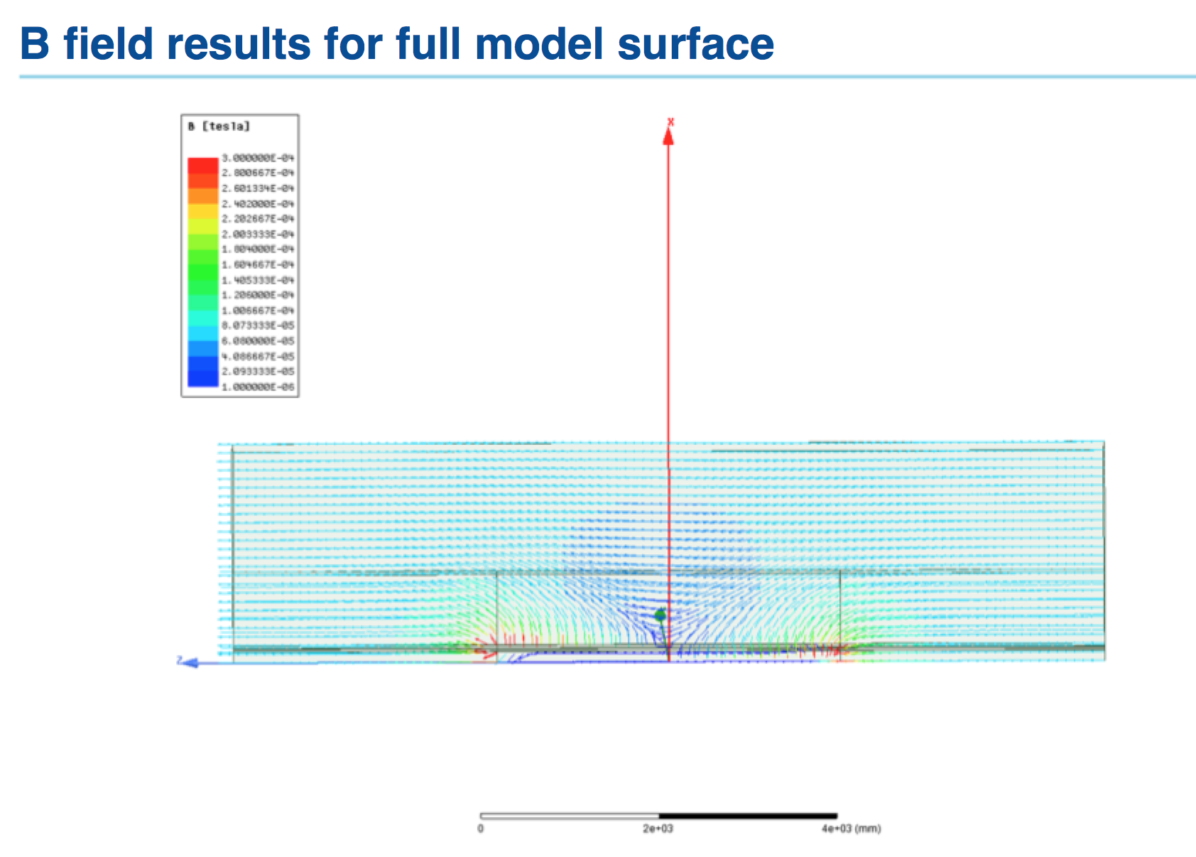
Magnetic shield simulations
3D simulations have been done at Fermilab in both classic ANSYS parametric design language and contemporary ANSYS Maxwell magnetic analysis program.

Slide 47


Shaft Photos

Slide 48

Shaft Photos

Slide 49

Shaft Photos

Slide 50

Shaft Photos

Slide 51


Shaft Photos

Slide 52
Clock Atom Interferometry Demonstration (Stanford)
First LMT clock interferometers using sequential single-photon transitions
Record LMT interferometer (141 ћk)
Demonstrated 81 ћk gradiometer (power limited)
Demonstrated T > 1 ms (>> lifetime)
Current work: upgrade to 1000 ћk
J. Rudolph, PRL 124, 083604 (2020)

Slide 53

Shaft Photos

