Slide 1
2023 Summer Shutdown Planning
10/20/23
Cons Gattuso / Tony Busch

Slide 2
Looking Ahead
Official end of the Summer Shutdown: Friday November 3rd
Grey Period (Cons will coordinate the activities)
November 3rd until Dec 30th (Soft Dates)
Selected tunnel work will be approved on a case-by-case basis
Priority will be given to activities that are needed to further the SAD or ACE
Where work is NOT being performed, we will have enclosures secured and in a standby state.
Safety system Testing Completed
Ready to be turned on
Water systems on and flowing (level to be determined)
Runco’s will be phased as after Linac beam has been established
Summer Shutdown 2024 (Tony will coordinate these activities)
Email went out to Department Headers requesting Machine/system Coordinator.
Kick off meeting will occur the Tuesday November 14th
Shutdown Parameters will be released then
Start/End/Duration ect.
Planning Schedule and milestone
Start the planning and execution of the 2024 shutdown

Slide 3
Power Outages
Saturday Oct 21st
IBA Campus
07:00- 16:0 hrs
Tuesday Oct 24th Canceled
CMTF Building Andy's pond pump station, Feeder 32/35
08:20-16:00
Monday Oct 23rd
Local Outage to AP30 Braided connection repair
Start time ~08:30 hrs
Wednesday Oct 25th Canceled
NML Feeder 35
08:20- 16:00 hrs
Thursday Oct 26th Canceled
LAB B, NML Cryo, LAB E&F, ABX, Feeder 35
08:20- 16:00 hrs
Wednesday Nov 1st
Feeder 45 TEV Ring, Transfer Hall, All MR Service Buildings
07:00- 16:00 hrs

Slide 4
Important Activities
Re-coring Back to Operational Keys (typically done after 16:00 hrs)
MI Monday Nov 6th
Muon Campus TBS (To Be Set)
MI Q319 and Main power Supplies Ramps Studies
More details in next slide
Tunnel Cleaning
Main Injector completed by Nov 3rd
Muon Campus will be scheduled soon
Beam Ready
“ALL” Tunnel activities complete
Safety System test completed
System Start-UP Sign-off sheets complete
Power Supply tests completed
“All” Systems on and in an operational state (Soft Time Frames)
Linac: Mid Dec
Booster: Early Jan
BNB: Early Jan
MI/RR: Early Jan
NuMI: Early Jan
External beam lines: Early Feb
Wild cards still in play
Gate installation to isolate the accelerator complex with the rest of the lab
Fencing around some buildings
Muon Campus
BNB
Booster
Ect.

Slide 5
MI Ramp and Q319 Testing
Why are we doing this now?
We have a new design for Quad Magnet that we can only really test in the tunnel.
If it fails, we have sometime to produce plan “B”
Significant power supply work done.

Slide 6
Moving into the Grey Period and in the Grey Period
Safety System Testing
Next Week SSI (Safety System Integrity testing)
MI-8, MI10, MI20-62 (leave it as you found it)
Next Week SST (Safety System Testing)
Area that work has fully been completed we will start securing and prepare for our annual testing. The intent here is to keep enclosures secured moving forward
List will be posted next week
Grey period Work
We have received several requests from several machine
We ask that all request are in by the close of Business Monday October 23rd
By Friday the 27th of October we will post a list of approved work and a Grey period Shutdown work list will be opened

Slide 7
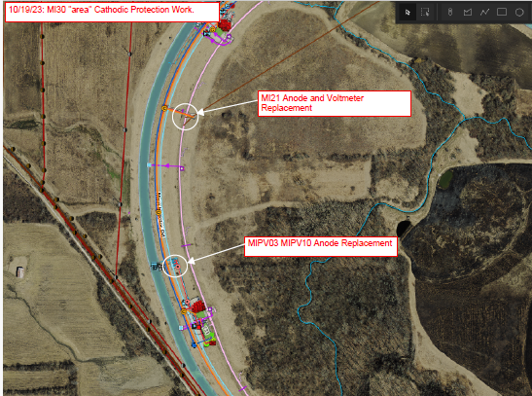
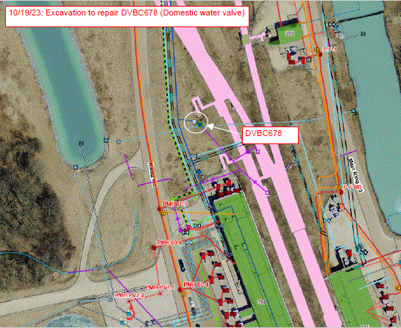
Current Excavations
Cathodic Protection work at MIPV03-10 (North of MI30), and further North at MI21. As of tomorrow, 10/20/23, all work in these areas are planned to be finished by end of business. Repair work at the MIPV03-10 vault will require the replacement of a type LB (90 degree electrical fitting) that was damaged during restoration work today. Volt Electric will be the contractor performing the work, and Kristian Bennett will be the Task Manager on this job. Kristian's number is 630-524-8171.
Domestic valve DVBC678 replacement North of MI60. Starting today (10/19/23), Concord Excavating is out to remove and replace a failed DWS valve. The attached graphic "101923_DVBC678.PDF" shows the location of this valve. We anticipate that this work will be completed by the end of next week (finished by 10/27/23). This only affects the domestic water in the area. Michael Wallace is the Task Manager for this work and can be reached at 630-524-8715.

Slide 8
MI30 pump vault
ALL Permits and Approval were in place it was a question of notification.
IMPACT has some problems that are being address
Repairs will be made today…

