Slide 1
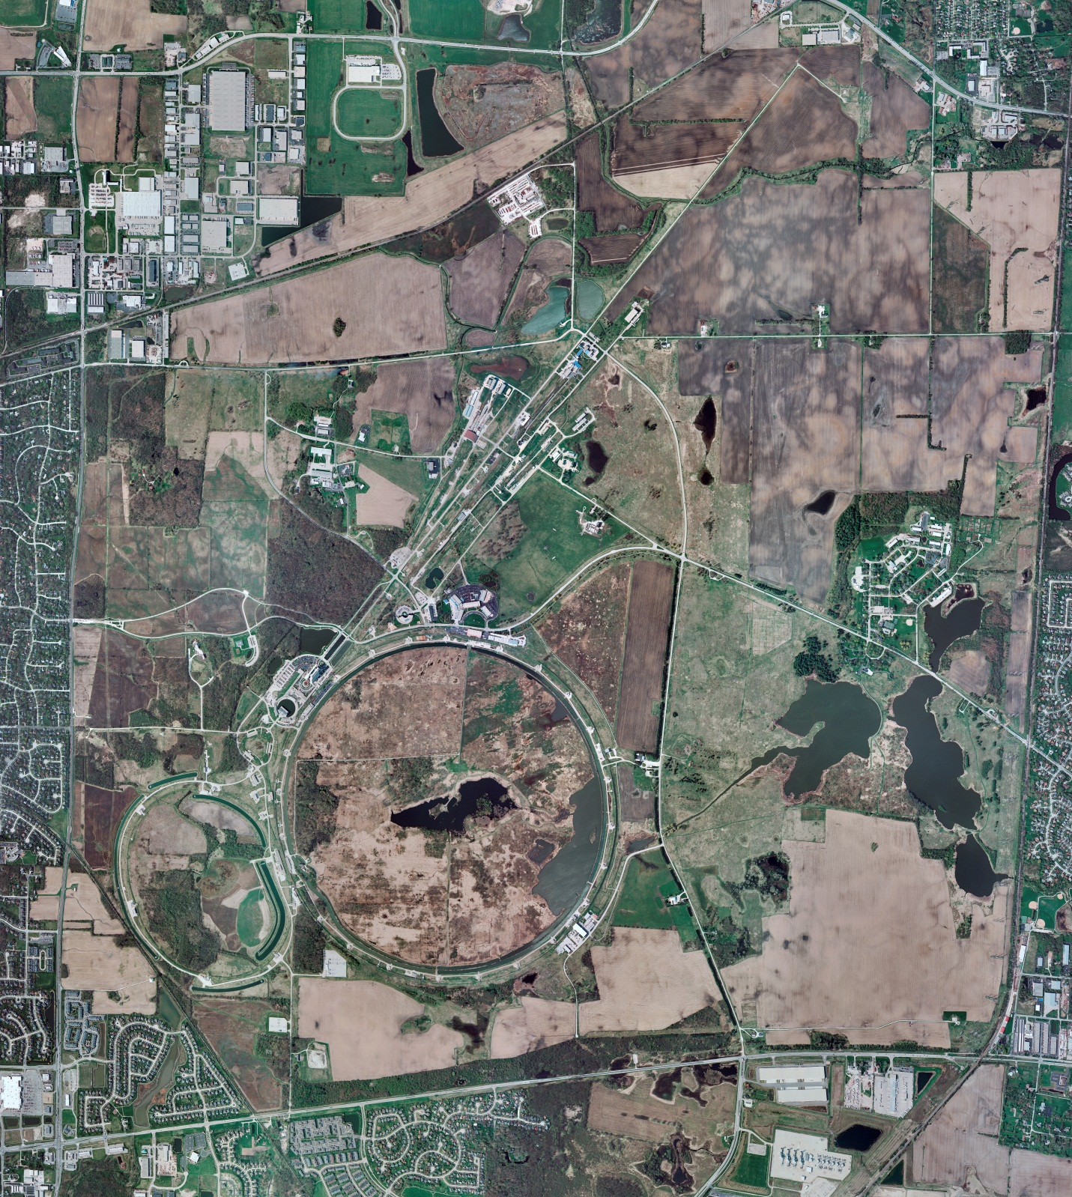
Helium Cryogenics
Status 10/20/2023 J.Makara
CMTF: SCP is cold and operating fine
CMTS: HECM27 CM at RT under LOTO for its removal
PIP2IT: SSR1 pCM at 2 K with cryo testing in progress
North CM stand empty
MCTF: cryo system warmed up to RT though 2 comprs and Purifier still operational
MDB/HTS: at RT
MDB/STC: .at RT
MDB Magnet: at RT
NML/FAST: Cryo system is cold and running fine with good excess capacity; controlled warmup to RT planned for next week
CC1: at 2 K
CC2: at 2 K
CM: at 2 K
IB1: cryo system is at RT for 4-week maintenance period.
Muon Campus: A0 comprs (3) online with MC-1 g-2 cryogenic system running fine at 5 K with g-2 magnet powering; G2 dry expander failed but was fixed.
Misc: .NML & CMTF annual electrical maintenance postponed to April to allow continued cryo operations

