Slide 1
Muon Campus Operation Report
Jim Morgan
Friday 09:00 Operation Meeting
October 20, 2023

Slide 2
Muon Campus status
Wall Current relocation from Delivery Ring to 907 in M4 Line
Vacuum pump-down began lasts Friday, looks good
Wall Current Monitor and vacuum pipe aligned, V907 surveyed
D30 straight section surveyed
ESS1 Electrostatic Septum at NWA
Vacuum got good enough for a low voltage power test
Turned on to 5 kV yesterday, will be increased next week
Electrostatic Septum ESS2 remains isolated and under vacuum
Venting to reconnect to Delivery Ring vacuum depends on ESS1 progress
Working on plan for draining AP-0 RAW systems
Still need Vault access to confirm isolation valve locations
Will keep Dump system filled and running for possible future Mu2e target test
Pre-Target exhaust blower EF1 replacement VFD controller on order
ISD ordered spare unit 8/30, part expected to arrive next week
AP-0 Air Conditioner Replacement work continues to be paused
Waiting on contractors to return and finish installation
Only a week or two of work needed before system can be tested
Study – M1-M3 Optics
Study – Alternative M5 optics
KPS5A PFL Repair
MC-1 Controlled Access
G-2 Trolley Run
Intentional Accelerator
Standby Period
<------------Week Days -------------------→

Slide 3
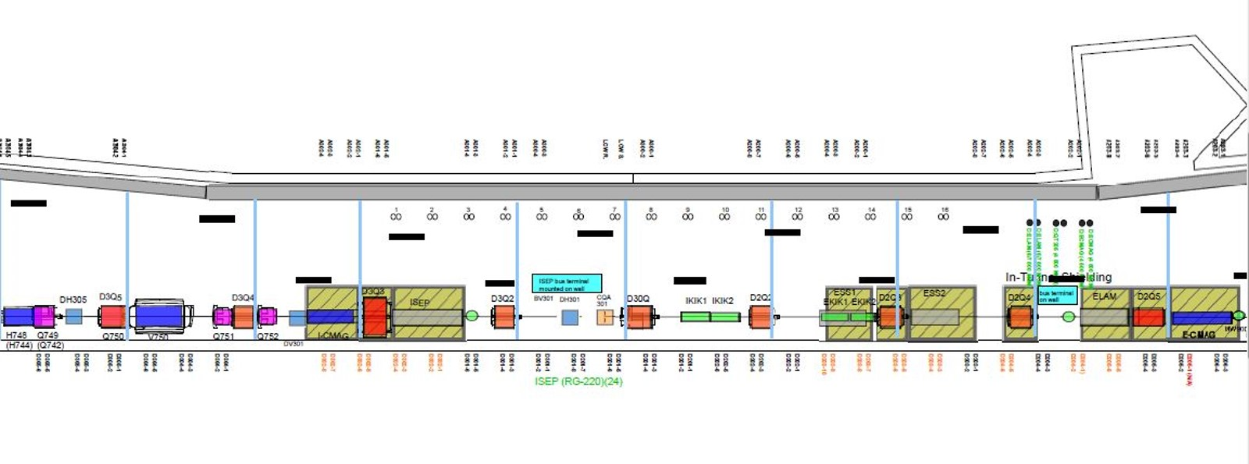
Mu2e Electrostatic Septa
Q203

Slide 4
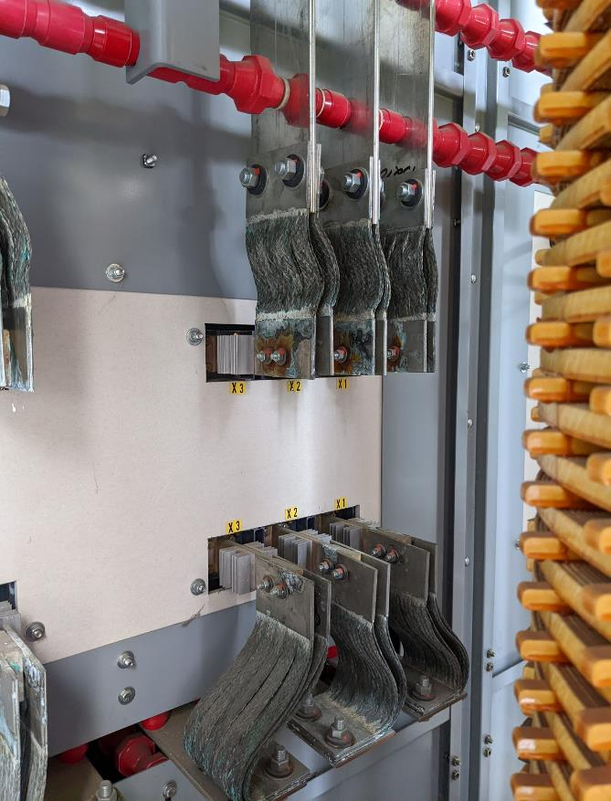
AP-30 transformer jumper replacement

Slide 5
Upcoming work
AP-30 Transformer jumper replacement this Monday 10/23
Power off by 09:00, ion pumps turned off by 08:00, controls crates without power
Replace two LCW sub-header braided hoses in Delivery Ring Enclosure
Replace four leaking NSA Sextupoles in the Delivery Ring
ESS1 at NWA, power testing has begun, conditioning starts next week
Survey and Alignment jobs
D30 survey and V907 area alignment and survey completed!
If ESS1 installed in Delivery Ring later this Fall, will need to be aligned
Finish plans for draining AP-0 RAW systems and schedule work
AP-0 A/C work on hold, awaiting return of contractor
Replace EF1 Pre-Target rad air exhaust VFD Controller when replacement arrives
Grey Zone proposed work
ESS1 installation, new compact ESS vacuum layout with new Q203 pipe
Rad hard Q205 magnet swap, new Q205 vacuum pipe that’s easier to service
Three rad hard quadrupole swaps in D30?

