Slide 1
Some of the work going on at Mu2e
2024 will be a busy year at the Mu2e building
Expecting delivery of the upstream Transport Solenoid (presently at HAB) before the end of CY2023, followed soon thereafter by downstream Transport Solenoid, then the Production Solenoid, and finally the Downstream Solenoid…
Calorimeter expected to arrive in Summer 2024, followed by the Tracker…
Preparing for TSu arrival
Cryo infrastructure prep ongoing on Feed Boxes & Transfer Lines
Heat and Radiation Shield maneuvering out of the way
Cleaning up pathway to TSu location through DS hatch
Perform party prep!
Preparing to install cables
Instrument air lines installed in cross trench to control (pneumatic) valves
Next: electricians install cable trays in trench
Then: install cable management system
Then: install cables!
DAQ group trying to understand temperatures in DAQ room
Lesson learned: make sure FPGA cooling fans are on & pointed the right direction

Slide 2
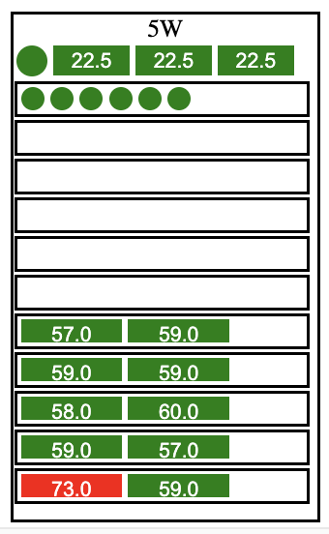
Example of temperatures in DAQ node relay racks 17-Oct-2023 17:40
Rack temperatures and status
Temperatures of 2x electronics boards installed in the PCI bus in node
Each box is a node
Addressing this next week
Notes:
.

Slide 3
Info: there won’t be a Mu2e report at this meeting next week

