Slide 1
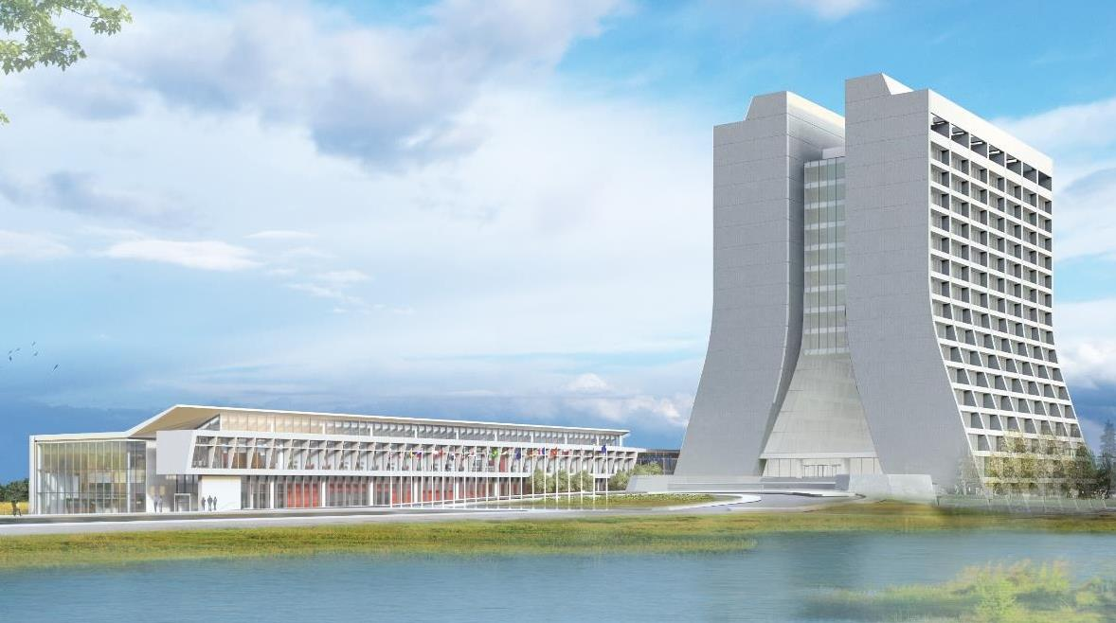
Infrastructure Services Division Updates
Roof Repairs in progress: MI-20 (shifted to warranty work), MDB, MS4, LINAC (BGE slide #5.).
Carpentry: BTW207 – Corkboard install - complete
Abatement: 102 (complete), 103 (complete). We are at capacity currently for office renovations for this year.
WH Leak Repair In Tunnel: Project is to stop the leaking into the tunnel leading from LINAC to WH. NOTICE – Slight change, access will be limited for the period that concrete work is completed for phase 1. slide #13 & slide #14.
Office Rehab work: We are currently looking at a larger application per building. Like doing bundles at a time. This will be cheaper for the lab and more aligned with regular maintenance. A proposal is in slide #6 LIG-124 is still getting scheduled.
Public Service Announcement – October is Breast Cancer Awareness Month – If you didn’t get your pin on the 17th, please reach out to the women’s Initiative Leadership Board. slide #7.
Kautz RD/Linac Road Closure – The road section where the guard shack is getting placed, the pad is going to be poured, traffic and parking will be altered. slide #8.

Slide 2
Infrastructure Services Division Updates
Active Shooter Drills: on Wednesday, 25th of October. Drill will be performed on floors 15/16 of Wilson Hall. slide #10
RAD Safety: we are working with the tenant liaisons to support the buildout for new safety members on the 2nd floor LINAC. We are about 2-3 months out for getting the materials for the cubicle buildout. A proposal is in slide #12
RAD Safety – Working to get new signs to replace warn and dated signs off the buildings. Carpenters are involved and working on the signage.
Drone Footage – We are starting to explore using the Lab’s drones for gaining footage of exterior project before and after shots, to help cut down on the multiple people walk throughs. slide #15
Boiler Work: NML is getting some boiler repairs done. slide #16
Fuel Depot: Is being decommissioned, gas up now. As of November 1st it will be closed. slide #17

Slide 3
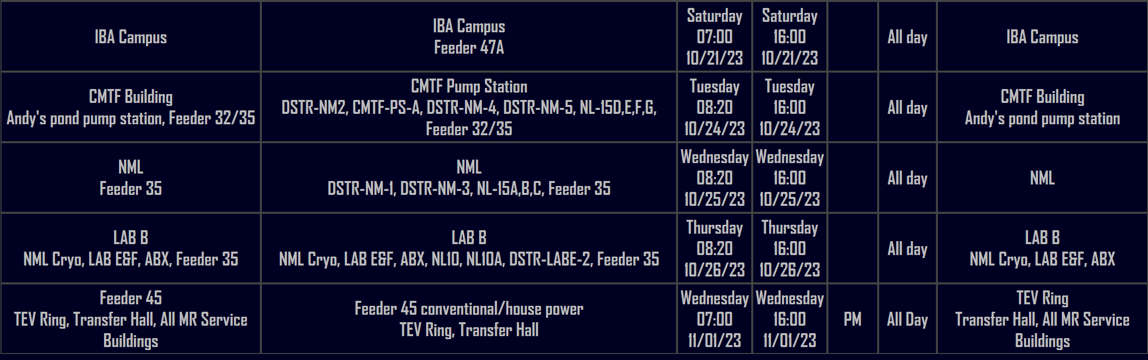
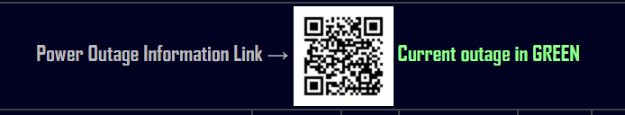
Utility Outages
Two-week outlook

Slide 4

Current Happenings
The below slides are more detailed information on current happenings. Feel free to review. Keep scrolling…or hit the stop button.

Slide 5
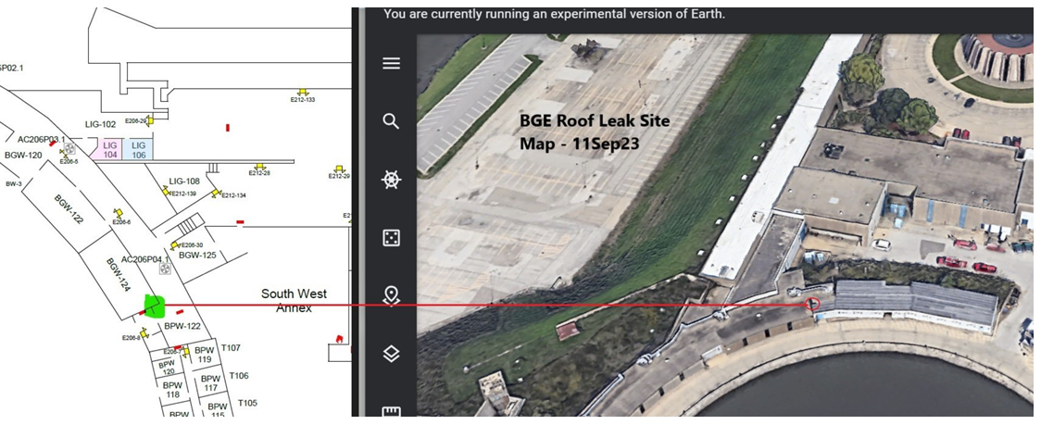
Current Happenings
BGE roof Leak Repair – HA has been approved and work started.

Slide 6
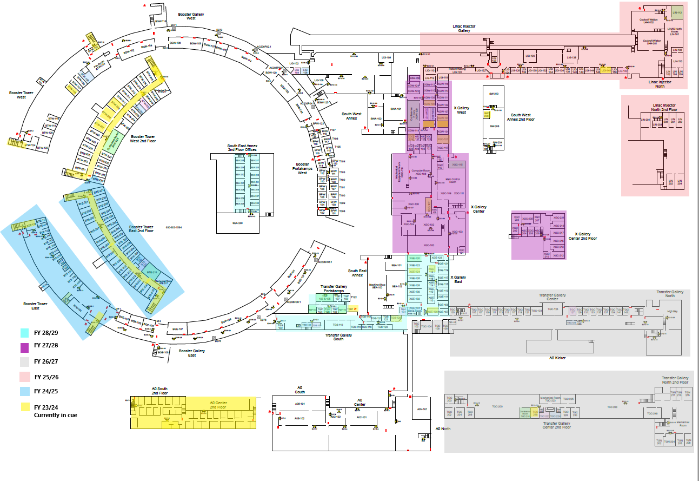
Current Happenings
For instance, this is a proposed plan for the spaceship.
Meetings with ISD managers has begun to secure buy-in and staffing to complete.
Our major focuses for AD will be for the below buildings first:
BTSW
BTSE
Spaceship
A0 Lab
F0 Service Building
NWA
NML
CMTF
MI60
Not in this order – this a draft.

Slide 7


Current Happenings
Team(s), this is not just a female thing, all people are affected by this situation.
Get checked, get fixed.

Slide 8
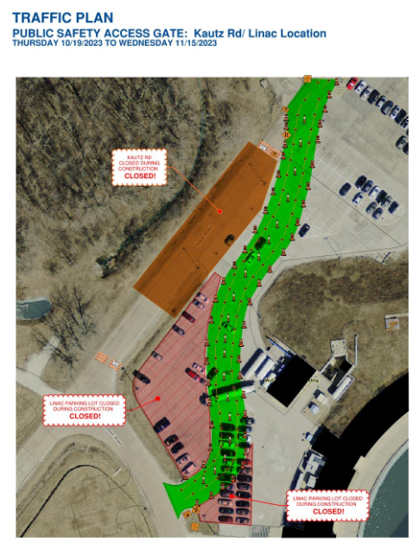
Current Happenings
Parking and traffic will be altered until the pad is complete and drivable.

Slide 9
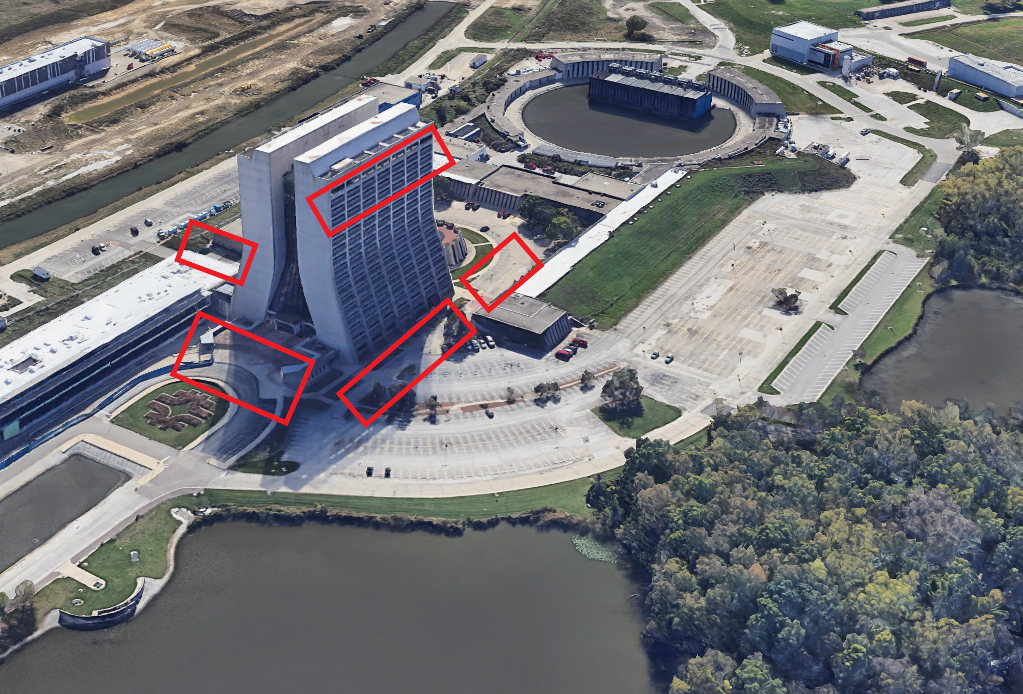
Current Happenings – Active Shooter Information
As communicated in September, there will be an active shooter drill on the morning of Wednesday, Oct. 25 in Wilson Hall. It will take place on the 15th and 16th floors. The drill is not sitewide and will not require participation from the Fermilab community. The purpose of the drill is to test internal policies and procedures.
The Fermilab Physical Security, Emergency Management and Fire departments, in collaboration with the DuPage County SWAT Team, will be hosting the active shooter drill. There will be an increased presence of law enforcement vehicles onsite between the hours of 8 a.m. and 11 a.m. Please note that the emergency responders will be carrying weapons, which do not contain live ammunition.
We understand that individuals may find this drill to be unsettling. If you have any questions, please contact SEMD@fnal.gov.

Slide 10
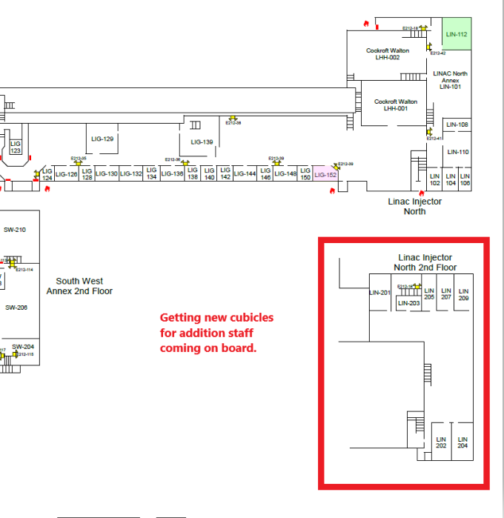
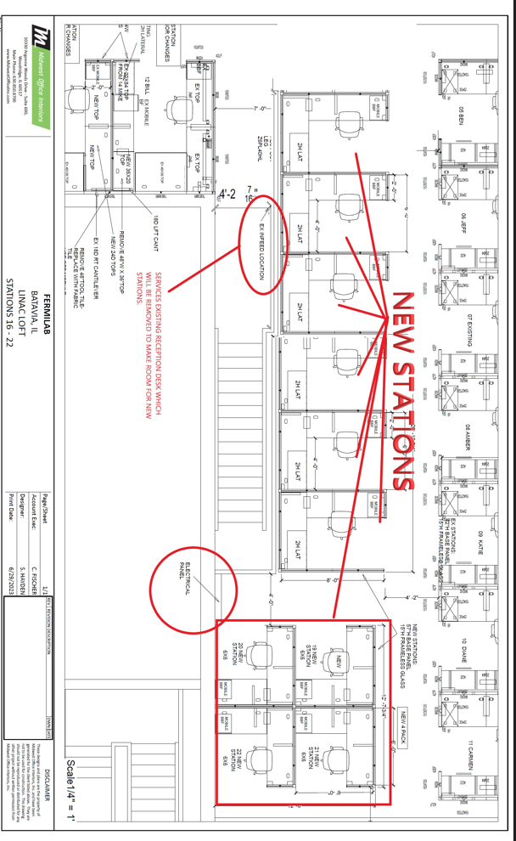
Current Happenings – LINAC RAD Safety Growth
Currently working on getting data drops and cubicle materials ordered and delivered.

Slide 11
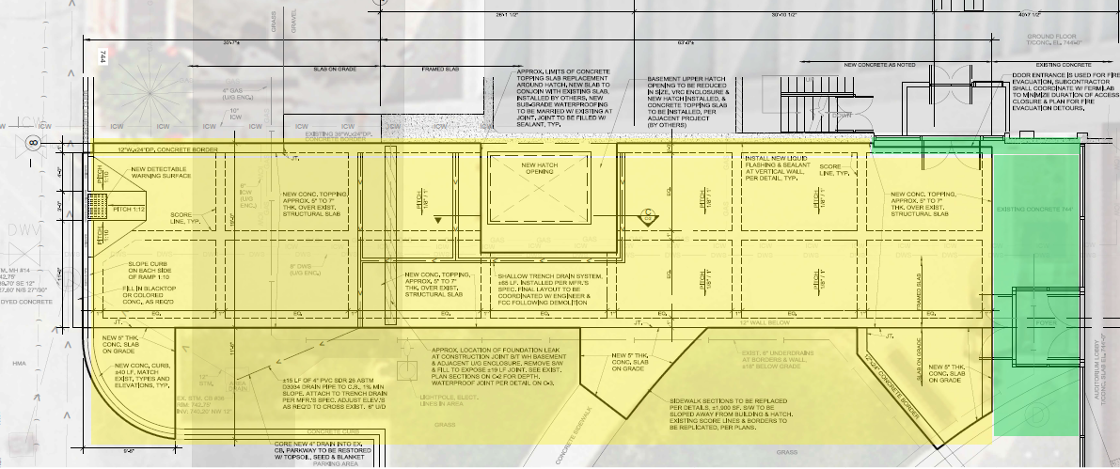
Current Happenings – WH Leak & Site Improvements
Work package has been reviewed.
All the red dots are where existing lighting will be removed and new LED lighting will be installed.

Slide 12
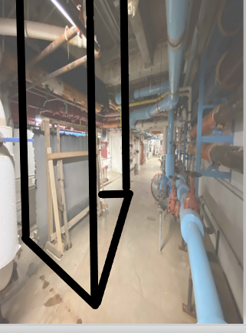
Current Happenings – WH Site Improvements
Work package has been reviewed.
All the red dots are where existing lighting will be removed and new LED lighting will be installed.

Slide 13
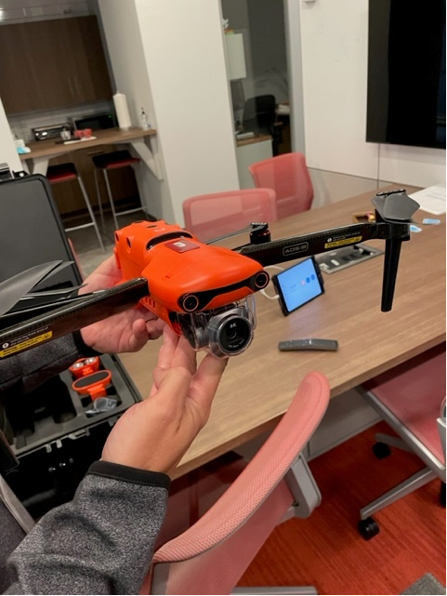
Current Happenings – Drone ariel photos
The lab has a couple drones in Creative Services and AD & AFM’s are working on a process for the use of drones on a larger scale.
There is plenty of projects where we can use the drones to be more efficient, we just need to iron out the details.

Slide 14
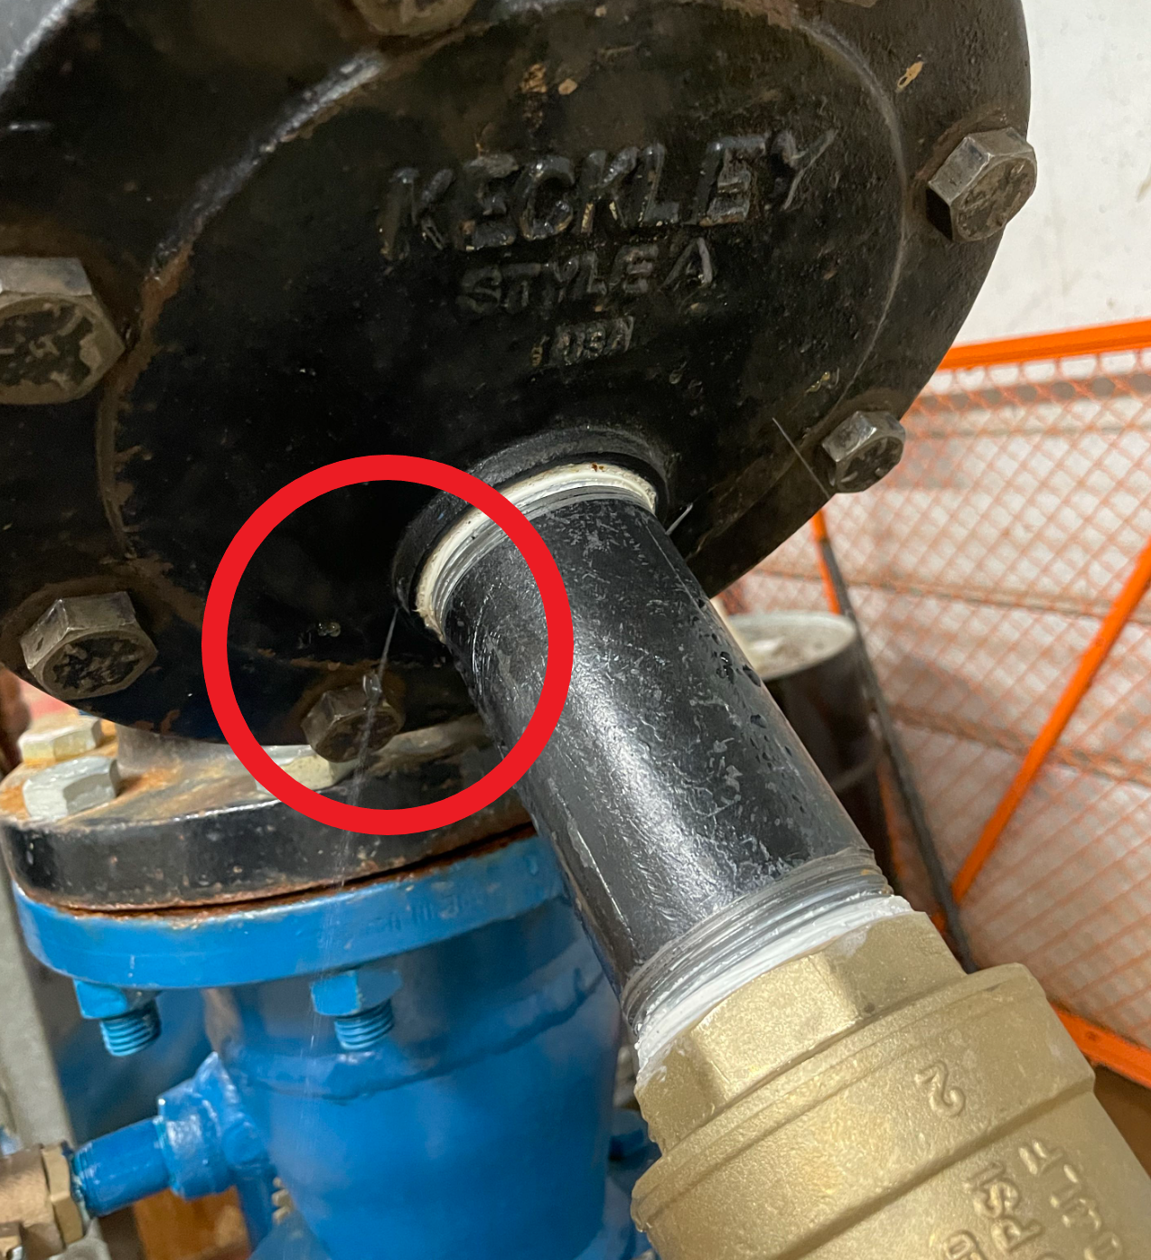
Current Happenings – NML Boiler Repairs
Multiple repairs needed on boilers at NML. Each are being addressed in hopes of completion before the weather really turns.

Slide 15
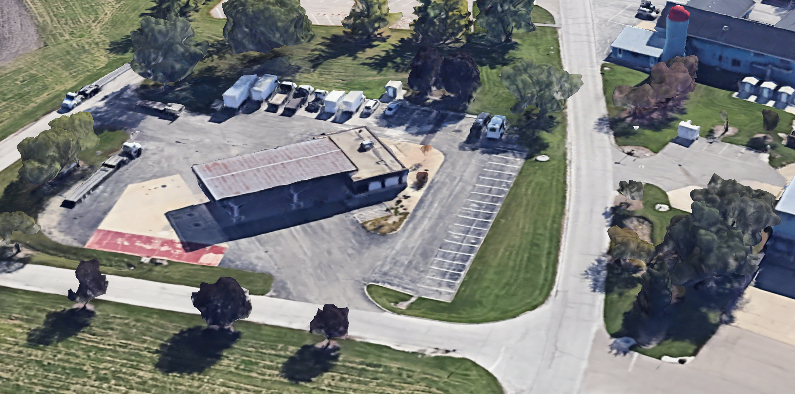
Current Happenings – Fuel Cte. Decom
WHAT ARE WE DOING?
Attention all GSA-leased vehicle custodians and users. The fuel center station at Site 38 is being decommissioned. As a result, you will need to refuel your vehicles at the nearby offsite fuel stations. However, if you have DOE-owned equipment such as UTVs, or heavy/small engine equipment, you can use the existing above-ground fuel tanks conveniently located next to the Site 37 Roads & Grounds facility. The site has an existing 1,000-gallon diesel tank and a 550-gallon unleaded tank for non-GSA vehicles.
WHEN WILL THIS OCCUR?
Fuel center operations will no longer be available as of Nov. 1 and will be placed in “OUT OF SERVICE.”
WHAT DO YOU NEED TO DO?
Next week, the Fleet Manager will send guidance and instructions to all custodians and users. On Oct. 25 at 11:30 a.m., there will be a 30-minute brown bag session covering the following topics: fuel center decommissioning, EVs with supporting infrastructure and GSA replacement vehicles. If you have any questions or concerns, this session will be an opportunity to have them addressed.
https://fnal.zoom.us/j/92753724888?pwd=bjJnVnZHd0N2MDVzdXpPMWxqaEVoZz09

