Slide 1


ACORN
Adam Watts
AD/Ops 0900 ACORN Update
20 October 2023

Slide 2
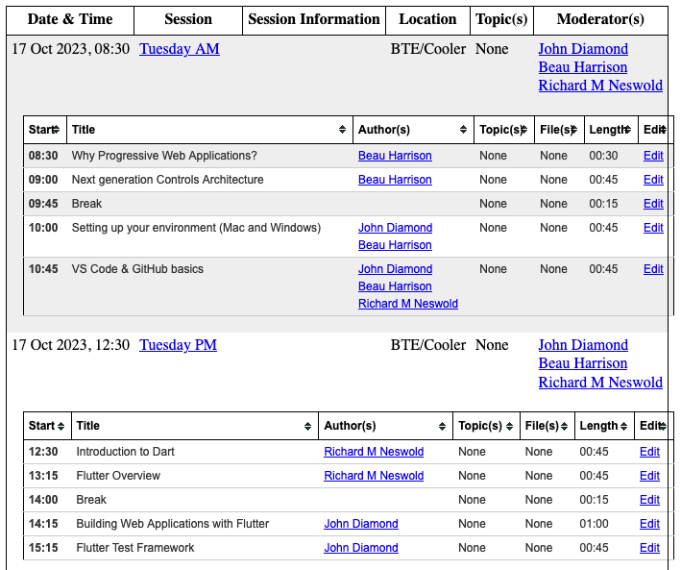
Controls Application Development Clinic
Very successful first clinic, many participants from within and without Controls department
Looking to do this yearly as R&D progresses to keep people informed, on-board new developers
Talks on software architecture, development processes and best practices, containerization and centralized management, web app development using Dart/Flutter, new ACORN/PIP-II parameter page, new standard inter-service protocol (gRPC), automated testing, common application API protocol (GraphQL), etc.
Gathering ideas for monthly hour-long seminars or tutorials to go deeper on these topics.
All slides and video recordings of talks available at https://beamdocs.fnal.gov/cgi-bin/sso/DisplayMeeting?conferenceid=276

Slide 3
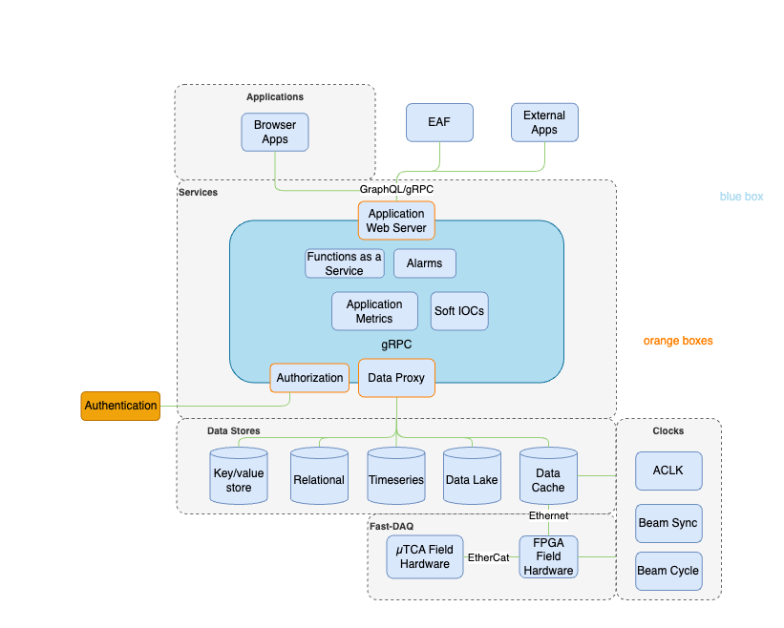
Work-in-Progress
Future Control System Architecture
From Beau Harrison
Key take aways:
Abstraction, separation of concerns, modularity.
Application requests are made via the web server to the rest of the control system. Databases are segregated via the Data Proxy.
Instead of every new system needing to implement its own features, all systems benefit from existing work.
This separation also means that technology choices on either side of the abstraction layer can be made independent of each other.
Unify inter-service communication under a single standard protocol (gRPC looking promising)

Slide 4
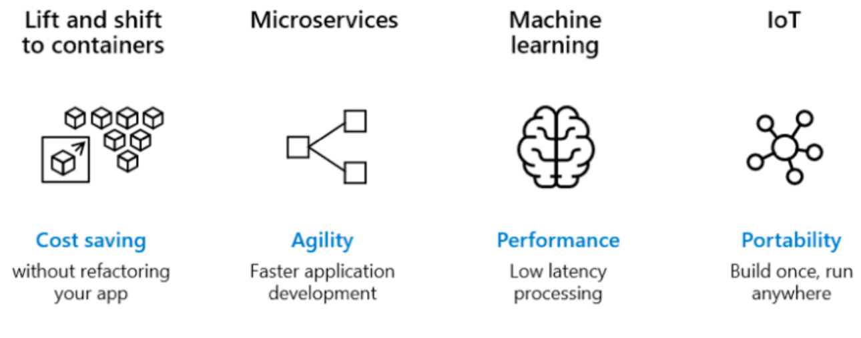
Containerization
From Maria Acosta
Containers are technologies that allow the packaging and isolation of applications with their entire runtime environment.
Think of containers like extremely light-weight virtual machines.
Containers are a standard way to distribute application code, configurations, and dependencies.
Ensure quick, reliable, and consistent deployments, regardless of environment.
Containers centrally managed on server cluster (orchestrator called “Kubernetes”). Central services, applications, user scripts and analysis notebooks, front ends / IOCs.
Usage example: allowed Robotics group to run Ubuntu 22.04 for latest ROS features on chipset that didn’t natively support it

Slide 5
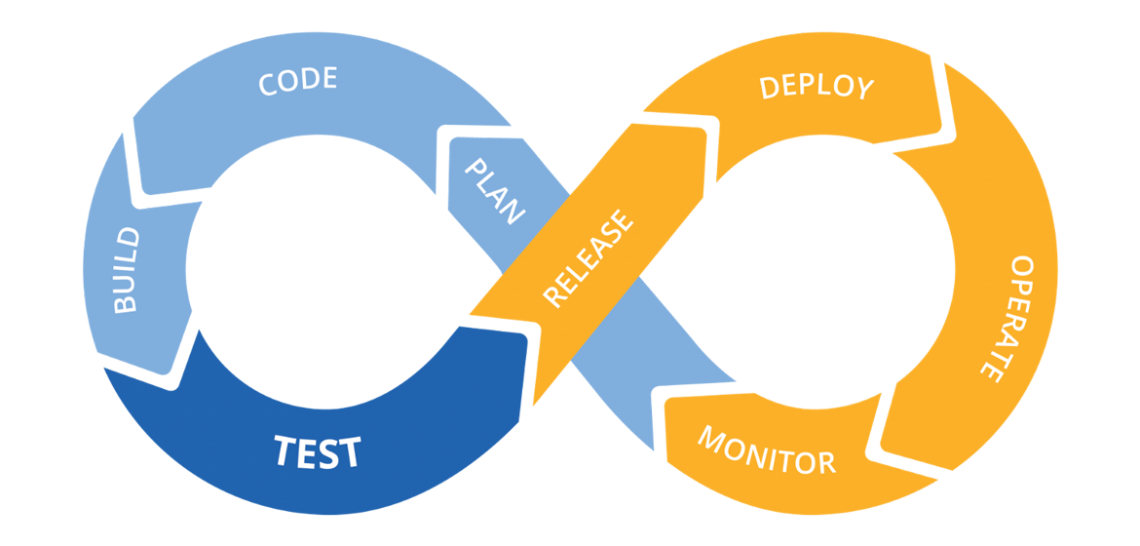
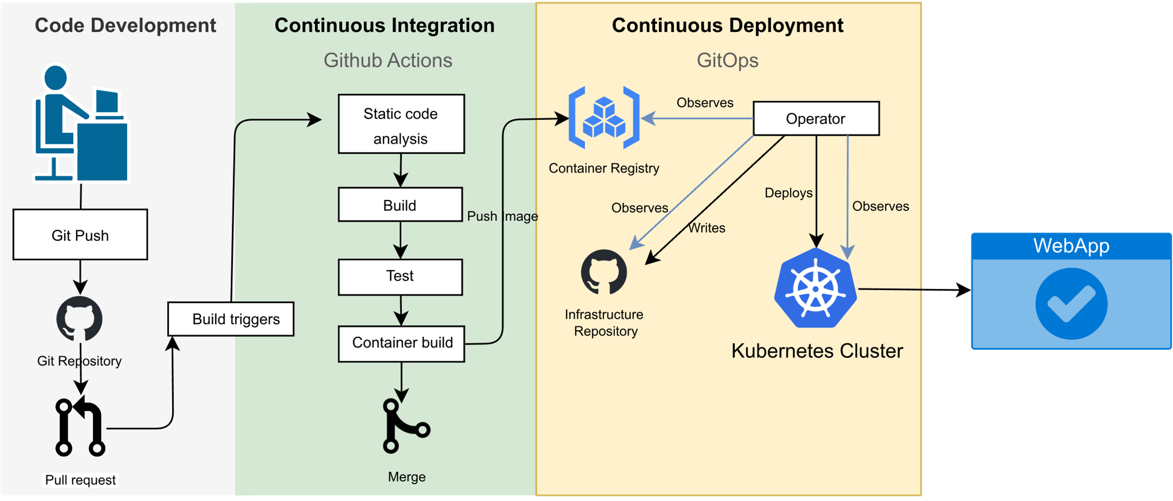
Containerization and Application Development Process
From Mariana Gonzales
Software development process CI/CD (continuous integration, continuous delivery) with containers mean software is routinely tested and deployed (or staged for deployment for sensitive applications).
Standard process to quickly respond to user needs, develop as a team, pass on work to other developers (not single expert), automate quality control, cooperate with AD staff on timing of deployment to operation.
Automated testing to verify component functionality (unit tests), or simulate user input to validate meeting user requirements (integration tests).
GitHub tool for software version control, automated testing, integration with container registry, collaboration between developers, and user feedback tracking.

