Slide 1
PIP-II Weekly Report
20 October 2023
the PIP-II team

Slide 2
PIP-II Advisors – P2MAC
Like any project – fair amount of oversight
PIP-II Machine Advisory Committee: P2MAC
Internationally recognized accelerator experts
Meet at least annually
Here next week: Tuesday - Thursday
P2MAC especially concerned with physics aspects of the project/interfaces to the entire complex
We welcome and heed their advice

Slide 3
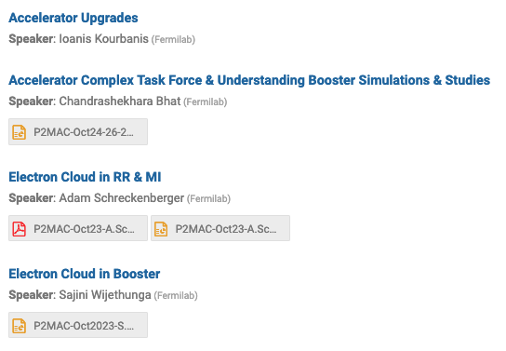
P2MAC Agenda

