Slide 1
IERC News (OCT 19, 2023)
Dan spoke with the contractor and agreed that Contractor will be removing all of their equipment and materials from G321 by end of day next Wednesday 10/25/23.
As already announced we will have monthly safety walk-through. First was today at 11:00am.
HEERC_safety mailing list is now fixed. Still not in the approval list for intervention on the HVAC system which might have an impact on the ODH analysis. Dan, can you comment ?
Monica, Flor and Daniel Urrea (Clorica) are making arrangements for Clorica to clean the Cleanroom, CCD room and Dune Warm Lab weekly. Donna will measure (since this is the first time we do it ourselves) ESD property of the floor before/after.
Optical table for A.Prosser in final location but larger optical table does not fit in the elevator. Need to understand what can be done.

Slide 2
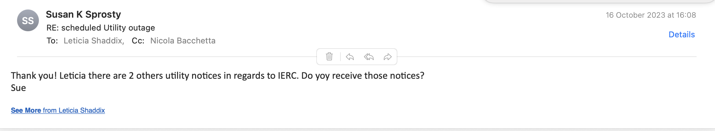
IERC News (OCT 19, 2023)
We continue experiencing issues with card readers, access is lost, regained, re-lost… and we do not seem to understand the root of the problem.
Follow up from Marcel Borcean on cranes.
  The limit switch adjustments were made during the monthly inspections. Cranes are operational. Audible warning devices are missing on 3 cranes. This was noted during commissioning. It is not a big task but it will need to be corrected. Please advise if the original contractor will warranty this repair.
HVAC to be shut-off next Monday but it still un-clear which one. Is it just the clean room HVAC system ? Also we do not receive these notes unless Sue’s forwarding them to us.

Slide 3
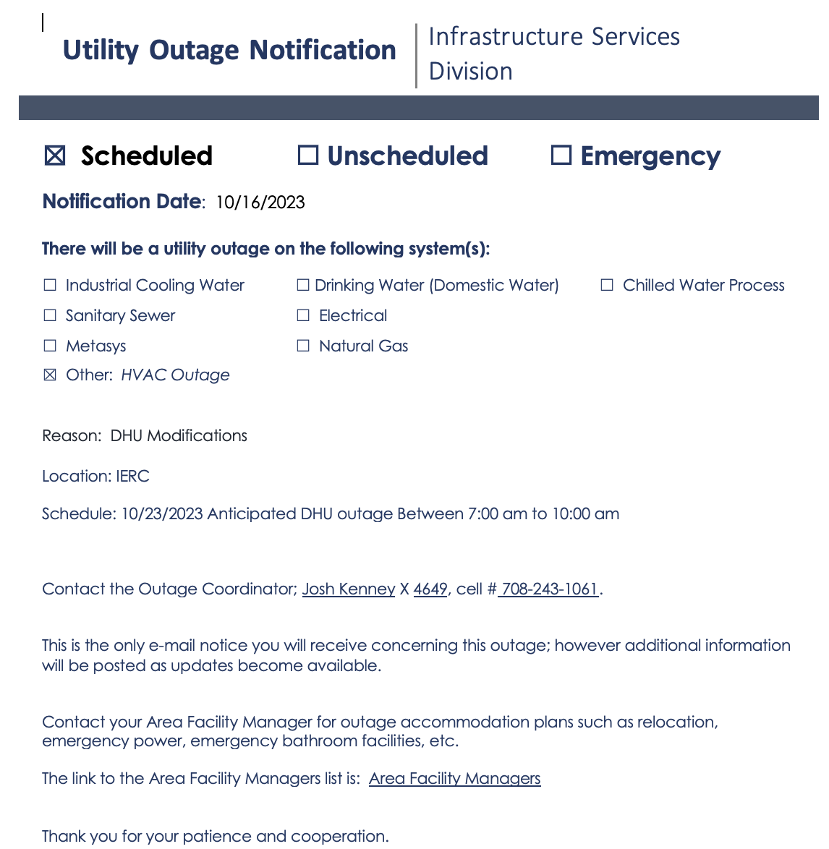
IERC News (OCT 19, 2023)

Slide 4
From Previous Meetings

Slide 5
IERC News (OCT 12, 2023)
Tenants at IERC should contact their department Admin for Travel / Vouchers / and Orders (this has not changed).
Spring Barrett and Cathy Barker will be stocking the cabinets, filling the copiers/printers with paper, and keeping track of the Conference room. They will go to IERC once a week to make sure things are good.
I agreed with James Burke (Safety) to have monthly safety walk-through. First is Thursday 19th at 11:00am. The idea is for them to familiarize with the equipment that is currently at IERC since they will be required to sign off on any ORC. If some of you can be in the lab and explain what is going on it would be beneficial.
Chilled water: fall under the purview of the ISD Mechanical Shop, supervised by John (JP) Pollock. Fehr Solution (water treatment consultant) should have the IERC chilled water system added to their list for regular sampling. Question: Was a Sample Point or Chem Feeder installed in this system?

Slide 6
IERC News (OCT 12, 2023)
As a follow up on the HVAC intervention on the 29th of September, we had a meeting with ISD and Safety to discuss better procedures for such cases as they potentially alter the normal situation in terms of ODH analysis for various places at IERC. A specific HEERC_safety@fnal.gov list will be created with the idea to be in the loop of the approval process for such events. In any case, once approved, all events will be announced to the HEERC_managers@fnal.gov list with as much advance notice as possible. Question: is ODH the only issue here ?
We are in the process of developing the necessary procedures for being able to perform simple “Julie scans” ourselves without having to call the outside company who is very expensive. We will test drive the procedure for the installation of the new gas shack outside IERC North/Est end soon.
If you need to place some equipment in the storage room (G523) you can do so. In the future we might purchase cabinets to populate the room.

Slide 7
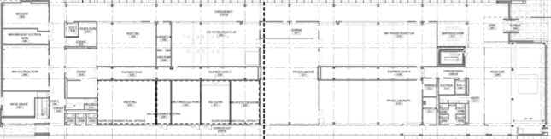
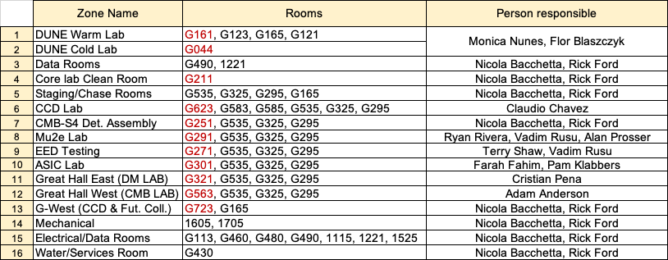
This slide was sent to Lori Limberg (card access). Let me know if there are modifications needed
G490
A.Anderson
C.Chavez
G671
G771
G480
G523
G723
G563
G623
Core Lab
Clean Room
G-WEST
CCD & Future Collider R&D
Great Hall West
(CMB-S4)
CCD
DUNE Cold
G460
G535
N.Bacchetta
F.Blaszczyk
G325
G295
N.Bacchetta
G165
C.Pena
G321
ASIC
Mu2e
EED
G251
DUNE Warm
G113
G044
G430
G301
G291
G271
CMB-S4
Det.Ass.
G211
M.Nunes
G123
G350
Great Hall East
(DM detectors)
R.Rivera
V.Rusu
A.Prosser
G161
F.Fahim
T. Shaw
V. Rusu
A.Anderson
G121
People requesting access to any of the zones (1 to 16) or to specific lab in red, should be given automatically access to the other rooms in the zone

Slide 8
IERC News (OCT 5, 2023)
Gas shack: Had a conversation with Arv Vasonis and agreed that for the moment we will install the gas rack where we now have the bottles next to the 3rd garage door on the north/east side of the building
2 large dumpsters (cardboard + regular waste) to be placed on the north/east side of the building. Sue is following this up.
People with office at IERC should ask for a key. There were instances when Security passed by and locked all doors and you might be locked out of your office if you do not have a key. I’ll try to understand whether I can ask security NOT to lock office door. Link for requesting a key here: https://www-esh.fnal.gov/pls/apex/f?p=150:1:17089239814925::::: Specify in the request your office number (but the key is actually the same for all offices and it is V2BB1)
We need waste basket for the offices. Also would the cleaning services clean the offices and emtpy the waste baskets ?
Admin person for IERC to be nominated

Slide 9
IERC News (OCT 5, 2023)
Great Hall East (G321) has now been assigned for work related to SNSPD characterization for BREAD, quantum capacitance detectors and related generic r&d. Person responsible for it would be Cristian Pena.
As a general reminder:
If electrical work is needed it should be addressed to Dave Featherston
If any type of gas is involved and ODH analysis should be done prior to move the relevant equipment there. Contact Del Allspach
If equipment is to be place in the chase, Don Mitchel is keeping track of the 3D model and should be consulted prior to install any new equipment. No equipment should be placed there without prior authorization.
An ORC should be requested before operating any setup in any lab at IERC, even when the setup has already been reviewed when elsewhere. https://fermipoint.fnal.gov/service/tsworc/Lists/tsworc/NewForm.aspx?Source=/service/tsworc/&Beam=0&orc=1

Slide 10
IERC News (OCT 5, 2023)
For any Ethernet connection, please follow the standard Fermilab procedures and submit a ServiceNow request:
http://appora.fnal.gov/pls/default/node_registration.html https://fermi.servicenowservices.com/kb_view.do?sysparm_article=KB0010655
We have found recently that some patch jumpers for the LAB connections at IERC were moved on the patch panels to centrally managed network equipment in the Equipment Chases. I think it should be a common sense that nobody but Network Services/Network Cabling are allowed to connect/disconnect/ move anything in the racks with network equipment. We expect that users in the new IERC building will demonstrate a common sense by not touching the centrally managed infrastructure. For any networking needs, users just need to submit a ServiceNow request and we will take care of the rest.
We have been scrutinized recently by Cyber security for locations with network equipment and who can access it. If it continues to happening, we might be required to replace all racks with network equipment in the IERC by the lockable cabinets at the expense of IERC stakeholders.
It is important that we are notified with some advance notice of any intervention at IERC, especially for what concern power outages and the HVAC system as it has an impact on safety since the ODH analysis is linked to the proper functioning of the HVAC system.

Slide 11
IERC News (OCT 5, 2023)
Plans for 1st floor open space laboratories:
  Electronics lab space: meant for bench top type of setups (electrical, optical, test stations etc.)
    In the process of getting appropriate space dividers
    Lab cubicles: 16.5’ wide by 21’ long
  Tech lab space: meant for more mechanical work and to provide space for the technicians to have their space/material and computer etc. in support of the activities on-going at IERC.
    Lab cubicles: 11’ wide by 21’ long
We are in the process of purchasing new benches/chairs for equipping more labs at a reasonable price.
TECH LAB SPACE
TECH LAB SPACE
ELECTRONICS LAB SPACE
ELECTRONICS LAB SPACE
A. Prosser
J.Estrada

Slide 12
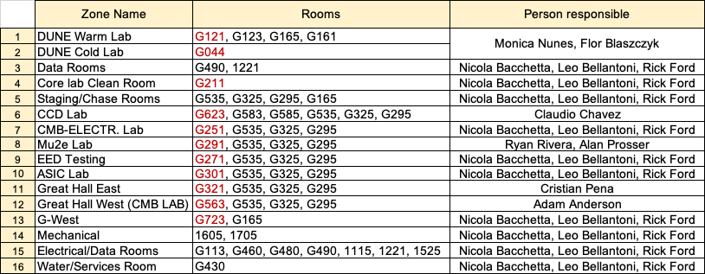
Access zones for HEERC
People requesting access to any of the zones (1 to 16) or to specific lab in red, should be given automatically access to the other room in the zone

Slide 13
Follow up items from previous meetings
There is a proposal for where to place fixed phones in the building and I need to follow that up with the formal request. A certain number of phones should be already available.
Need to add a card reader for G165 (south chase)
Would be nice to upgrade one of the meeting rooms to ZOOM room in 2024 (likely 1880)
Need to take care of properly drain the condesation water from the compressor in G430

