Slide 1
DAQ Consortium Responsibilities and Milestones
G. Lehmann Miotto / CERN

Slide 2
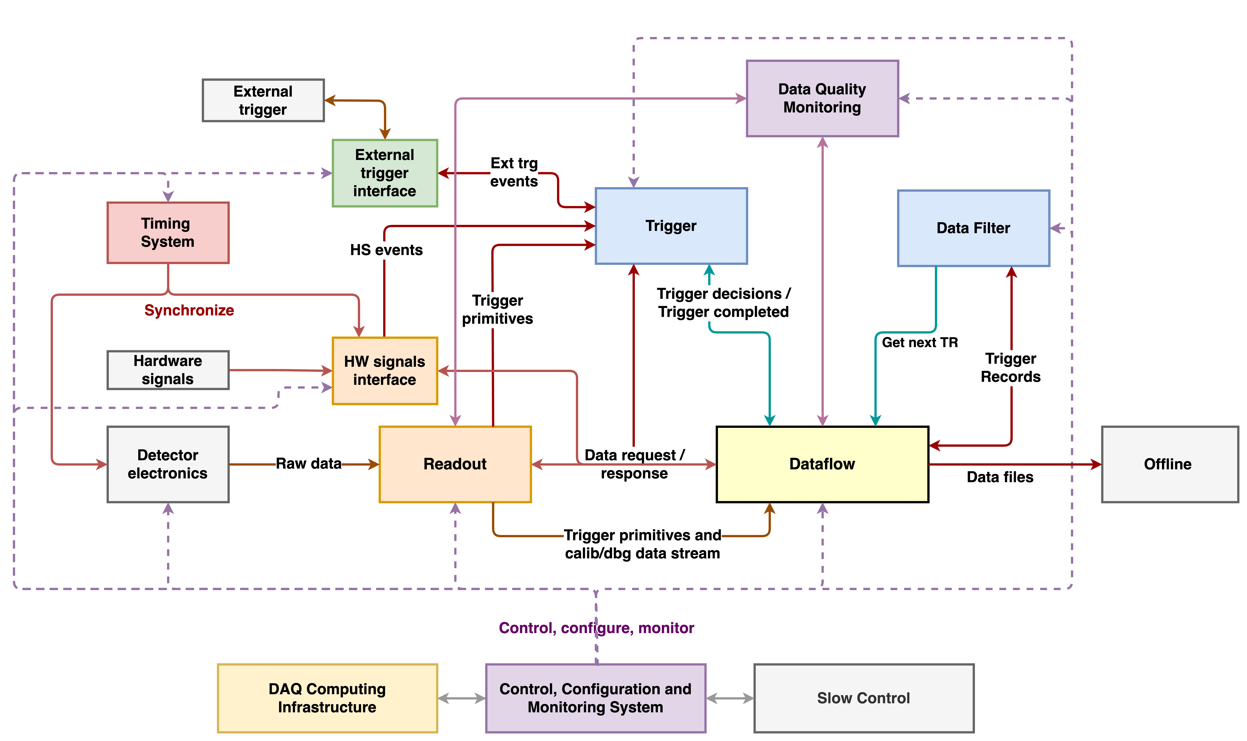
DAQ Overview https://edms.cern.ch/project/CERN-0000193830

Slide 3
DAQ FD Hardware Responsibilities
RAL
Equivalent matrix to be prepared for ND!
Bristol/RAL
Bristol
CERN
FNAL
Bristol
CERN/RAL/Toronto
FNAL
FNAL
RAL
~ 7M$ for production HW only; adding prototypes, ProtoDUNE, spares -> 8M$

Slide 4
Beware… US fiscal year starts on Oct 1st!

Slide 5
Preliminary strategy for FD HW production/procurement
Produce the complete Timing HW for FD1 and FD2 in one go
Procure separately for FD1 and FD2 (~15 months difference)
Readout network switches
Infrastructure servers
Procure readout, storage, CCM servers in batches: initially only the minumum to support detector commissioning
Deliver trigger, data filter, DQM and all remaining servers at least 1 year before the cryostat is full
Maybe more due to external constraints
Detector installation:
Readout validation, check channels status and noise levels; data flow and data transfers to FNAL validation.
Experiment commissioning:
Readout full detector, gear up for triggering based on interactions, add data filtering and comprehensive data quality monitoring; validate automated recovery procedures; validate SNB workflow from readout to offline.

Slide 6
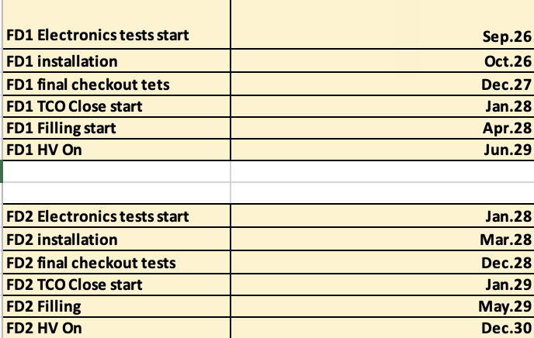
Timeline for PRRs to launch final production/procurement
Driven by the present FD1 and FD2 installation dates
Timing PRR: August 2024
Readout network PRR: August 2024
All servers: November 2024
A lot of effort required in the next 12 months to finalize requirements, test candidate equipment, pass any electrical compliance review, ensure we fit into the power budget, write specifications documents for tendering…
The 5 institutions responsible for DAQ HW are expected to take a leading role, but this work requires contributions throughout the consortium!

Slide 7
DAQ FW/SW Responsibilities
Edinburgh, Imperial, UCL
Bristol
Bristol, RAL
Bristol
Bristol, Oxford, Sussex, UCL, CERN, BNL
Algorithms, performance, simulation: Imperial, Oxford, Sussex, UCL, Toronto, Columbia, Pennsylvania
Toronto
CERN, Bristol, Oxford, RAL, Sussex, Toronto
Birmingham, Imperial, Liverpool, CERN, BNL
FNAL, CERN
UMN Duluth, FNAL
SW/FW management: FNAL, RAL
Notes:
Dark red: problematic, under-resourced areas
Brown: under-resourced areas but not yet on critical path
Blue: OK
UCL moved resources form DQM to CCM to support more critical activities

Slide 8
Contributions beyond MoU
Montreal (Toronto), Pennsylvania contributed to Timing HW/FW components design
Contributions to Trigger and operations at CERN by Indiana University Bloomington
Tel Aviv, FNAL contributing to DQM tools in view of ProtoDUNE
Tel Aviv, RHUL, Imperial contributing to readout customization for ND, and ND test beams support
Queen Mary in charge of ND trigger, and started contributing to FD trigger

Slide 9
A word on the Near Detector DAQ
The DAQ consortium was extended at the end of 2020 to also include the ND DAQ (2nd technical lead introduced, A. Kaboth)
Long term it is obvious that we will all profit from maintaining and improving a single system, with uniform interfaces to detectors and offline
Resources for the ND DAQ are not secured yet
The FDR and MoUs will hopefully help clarifying contributions
Few people in the DAQ consortium developed the readout plugins to integrate with some of the near detectors
To be honest, so far the effort from “FD resources” to support ND is definitely higher than the “ND resources” contributing to the overall DAQ developments
SW management, deployment support, coaching and debugging, …

Slide 10
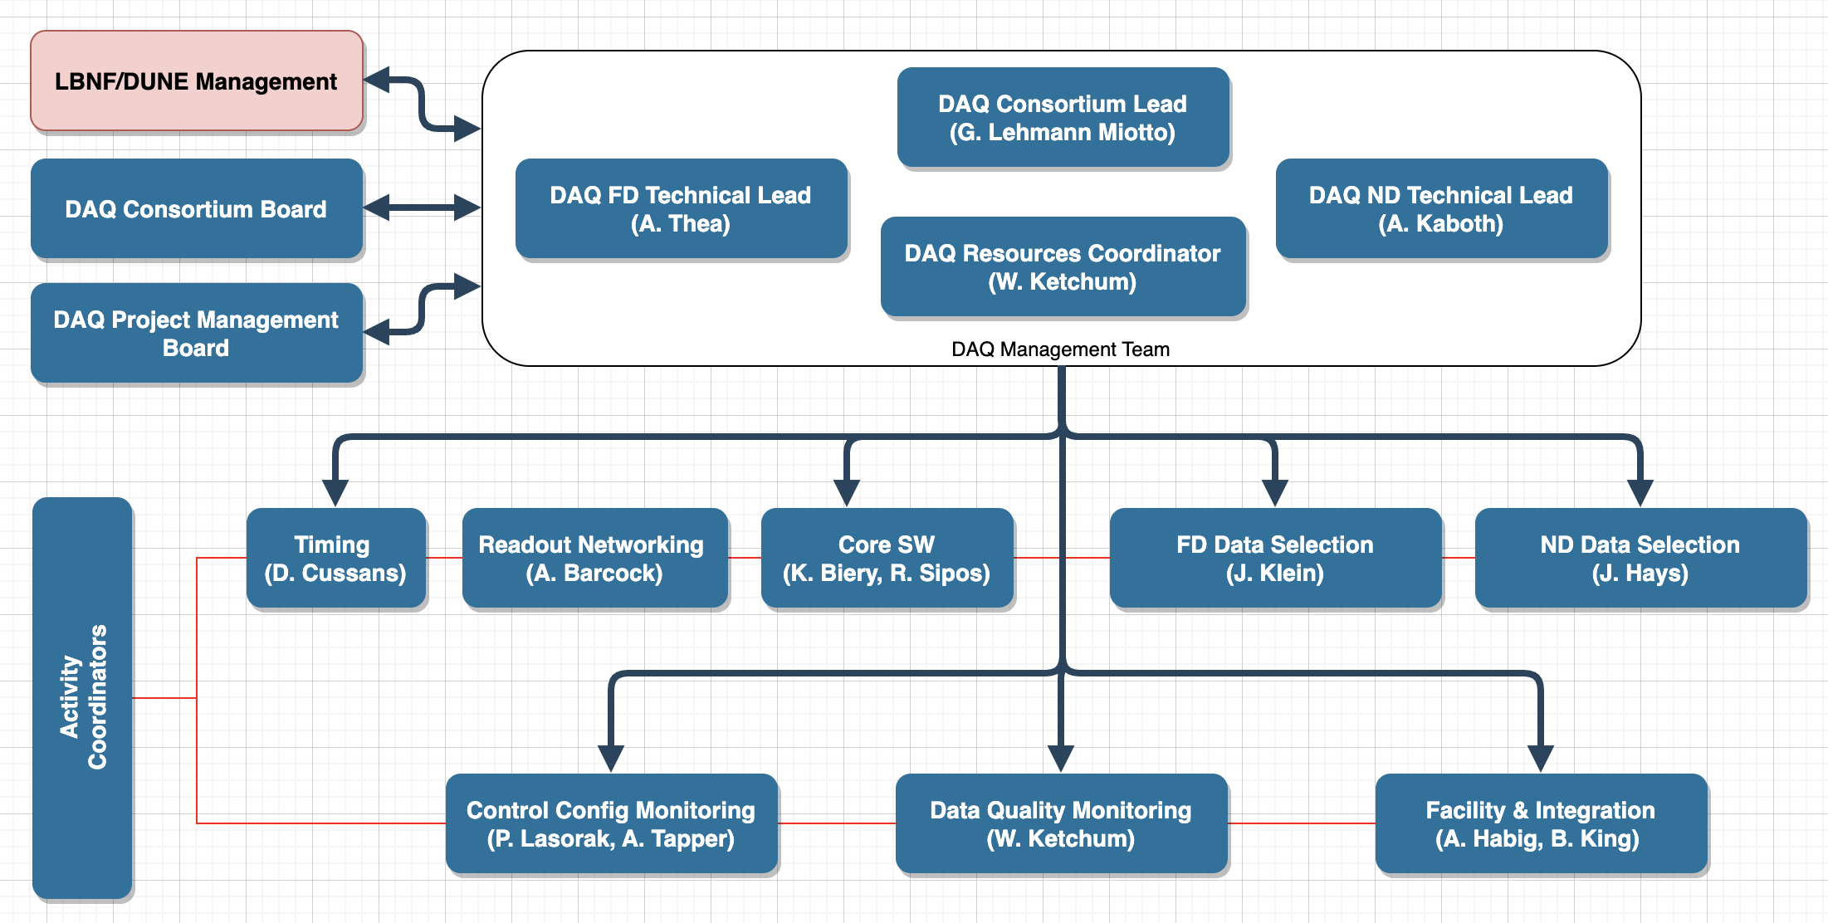
DAQ Consortium organisation

Slide 11
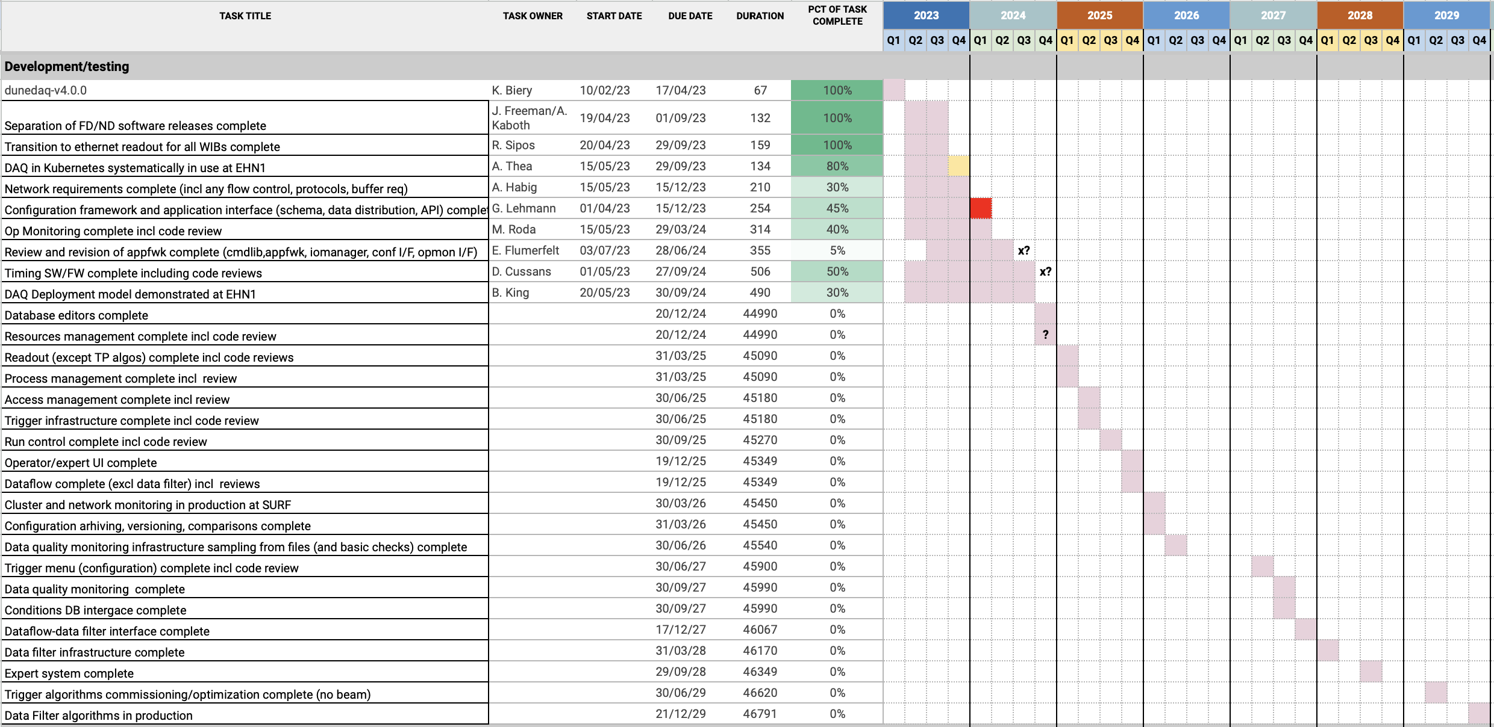

Slide 12
Summary
Maturing SW to the level needed for specifying hardware of servers is mandatory in 2024 (in particular for readout and storage servers, readout network)
Quite a bit of time goes into supporting detector test setups (ND and FD)
There is steady progress, but not at the required pace
Several contributors at very small fraction of their time on DUNE DAQ => ineffective and sometimes counterproductive
Insufficient level of engagement of some institutions (despite MoU!)
Will be contacted individually
Overall, missing software engineering skills!
DAQ team is spread with few occasions to meet in person
Many meetings (double sided sword): round tables are good over a coffee, a killer on zoom
Early 2024, workshop at CERN on appfwk and CCM interfaces to core SW
Try to have a sizeable team at CERN for readout/trigger work
Possibly aggregate in the UK for making focused progress on CCM

