Slide 1
Switchyard & Meson Report
Michael K. Olander
AD 9:00 Meeting
27 October 2023

Slide 2
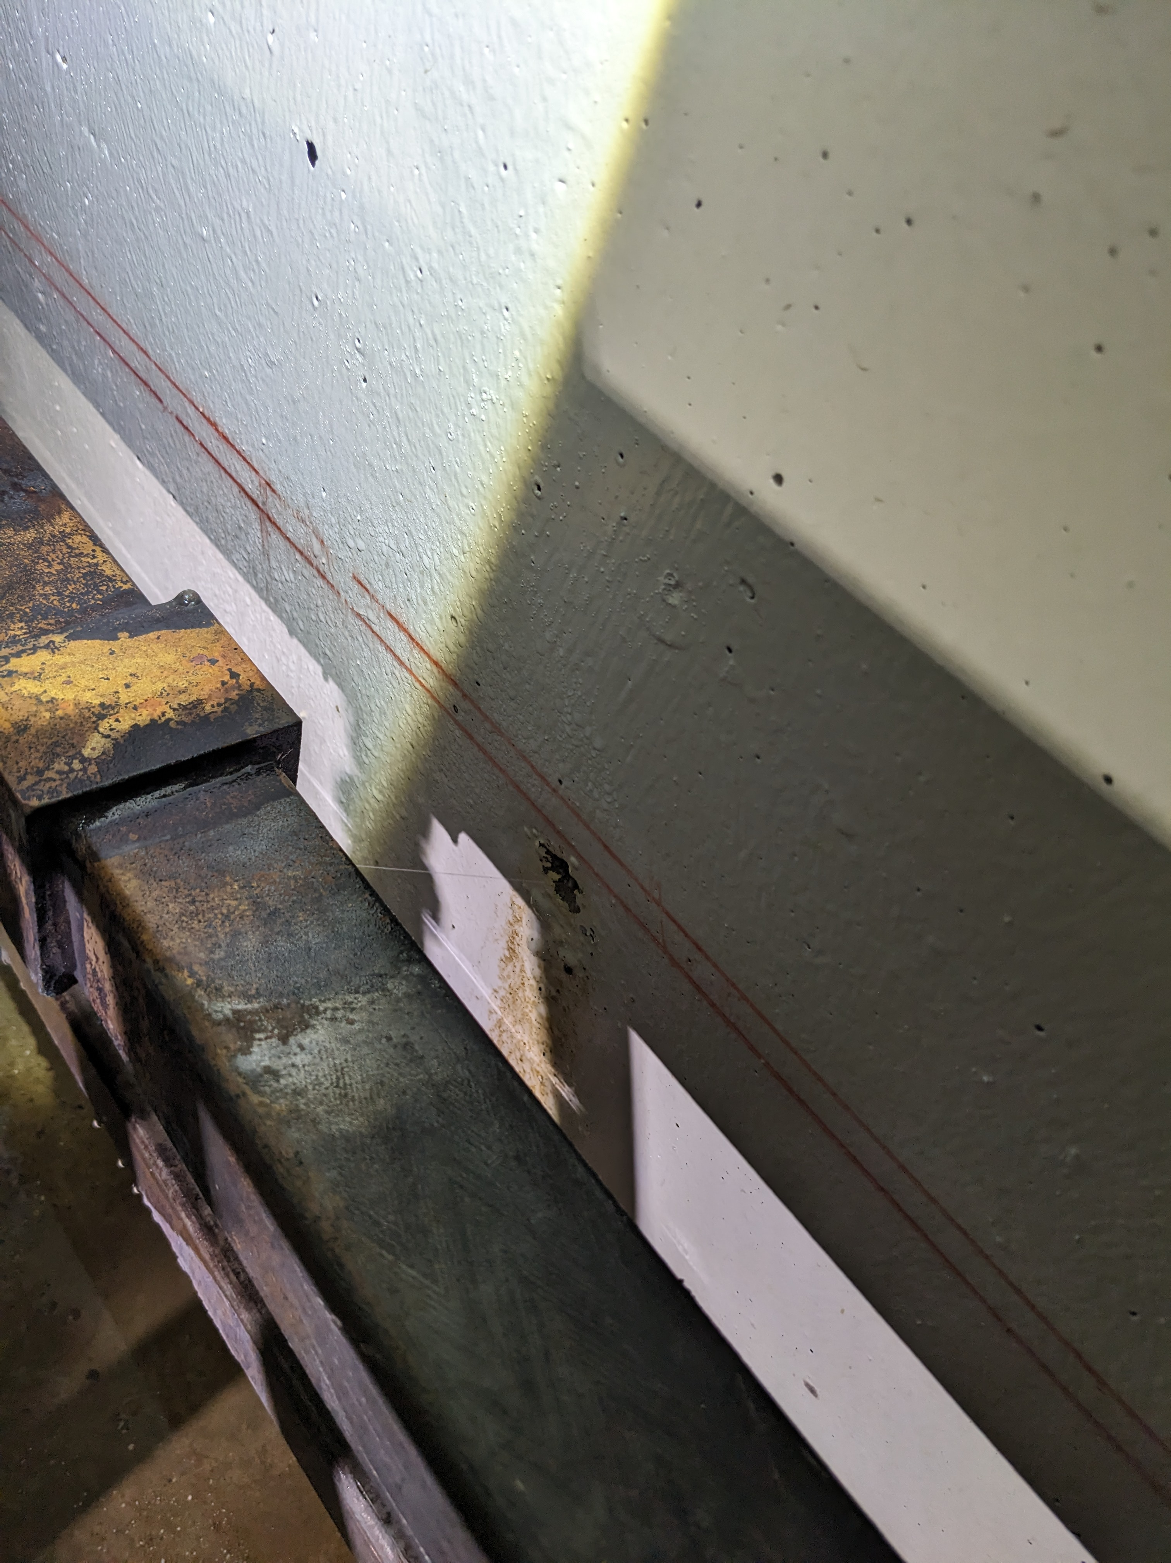
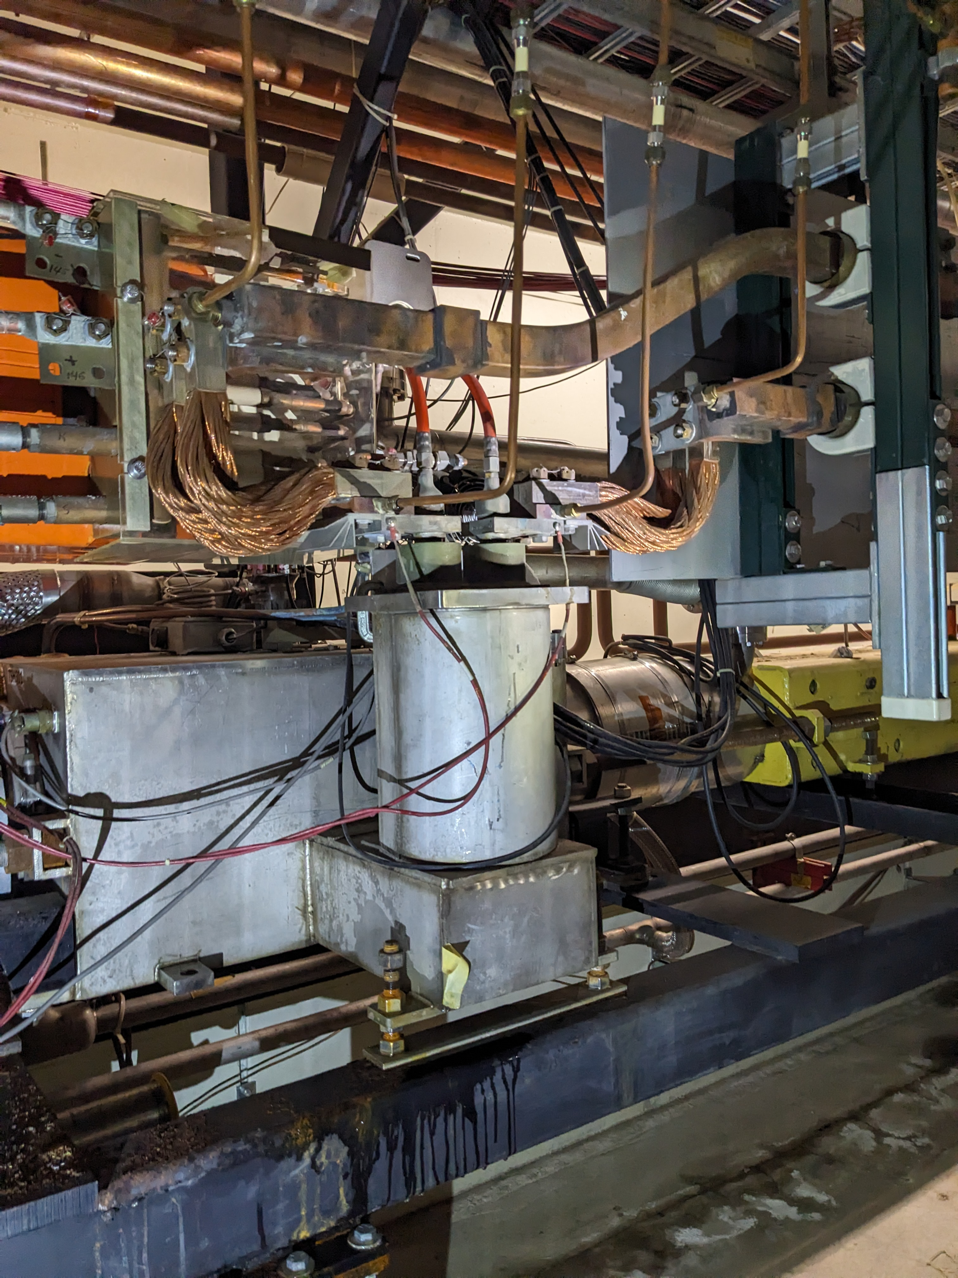
Tevatron Bus Leak @ F0
Tevatron Bus LCW Leak discovered at F0 on the P1 Line near Q713-1.
Tevatron Conventional to SC Feed-can shows a leak as well.

Slide 3
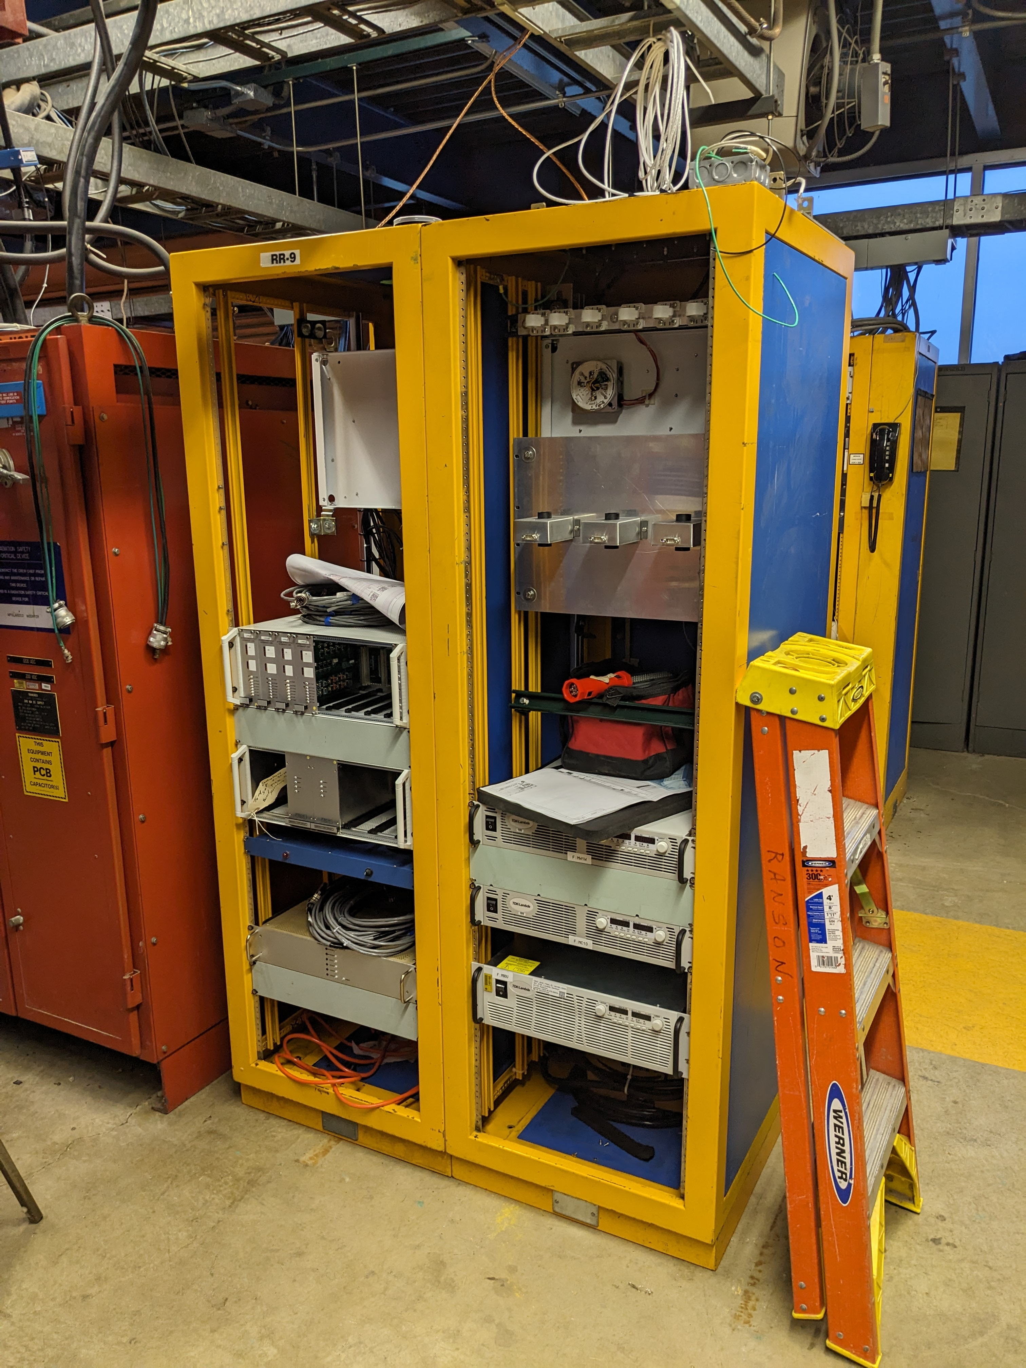
MS1 Power Supply Upgrade Progress
Thanks to EE Support for getting the rack installed!!
Rack still needs conventional power.
These new power supplies will replace F:MW1W, F:M01D, & F:MC1D Transrex power supplies.

Slide 4
In Other News…
Magnet Leaks
  MSD identified 7 magnet leaks in F-Sector & Transfer Hall
    Will require TD repairs.
Other leaks
  1 secondary header leak
  2 main header isolation valve leaks
    MSD coordinating repairs.

