Slide 1
PIP-II Weekly Report
27 October 2023
the PIP-II team

Slide 2
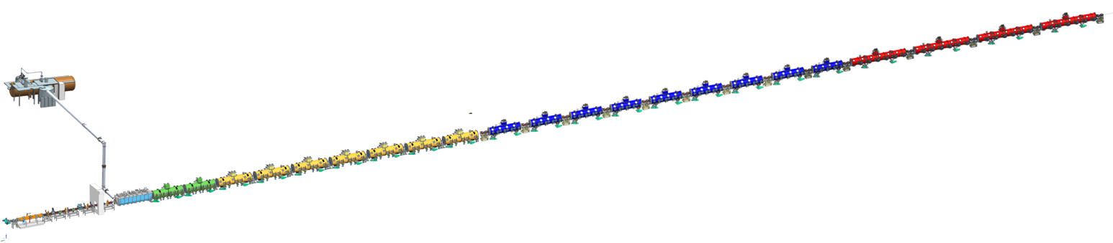
Cryogenics
PIP-II is based on superconducting RF technology
  100+ Niobium cavities in 23 cryomodules
  Cryomodule Thermal shields
  Distribution system
  Cryoplant
  Storage
  2K helium: subatmospheric, superfluid

Slide 3
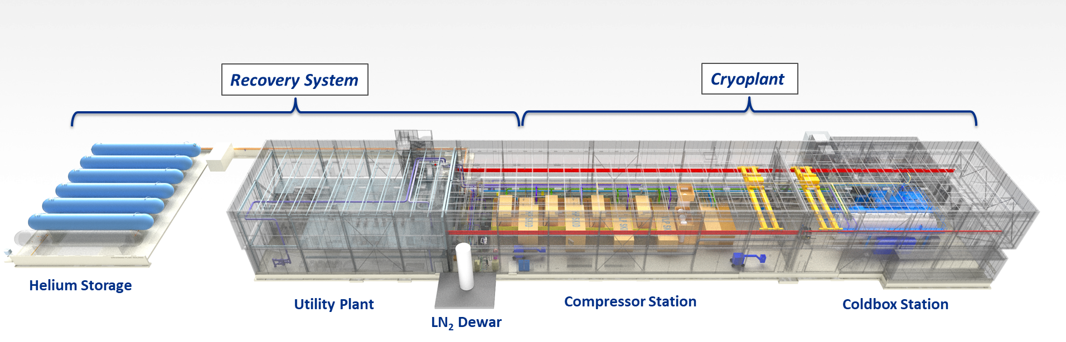
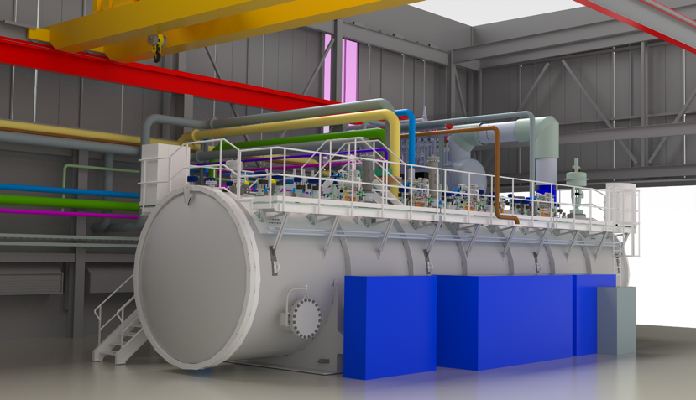
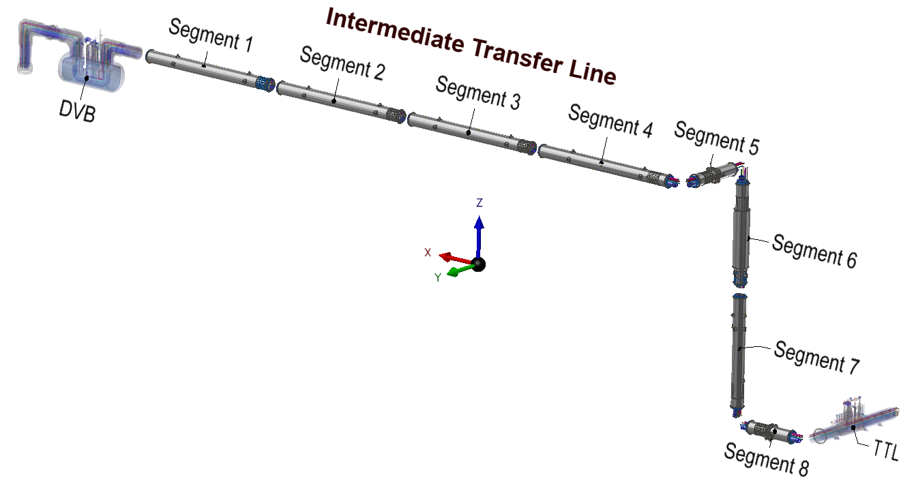
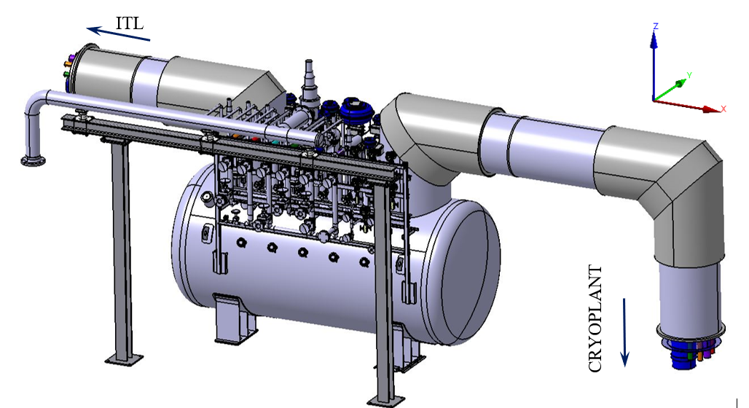
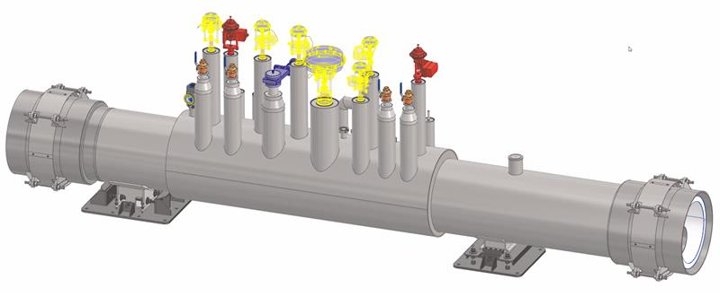
Cryoplant & Distribution
Tunnel Transfer Line Module
~8-12 m
TTL comprises 25 such modules in series
Distribution Valve Box

Slide 4
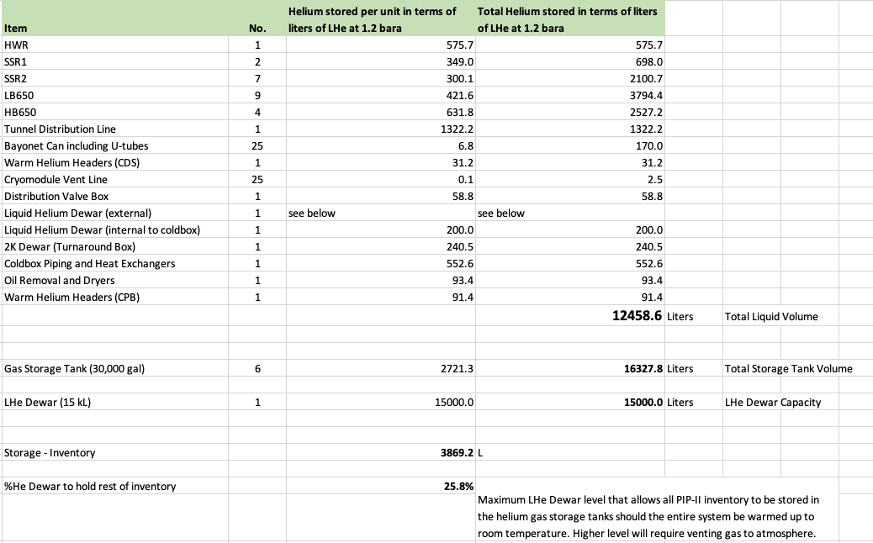
Cryo Volume

