Slide 1


ACORN
Adam Watts
AD/Ops 0900 ACORN Update
27 October 2023

Slide 2
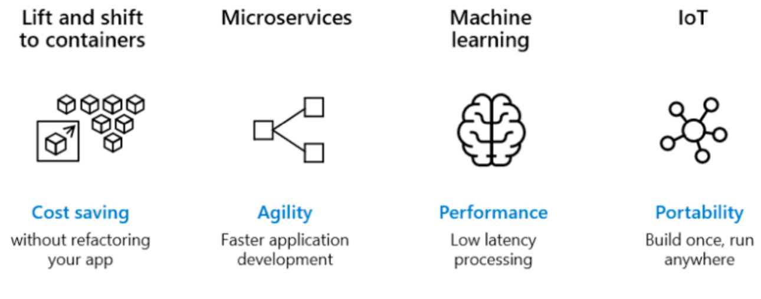
Containerization
From Maria Acosta
Containers are technologies that allow the packaging and isolation of applications with their entire runtime environment.
Think of containers like extremely light-weight virtual machines.
Containers are a standard way to distribute application code, configurations, and dependencies.
Ensure quick, reliable, and consistent deployments, regardless of environment.
Containers centrally managed on server cluster (orchestrator called “Kubernetes”). Central services, applications, user scripts and analysis notebooks, front ends / IOCs.
Usage example: allowed Robotics group to run Ubuntu 22.04 for latest ROS features on chipset that didn’t natively support it

Slide 3
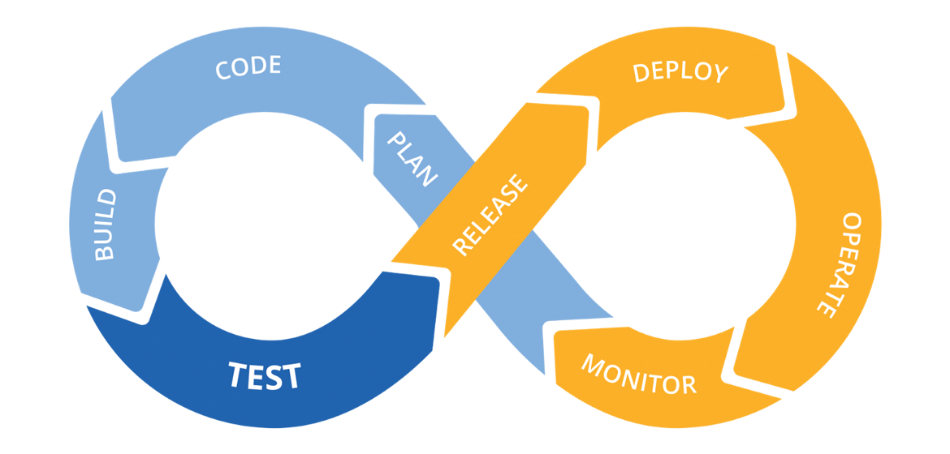
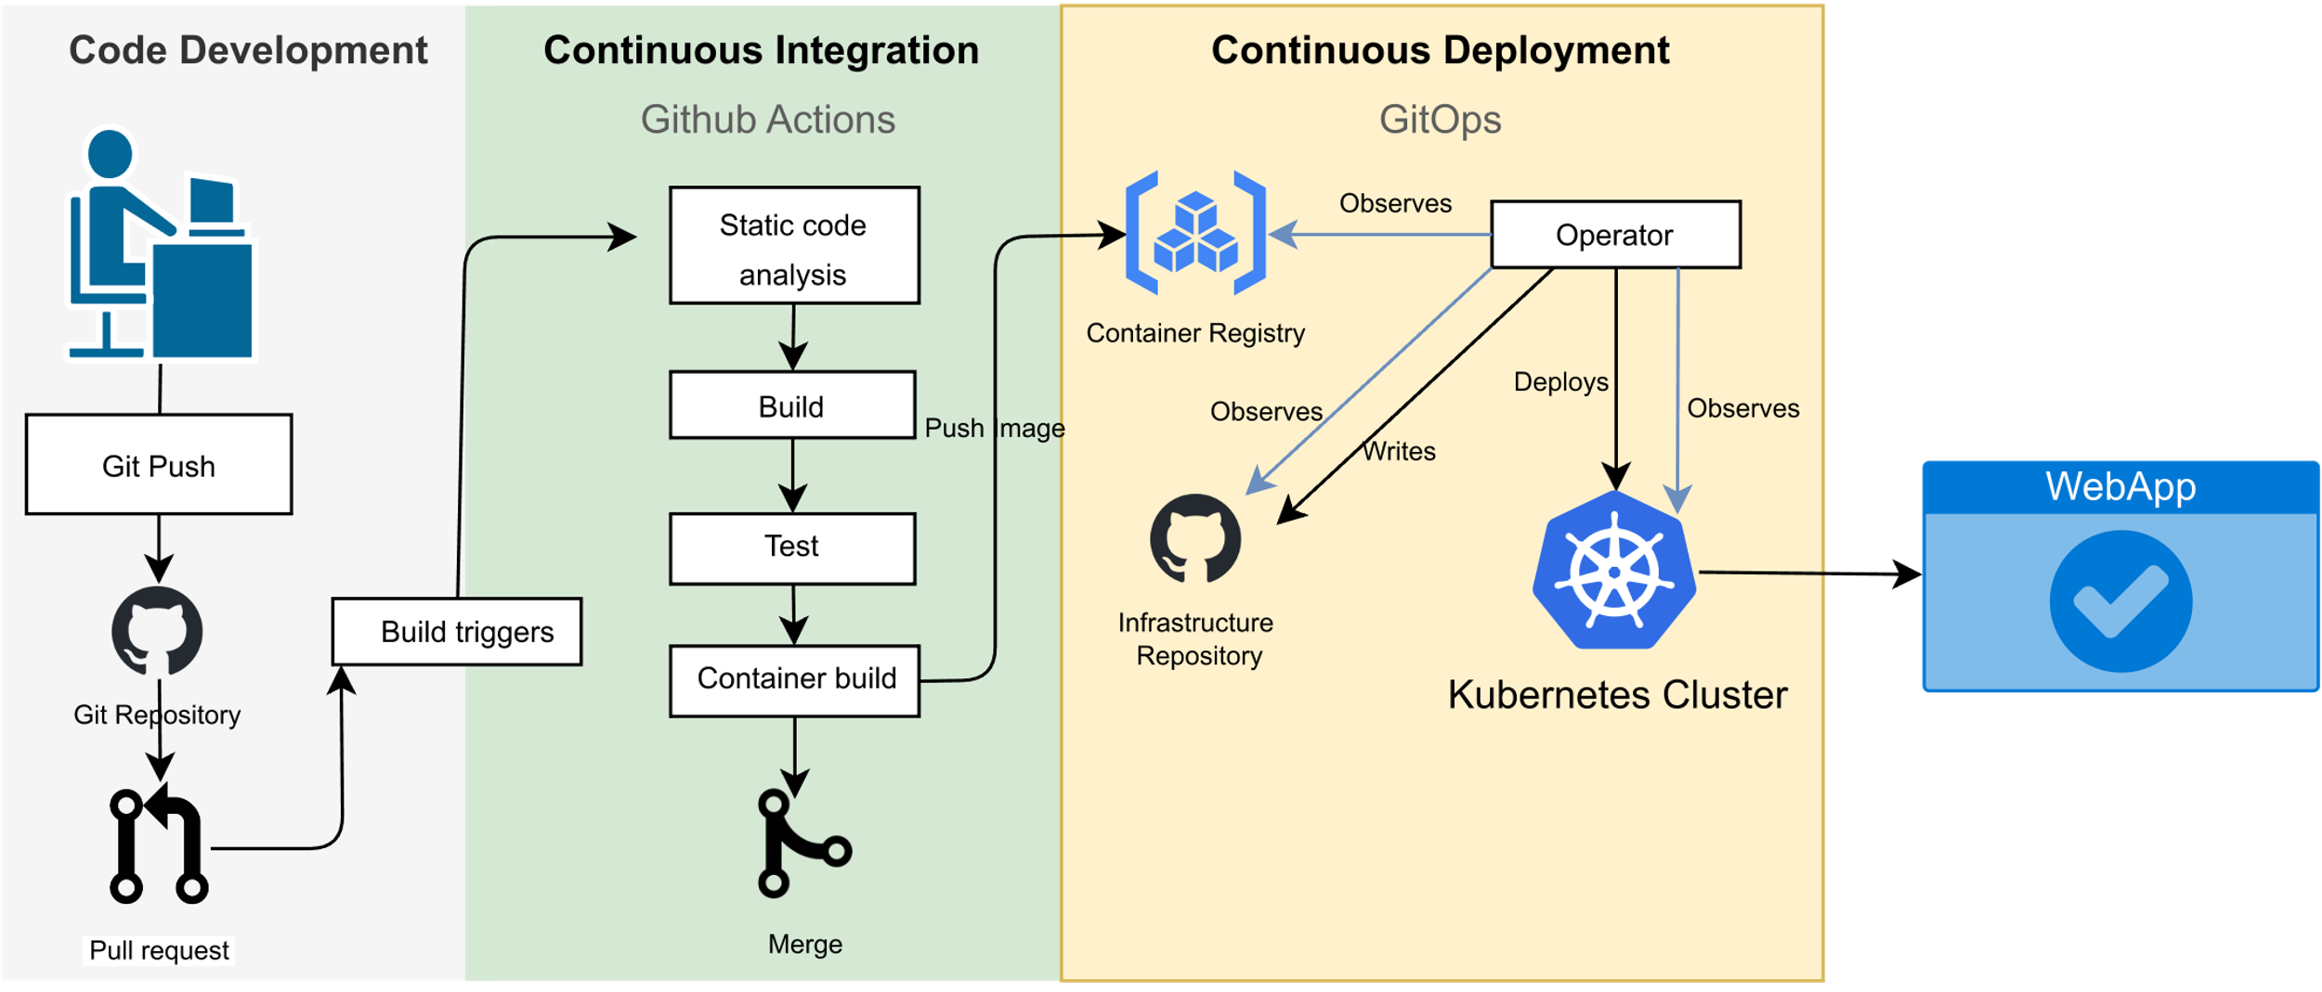
Containerization and Application Development Process
From Mariana Gonzales
Software development process CI/CD (continuous integration, continuous delivery) with containers mean software is routinely tested and deployed (or staged for deployment for sensitive applications).
Standard process to quickly respond to user needs, develop as a team, pass on work to other developers (not single expert), automate quality control, cooperate with AD staff on timing of deployment to operation.
Automated testing to verify component functionality (unit tests), or simulate user input to validate meeting user requirements (integration tests).
GitHub tool for software version control, automated testing, integration with container registry, collaboration between developers, and user feedback tracking.

