Slide 1
Muon Campus Operation Report
Jim Morgan
Friday 09:00 Operation Meeting
October 27, 2023

Slide 2
Muon Campus status
ESS1 Electrostatic Septum at NWA
Began powering septum at 5 kV on Thursday, 10/19
Septum conditioning began late on Monday, 10/23
AP-30 transformer braided connections were replaced on Monday, 10/23
Circuit breakers for D:V906 and D:V907 checked while power off
LCW sub-header braided hoses were replaced
Electrostatic Septum ESS2 remains isolated and under vacuum
Venting to reconnect to Delivery Ring vacuum depends on ESS1 progress
Working on plan for draining AP-0 RAW systems
HA has been approved, Vault access early next week to review procedure
Will keep Dump system filled and running for possible future Mu2e target test
Pre-Target exhaust blower EF1 VFD controller has arrived
Waiting for repair to be scheduled
AP-0 Air Conditioner Replacement work continues to be paused
Waiting on contractors to return and finish installation
Only a week or two of work needed before system can be tested
Study – M1-M3 Optics
Study – Alternative M5 optics
KPS5A PFL Repair
MC-1 Controlled Access
G-2 Trolley Run
Intentional Accelerator
Standby Period
<------------Week Days -------------------→

Slide 3
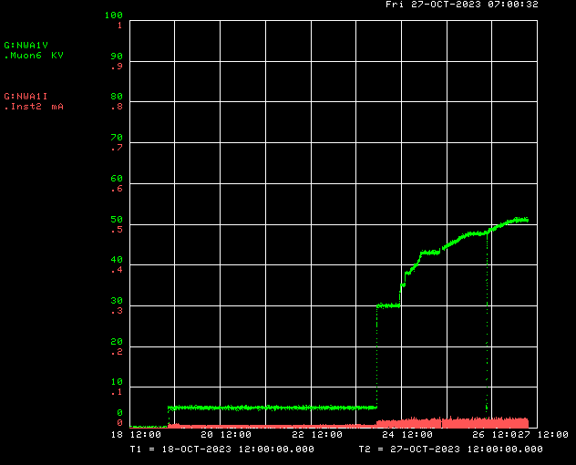
Mu2e Electrostatic Septa ESS1 conditioning
Voltage
Current

Slide 4
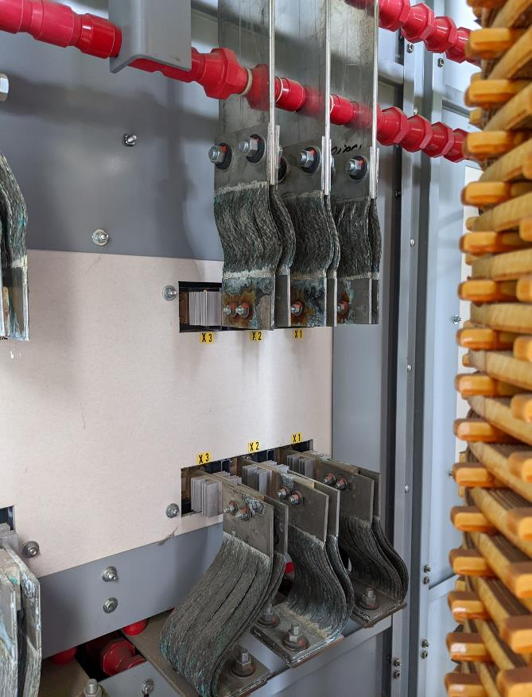
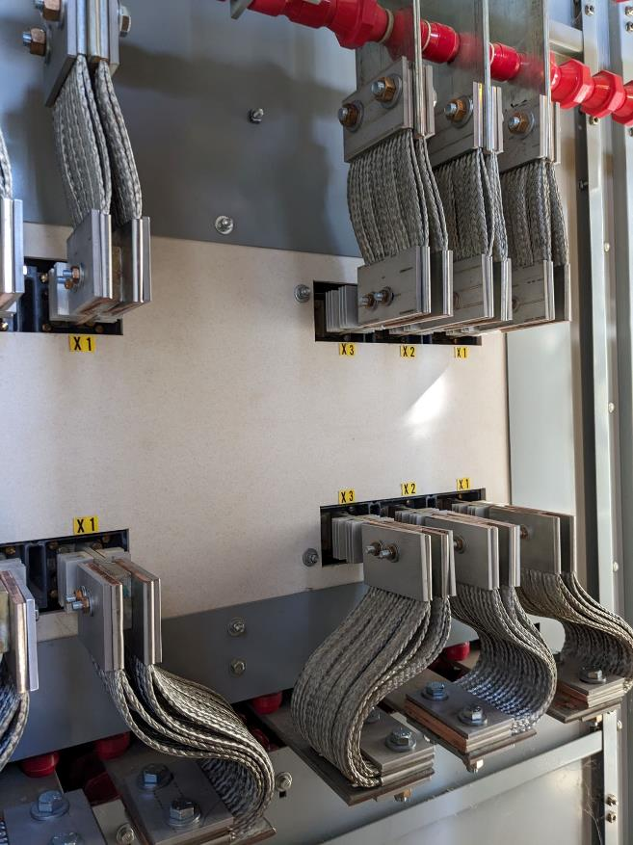
AP-30 transformer jumper replacement, before and after
Picture courtesy of Ryan Crawford

Slide 5
Upcoming work
ESS1 high voltage conditioning continues at NWA
Replace four leaking NSA Sextupoles in the Delivery Ring
Survey and Alignment jobs, done for now
If ESS1 installed in Delivery Ring later this Fall, will need to be aligned
Vault access to finalize plans for draining AP-0 RAW systems
AP-0 A/C work on hold, awaiting return of contractor
Replace EF1 Pre-Target rad air exhaust VFD Controller when scheduled by ISD
Try to fix old unit?
Grey Zone proposed work
ESS1 installation, new compact ESS vacuum layout with new Q203 pipe
Rad hard Q205 magnet swap, new Q205 vacuum pipe that’s easier to service
Receive three rad hard quadrupoles from TD, then swap with three in D30

