Slide 1
2023 Summer Shutdown Planning
10/27/23
Cons Gattuso / Tony Busch

Slide 2
Looking Ahead
Official end of the Summer Shutdown: Friday November 3rd
Grey Period (Cons will coordinate the activities)
  November 3rd until Dec 30th (Soft Dates)
  Selected tunnel work will be approved on a case-by-case basis
    Priority will be given to activities that are needed to further the SAD or ACE
  Where work is NOT being performed, we will have enclosures secured and in a standby state.
    Safety system Testing Completed
    Ready to be turned on
      Water systems on and flowing (level to be determined)
  Runco’s will be phased as after Linac beam has been established
Summer Shutdown 2024 (Tony will coordinate these activities)
  Email went out to Department Headers requesting Machine/system Coordinator.
  Kick off meeting will occur the Tuesday November 14th
    Shutdown Parameters will be released then
      Start/End/Duration ect.
      Planning Schedule and milestone
  Start the planning and execution of the 2024 shutdown

Slide 3
Power Outages
Wednesday Nov 1st
  Feeder 45
  TEV Ring, Transfer Hall, All MR Service Buildings
      07:00- 16:00 hrs
Summary of power outage Shutdown 2023
  Scheduled 74
  Re-Scheduled/completed 6
  Completed 70
  Deferred until next year 4
  We will end up 94.5% being completed

Slide 4
Important Activities
Re-coring Back to Operational Keys (typically done after 16:00 hrs)
  MI Monday Nov 6th
  Muon Campus TBS (To Be Set)
MI Q319 and Main power Supplies Ramps Studies
  More details in next slide
Tunnel Cleaning
  Main Injector completed by Nov 3rd
  Muon Campus will be scheduled soon
Beam Ready
  “ALL” Tunnel activities complete
  Safety System test completed
  System Start-UP Sign-off sheets complete
  Power Supply tests completed
  “All” Systems on and in an operational state (Soft Time Frames)
    Linac: Mid Dec
    Booster: Early Jan
    BNB: Early Jan
    MI/RR: Early Jan
    NuMI: Early Jan
    External beam lines: Early Feb
Wild cards still in play
Gate installation to isolate the accelerator complex with the rest of the lab
Fencing around some buildings
  Muon Campus
  BNB
  Booster
  Ect.

Slide 5
MI Ramp and Q319 Testing
Why are we doing this now?
We have a new design for Quad Magnet that we can only really test in the tunnel.
  If it fails, we have sometime to produce plan “B”
Significant power supply work done.

Slide 6
Grey Period Tasks
Finish SD work
Projector Support
Linac
  Klystron swap at the Debuncher
  KRF2 Klystron tuning
Booster
  BLM calibration
  BPM impedance resistor repair
  GMPS transformer heater installation
  Corrector control chassis checkout
  New Low level system testing
  New GMPS FE testing
MI/RR
  8 Gev line Multi Wire relocations
  Dual PA Conversion for PIP II
  Building new PIP-II era modulator power supplies
  VCB replacement
  PS studies
F-sector
  Removal of Tevatron magnets in the F3 Tevatron sector where the PIP-II Beam Transfer Line will cross the Main Ring tunnel.
Muon Campus
  Final installation of the extraction section
    Opening and closing AP40 hatch
    Remove EKIK (g-2 kicker)
    Install ESS1
    Change beam pipe in Q203
    Re-introduce ESS2 to the DR vacuum system (it has been isolated since July)
    Replace Q205 with rad hard replacement.
    Complete De-oxygenation skid
SY
  LCW HX Cleaning in F-Sector
  LCW Leak Repairs
  Lower M00U-1 and Q230 in F3 manhole and replace with beam pipe.
  Inspect MSEP2D motor
  Refill and Restart MS2 LCW System
  MT5VT2 LCW Leak Repair
  H202-4 Alignment
FAST/IOTA
  Final LCW connections from beamline to header
  Test LCW system
  Build cooling lines for extension of proton driver

Slide 7
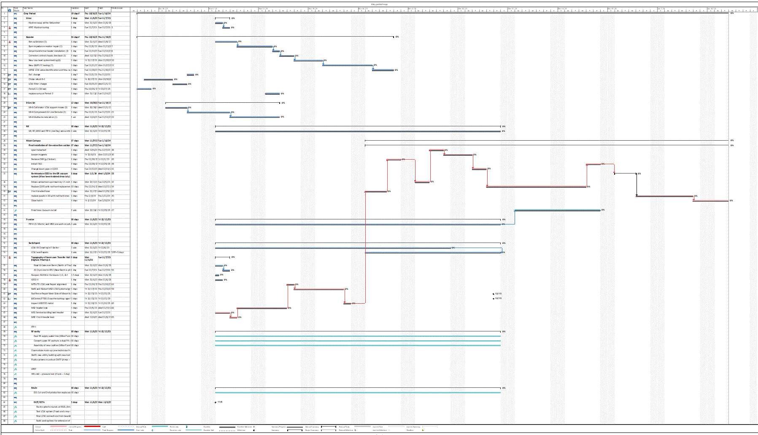
Schedule
Today
Nov
Thanksgiving
Dec
Dec 15
Jan
Jan 15
Linac
End of Grey period
Booster
8 GeV
Muon Campus
F-sector &
Switchyard
Critical Path
PIPII
FAST/IOTA

Slide 8
Search and Secure
This weekend the following enclosures will be secured and stayed secure moving forward to safety system testing
  Weekend of 28th/29th
    MI12A/B
    MI65, Minos Alcoves and Minos Absorber
    Muon Campus
      Pre-target/PreVault/Transport US and Mid
    Enclosure B
    Switchyard G2, N01, NM2
  Weekend of Nov 4th/5th
    MI8, MI10 and MI20-62
    Safety system testing for MI Monday Nov 6th

