Slide 1
LCSim Tutorial for Muon Collider Detector Studies
Jeremy McCormick, Norman Graf
SLAC
Hans Wenzel
FNAL

Slide 2
What can LCSim Framework do?
SLIC
  simulation of diverse detector geometries and readout technologies with SLIC
LCSim
  track-based and calorimeter reconstruction algorithms
  analysis, histogramming, etc.
JAS3
  event display / visualization
  histogram display
  data browser

Slide 3
Framework Overview
DETECTOR
DESCR
APPLICATIONS
DATA
Event Gen
Pythia,
WHIZARD, etc.
StdHep
LCDD
SLIC
LCIO Events
Simulation
XML
Tracking, PFA, etc.
LCIO PFOs
Reconstruction
Compact
LCSim
AIDA
Analysis
JAS3
(or any AIDA tool)
Visualization

Slide 4
Full Workflow
event generation
  generate StdHep physics events using generator of choice (Pythia, etc.)
full detector simulation
  run SLIC with LCDD detector and StdHep file
  produces LCIO with sim data
LCSim
  run reconstruction and analysis in batch mode using XML steering files
  produces LCIO with sim + recon data
  create histograms using AIDA and save them
JAS3
  load LCIO file and view in browser and event display
  load AIDA histograms to view/style

Slide 5
Preliminaries
analysis in Java
  Java JDK 1.6
  Maven 3
  Netbeans or other IDE such as Eclipse
simulation
  StdHep event generators
    for creating physics events
    usually best to have 1 person in charge of this for consistency
  SimDist for building SLIC
    g++, Make, CMake, wget, etc.
    configure script will tell you what you’re missing

Slide 6
CVS
All projects in LCSim are contained in SLAC’s Freehep CVS repository.
  Need to get a CVS account to checkin changes.
  contact tony_johnson AT slac.stanford.edu
setting the CVSROOT (uses anonymous instead of your real CVS user name)
export CVSROOT=:pserver:anonymous@cvs.freehep.org:/cvs/lcd
checking out a project (with CVSROOT set)
cvs co lcsim
cvs co SimDist
etc.

Slide 7
SLIC
Simulator for the Linear Collider
LCDD XML format for detector representation
grid compatible
fast, easy to use
command line interface
Geant4 backend with built-in visualization output (OpenGL, VRML, HepRep, etc.)
LCIO output

Slide 8
SLIC
Flexible command-line simulation tool with Geant4 backend
StdHep event input
LCIO event output
Grid ready (no ext. DB or internet connection required)
Fully descriptive runtime geometry with no “magic numbers” (LCDD)
Extended particle set from HepPDT (SUSY, resonances, etc.) with generic tracking + edep
Maintained by SLAC
Also used by non-ILC experiments
LCDD Geometry
<xml/>
StdHep
Events
LCIO
Events
SLIC Frontend
Geant4
LCDD
LCIO
HepPDT
Example Command Line Usage:
slic –g geometry.lcdd –m stuff.mac –i events.stdhep –o output.slcio –l QGSP_BERT –r 1000
slic –h # print help
slic –m run.mac # run with macro only
slic –n # run interactively

Slide 9
SimDist
for building SLIC locally
cvs co SimDist
cd SimDist
./configure [options]
make
for batch build
./batch_configure
to test (should show splash screen)
./scripts/slic.sh

Slide 10
Running SLIC
interactive mode
./scripts/slic.sh –g ./geometry.lcdd –n
run a macro with Geant4 commands
./scripts/slic.sh –g ./geometry.lcdd –m commands.mac
batch mode, deleting old output and automatically generating file name
  ./scripts/slic.sh –g geometry.lcdd –i events.stdhep –r 1000 –x –O
batch mode, skipping some events
./scripts/slic.sh –g ./geometry.lcdd –s 50 –r 1

Slide 11
LCSim
Java package providing analysis and reconstruction tools
Maven build system
AIDA for histogramming and data analysis
LCIO input format
command-line with XML steering files
plugin to JAS3/Wired
  event browser

Slide 12
Building LCSim
checkout from CVS and build
cvs co lcsim
cd lcsim
mvn
check the build
java –jar ./lcsim/target/lcsim-2.6-SNAPSHOT-bin.jar

Slide 13
Running LCSim
This is the template for running LCSim.
java –jar ./lcsim/target/lcsim-[version]-bin.jar [steeringFile]
For instance, this will print the event numbers in an LCIO input file.
java –jar ./lcsim/target/lcsim-2.6-SNAPSHOT-bin.jar ./lcsim/examples/template.lcsim –DinputFile=myevents.slcio

Slide 14
Drivers
module of analysis code
event processor
can have child sub-drivers called through super
  ex. to call child process methods => super.process(event)
access to all event and detector information
Driver Template
package org.lcsim;
// imports here
class MyAnalysis extends Driver {
public void process(EventHeader event) {
// my event analysis here
}
}

Slide 15
Accessing Event Data
Drivers
  process(EventHeader event) <= primary access
EventHeader provides access to all event data
  detector, LCIO event
specific class and name => get(type, name)
List<CalorimeterHit> hits = event.get(CalorimeterHit.class, “HcalHits”);
all collections with specific type
List<List<CalorimeterHit>> hitCollections = event.get(CalorimeterHit.class);
Detector object
Detector det = event.getDetector();

Slide 16
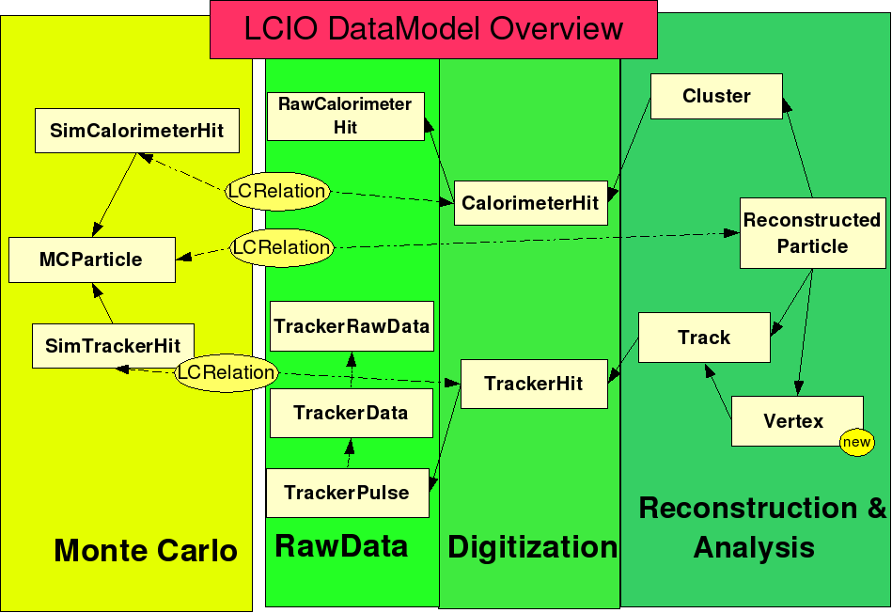
LCIO Data Format
Simulation
  SimCalorimeterHit
  SimTrackerHit
  MCParticle
Reconstruction
  CalorimeterHit
  Cluster
  RawTrackerHit
  TrackerHit
  Track
    TrackState
  ReconstructedParticle

Slide 17
LCSim XML
command line utility for running lcsim in batch mode (e.g. in batch computing env or grid)
basically a list of Drivers to execute on a set of input files, along with control parameters
Driver XML parameters map to set methods
external variables
  resolved using –D command-line parameter
Full guide here

Slide 18
Anatomy of an LCSim XML File
<lcsim xmlns:xs="http://www.w3.org/2001/XMLSchema-instance" xs:noNamespaceSchemaLocation="http://www.lcsim.org/schemas/lcsim/1.0/lcsim.xsd">
<inputFiles>
<file>${inputFile}</file>
</inputFiles>
<control>
<numberOfEvents>-1</numberOfEvents>
</control>
<execute>
<driver name="EventMarkerDriver"/>
</execute>
<drivers>
<driver name="EventMarkerDriver" type="org.lcsim.job.EventMarkerDriver">
<eventInterval>1</eventInterval>
</driver>
</drivers>
</lcsim>
Input file with variable
N events to run (-1 means all)
Driver to execute
Driver definition
Driver parameter

Slide 19
Driver Parameters
Dummy Driver Example
LCSim XML
package org.lcsim;
class MyAnalysis extends Driver {
int importantNumber = 0;
public MyAnalysis() {}
public void setImportantNumber(int i) {
importantNumber = i;
}
}
<execute>
<driver name=“MyAnalysis”/>
<execute>
<drivers>
<driver name=“MyAnalysis”
type=“org.lcsim.MyAnalysis”>
<importantNumber>1234</importantNumber>
</driver>
</drivers>
(references)
basic Java set methods are mapped automatically to XML elements
by convention decapitalize first letter, setMyVar => <myVar>1234</myVar>
Java primitive types supported (float, double, int, etc.) as well as arrays of these
supports parsing of arbitrary data using form: setSomething(Element node)
see full guide for details

Slide 20
Booking Histograms
Simple Cloud Example
public class MyDriver extends Driver {
// default instance of AIDA
AIDA aida = AIDA.defaultInstance();
// create a cloud
public void process(EventHeader event) {
List<CalorimeterHit> hits = event.get(CalorimeterHit.class, "HcalHits");
for (CalorimeterHit hit : hits) {
aida.cloud1D("Hit Energy").fill(hit.getCorrectedEnergy());
}
}
// save plots
public void endOfData() {
try {
aida.saveAs(“plots.aida”);
} catch (IOException x) {
throw new RuntimeException(x);
}
}
}

Slide 21
AIDA
1, 2, 3D Histograms
1,2, 3D Clouds
DataPointSet
Profile
Fitting
addition, subtraction, division of histos
see AIDA class in LCSim for access to full API
graphical display of 3D objects not supported but this data can still be stored/loaded to/from XML

Slide 22
Saving Output from XML
Save an LCIO File
<driver name=“LCIODriver”
type=“org.lcsim.util.loop.LCIODriver”>
<outputFilePath>myEvents.slcio</outputFilePath>
</driver>
Save an AIDA File
<driver name=“AidaSaveDriver”
type=“org.lcsim.job.AidaSaveDriver”>
<outputFileName>plots.aida</outputFileName>
</driver>

Slide 23
MCD Analysis
package for MCD detector studies
separates LCSim code from MCD-specific algorithms/Drivers
To checkout and build
  cvs co mcd-analysis
  cd mcd-analysis
  mvn

Slide 24
Running MCD Analysis Sample Code
assuming already built mcd-analysis
run command-line XML
  java –jar ./mcd-analysis/target/mcd-analysis-1.0-SNAPSHOT-bin.jar
  ./mcd-analysis/resources/org/lcsim/mcd/steering/mcd_cal_occupancy.lcsim
  -DinputFile=mucalEvents.slcio

Slide 25
JAS3 / Wired
JAS3 provides a Java workbench with a plugin architecture.
LCSim is installed as plugin (should build locally as covered previously).
view/style histograms
Wired event display
  detector wireframe + LCIO data display (hits, particles, tracks, etc.)

Slide 26
JAS3 Setup
install and run JAS3 locally
wget http://java.freehep.org/maven2/org/freehep/jas-assembly/0.9.9/jas-assembly-0.9.9-distribution.tar.gz
tar –zxf ./jas-assembly-0.9.9-distribution.tar.gz
cd jas-assembly-0.9.9
./jas3 &
get JAS3 plugins
Plugin Manager
select “Wired 4”, “Wired 4 Base Library” + click “Update installed...”
install MCD tools
build lcsim, mcd-analysis (see previous slides) to install the jars
restart JAS

Slide 27
Working with JAS3
load LCIO events
File > Open > [select LCIO file] > click “Open”
event display
File > New > Wired4 View
browser
File > New > LCSim Event Browser
step through events
Click the “Next” button (after loading LCIO file)
create some analysis code
File > New > Java file (write code and Save)
load a Driver
File > Load > input Driver name e.g. “org.lcsim.MyDriver” > click “OK”

Slide 28
Detectors
Detector data is associated to events via a unique tag in the event header.
The files can be either fetched from the web or built into a jar. (We use 2nd method.)
mcd-analysis has dependency on mcd-detectors jar which is deployed to maven repo.
  This jar contains all detector description data for the analysis/reconstruction.
  Also has LCDD file for running SLIC.

Slide 29
GeomConverter
HepRep
Wired
Compact Detector
<xml/>
GDML / LCDD
SLIC, ROOT, Geant4
GeomConverter
Pandora XML
SlicPandora
(PandoraPFANew)
Compact subdetector types added as needed/requested.
Java Runtime
LCSim
Convertor Example:
java –jar GeomConverter-bin.jar –o lcdd compact.xml mydet.lcdd

Slide 30
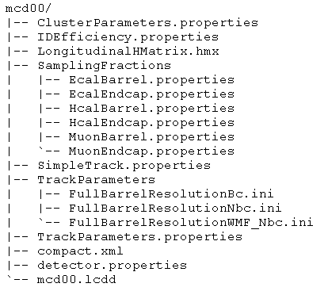
Sample Detector Data
FastMC
Calorimetric sampling fractions
FastMC tracking parameters
compact detector description
detector name
LCDD file for SLIC

Slide 31
Hidden Directories (Where is everything?!)
detector data cache (when .zip files are downloaded from www)
~/.lcsim/cache
data cache (when FileCache class is used e.g. in test cases or from your code)
~/.cache
local JAS3 installation
~/.JAS3/classes <= compiled classes from the editor
~/.JAS3/extensions <= installed plugin jars (‘mvn install’)
Maven dirs (default)
~/.m2/repo <= Maven jar repository
~/.m2/settings.xml <= user settings (create yourself)

Slide 32
Links
ILC Confluence Wiki
LCSim Tutorials

