Slide 1
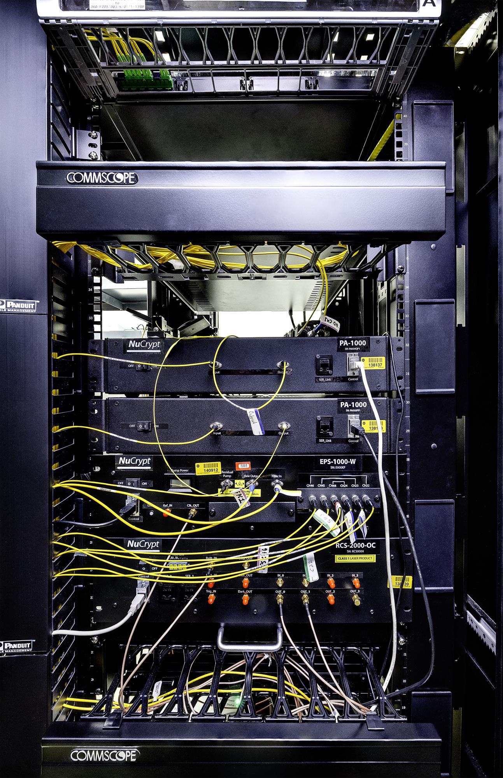
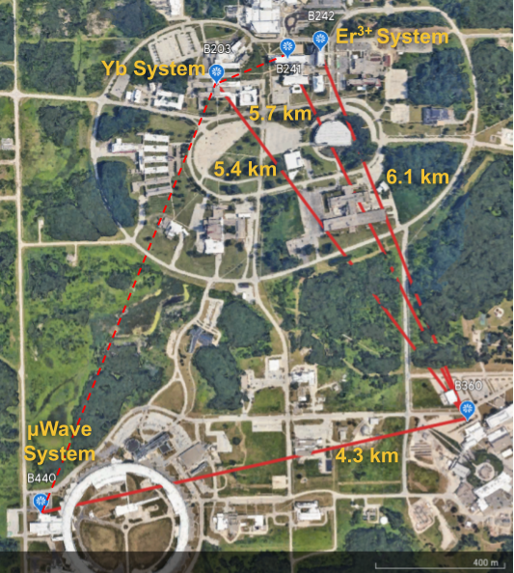
Argonne Quantum Network (ARQNET) Testbed
Connects 5 buildings in the Argonne campus on a star topology using deployed fiber
Long distance connections to Fermilab and StarLight using dark fiber
NuCrypt EPS – cascaded SHG-SPDC
|HH> + |VV> Bell state generated in Sagnac Loop
3-wavelength channels
Pump @ 1550.1 nm (ITU Ch. 34)
Polatis 16x16 SDN Switch
16 input and output channels
Controlled via REST and NETCONF APIs
Quantum Opus SNSPD
2 detectors
85% efficiency at 1550 nm

Slide 2
Team Structure & Project Timeline
Argonne team:
Ji Liu (co-PI), Md Shariful Islam, ARQNET team
Year1(FNAL, ANL):
Deployment of ultra-low jitter superconducting nanowire single photon detectors (SNSPDs) in the Fermilab and ANL QNodes.
Year2&3(FNAL, Caltech, ANL):
Demonstrate long-distance entanglement swapping between Fermilab and ANL.
Year2&3(NU, FNAL, Caltech, ANL):
Achieve entanglement swapping with classical coexistence.

