Slide 1
High Energy Physics Center for Computational Excellence
AHM Welcome/Introduction/Overview
Salman Habib
for HEP-CCE
All-Hands Meeting
December 18, 2023

Slide 2
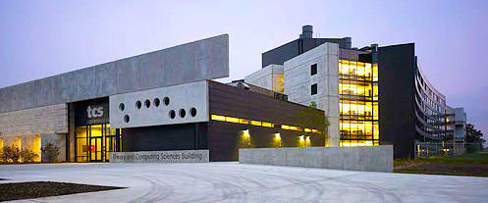
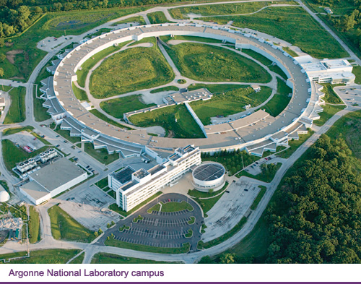
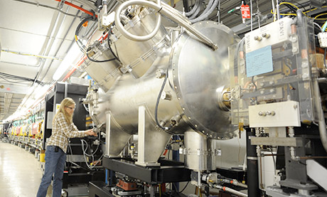
HEP-CCE All Hands Meeting
December 18-19, 2023
Welcome to Argonne!

Slide 3
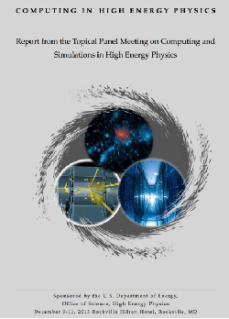
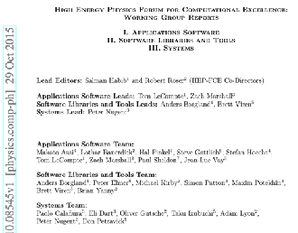
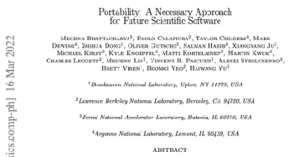
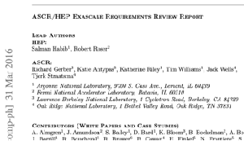
HEP-CCE Mission
Advanced Scientific
Computing Research (ASCR)
High Energy Physics (HEP)
Research and Facilities
HEP-CCE
Research and Facilities
ASCR Programs
Computational HEP Program
Cross-Cuts
HEP-CCE Primary Mission
Bring large-scale computational and data management resources to bear on pressing HEP science problems
Focus on cross-cutting solutions leveraging ASCR and HEP expertise and resources (ESnet, LCFs, NERSC, IRI, --)
Work closely with experiments and carry out other tasks as directed by DOE HEP
HEP-CCE as a joint effort across the participating laboratories – key to providing the ability to integrate individual strengths and resources

Slide 4
HEP-CCE: Current Context
HEP-CCE Roles
FY19-23; HEP-CCE funded as a joint effort – now is considered to be a base program targeting:
Future architectures — evolution of ASCR HPC systems and HEP priorities for future systems and engagement with the HPC environment (ASCR, cloud, international, e.g., ALCF-4, NERSC-10, OLCF-6 – )
Long-term engagement with ASCR facilities — LCF and NERSC projects (future HPDF and IRI connections); significant ASCR/HEP “cross-infrastructure” opportunities
LCFs moving to host data-intensive computing resources – separate resources and via queueing rules on exascale systems
HEP requirements — What do experiments need from ASCR facilities? What is possible to do on ASCR HPC systems? How do these resources fit within the HEP computing ecosystem? How can the HEP and ASCR HPC environments best engage and help each other?

Slide 5
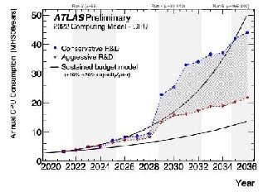
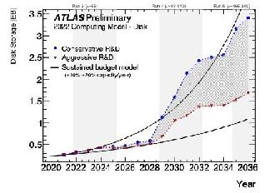
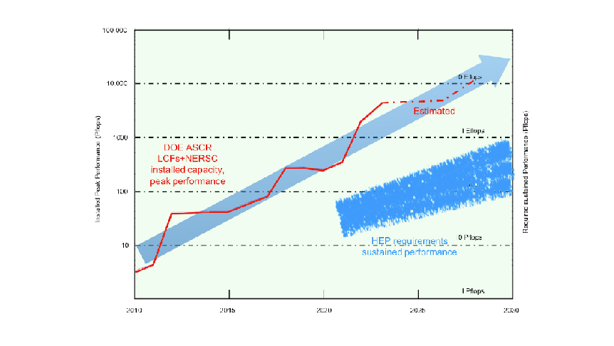
HEP Experiments and the HPC Ecosystem
HEP Computing Resource Challenges
HL-LHC example: 10X data, 10X complexity
In 2030, LHC experiments will need:
> O(100) PFlops in sustained compute performance
O(10) Exabyte/year data throughput
HEP Long-Term Involvement in HPC
Chosen platform for Cosmic Frontier (CMB-S4, DESI, LSST DESC, LZ, —)
LHC experiments among top users of NERSC’s Cori system (~10% of available cycles in 2021)
DUNE has identified HPC resource utilization as a major component of its computing strategy
ATLAS CPU and disk requirements
HPC Challenges
Ability to run multiple HEP workflows at O(10) Pflops sustained on multiple heterogeneous exascale systems
Match HEP I/O requirements to HPC file systems and networking infrastructure
Address realtime to near-realtime applications and resilience challenges
Evolution of ASCR and HEP computing resources

Slide 6
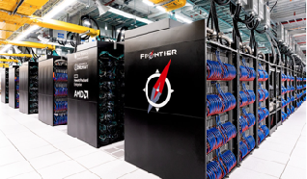
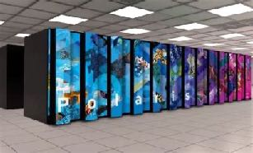
What do Experiments Need from HEP-CCE?
ASCR Liaison Role
Track ASCR HPC system evolution, provide early access/input to ASCR facility planning and broker access to HPC testbeds
Enable long-term allocations at ASCR facilities; effort also related to sustainability issues for programmatic DOE/SC software
Aurora
Specific HEP-CCE Tasks
Ability for HEP workflows to exploit concurrency at the node level of HPC platforms — natural event-level parallelism is not enough
Multiple compute platforms as a portability challenge — complex HEP code needs to run on grid/cloud/HPC systems in production
I/O needs to scale to thousands of HPC nodes — not just for data but also for software libraries, databases, configurations (~100K files)
Ability to run complex HEP workflows robustly on HPC systems – resilience challenge
Mixed CPU/GPU pipelines will become more common as AI/ML methods are increasingly incorporated – HPC facilities offer unique large-scale AI/ML training opportunities
Frontier
ASCR HPC systems
(2023)

Slide 7
Evolution of HEP-CCE Role
HEP-CCE Phase I
Exploration of portability frameworks/tools and successful demonstration of running HEP applications on heterogeneous architectures
Experiment-agnostic mimicking framework – testing structure for I/O performance across I/O packages
I/O characterization using Darshan; improvement of Darshan for HEP applications
HDF5 as intermediate event storage for HPC workflows
Porting EGs from CPUs to GPUs; working with the broader EG community
Identified need to move from applications to workflows with different requirements across the partner experiments
Workflows for remote computing applications and improved workflow monitoring
Data storage and data management, more generally, identified as new vectors for HEP-CCE efforts
HEP-CCE Phase 2
Transition to mini-apps and cookbooks for interactions with experiments as distinct from work on individual applications
Optimizing data reduction, organization, and data movement for reducing the data storage footprint
End-to-end demos and tests for experiment workflows (including hybrid examples), testing interfaces, resilience, and other requirements (e.g., near-realtime) for successful integration with facilities
Accelerated simulation effort to continue work on event generators and to potentially include GPU-optimized optical photon transport (important for DUNE and LZ)
AI/ML application scale-up on HPC resources as component of hybrid workflows
Tighter, planned coordination with HPC facilities as part of IRI and other initiatives
Cross-cutting outreach and EDIA program with its own set of funding/resources

Slide 8
HEP-CCE Structure Evolution (Technical)
Future: Four Technical Teams
Coordinated by team leads
Stakeholder oversight
Optimizing Data Storage
Data management, data reduction/compression
Optimized data delivery
Portable Applications to Portable Workflows
HEP workflow overlay for HPC
Hybrid CPU/GPU application support
Scaling up HEP AI/ML Applications
Large-scale training and hyperparameter optimization on HPC systems
Accelerating HEP Simulation
Event generators for accelerated systems
Optical photon transport on GPUs
GPU-enabled tracking geometries
Current: Four Technical Teams
Coordinated by team leads
Stakeholder oversight
PPS: Portable Parallelization Strategies
Exploit massive concurrency
Portability requirements
IOS: HEP I/O and HPC Storage
Accelerator-friendly data models
Fine-grained I/O, event batching
EG: Event Generators
Optimizing event generators for accelerated systems
CW: Complex workflows
Porting and running HEP workflows on HPC systems

Slide 9
HEP-CCE Structure Evolution (Management)
Management Team
PI, Deputy PIs (technical coordination, outreach/EDI), project coordinator*
Technical Leads
Institutional Council
PI, Deputy PIs, admin lead
Institutional leads
Steering Group
PI, Deputy PIs, project coordinator
Experiment POCs for ATLAS, CMB-S4, CMS, DUNE, Rubin/LSST DESC, LZ
ASCR facility POCs for ALCF, NERSC, OLCF
Technical Team
PI, Deputy PI (technical coordination), project coordinator
Technical Leads (Data storage, Portable Applications/Workflows, Scaling up HEP ML, Accelerating HEP Simulation)
Task leads
*administrative
support

Slide 10
Current HEP-CCE Organization
Leadership
PI/Deputy PIs: Salman Habib, Paolo Calafiura (Technical), Kerstin Kleese Van Dam (EDI)
Institutional Leads: Salman Habib (Argonne), Kerstin Kleese Van Dam (BNL), Adam Lyon (Fermilab), Peter Nugent (LBNL)
Experiment Reps: Ed Moyse (ATLAS), Julian Borrill/Ted Kisner (CMB-S4), Jim Chiang (Rubin/LSST DESC), Lindsey Gray (CMS), Andrew Norman (DUNE), Maria Elena Monzani (LZ)
Technical Teams
PAW: Portable Applications and Workflows (Leads: Charles Leggett, Meifeng Lin)
Exploit massive concurrency and heterogeneous architectures
Portability in computing as well as running HEP workflows on HPC systems
SOP: Storage OPtimization (Leads: Rob Ross, Peter van Gemmeren)
Accelerator-friendly data models, data reduction, IO optimization on HPC systems
Data delivery/orchestration
SIM: HEP SIMulations for Experiments (Leads: Taylor Childers, Tom Evans, Stefan Hoeche)
Optimizing event generators and detector simulation for accelerated systems
SMiLe: Complex workflows (Leads: Paolo Calafiura, Walter Hopkins)
Enabling HEP AI/ML applications at scale on ASCR HPC resources
Project Coordinator:
Samantha Tezak

Slide 11
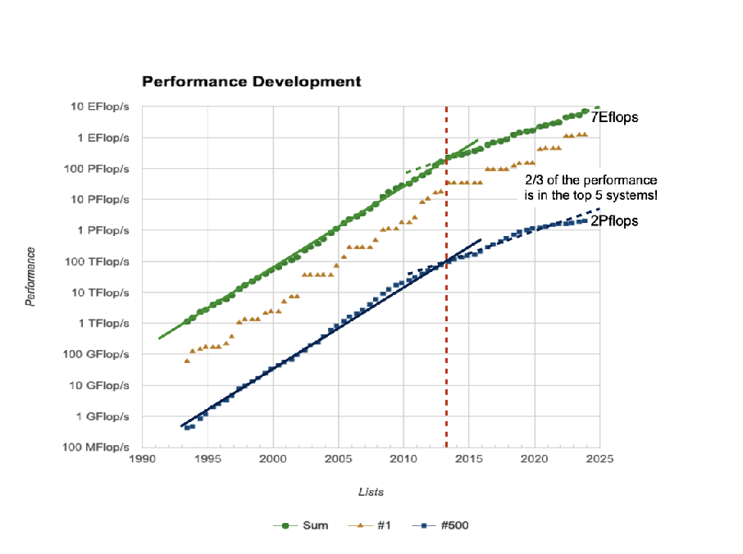
Evolution of ASCR Facility Roles
ASCR Facility Plans
Replacements for current systems already in planning stages – NERSC-10 in 2026+, OLCF-6 in 2027+, ALCF-4 in 2028+
All require significant improvements in compute performance, ability to handle data-intensive applications and AI/ML workloads, all more or less within current power envelopes
All acknowledge IRI as a scenario within which the system should operate
Given the timescales, specific architecture choices are somewhat uncertain but CPU/GPU mixes are likely
AI/ML will be the key driver for hardware evolution

Slide 12
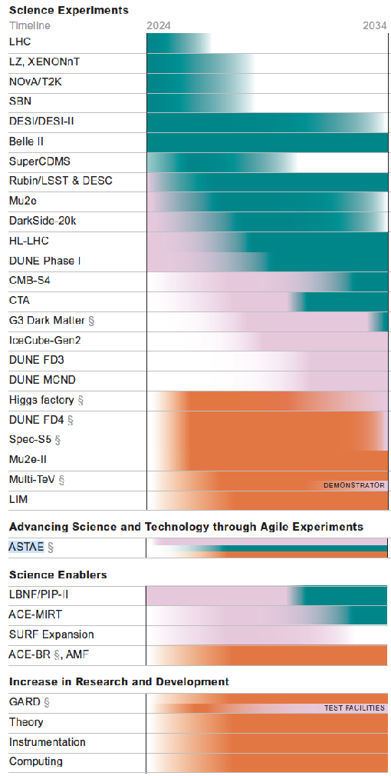
HEP Experiment Timelines
2024
2034
HEP-CCE Planning
Track experiment timelines as well as architecture/software/facility/integration roadmap
Current choice of HEP-CCE experiments aims to provide coverage as well as aim at best use of ASCR facilities; new experiments can be added in the longer term, partly depending on P5 recommendations
Need to work with experiments that are in planning, construction, and execution phases
Experiment needs, priorities and readiness also factor into work with the facilities as well as with broader ASCR software efforts (including ASCR R&D)
HEP-CCE Steering Group consisting of experiment and facility POCs will be a very important component of planning going forward
Key HEP-CCE focus will be on pilot “end to end” demo/proof projects (aside from individual challenges) to address portability, infrastructure, and resilience challenges
Note recommendations for computing in the P5 report are positive, but, in general, the needed scope of effort is much larger than the resource-limited outlay; CPAD-like group is being set up

Slide 13
Schedule
December 18
Morning Session 1 (Plenary): Intro/overview talks (9am-10.30am)
Morning Session 2 (Plenary): Input from experiments and stakeholders (11am-12.50pm)
Working Lunch (get lunches and go to parallel sessions)
Parallel Sessions: First-round planning (1pm-4pm)
Report Out and Overnight Action Items (Plenary): Draft Plans (4pm-5.15pm)
December 19
Morning Session 1 (Plenary): Phase 1 Wrapup Reports (9am-11am)
Morning Session 2 (Plenary): Updated Draft Plans (11.30am-1.30pm)
Working Lunch (1.30-2pm)
Summary/Conclusions: Organization/Actionables (2pm-4pm)

