Slide 1
High Energy Physics Center for Computational Excellence Detector Simulation
Tom Evans
for Celeritas, HEP-CCE
DOE HEP CCE All Hands
Dec 18 2023

Slide 2
HEP-CCE Phase 2 – Detector Simulation
Platform portable geometric tracking
Optical photons
Specific objectives and deliverables discussed this afternoon

Slide 3
Geometric capabilities - current status
Monte Carlo general particle simulations use VecGeom as the standard package
Adapted from CPU vectorization prototype
Extended to work for Nvidia CUDA
Supports Geant4 model construction and tracking
Optical photons use several approaches
Native Geant4 navigation in full event-stepping loop
Opticks HEP library (uses Nvidia OptiX™ ray-tracing engine)
Drawbacks:
No platform portability - existing libraries are Nvidia-centric
Distinct code bases reduce opportunities to amortize common capabilities
Objective:
Support platform portability across DOE LCFs
Unified geometry components that can support multiple applications

Slide 4
Geometric modeling in HEP - application objectives
General Monte Carlo navigation
Robust boundary crossings (double precision)
Error checking
Graph-based search and subcell optimations
Ray-tracing for optical photons and visualization
Graph-based multi-surface tracking
Track batching
Variable-precision
Commonalities:
Portability: (Intel, AMD, Nvidia GPUs, multicore)
Physics-based simulations require high-precision tracking
Bounding volume hierarchy (BVH) graph-based optimizations
Many low-level components can be shared
High-level APIs will be different depending on application
HEP Geometry Applications
General Monte Carlo transport
Ray-tracing
optical photons
visualization
reconstruction
Geometry packages must support existing HEP model formats and descriptions

Slide 5
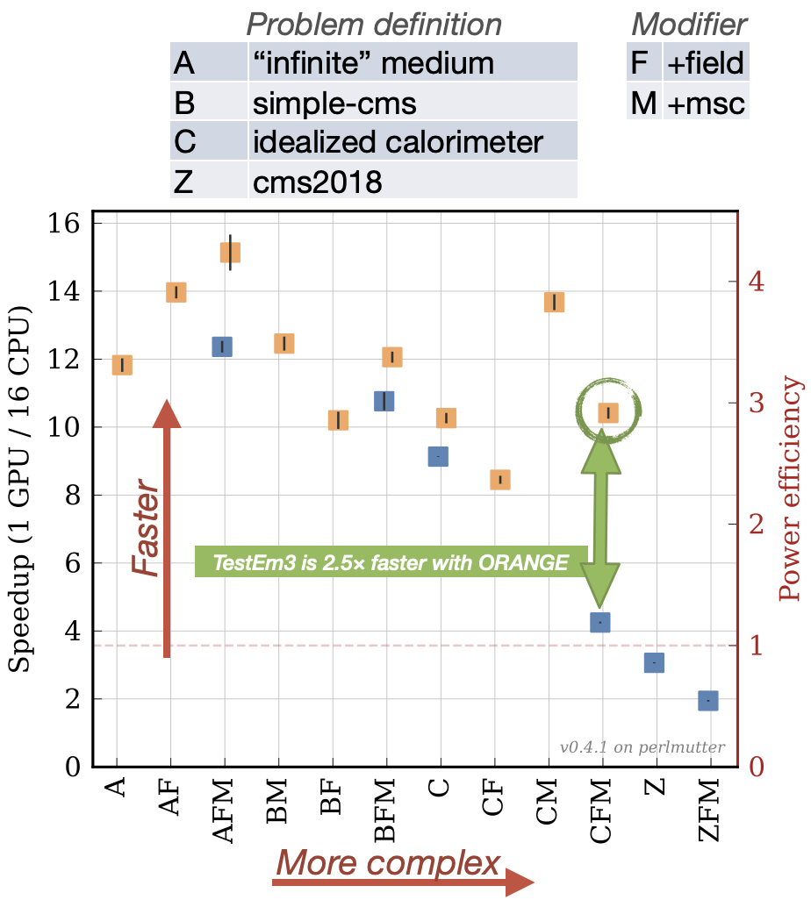
Geometry - benefits to HEP community
Provide geometric capabilities for spectrum of applications
Monte Carlo detector simulation
Optical photon ray-tracing
Reconstruction tracking
Visualization
Platform portability
Support current and future architectures in DOE LCFs
Community sustainability
Interdisciplinary applications beyond HEP
ORANGE geometry engine
New engine developed in Celeritas
Tracking based on CSG tree of surfaces constructed from volumes
Collaboration to implement surface-based tracking in VecGeom

Slide 6
Optical photon transport - current status
Critical application spaces:
DUNE (art)
LZ (BACCARAT)
CalVision
Current approaches:
Direct transport using Geant4 generalized navigation engine
e.g., BACCARAT spends >95% of CPU time on optical photon transport when using Geant4
Full transport replaced with fast approximation methods
Optimized optical photon transport using Opticks
Drawbacks:
Portability
Geant4 capabilities CPU-only
Opticks only available on Nvidia architectures
Performance for direct simulation

Slide 7
Optical photon transport - application objectives
Fast throughput for direct transport
Avoid or accelerate fast approximations (e.g. optical maps in BACCARAT)
Platform portability
Ease of integration into existing application frameworks
art
BACCARAT
future luminescent detector applications
Compatibility with Geant4 geometry models
Large detector regions
Large detector arrays
Optical photon transport efficiency is closely tied to geometric modeling capabilities

Slide 8
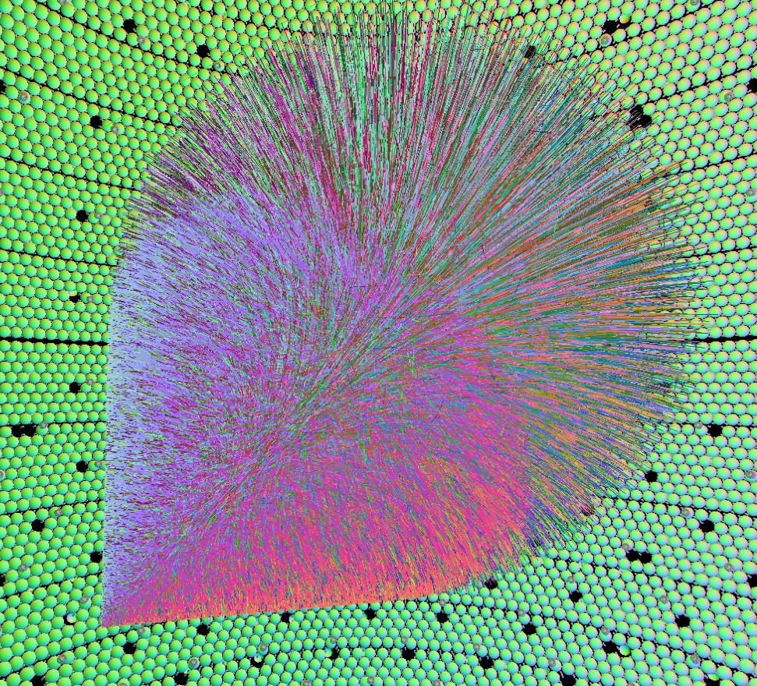
Optical photon transport approaches
Opticks demonstrated that very high efficiencies can be obtained using GPU ray-tracing
>1000x Geant4 direct simulation
Efficiency gains result from:
Specialized optical photon ray-tracing loop
Hardware acceleration (BVH traversal)
Cherenkov source model
Optical tracking loop
Optical photon shower (JUNO neutrino detector); S.C. Blyth, Opticks: GPU Optical Photon Simulation for Particle Physics with Nvidia OptiX™, CHEP 2018.
Optical physics
Detector hits
Geometry engine

Slide 9
Detector simulation throughput

