Slide 1
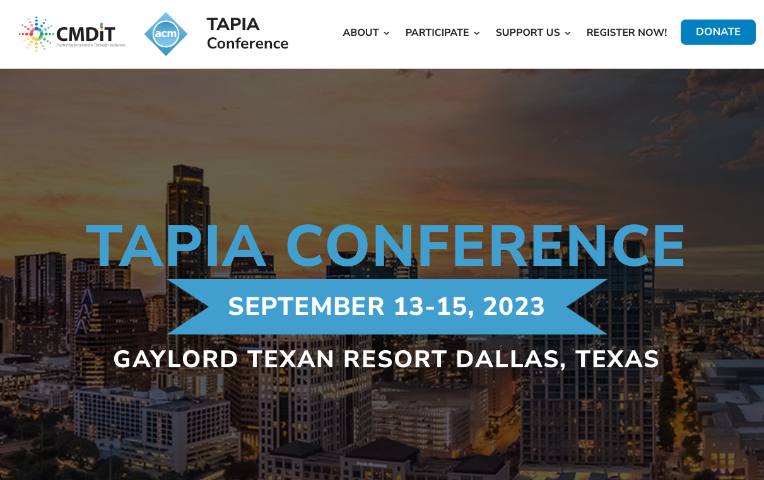
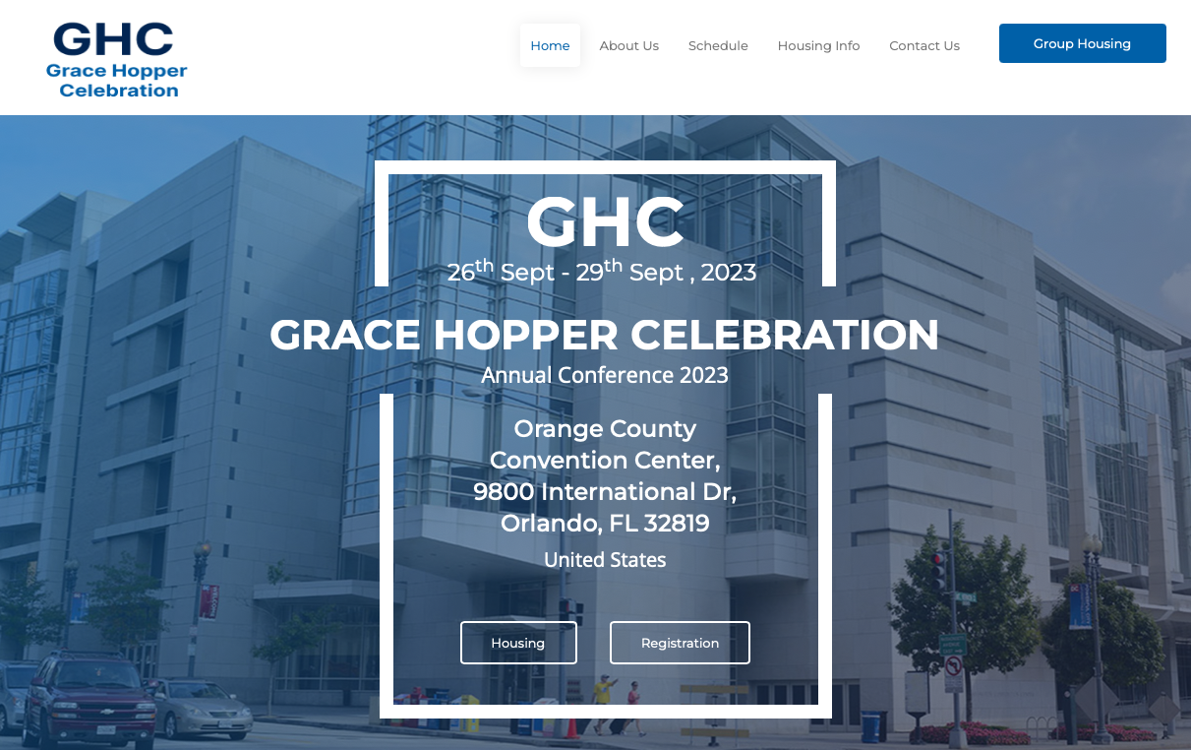
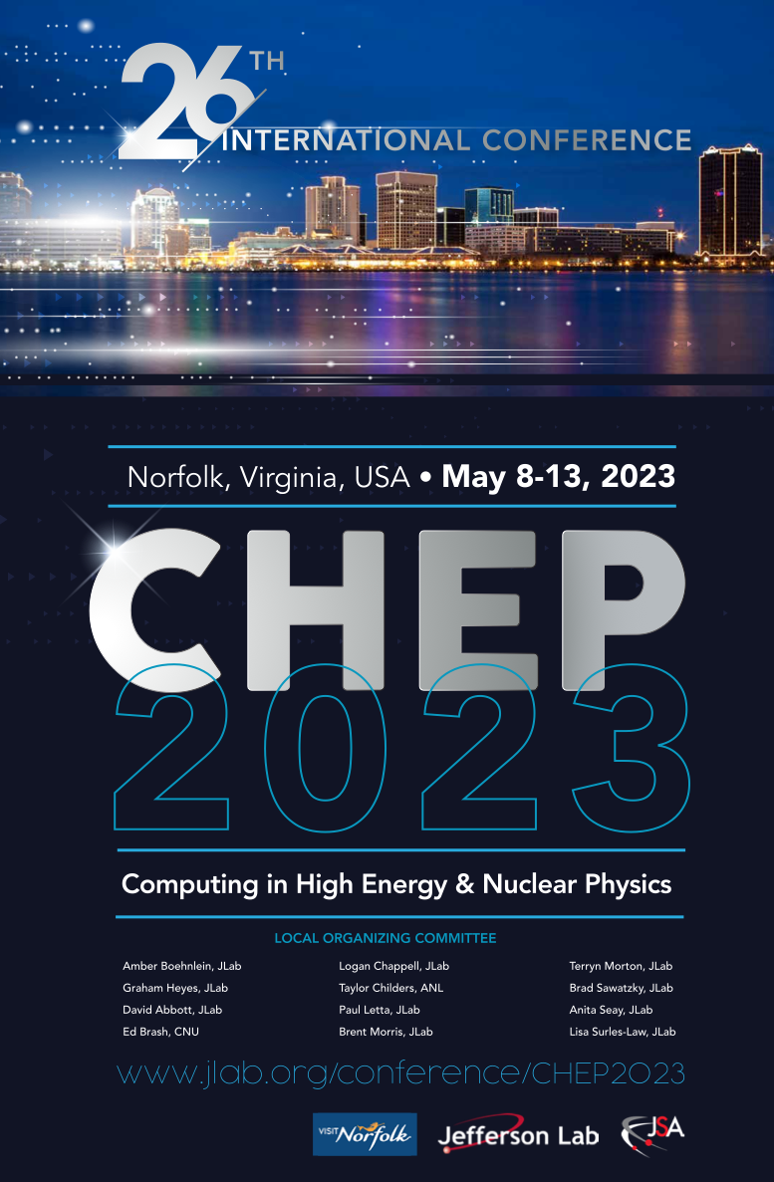
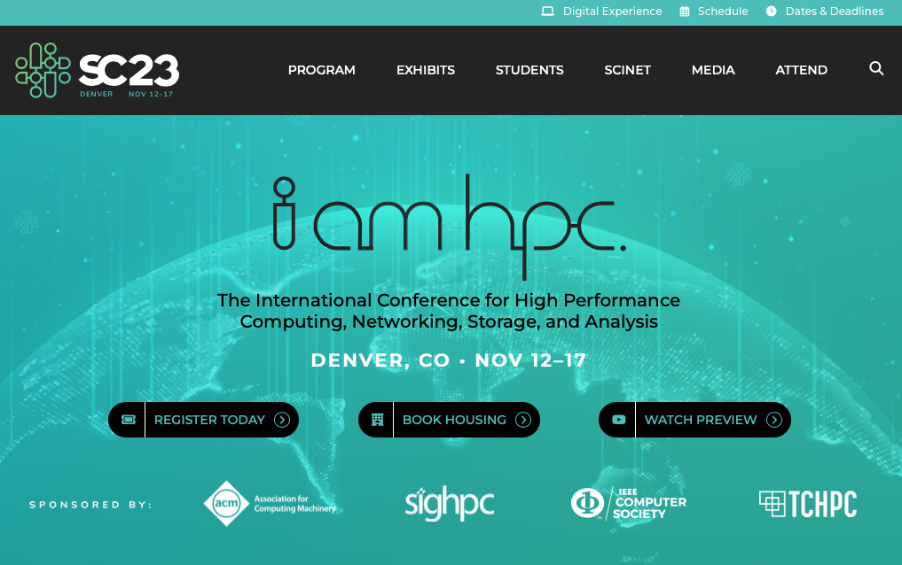
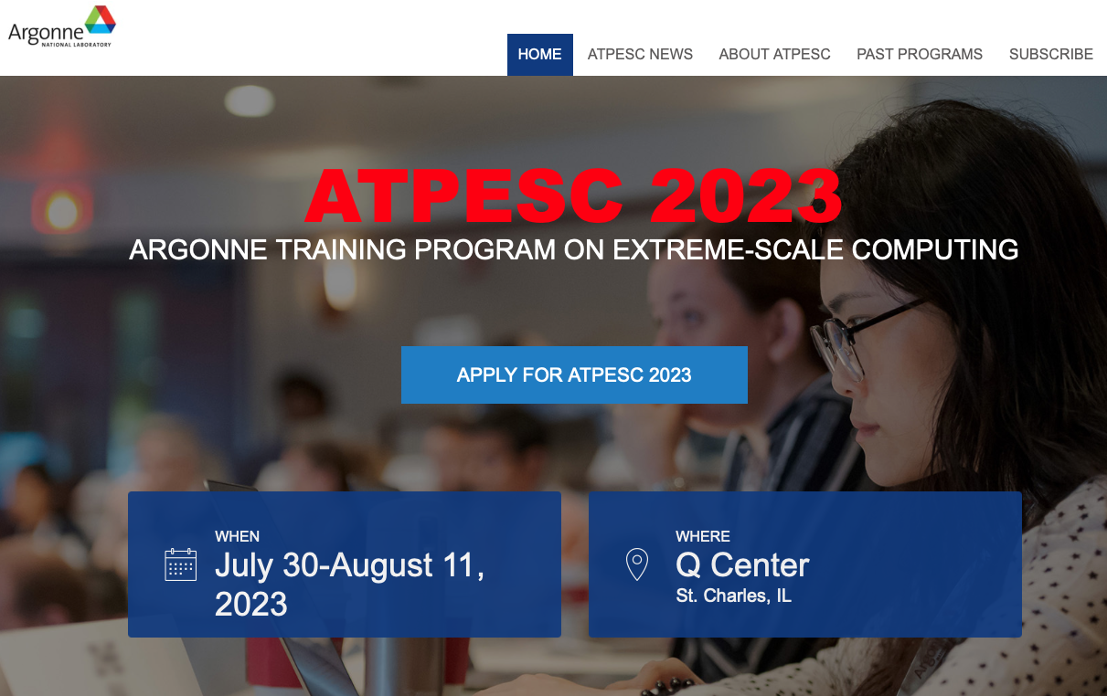
Outreach/EDIA Plans
Sustained Program based on Five Pillars
Raising Awareness: Seminars and presentations at different venues (e.g., CHEP, Supercomputing, Grace Hopper, Tapia, –) to promote HEP-CCE roles and goals, available internship and faculty engagement programs, future careers, and collaboration opportunities; develop programs with the Sustainable Horizons Institute, National Society of Black Physicists, and EDI programs at the participating laboratories
Sustained Engagement: Multi-year opportunities at all the partner labs, support for joint or separate funding opportunities (DOE ECRP, RENEW, FAIR, named fellowships –)
Training Opportunities: HEP-CCE will provide training opportunities through hands-on workshops and hackathons at key events, providing direct experience and support for those in HEP that are either new to HPC, or to be exposed to new directions in HPC, thus creating a broader HPC-aware workforce for HEP (jointly with ASCR efforts)

Slide 2
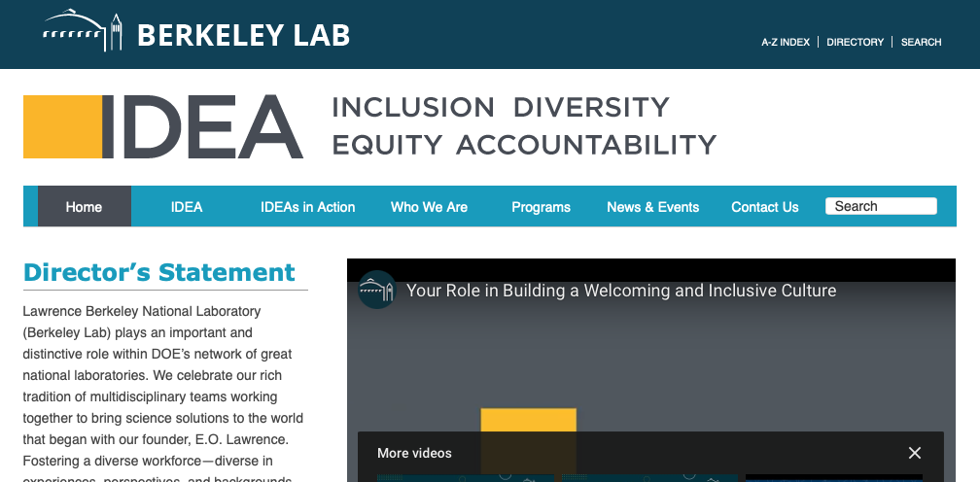
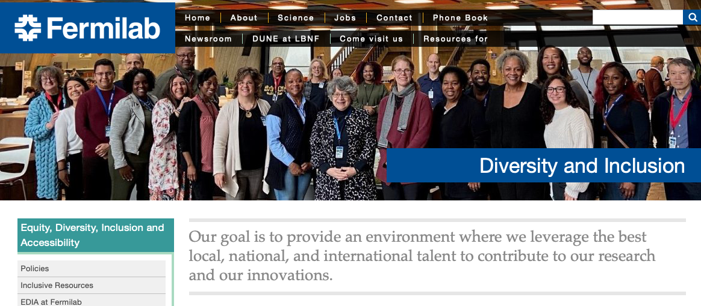
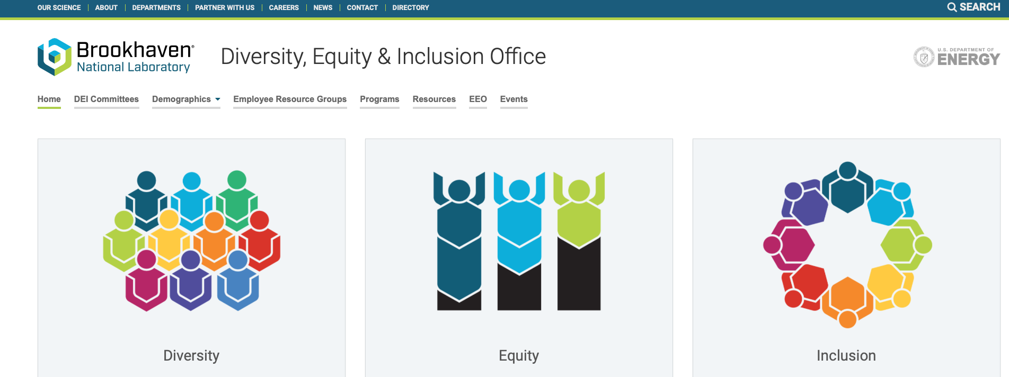
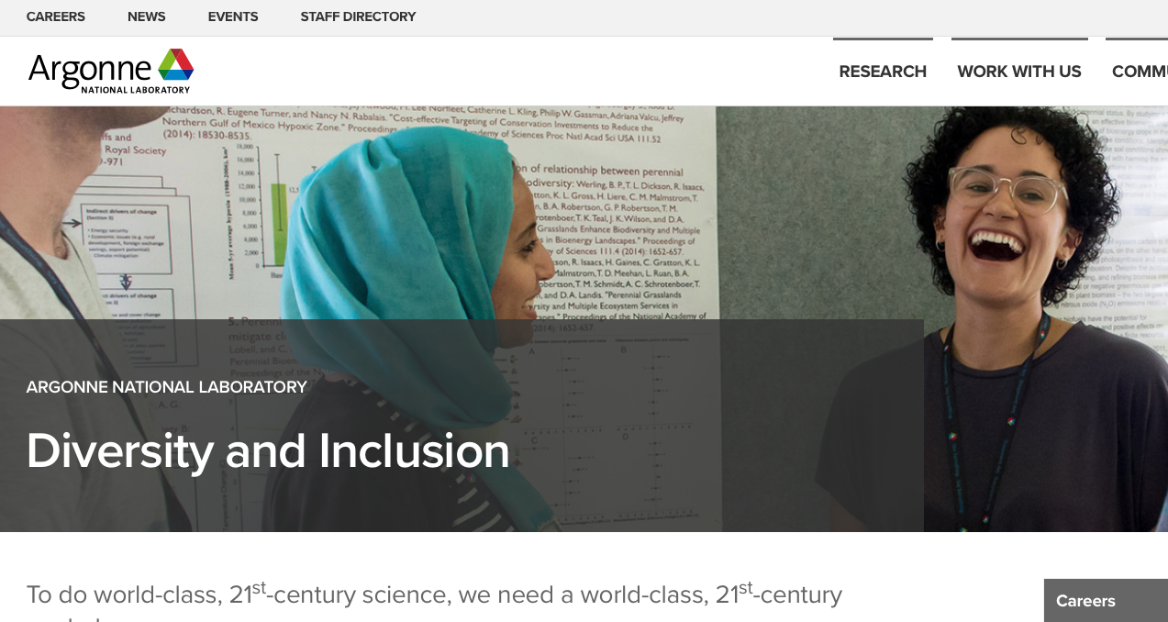
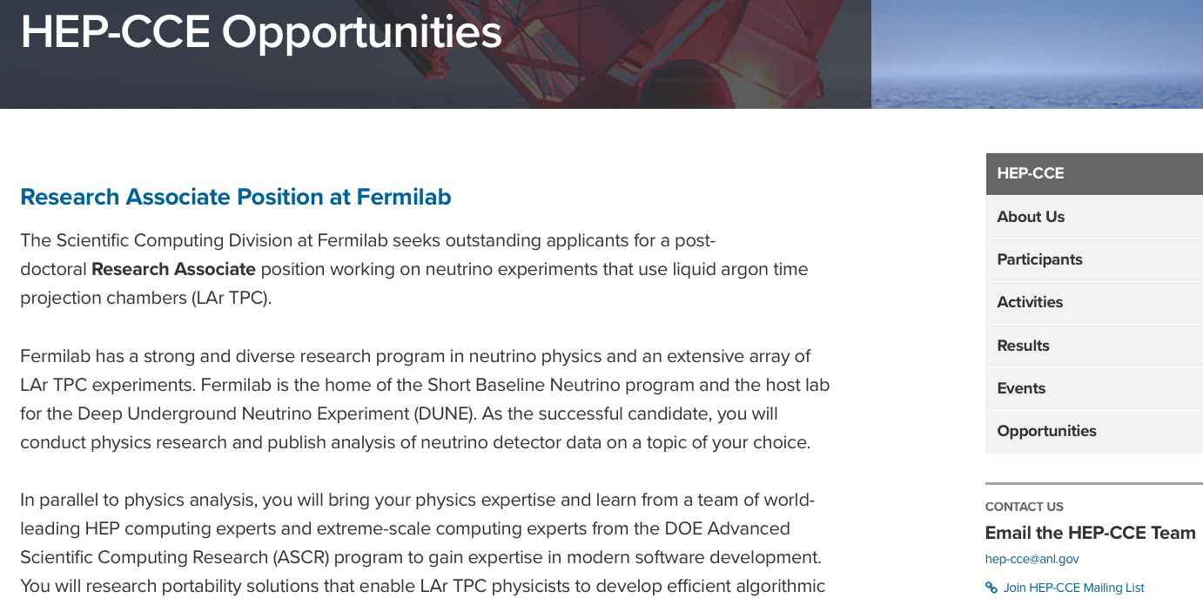
Outreach/EDIA Plans
Accessibility: Where possible we will consider how to make the opportunities more available to those less experienced in HPC code development and data management, or lack resources at their sites for increased engagement via documentation, placement of test examples that can be used for training and research (at HEP-CCE sites, HPC centers, cloud –), and recorded training sessions
Career Development: Early career researchers have been a focus for HEP-CCE since its inception – we will continue the tradition of support and mentoring from very early career stages onwards to provide personalized career guidance and help with career opportunities
Individual Lab Plans: The partner laboratories will collaborate on the global plan and have their own individual efforts and initiatives. Lab POCs will work with a Deputy PI for Outreach/EDIA to share responsibilities and maximize impact

Slide 3
Outreach/EDIA Plans
What have you planned for this year and next?
Key component will be to link and coordinate our efforts.

