Slide 1
Workflows for the Dark Energy Science Collaboration and the Rubin Observatory
Jim Chiang
SLAC
HEP-CCE All Hands, 2023-12-18

Slide 2
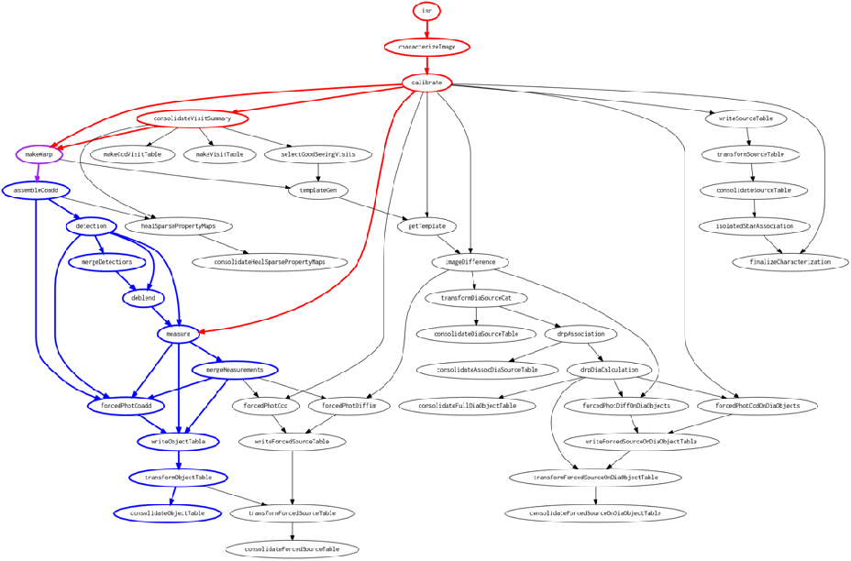
Rubin Workflows
Large image processing pipelines at scale:
Complicated DAGs
Large numbers of small, interdependent tasks, with widely varying resource needs.
Orchestrating processing campaigns at multiple sites:
Moving large numbers of files and distributing payloads in an optimal fashion
Long campaigns:
We expect Data Release Processing campaigns to last ~200 days/year.
~40M instances
28M instances
Graph showing dependencies between task types for Rubin image processing.

Slide 3
Rubin Workflows:
Current solutions/technologies
HEP-CCE
Rubin LSST middleware provides:
DAG-generation
Plugin-based batch processing framework that works with various workflow management systems: PanDA, Parsl, DAGMan/HTCondor.
Data "Butler" as an abstraction layer between data products and processing tasks allowing for different kinds of backend storage, e.g., posix, S3, etc..
For Rubin production work, PanDA chosen for multi-site capabilities, and Rucio for data management between sites.
Both are extensively used and supported in the HEP community.
Significant friction because of differences between Rubin processing needs and more typical HEP workloads.
Development needed to integrate Rubin Butler with Rucio.
Monitoring the finely grained Rubin processing across the three different data facilities–USDF, FrDF, UKDF–is challenging.
HEP-CCE
HEP-CCE
HEP-CCE

Slide 4
DESC Workflows
DESC image processing pipelines:
Running subsets of Rubin pipelines with alternative data selections (including injecting simulated objects), algorithms, and configurations to understand systematics.
Joint pixel analysis of Rubin data with data from other observatories.
DESC cosmology analysis pipelines:
These will be run at various sites, mostly HPC, but also at local university clusters.
They consist of many heterogeneous pipelines using different kinds of compute: MPI-based, AI/ML, MCMC.
We expect challenges in managing data products exchanged between these pipelines because of distributed nature of the processing.

Slide 5
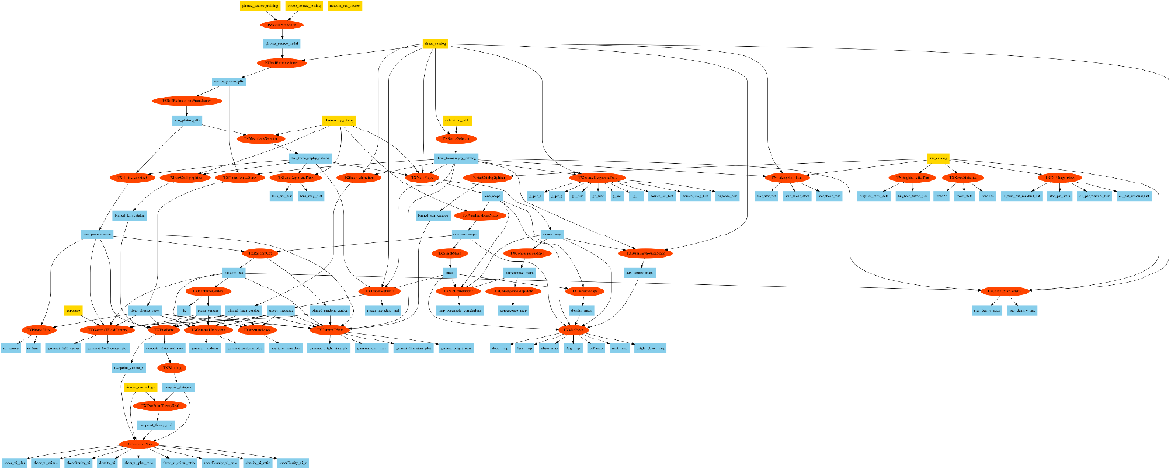
DESC Workflows:
Current solutions/technologies
Custom pipeline framework for analysis pipelines (Ceci)
Parsl for workflow management at HPC facilities and local clusters
Custom solution for data management
HEP-CCE
HEP-CCE
Example workflow from DESC’s 3x2 pt pipeline

