Slide 1

Accelerator Events and RWM Signals
for ArgonCub 2x2 Demonstrator
Geoff Savage
05 November 2023

Slide 2
Accelerator Signals and RWM
Events from the Accelerator come from building ground
  Events control the operations of the accelerators
  CAMAC crate in Minos cavern
  Beam early warning goes to Minerva
    Minerva is also on building ground
    Long copper coaxial cable from AD rack to Minerv readout rack
Resistive Wall Monitor signals arrive via fiber
  Signal generated when protons pass the RWM device
  One for NUMI and one for BNB
  Converted to fiber in MI12 and MI60
Grounds
  2x2 electronics is on detector low-noise ground
  Minerva is on quiet building ground
  Building ground is used by noisy devices – pumps, vfds, …

Slide 3
2x2 Signals and Events from Accelerators
Early Warning Event
  Used by Minerva top open readout gate
    quiet building to quiet building
  Used by 2x2 to synchronize data
    quiet building to detector low-noise
RWM – NUMI and BNB
  Used by 2x2 for more precise timing
    fiber to detector low-noise (x2)
  Use for Minerva for more precise timing?
    Use veto wall readout board to insert signal
    fiber to quiet building (x2)
    Still under discussion

Slide 4
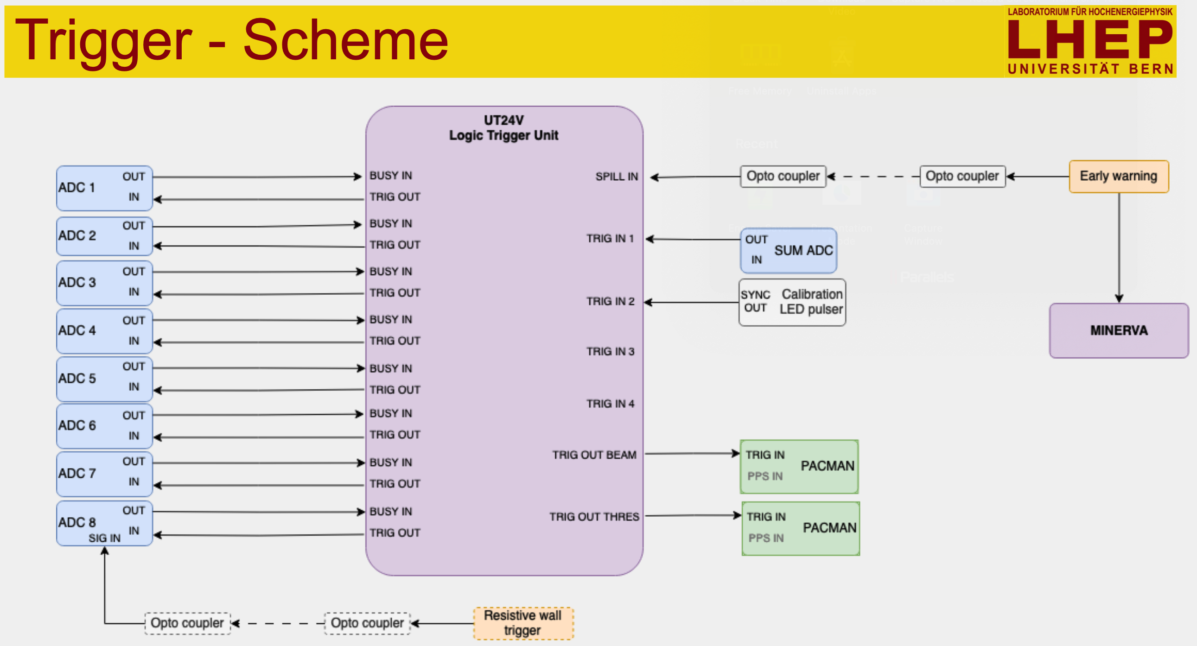

Slide 5
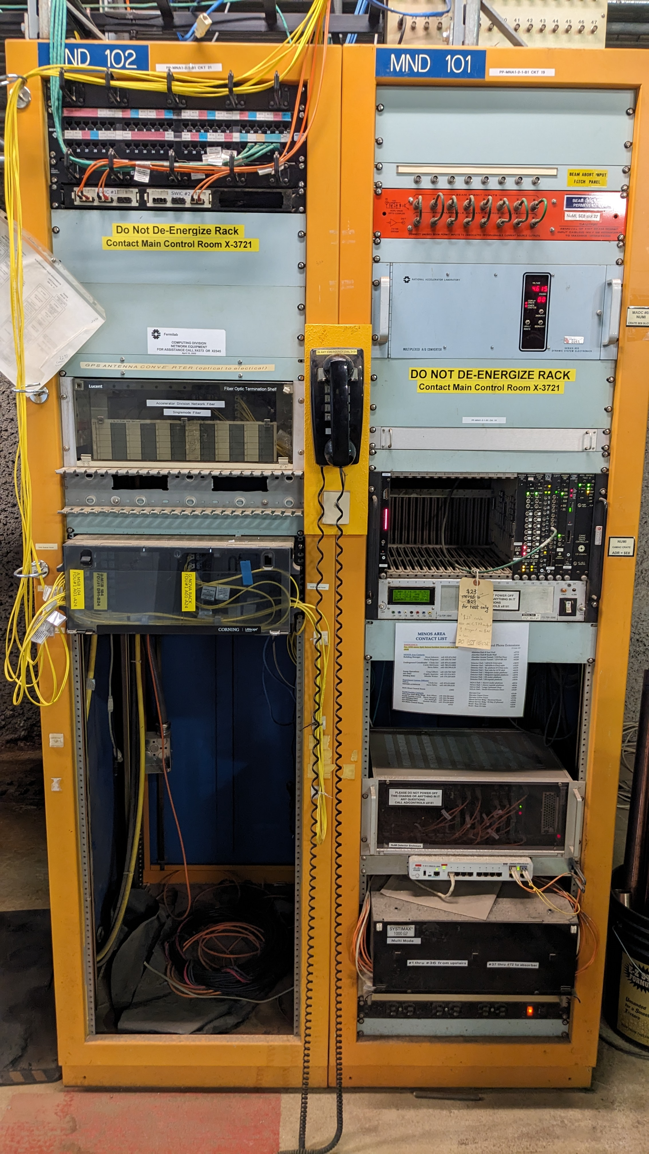
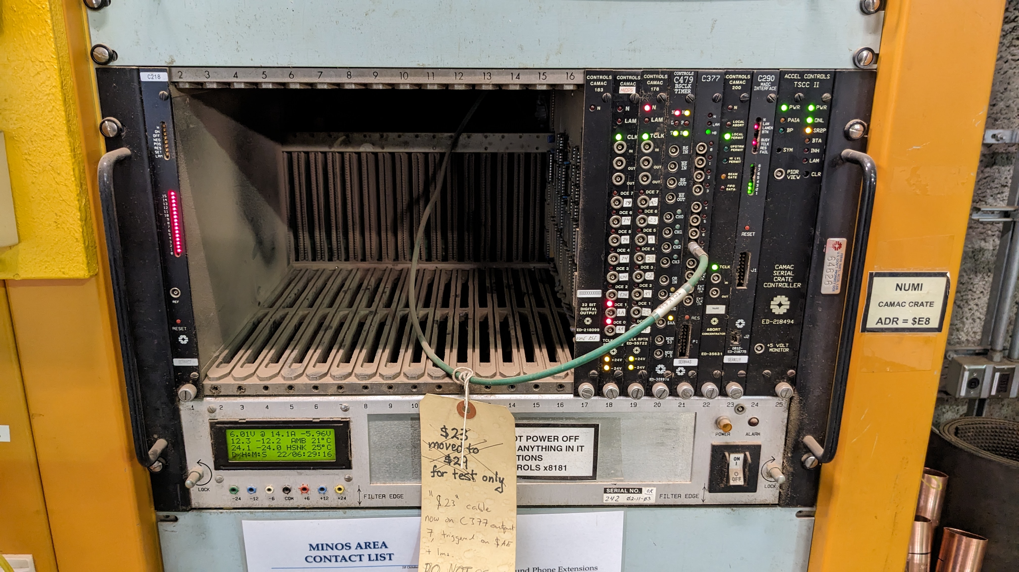
AD CAMAC Crate for Event Signals

Slide 6
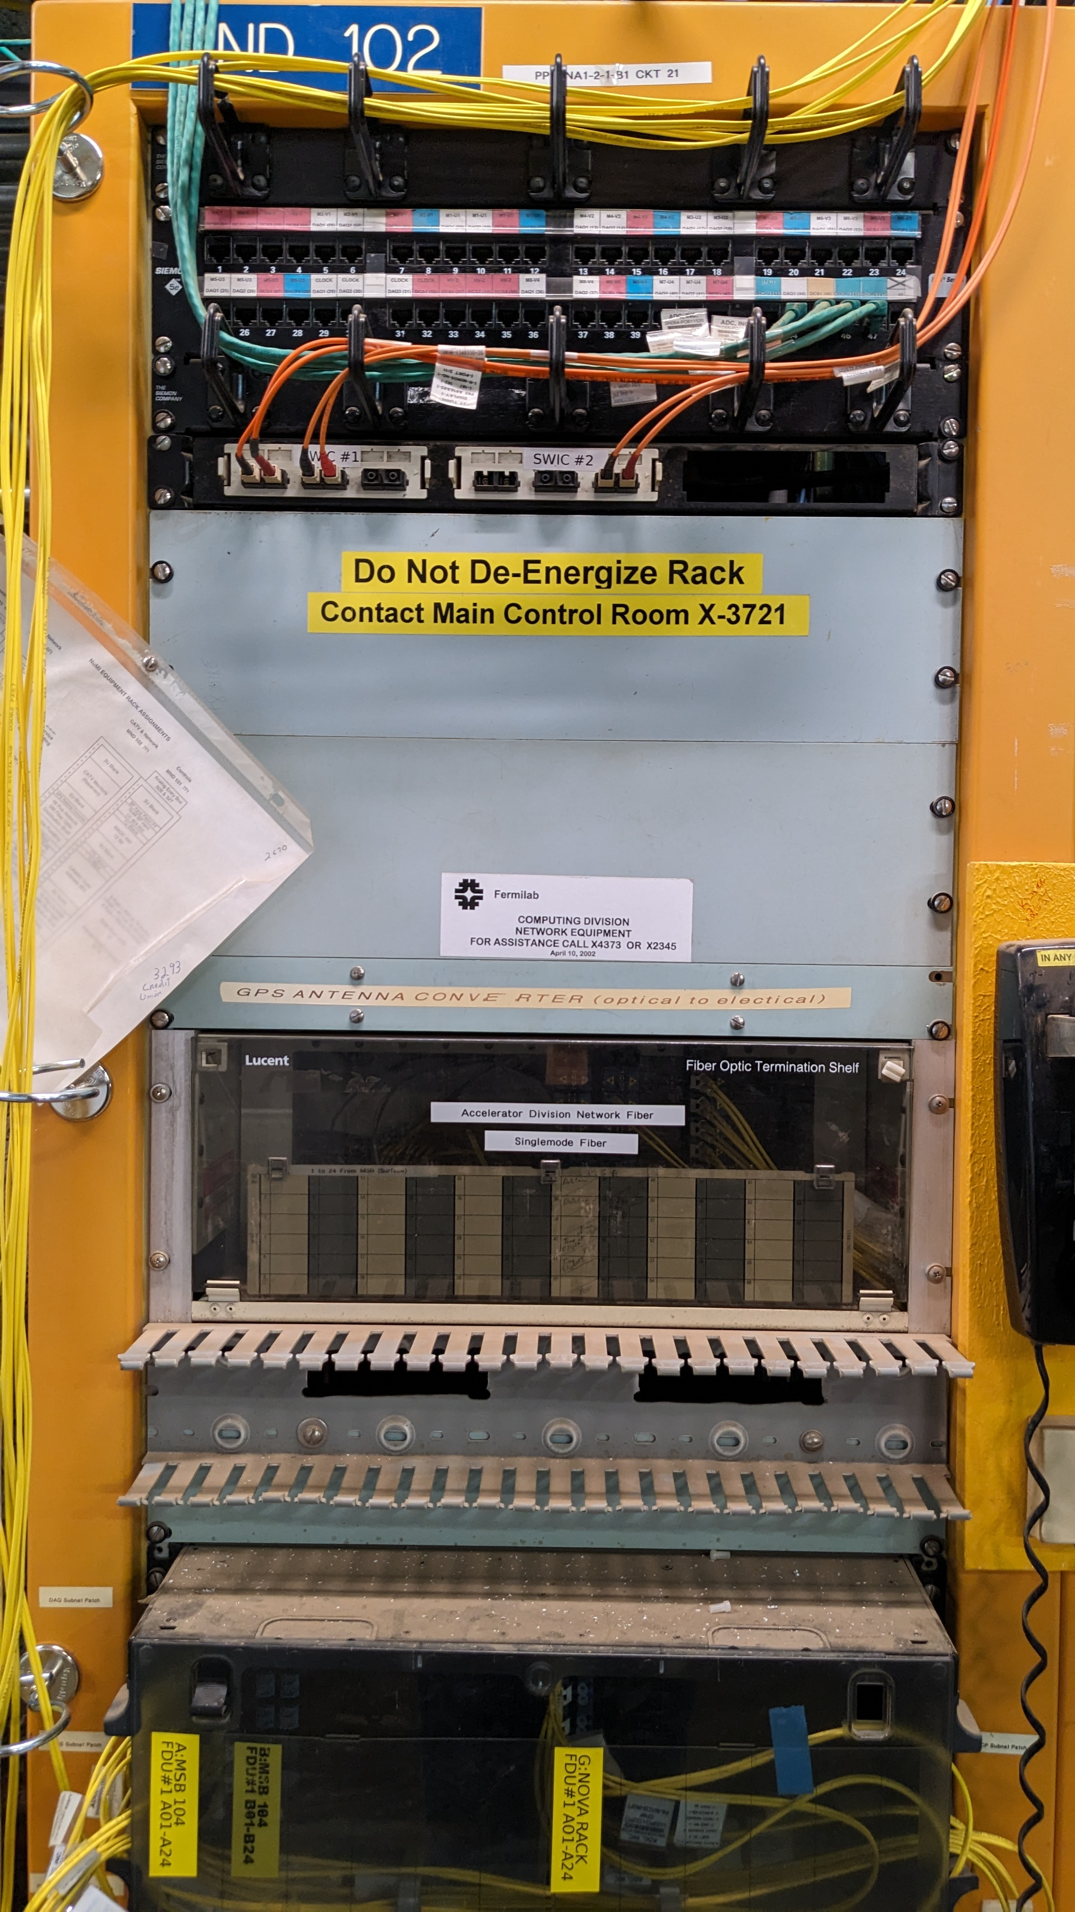
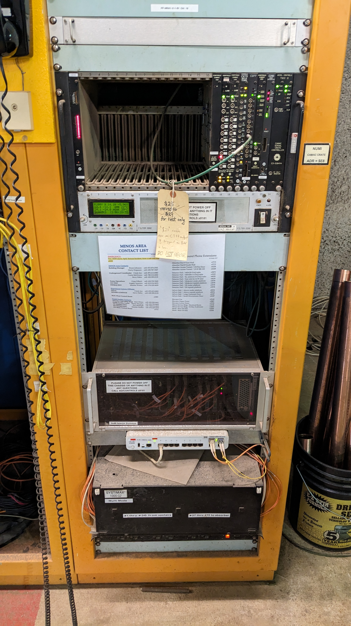

Slide 7
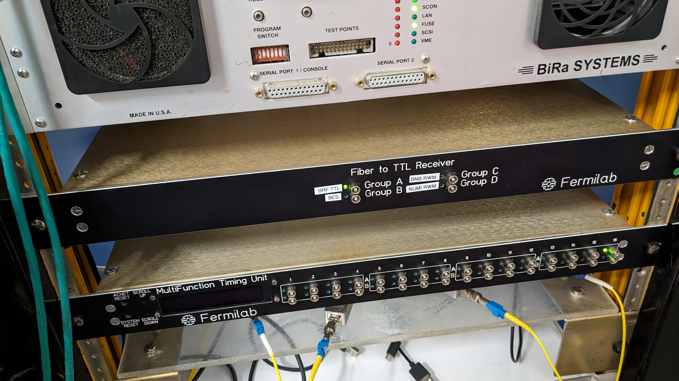
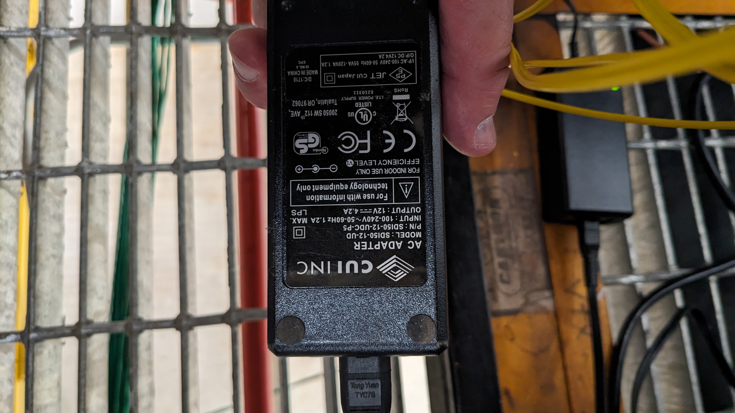
Fiber to TTL Receiver

Slide 8
Solutions
Two options to handle these signals, both used by Icarus
  Fiber to TTL Receiver Unit (built by AD)
    handles 4 signals (channels) with 6 outputs per channel
    fiber to copper for RWM
    $1.6k
  Commercial converters
    copper-to-fiber then fiber-to-copper for accelerator events
    $1k per signal + spare
Early Warning Event - used by 2x2 to synchronize data
  quiet building to detector low-noise - commercial converters
RWM – NUMI and BNB
  Used by 2x2 for more precise timing
    fiber to detector low-noise (x2) – fiber to ttl reciever
  Use for Minerva for more precise timing?
    fiber to detector low noise to quiet building - commercial converters

Slide 9
fiber to ttl
(4 channels)

Slide 10
RWM Signals
RWM signals
  MI12 (BNB)
  MI60 (NUMI)
  Fiber connection through fiber trunks and fiber jumpers
Fiber trunks go between locations
  Need to verify the continuity
  MI60 to ???
  ??? to Minos surface
  Minos surface to Minos racks
  Minos racks to 2x2 Network rack
  2x2 Network rack to Light ADC rack
  Light ADC rack to …
If two Fiber to TTL Receivers are used then two sets of fibers from each location are needed

