Slide 1
Stefano Profumo
University of California, Santa Cruz
Santa Cruz Institute for Particle Physics
Baryogenesis and Astrophysics
Cosmic Frontier Workshop
SLAC, March 6-8 2013

Slide 2
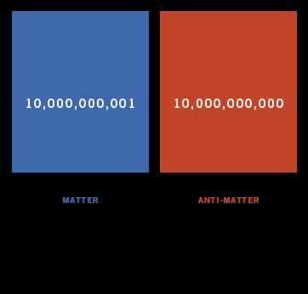
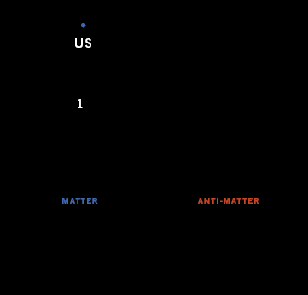
What is the origin of the tiny
excess of matter over anti-matter?

Slide 3
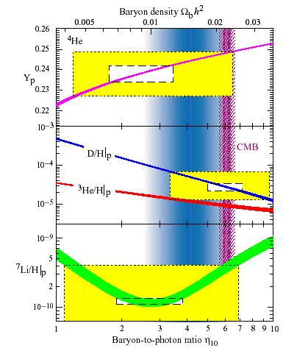
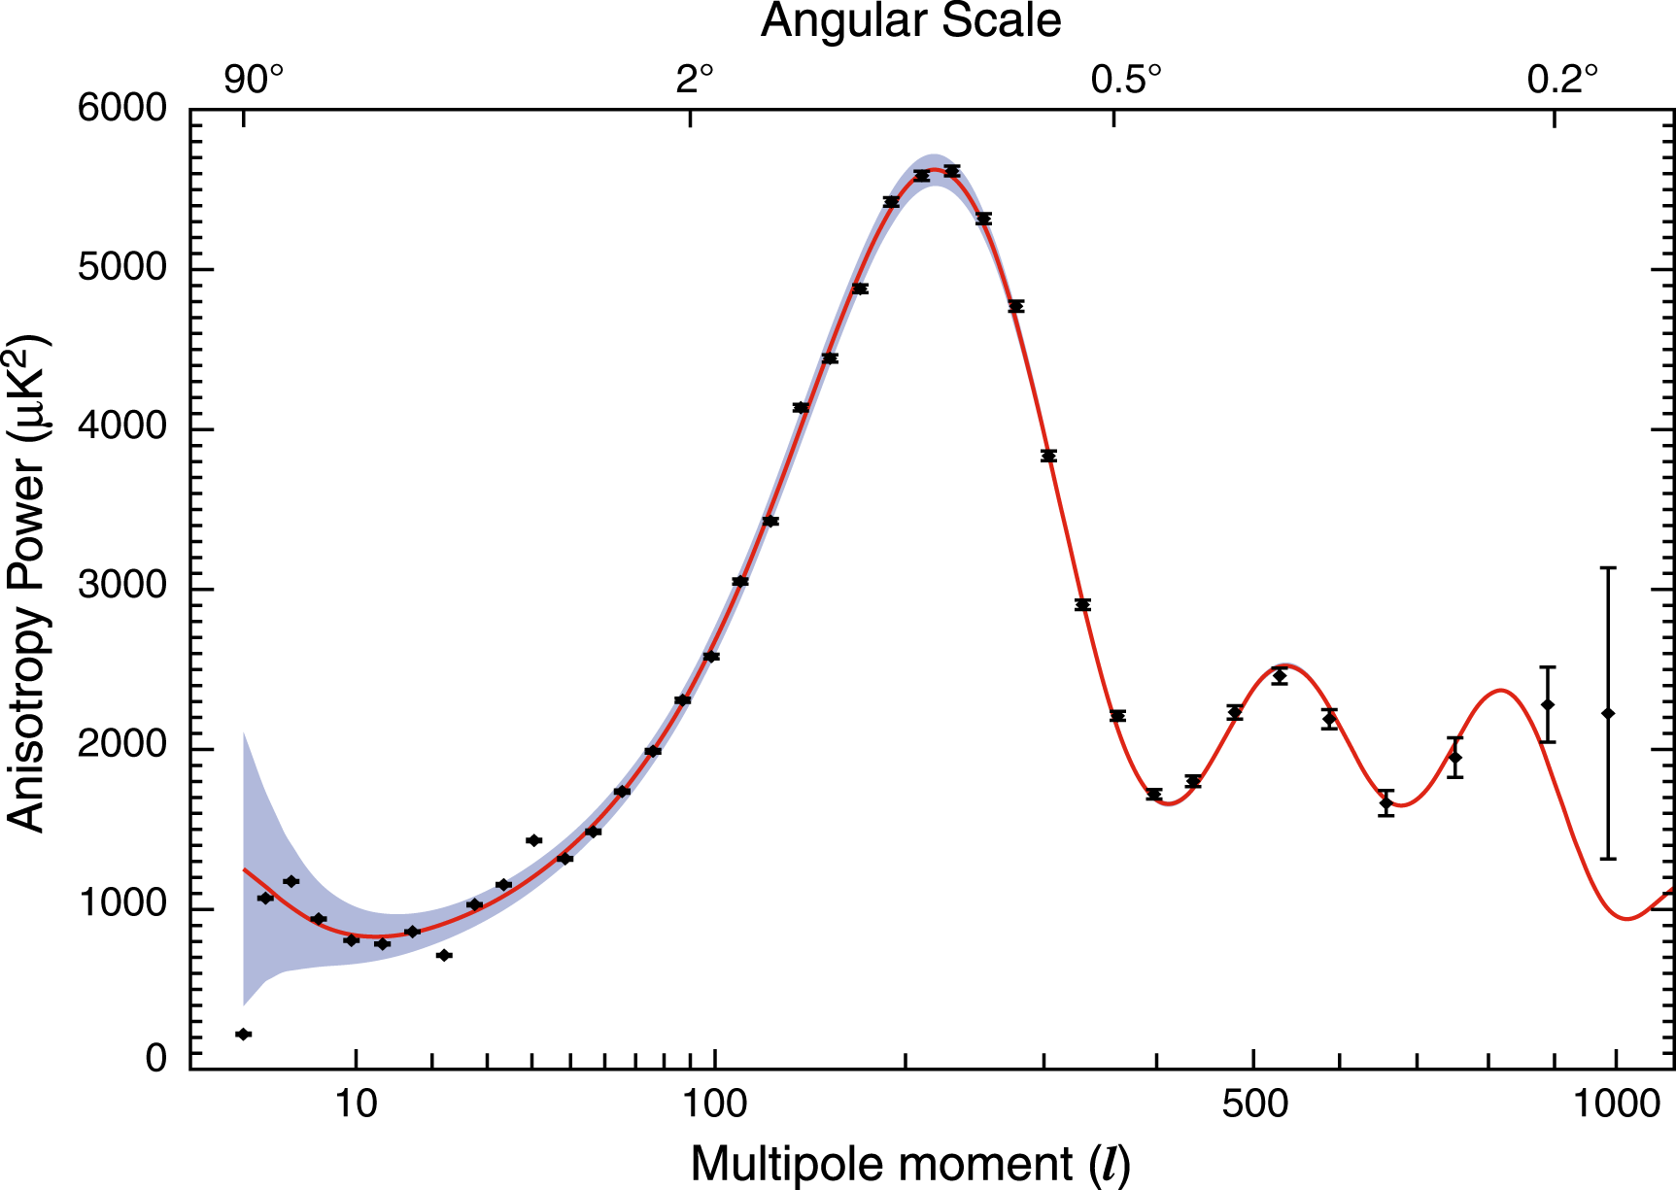
The Matter-Antimatter (Baryon) Asymmetry

Slide 4
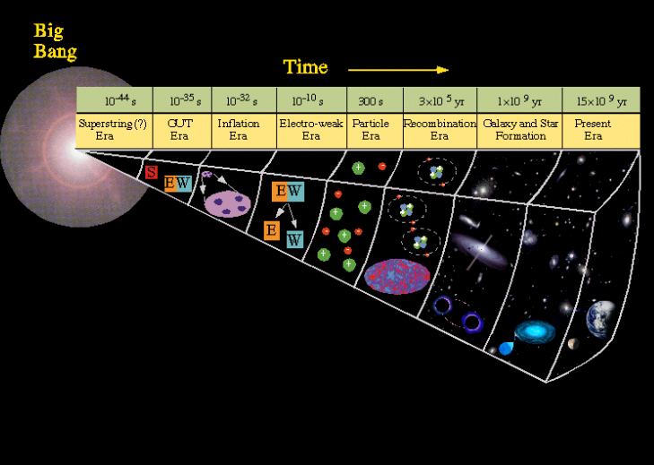
No “Standard Model” of Baryogenesis!
CERN
Large Hadron Collider
Electro-weak
Baryogenesis
Leptogenesis
GUT-scale
Baryogenesis
Colliders (LHC, Linear Collider)
Gravity Waves (Ligo, LISA)
Dark Matter (direct and indirect)
Electric Dipole Moments (d_{e}, d_{n}, atoms)
Primordial
Asymmetry

Slide 5
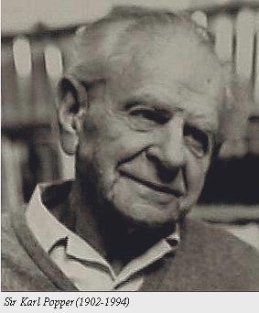
“In so far as a scientific statement
speaks about reality,
it must be falsifiable:
And in so far as it is not falsifiable
it does not speak about reality”
Karl Popper, “Logik der Forschung” (1934)
“The Logic of Scientific Discovery”
(Supersymmetric) Electro-Weak Baryogenesis:
a falsifiable theory

Slide 6
Electro-Weak Baryogenesis
(1) Out of equilibrium regions
(bubble walls)
(2) CP-violating interactions
(3) B-viol. Sphalerons produce
net baryon number ρ_{B} in the
regions of unbroken phase
Unbroken
Phase
Broken
Phase
ρ_{B} diffuses in the broken EW phase
region, and freezes in
ρ_{B} is not washed out if sphaleron transitions
are strongly suppressed in the br. phase
(i.e. if the PT is strongly first order)

Slide 7
Electro-Weak Baryogenesis: Physical Concepts
Electro-Weak
Phase Transition
Dark Matter
(if supersymmetric)
SUSY Electro-Weak
Baryogenesis
(non-standard)
Higgs Sector
CP
Violation

Slide 8
Electro-Weak Baryogenesis: Probes
Electro-Weak
Phase Transition
Electro-Weak
Phase Transition
Gravitational
Waves
Gravitational
Waves
(non-standard)
Higgs Sector
Dark Matter
(if supersymmetric)
SUSY Electro-Weak
Baryogenesis
(non-standard)
Higgs Sector
Collider
Searches
DM detection
CP
Violation
EDM Searches

Slide 9
Electro-Weak Baryogenesis: Probes
Electro-Weak
Phase Transition
Electro-Weak
Phase Transition
entropy injection
(latent heat)
strongly
first order?
Gravitational
Waves
Gravitational
Waves
(non-standard)
Higgs Sector
Dark Matter
(if supersymmetric)
SUSY Electro-Weak
Baryogenesis
(non-standard)
Higgs Sector
Collider
Searches
DM detection
CP
Violation
EDM Searches

Slide 10
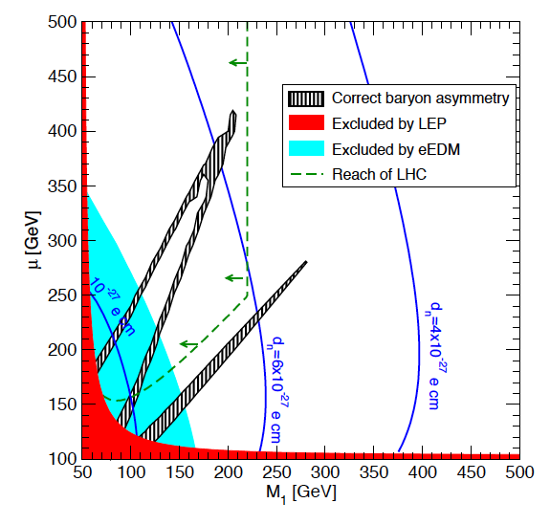
Electro-Weak Baryogenesis
Masses of superpartners
of Higgs and Photon
Cirigliano, Profumo and Ramsey-Musolf, JHEP 2009; DoE NP Long Range Plan

Slide 11
Electro-Weak Baryogenesis
Within Reach of Large
Hadron Collider
Cirigliano, Profumo and Ramsey-Musolf, JHEP 2009; DoE NP Long Range Plan

Slide 12
Electro-Weak Baryogenesis
Within Reach of
Next-Generation
EDM Searches
Cirigliano, Profumo and Ramsey-Musolf, JHEP 2009; DoE NP Long Range Plan

Slide 13
Outline
The fate of sfermion (e.g. stop) sources
Accidental SUSY baryogenesis and dark matter
A (next-to-minimal) model that does everything
Kozaczuk, Profumo, Ramsey-Musolf and Wainwright, 2012
Kozaczuk, Profumo and Wainwright, 2012 and 2013

Slide 14
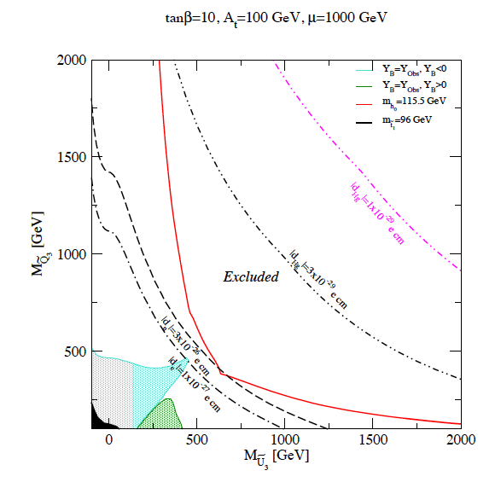
Sfermion sources?
Mercury EDM
Neutron EDM
Electron EDM
Kozaczuk, Profumo, Ramsey-Musolf, Wainwright, 2012

Slide 15
Sfermion sources?
Stop (and sbottom, at large tanβ) resonant sources
are ruled out by EDM searches
Statement robust to >>factor 10 systematics in Y_{B}
Resonant stau sources OK, but extremely finely tuned
(Higgs connection? light staus could enhance h→γγ)
Kozaczuk, Profumo, Ramsey-Musolf, Wainwright, 2012
Carena, Gori, Shah, Wagner and Wang, 2012

Slide 16
SUSY Electro-Weak Baryogenesis Sources
must be fermionic (resonant higgsino-gaugino)
x
x
Cirigliano, Profumo, Ramsey-Musolf, 2006

Slide 17
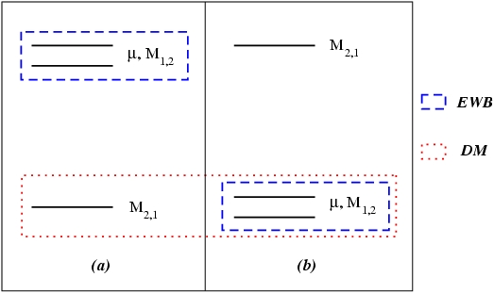
SUSY Electro-Weak Baryogenesis:
the connection with Dark Matter
Mass
(a): EWB and DM are “unrelated”
(b): EWB-DM connection
Kozaczuk and Profumo

Slide 18
Electro-Weak Baryogenesis and Dark Matter
χ
Direct
Detection
h
N
~
H
Indirect
Detection
~
Large annihilation rate into gauge bosons:
lots of gamma rays, neutrinos
W
~
H

Slide 19
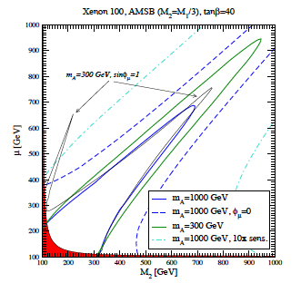
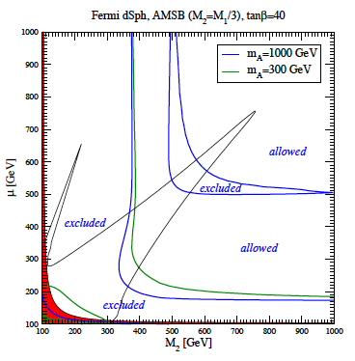
Electro-Weak Baryogenesis and Dark Matter
Direct Detection
Indirect Detection
Kozaczuk and Profumo, 1108.0393, JCAP 2011

Slide 20
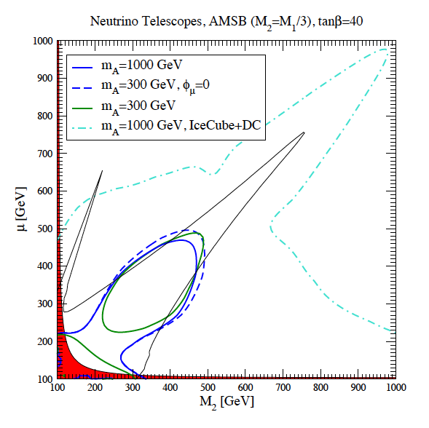
Electro-Weak Baryogenesis and Dark Matter
Kozaczuk and Profumo, 1108.0393, JCAP 2011

Slide 21
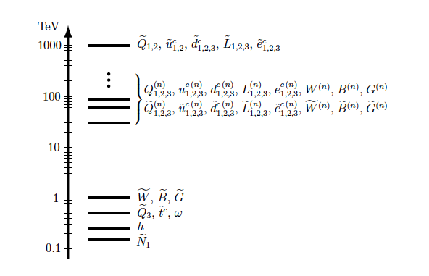
Accidental SUSY and Electro-Weak Baryogenesis
Bonus: in RS models generically radion
can induce super-cooling of EWPT,
making it more strongly first order
Gherghetta et al, 2011; Kozaczuk, Profumo and Wainwright, 2012

Slide 22
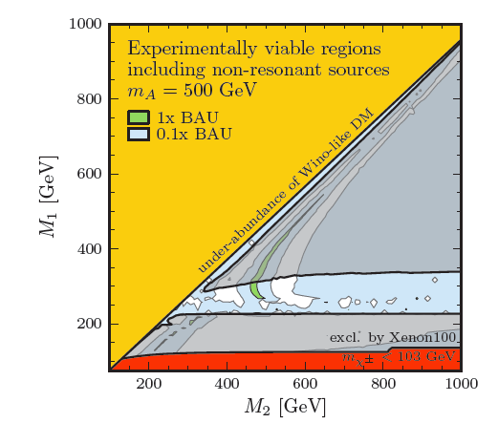
Accidental SUSY and Electro-Weak Baryogenesis
* “Well-tempered”
neutralino
* OK with EDM limits
* Close to be probed
by direct detection!
Kozaczuk, Profumo and Wainwright, 2012

Slide 23
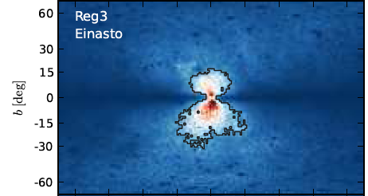
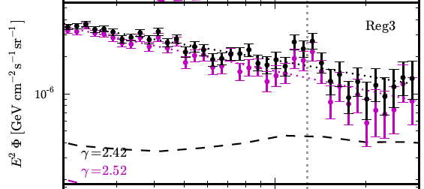
A model that does everything
Line with right cross section
Suppressed GR continuum
Right Higgs mass
Strongly first order EWPT
OK with direct detection
OK with SUSY searches
OK with EDM searches
OK with direct DM searches
Weniger, 2012; Kozaczuk, Profumo and Wainwright 2013

Slide 24
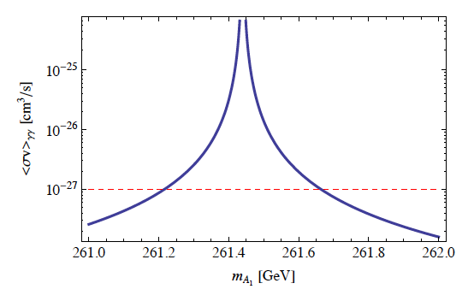
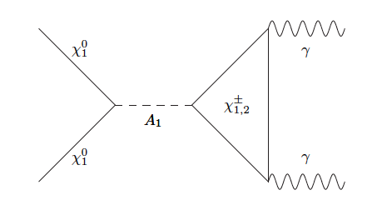
A model that does everything
Kozaczuk, Profumo and Wainwright, 2013

Slide 25
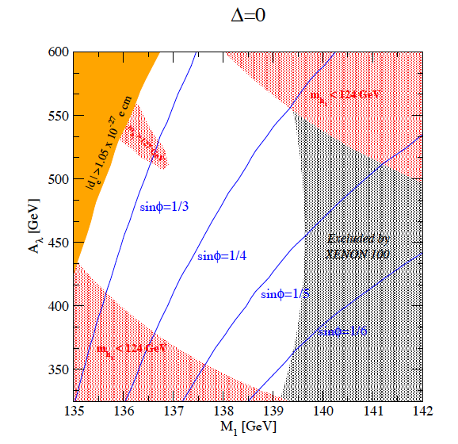
A model that does everything
Kozaczuk, Profumo and Wainwright, 2013

Slide 26
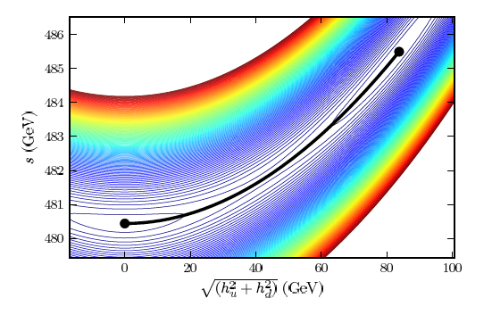
A model that does everything
Tunneling
Direction
in field space
Effective potential at critical temperature
(all NMSSM degrees of freedom included!)
Kozaczuk, Profumo and Wainwright, 2013

Slide 27
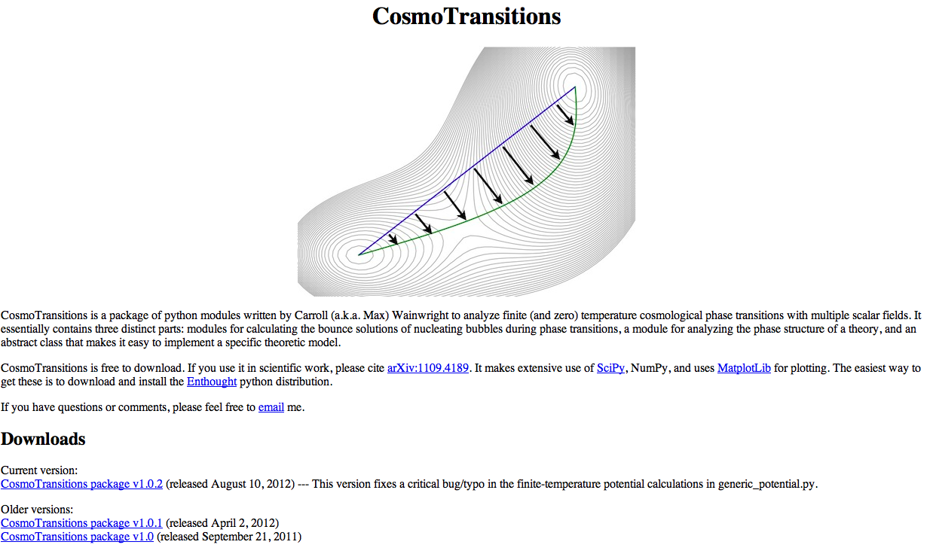
Wainwright, 2012

Slide 28
Conclusions
SUSY EWB alive – as long as something explains
how the EWPT can be made strongly first order
Sfermion sources are dead
Multiple probes are closing in, especially
EDM, direct dark matter detection

Slide 30
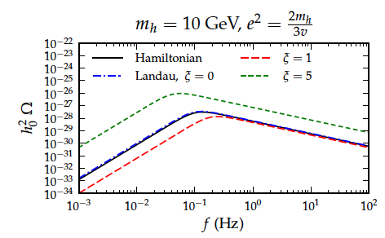
Theory issue: gauge dependence in effective potential

