Slide 1
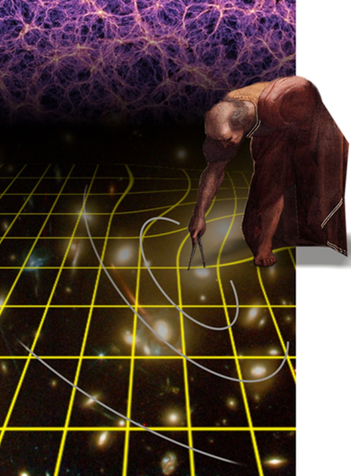
The Euclid Mission
Jason Rhodes (Caltech/JPL)
March 7, 2013
© 2013, government
sponsorship acknowledged

Slide 2
Euclid goals
Understand the nature of Dark Energy and Dark Matter by:
Measuring the DE equation of state parameters w₀ and w_{a} to a precision of 2% and 10%, respectively, using both expansion history and structure growth.
Measuring the growth factor exponent γ with a precision of 2%, enabling to distinguish General Relativity from the modified-gravity theories
Testing the Cold Dark Matter paradigm for structure formation, and measure the sum of the neutrino masses to a precision better than 0.04eV when combined with Planck.
Improving by a factor of 20 the determination of the initial condition parameters compared to Planck alone.
scientific goals outlined in NWNH Panel Reports:
• How did the universe begin?
• Why is the universe accelerating?
• What is dark matter?
• What are the properties of neutrinos?

Slide 3
NASA: Euclid Science Teams Competition
ESA-NASA MoU provided for NASA to nominate
40 members to Euclid Consortium (EC)
1 member of the Euclid Science Team (EST)
1 member of the Euclid Consortium Board (EC)
ROSES competition for funded teams:
proposals due 31 August 2012; selections 7 December 2012
Jason Rhodes (JPL) selected for EST and Euclid Consortium Board
Total of 3 science proposals selected: PIs Rhodes, Kashlinsky, Chary
Join 14 members of US community already part of Euclid Consortium, including 7 from LBNL and 1 from SLAC
54 US scientists are now full members of the Euclid Consortium
IPAC study on NASA contributing a US Euclid Science Data Center,
due April 2013: this center is NOT included in ESA-NASA MoU
Only the study is funded in current baseline

Slide 4
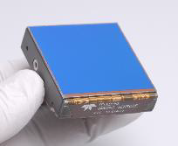
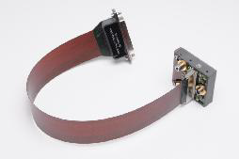
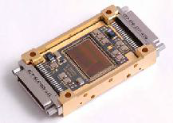
NASA’s Partnership Agreement with ESA
ESA Responsibilities
Mission, Spacecraft, Launch vehicle, GDS
Spacecraft/Prime contractor ITT underway – selection by June 2013
Euclid Consortium (EC) responsibilities – 2 Instruments, Science Data Centers, science
ESA/NASA MOU signed January 10, 2013
NASA responsible for Sensor Chip Systems (SCS) for Near Infrared Spectrometer and Photometer (NISP) Instrument. ($45M)
Teledyne H2RG HgCdTe detector, SIDECAR ASIC, and flexible cryogenic cable. (16 FM and 4 FS)
NASA gets 40 new EC member slots, selected through NRA. ($50M lifetime science team cost)
JPL Project Office (PM Ulf Israelsson, PS Michael Seiffert)
Detector char. at GSFC DCL [PCOS Program Office MM Tom Griffin]
US Science Lead Jason Rhodes
H2RG
Flexible
Cable
SIDECAR
ASIC
Overview
SIDECAR™ (system image, digitizing, enhancing, controlling, and retrieving) ASIC (Application Specific Integrated Circuit)

Slide 5
Euclid concept
Optimized for two complementary cosmological probes:
Weak Gravitational Lensing
Baryonic Acoustic Oscillations
Additional probes: clusters, redshift space distortions, ISW
15,000 square degree survey
Imaging (WL):
High precision imaging at visible wavelengths
Photometry/Imaging in the near-infrared
Near Infrared Spectroscopy (BAO)
SN, exoplanet microlensing not part of science goals now
Possible, but not planned

Slide 6
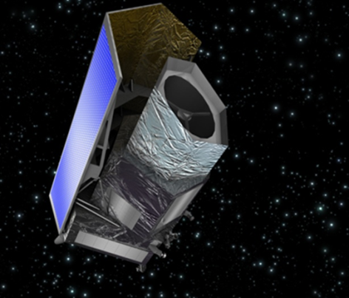
Euclid Mission Baseline
Mission elements:
L2 Orbit
6.25 yr primary mission
Telescope: three mirror astigmat (TMA) with 1.2 m primary
Instruments:
VIS: Visible imaging channel: 0.5 deg², 0.10’’ pixels, 0.16’’ PSF FWHM, broad band R+I+Z (0.5-0.9mu), 36 CCD detectors
NISP: NIR channel: 0.5 deg^{2,}
16 HgCdTe detectors, 1-2mu:
Photometry: 0.3’’ pixels, 3 bands Y,J,H, photo-z’s
Spectroscopy: slitless, R=250, redshifts
From NASA
Launch Q2 2020

Slide 7
Euclid Surveys
In 6.25 years
15,000 deg²
40 deg²
N+S?
^{Obs strategy?}
z of n=5x10⁷ galaxies
TBD: SN and/or μ-lens surveys – Milky Way survey does not seem competitive?
Ref: Euclid RB arXiv:1110.3193

Slide 8
Euclid Science Reach
From Euclid Red Book :
sci.esa.int/science-e/www/object/index.cfm?fobjectid=48983

Slide 9
Synergy With Ground
Like WFIRST, Euclid does not stand alone
Ground based photometry for photo-zs is required
LSST, DES in south
HSC, PS, CFHT in the north
Spectro-zs also likely needed for photo-z calibration
MS-DESI, PFS, TMT, 10-meter telescopes
A shear comparison would be useful, especially in the Euclid Deep fields
Benefits LSST by allowing calibration of shapes

Slide 10
Synergy With WFIRST
Euclid makes WL measurements in a different wavelength
Euclid and WFIRST use different detector technologies for the WL surveys
Different systematics
Euclid will be wider and shallower, WFIRST narrower and deeper

