Slide 1
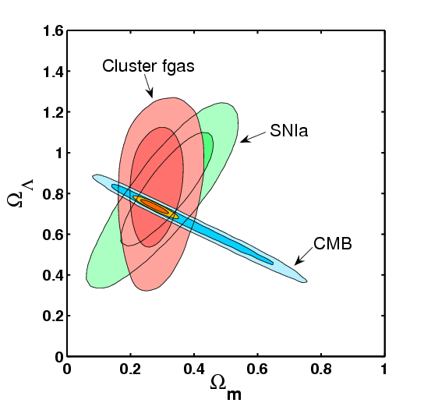
Cluster Distance Measurements
Steve Allen (Stanford/SLAC)
In collaboration with:
MACSJ0025.4-1222 (z=0.59)
Adam Mantz (Chicago)
David Rapetti (Copenhagen)
R. Glenn Morris (SLAC)
Robert Schmidt (Heidelberg)
Harald Ebeling (Hawaii)
Andy Fabian (Cambridge)
Doug Applegate (Bonn)
Patrick Kelley (Berkeley)
Paul Nulsen (CfA)
Anja von der Linden (Stanford)
Red: X-rays Blue: lensing
(+ many more)

Slide 2
Outline of talk:
I will discuss two ways to measure distances with galaxy clusters.
These are complementary to the more familiar tests based on cluster counts, i.e. the mass function and clustering.
Measurements of the baryonic mass fraction in the largest dynamically relaxed clusters (a.k.a. the fgas test).
Combined X-ray and SZ measurements of the Compton y-parameter (a.k.a. the XSZ test).
For further info: Allen, Evrard & Mantz, 2011, ARA&A, 49, 409.

Slide 3
Cluster Distance Measurements
1. The fgas experiment
Featured work: Allen et al. 2008, MNRAS, 383, 879
See also e.g. White & Frenk ’91; Fabian ’91; Briel et al. ’92; White et al ’93; David et al. ’95; White & Fabian ’95; Evrard ’97; Mohr et al ’99; Ettori & Fabian ’99; Roussel et al. ’00; Grego et al ’00; Allen et al. ’02, ’04; Ettori et al. ’03, ‘09; Sanderson et al. ’03; Lin et al. ’03; LaRoque et al. ’06 …

Slide 4
Constraining cosmology with f_{gas} measurements
BASIC IDEA: galaxy clusters are so large that their matter content should provide a ~ fair sample of matter content of Universe.
Define: and
Then:
Since clusters provide ~ fair sample of Universe:
Simulations
BBNS/CMB
Measure

Slide 5
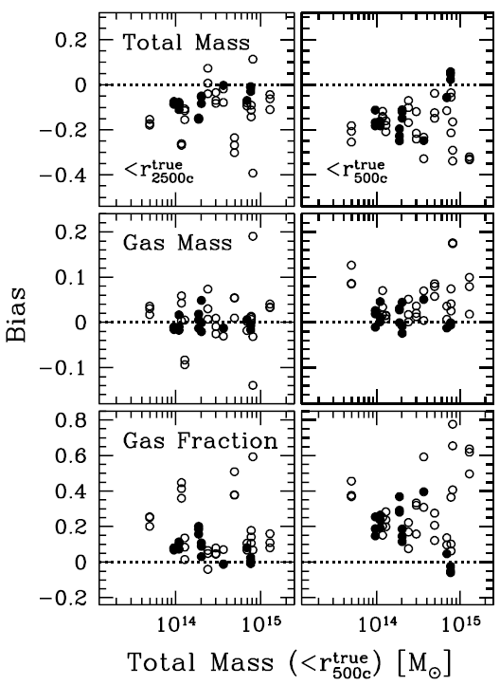
For relaxed clusters, HSE modeling → precise masses
Nagai, Vikhlinin & Kravtsov ‘07
For largest, relaxed clusters (selected on X-ray morphology) measured at r₂₅₀₀
X-ray data + hydrostatic eq. →
Total mass and fgas to better 10 % accuracy (both bias and scatter).
X-ray gas mass to few % accuracy.
Note: weak gravitational lensing data can in principle also aid absolute mass calibration for ensembles of clusters.
Relaxed clusters (filled circles)

Slide 6
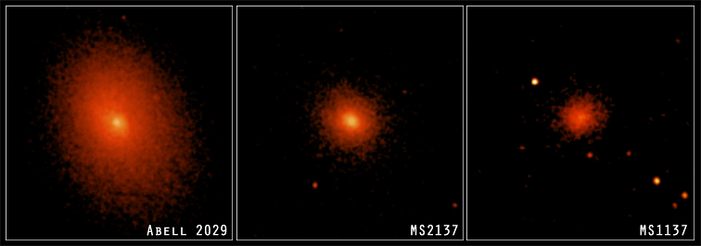
The observations
1.6Ms of Chandra data for 42 hot (kT>5keV), dynamically relaxed clusters spanning redshift range 0<z<1.1.
Selected on X-ray morphology: sharp central X-ray surface brightness peaks, minimal X-ray isophote centroid variations and high overall symmetry.
Restriction to hot, relaxed clusters minimizes all systematic effects.

Slide 7
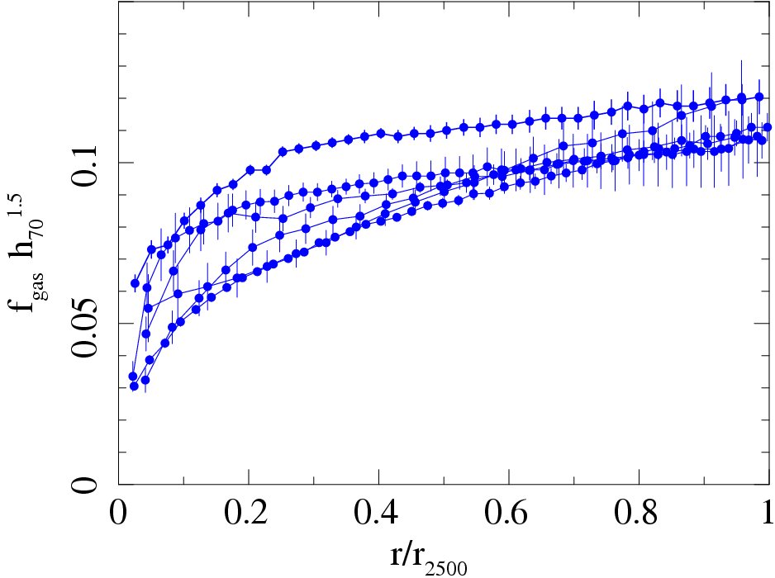
Chandra results on f_{gas}(r)
6 lowest redshift relaxed clusters (0<z<0.15) :
f_{gas}(r) → approximately universal value at r₂₅₀₀
Fit constant value at r₂₅₀₀
f_{gas}(r₂₅₀₀)=(0.113±0.003)h₇₀^{-1.5}
For Ω_{b} h²=0.0214±0.0020 (Kirkman et al. ‘03), h=0.72±0.08 (Freedman et al. ‘01), s=0.16±0.05 (Lin & Mohr ‘04) and b=0.83±0.09 (Eke et al. ‘98 +10% systematics)

Slide 8
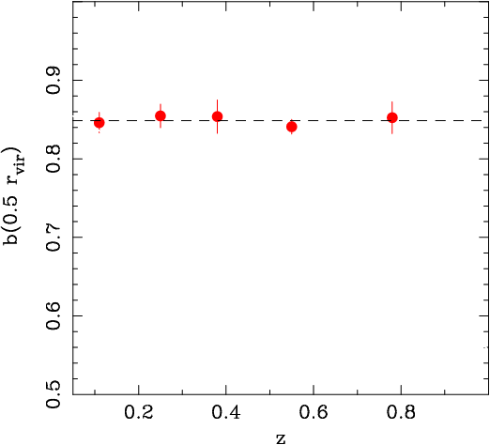
Distances and dark energy with f_{gas}(z)
The measured f_{gas} values depend upon the assumed distances to clusters as f_{gas} ∝ d ^{1.5}, which brings sensitivity to dark energy through the d(z) relation. To use this information, we need to know the expected f_{gas}(z).
What do we expect to observe?
Simulations:
For large (kT>5keV) clusters, we expect b(z) and therefore f_{gas}(z) to be approximately constant with z.
The precise prediction of b(z) is a key task for hydro. simulations. See e.g. Battaglia et al. 2013, Planelles et al. 2013.
predicted b(z) (0.5r_{vir})
Eke et al. 98

Slide 9
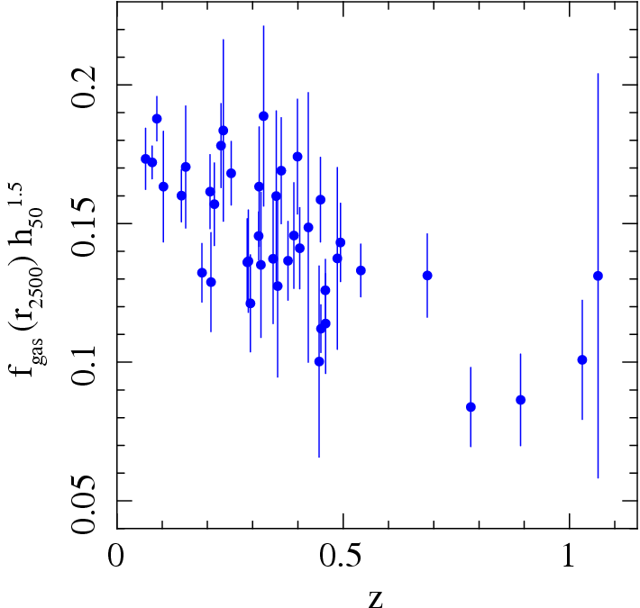
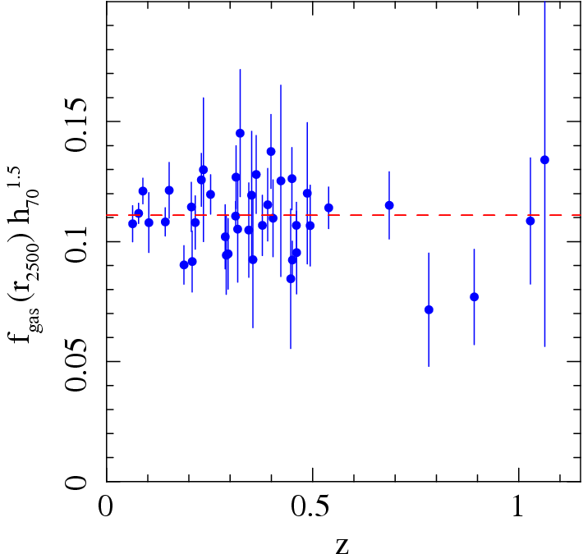
Chandra results on f_{gas}(z) at r₂₅₀₀
SCDM (Ω_{m}=1.0, Ω_{Λ}=0.0) ΛCDM (Ω_{m}=0.3, Ω_{Λ}=0.7)
Brute-force determination of f_{gas}(z) for two reference cosmologies:
→ Inspection clearly favours ΛCDM over SCDM cosmology.

Slide 10
To quantify: fit data with model which accounts for apparent variation in f_{gas}(z) as underlying cosmology is varied → find best fit cosmology.
For details see Allen et al. (2008).

Slide 11
Allowances for systematic uncertainties
Our analysis includes a conservative treatment of potential sources of systematic uncertainty (marginalized over in analysis).
1) The depletion factor (simulation physics, feedback processes etc.)
b(z)=b₀(1+α_{b}z) ± 20% uniform prior on b₀ (simulation physics)
±10% uniform prior on α_{b} (simulation physics)
2) Baryonic mass in stars: define s= f_{star}/f_{gas} =0.16h₇₀^{0.5}
s(z)=s₀(1+α_{s}z) ± 30% Gaussian uncertainty in s₀ (observational uncertainty)
± 20% uniform prior on α_{s} (observational uncertainty)
3) Non-thermal pressure support in gas: (primarily bulk motions)
β = M_{true}/M_{X-ray} 10% (standard) or 20% (weak) uniform prior [1<γ<1.2]
4) Instrument calibration, X-ray modelling
K ± 10% Gaussian uncertainty

Slide 12
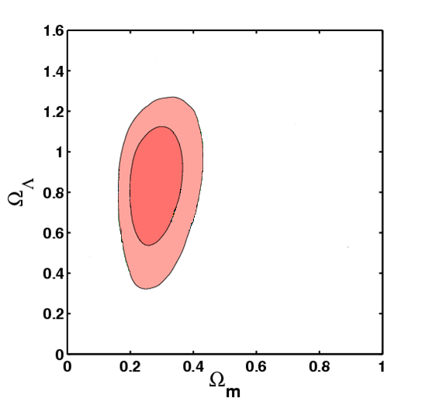
With these (conservative) allowances for systematics
Model:
Results (ΛCDM)
Including all systematics + standard priors:
(Ω_{b}h²=0.0214±0.0020, h=0.72±0.08)
Best-fit parameters (ΛCDM):
Ω_{m}=0.27±0.06, Ω_{Λ}=0.86±0.19
(Note also good fit: χ²=41.5/40)
Davis et al. ‘07
Result limited by b(z),K priors
Important

Slide 13
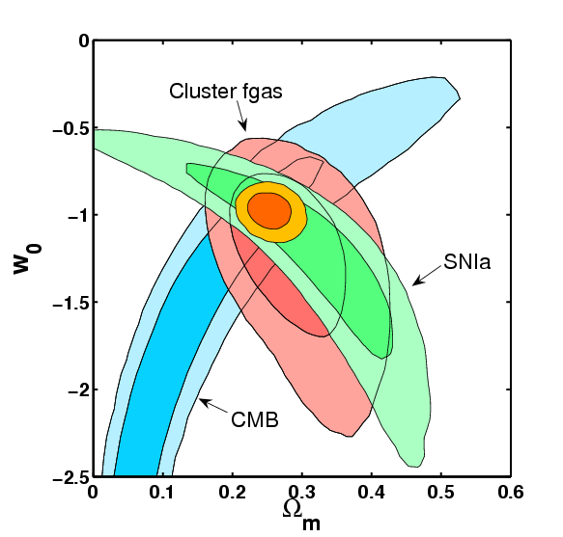
Dark energy equation of state
Constant w model (flat):
68.3, 95.4% confidence limits for all three data sets consistent with each other.
Combined constraints (68%)
Ω_{m} = 0.253 ± 0.021 w₀ = -0.98 ± 0.07
Results marginalized over all systematic uncertainties.
Note: combination with CMB data removes the need for Ω_{b}h² and h priors.

Slide 14
f_{gas}(z) distances have low systematic scatter.
χ² for best fit acceptable. Intrinsic scatter is undetected.
68% upper limit on fgas scatter σ_{fgas}~10% (7% in distance).
(Consistent with expectations from hydro. simulations)
fgas → precise tracer of expansion history (individually, better than SNIa?).
Mgas → excellent mass proxy for hot, massive clusters.

Slide 15

Mantz et al., in preparation.
(5 year project, just unblinded.)
Expanded sample: 3x more fgas data.
Automated target selection applied to archives (20Ms of observations).
Optimized X-ray analysis engine.
Improved external priors.
Blind analysis: fgas(r) measurements unblinded Feb 2013.

Slide 16
Cluster Distance Measurements
2. The XSZ experiment
See also e.g. Silk & White 1978, Cavaliere et al. 1979, Myers et al. 1997, Mauskopf et al. 2001, Mason et al. 2001, Jones et al. 2001, Carlstrom et al. 2002, Reese et al. 2002, Schmidt et al. 2004, Bonamente et al. ’06 …

Slide 17
X-ray+SZ distance measurements
The thermal SZ effect is a modification to the CMB spectrum caused by Compton scattering by hot electrons in the ICM.
BASIC IDEA: The SZ flux measured at mm wavelengths can be expressed in terms of the Compton y-parameter. For a given reference cosmology, the y-parameter can also be determined independently from X-ray observations.
For the correct reference cosmology, the X-ray and mm values should be equal. Expressing the distance dependence of the X-ray measurement we have
Systematics (geometry, calibration, clumping etc)

Slide 18
X-ray+SZ distance measurements
Note 1: the best clusters to observe for the XSZ experiment are the same clusters * used for the fgas experiment, i.e. the largest, most dynamically relaxed clusters (strongest SZ signals and minimal systematics associated with thermodynamic structure and geometry).
Note 2: since the distance dependence for the XSZ experiment is weaker than for the fgas experiment (d^{0.5} vs. d^{1.5}) it has less intrinsic cosmological constraining power.
However, the XSZ experiment has different systematic uncertainties and used in combination with fgas data brings enhanced robustness and some degeneracy breaking power.
* The same X-ray data can (should) be utilized by both experiments.

Slide 19
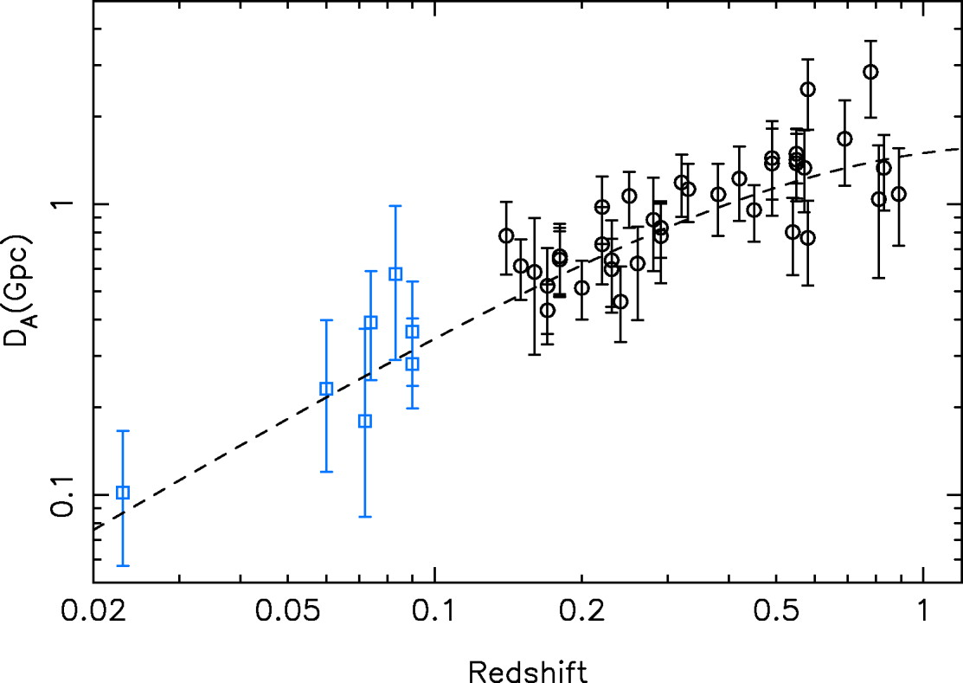
X-ray+SZ distance measurements
Bonamente et al. ‘06
H₀=77 ± 4 ± 9 kms⁻¹Mpc⁻¹
Bonamente et al. ‘06
Mason et al. ‘01

Slide 20
Prospects
Featured work: Rapetti et al. 2008, MNRAS, 388, 1265

Slide 21
Longer term prospects
Assuming that Chandra/XMM-Newton are extended into 2020s, one can envisage a program like the following. (For a next generation X-ray mission the plans would be more ambitious.)
STAGE 1:
Short X-ray exposures of the ~thousand hottest, X-ray brightest or highest SZ flux clusters detected in surveys like eROSITA and SPT-3G.
mass proxy information for standard cluster tests: Lx, gas mass, gas temperature, Yx (product of gas mass and mean temperature).
→ identify ~200 most relaxed systems (morphology + velocity width).
STAGE 2:
Deeper follow-up of ~200 most relaxed clusters.
→ sufficient to measure fgas(r) and predict Compton y-parameter to ~10% precision (~7% in distance).

Slide 22
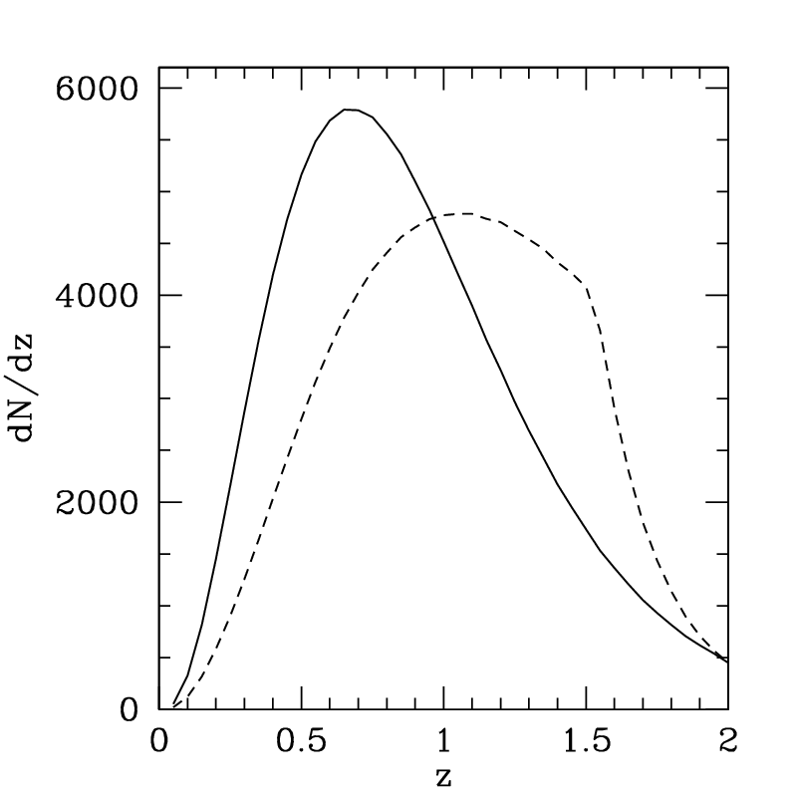
Redshift distribution of target clusters
Target clusters provided by eROSITA flux limited X-ray survey.
Solid curve shows >5 keV clusters (same kT range used with present data).
Density of target clusters peaks at z~0.7.
Rapetti et al. 2008, MNRAS, 388, 1265

Slide 23
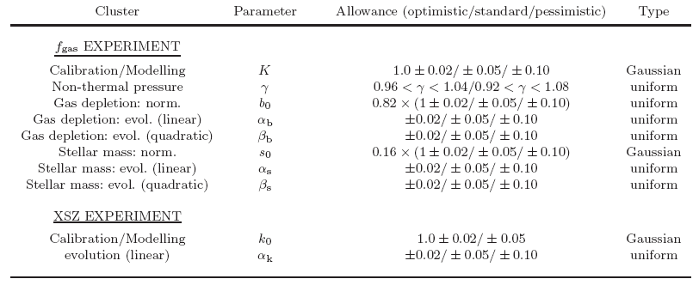
DETF figure of merit for cluster distance measurements.
FoM calculations in the style of the Dark Energy Task Force (DETF).
A next generation (IXO-like) X-ray experiment with 500 clusters observed to 5% fgas precision is assumed. Following the DETF, `Planck priors’ and `optimistic’, `standard’ and `pessimistic’ systematics are allowed. Results shown are based on full MCMC simulations.
Rapetti et al. 2008, MNRAS, 388, 1265

Slide 24
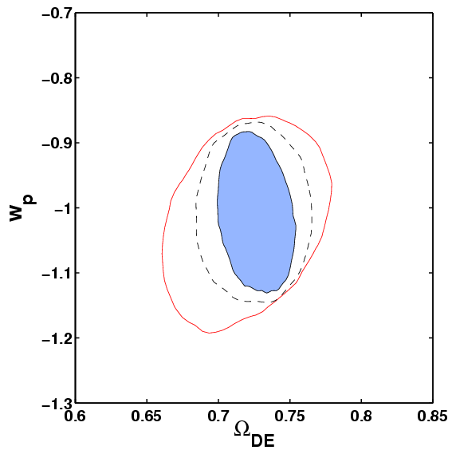
DETF figure of merit for cluster distance measurements.
optimistic (blue)
standard (dashed)
FoM=[σ(w_{p})xσ(w_{a})]⁻¹
w_{p}=w(a_{p}); minimal σ(w(a)).
σ(Ω_{DE}) σ(w_{p}) FoM
Optim. 0.009 0.044 38.5
Pessim. 0.023 0.058 25.2
Comparable to constraints for other methods: DETF (opt./pes.)
95.4% contours
Rapetti et al. 2008, MNRAS, 388, 1265

