Slide 1
Underground Capabilities Working Group
M. G. D. Gilchriese
On behalf of the Working Group
March 6, 2013
Longer version of this talk at DURA Meeting March 5

Slide 2
Working Groups
NAF1 – on underground facilities to support very large detectors for neutrino physics, proton decay and other science requiring detectors of the multi-kiloton scale.
NAF1 conveners: K. Heeger (Wisconsin), K. Scholberg (Duke), H. Sobel (Irvine)
NAF2 – on underground facilities for dark matter experiments, neutrinoless double beta decay experiments, underground accelerators for nuclear astrophysics or other physics, low background assay of materials and related topics.
NAF2 conveners: P. Cushman (Minnesota), J. Klein (Pennsylvania), M. Witherell (Santa Barbara)
Underground facilities in support of instrumentation development in both working groups
Conveners, contact with Instrumentation: P. Cushman (Minnesota), M. Gilchriese (LBNL). Talk at DURA Meeting March 5
Neutrinos and society
Convener is A. Bernstein (LLNL), potential connections with underground capabilities.

Slide 3
General Charge
Assess the status and potential plans for underground facilities worldwide, with particular attention to the current and planned role of U.S. scientists;
Answer the following question in conjunction with the relevant Cosmic Frontier, Intensity Frontier and Instrumentation Frontier working groups – how will the existing or planned underground facilities meet the needs of US scientists and their scientific goals over the next 10 – 15 years (to about 2025)?
Address future U.S. organizational aspects for underground facilities

Slide 4
Working Group Activities
Have asked (or in few cases will ask) for status and plans for world-wide underground facilities (also South Pole). Will be summarized in report.
Quantify U.S. scientists at underground facilities.
Have met by phone with heads of the four U.S. underground facilities(KURF, Soudan, SURF, WIPP) and South Pole.
Presentations to working group of status and roadmap
Thoughts on organization of U.S. underground science and facilities. Discussed also yesterday at DURA meeting.
Future activities TBD after this meeting. Likely phone discussions with non – U.S. lab heads, key stakeholders
Planning on “Snowmass” summary document. Outline circulated to the working group.

Slide 5
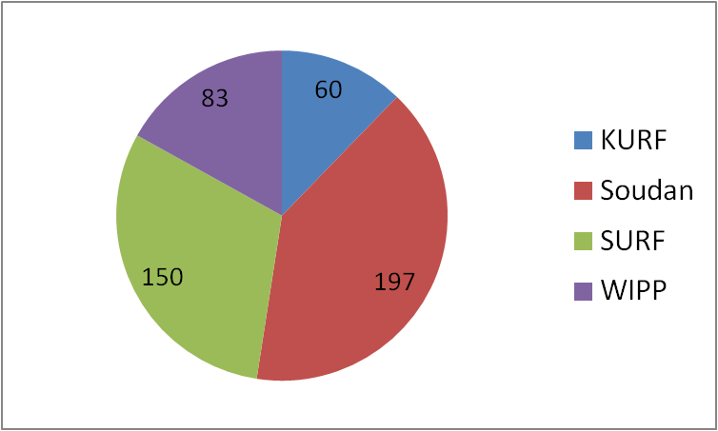
U.S. Scientists Underground
Count of current U.S. heads* at underground facilities, including Antarctica. More details in backup. Roughly 1,000 U.S. heads.
*Duplicate heads not removed

Slide 6
Capabilities Questions to CF
Our preliminary conclusion is that existing (or already approved) underground facilities are adequate for the anticipated G2 dark matter experiments to be realized by about the middle of the decade
If this is not correct, what new facilities are needed?
Identify missing underground capabilities, if any, needed to support G2 experiments, but not directly associated with the experiments (assay, etc).
Provide a “roadmap” of underground facility/capability requirements for dark matter experiments beyond G2, under different physics assumptions (to be determined by the CF working group).
Include in this assessment underground capabilities for support of R&D for experiments beyond G2.

Slide 7
Capabilities Questions to νF
Our preliminary conclusion is that underground facilities for approved 0νββ experiments with U.S. participation are adequate.
If this is not correct, what new facilities are needed?
Provide a “roadmap” of underground facility/capabilities requirements for 0νββ experiments beyond ∼ mid-decade, under different physics assumptions (to be determined by the νF working group).
Include in this underground capabilities for support of R&D for future experiments.
Provide a “roadmap” of underground facility/capabilities requirements for long-baseline experiments beyond ∼ 2015, under different physics assumptions (to be determined by the νF working group).
Include in this underground capabilities for support of R&D for future experiments.
Define potential overlap and synergies of underground facilities/capabilities between short reactor and long-baseline neutrino experiments and planned non-proliferation demonstration detectors.

