Slide 1
Very Near Future Plan to Check Translation and Rotation for ND2FD
Chiaki Yanagisawa
N2FD Meeting
11/03/2023

Slide 2
Data to Be Used
Hit/Deposit Information
larbath_vtx_cm
larbath_deps_start_x_cm
larbath_deps_start_y_cm
larbath_deps_start_z_cm
stop_x
stop_y
stop_z
nd_vtx_nd_cm_nonecc
nd_deps_start_x_cm_nonecc
nd_deps_start_y_cm_nonecc
nd_deps_start_z_cm_nonecc
stop_x
stop_y
stop_z
fd_vtx_cm_pair_nd_nonecc
fd_deps_start_x_cm_pair_nd_nonecc
fd_deps_start_y_cm_pair_nd_nonecc
fd_deps_start_z_cm_pair_nd_nonecc
stop_x
stop_y
stop_z
…..

Slide 3
Sanity Check with Coordinate Transformations
Idea
- Basically all the operations are either translations or rotations
($RT)\vec{v}={\vec{v}}^{′}$ where T and R are the matrix for the translation and rotation,
and $\vec{v}$ and ${\vec{v}}^{′}$are the initial and final coordinates of energy deposits, namely,
before and after the operations ($\vec{v}$ is a column vector of the coordinates).
- Let’s define M = RT. Then M$\vec{v}={\vec{v}}^{′}.$
M has 3 x 3 elements/parameters, and $\vec{v}$ and ${\vec{v}}^{′}$ each has 3 elements ($\vec{v}={\left(x,y,z\right)}^{t}$)
→ 3 deposit locations needed to solve 3 x 3 = 9 equations.
$$\left(\begin{matrix}M & O & O \\ O & M & O \\ O & O & M\end{matrix}\right)\left(\begin{matrix}\vec{v_{0}} \\ \vec{v_{1}} \\ \vec{v_{2}}\end{matrix}\right)=\left(\begin{matrix}{\vec{v_{0}}}^{′} \\ {\vec{v_{1}}}^{′} \\ {\vec{v_{2}}}^{′}\end{matrix}\right)$$
- Compare the solutions from every three points in an event in a sliding window of length 3.
[ x₀,x₁,x₂,x₃,x₄,x₅,x_{6,…}] Then compare all the values of the elements of M.

Slide 4
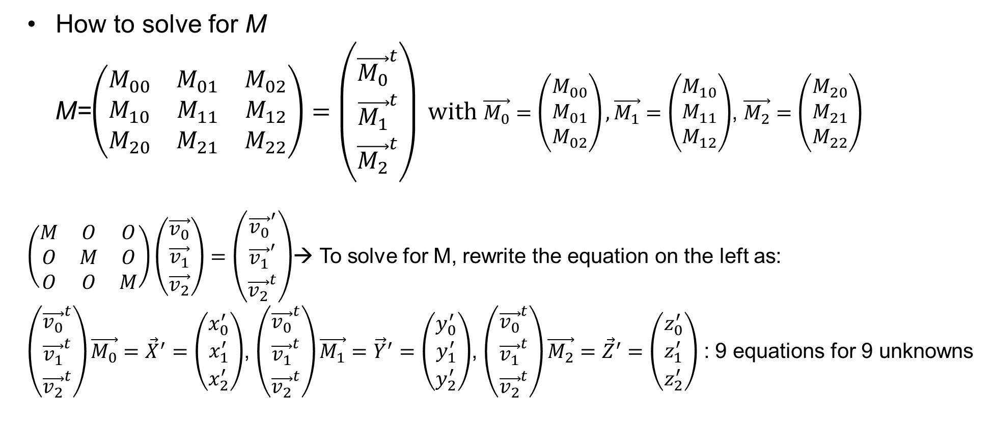
Solution for M
How to solve for M
M=$\left(\begin{matrix}M_{00} & M_{01} & M_{02} \\ M_{10} & M_{11} & M_{12} \\ M_{20} & M_{21} & M_{22}\end{matrix}\right)=\left(\begin{matrix}{\vec{M_{0}}}^{t} \\ {\vec{M_{1}}}^{t} \\ {\vec{M_{2}}}^{t}\end{matrix}\right) with$ $\vec{M_{0}}=\left(\begin{matrix}M_{00} \\ M_{01} \\ M_{02}\end{matrix}\right), \vec{M_{1}}=\left(\begin{matrix}M_{10} \\ M_{11} \\ M_{12}\end{matrix}\right)$, $\vec{M_{2}}=\left(\begin{matrix}M_{20} \\ M_{21} \\ M_{22}\end{matrix}\right)$
$\left(\begin{matrix}M & O & O \\ O & M & O \\ O & O & M\end{matrix}\right)\left(\begin{matrix}\vec{v_{0}} \\ \vec{v_{1}} \\ \vec{v_{2}}\end{matrix}\right)=\left(\begin{matrix}{\vec{v_{0}}}^{′} \\ {\vec{v_{1}}}^{′} \\ {\vec{v_{2}}}^{t}\end{matrix}\right)$→ To solve for M, rewrite the equation on the left as:
$\left(\begin{matrix}{\vec{v_{0}}}^{t} \\ {\vec{v_{1}}}^{t} \\ {\vec{v_{2}}}^{t}\end{matrix}\right)\vec{M_{0}}={\vec{X}}^{′}=\left(\begin{matrix}x_{0}^{′} \\ x_{1}^{′} \\ x_{2}^{′}\end{matrix}\right)$, $\left(\begin{matrix}{\vec{v_{0}}}^{t} \\ {\vec{v_{1}}}^{t} \\ {\vec{v_{2}}}^{t}\end{matrix}\right)\vec{M_{1}}={\vec{Y}}^{′}=\left(\begin{matrix}y_{0}^{′} \\ y_{1}^{′} \\ y_{2}^{′}\end{matrix}\right)$, $\left(\begin{matrix}{\vec{v_{0}}}^{t} \\ {\vec{v_{1}}}^{t} \\ {\vec{v_{2}}}^{t}\end{matrix}\right)\vec{M_{2}}={\vec{Z}}^{′}=\left(\begin{matrix}z_{0}^{′} \\ z_{1}^{′} \\ z_{2}^{′}\end{matrix}\right)$ : 9 equations for 9 unknowns

Slide 5
Solution for M
How to solve for M
M=$\left(\begin{matrix}M_{00} & M_{01} & M_{02} \\ M_{10} & M_{11} & M_{12} \\ M_{20} & M_{21} & M_{22}\end{matrix}\right)=\left(\begin{matrix}{\vec{M_{0}}}^{t} \\ {\vec{M_{1}}}^{t} \\ {\vec{M_{2}}}^{t}\end{matrix}\right) with$ $\vec{M_{0}}=\left(\begin{matrix}M_{00} \\ M_{01} \\ M_{02}\end{matrix}\right), \vec{M_{1}}=\left(\begin{matrix}M_{10} \\ M_{11} \\ M_{12}\end{matrix}\right)$, $\vec{M_{2}}=\left(\begin{matrix}M_{20} \\ M_{21} \\ M_{22}\end{matrix}\right)$
$\left(\begin{matrix}M & O & O \\ O & M & O \\ O & O & M\end{matrix}\right)\left(\begin{matrix}\vec{v_{0}} \\ \vec{v_{1}} \\ \vec{v_{2}}\end{matrix}\right)=\left(\begin{matrix}{\vec{v_{0}}}^{′} \\ {\vec{v_{1}}}^{′} \\ {\vec{v_{2}}}^{t}\end{matrix}\right)$→ To solve for M, rewrite the equation on the left as:
$\left(\begin{matrix}{\vec{v_{0}}}^{t} \\ {\vec{v_{1}}}^{t} \\ {\vec{v_{2}}}^{t}\end{matrix}\right)\vec{M_{0}}={\vec{X}}^{′}=\left(\begin{matrix}x_{0}^{′} \\ x_{1}^{′} \\ x_{2}^{′}\end{matrix}\right)$, $\left(\begin{matrix}{\vec{v_{0}}}^{t} \\ {\vec{v_{1}}}^{t} \\ {\vec{v_{2}}}^{t}\end{matrix}\right)\vec{M_{1}}={\vec{Y}}^{′}=\left(\begin{matrix}y_{0}^{′} \\ y_{1}^{′} \\ y_{2}^{′}\end{matrix}\right)$, $\left(\begin{matrix}{\vec{v_{0}}}^{t} \\ {\vec{v_{1}}}^{t} \\ {\vec{v_{2}}}^{t}\end{matrix}\right)\vec{M_{2}}={\vec{Z}}^{′}=\left(\begin{matrix}z_{0}^{′} \\ z_{1}^{′} \\ z_{2}^{′}\end{matrix}\right)$ : 9 equations for 9 unknowns

Slide 6
Solution for M
How to solve for M
M=$\left(\begin{matrix}M_{00} & M_{01} & M_{02} \\ M_{10} & M_{11} & M_{12} \\ M_{20} & M_{21} & M_{22}\end{matrix}\right)=\left(\begin{matrix}{\vec{M_{0}}}^{t} \\ {\vec{M_{1}}}^{t} \\ {\vec{M_{2}}}^{t}\end{matrix}\right) with$ $\vec{M_{0}}=\left(\begin{matrix}M_{00} \\ M_{01} \\ M_{02}\end{matrix}\right), \vec{M_{1}}=\left(\begin{matrix}M_{10} \\ M_{11} \\ M_{12}\end{matrix}\right)$, $\vec{M_{2}}=\left(\begin{matrix}M_{20} \\ M_{21} \\ M_{22}\end{matrix}\right)$
$\left(\begin{matrix}M & O & O \\ O & M & O \\ O & O & M\end{matrix}\right)\left(\begin{matrix}\vec{v_{0}} \\ \vec{v_{1}} \\ \vec{v_{2}}\end{matrix}\right)=\left(\begin{matrix}{\vec{v_{0}}}^{′} \\ {\vec{v_{1}}}^{′} \\ {\vec{v_{2}}}^{t}\end{matrix}\right)$→ To solve for M, rewrite the equation on the left as:
$\left(\begin{matrix}{\vec{v_{0}}}^{t} \\ {\vec{v_{1}}}^{t} \\ {\vec{v_{2}}}^{t}\end{matrix}\right)\vec{M_{0}}={\vec{X}}^{′}=\left(\begin{matrix}x_{0}^{′} \\ x_{1}^{′} \\ x_{2}^{′}\end{matrix}\right)$, $\left(\begin{matrix}{\vec{v_{0}}}^{t} \\ {\vec{v_{1}}}^{t} \\ {\vec{v_{2}}}^{t}\end{matrix}\right)\vec{M_{1}}={\vec{Y}}^{′}=\left(\begin{matrix}y_{0}^{′} \\ y_{1}^{′} \\ y_{2}^{′}\end{matrix}\right)$, $\left(\begin{matrix}{\vec{v_{0}}}^{t} \\ {\vec{v_{1}}}^{t} \\ {\vec{v_{2}}}^{t}\end{matrix}\right)\vec{M_{2}}={\vec{Z}}^{′}=\left(\begin{matrix}z_{0}^{′} \\ z_{1}^{′} \\ z_{2}^{′}\end{matrix}\right)$ : 9 equations for 9 unknowns

