Slide 1
ProtoDUNE 2 PDS Connector Issues
Manuel Arroyave, David Warner, Francesco Terranova
FD1 Technical Board Meeting
8 November 2023

Slide 2
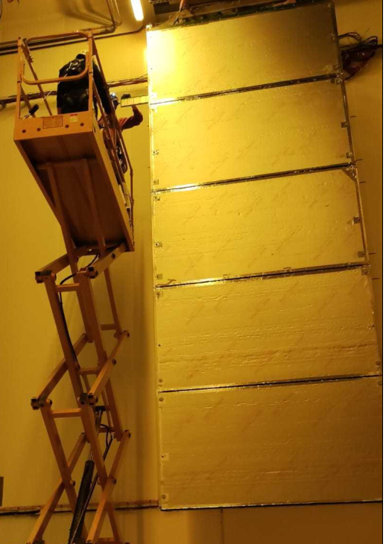
FD1 Photon Detector (PDS) TCO Closure Status: SUMMARY
PD rails and cables have been installed in 4 ProtoDUNE 2 APAs .
40 modules successfully installed and tested in CERN cold box.
Two channels in APA2 were observed to be problematic during cold box testing.
  Problems observed in modules 7 and 8 in APA2 .
  Initially thought to be limited to one channel per module.
  Later discovered that all channels in module 8 and 1 channel in module 7 will need to be disconnected during ProtoDUNE operation.
  Problem traced to short circuits inside the APA cables- unrecoverable.
  5 channels (out of 160 total) will be impacted.
Design improvements to the cable and connector, as well as cable testing techniques post-installation, have been made made.

Slide 3
PD cable issues (See incident report by M. Arroyave- attached to Indico page)
The noise issue was traced back to two channels that were already flagged as troublesome during the installation: One channel in Module 7 and one in Module 8. In the 2022 cold box tests, we identified these faulty channels and we traced back the origin of the problem.
Cold electronics/PD
Cross Talk

Slide 4
Final ProtoDUNE 2 Operating Configuration
We were able to remove the cable-induced cross talk with the TPC electronics and DAPHNE readout problems by disconnecting the module 8 connector at the DAPHNE input, while keeping the Module 7 cable connected (but disconnecting the faulty channel). In APA2, we will thus run with 4+1=5 dead channels.
Remaining 800 kHz noise pickup likely due to internal DAPHNE grounding issue.
Under investigation now.

Slide 5
PD Cable Design Issues
Each PD module has 4 readout channels read out through a single cable.
Two channels (one channel per supercell) in APA 2 were observed to have no connection when installed into APA.
  Traced to connection inside APA- not possible to repair.
  Connector ground short to APA ground leads to crosstalk- requires disconnecting APA2 PDS cable 5 at warm electronics to eliminate interference
A site visit to Daresbury the week of July 25 2022 was conducted to trace potential issues.
Lessons learned:
  Interference between cable clips and PD cable connector required re-design of tie-down points. IMPLEMENTED
  Additional strain relief required to support PD cable connectors. IMPLEMENTED
  Procedure changed to have continuity check of cables improved, automated connectivity/short circuit testing AFTER cinching down cable ties. IMPLEMENTED

Slide 6
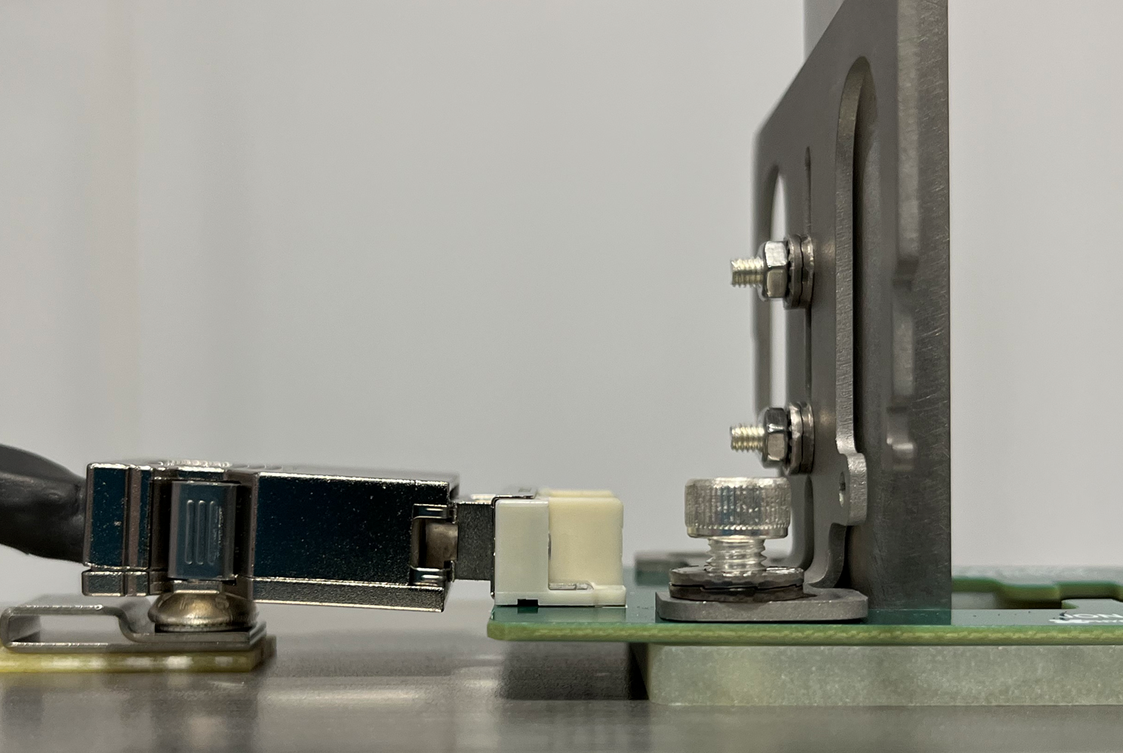
ProtoDUNE 2 Design: Significant (~2mm) PD cable interference with temperature sensor and cable tie clip (Upper APA only)

Slide 7
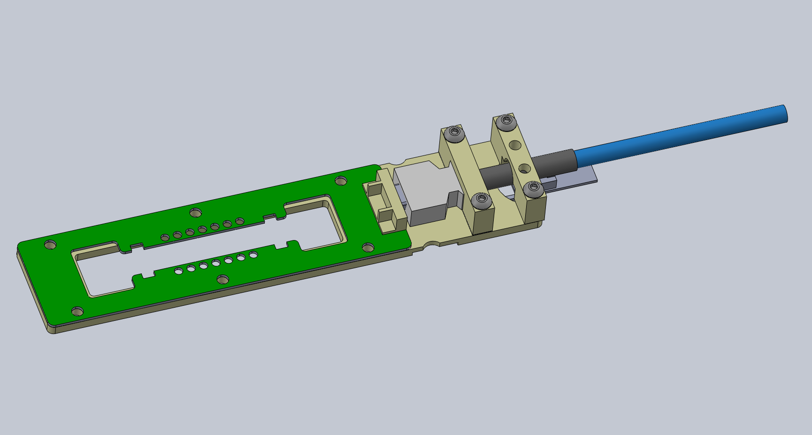
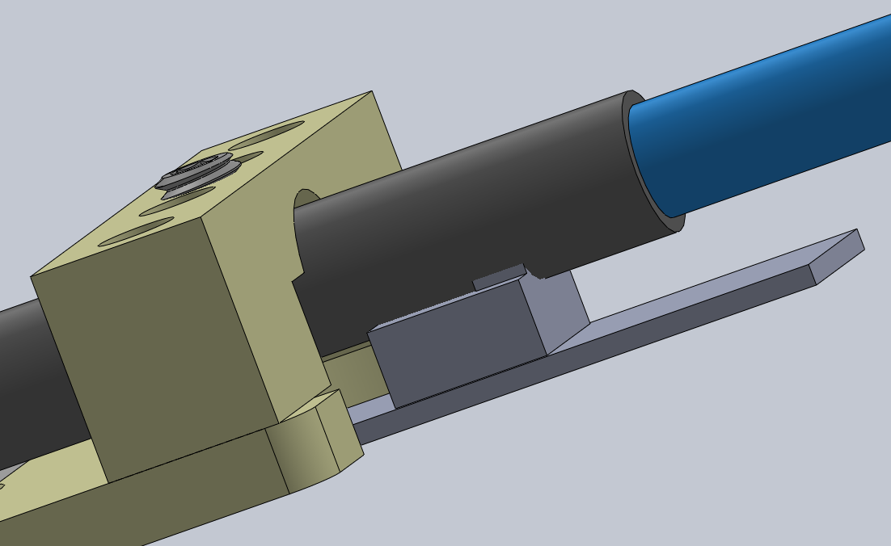
New PD cable strain relief (prototype August 2022)

Slide 8
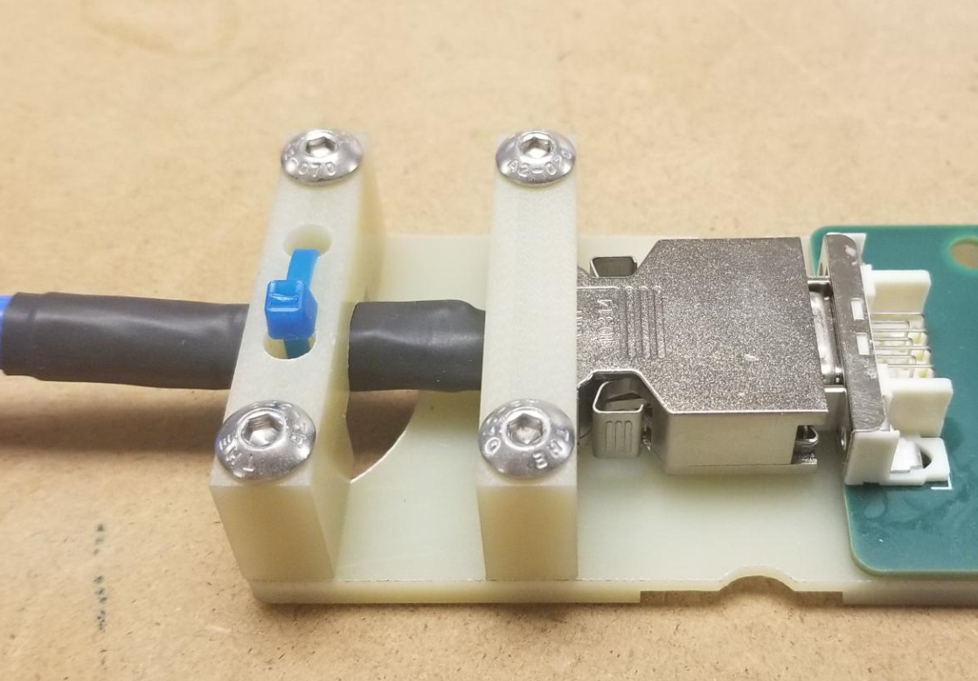
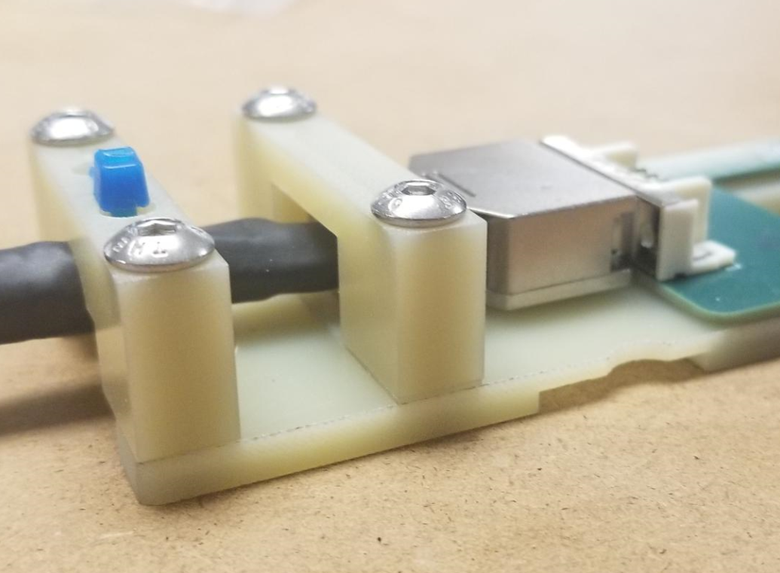
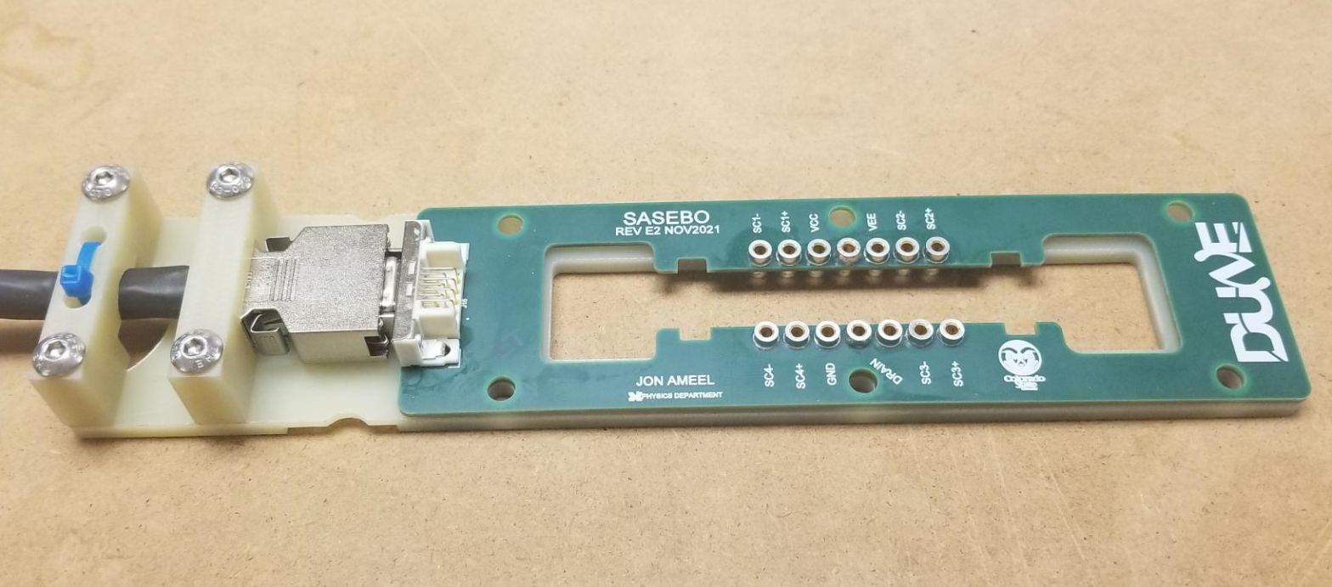

Slide 9
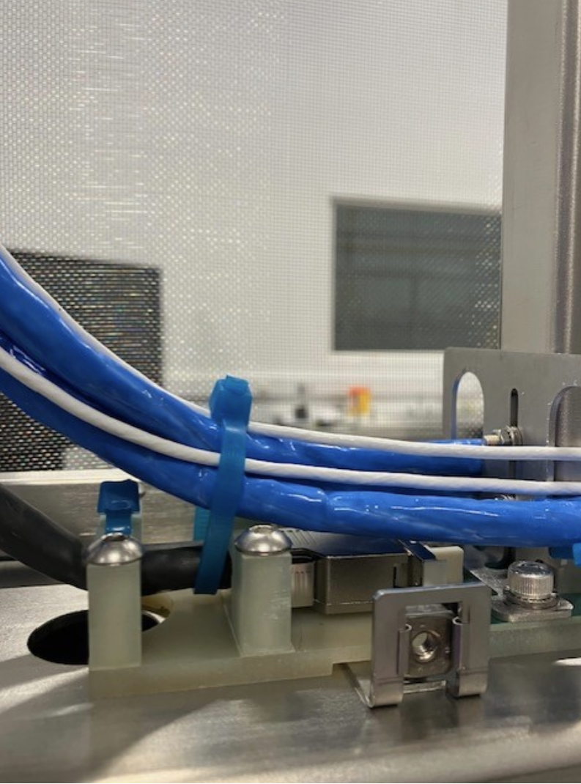
New Connector Support Installed in APA
Updated PDS connector assemblies installed in all APAs assembled following ProtoDUNE 2
Initial testing looks very promising- no shorts or cross-talk observed during installation testing.
Procedures and interface documents being modified to reflect new design.

Slide 10
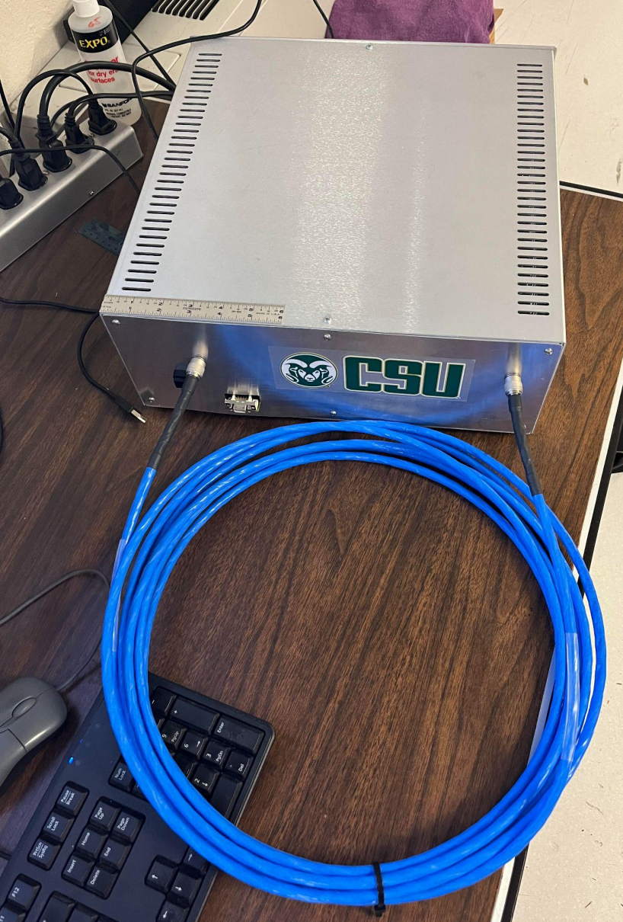
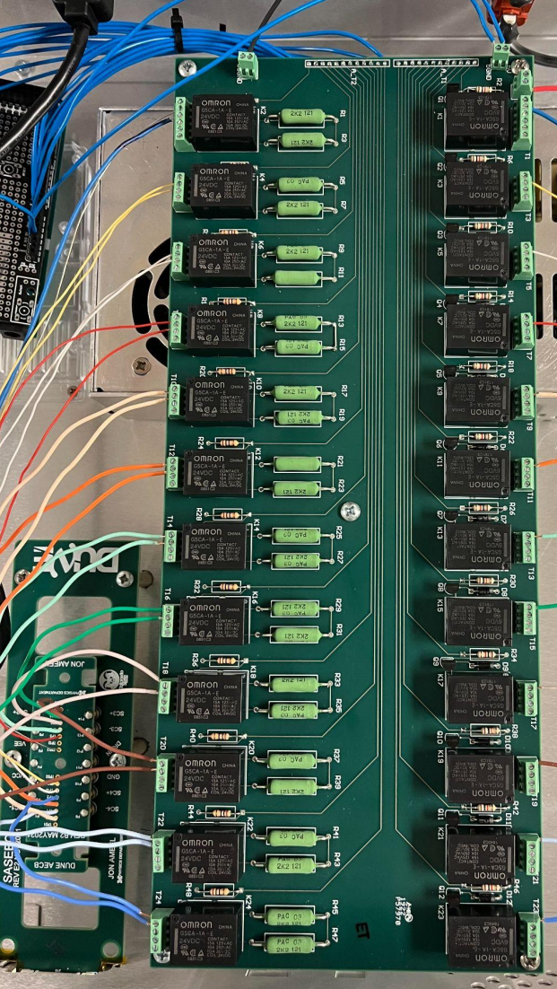
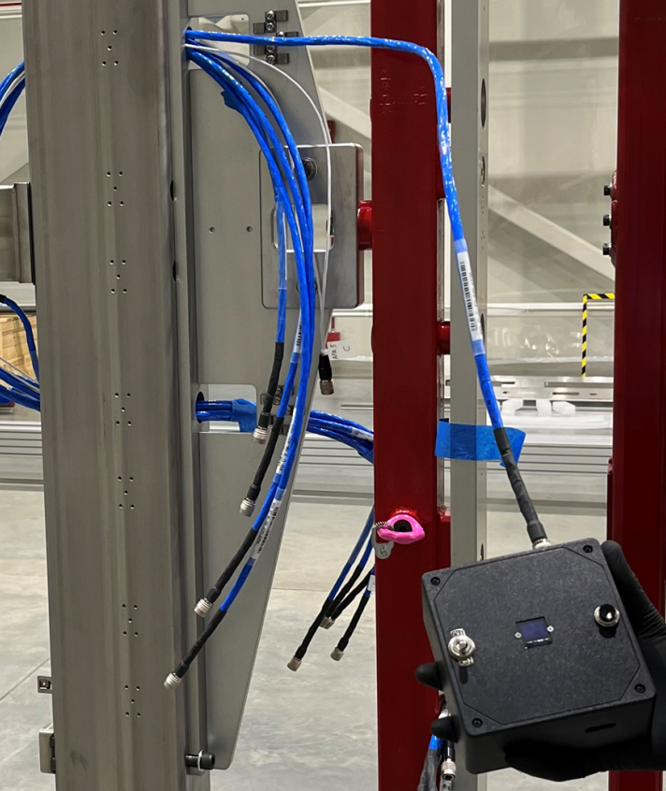
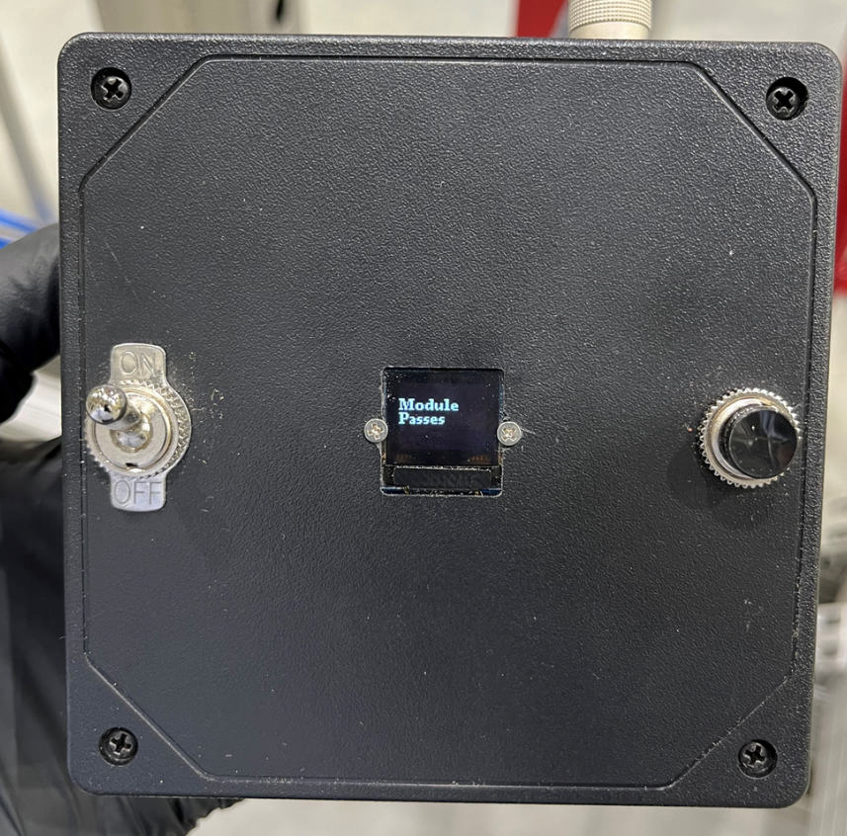
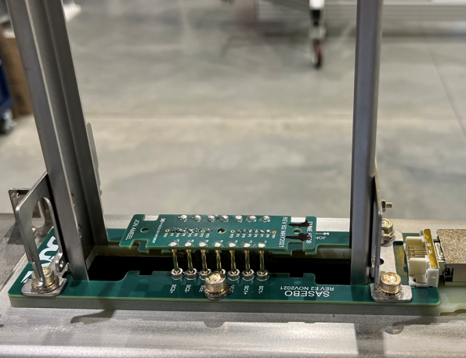
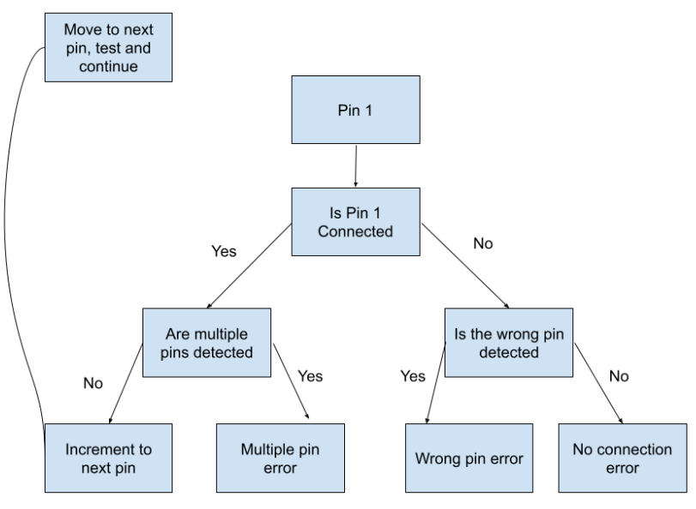
Improved Automated Cable Testing
Cable test station readout
Dummy module connector
Installed for cable testing
Post installation automated cable tester at U of Chicago
(Same at Daresbury)
Production cable test stand at CSU

Slide 11
Summary:
The FD1 PDS will operatE in ProtoDUNE 2 with 5 missing channels:
  APA2 Module 7: 1 channel
  APA2 Module 8: all 4 channels
This problem is due to a cable connection failure inside the APA- not possible to repair.
  Design revisions implemented to reduce risk of continuing problems. Included in post-ProtoDUNE 2 APAs (APA5 on).
Problem in APA 2 was identified upon cold box testing.
Improved automated cable testing implemented to catch problems earlier, including ground shorts.
Eagerly awaiting cold box tests in production APAs to continue validation of improved design!

